Slide 1


Bank Queue Simulation
Gulam Mohiuddin Abdul Qader (195461)
Shohiduzzaman Shakil (195674)

Slide 2
Introduction
Every bank need to give services to its customers. So having a counter which can work at its optimum output is necessary. A bank service area consists of several servers and customer queues.

Slide 3
Target
A server is free, and customers are waiting, the first customer in the queue advances to the server's counter and begins their transaction. When a customer is done, they depart, and the server becomes free.
If servers are busy, customers in the queue must wait for a server.
The simulation is run through many units of time. At the end of each time unit, the program prints out a snapshot of the queues, customers, servers, interval time of customer arrival and service time per customer.

Slide 4
Limitations
Maximum number of servers 10.
The estimated average customer per hour is 100.
The estimated interval time of customer arrival is between 30-45 seconds (random).
The estimated service time per customer is between 120-600 seconds (random).

Slide 5
Queue methods
 | Throws exception | Returns special value
Insert | add(e) | size()
Remove | remove() | poll()
Examine | element() | peek()

Slide 6
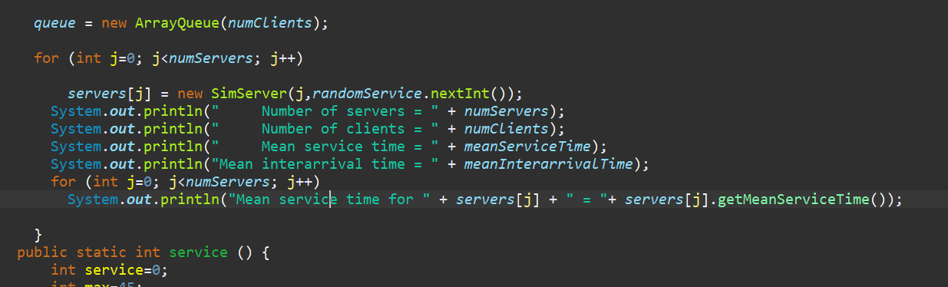
Big O of multipale server/counter single queue
O(n)=4n is n
O(n) = 4n

Slide 7
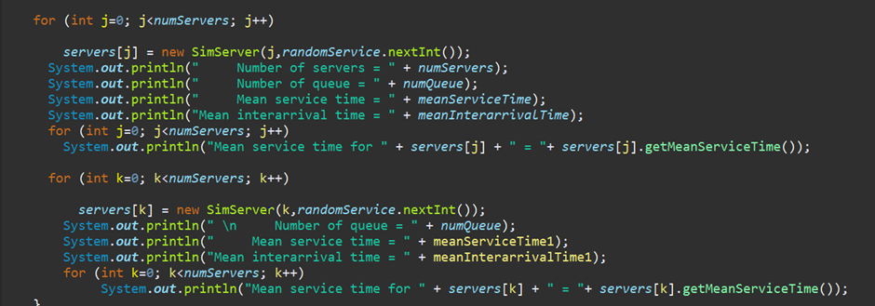
Big O of multiple servers/counters and queue
O(n)=8n is n

Slide 8
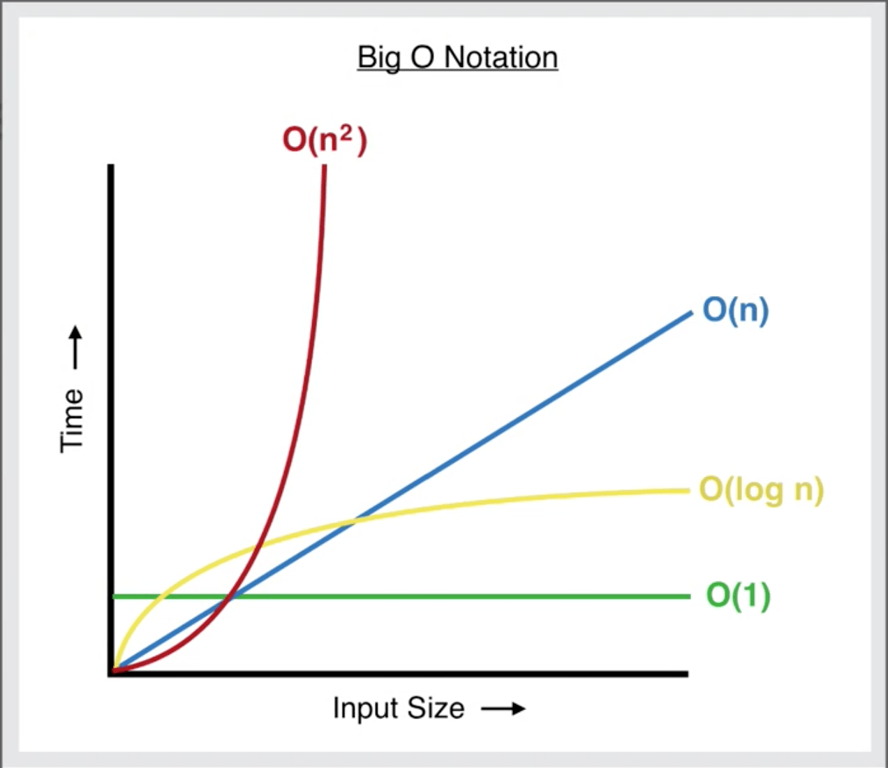
Time complexity
An algorithm with linear complexity will take more time, by a constant gradient. The larger the n value, the longer it takes, with the time being n times larger than if n = 1. So, from here we can safely say 4n will process faster than 8n.

Slide 9
Thank you

