Slide 1


FACE RECOGNITION BASED ATTENDANCE SYSTEM
Zameer Ali Tunio
AI-13
Muhammad Umar
AI-09

Slide 2
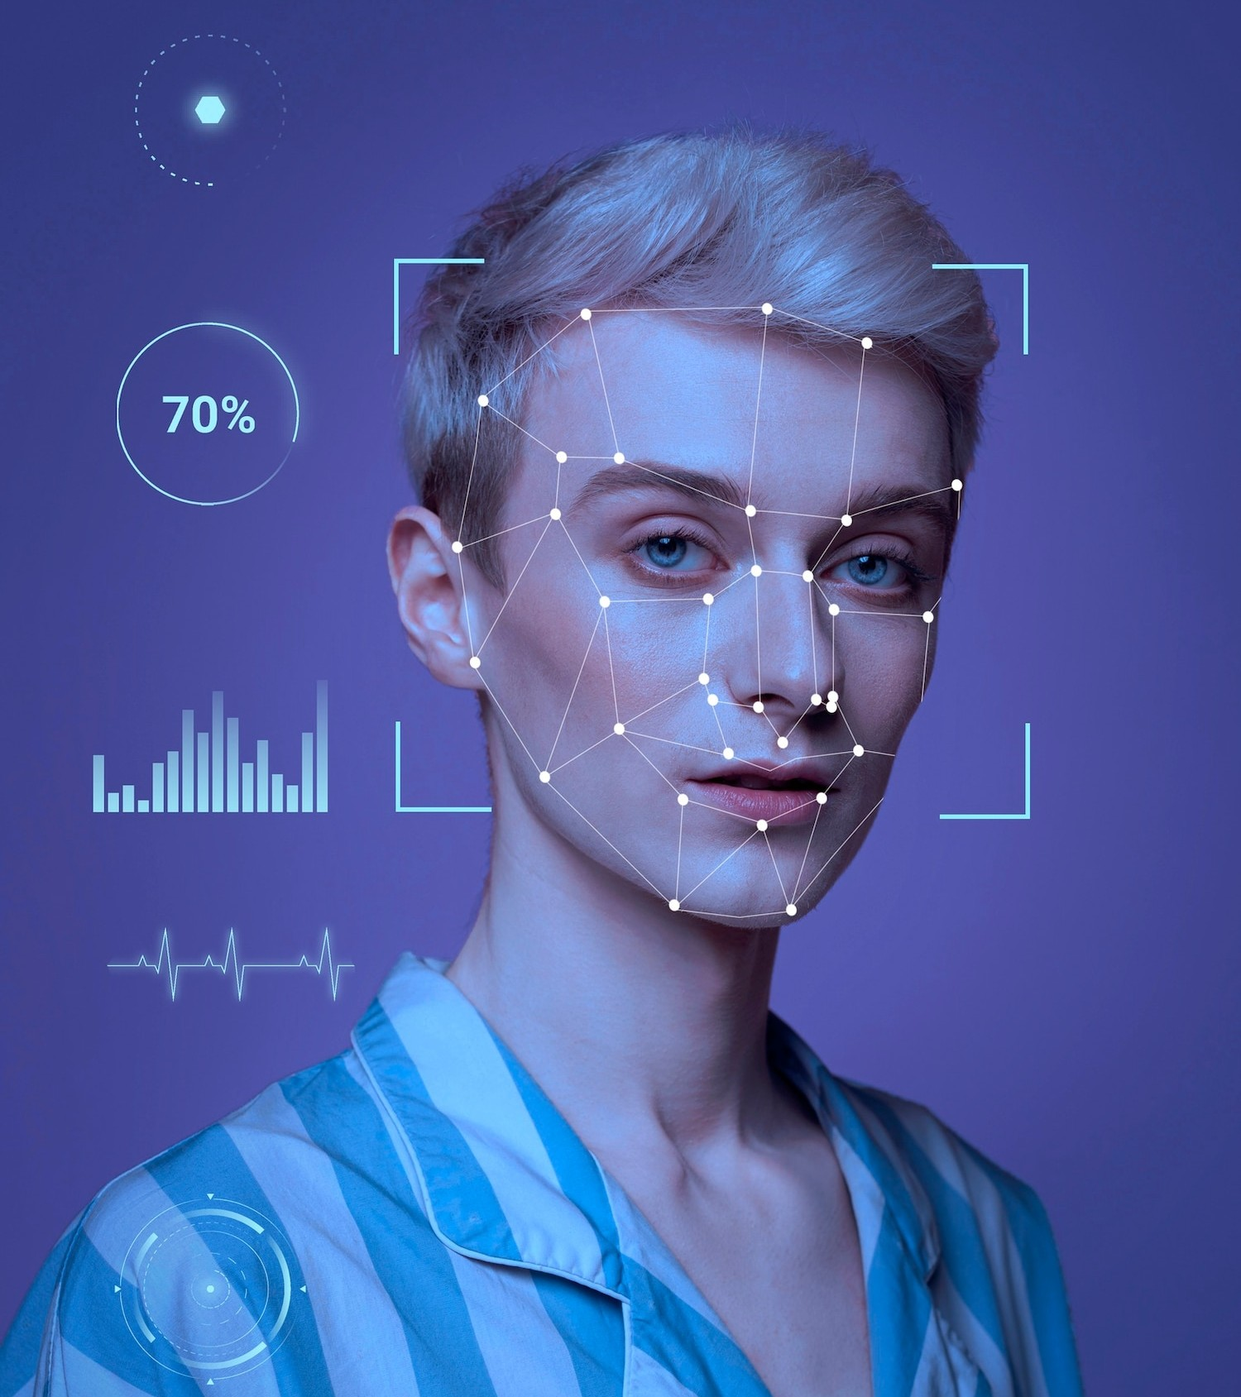
Problem Statement
"Traditional student attendance marking techniques often face numerous challenges. Manual attendance taking by calling names or checking ID cards disrupts teaching and causes distractions. Passing attendance sheets around large classes is inefficient and prone to errors. Face recognition-based attendance systems aim to address these issues by automating the process."

Slide 3
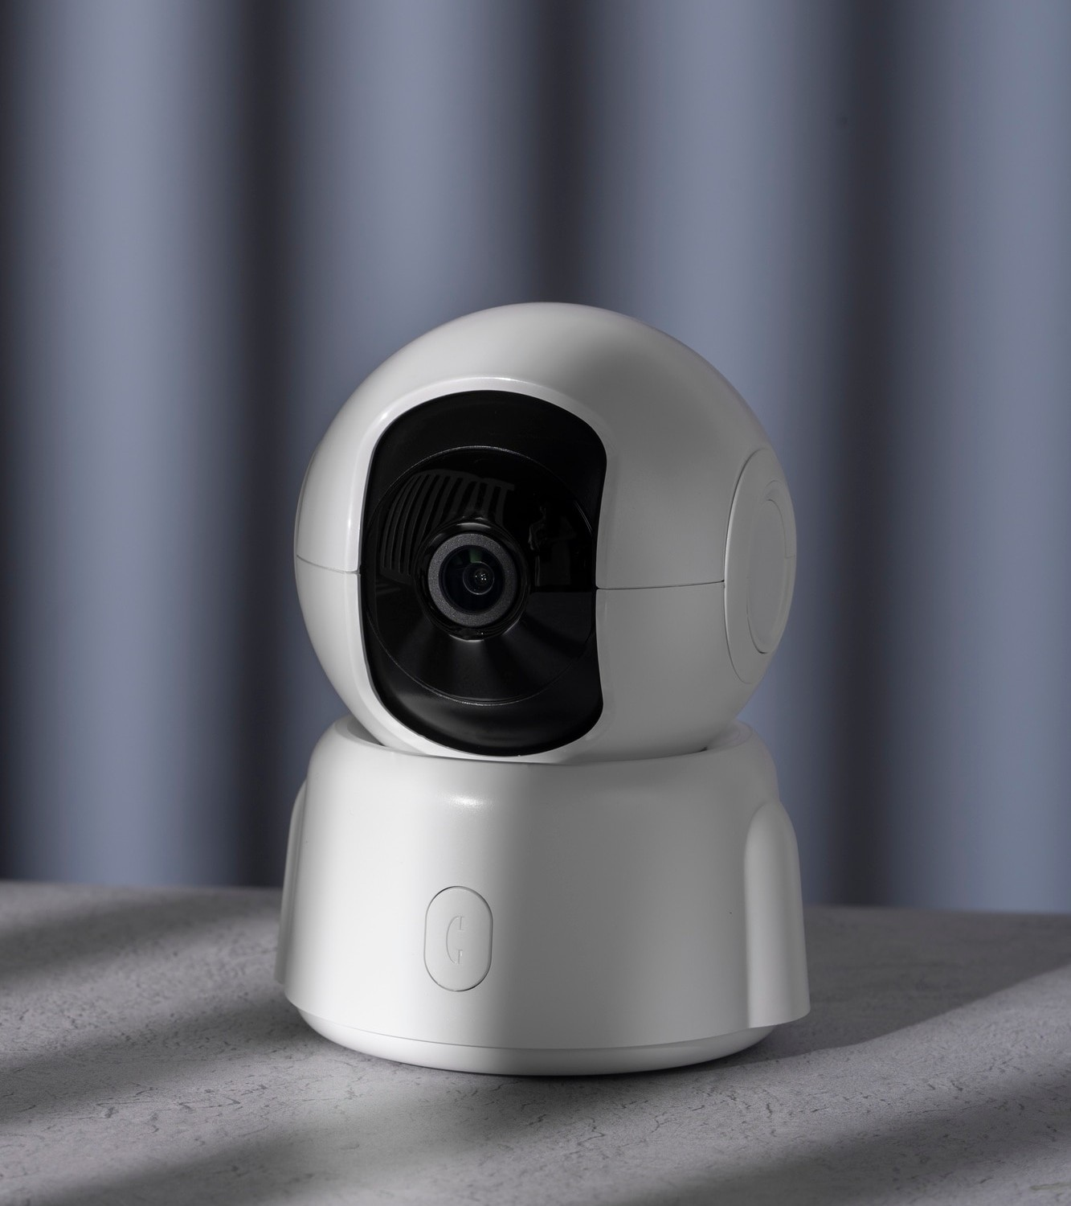
Methodology
"The project utilizes face recognition technology to automate attendance marking. Key steps include face detection using Haarcascade classifier and face recognition using the LBPH algorithm. Images are captured via a web camera and processed to compare against a pre-trained dataset. Attendance is marked automatically and recorded in an Excel sheet."

Slide 4
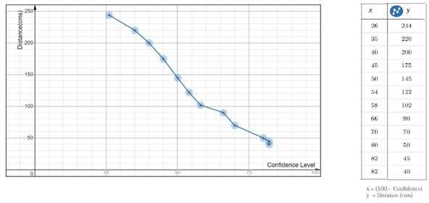
Result
The face recognition system demonstrated high accuracy in identifying students. Real-time processing and attendance marking were achieved with minimal delays. The system was able to handle variations in lighting and facial expressions.

Slide 5
Conclusion
The automated face recognition attendance system successfully addresses the limitations of manual methods. It offers a reliable and efficient solution for attendance management in educational institutions. The system reduces classroom disruptions and improves overall attendance tracking accuracy.

Slide 6
Future work
Enhancing the system's robustness to handle more diverse environmental conditions. Integrating additional biometric methods for multi-factor authentication. Developing a mobile application interface for easier access and usage. Implementing cloud storage for better scalability and data management.

Slide 7
Thank You!

