Slide 1
Pattern Recognition: Introduction
Shahadat Hoshen
Lecturer
Dept. of CSE; NUBTK

Slide 2
Introduction
A shop manager of electronic goods may use traditional data analysis tools to investigate the sales of air conditioners in different months of a year.
He/she can also analyze the sales relationship between computers and printers.
Precisely, a domain expert needs to provide some sort of assumptions to formulate a query in traditional data analysis.

Slide 3
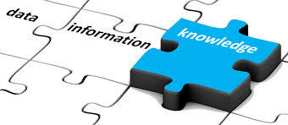
Introduction
However, with the increase of volume and dimensions of data sets, manual assumptions become more and more complicated and thus traditional approaches become unsuitable in most domains.

Slide 4
What is pattern recognition?
Pattern recognition is a data analysis method that uses machine learning algorithms to automatically recognize patterns and regularities in data.
This data can be anything from text and images to sounds or other definable qualities.
Pattern recognition systems can recognize familiar patterns quickly and accurately.
They can also recognize and classify unfamiliar objects, recognize shapes and objects from different angles, and identify patterns and objects even if they’re partially obscured.

Slide 5
Knowledge Discovery from Data (KDD)
KDD is a process of discovering useful patterns and knowledge from large datasets. Steps of KDD:
Data Selection
Data Cleaning
Data Transformation
Data Integration
Data Mining
Pattern Evaluation
Knowledge Representation
Notes:
Data Selection: In order to perform different data mining tasks, at first relevant data sets are selected from the data source(s) (e.g. weather station, data warehouse, etc.).
Data Cleaning: In a real-world scenario, data may corrupt in different ways. This step involves the removal of noise and inconsistencies from the dataset, such as missing values, duplicates, and outliers For example, a weather station may deploy a number of sensors to record the temperature of a place. Due to malfunction of sensor(s), the recorded temperature may be inconsistent or the temperature may not be recorded at all.
Data Transformation: In this step, data are transformed/consolidated in similar scales by applying different conversion/aggregation operations. For example, let there be two different weather stations recording the temperature from two nearby places. One of them is older; recording the temperature in Celsius in a month. The newer one is recording the temperature daily but in Fahrenheit. Now, to facilitate analysis of temperatures for the whole area (that includes the two nearby places), temperatures recorded from the two weather stations need to be converted in similar scale (either in Celsius or in Fahrenheit).
Data Integration: After all the required transformations are complete, multiple data sets can be combined to form data set(s) as per the need of data mining tasks.
Data mining: This step involves applying appropriate data mining tasks (like, machine learning techniques) on available data set(s) to extract patterns and knowledge.
Pattern evaluation: It involves evaluating the extracted patterns to determine their usefulness and relevance to the problem at hand.
Knowledge representation: It involves representing the discovered knowledge in a suitable format, such as rules, trees, or graphs.

Slide 6
Application of PR
Computer Vision
Business
Speech Recognition
Natural Language Processing
Medical Diagnosis
Biometrics
Robotics
Notes:
Computer Vision: Pattern recognition is extensively used in computer vision to recognize objects, faces, gestures, and patterns in images and videos. It is used in self-driving cars, surveillance systems, and robotics to interpret the environment.
Business: Pattern recognition is used in business modeling and prediction to identify patterns in financial data and predict market trends and stock prices.
Speech Recognition: Pattern recognition is used to recognize and interpret speech signals to convert them into text or commands. It is used in virtual assistants, automated call centers, and speech-to-text software.
Natural Language Processing: Pattern recognition is used to recognize patterns in text and speech data to perform tasks such as sentiment analysis, text classification, and information retrieval.
Medical Diagnosis: Pattern recognition is used in medical imaging to recognize patterns in MRI, CT scans, and X-rays to detect and diagnose diseases such as cancer, Alzheimer's, and Parkinson's.
Biometrics: Pattern recognition is used in biometric systems such as fingerprint recognition, facial recognition, and iris recognition to identify individuals.
Robotics: Pattern recognition is used in robotics to recognize objects, gestures, and speech commands to perform tasks such as object manipulation, navigation, and human-robot interaction.

Slide 7
Machine Learning
Machine learning (ML) is defined as a discipline of artificial intelligence (AI) that provides machines the ability to automatically learn from data and past experiences to identify patterns and make predictions with minimal human intervention.
Self-Study: Application areas of machine learning in modern life

Slide 8
Types ML
Unsupervised Learning
models are trained using unlabeled datasets and are allowed to act on that data without any supervision.
types - Clustering and Association
Supervised Learning
train the machines using the “labeled" dataset, and based on the training, the machine predicts the output on new, unseen data.
Types- classification, and regression
Reinforcement Learning
works on a feedback-based process, in which an AI agent (A software component) automatically explores its surrounding by hitting & a trail, taking action, learning from experiences, and improving its performance.

Slide 9
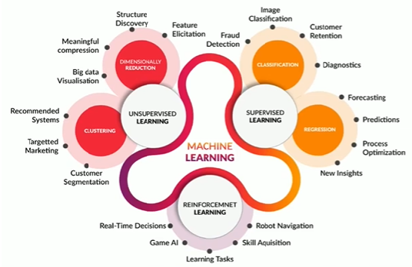

Slide 10
Association Rules Learning
Association rules are generally used for discovering interesting relationships in a data set.
They are often expressed in a rule form {X} ⇒ {Y} to express reasoning that;
if X is satisfied then Y is also satisfied.
Market-Based Analysis is one of the key techniques used by large relations to show associations between items. It allows retailers to identify relationships between the items that people buy together frequently.
In a real-world scenario, the following rule can be discovered from a transactional data set of a retail shop. {Milk} ⇒ {Bread}

Slide 11
Support
Support of an association rule is measured by its frequency in the transactions of a data set.
For example, {Milk} ⇒ {Bread} has a support of 60/100 meaning that 60% of all transactions contain the association rule.
Thus, a low-support rule is likely to be uninteresting from a business perspective as it may occur simply by chance.

Slide 12
Confidence
Many customers who buy Milk may buy other goods instead of Bread. Thus, the reliability (confidence) of an association rule needs to be measured.
For example, {Milk} ⇒ {Bread} has the confidence of 90/100 meaning that when Milk was purchased, in 90% of cases bread was also purchased.
Thus, an association rule {Milk} ⇒ {Bread} [Support: 60%; Confidence: 90%] indicates that there exists a strong relationship between the sales of Milk and Bread.

Slide 13
Clustering
Clustering divides a data set into a set of clusters (groups) where instances of the same cluster have high similarity while instances of different clusters have high dissimilarity.
It is an unsupervised learning technique, meaning that it does not require labeled data to learn from.
It is useful in many applications, including market segmentation, customer profiling, image and text analysis, and anomaly detection.

Slide 14
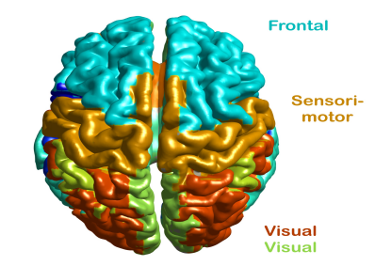
Example: in a real-world scenario, clustering can identify different brain areas (i.e. frontal, sensorimotor, and visual areas) with similar spectral profiles.

Slide 15
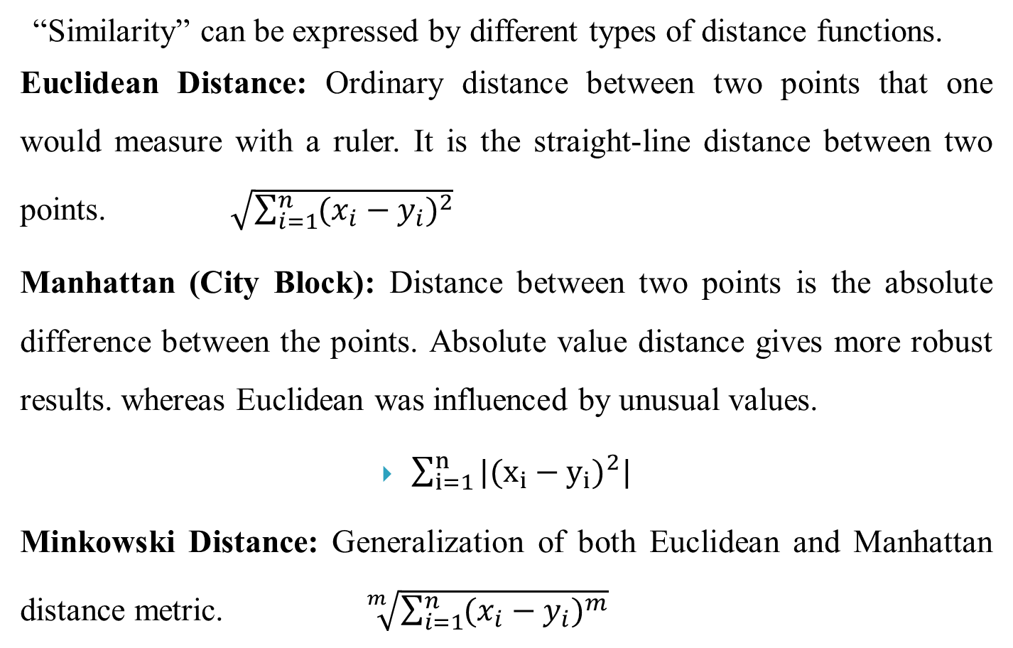
Distance functions
“Similarity” can be expressed by different types of distance functions.
Euclidean Distance: Ordinary distance between two points that one would measure with a ruler. It is the straight-line distance between two points. $\sqrt{\sum_{i=1}^{n}{({x_{i}−y_{i})}^{2}}}$
Manhattan (City Block): Distance between two points is the absolute difference between the points. Absolute value distance gives more robust results. whereas Euclidean was influenced by unusual values.
$\sum_{i=1}^{n}{|({x_{i}−y_{i})}^{2}|}$
Minkowski Distance: Generalization of both Euclidean and Manhattan distance metric. $\sqrt[m]{\sum_{i=1}^{n}{({x_{i}−y_{i})}^{m}}}$

Slide 16
K-Means Clustering
K-Means Clustering is an Unsupervised iterative Learning algorithm, which groups the unlabeled dataset into K different clusters in such a way that each dataset belongs to only one group that has similar properties.
It is a centroid-based algorithm, where each cluster is associated with a centroid.
The main aim of this algorithm is to minimize the sum of distances between the data point and their corresponding clusters.
It can be used in Image Segmentation, Customer Segmentation, Fraud Detection, Bioinformatics, Text Clustering, Recommendation Systems, Environmental Monitoring.

Slide 17
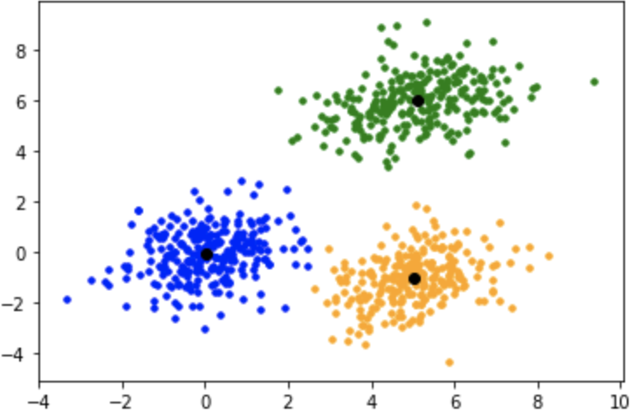
K-Means

Slide 18
K-Means algorithms
Choose the number of clusters(K) and obtain the data points
Randomly initialize the centroids c_1, c_2, ..... C_k
for each data point x_i: - find the nearest centroid(c_1, c_2 .. c_k) - assign the point to that cluster
for each cluster j = 1..k - new centroid = mean of all points assigned to that cluster
Repeat steps 3 and 4 until convergence or until the end of a fixed number of iterations
End
Self-study: limitation of K-means algorithm and how can solve?

Slide 19
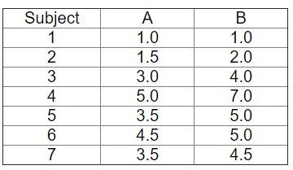
K-Means: Step-By-Step Example
Consider the following data set consisting of the scores of two variables on each of seven individuals.
This data set is to be grouped into two clusters.

Slide 20
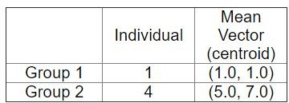
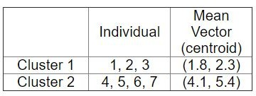
K-Means Example(cont.)
As a first step in finding a sensible initial partition, let the A & B values of the two individuals furthest apart (using the Euclidean distance measure), define the initial cluster means, giving:
Now the initial partition has changed, and the two clusters at this stage having the following characteristics:

Slide 21
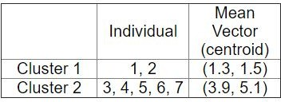
K-Means Example(cont.)
Only individual 3 is nearer to the mean of the opposite cluster (Cluster 2) than its own (Cluster 1). Thus, individual 3 is relocated to Cluster 2 resulting in the new partition

Slide 22
K-Means
Problem-01:
Cluster the following eight points (with (x, y) representing locations) into three clusters:
A1(2, 10), A2(2, 5), A3(8, 4), A4(5, 8), A5(7, 5), A6(6, 4), A7(1, 2), A8(4, 9)
Initial cluster centers are A1(2, 10), A4(5, 8), and A7(1, 2).
Use K-Means Algorithm to find the three cluster centers after the second iteration.

Slide 23
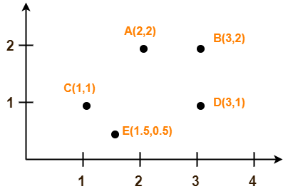
K-Means
Problem-02:
Use K-Means Algorithm to create two clusters-
Assume A(2, 2) and C(1, 1) are centers of the two clusters.

Slide 24
Hierarchical clustering
It is a type of unsupervised machine learning algorithm that groups similar objects into clusters based on their similarity or dissimilarity.
The algorithm builds a hierarchy of clusters by successively merging or dividing them until a stopping criterion is met.
To measure similarity or dissimilarity between two clusters or data points, hierarchical clustering algorithms use a distance metric such as Euclidean distance
We develop the hierarchy of clusters in the form of a tree, and this tree-shaped structure is known as the dendrogram that shows the hierarchical relationships between clusters.
Notes:
Dendrogram => tree-structured graph

Slide 25
Hierarchical clustering(cont.)
There are two types of hierarchical clustering:
Agglomerative (bottom-up)
Divisive(top-down)

Slide 26
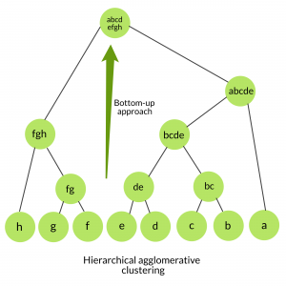
Agglomerative Clustering
Agglomerative clustering is the most common type of hierarchical clustering that starts with each data point as a separate cluster and iteratively merges clusters until a stopping criterion is met.

Slide 27
Steps to agglomerative clustering
Initialization
Compute pairwise distances
Find the closest pair of clusters
Merge the closest pair of clusters
Update the distance matrix: Recalculate the distance between the new cluster and each of the remaining clusters using a linkage method such as single linkage, complete linkage, or average linkage.
Repeat steps 3-5
Output the dendrogram

Slide 28
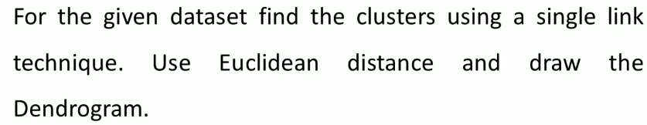
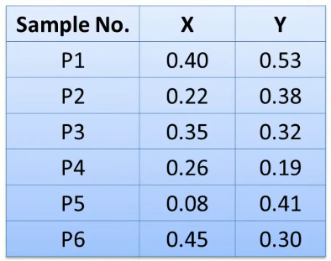
Example-1

Slide 29
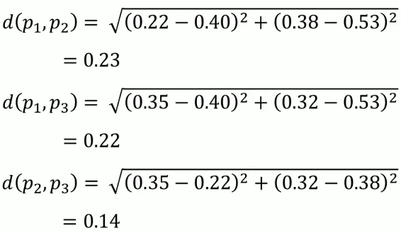
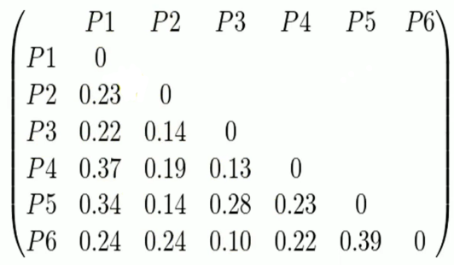

Slide 30
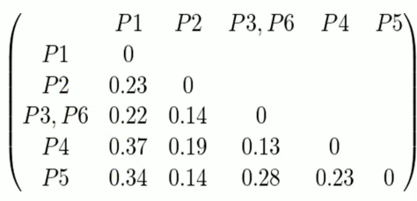

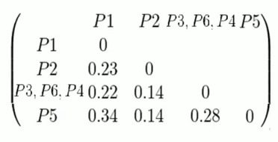

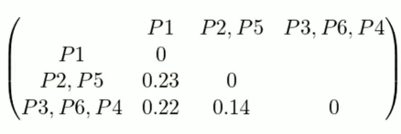


Slide 31
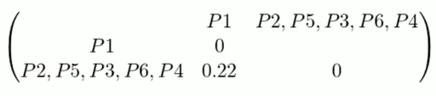

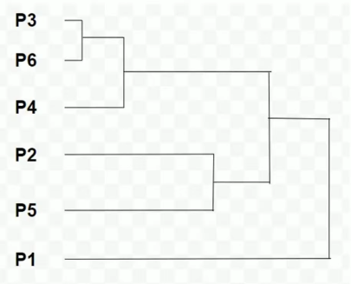

Slide 32
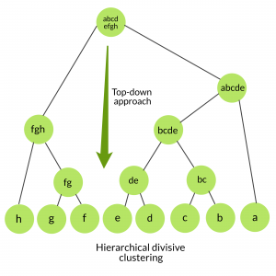
Divisive hierarchical clustering
All the data points are considered an individual cluster, and recursively dividing the data into smaller subsets until each subset contains only one data point or satisfies a stopping criterion.
Steps of Divisive Clustering:
Initialize the algorithm
Select a cluster to split
Split the cluster
Recurse on the subsets
Generate the dendrogram
Notes:
Initialize the algorithm: Start by considering all the data points as a single cluster.
Select a cluster to split: Choose a cluster to split based on a similarity criterion, such as maximum distance, maximum variance, or minimum variance. This step involves selecting a splitting point that divides the cluster into two smaller subsets.
Split the cluster: Split the selected cluster into two smaller subsets using the splitting point selected in step 2. The splitting can be done by dividing the cluster into two groups based on a threshold or by using a clustering algorithm on the subset.
Recurse on the subsets: Apply steps 2 and 3 recursively to the two subsets generated in step 3 until the stopping criterion is met. The stopping criterion can be based on the number of clusters desired or the minimum size of the cluster.
Generate the dendrogram: As the algorithm proceeds, it generates a dendrogram, which is a tree-like diagram that shows the hierarchy of clusters formed by the algorithm. The dendrogram shows the clusters at each level of the hierarchy and the order in which they were formed.

Slide 33
Fuzzy c-means (FCM)
fuzzy c-means clustering, is a soft clustering technique in machine learning in which each data point is separated into different clusters and then assigned a probability score for being in that cluster that provides one element of data or image belonging to two or more clusters.
Self-study: soft vs hard clustering

Slide 34
Fuzzy c-means (FCM)
It starts with a random initial guess for the cluster centers; that is the mean location of each cluster.
Next, FCM assigns every data point a random membership grade for each cluster.
By iteratively updating the cluster centers and the membership grades for each data point, FCM moves the cluster centers to the correct location within a data set and, for each data point, finds the degree of membership in each cluster.

Slide 35
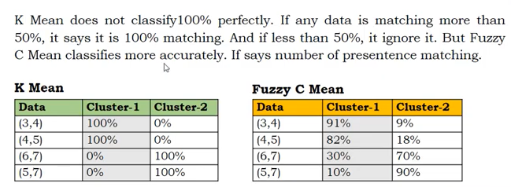
K-Means vs FCM
k-means clustering algorithm gives the values of any point lying in some particular cluster to be either 0 or 1 i.e., either true or false. But the fuzzy logic gives the fuzzy values of any particular data point to be lying in either of the clusters.

Slide 36
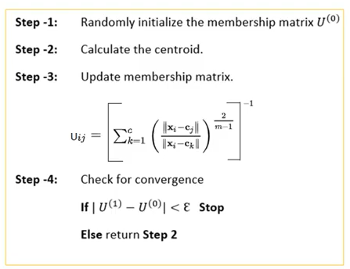
Steps of FCM

Slide 37
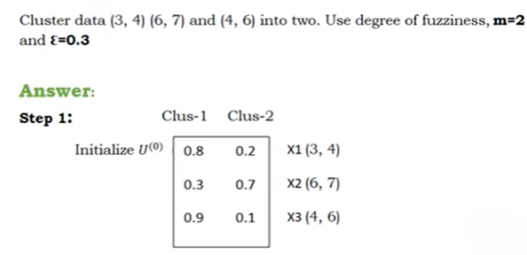
Example-1:
summation of membership of each data point should be equal to one.

Slide 38
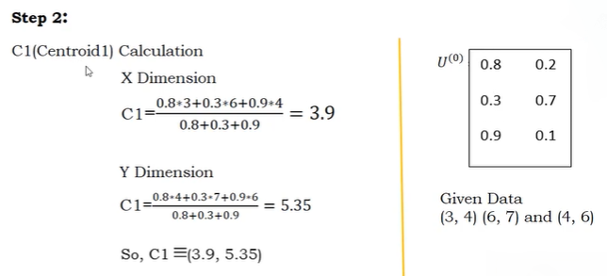


Slide 39
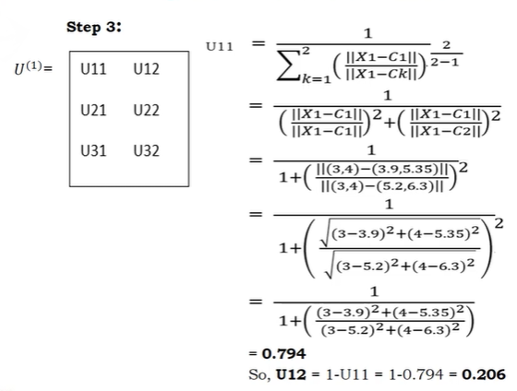

Slide 40
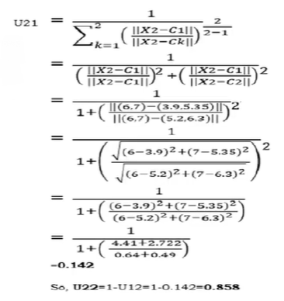

Slide 41
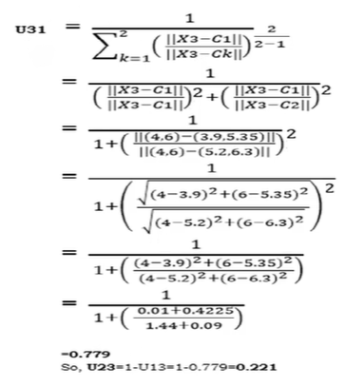

Slide 42
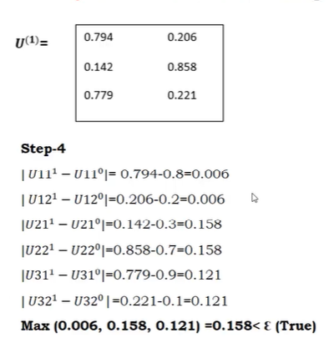
Example-2:
Suppose the given data points are {(1, 3), (2, 5), (6, 8), (7, 9)}, use fuzzy-c means clustering these data.

