Slide 1
Lesson 5:DESIGN PROCESS
EXAMPLES –Automatic Chocolate vending machine, smart card and digital camera

Slide 2
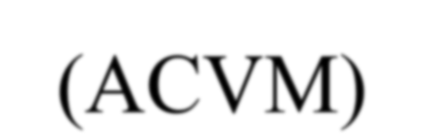

Automatic Chocolate Vending Machine (ACVM)

Slide 3








Diagrammatic representation of ACVM
Keypad for user Interface
LCD Display or Touch Screen for user
Mechanical Coin Sorter
Microcontroller based hardware
USB_Wireless
_Modem
RTOS
Software
Chocolate and refunded coins collector

Slide 4

ACVM
Coin insertion slot
Keypad on the top of the machine.
LCD display unit on the top of the machine. It displays menus, text entered into the ACVM and pictograms, welcome, thank and other messages.
Graphic interactions with the machine.
Displays time and date.

Slide 5
ACVM
Delivery slot so that child can collect the chocolate and coins, if refunded.
Internet connection port so that owner can know status of the ACVM sales from remote.

Slide 6
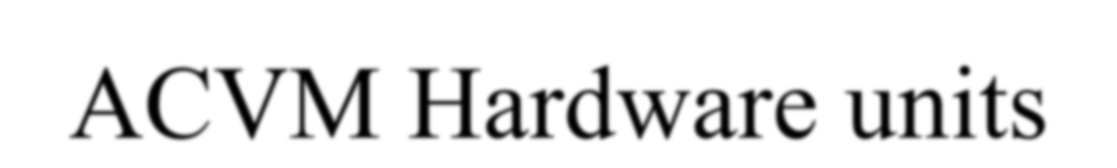
ACVM Hardware units
Microcontroller or ASIP (Application Specific Instruction Set Processor)
RAM for storing temporary variables and stack
ROM for application codes and RTOS codes for scheduling the tasks
Flash memory for storing user preferences, contact data, user address, user date of birth, user identification code, answers of FAQs

Slide 7

ACVM Hardware units (contd.)
Timer and Interrupt controller
A TCP/IP port (Internet broadband connection) to the ACVM for remote control and for getting ACVM status reports by owner.
ACVM specific hardware
Power supply .

Slide 8
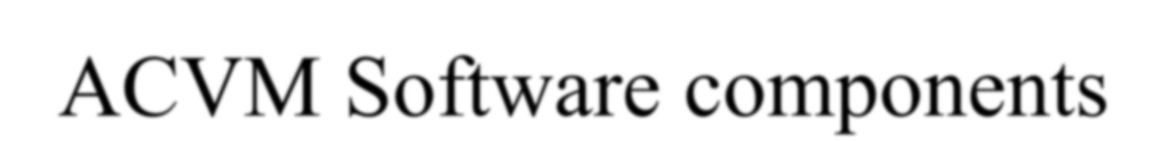
ACVM Software components
Keypad input read
Display
Read coins
Deliver chocolate
TCP/IP stack processing
TCP/IP stack communication

Slide 9
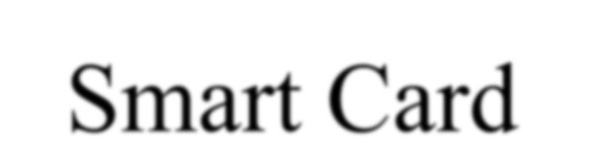
Smart Card

Slide 10
Smart Card
Smart card– a plastic card in ISO standard dimensions, 85.60 mm x 53.98 x 0.80 mm.
Embedded system on a card.
SoC (System-On-Chip).
ISO recommended standards are ISO7816 (1 to 4) for host-machine contact based cards and ISO14443 (Part A or B) for the contact-less cards.
Silicon chip is just a few mm in size and is concealed in-between the layers. Its very small size protects the card from bending

Slide 11








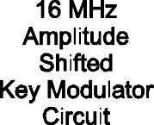


Embedded hardware components in a contact less smart card

Slide 12
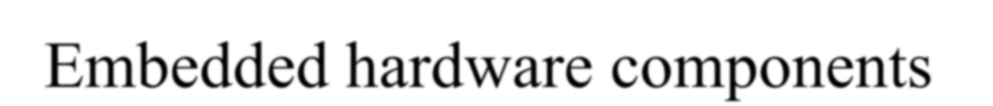
Embedded hardware components
Microcontroller or ASIP (Application Specific Instruction Set Processor)
RAM for temporary variables and stack
ROM for application codes and RTOS codes for scheduling the tasks
EEPROM for storing user data, user address, user identification codes, card number and expiry date
Timer and Interrupt controller
A carrier frequency ~16 MHz generating circuit and Amplitude Shifted Key (ASK)
Interfacing circuit for the I/Os
Charge pump

Slide 13

ROM
Fabrication key, Personalization key An utilisation lock
RTOS and application using only the logical addresses.

Slide 14
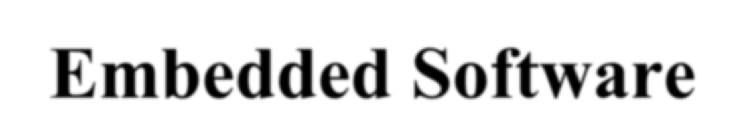
Embedded Software
Boot-up, Initialisation and OS programs
Smart card secure file system
Connection establishment and termination
Communication with host
Cryptography
Host authentication
Card authentication
Addition parameters or recent new data sent by the host (for example, present balance left)

Slide 15
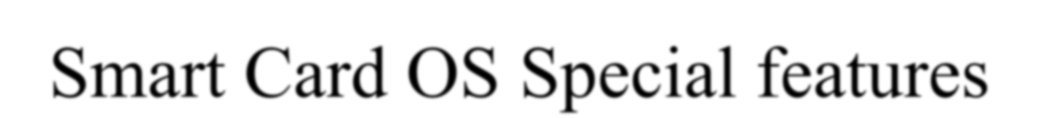
Smart Card OS Special features
Protected environment.
Every method, class and run time library should be scalable.
Code-size generated be optimum.
Memory should not exceed 64 kB memory.
Limiting uses of specific data types; multidimensional arrays, long 64-bit integer and floating points

Slide 16

Smart Card OS Limiting features
Limiting uses of the error handlers, exceptions, signals, serialization, debugging and profiling. [Serialization means process of converting an object is converted into a data stream for transferring it to network or from one process to another. At receiver
end there is de-serialization.]

Slide 17
Smart Card OS File System and Classes
Three-layered file system for the data.
Master file to store all file headers.
Dedicated file to hold a file grouping and headers of the immediate successor elementary files of the group.
Elementary file to hold the file header and its file data.
Fixed-length or variable-file length management
Classes for the network, sockets, connections, data grams, character-input output and streams, security management, digital-certification, symmetric and asymmetric keys-based cryptography and digital signatures.

Slide 18
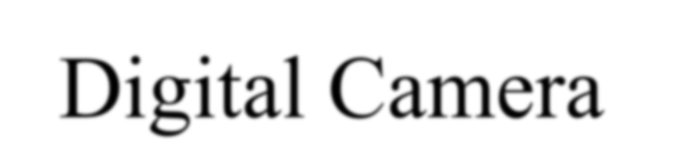
Digital Camera

Slide 19













Digital camera hardware components
LCD or Touch screen the frame view
Keys
ADC
CCD
DAC
Microcontroller
CCD coprocessor and
ASIP (DSP) CODEC
Pixel processor
Microcontroller, Timer, DMAC
Embedded Software in Memory
Serial COM
Flash Memory
USB Port
Bluetooth
Computer
Printer

Slide 20
A typical Camera
4 M pixel/6 M pixel still images, clear visual display (ClearVid) CMOS sensor, 7 cm wide LCD photo display screen, enhanced imaging processor, double anti blur solution and high-speed processing engine, 10X optical and 20X digital zooms
Record high definition video-clips. It therefore has speaker microphone(s) for high quality recorded sound.
Audio/video Out Port for connecting to a TV/DVD player.

Slide 21
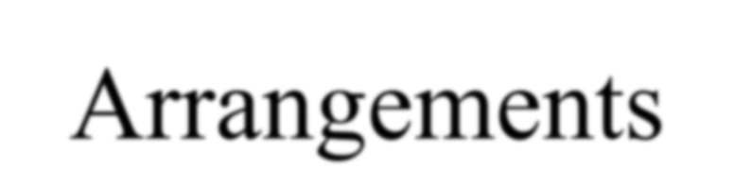
Arrangements
Keys on the camera.
Shutter, lens and charge coupled device (CCD) array sensors
Good resolution photo quality LCD display unit
Displays text such as image-title, shooting data and time and serial number. It displays messages. It displays the GUI menu when user interacts with the camera.
Self-timer lamp for flash.

Slide 22
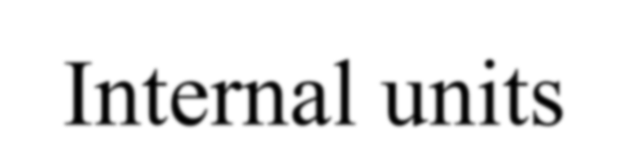
Internal units
Internal memory flash to store OS and embedded software and limited number of image files
Flash memory stick of 2 GB or more for large storage.
Universal Serial Bus (USB), Bluetooth and serial COM port for connecting it to computer, mobile and printer.

Slide 23
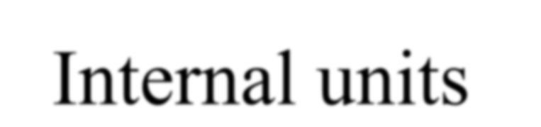
Internal units
LCD screen to display frame view.
Saved images display using the navigation keys.
Frame light falls on the CCD array, which through an ADC transmits the bits for each pixel in each row in the frame and for the dark area pixels in each row for offset correction in CCD signaled light intensities for each row.
The CCD bits of each pixel in each row and column are offset corrected by CCD signal processor (CCDSP).

Slide 24

ASIP and Single purpose processors
For Signals compression using a JPEG CODEC and saved in one jpg file for each frame.
For DSP for compression using the discrete cosine transformations (DCTs) and decompression.
For DCT Huffman coding for the JPEG compression.
For decompression by inverse DCT before the DAC sends input for display unit through pixel processor.
Pixel processor (for example, image contrast, brightness, rotation, translation, color adjustment)

Slide 25

Digital Camera Hardware units
Microcontroller or ASIP (Application Specific Instruction Set Processor)
Multiple processors (CCDSP, DSP, Pixel Processor and others)
RAM for storing temporary variables and stack
ROM for application codes and RTOS codes for scheduling the tasks

Slide 26
Digital Camera Hardware units
Timer, Flash memory for storing user preferences, contact data, user address, user date of birth, user identification code, ADC, DAC and Interrupt controller
The DAC gets the input from pixel processor, which gets the inputs from JPEG file for the saved images and also gets input directly from the CCDSP through pixel processor or the frame in present view
USB controller Direct Memory Access controller
LCD controller
Battery and external charging circuit

Slide 27
Digital Camera Software components
CCD signal processing for off-set correction
JPEG coding
JPEG decoding
Pixel processing before display
Memory and file systems
Light, flash and display device drivers
LCD, USB and Bluetooth Port device- drivers for port operations for display, printer and computer communication control

Slide 28
Digital camera software components
Light, flash and display device drivers
CCD signal processing
JPEG coding
JPEG decoding
Pixel co-processing
LCD and USB Port device drivers
LCD, Bluetooth COM and USB Port device drivers

Slide 29
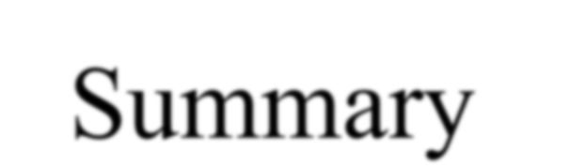
Summary
We learnt functions, hardware and software components for
Automatic Chocolate vending machine,
Ssmart card and
Digital camera

