Slide 1
Context Free Grammar (CFG)
A context Free Grammar (CFG) is a 4-tuple such that-
G = (V , T , P , S)
where-
V = Finite non-empty set of variables / non-terminal symbols
T = Finite set of terminal symbols
P = Finite non-empty set of production rules of the form A → α where A ∈ V and α ∈ (V ∪ T)*
S = Start symbol

Slide 2
Context Free Grammar (CFG)
Example:
S → aSbS
S → bSaS
S → ∈
Consider a grammar G = (V , T , P , S) where-
V = { S }
T = { a , b }
P = { S → aSbS , S → bSaS , S → ∈ }
S = { S }

Slide 3
Context Free Grammar (CFG)
Construct a CFG for the regular expression (a+b)*
Solution:
The CFG can be given by,
Production rule (P):
S → aS | bS
S → ε
(a+b)*={ε , aa,bb,aab……}
For implementing ‘aab’
S
aS
aaS
aabS
aab ε
aab

Slide 4
Problem-1
S → bB / aA
A → b / bS / aAA
B → a / aS / bBB
w = bbaababa
1. Leftmost Derivation-
S → bB
→ bbBB (Using B → bBB)
→ bbaB (Using B → a)
→ bbaaS (Using B → aS)
→ bbaabB (Using S → bB)
→ bbaabaS (Using B → aS)
→ bbaababB (Using S → bB)
→ bbaababa (Using B → a)
2. Rightmost Derivation-
S → bB
→ bbBB (Using B → bBB)
→ bbBaS (Using B → aS)
→ bbBabB (Using S → bB)
→ bbBabaS (Using B → aS)
→ bbBababB (Using S → bB)
→ bbBababa (Using B → a)
→ bbaababa (Using B → a)

Slide 5
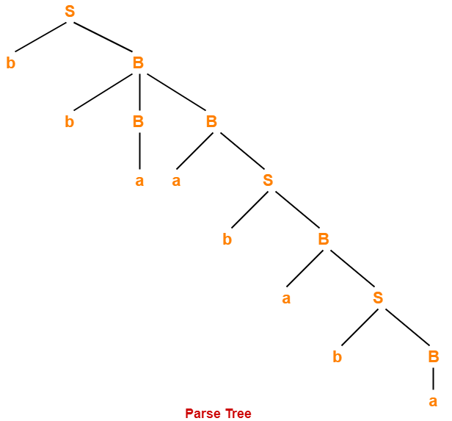
Problem-1
3. Parse Tree-
Whether we consider the leftmost derivation or rightmost derivation, we get the above parse tree.
The reason is given grammar is unambiguous.

Slide 6
Ambiguity in Grammar
Consider the following grammar-
E → E + E / E x E / id
(Ambiguous Grammar)
This grammar is an example of ambiguous grammar.
Any of the following reasons can be stated to prove the grammar ambiguous-

Slide 7
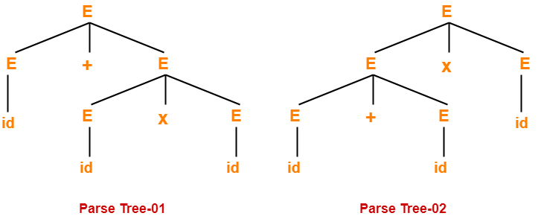
Ambiguity in Grammar
Reason-01:
Let us consider a string w generated by the grammar- w = id + id x id
Now, let us draw the parse trees for this string w.
E → E + E / E x E / id
Since two parse trees exist for string w, therefore the grammar is ambiguous.

Slide 8
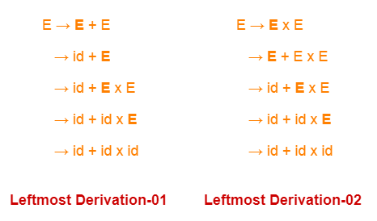
Ambiguity in Grammar
Reason-02:
Let us consider a string w generated by the grammar-
w = id + id x id
Now, let us write the leftmost derivations for this string w.
Since two leftmost derivations exist for string w, therefore the grammar is ambiguous.

Slide 9
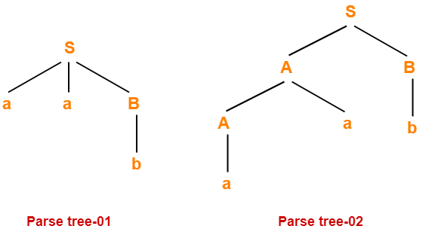
Ambiguity in Grammar
Check whether the given grammar is ambiguous or not-
S → AB / aaB
A → a / Aa
B → b
Let us consider a string w generated by the given grammar w = aab
Now, let us draw parse trees for this string w.
Since two different parse trees exist for string w, therefore the given grammar is ambiguous

Slide 10
Recursive Grammar
Recursive Grammar- A grammar is said to be recursive if it contains at least one production that has the same variable at both its LHS and RHS.
Or
A grammar is said to be recursive if and only if it generates infinite number of strings.
1.Left Recursive Grammar-A recursive grammar is said to be left recursive if the leftmost variable of RHS is same as variable of LHS.
Example-
S → Sa / b
(Left Recursive Grammar)
Left recursion is a problem in top-down parsers because top down parsers use left-most derivation to derive the required string by using the start symbol of the grammar. Due to this reason top-down parsers might go into infinite loop with left recursive grammar.
Therefore, left recursion has to be eliminated from the grammar.

Slide 11
Recursive Grammar
2. Right Recursion- A production of grammar is said to have right recursion if the rightmost variable of its RHS is same as variable of its LHS.
Example-
S → aS / ∈
(Right Recursive Grammar)
Right recursion does not create any problem for the Top down parsers.
Therefore, there is no need of eliminating right recursion from the grammar.

Slide 12
Elimination of Left Recursion
Left recursion is eliminated by converting the grammar into a right recursive grammar.
If we have the left-recursive pair of productions-
A → Aα / β
(Left Recursive Grammar)
where β does not begin with an A.
Then, we can eliminate left recursion by replacing the pair of productions with-
A → βA’
A’ → αA’ / ∈
(Right Recursive Grammar)
This right recursive grammar functions same as left recursive grammar.

Slide 13
Elimination of Left Recursion
Consider the following grammar and eliminate left recursion-
E → E + T / T
T → T x F / F
F → id
Solution:
E → TE’ [A → βA’]
E’ → +TE’ / ∈ [A’ → αA’ / ∈]
T → FT’ [[A → βA’]
T’ → xFT’ / ∈ [A’ → αA’ / ∈]
F → id

Slide 14
Elimination of Left Recursion
Consider the following grammar and eliminate left recursion-
S → S0S1S / 01
Solution-
The grammar after eliminating left recursion is-
S → 01S’
S’→ 0S1SS’ / ∈

Slide 15
Practice Session
Consider the following grammar and eliminate left recursion-
S → (L) / a
L → L , S / S
Solution:
The grammar after eliminating left recursion is-
S → (L) / a
L → SL’
L’ → ,SL’ / ∈

Slide 16
Elimination of Left Recursion
The general form for left recursion is
A → Aα₁|Aα₂| … . |Aα_{m}|β₁|β₂| … . . β_{n}
can be replaced by
A → β₁A′|β₂A′| … . . | … . . |β_{n}A′
A‘ → α₁A′|α₂A′| … . . |α_{m}A′|ε

Slide 17
Elimination of Left Recursion
Consider the following grammar and eliminate left recursion-
E → E + E / E x E / a [A → Aα1/ Aα2/ β]
Solution-
The grammar after eliminating left recursion is-
E → aE’ [A → βA’]
E’→ +EE’ / xEE’ / ∈ [A’ → α1A’ / α2A’ /∈]

Slide 18
Practice Session
Consider the following grammar and eliminate left recursion-
S → A
A → Ad / Ae / aB / ac [ A →Aα1/Aα2/ β1/ β2]
B → bBc / f
Solution:
The grammar after eliminating left recursion is-
S → A
A → aBA’ / acA’ [ A → β1A’/ β2A’]
A’ → dA’ / eA’ / ∈ [A → α1A’/α2A’/ ∈]
B → bBc / f

Slide 19
Common Prefix Problem
If more than one grammar production rules has a common prefix string, then the top-down parser cannot make a choice as to which of the production it should take to parse the string in hand.
A => αβ1 | αβ2 | αβ3 |......... Αβn
Suppose, Input string is ‘αβ3’
A
A
A
α
β1
α
β2
α
β3
Need Backtracking
Need Backtracking
Success
As every portion of the above rule (αβ1 | αβ2 | αβ3 |......... Αβn ) starts with α. So, if the input string is not found then it needs to backtrack until the input string matches. This problem is known as ‘Common Prefix Problem’.

Slide 20
Common Prefix Problem
So, If RHS of more than one production starts with the same symbol, then such a grammar is called as Grammar With Common Prefixes.
This kind of grammar creates a problematic situation for Top down parsers.
Top-down parsers can not decide which production must be chosen to parse the string in hand.
To remove this confusion, we use left factoring.

Slide 21
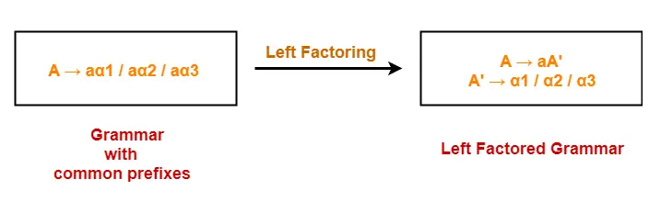
Left-Factoring
Left factoring is a process by which the grammar with common prefixes is transformed to make it useful for Top down parsers.
How?
In left factoring,We make one production for each common prefixes.
The common prefix may be a terminal or a non-terminal or a combination of both.
Rest of the derivation is added by new productions.
The grammar obtained after the process of left factoring is called as Left Factored Grammar.
Example-

Slide 22
Left-Factoring
Perform left factoring in the following grammar-
S → iEtS / iEtSeS / a
E → b
Solution-
The left factored grammar is-
S → iEtSS’ / a
S’ → eS / ∈
E → b

Slide 23
Left-Factoring
Perform left factoring in the following grammar-
A → aAB / aBc / aAc
Solution-
Step-01:
A → aA’
A’ → AB / Bc / Ac
Again, this is a grammar with common prefixes.
Step-02:
A → aA’
A’ → AD / Bc
D → B / c
This is a left factored grammar.

Slide 24
Practice Session
Perform left factoring in the following grammar-
S → bSSaaS / bSSaSb / bSb / a
Solution-
Step-01:
S → bSS’ / a
S’ → SaaS / SaSb / b
Again, this is a grammar with common prefixes.
Step-02:
S → bSS’ / a
S’ → SaA / b
A → aS / Sb
This is a left factored grammar.

Slide 25
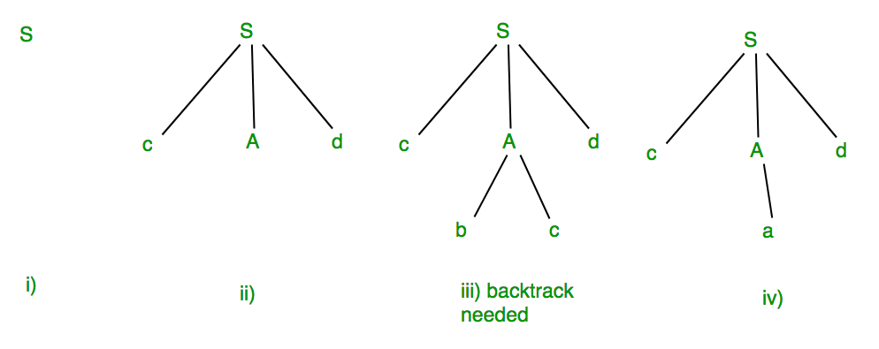
FIRST and FOLLOW
Suppose Production rules for the Grammar of a language are:
The Input string is “cad”.
To generate string “cad” it uses the rules as shown in the given diagram:
S -> cAd
A -> bc|a
In step (iii) above, the production rule A->bc was not a suitable one to apply (because the string produced is “cbcd” not “cad”), here the parser needs to backtrack, and apply the next production rule available with A which is shown in step (iv), and the string “cad” is produced.

Slide 26
FIRST and FOLLOW
Thus, the given input can be produced by the given grammar, therefore the input is correct in syntax. But backtrack was needed to get the correct syntax tree, which is really a complex process to implement. There can be an easier way to solve this, which is the “Concepts of FIRST and FOLLOW rule.

Slide 27
End

