Slide 1
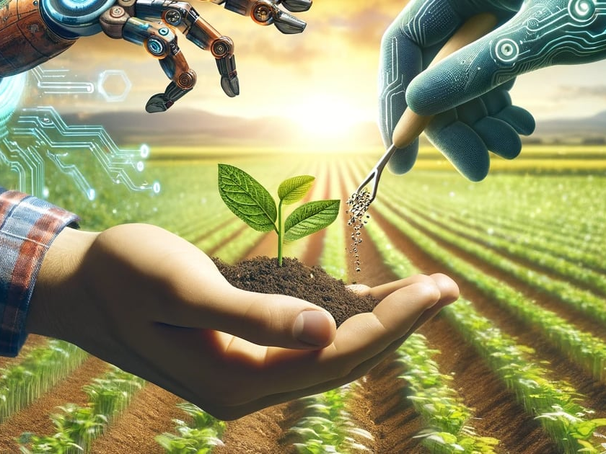

From Pixels to Diagnosis: Machine Learning Approaches for Tomato Leaf Disease Detection
Author: Zamir Osmenaj
Supervisor: Nikolaos Tselikas

Slide 2





Introduction
Tackling Tomato Leaf Diseases through Technology
Goal: Enhancing Agricultural Efficiency The aim is to design a specialized Convolutional Neural Network to classify diseases in tomato leaves, alongside identifying healthy ones, thereby streamlining agricultural processes. | Problem Statement: Manual Detection Limitations Traditional methods of disease identification involve significant manual labor, are subject to human inaccuracies, and lack scalability—resulting in delayed responses and crop losses.
Proposed Solution: Automation through AI and ML Implementing AI-driven solutions enables faster, more accurate diagnostics, which are essential for modern farming efficiency, helping farmers to act with immediacy and precision. | Thesis Objective: Explore CNN and Transfer Learning The focus will be on leveraging Convolutional Neural Networks and transfer learning techniques to maximize classification accuracy using diverse image datasets.

Slide 3
Motivation & Research Gap
Motivation
Real World Impact: Tomato plants are among the most widely cultivated crops globally, with diseases like late blight, bacterial spots, and early blight causing significant losses. Early and accurate detection can reduce yield losses by up to 20-30%.
Technology Relevance: With advancements in machine learning, particularly CNNs and transfer learning, there's an opportunity to automate and scale disease detection processes.
Research Gap
Previous works have focused primarily on general image datasets or traditional machine learning methods, but few studies explore transfer learning combined with a custom CNN architecture to achieve robust results in this specific domain.
Key Contribution
Developing a custom CNN model and comparing its performance with transfer learning approaches (VGG16 and VGG19).
Practical Application: The model developed will provide a readily deployable tool that can be used in a web or mobile application for real-time disease detection, empowering farmers to take timely corrective actions.
While there has been significant progress in using CNNs for image classification in general, there is a lack of focused research on custom deep learning models and fine-tuning of pre-trained networks (such as VGG16 and VGG19) for specific agricultural applications, particularly for tomato leaf diseases.
Evaluating these models on a real-world dataset of tomato leaf images and demonstrating their applicability in creating user-friendly web interfaces for practical deployment.
Inspiration and Unmet Needs in Current Research

Slide 4







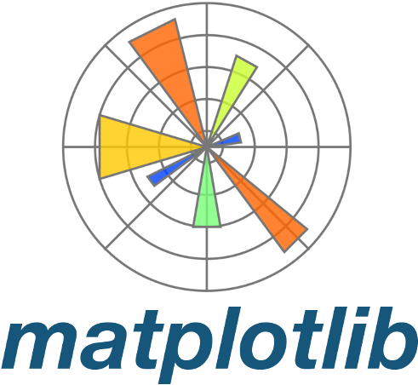



Tools & Technologies
Essential Tools and Frameworks for Model Implementation
Python Packages
TensorFlow/Keras: Used to build and train the Convolutional Neural Network (CNN) model for image classification.
NumPy & Pandas: Essential for data manipulation and preprocessing tasks like handling the dataset before training.
Matplotlib & Seaborn: Employed for visualizing training metrics (accuracy, loss) and performance comparison across models.
Scikit-learn: Utilized for additional metrics (e.g., precision, recall, f1-score) and model evaluation.
Jupyter Notebook: The primary environment used for developing and testing the machine learning models.
Note on Virtual Environment: All packages were installed within a virtual environment to ensure consistent dependencies, avoid conflicts between package versions, and maintain a clean, isolated workspace for the project.
GPU Toolkit and Libraries
CUDA Toolkit and cuDNN: These GPU-accelerated libraries are used to speed up the training process. Running deep learning models on GPU (Graphics Processing Unit) significantly reduces the time required for training large models on high-dimensional datasets like the tomato leaf dataset.
Min: 56°C
Max: 66°C

Slide 5
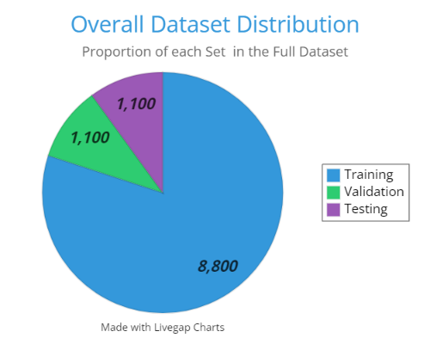

Dataset Description (1/2)
Dataset Structuring and Augmentation for Improved Model Robustness
The dataset of tomato leaves was obtained from Kaggle, comprising over 11,000 images across 10 classes (9 diseases and 1 healthy class).
Test
Validation
Train
A completely unseen set for evaluating the final model performance.
The dataset initially had two sets: training and validation. To build a more robust model, the two sets were merged, and a new dataset structure was created with three subsets
Used to validate the model during training.
Used to train the model.

Slide 6
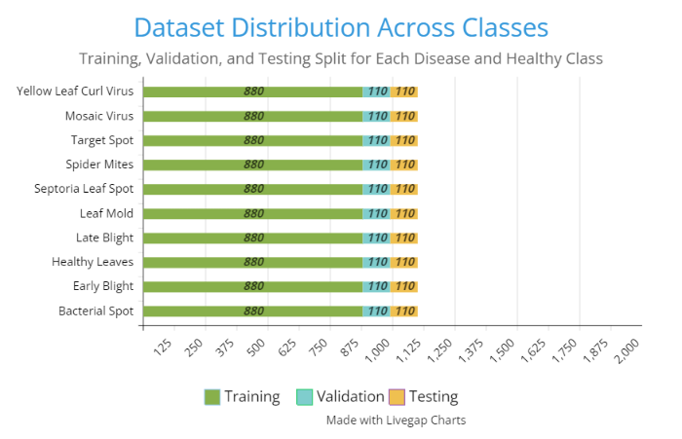

Dataset Description (2/2)
Dataset Structuring and Augmentation for Improved Model Robustness
Data Augmentation
Online data augmentation techniques such as image rotation, zooming, and shearing were applied to generate more diverse training data, enhancing the model's ability to generalize and prevent overfitting.

Slide 7
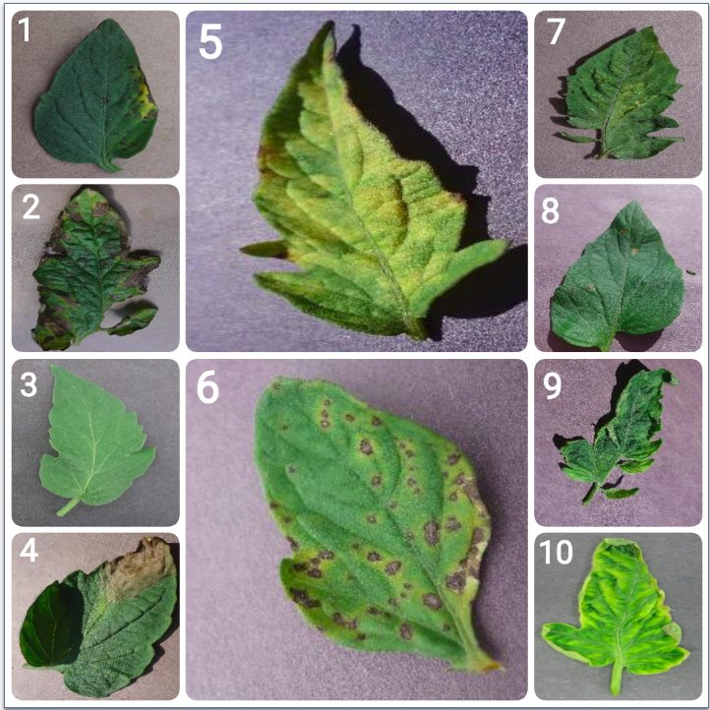
Disease Types in Tomato Leaves
Common Tomato Leaf Diseases and Their Symptoms
Bacterial Spot: Caused by bacteria in wet, warm conditions, spread by splashing water or infected tools.
Early Blight: Dark concentric rings on older leaves. Fungus attacks older leaves first, often due to high humidity and poor air circulation.
Healthy Leaves: No discoloration or spots; uniform green. Proper watering, sunlight, and nutrient balance keep leaves free from diseases and pests.
Late Blight: Dark, water-soaked lesions; often a grayish color. Fungus-like pathogen spreads rapidly in cool, wet weather, affecting entire plant.
Leaf Mold: Fungus thrives in high humidity, causing yellow spots and mold on the underside of leaves.
Septoria Leaf Spot: Caused by fungal spores in wet conditions, it creates brown spots on leaves.
Spider Mites: Fine webbing and yellow stippling on leaves.
Target Spot: Fungus creates concentric dark spots, common in warm, moist environments.
Tomato Mosaic Virus: Virus spreads by touch or infected tools, causing mottling and distorted growth.
Tomato Yellow Leaf Curl Virus: Virus spread by whiteflies, causes yellowing and curling of leaves, stunting growth.

Slide 8





Deep Learning Fundamentals & CNNs
Insights into Neural Networks and CNNs
What are CNNs? Convolutional Neural Networks are specialized deep learning algorithms that recognize patterns in visual input by mimicking human visual perception mechanisms. | Layers in CNN CNNs consist of distinct layers including convolutional layers, activation functions, pooling layers, and fully connected layers to refine input images and enhance classification accuracy.
How CNNs Work Through a sequence of convolutional operations and pooling, CNNs extract features from images, reducing dimensionality while retaining essential information for classification tasks. | Application in Image Classification CNNs have proven highly effective in various applications, particularly in image recognition, medical imaging, and agricultural diagnostics, enabling intelligent decision-making.

Slide 9





Transfer Learning Explained
Harnessing Transfer Learning for Efficient and Accurate Predictions
Concept of Transfer Learning Transfer Learning involves leveraging a pre-trained model to solve a new but related task, dramatically reducing the amount of training data needed. | Importance in Deep Learning It accelerates training times and enhances performance, particularly, useful when labeled data is scarce, as often the case in agricultural applications.
Pre-trained Models Used VGG16 and VGG19 are stat-of-the-art convolutional networks pre-trained on extensive datasets, acting as strong feature extractors to enhance our model's accuracy. | Benefits of Transfer Learning Significantly speeds up model development, improves classification performance, and minimizes the risk of overfitting, boosting reliability and efficiency.

Slide 10
Training the Deep Learning Model
Processes of Educating the CNN
Training Process
Validation Techniques
While training, it's essential to constantly validate the model on a separate dataset to monitor its performance and prevent overfitting, ensuring it generalizes well.
Hyperparameter Tuning
Performance Metrics
Evaluating the model's effectiveness involves metrics such as loss function values and accuracy percentages to determine its ability to identify and classify tomato leaf diseases.
The training phase involves feeding the model annotated images and adjusting its weights through backpropagation to minimize predictions errors across iterations.
Optimizing specific parameters such as learning rate, batch size, and number of epochs is critical for enhancing model performance and accuracy during training.

Slide 11


Model Evaluation Techniques
Assessing Model Performance
Precision
Question: "Out of all the times the model predicted a certain class (like a specific disease), how many times was it correct?"
Definition: Precision tells us how accurate the model is when it predicts a specific class (like a particular disease or healthy). It focuses on how often the model is right when it chooses a certain class.
Recall
Question: "Out of all the instances that actually belong to a certain class (like a specific disease), how many did the model correctly identify?"
Definition: Recall measures how good the model is at finding all instances of a specific class. For example, it tells us how well the model detects a particular disease when it’s present.
F1-Score
Question: "How well is the model balancing accuracy and detection across all classes?"
Definition: The F1 score combines precision and recall for each class. It gives a balanced evaluation of the model’s performance, especially useful when some classes are harder to predict than others.
Confusion Matrix
Question: "How often is the model correctly identifying each class, and where does it confuse one class with another?"
Definition: The confusion matrix shows all the prediction results across all classes. It reveals where the model gets it right (e.g., correctly predicting a certain disease) and where it makes mistakes (e.g., predicting one disease when it’s actually another). It provides a detailed view of errors and correct predictions for each classes.

Slide 12
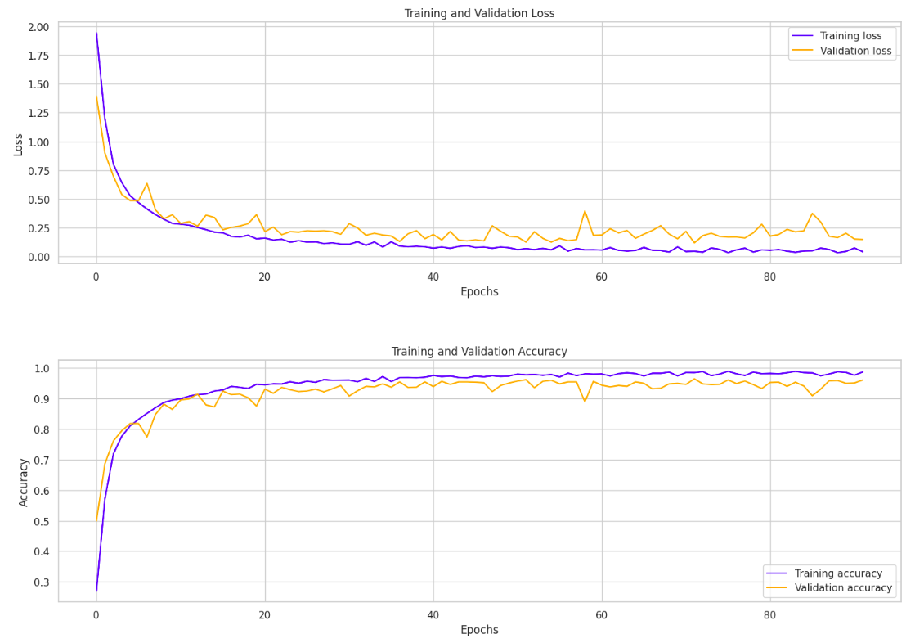
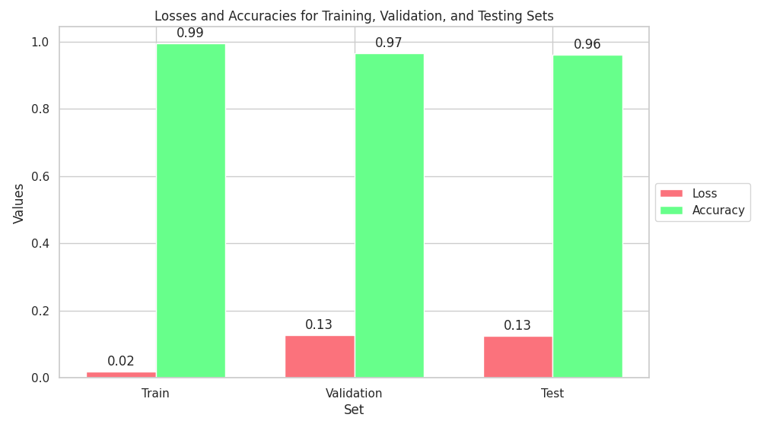
Visual Representation of Model Performance (1/4)
Graphical Comparison of Accuracy, Loss, and Model Evaluation Metrics

Slide 13
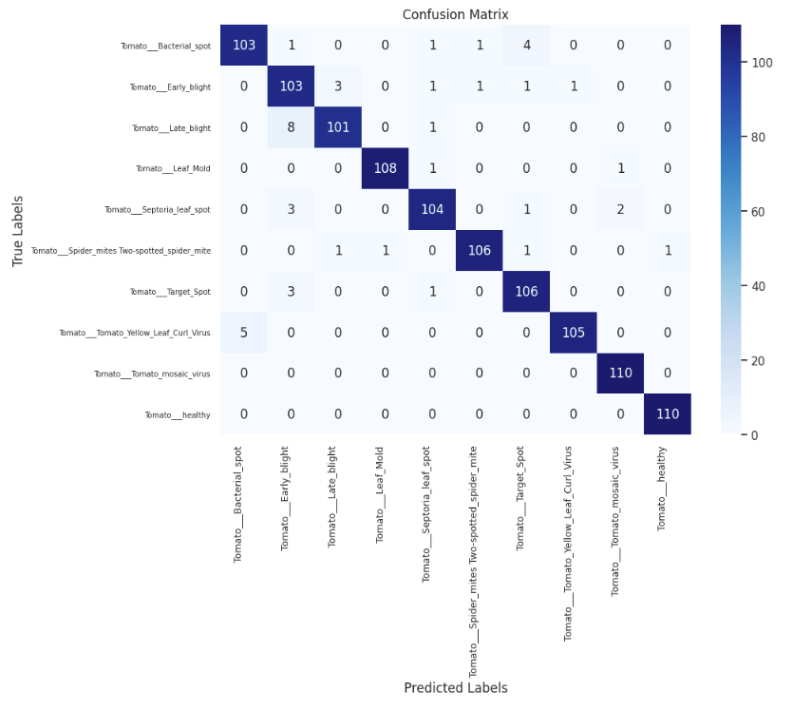
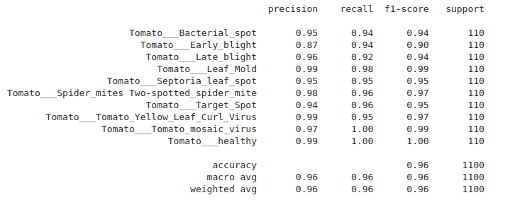
Visual Representation of Model Performance (2/4)
Graphical Comparison of Accuracy, Loss, and Model Evaluation Metrics

Slide 14
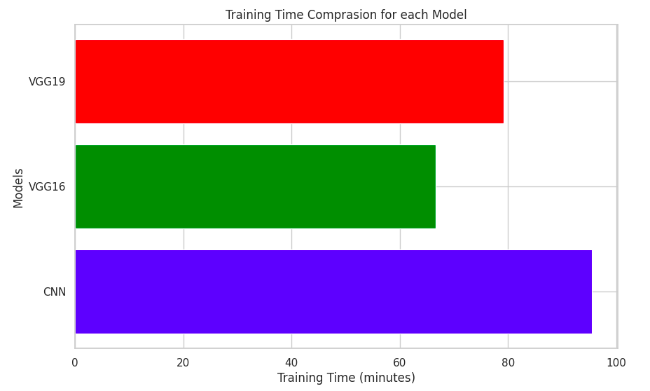
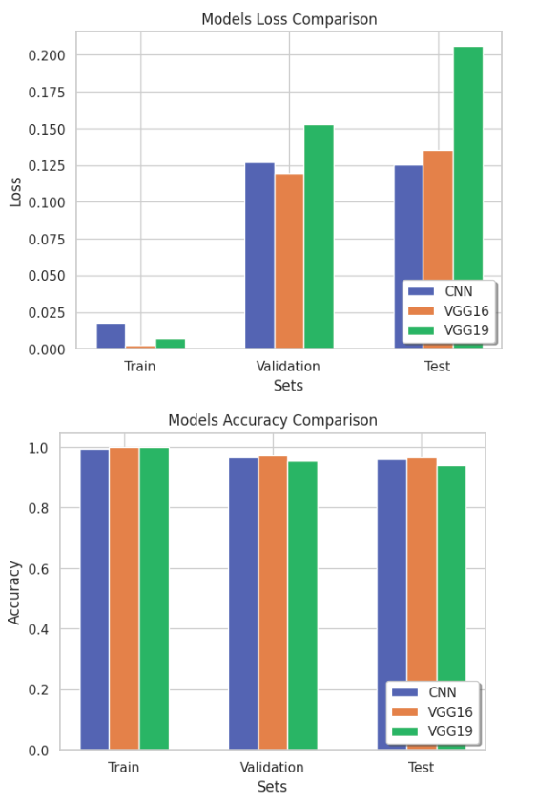
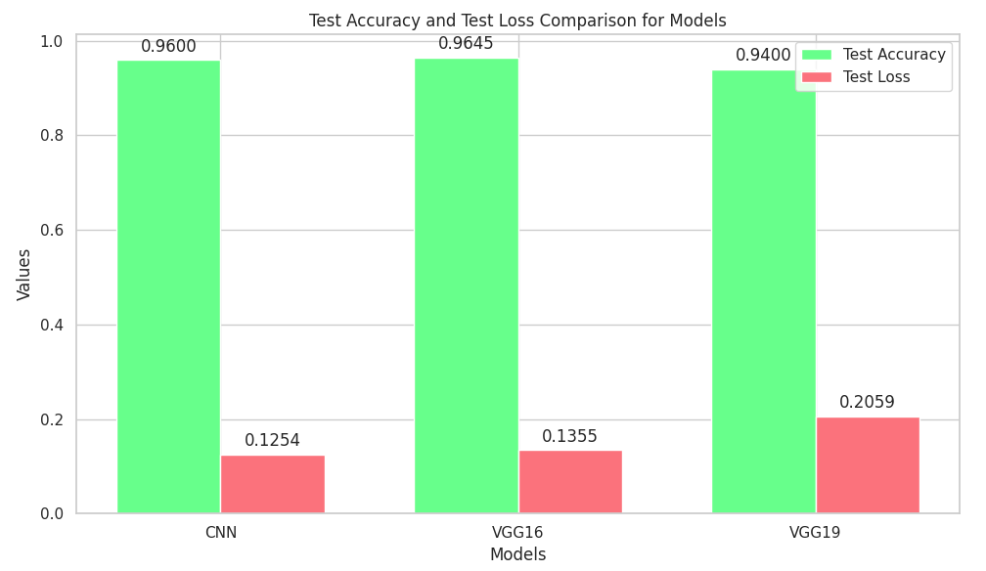
Visual Representation of Model Performance (3/4)
Graphical Comparison of Accuracy, Loss, and Model Evaluation Metrics

Slide 15
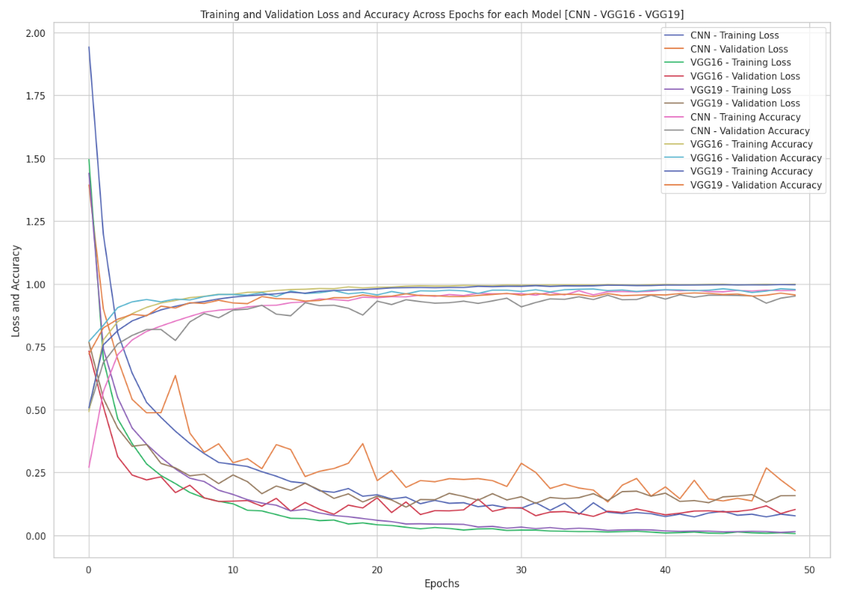
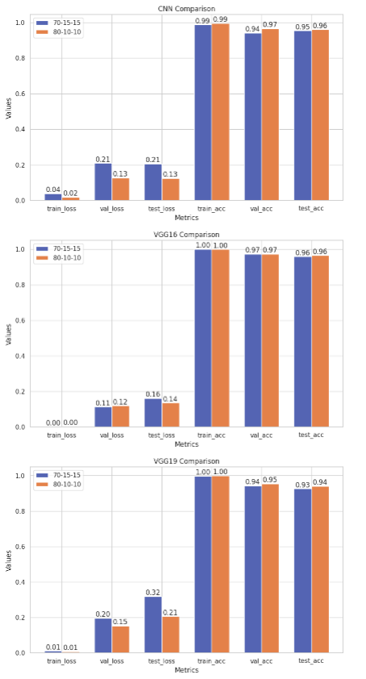
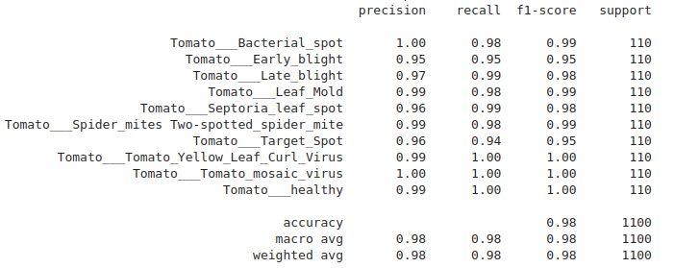
Visual Representation of Model Performance (4/4)
Graphical Comparison of Accuracy, Loss, and Model Evaluation Metrics

Slide 16


Web Application (1/2)
How the Application Detects and Assists with Disease Management
Image Upload
Prediction & Confidence
Visual Indicators
Users upload a leaf image, and the model preprocesses it to make a prediction based on learned features.
The prediction, along with the confidence level, is displayed on the UI. This helps users assess how reliable the model's prediction is.
Green Frame: High confidence in a healthy leaf.
Yellow Frame: Low confidence, suggesting manual inspection.
Red Frame: High confidence in a diseased leaf.
Treatment Suggestions: If a disease is detected, the app also provides recommended treatments to assist farmers or gardeners in managing the disease.

Slide 17
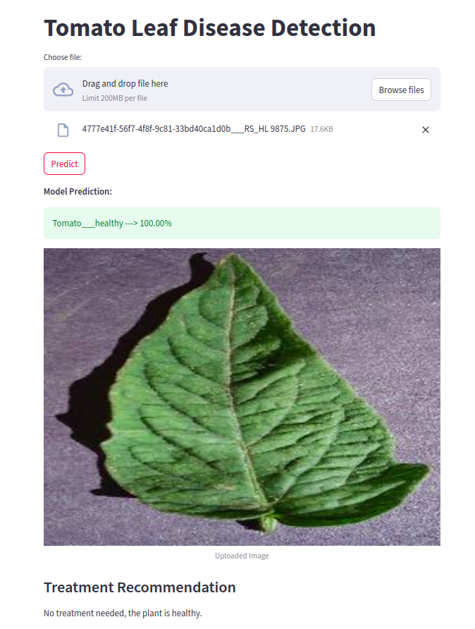
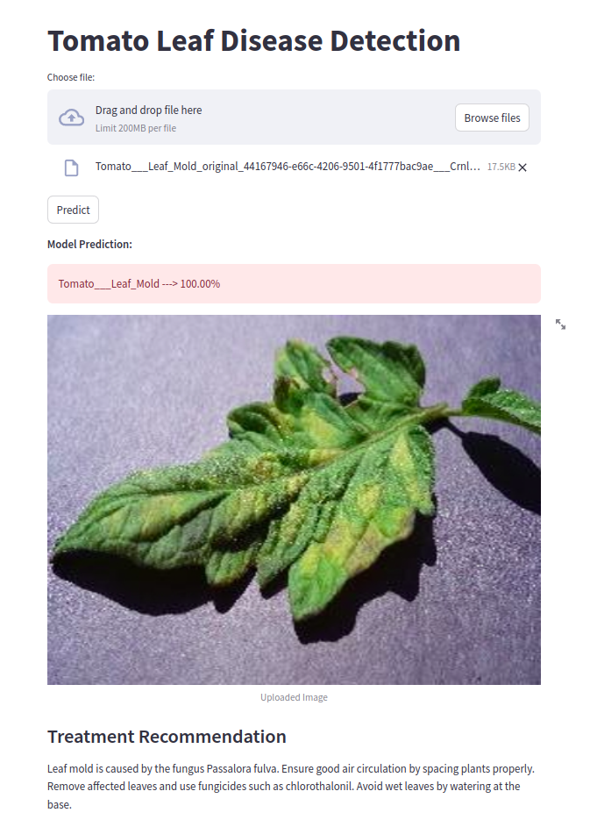
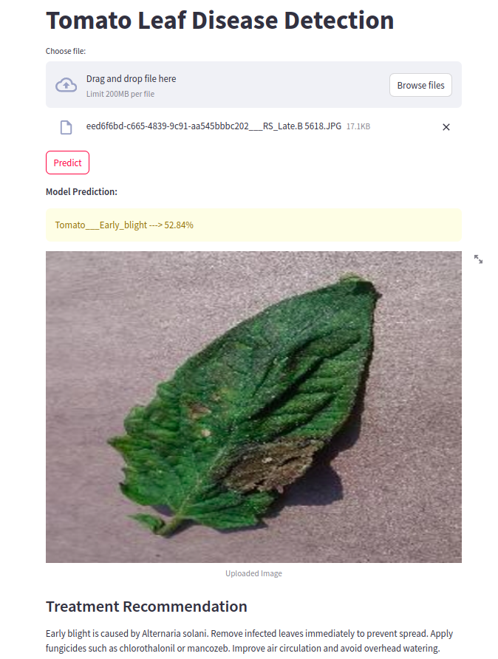
Web Application (2/2)
How the Application Detects and Assists with Disease Management

Slide 18
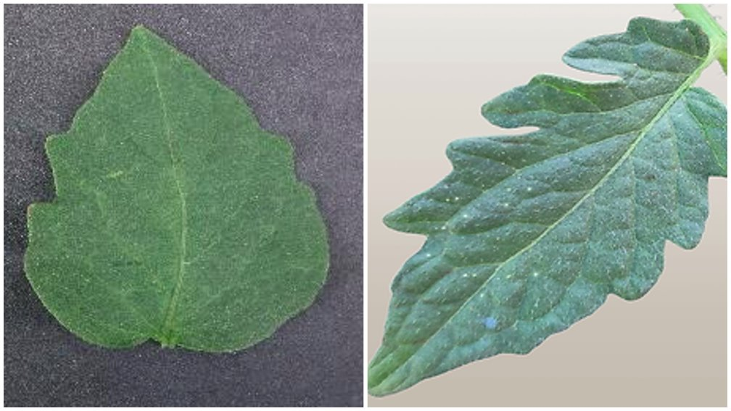

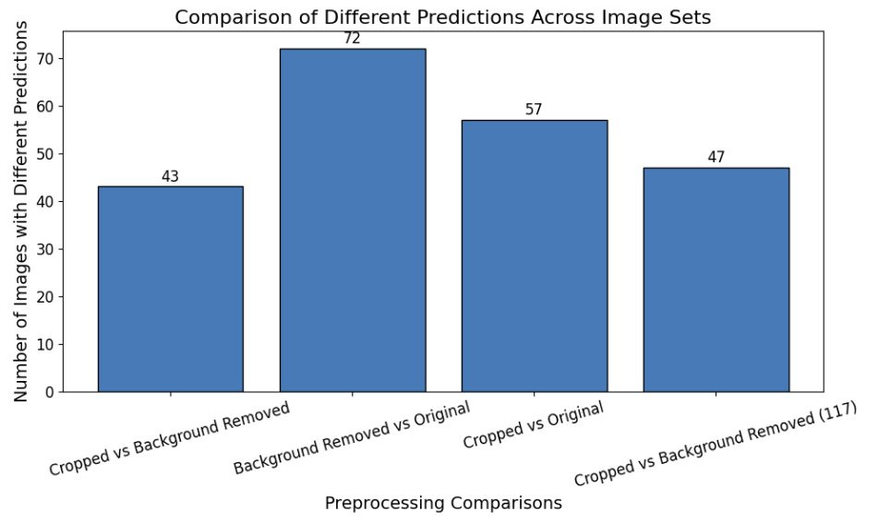
Custom Garden Image Evaluation
Assessing Model Performance with Captured Data from My Garden
Pre-processing Phase
Capturing
Classification
Performed manual classification before testing the model’s prediction to verify its accuracy.
Captured images from different gardens were used to test the model’s robustness.
Findings
Variation in Tomato Leaf Shape: Greek tomato leaves were thinner and narrower compared to the dataset’s thicker leaves, causing a slight dip in confidence when testing with local samples.
Background Interference: Initial testing with raw images suffered from background noise, impacting the model’s predictions.
Image Preprocessing:
Cropping the Image: Improved the model's performance by removing irrelevant background details.
Neutral Background: Significant improvement in prediction confidence after replacing the background with a neutral one.

Slide 19
Future Work
Next Steps: Enhancing Models and Expanding Applications
Develop a mobile application that integrates real-time image processing for instant disease detection.
Expand the dataset to include different crops, additional disease classes, and images from various geographical regions.​
Dataset Expansion
Model Improvements
Real Time Mobile Integration
Integration with IoT and Smart Farming
Explore more advanced architectures (e.g., EfficientNet, ResNet). Implement ensemble learning for better accuracy.
Link with IoT devices (e.g., drones, smart cameras) for continuous crop monitoring. Use predictive analytics based on weather or soil data to forecast disease outbreaks.

Slide 20


Thank you!
Any questions?

