Slide 1

DATA ALPHAs
NOMPILO HADEBE
TSHIAMO KGAPHOLA
TSIDI TSOTETSI
THOMAS MPHERWANE
ZAMOKUHLE NGCOBO

Slide 2

AGENDA
Introduction
Data Handling
Graphs & Analysis
Conclusion & Recommendations

Slide 3
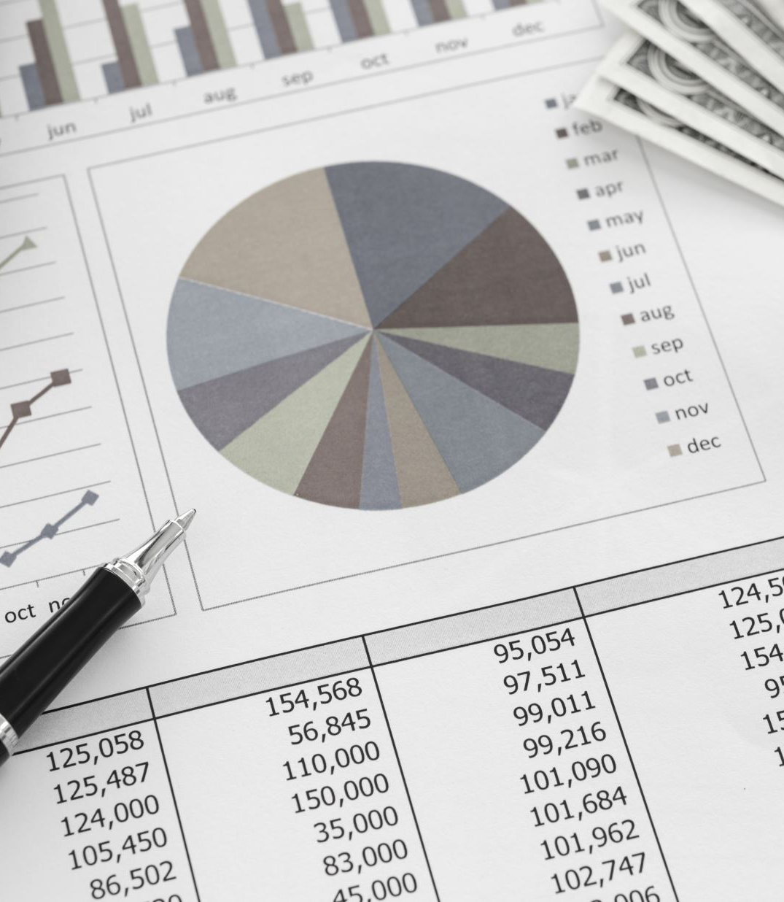
INTRODUCTION
Dataset Analysis on Money Spending Habits
• Utilizes data from a spending habits app with 25 users.
• User demographics: 14 men, 11 women.
• Transactions made: 373 transactions from 2018 to 2022.
• Purchases: Details of stores and products purchased.
• Money Matters: Monthly income and living arrangements.
• Aims to understand how financial situations affect spending habits.
• Data will aid in making informed decisions about future buying and selling strategies.

Slide 4

DATA HANDLING
Data Analysis Process:
• Importing essential libraries for data analysis.
• Loading CSV file for initial examination.
• Data cleaning: addressing missing values, removing notable data, and filling categorical columns.
• Ensured no duplicates in the dataset.
• Converted date-time columns from categorical to datetime format.
• Extracted specific time elements like hours, days, months, and years.
• Grouped months of the year into quarters using a for loop.
• Categorized time of day using a customized function.
• Proceeded to tackle formulated questions and deepen analysis.

Slide 5
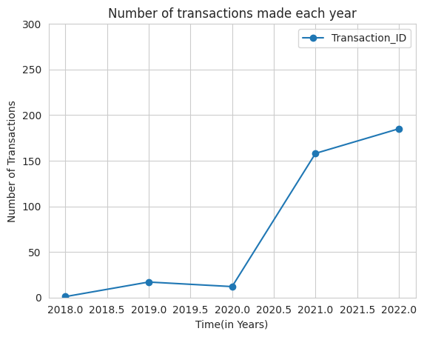
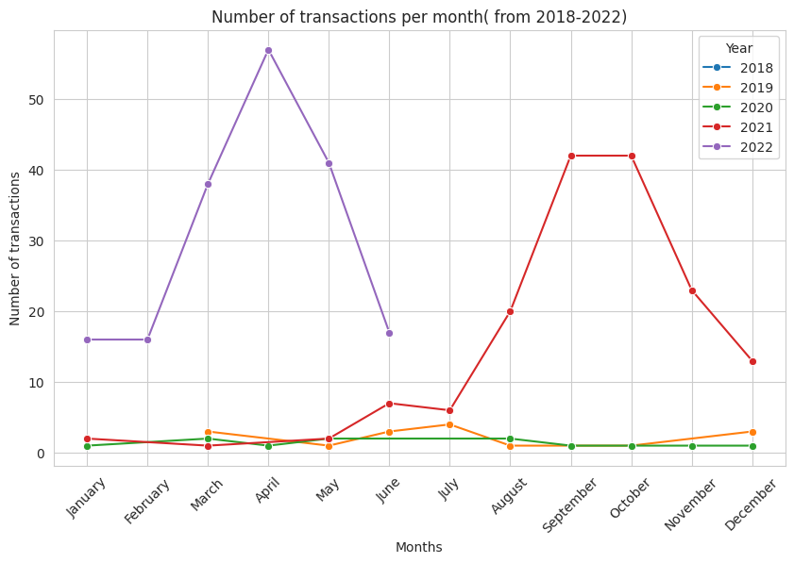
GRAPHS
Notes:
How many transactions were conducted on each day, categorized by year, month, and day ?
Recommendations: Seasonal Trends and Budget Allocation
• Adjust budgeting and spending plans accordingly.
Budget Allocation
• Consider stricter budgets or reducing expenses through discounts, bulk purchasing, or service provider negotiation.

Slide 6
Analysis
2021 and 2022 Transactions:
• Initial low transactions in 2021: less than 10 until August, then 40 in September and October.
• Decline in transactions from December 2021 to February, peaking in April 2022.
• 242 transactions made between February and May 2022, accounting for 65% of total transactions.
• Most transactions spent on groceries, miscellaneous items, and Bills and Fees in March.

Slide 7
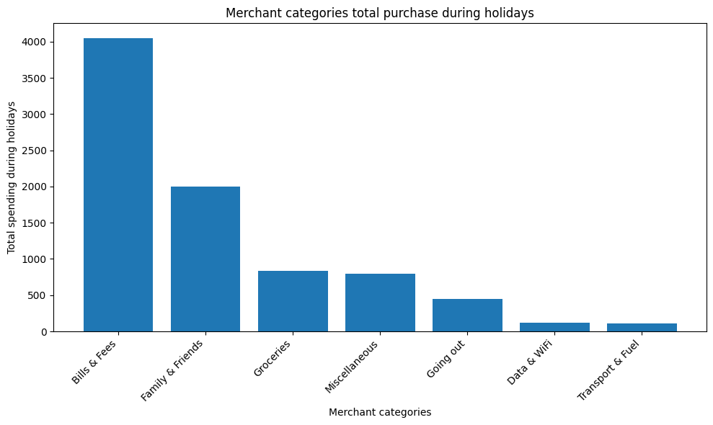
Merchant categories total purchase during holidays
Analysis:
Holiday Bill Payments and Expenses
• Majority settle bills and expenses during holidays.
• Total payment exceeds K4000.00.
• Spending on loved ones totals K2000.00.
• Less money allocated to Data, wi-fi, transport, fuel.
Notes:
What are the merchant categories that users predominantly purchase during holidays?
Reccommandations Budget Planning: Encourage individuals to create a holiday budget in advance to better manage their expenses.
Prioritize Essential Bills: Emphasize the importance of prioritizing essential bills and expenses, such as utilities, rent or mortgage payments, and insurance premiums, even during the holiday season.

Slide 8
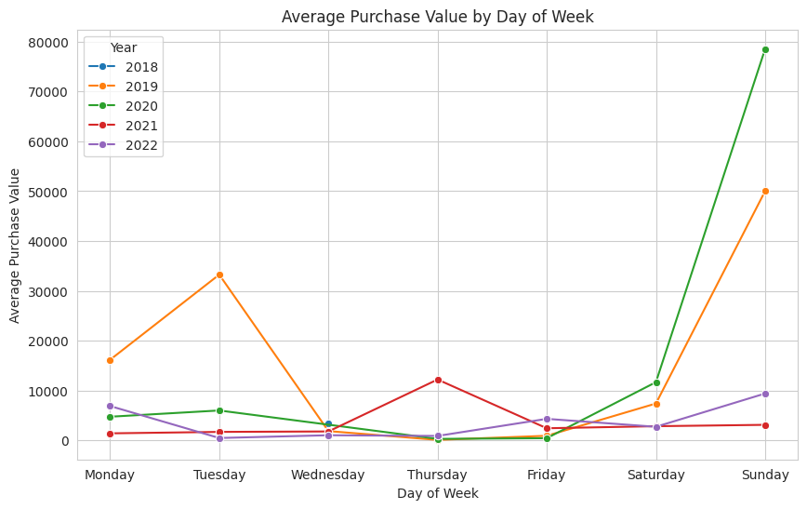
Average Purchase Value by Day of week
Analysis:
Yearly Trends and Day-of-Week Analysis
Average purchase values vary slightly across years.
2021 showed a noticeable increase in average purchase values, possibly due to changing consumer preferences or economic factors.
Sundays and Saturdays typically have higher average purchase values than weekdays, suggesting weekends are busiest shopping days.
Notes:
Are there any notable differences in the average purchase value between weekdays and weekends?
Recommendations: Business Trend Analysis Recommendations:
• Tailor sales and marketing strategies to data trends.
• Increase weekend promotions for higher-spending customers.
• Offer weekday special deals and discounts for off-peak shopping.

Slide 9
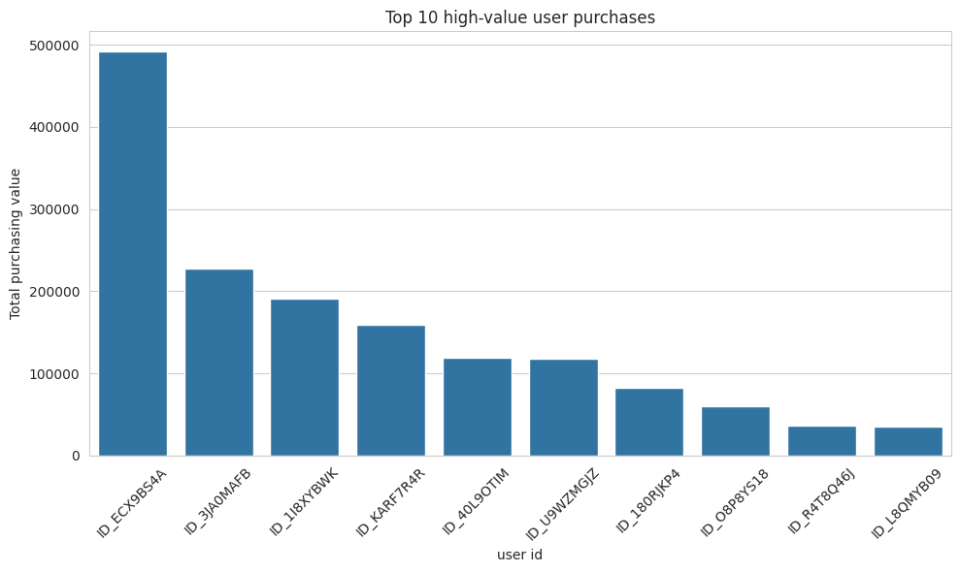
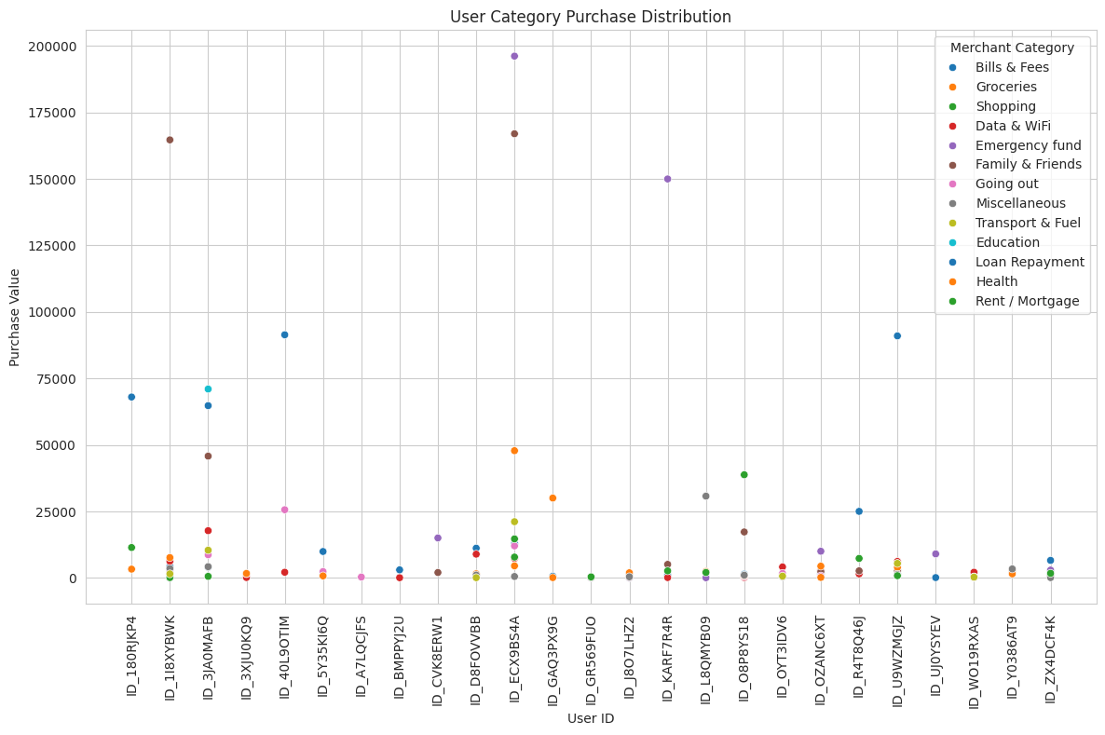
High-Value User Purchase
Notes:
What is the combined spending amount of purchases made by the top ten users?
Recommendations: Businesses can effectively leverage customer purchasing behavior to drive revenue growth, enhance customer satisfaction, and foster long-term relationships with their customer base.

Slide 10
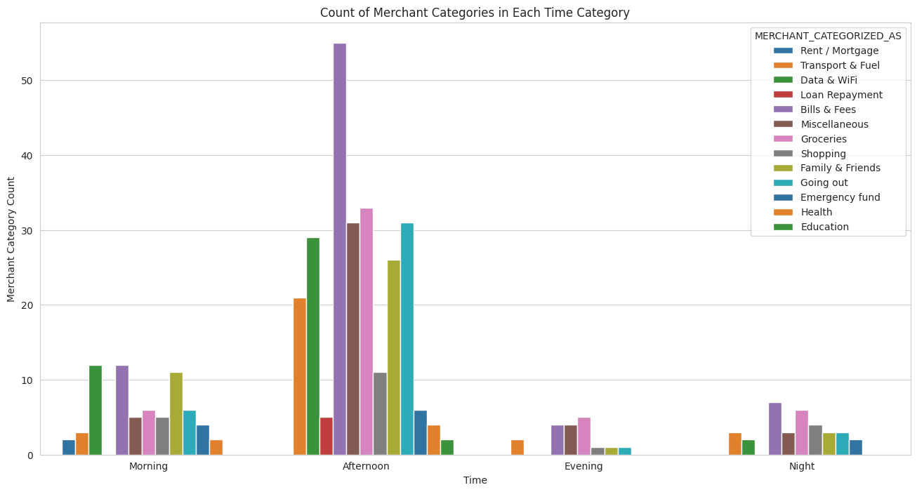
Count of Merchant Categories in Each Time Category
Notes:
What products are purchased during various times of the day, including morning, afternoon, evening, and at night?
Recommendations: Improve Customer Experience: Streamline transaction processes and enhance convenience for customers, particularly during peak transaction times.
Optimize Marketing Strategies: Tailor marketing efforts to align with transaction patterns throughout the day. For example, focus on promoting bill payment services and data/Wi-Fi packages in the mornings when people are more likely to make transactions in these categories.

Slide 11
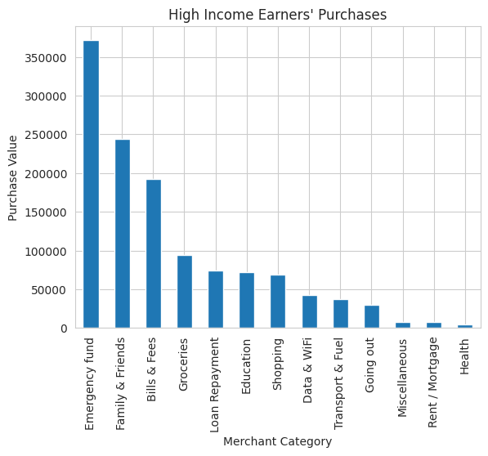
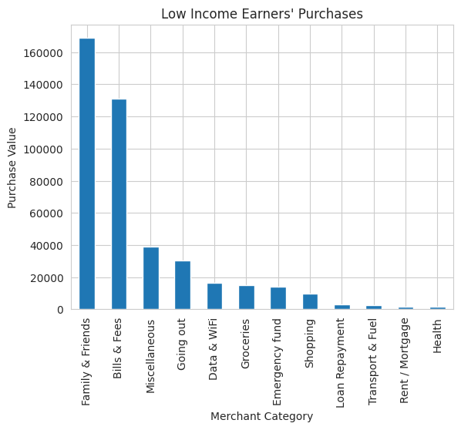
Exploring Income-Based Spending Patterns
Notes:
Do individuals with higher incomes typically direct more of their spending toward specific categories of items in contrast to those with lower incomes?
Recommendations: Promotion of Health and Wellness: Raise awareness about the importance of prioritizing health and wellness by offering incentives or discounts on health-related products and services.
Financial Education: Offer financial education programs or resources to both high income and low income earners to help them understand the importance of budgeting and allocating funds to different categories, including emergency savings, health, and miscellaneous expenses.

Slide 12
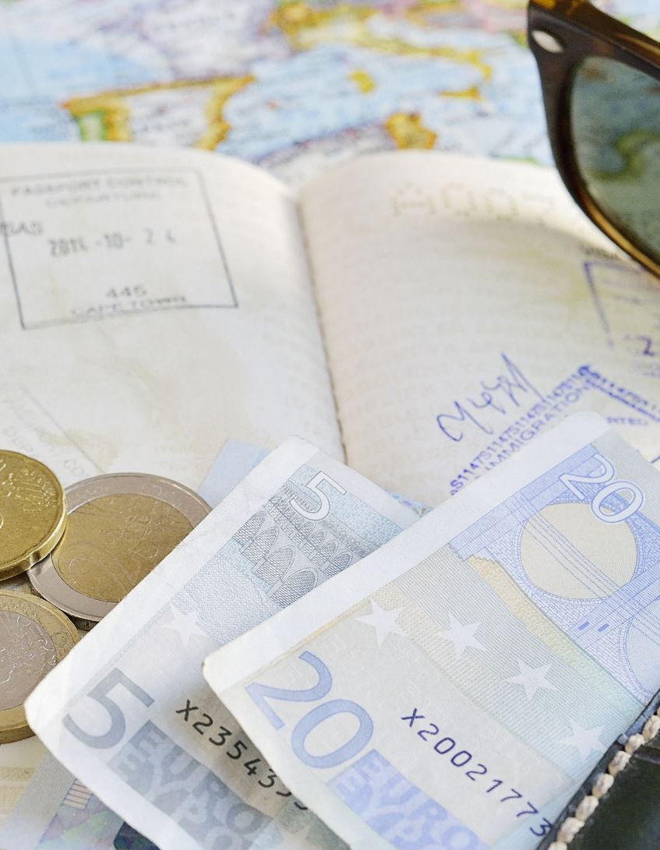
Conclusion
In conclusion, there are 373 transactions made from the dataset and 218 merchants used to register this transactions. On the 373 transactions, most of the transactions were made during April 2022 and the most popular category is Bills and Fees.
Most of the transactions were made during normal days as compared to holidays and most transactions were made on a Sunday. The most busy hour of the day is between mid-day from 11 o'clock until 5 o'clock
Based on the analysis, businesses can tailor their sales and marketing strategies to capitalize on trends observed in the data. For example: Increase promotions and marketing efforts on weekends to target higher-spending customers. Offer special deals and discounts on weekdays to attract more customers during off-peak shopping times. Analyze factors contributing to the increase in average purchase values in certain years and leverage this information to optimize product offerings and pricing strategies.

Slide 13


