Slide 1

Analysis report based on Burger Café Store Transactions.
Team: DATA ALPHAs
Nompilo Hadebe
Thomas Mpherwane
Tsidi Tsotetsi
Tshiamo Kgaphola
Zamokuhle Ngcobo

Slide 2
Introduction and Data Handling
Chinese Burger Cafe Dataset Analysis:
• Data collected from January 2012 to September 2015 • Merged 2 datasets for comprehensive analysis. • Total Price and Seasons Column feature engineering. • Dataset includes 13 columns and 5420 rows. • Extracted calendar date days, months, and seasons. • Replaced non-holiday NaN value in holiday column. • Removed 6 duplicate entries, resulting in 5414 rows and 12 columns.
Aim: Analyze the sale of each item sold by the cafe store over a period of time and what influences the sale of each item.

Slide 3
Tools used:
Python
Microsoft Power BI
Tableau
SQL
Google Colab
Google Slides
Google Docs

Slide 4

ANALYSIS

Slide 5
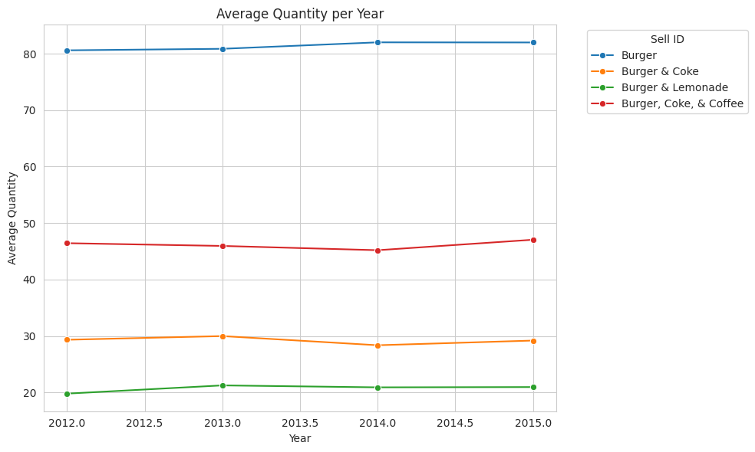
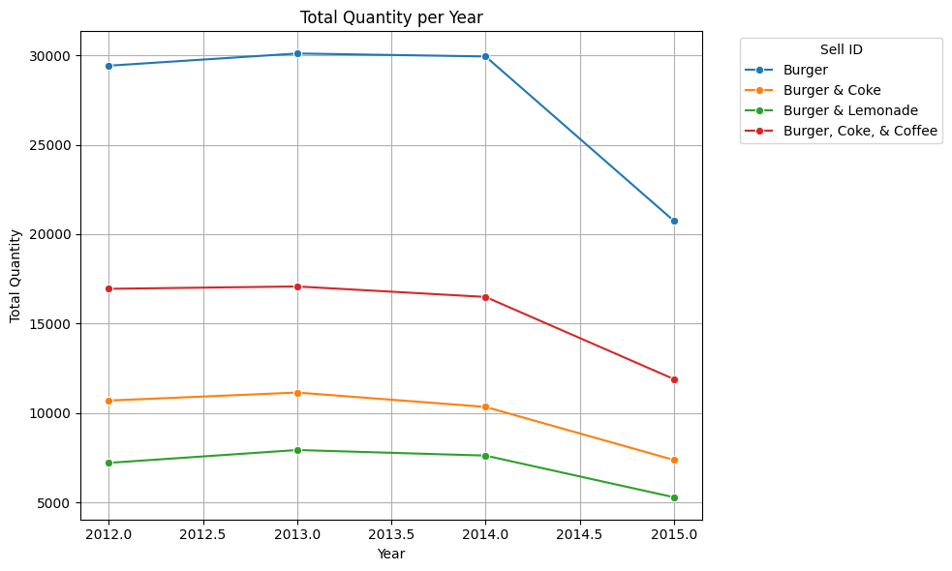
Customer Preferences & Popular Menu Items
Average quantity per year
Total quantity per year
Notes:
This graph shows how many units of each item were sold on average each year. Identifying trends in the average quantity can help determine if certain items are becoming more or less popular over time.
If the average quantity of a particular item is increasing, it indicates growing popularity. Conversely, a declining trend might suggest that the item is losing favor among customers.

Slide 6
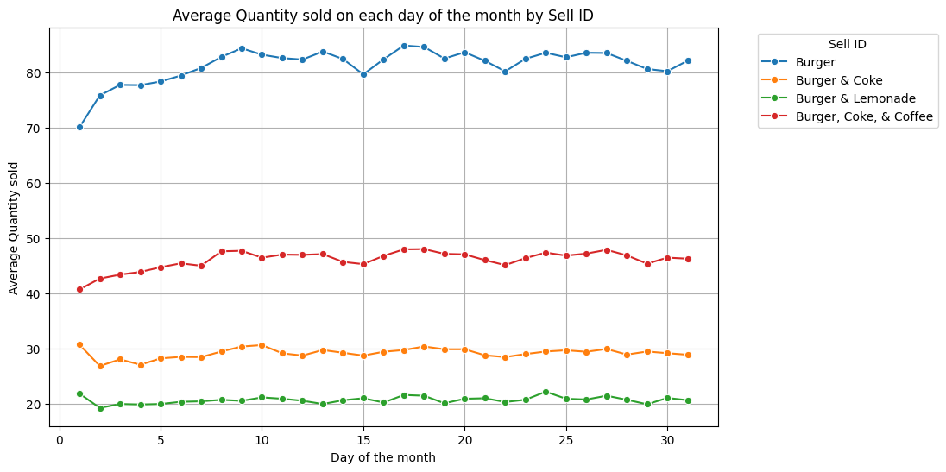
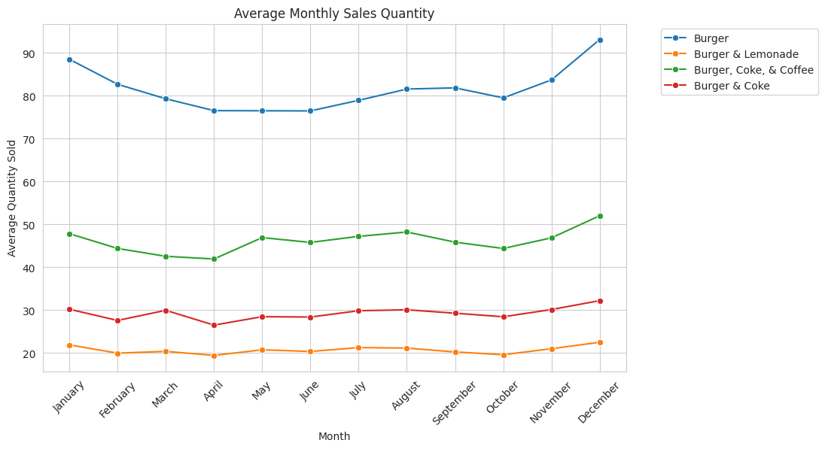
Sales over days, months & years
Notes:
This graph shows daily sales patterns. It helps identify peak days and low days, which can inform staffing and inventory decisions.
If certain days consistently show higher sales, those days may benefit from additional staffing and promotions. Low sales days could be targeted for special deals to increase foot traffic.

Slide 7
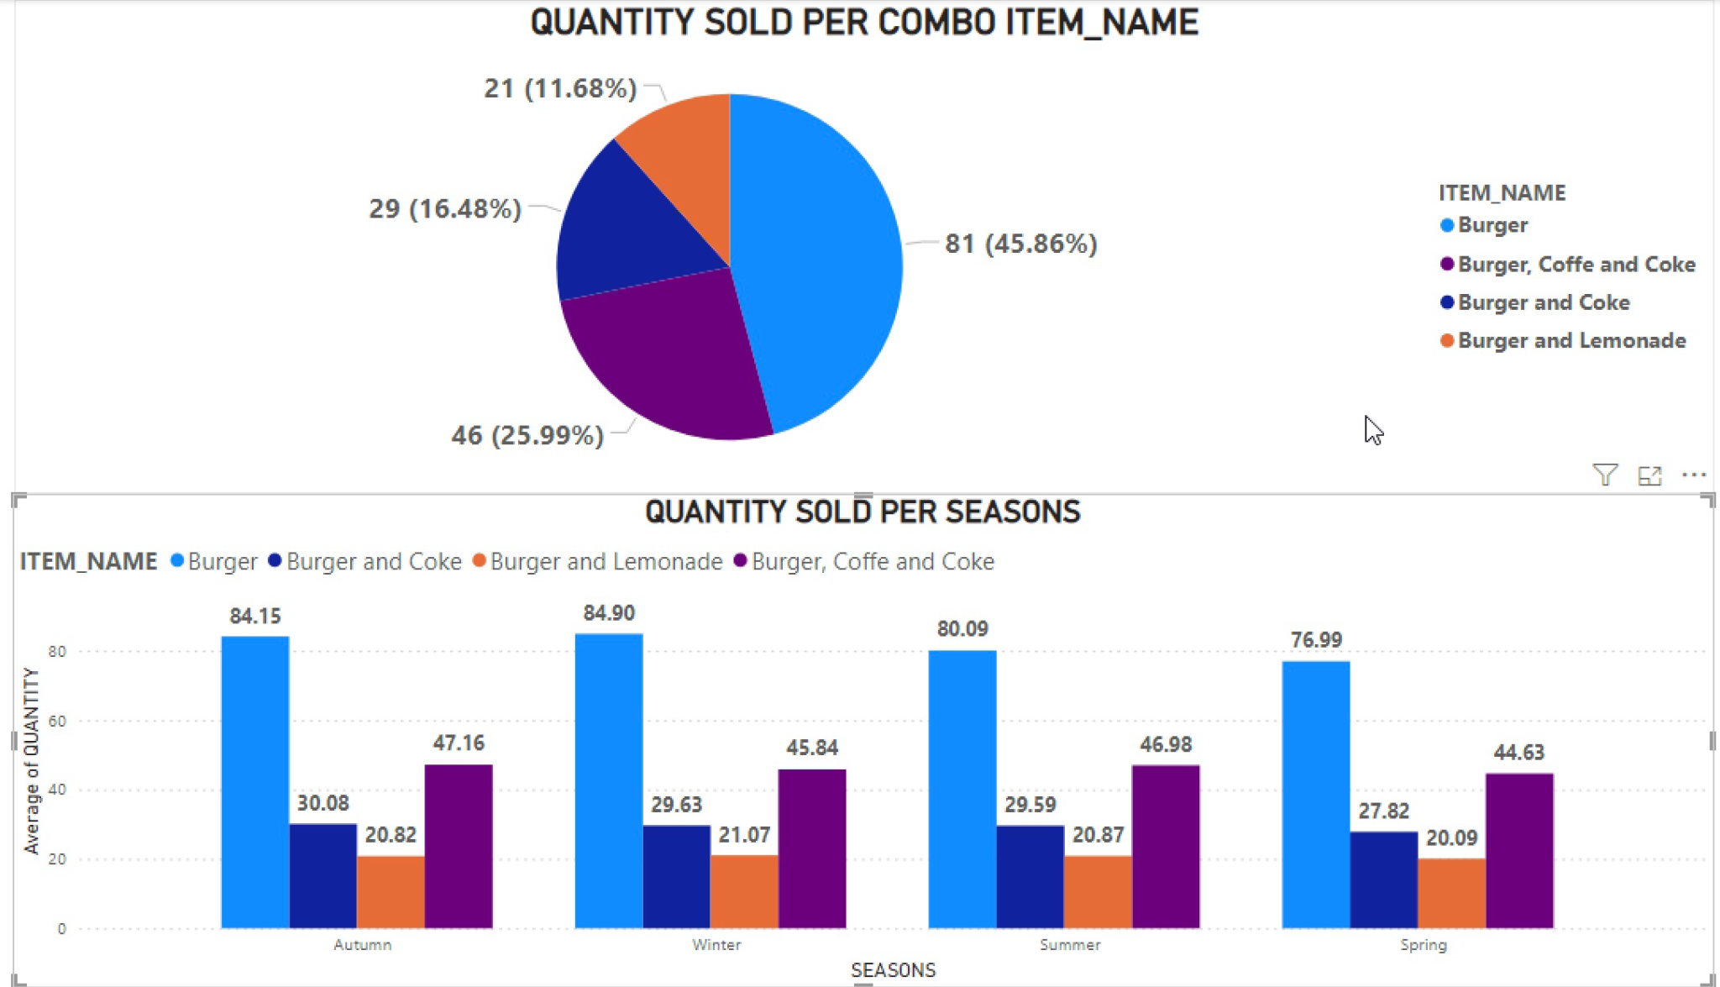
Sale of each item during each season
Notes:
This graph shows how sales of different items vary by season. It can help identify which items are more popular in specific seasons.
Items that sell well in particular seasons can be featured more prominently during those times. For example, hot beverages may be more popular in winter, while cold drinks and lighter meals might sell better in summer.

Slide 8
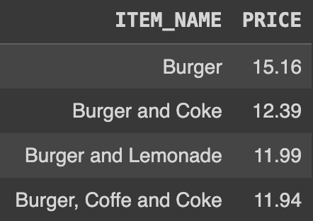
Price variations of each item
Burger Cafe Pricing in China
• Average burger price is high.
• Cheapest meals: Burger, Coke & Coffee.
• Burger is a core item in the combos.
Notes:
This graph tracks the price changes of different items over time.
Insight: Identifying periods when prices peaked or dropped can help understand the impact on sales volumes.

Slide 9
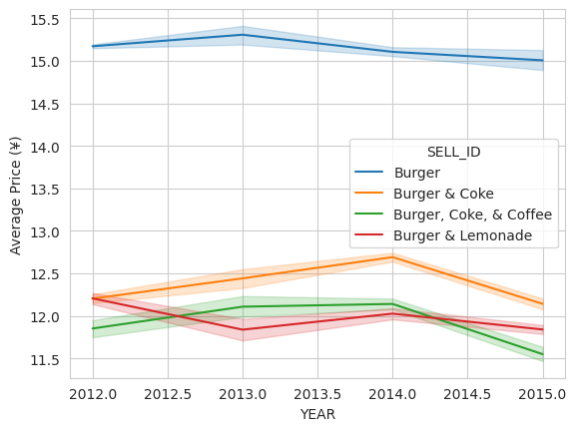
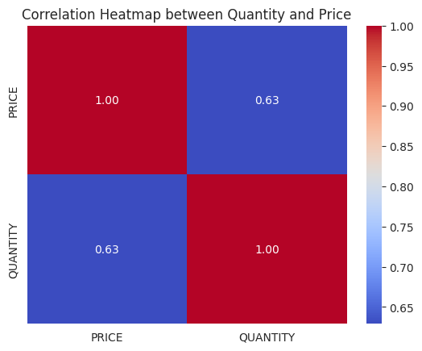
Influence of Price on sale over time
The price of items also decrease over time.
The price of burger peak in 2013 is at 15.30 Yuan.
There is also a moderate correlation between Price and Quantity of the items sold.
Notes:
This graph examines how changes in price affect the number of items sold.
Insight: A weak correlation suggests that other factors, such as customer preferences or external events, might have a stronger impact on sales than price changes.

Slide 10
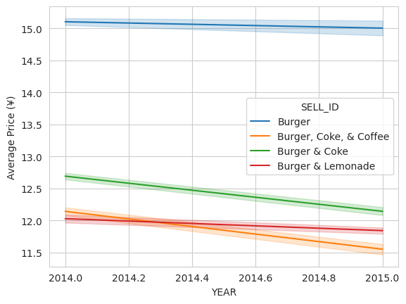
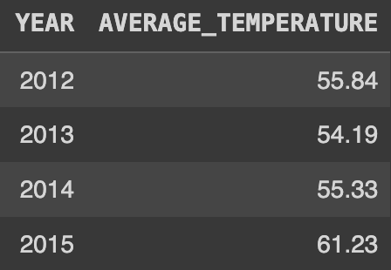
What may have caused a sharp decline of sale from 2014
Average Temperature for each year
2014 Temperature and Sales Impact
• There is an increase in temperature of over 5°F compared to previous years.
• Decline in prices for some items may cause a decline in sales.
• Dataset ends in September 2015, excluding entire 2015 data.
Notes:
This graph looks at the sharp decline in sales from 2014, possibly due to temperature increases and other factors.
Insight: A significant temperature rise might have contributed to decreased sales, suggesting that external factors like weather can impact customer behavior.

Slide 11
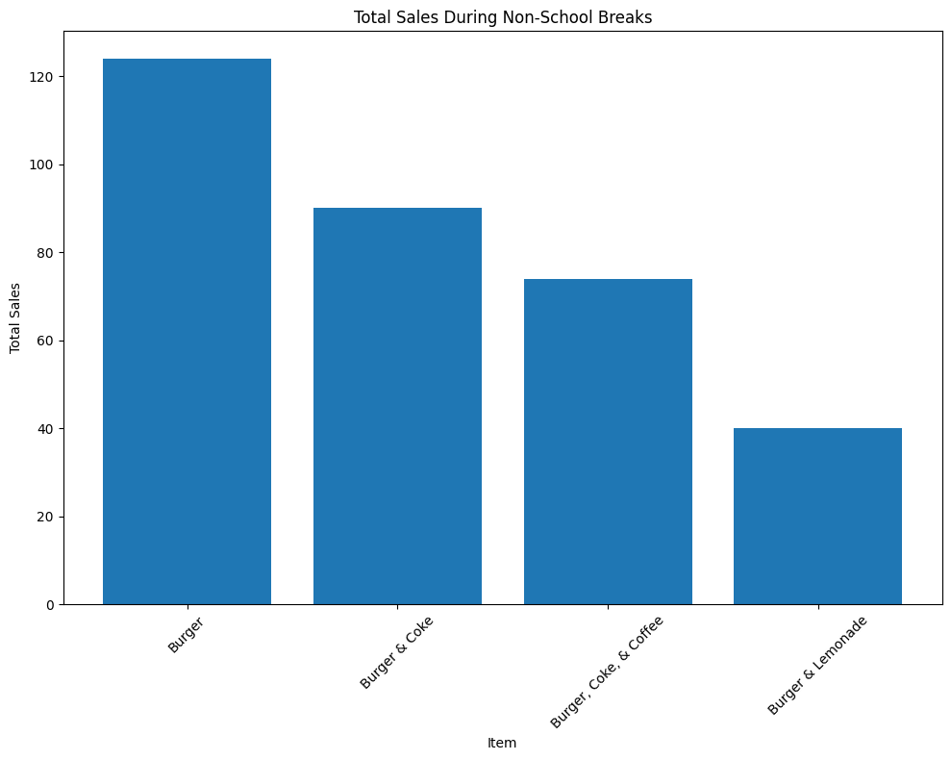
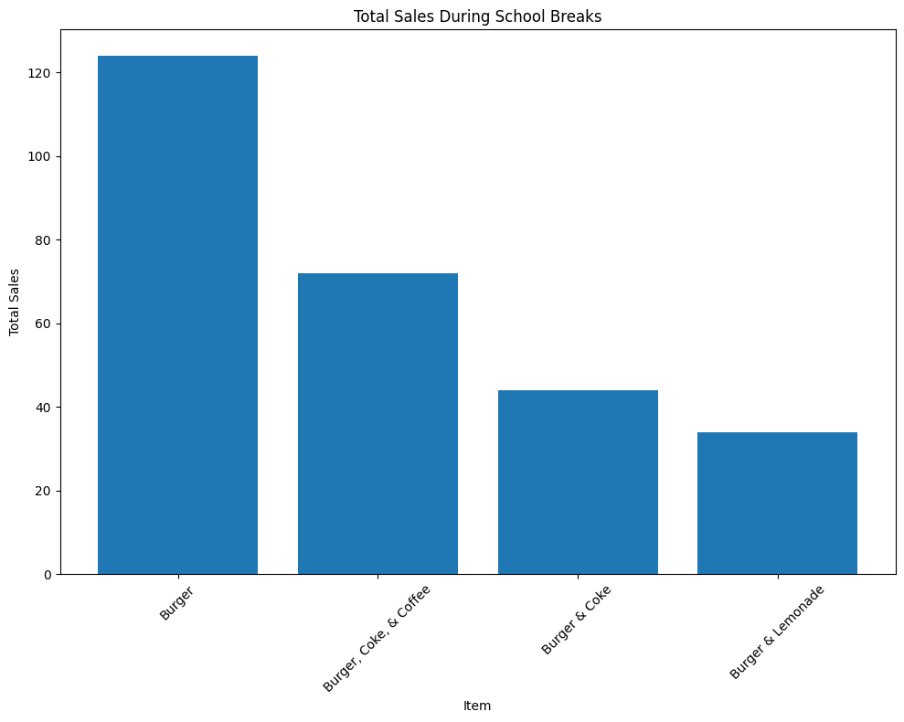
How do School breaks affect the sale of each item
Notes:
This graph compares sales volumes during school breaks to regular periods.
Insight: If sales drop during school breaks, it might indicate that the customer base includes many families or students.

Slide 12
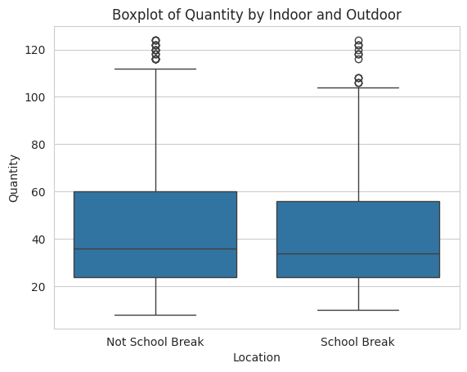
Relationship between quantity sold and school holidays
School Break Meal Popularity
• Burger, Coffee, and Coke are the most popular meals.
• Burgers are the least popular.
• Quantity sold during school holidays is less than non-school holidays.
• Low correlation between items sold and school breaks.
• Average quantity sold during school holidays and non holidays is consistent.
Notes:
This graph explores how temperature fluctuations impact sales.
Insight: A weak negative correlation suggests that extremely high or low temperatures might slightly reduce sales.

Slide 13
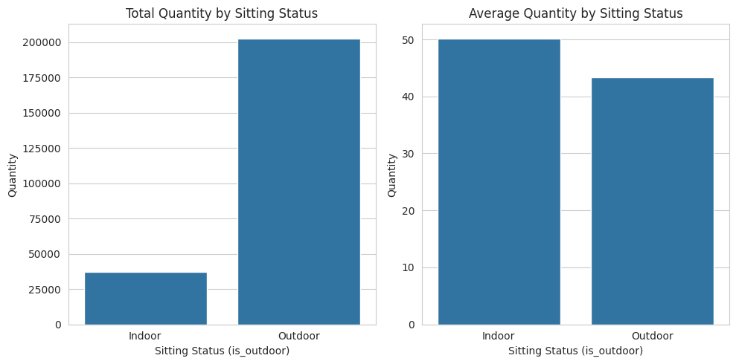
Impact of place of sitting(Whether Indoor or Outdoor) on sale
Outdoor Customer Sales Analysis
• Total quantity of items sold for outdoor customers outweighs sales for indoor customers.
• Average quantity sold for outdoor customers surpasses those for indoor customers.
• on an average, there is slight difference in the sitting status.
Notes:
This graph compares sales volumes between indoor and outdoor seating.
Insight: Higher sales for outdoor seating suggest a preference for outdoor dining.

Slide 14
Conclusion
• Popular burgers and combos like Burger Coffee and Coke consistently generate high sales.
• Seasonal trends show preference for hot beverages and hearty meals in colder months, and lighter, refreshing options in warmer weather. • Price changes have an impact on sales quantity, suggesting stable pricing for popular items. • Cooler weather correlates with higher sales, especially with outdoor seating.
Recommendations
•Pricing Strategy: focuses on maintaining stable prices for popular items and experimenting with price changes for less popular items.
•Order less of lemonade and cold beverages. Include more hot beverages on the menu such as Tea.
•Increase the size of outdoor sitting since there is seem to popularity in outdoor setting.
•Include some Windfree air conditioners outside to control the temperature of the place since temperature has some influence on sales.
•Marketing and Promotions: Introduce more combo meals and have more hot beverages and market more of the combo meals.
•Customer Feedback and Engagement: highlight the importance of collecting feedback and increasing customer engagement.
•Menu Optimization: advises highlighting popular items and diversifying the menu.

Slide 15


