Slide 1
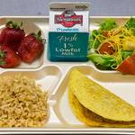
School Lunch made easy Vicki Lewis, Mariana Valles Meza, Mackenzie Richards and Daniel Zamora

Slide 2
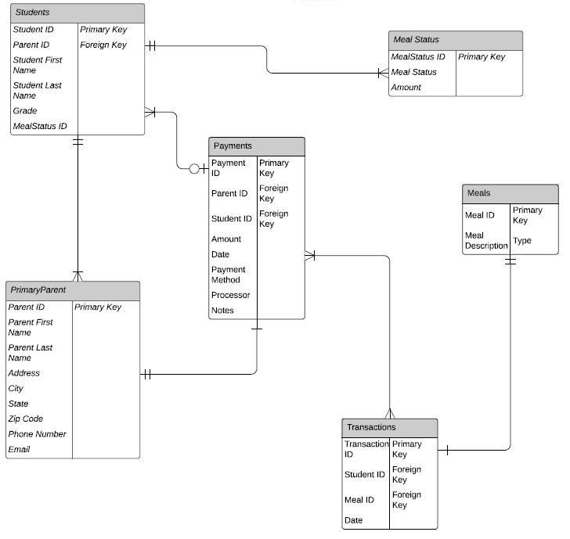
Visual Representation
This is a visual image of how all the information was divided up to be able to store each student’s information and provide you with the information you need at a moments notice.
Hyperlink: https://github.com/ZamoraD/SchoolLunchMadeEasy.git

Slide 3
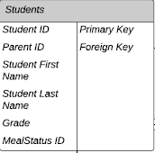
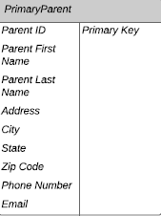
Database
Each section is titled with the information that is housed within it. Each student is recognized by their student ID and has 1 primary parent.

Slide 4
YOUR DAILY REPORTs
We have made the reports that you use on a daily basis and added them in an easy to use report.

Slide 5
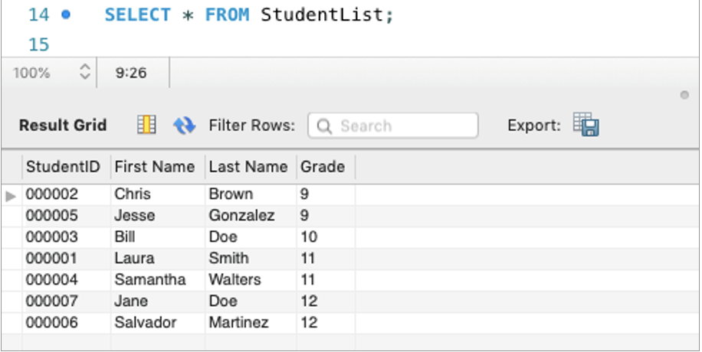
Student List
This report allows you to view all students in each grade in order by last name.
To get this report type:
SELECT * FROM StudentList;

Slide 6
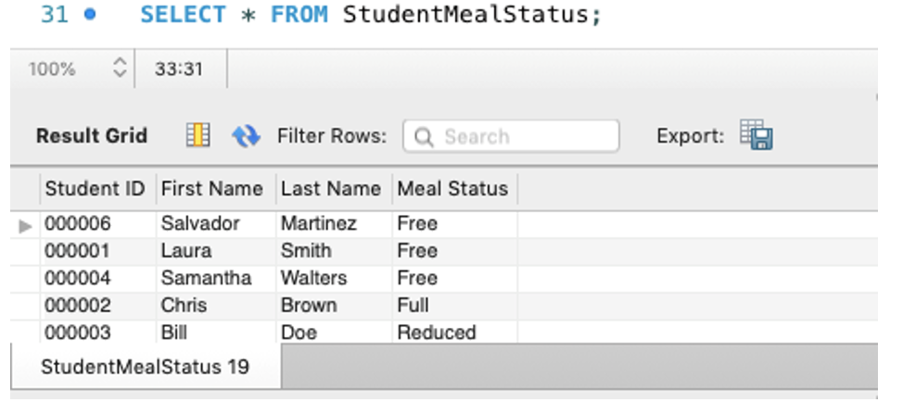
Students and meal status
This report groups students into meal status type: free, reduced, or full price.
To get this report type:
SELECT * FROM StudentMealStatus;

Slide 7
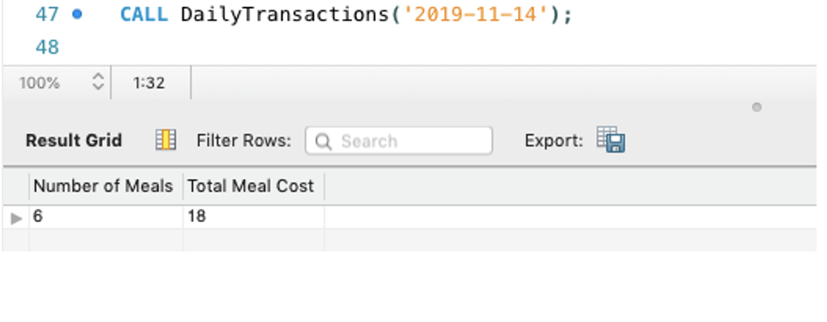
Daily transactions
All lunches are complete lunches outlined by the USDA.
Each meal purchased by a student is a separate transaction.
This report tells us how many meals were purchased on a certain day, and the total cost of all meals.
To get this report type:
CALL DailyTransactions(‘YEAR-MONTH-DAY’);

Slide 8
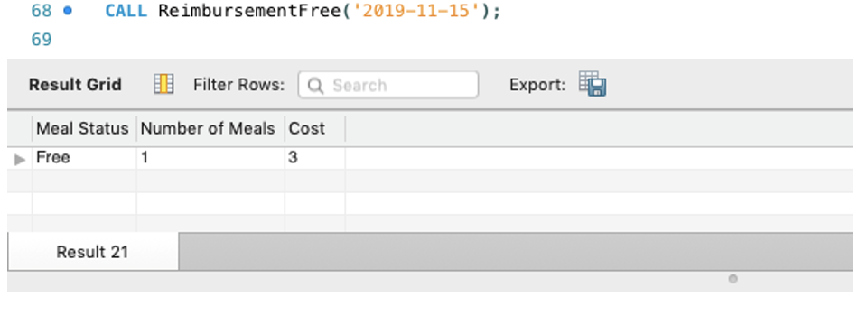
Total free meals
This report shows how many free meals were given on a specified day, and the total cost of those free meals.
This information can be used to get reimbursement from the state.
To get this report type:
CALL ReimbursementFree(‘YEAR-MONTH-DAY’);

Slide 9
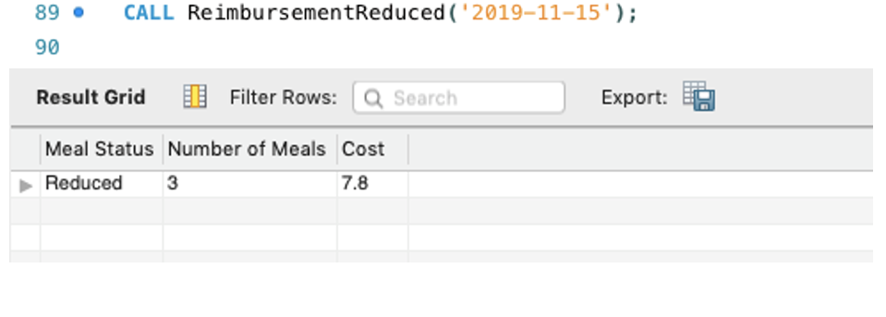
Total reduced meals
This report shows how many reduced meals were given on a specified day, and the total cost of those free meals.
This information can be used to get reimbursement from the state.
To get this report type:
CALL ReimbursementReduced(‘YEAR-MONTH-DAY’);

Slide 10
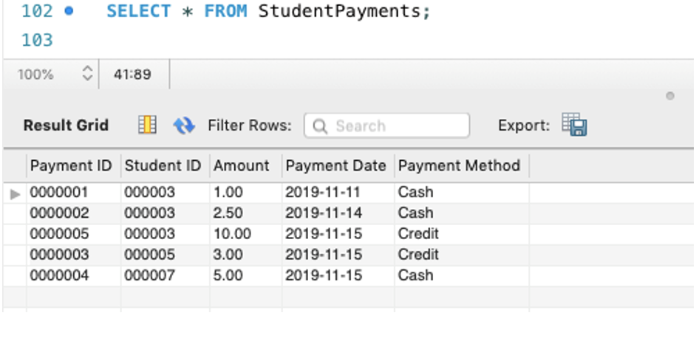
Payment by student
This report shows each separate payment made to a student’s lunch account and the payment method.
To get this report type:
SELECT * FROM StudentPayments;

Slide 11
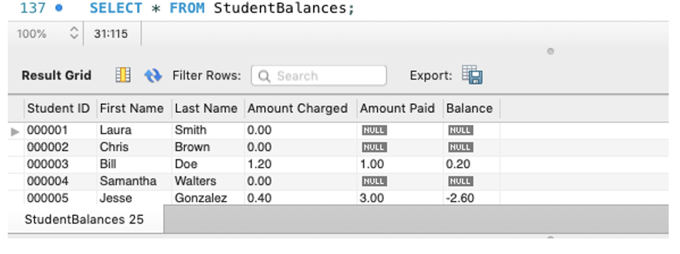
Student balances
This report shows how much each student was charged, how much each has paid and their balance.
Positive Balance: They still have money in account.
Negative Balance: They owe money.
NULL Amount Paid: Have not made any payments.
NULL Balance: Nothing is due.
To get this report type:
SELECT * FROM StudentBalances;

