Slide 1

Should hypothesis testers spend less time testing hypotheses?
The Crises in Psychology
Notes:
NOTE:
To change the image on this slide, select the picture and delete it. Then click the Pictures icon in the placeholder to insert your own image.

Slide 2
Structure of the Presentation
The replication crisis: problems
The replication crisis: proposed solutions
The theory crisis
Article: “Why Hypothesis Testers Should Spend Less Time Testing Hypotheses”

Slide 3
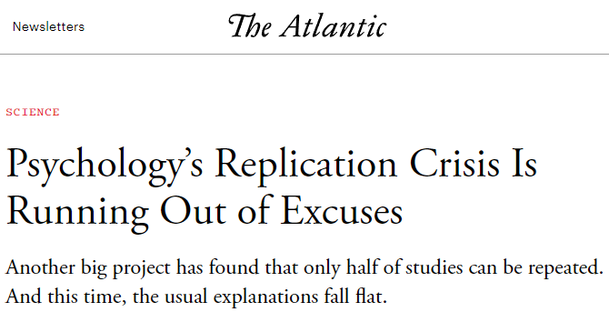
THE replication CRISIS: BACKGROUND
Problems and Proposed Solutions
https://www.theatlantic.com/science/archive/2018/11/psychologys-replication-crisis-real/576223/

Slide 4

Background - $Ψ$ (“psi”)
In 2011, a paper was published by Bem (2011) in the Journal of Personality and Social Psychology supporting the existence of extrasensory perception (ESP); participants judgement were influenced by future events (Fidler & Wilcox, 2021).
Sparked controversy - three independent studies tried to replicate the findings and failed.
Four different journals rejected the failed replications – they were not “novel”.
Eventually they were published in PLoS ONE (Ritchie et al., 2012).
Many studies started to investigate publishing practices and methods used within psychology.
Establishment of meta-science: “the scientific study of science itself” (Munafó et al., 2017).

Slide 5
Problem 1: Replication
Replication is often seen as the gold standard of science – rare in psychology.
Makel et al. (2012) examined the complete publication history of the 100 largest psychology journals. They found that 1% of published studies were replication studies.
The Reproducibility Project: Psychology was coordinated by the Center for Open Science. 270 researchers from 11 different countries tried to replicate 100 studies published in three leading psychology journals in the year 2008 (Open Science Collaboration, 2015).
39 % of studies were considered successful replications.
Recent review of 307 replication studies showed that 64% obtained a significant result in the same direction, with effect sizes 68% as large as the original study (Nosek et al., 2022).
Documented lack of transparency and completeness in the reporting of methods, data and analysis in scientific publications (Bakker & Wicherts 2011; Nuijten et al. 2016, Wicherts et al., 2006).
Hard to replicate studies or tell when a study has been replicated.

Slide 6
Problem 2: Publication bias
Psychology journals have traditionally had policies against publishing replication studies and other work that is not considered ”novel” (Fidler & Wilcox, 2021).
Funding bodies also want to fund ”novel” and ”original” research (Schmidt, 2009).
Nonreplicable studies are cited more than replicable studies, and they continue to be cited more even after failing to replicate (Serra-Garcia & Gneezy, 2021).
Bias towards “statistically significant” or “positive” results and away from “null” results (Fanelli, 2010; Ferguson & Heene, 2012; Rosenthal, 1979; Sterling, 1959).
Over 90% of results in psychology support the tested hypothesis, higher than all other disciplines (Fanelli, 2010).

Slide 7
Problem 3: Inflated false positive rates
Statistical power: the probability that a statistical test correctly rejects the null hypothesis when the null hypothesis is false (true positive).
Small effects coupled with small sample sizes leads to low statistical power on average in psychology (e.g., Button et al., 2013, Cohen, 1962, Szucs & Ioannidis 2017).
Low power leads to exaggerated effect sizes and makes it less likely that a statistically significant result reflects a true effect (Button et al., 2013).
92% of published studies report significant results, while the average power to detect medium effect sizes is about 44% (Szucs & Ioannidis 2017).
False report probability – the probability that statistically significant findings are false – is estimated to exceed 50% for psychology (Szucs & Ioannidis 2017).

Slide 8
Problem 4: Questionable research practices (QRP)
Decisions researchers make that raise doubts about the validity of the measures and study conclusions. Surprisingly high levels of QRP have been discovered (e.g., John et al., 2012; Agnoli et al. 2017).
“P-hacking”: looking at the data and deciding whether to collect more depending on if the results are significant, removing an outlier in order to get a significant result (and not reporting the decision), choosing whether to include covariates (such as gender) in statistical models based on if results are significant.
“Cherry picking”: selectively reporting dependent variables, conditions, or experiments that are significant.
“HARKing”: reporting unexpected findings as having been predicted all along, presenting exploratory work as though it was confirmatory hypothesis testing.
These practices inflate false positive rates and decrease replication rates (e.g., Simmons et al., 2011, Wagenmakers et al., 2012).

Slide 9
Proposed solutions
Many proposed solutions for the problems have focused on the improvement of methods for data collection, analysis, and reporting, including:
The use of Bayesian hypothesis testing, the focus on estimation instead of hypothesis testing, or simply changing the default P-value threshold for statistical significance from 0.05 to 0.005 (e.g., Benjamin et al., 2018, Cumming, 2013, Wagenmarkers et al., 2011).
Increased focus on high-powered replications, preferentially distributed across many labs, using the exact same materials and protocol as the original study (e.g., Wagenmakers et al., 2016).
The sharing of data, materials, and analysis code (open science).
A clear distinction between exploratory and confirmatory research (e.g., Wagenmakers et al, 2012).
Preregistration of the hypotheses (HARKing), the data collection (cherry picking), and the analysis plan (p-hacking) to limit the “researcher degrees of freedom” (Simmons et al., 2011).

Slide 10
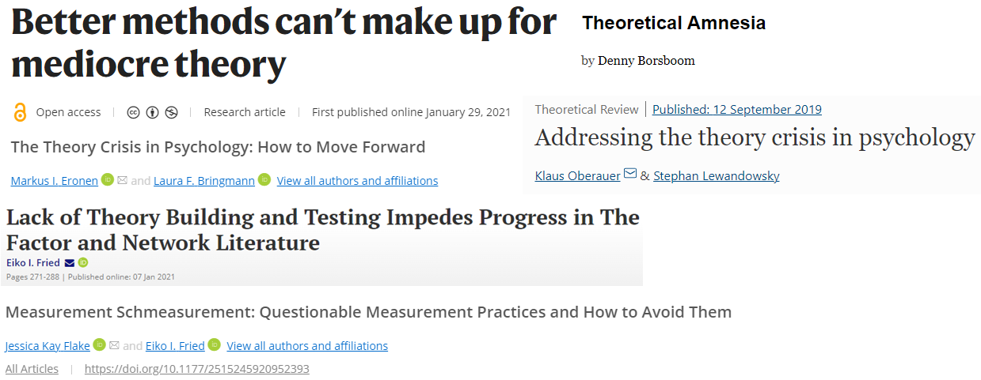
Theory Crisis
Recently, however, a different focus has begun to emerge:

Slide 11
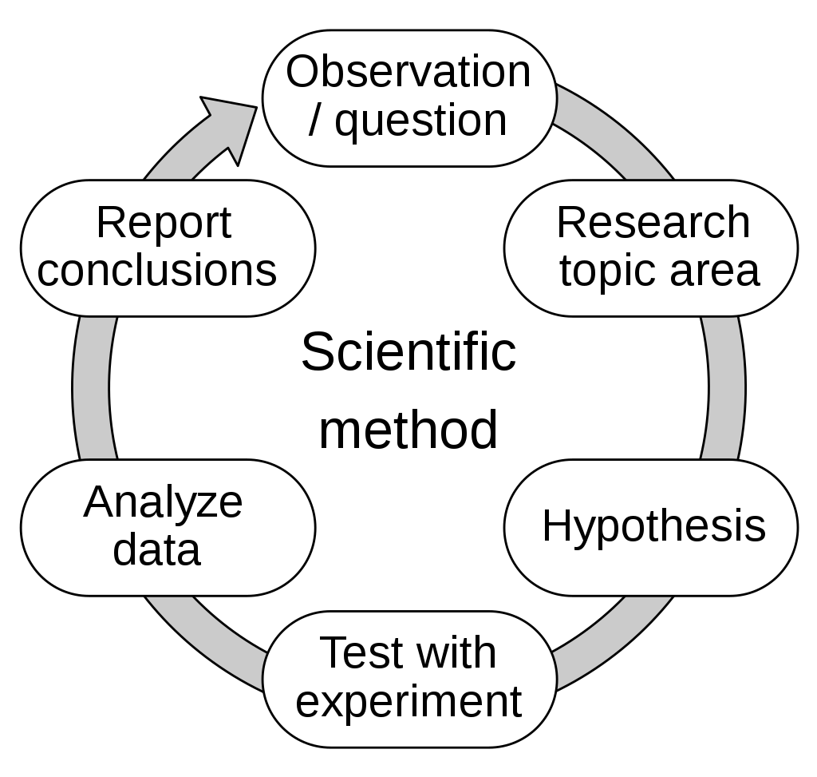
The hypothetico-deductive model
Before continuing, a few definitions:
The hypothetico-deductive (HD) model relies on testing predictions deduced from hypotheses.
A theory is a logically coherent and useful framework that aims to explain one or more phenomena. It is a framework into which existing knowledge can be integrated (Fried, 2020b; Oberauer & Lewandowsky, 2019).
A hypothesis is a prediction implied by the theory. If the hypothesis is falsified, so is the theory. A theory that withstands many falsification attempts is considered a good theory (Poppers falsificationism).
Image by Efbrazil - Own work, CC BY-SA 4.0, https://commons.wikimedia.org/w/index.php?curid=102392470
Notes:
Definition of terms

Slide 12
The Theory crisis
Many are now claiming that psychological theories tend to be “weak”, imprecise, vague, and do not imply any specific hypotheses. There is no clear logical link between the theory and the hypothesis being tested, and many claims in psychology are therefore not sufficiently well-defined to be empirically testable. Some have called this missing link a theory crisis (e.g., Oberauer & Lewandowsky, 2019).
The statistical framework used in psychology (NHST) is rarely used to test a prediction from a theory – it tests a “nil null hypothesis” that there is “no difference between groups” or “no effect”. If the probability of observing the data is low given the null hypothesis (e.g., p<0.05), one “rejects” the null hypothesis in favour of the alternative hypothesis: “any nonzero effect” (Fidler et al., 2018).
Showing that there is “any nonzero effect” is not very impressive. Some would even argue that there are no psychological effects that are zero in the real world (Fidler et al., 2018, Meehl, 1990).

Slide 13
The Theory crisis
The actual theories we want to be testing is unlikely to be as imprecise as “any nonzero effect” – there is a mismatch between the theories and hypotheses we wish to test and the actual statistical tests conducted (Meehl, 1967, 1978; Scheel et al., 2021).
What is needed are theories that produce hypotheses that are more specific and bolder than “any nonzero effect.” We need falsifiable hypotheses (Fidler et al., 2018, Meehl, 1967).
These problems – the vagueness of psychological theories and the mismatch between theory and statistics – have been pointed out for over 50 years by, among others, Paul Meehl (e.g., 1967, 1978, 1990).
In 1978, Meehl wrote that theories in many “areas of Psychology lack the cumulative character of scientific knowledge. They tend neither to be refuted nor corroborated” (Meehl, 1978, p. 806).

Slide 14
What are the proposed solutions to the theory crisis?
Linking Theory to Test

Slide 15
Beyond Statistical Ritual
43 years after Meehl’s statement, in 2021, a special issue was published in Perspectives on Psychological Science with 16 different articles about improving psychological theories. The entire issue was dedicated to Paul Meehl’s work.

Slide 16
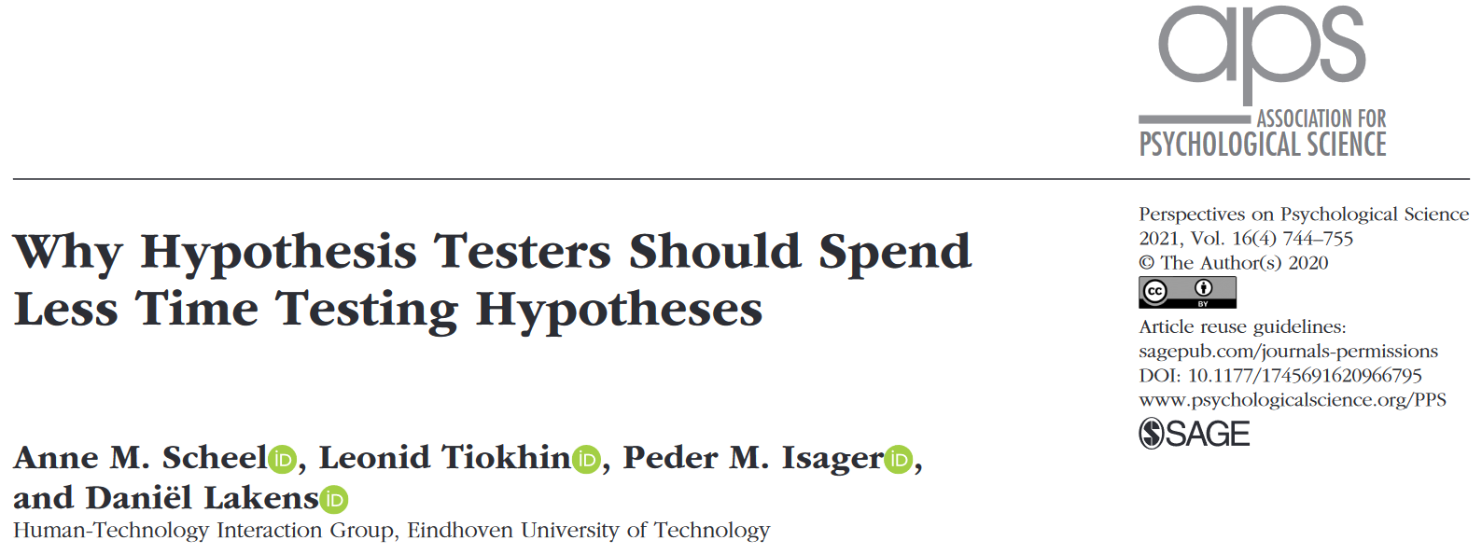
The Present Article

Slide 17
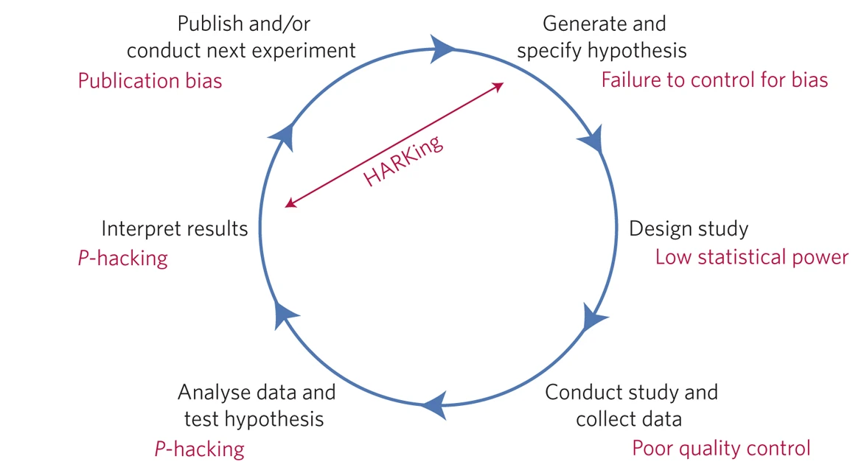
The Present Article - Introduction
They start by briefly summarizing the replication crisis:
Psychologists tested hypotheses, but the tests were weak, and their interpretations were warped (through publication bias, p-hacking, etc), resulting in overconfidence and false inferences.
Solutions proposed so far have tried to make the HD “machinery” more rigorous (formulate hypothesis based on theory, design a study to test the hypothesis, collect and analyze data, evaluate if the results support or contradict the theory).
Simplified version of the hypothetico-deductive model and potential problems. Adapted from Munafó et al., 2017.

Slide 18
The Present Article - Introduction
“The story could have ended here. Psychological scientists used to cut corners when testing hypotheses, new practices and standards were developed in response, and now the discipline moves forward. But in our view, this is not what happened. Rather than just closing a loophole, tightening the screws on hypothesis testing has revealed a deeper problem: The input for the testing machinery is missing.” (p. 745).
For example, many researchers are experiencing that incorporating new recommendations into their practices, such as preregistering hypotheses, conducting a priori power analysis, and specifying the predicted effect sizes, is more problematic than expected – leading to the use of arbitrary rules of thumb (“medium effect size d=0.5) or the default settings of statistical software.
The Reproducibility Project: Psychology showed that researchers struggle to agree on the basic content of theories and whether findings have been replicated.
These problems suggest that theories and hypotheses are not specific enough, and the field often may not be ready for conducting confirmatory hypothesis testing.

Slide 19
The Present Article – The Derivation Chain
Scheel et al. (2021) argue that focusing primarily on confirmatory hypothesis testing often leads to neglecting the necessary groundwork for ensuring a sound link between the test and the tested theory.
Within the HD model, moving from a theoretical framework to a statistical test is seen as a sequence of logical steps, where a testable model is derived from the theory, and additional (auxiliary) assumptions are made (e.g., how to measure a theoretical construct).
Meehl (1990) termed this sequence the “derivation chain”. A combination of theoretical premises and auxiliary assumptions that are necessary to predict an observable outcome.
The statistical prediction at the end of the derivation chain is highly specific (i.e., not “any nonzero effect”). If the derivation chain from theory (together with auxiliary assumptions) to the predicted outcome is loose, a falsified prediction cannot be considered a falsification of the theory (Meehl, 1990).

Slide 20
The Present Article – Inputs to Informative Tests
What elements are needed for a strong derivation chain - from theory to test?
They suggest several necessary steps before testing hypotheses, with the goal of improving the input into the HD “machinery” and making hypothesis tests more informative (Dubin , 1969).
1. Concept formation
2. Developing measures
3. Establishing relationships between concepts
4. Specifying boundary conditions
5. Specifying auxiliary assumptions
6. Deriving statistical predictions
Notes:
Recall that the HD machinery starts with the generation of a hypothesis that is to be tested.

Slide 21
Element 1. Concept formation
To translate a theoretical prediction into an observable outcome requires researchers to know what they want to observe.
What is meant by concepts such as depression, anger, agency, etc?
Two criteria for good concepts are coherence and differentiation. It should be clear which elements are part of the concept (coherence) and how the concept differs from other concepts (differentiation).
For example: in cognitive psychology, priming refers to when exposure to a stimulus influences the response to a subsequent stimulus, an effect that lasts a few seconds. Social psychologists have used the same name for effects that supposedly last for many months. It is not clear that these two definitions are coherent.
A lack of differentiation have been noted with the concept grit, with suggestions that it simply reflects conscientiousness.

Slide 22
Element 2. Measurement
To empirically examine concepts, we need to specify how they will be measured.
Ensuring reliability and validity (or precision and bias) of the psychological measures is important.
Low validity and reliability reduce the extent to which hypothesis tests inform a theory: A positive finding does not support a theory if the wrong thing was manipulated, and a negative finding does not contradict a theory if the measurement did not capture the concept of interest.
Scales are often used without evidence of their validity or are simply created on the fly in psychology (Flake et al., 2017).
Example: Over 280 scales exist to measure depression, 19 of which are commonly used today. Many of these scales differ considerably in content, and arguably assess different concepts (Fried, 2020b).

Slide 23
Element 3. Relationships Between Concepts
“Once concepts are sufficiently defined, we need to specify a causal model of how they relate to one another.” (p. 747).
When a theory is formalized as a set of equations or propositions, one can use mathematics or logic to derive exactly which hypotheses do or do not follow from the theory (instead of the “nil null hypothesis”), creating a strong logical link between the theory and the hypotheses derived from the theory (Oberauer & Lewandowsky, 2019).
Which variables should be related and in which ways (linearly, exponential, etc)? What would happen if we control for a certain variable? This can be specified in a causal model.
“Without sufficiently defined concepts and information about their causal relations, we lack information about a theory’s content: Its scope is unclear, its assumptions are not specified, and its predictions are vague.” (p. 747).

Slide 24
Element 4. Boundary Conditions
“A good theory is clear about its boundary conditions (i.e., the regions of the parameter space in which the theory applies).” (p. 747).
While theories provide answers to the “what,” “how,” and “why” questions, boundary conditions refer to the “who, where, when” aspects of a theory (Busse et al., 2016).
For example, for which population, across which situations, and which time points. They are related to the generalizability of a theory.
Mature or “strong” theories should precisely specify boundary conditions. A lack of boundary conditions makes it hard to interpret discrepancies between theory and empirical results - to discern whether predictions are confirmed or not.

Slide 25
Element 5. Auxiliary Assumptions
To test predictions derived from a theory, it is often necessary to rely on additional auxiliary theories or assumptions (Meehl, 1978, 1990).
For example, to test the prediction that feeling socially excluded increases the sensitivity to physical pain, one needs to assume that the experimental conditions induce feelings of social exclusion and does not influence pain sensitivity in unintended ways, that participants complete the task correctly, that our measurements of pain sensitivity are valid, that group assignment is random, and so on.
When the validity of auxiliaries is unknown, hypothesis tests are less informative because failed predictions can be blamed on either the theory (e.g., poor theoretical assumptions) or one of the auxiliary assumptions (e.g., poor measurement).

Slide 26
Element 6. Statistical Predictions
Only when the theoretical predictions are clearly specified can it be evaluated how well a statistical test falsify or support a theory.
When preregistering hypotheses, “researchers should specify which findings would support and falsify their hypotheses and indicate the test’s capacity to provide informative results (e.g., statistical power, sensitivity).” (p. 748).
Researchers have many decisions to make, including which sample sizes to use, which effect sizes are theoretically predicted, and which measurements to use. “If researchers lack a principled way to make these decisions, they may rely on arbitrary default values, and subsequent test results will be arbitrary in return.” (p. 748).

Slide 27
Suggestions to Strengthen the Derivation Chain
All six elements determine the strength of the derivation chain and the inferences that can be drawn from a hypothesis test.
Scheel et al. argue that the proposed solutions to the replication crisis has primarily focused on the final element of the derivation chain: statistical predictions and inferences.
The problem may, however, lie further upstream: crucial knowledge about concepts, measures, causal relationships, boundary conditions, or auxiliary assumptions might be missing,
Instead of taking a premature leap from a theoretical idea to a statistical prediction, psychologists may want to ask themselves: “Are we ready to test a hypothesis or would we be better off strengthening the weakest parts of the derivation chain first?” (p. 748).
Notes:
So, these were the elements of a strong derivation chain. Now, let’s talk about some suggestions to strengthen the derivation chain from theory to test. First of all, all 6 elements matter.

Slide 28
Suggestions to Strengthen the Derivation Chain
Strengthening the derivation chain requires research activities that are distinct from the final confirmatory test of a prediction. This groundwork constitutes a wide range of nonconfirmatory activities, including:
There is quite an extensive literature on theory development (e.g., translating verbal theories into formal models, conceptual analysis) and psychometric work (e.g., validating a measurement instrument) that can be consulted.
Formalizing a hypothesis via mathematical or computational modelling can help evaluate a theory’s logical coherence, scope, and plausibility.
Formalization makes theories more transparent and testable by specifying all assumptions, concepts and their relations, and boundary conditions.
Notes:
First of all, there is already an extensive literature…
* extensive literature on theory development (e.g., translating verbal theories into formal models, conceptual analysis) and psychometric work (e.g., validating a measurement instrument) that can be consulted.
These fields will be related to building theoretical concepts and validing measurement instruments.

Slide 29
Suggestions to Strengthen the Derivation Chain
Parameter-range exploration can help identify boundary conditions. Look for regions of a parameter space where a theory may not apply (for example, by testing different samples, such as non-WEIRD populations).
Alternatively, one can vary a specific dimension to find the “edges” of the dimension where the theory applies. For example, vary the stimulus size or luminance to find out how an event-related potential (ERP) component changes as a function of the varied dimension.
Manipulating a variable across a range is more informative than simply manipulating two levels (Meehl, 1990).
Exploratory experimentation, in which many different parameters are varied without a priori predictions, can be used to search for stable patterns. Common approach in psychophysics to attempt to infer law-like relationships.

Slide 30
Suggestions to Strengthen the Derivation Chain
Feasibility and pilot studies are used within medical science to assess recruitment and retention rates, how well participants follow instructions, rate of unusual responses, the reliability and validity of measures and the standard deviation of dependent measures. Can be used to discover and examine auxiliary assumptions.
“As a way forward, we suggest that researchers consider which element of their derivation chain is the weakest, such that strengthening it would have the largest effect on the extent to which an eventual hypothesis test can inform a theory.” (p. 751).

Slide 31
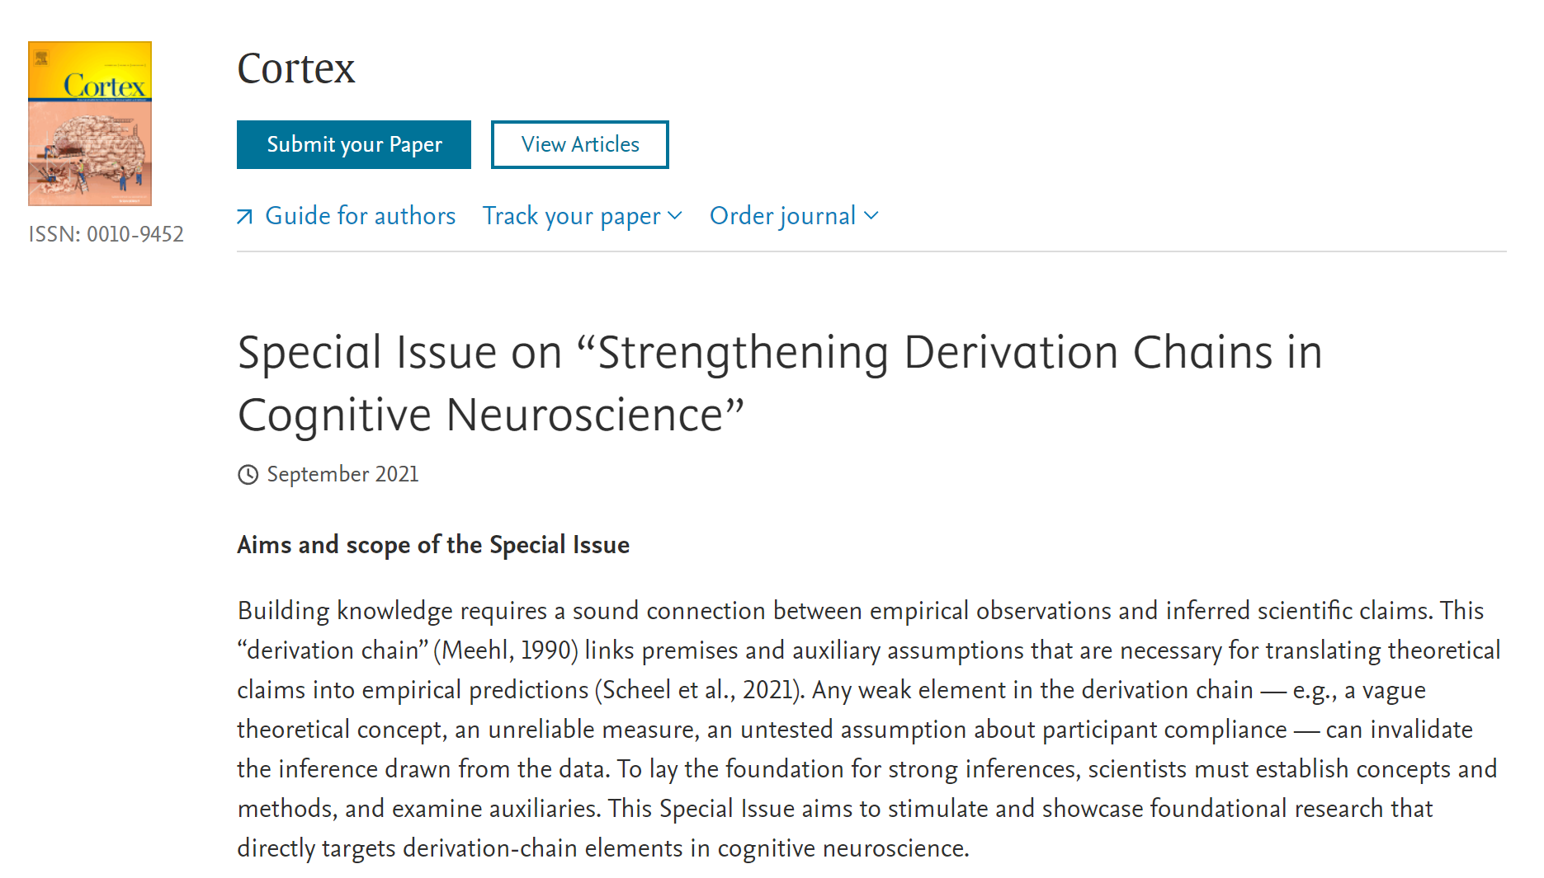
Notes:
Finally, I quickly wanted to mention that the journal cortex is planning a special issue for next year called….
For anyone interested in this type of research.

Slide 32
References
Agnoli, F., Wicherts, J. M., Veldkamp, C. L. S., Albiero, P., & Cubelli, R. (2017). Questionable research practices among italian research psychologists. PLOS ONE, 12(3), e0172792. https://doi.org/10.1371/journal.pone.0172792
Bakker, M., & Wicherts, J. M. (2011). The (mis)reporting of statistical results in psychology journals. Behavior Research Methods, 43(3), 666–678. https://doi.org/10.3758/s13428-011-0089-5
Bem, D. J. (2011). Feeling the future: Experimental evidence for anomalous retroactive influences on cognition and affect. Journal of Personality and Social Psychology, 100(3), 407–425. https://doi.org/10.1037/a0021524
Benjamin, D. J., Berger, J. O., Johannesson, M., Nosek, B. A., Wagenmakers, E. J., Berk, R., Bollen, K. A., Brembs, B., Brown, L., Camerer, C., Cesarini, D., Chambers, C. D., Clyde, M., Cook, T. D., De Boeck, P., Dienes, Z., Dreber, A., Easwaran, K., Efferson, C., . . . Johnson, V. E. (2017). Redefine statistical significance. Nature Human Behaviour, 2(1), 6–10. https://doi.org/10.1038/s41562-017-0189-z

Slide 33
References
Busse, C., Kach, A. P., & Wagner, S. M. (2016). Boundary Conditions. Organizational Research Methods, 20(4), 574–609. https://doi.org/10.1177/1094428116641191
Button, K. S., Ioannidis, J. P. A., Mokrysz, C., Nosek, B. A., Flint, J., Robinson, E. S. J., & Munafò, M. R. (2013). Power failure: why small sample size undermines the reliability of neuroscience. Nature Reviews Neuroscience, 14(5), 365–376. https://doi.org/10.1038/nrn3475
Cumming, G. (2013). The New Statistics. Psychological Science, 25(1), 7–29. https://doi.org/10.1177/0956797613504966
Dubin, R. (1969). Theory building. The Free Press.
Estimating the reproducibility of psychological science. (2015). Science, 349(6251). https://doi.org/10.1126/science.aac4716
Fanelli, D. (2010). “Positive” Results Increase Down the Hierarchy of the Sciences. PLoS ONE, 5(4), e10068. https://doi.org/10.1371/journal.pone.0010068

Slide 34
References
Fanelli, D. (2010). “Positive” Results Increase Down the Hierarchy of the Sciences. PLoS ONE, 5(4), e10068. https://doi.org/10.1371/journal.pone.0010068
Ferguson, C. J., & Heene, M. (2012). A Vast Graveyard of Undead Theories. Perspectives on Psychological Science, 7(6), 555–561. https://doi.org/10.1177/1745691612459059
Fidler, Fiona and John Wilcox, "Reproducibility of Scientific Results", The Stanford Encyclopedia of Philosophy (Summer 2021 Edition), Edward N. Zalta (ed.), https://plato.stanford.edu/archives/sum2021/entries/scientific-reproducibility/
Fidler, F., Singleton Thorn, F., Barnett, A., Kambouris, S., & Kruger, A. (2018). The Epistemic Importance of Establishing the Absence of an Effect. Advances in Methods and Practices in Psychological Science, 1(2), 237–244. https://doi.org/10.1177/2515245918770407

Slide 35
References
Flake, J. K., Pek, J., & Hehman, E. (2017). Construct Validation in Social and Personality Research. Social Psychological and Personality Science, 8(4), 370–378. https://doi.org/10.1177/1948550617693063
Fried, E. I. (2020). Theories and Models: What They Are, What They Are for, and What They Are About. Psychological Inquiry, 31(4), 336–344. https://doi.org/10.1080/1047840x.2020.1854011
John, L. K., Loewenstein, G., & Prelec, D. (2012). Measuring the Prevalence of Questionable Research Practices With Incentives for Truth Telling. Psychological Science, 23(5), 524–532. https://doi.org/10.1177/0956797611430953
Makel, M. C., Plucker, J. A., & Hegarty, B. (2012). Replications in Psychology Research. Perspectives on Psychological Science, 7(6), 537–542. https://doi.org/10.1177/1745691612460688
Meehl, P. E. (1967). Theory-Testing in Psychology and Physics: A Methodological Paradox. Philosophy of Science, 34(2), 103– 115. https://doi.org/10.1086/288135

Slide 36
References
Meehl, P. E. (1978). Theoretical risks and tabular asterisks: Sir Karl, Sir Ronald, and the slow progress of soft psychology. Journal of Consulting and Clinical Psychology, 46(4), 806–834. https://doi.org/10.1037/0022-006x.46.4.806
Meehl, P. E. (1990). Why Summaries of Research on Psychological Theories are Often Uninterpretable. Psychological Reports, 66(1), 195– 244. https://doi.org/10.2466/pr0.1990.66.1.195
Munafò, M. R., Nosek, B. A., Bishop, D. V. M., Button, K. S., Chambers, C. D., Percie du Sert, N., Simonsohn, U., Wagenmakers, E. J., Ware, J. J., & Ioannidis, J. P. A. (2017). A manifesto for reproducible science. Nature Human Behaviour, 1(1). https://doi.org/10.1038/s41562-016-0021
Nosek, B. A., Hardwicke, T. E., Moshontz, H., Allard, A., Corker, K. S., Dreber, A., Fidler, F., Hilgard, J., Kline Struhl, M., Nuijten, M. B., Rohrer, J. M., Romero, F., Scheel, A. M., Scherer, L. D., Schönbrodt, F. D., & Vazire, S. (2022). Replicability, Robustness, and Reproducibility in Psychological Science. Annual Review of Psychology, 73(1), 719–748. https://doi.org/10.1146/annurev- psych-020821-114157

Slide 37
References
Nuijten, M. B., Hartgerink, C. H. J., van Assen, M. A. L. M., Epskamp, S., & Wicherts, J. M. (2015). The prevalence of statistical reporting errors in psychology (1985–2013). Behavior Research Methods, 48(4), 1205–1226. https://doi.org/10.3758/s13428-015-0664-2
Oberauer, K., & Lewandowsky, S. (2019). Addressing the theory crisis in psychology. Psychonomic Bulletin &Amp; Review, 26(5), 1596– 1618. https://doi.org/10.3758/s13423-019-01645-2
Proulx, T., & Morey, R. D. (2021). Beyond Statistical Ritual: Theory in Psychological Science. Perspectives on Psychological Science, 16(4), 671–681. https://doi.org/10.1177/17456916211017098
Ritchie, S. J., Wiseman, R., & French, C. C. (2012). Failing the Future: Three Unsuccessful Attempts to Replicate Bem’s ‘Retroactive Facilitation of Recall’ Effect. PLoS ONE, 7(3), e33423. https://doi.org/10.1371/journal.pone.0033423
Rosenthal, R. (1979). The file drawer problem and tolerance for null results. Psychological Bulletin, 86(3), 638–641. https://doi.org/10.1037/0033-2909.86.3.638

Slide 38
References
Schmidt, S. (2009). Shall we Really do it Again? The Powerful Concept of Replication is Neglected in the Social Sciences. Review of General Psychology, 13(2), 90–100. https://doi.org/10.1037/a0015108
Serra-Garcia, M., & Gneezy, U. (2021). Nonreplicable publications are cited more than replicable ones. Science Advances, 7(21). https://doi.org/10.1126/sciadv.abd1705
Simmons, J. P., Nelson, L. D., & Simonsohn, U. (2011). False-Positive Psychology. Psychological Science, 22(11), 1359–1366. https://doi.org/10.1177/0956797611417632
Sterling, T. D. (1959). Publication Decisions and their Possible Effects on Inferences Drawn from Tests of Significance—or Vice Versa. Journal of the American Statistical Association, 54(285), 30–34. https://doi.org/10.1080/01621459.1959.10501497
Szucs, D., & Ioannidis, J. P. A. (2017). Empirical assessment of published effect sizes and power in the recent cognitive neuroscience and psychology literature. PLOS Biology, 15(3), e2000797. https://doi.org/10.1371/journal.pbio.2000797

Slide 39
References
Wagenmakers, E. J., Beek, T., Dijkhoff, L., Gronau, Q. F., Acosta, A., Adams, R. B., Albohn, D. N., Allard, E. S., Benning, S. D., Blouin- Hudon, E. M., Bulnes, L. C., Caldwell, T. L., Calin-Jageman, R. J., Capaldi, C. A., Carfagno, N. S., Chasten, K. T., Cleeremans, A., Connell, L., DeCicco, J. M., . . . Zwaan, R. A. (2016). Registered Replication Report. Perspectives on Psychological Science, 11(6), 917–928. https://doi.org/10.1177/1745691616674458
Wagenmakers, E. J., Wetzels, R., Borsboom, D., & van der Maas, H. L. J. (2011). Why psychologists must change the way they analyze their data: The case of psi: Comment on Bem (2011). Journal of Personality and Social Psychology, 100(3), 426–432. https://doi.org/10.1037/a0022790
Wagenmakers, E. J., Wetzels, R., Borsboom, D., van der Maas, H. L. J., & Kievit, R. A. (2012). An Agenda for Purely Confirmatory Research. Perspectives on Psychological Science, 7(6), 632–638. https://doi.org/10.1177/1745691612463078

Slide 40
References
Wicherts, J. M., Borsboom, D., Kats, J., & Molenaar, D. (2006). The poor availability of psychological research data for reanalysis. American Psychologist, 61(7), 726–728. https://doi.org/10.1037/0003-066x.61.7.726

Slide 41
Thank you for listening!

