Slide 1
Web APIs & NLP
By Zamzam Alsarayrah
Data Scientist | General Assembly

Slide 2

Problem Statement
As a data scientist for the advertising department at reddit, Our team has recently noticed, during the covid 19 period, an increase in the number of views for special subreddit on the diet and healthy food, and one of the most popular types of diet is Keto. Therefore the team decided to use a classification model to classify the post in two subreddits based on the post title and the post content. This classification will help us to determine in which post to add the specific advertisement.
We have two hypothesis to test:
The null hypothesis: There is no relation between the post title/post content and the subreddit
The alternative hypothesis: there is a relationship between the post title/content and the subreddit and we can predict the subreddit from the post title and post content.
To reject or accept the null hypothesis, we have to check the model accuracy, if it is higher than the baseline accuracy we reject the null otherwise accept it.

Slide 3


Subreddit 1 = Nutrition
2.0 Members
5000 posts
https://www.reddit.com/search/?q=nutrition&source=recent
Subreddit 2 = Keto
2.6 Members
5000 posts
https://www.reddit.com/r/keto/
Why did I pick this subreddi?
1- I’m familiar with Keto 2- Very strong and interesting. 3- Very important for everyone.

Slide 4
Reddit is a social news, content, and discussions website. Posts are organized according to subject into user-created 'subreddits'. Members submit content (such as images, texts, and links) to subreddits, which can then be voted up ('upvote') or down ('downvote') by other members.

Slide 5
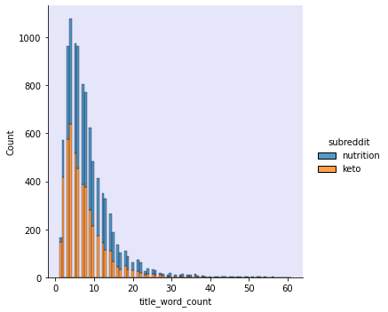
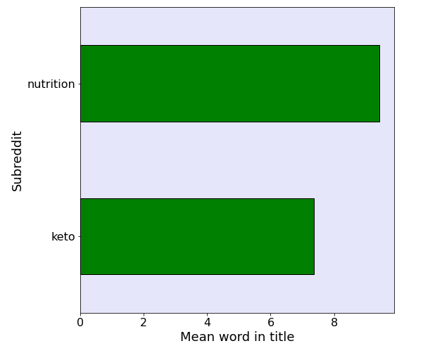
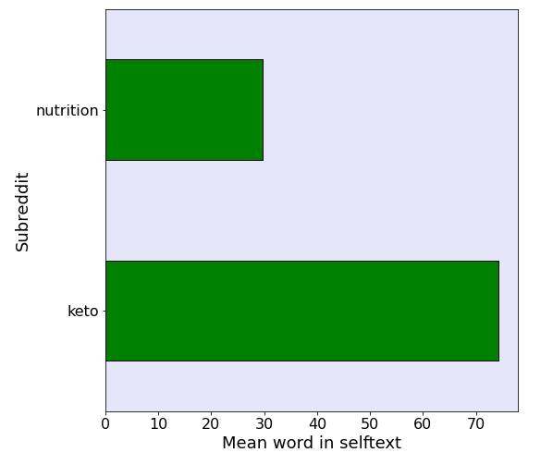
Exploratory Data Analysis
1- Remove the null value
2- add the length and word counts for both the post content and the post title
3- Replace any (Http , www) with word link.
4- Breaking the raw text into small chunks.
5- Extract the most common words.
6- Add stope words.
7- Drop the empty row.
8- check the longest and shortest posts (title, self text)

Slide 6
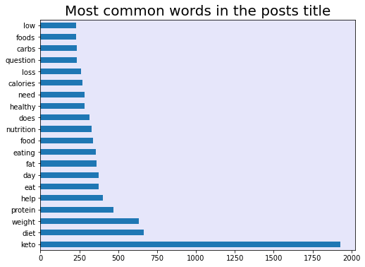
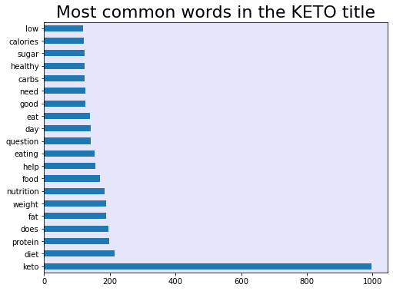
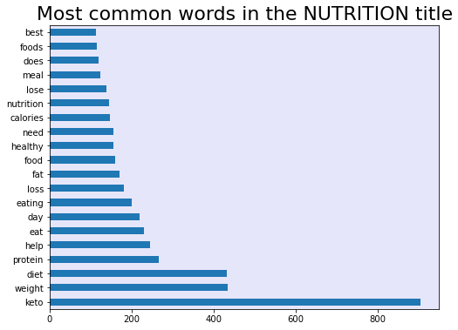
Pre-NLP Comparisons

Slide 7
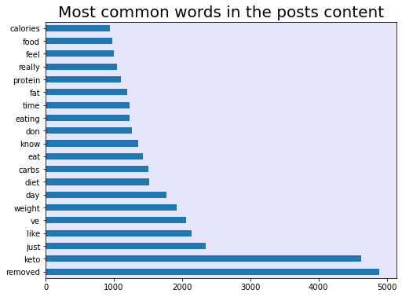
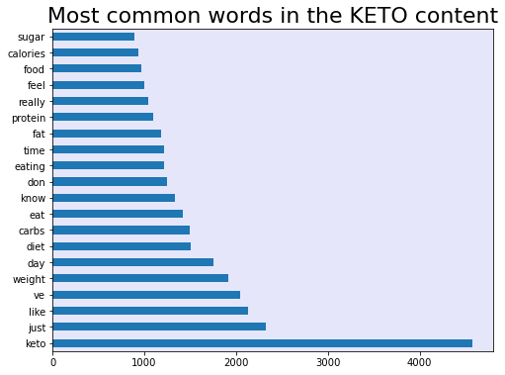
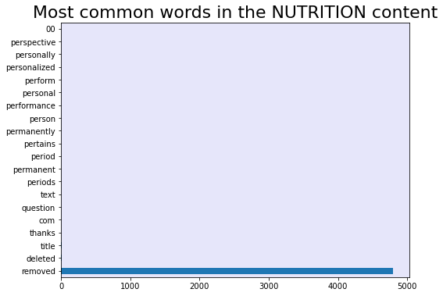
Pre-NLP Comparisons

Slide 8

NLP Data Pre_Processing
Convert the letter to lowercase letters
Remove special characters
Tokenizing (Split the text into words)
Stemming (get back the base form of the word)
Stop word

Slide 9
Modeling Process
logistic regression
counterVictorizer
(TF-IDF) Vectorizer
pipline
RandomizedSearchCV
Multinomial Naive Bayes
counterVictorizer
(TF-IDF) Vectorizer
pipline
RandomizedSearchCV
Random Forests
counterVictorizer
(TF-IDF) Vectorizer
pipline
RandomizedSearchCV
selftext:
Lr_cvec TRAIN .78
Lr_cvec TEST .73
Lr_tvec TRAIN .75
Lr_tvec TEST .74
selftext:
mnb_cvec TRAIN .73
mnb_cvec TEST .72
Mnb_tvec TRAIN .72
mnb _tvec TEST .70
selftext:
Rfc_cvec TRAIN .74
Rfc_cvec TEST .73
Rfc_tvec TRAIN .74
Rfc_tvec TEST .73
Title:
Lr_cvec TRAIN .88
Lr_cvec TEST .80
Lr_tvec TRAIN .86
Lr_tvec TEST .80
Title:
mnb_cvec TRAIN .85
mnb_cvec TEST .80
Mnb_tvec TRAIN .86
mnb _tvec TEST .79
Title:
Rfc_cvec TRAIN .76
Rfc_cvec TEST .74
Rfc_tvec TRAIN .77
Rfc_tvec TEST .74

Slide 10
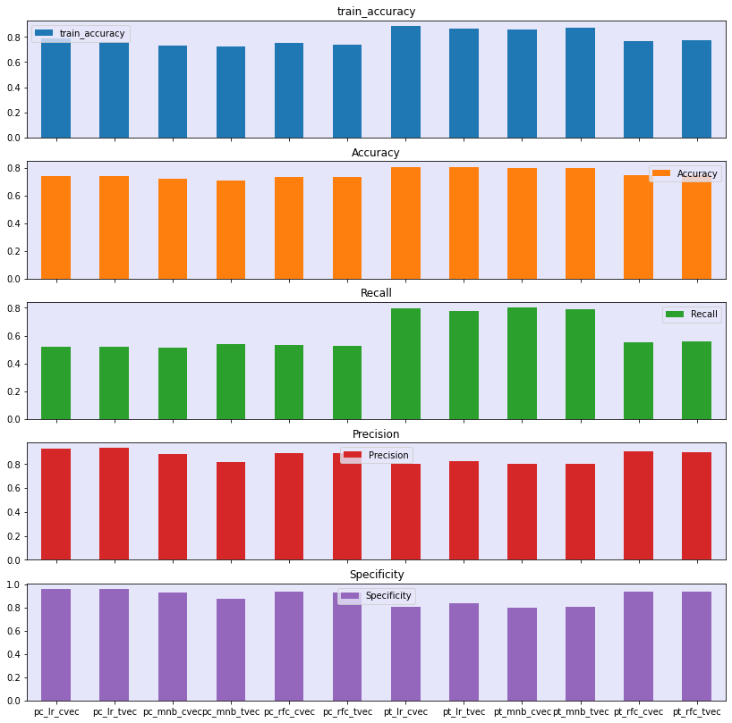
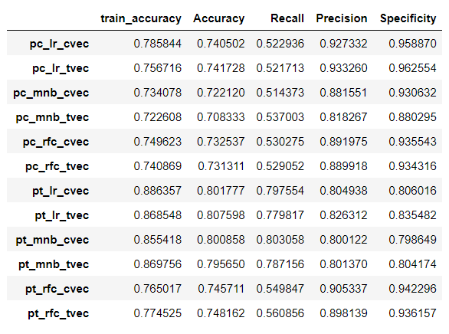
Confusion matrix

Slide 11

Conclusion
We can notice from the accuracy results for all the models we have examined that the post title, and the post content can be used to classify the post subreddit. The accuracy values for all the 12 models is higher than the Baseline accuracy which was 0.5009. This was the concluded result for all the proposed models. Regarding the best model to use among the tested models, the logistic regression with the Counterectorizer with using the post title as predictor gives as the best scores as we can see from the scores figures and dataframe. It predicted 0.88 of the trained post correctly and 0.8 of the test posts. Also, the recall score were 0.797554 which outperform the other models. The Precision and Specificity scores for the chosen model were both good comparing to the other models. If we want to choose other model, we can think about the logistic regression with the TfidfVectorizer using the post title as predictor. This model has scores near to our chosen model. In addition to all the mentioned point regarding the choice of the model that uses Logistic regression, Logistic regression is a very fast classification model comparing to the other model.

Slide 12


