Slide 1


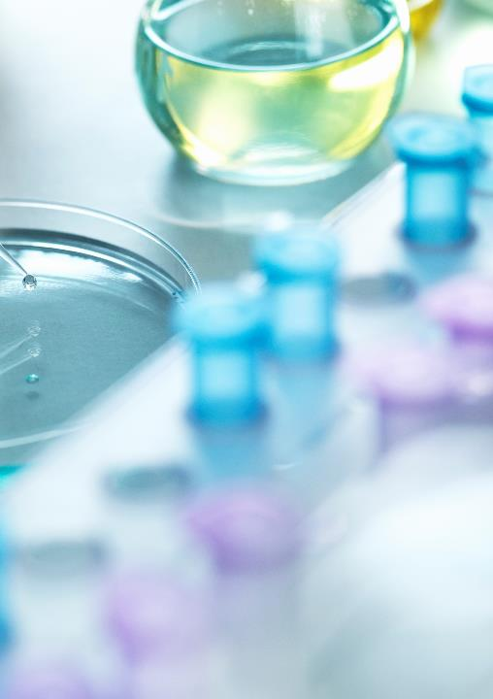
Chest X-Ray (viral_Pneumonia,Covid19, Normal, Tuberculosis, Lung_opacity)
By Zamzam Alsarayrah
Data Scientist | General Assembly

Slide 2
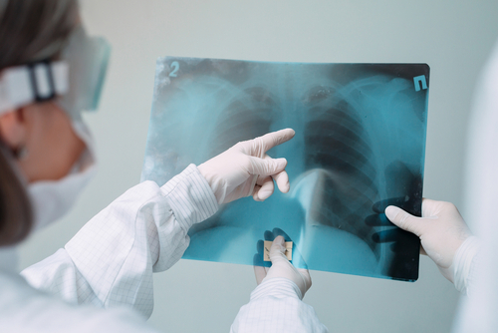
Problem statement:
The global pandemic of coronavirus disease 2019 (COVID-19) has resulted in an increased demand for testing, diagnosis, and treatment. So the chest X-ray radiography (CXR) is a fast, effective, and affordable test that identifies the possible COVID-19-related pneumonia. We are going to check if we can diagnose the chest disease based on the X_RAY by using machine learning method. One main goal is the covid-19, we are going to test different machine learning models and their ability to diagnose the covid-19 chest-ray among other 4 different chest diseases.
Source: https://dataverse.harvard.edu/file.xhtml?fileId=5210381&version=5.0

Slide 3

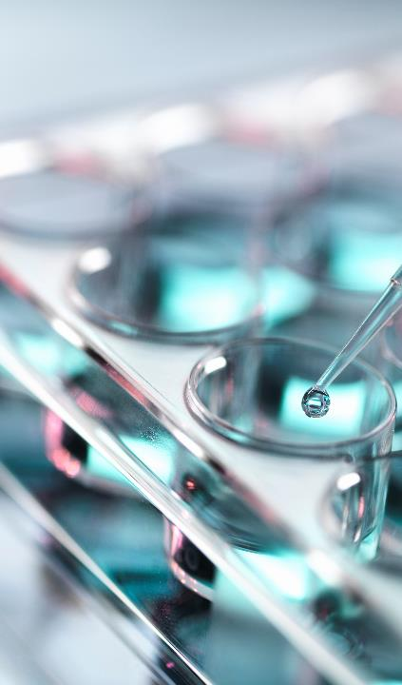
Dataset :
Lung_opacity
NORMAL
TURBERCULOSIS
viral_Pneumonia
COVID19

Slide 4
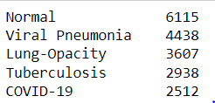
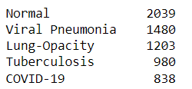
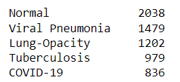
Dataset :
The dataset is organized into 3 folders (train, test, val) and contains subfolders for each image category (viral_Pneumonia,Covid19,Normal,Tuberculosis, Lung_opacity).
A total of 32,687 x-ray images are present.
Training
19,610
Testing
6,540
Validation
6,534

Slide 5
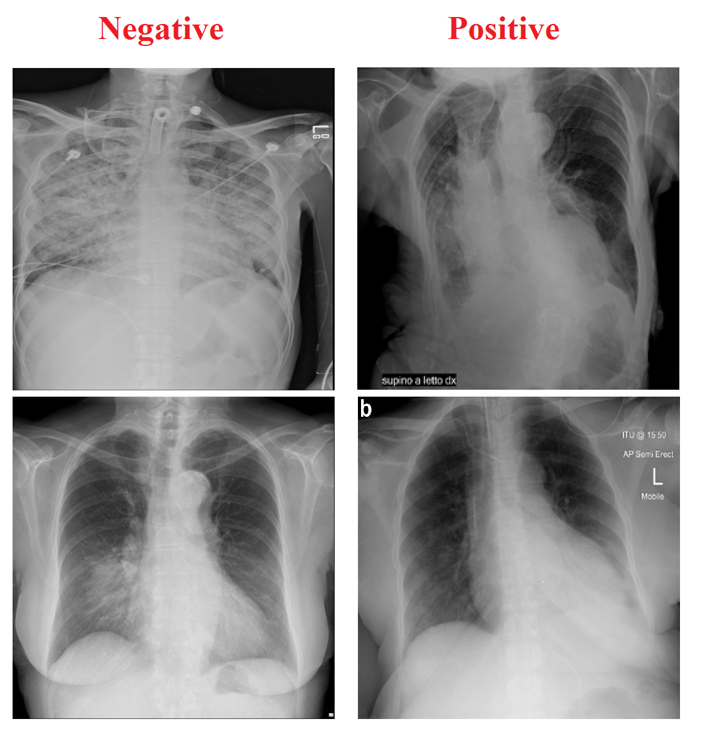
What are symptoms of COVID-19 affecting the lungs?
Some people may feel short of breath. People with chronic heart, lung, and blood diseases may be at risk of severe COVID-19 symptoms, including pneumonia, acute respiratory distress, and acute respiratory failure.

Slide 6
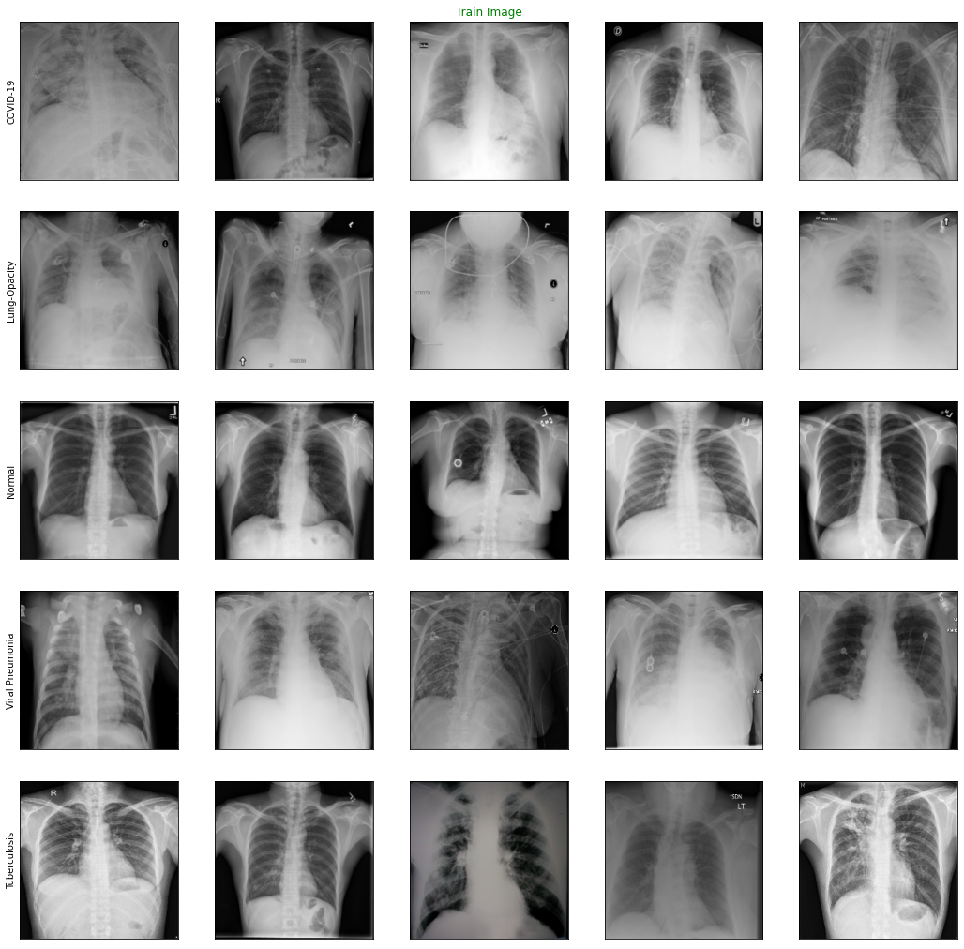
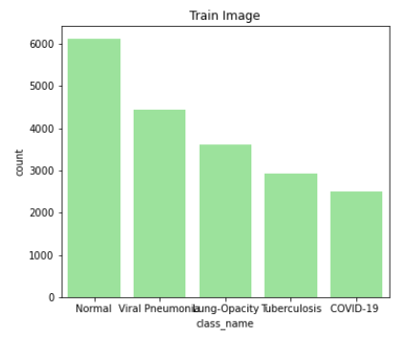
Images for each class in Training data set

Slide 7
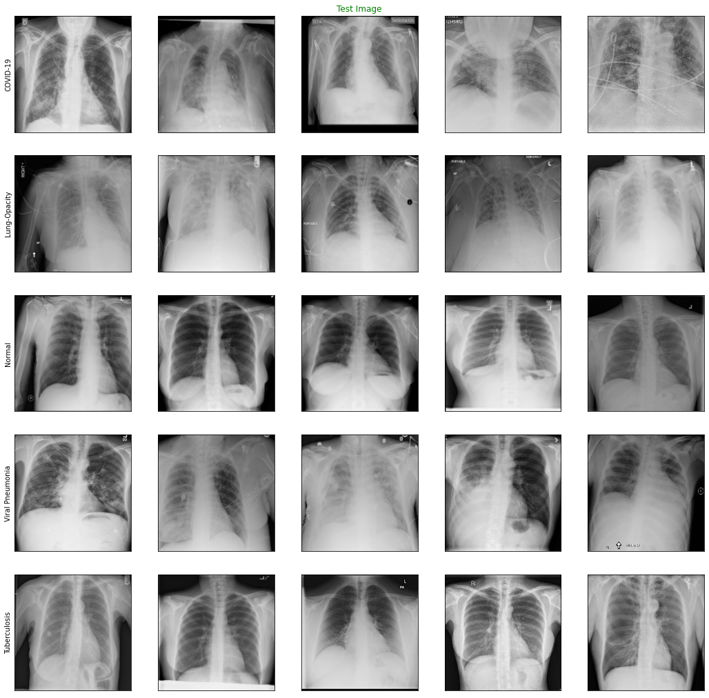
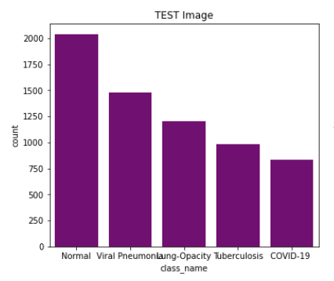
Images for each class in Testing data set

Slide 8
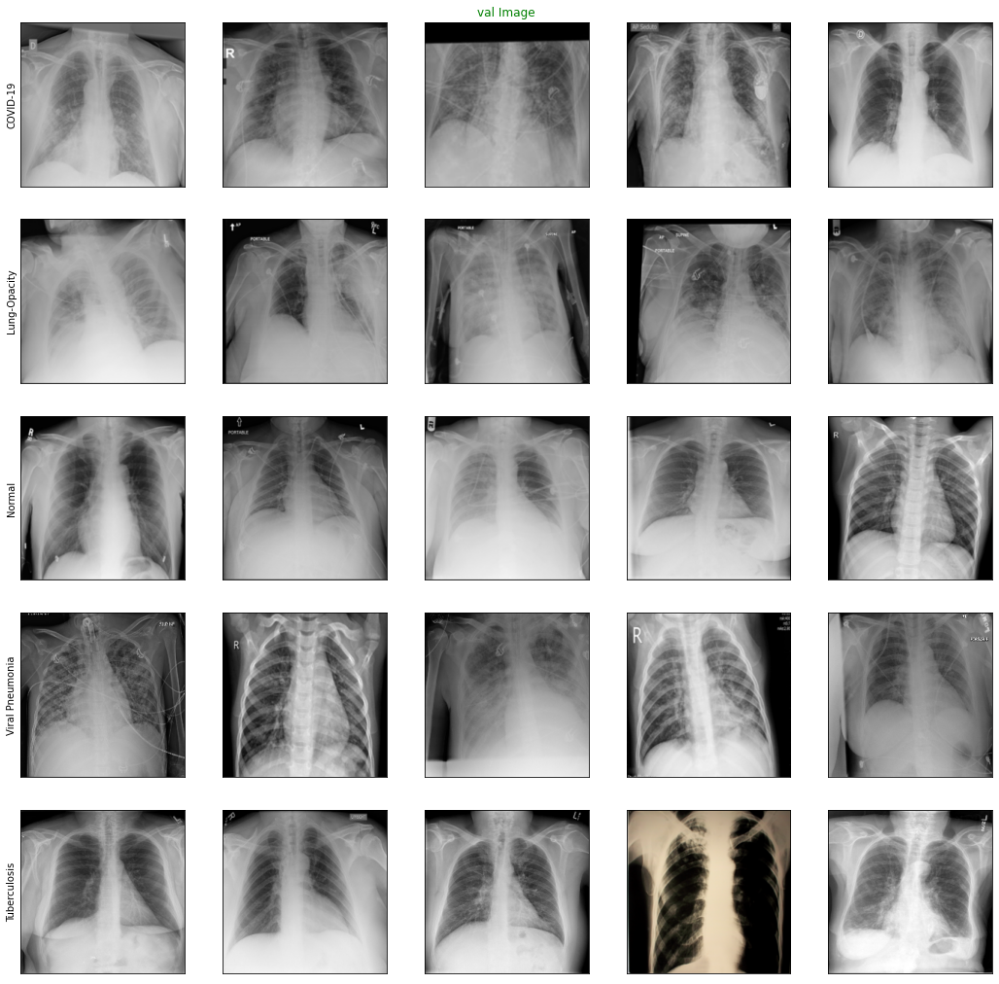
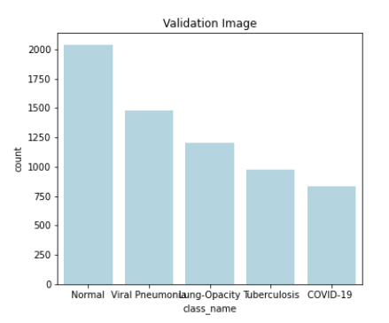
Images for each class in Validation data set

Slide 9




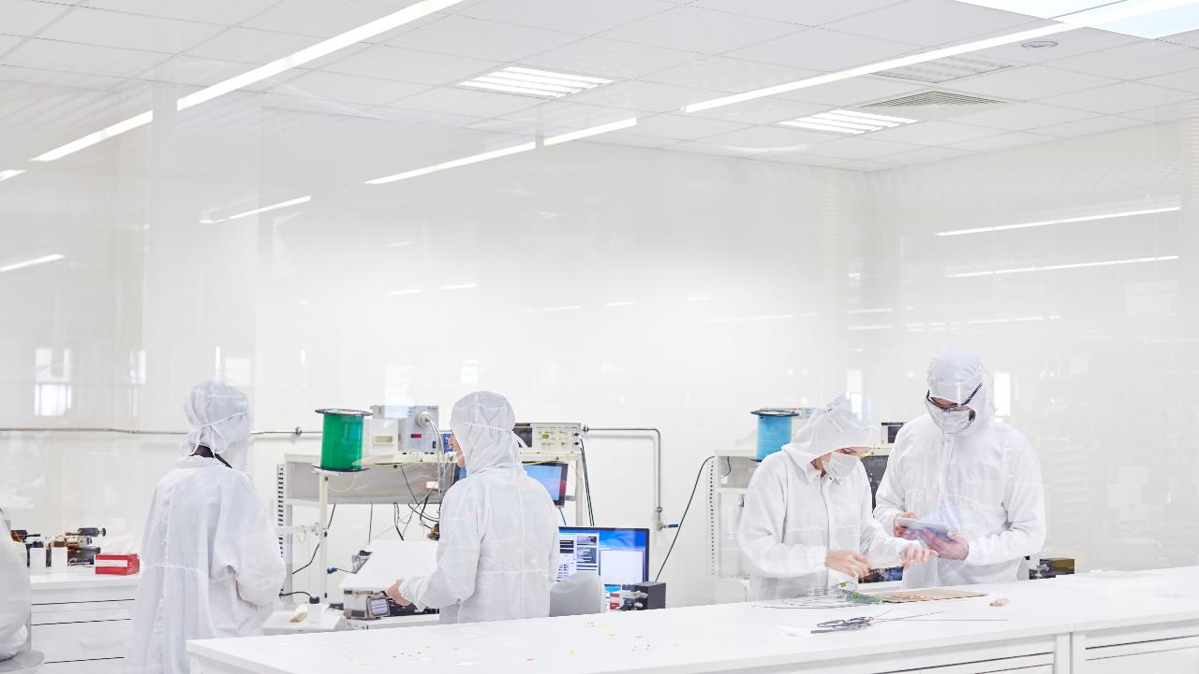
methods and models:
Base Model :
convolutional neural networks (cnn)
Base Model Architecture:
Custom CNN Model This model has 2 Convolutional (Conv) (Conv2D + MaxPooling2D) layers, followed by 2 Fully Connected (FC) layers and a final SoftMax activation layer for classification. All layers use ReLU activation except where mentioned.
Transfer learning via feature extraction:
We used two different techniques for feature extraction. One using PCA and the other using pre-trained CNN (VGG16). We input the images to the feature extractor, the output is the features of each image, then these feature used as an input to a classification technique to classify the image.
VGG16 Model Architecture:
VGG16 is a pre-trained CNN network by Simony an and Zisserman. It used as a classifier or features extractor. When using it as a feature extractor we chop “chop off” the network at a specified layer which is mainly prior to the fully-connected layers. The output of the VGG16 extractor will be 7 x 7 x 512 = 25,088 features, which is the shape of the final max-pooling layer of the chopped VGG16. These extracted features will be fed into other classifier to classify the image.
Classification Models:
Classification using logistic regression and random forest models with multi class output. We used Random-search with both model to help with tuning the hyperparamters. We fed these models with the extracted features from the PCA and the VGG16.
Transfer learning via feature extraction:
1- Principle component analysis(pca)
2- VGG16
Classification Models:
1- logistic regression
2- Random forest models
confusion matrix:
accuracy, precision, recall, and F1-score

Slide 10
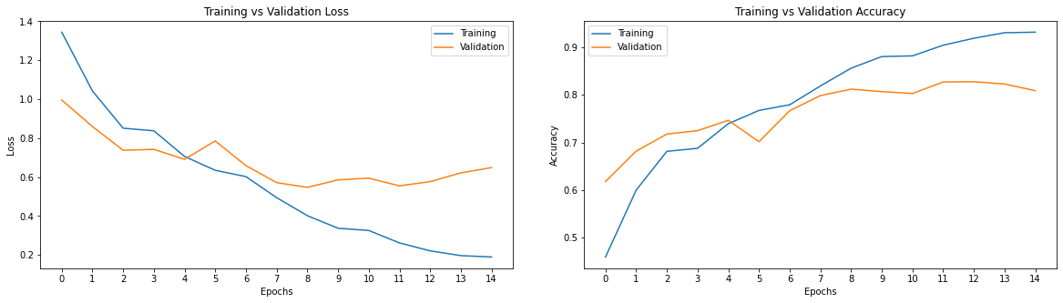
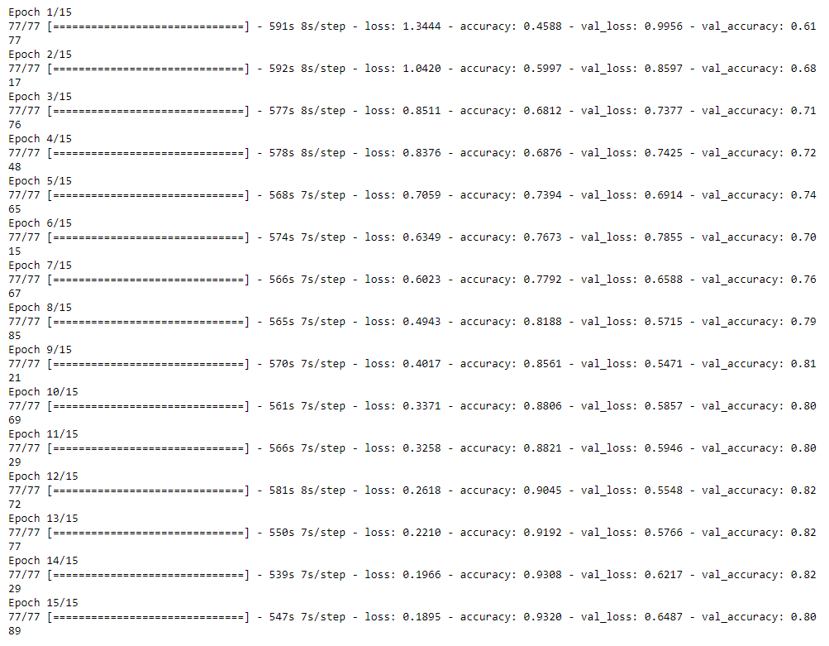
Base Model :
convolutional neural networks (cnn)
For the base model we are going to input the image to a simple CNN with the structure of 2 CNN layers, 2 Maxpooling, 2 fully connected dense layers with relue activation and Droop out with P =0.2. The classification will be done using the final dense layer with softmax activation function.
Loss = .189
Accuracy = .93
Val_loss = .64
Val_accuracy = .80
Loss should be as minimum as possible (near 0) and the loss and validation loss should be near to each other

Slide 11
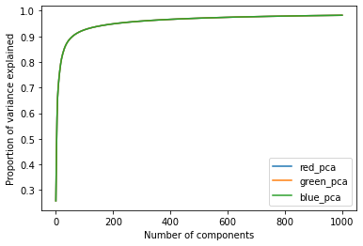
Transfer learning via feature extraction:
Pca & vgg16
We used two different techniques for feature extraction. One using PCA and the other using pre-trained CNN (VGG16). We input the images to the feature extractor, the output is the features of each image, then these feature used as an input to a classification technique to classify the image.
And after that using logistic regression and random forest models with multi class output. We used Random-search with both model to help with truning the hyperparamters. We fed these models with the extracted features from the PCA and the VGG16.
Logistic & RFC
As seen from the plot above the used number of components is sufficient to explain more than 90% of the variance in the train images.

Slide 12
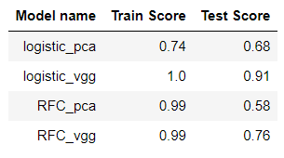

Results:
From the table above which shows the train and test accuracy for the different models we have applied, we can see that all of them has an overfit. The one with the best performance among them is the vgg16 with logistic regression, it has a 1 train accuracy and 0.91 test accuracy. If we would pick one model from the above model we will pick the vgg16 with logistic regression. We can notice that the PCA for feature extraction and then apply simple classification models didn’t work well. Even though the features extracted using the PCA covers almost more than 90% of the variance on the images, it didn’t do well in the classification. The base model we have did good work compare to the other models.

Slide 13
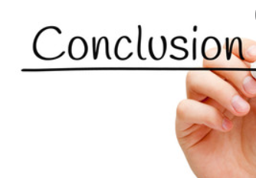
Conclusion & Recommendation
Conclusion: The features extracted by the PCA can’t do well with the classification
VGG feature extractor did well but still has overfit
For our problem and data, logistic regression is better than random forest classifier
The base model did well and model with PCA features extractor could not get performance better than the base model.
Recommendation:
- Do More error analysis such that the precision and recall and check what class did confused with the COVID-19 more to work on this class.
- Try to get the human level error (the percentage of error that the doctor can do while classify these x-ray) and compare it with the best model we have to work more on it.
- Try to get more data for the test so the model will have more data to test on and improve the performance.
- Use NN after the VGG feature extractor with overfitting solution such as drop out and regularization
- Do some images augmentation to increase the train and test data
- Use more powerful computer with better storage to be able to run the model faster as we are working with images data which has large size.

Slide 14


Contact me
Any Question ?
Zamzam.sar@yahoo.com

