Slide 1
Localizing image tampering
Given an image, identify the edited pixels
Photographs, documents and AI-assisted local edits
Žan
30 October 2026
Notes:
My thesis studies image manipulation localization. The input is an image, and the output is a score map showing which pixels are likely to have been edited. This is more specific than deciding whether a whole image is fake. The practical motivation is to help a reviewer find a suspicious region, including a small change to a document.
We began with classical photographic manipulation and expanded the evaluation to documents and AI-assisted local edits because these are priorities for ZCAM. The main research question is how well a simple pretrained model transfers when the image source, editing method or subsequent processing changes. Fully generated images are outside our main local-edit evaluation.
I will first establish the literature, data and evaluation protocol, then show the baseline results, diagnose their failures and explain the experiments motivated by those failures. The findings are about the tested datasets and conditions. We have not yet established a calibrated operational review system.
Sources
1. https://github.com/ZanMervic/Thesis/blob/75f077cb4a745fbe61871ab99f3fdd494e0486c0/Code/experiments/dino_mvss_corrected/REPORT.md
2. https://github.com/ZanMervic/Thesis/blob/75f077cb4a745fbe61871ab99f3fdd494e0486c0/Code/evaluation/README.md
Research snapshot: 29 October 2026. Meeting: 30 October 2026.
Visual references
https://www.zurich.com/-/media-assets/project/zurich/dotcom/investor-relations/docs/investors/zurich-investors-intro-pack-2026.pdf
https://www.zurich.at/rechtliche-hinweise/barrierefreiheitserklaerung
https://www.zurich.at/

Slide 2
Model approaches in the literature
Approach | Examples
Foundation-model features | DINOv3, Detective SAM, TRAIL
RGB with forensic evidence | TruFor, Omni-IML, MMFusion
Document-specific models | DTD, ADCD-Net
AI-edit localization | MaskCLIP, FUSED
Within-image consistency | EXIF as Language, EXIF-SC, GIFL¹
Reconstruction discrepancy | Training-free diffusion, IFA-Net
¹ GIFL was withdrawn on 26 October 2026. It remains part of the reading history.
Notes:
These categories describe the main source of evidence and overlap. TruFor combines RGB with Noiseprint++, a learned processing fingerprint. Omni-IML adapts modalities and decoding across domains. MMFusion combines forensic filters. DTD and ADCD-Net target document text and frequency evidence. FUSED combines semantic and forensic branches for AI inpainting.
Foundation models provide a strong representation that can be adapted or probed. Detective SAM uses SAM2 with forensic adaptations. TRAIL instead probes frozen DINO features without a trained localizer. Within-image methods ask whether regions share a consistent acquisition or processing history. Reconstruction methods ask whether a region behaves differently when a model reconstructs it.
Our experiments draw on several of these ideas, but we do not claim to reproduce all these systems. Additional inspirations include feature pyramids, dense transformer decoding, AugMix, FOCAL and SISL. GIFL is a historical reading and inspiration only: its arXiv record was withdrawn on 26 October 2026 because the main method had been substantially modified. Avoid citing its original claims as current validated evidence.
Sources
1. https://arxiv.org/abs/2604.16083
2. https://arxiv.org/abs/2608.18968
3. https://arxiv.org/abs/2411.14823
4. https://arxiv.org/abs/2312.01790
5. https://arxiv.org/abs/2608.28302
6. https://arxiv.org/abs/2504.07462
7. https://arxiv.org/abs/2602.18842
8. https://openaccess.thecvf.com/content/CVPR2023/html/Guillaro_TruFor_Leveraging_All-Round_Clues_for_Trustworthy_Image_Forgery_Detection_and_CVPR_2023_paper.html
9. https://proceedings.iclr.cc/paper_files/paper/2026/hash/262dd62fd1bbb30d6a6b4d578f5e65ff-Abstract-Conference.html
10. https://openaccess.thecvf.com/content/ICCV2025/html/Wong_ADCD-Net_Robust_Document_Image_Forgery_Localization_via_Adaptive_DCT_Feature_ICCV_2025_paper.html
11. https://openaccess.thecvf.com/content/CVPR2023/html/Zheng_EXIF_As_Language_Learning_Cross-Modal_Associations_Between_Images_and_Camera_CVPR_2023_paper.html
12. https://openaccess.thecvf.com/content_ECCV_2018/html/Jacob_Huh_Fighting_Fake_News_ECCV_2018_paper.html
13. https://ojs.aaai.org/index.php/AAAI/article/view/33126
Research snapshot: 29 October 2026. Meeting: 30 October 2026.

Slide 3
Generalization has several dimensions
What changes? | Examples
Image source | Property photographs, rendered documents, scans, screenshots
Editing process | Copy–move, splicing, text replacement, AI inpainting
Later processing | JPEG compression, resizing, blur, scanning
A good score within one data pipeline may not transfer to another.
Notes:
The challenge is broader than unseen generators. A model can see a new image source, a new manipulation process or new post-processing. These changes can occur together. A screenshot of an edited document differs from a direct digital rendering in both source appearance and processing history.
This creates competing explanations for poor transfer. The model may have lost small details during resizing. It may rely on source-specific compression traces. Or the new edits may simply differ from those in training. Our experiments aim to separate these explanations rather than treat every failure as an architecture problem.
The diagnostic axes are not mutually exclusive. For example, RTM versus DocTamper changes document content and manipulation construction, so the result is a combined distribution shift. We cannot identify one cause from a low cross-dataset score alone.
Sources
1. https://github.com/ZanMervic/Thesis/blob/75f077cb4a745fbe61871ab99f3fdd494e0486c0/Code/experiments/dino_c1_crossdomain_x1/REPORT.md
2. https://arxiv.org/abs/2406.10580
3. https://github.com/DrLuo/RTM
Research snapshot: 29 October 2026. Meeting: 30 October 2026.

Slide 4
Data used in the main benchmark
Domain | Training images | Within-source test | Transfer tests
Classical photos | CASIA2 4,611 manipulated | — | CASIA1, Columbia, NIST16, COVERAGE, IMD2020
Documents | DocTamper 108,000 manipulated | DocTamper Test | FCD, SCD, RTM
AI local edits | OpenSDI SD1.5 78,657 manipulated | SD1.5 | SD2.1, SDXL, SD3, FLUX, CocoGlide, AutoSplice
Counts exclude source-validation splits. Authentic images are evaluated separately.
Notes:
These are the actual training split counts, not the total public dataset sizes. CASIA2 contributes 4,611 manipulated training examples and 512 validation examples. DocTamper contributes 108,000 training and 12,000 validation examples. OpenSDI SD1.5 contributes 78,657 local-edit training examples and 8,740 validation examples.
The main document tests contain 30,000 DocTamper TestingSet images, 2,000 FCD images and 18,000 SCD images. RTM has 1,203 manipulated and 1,994 authentic test images. Each OpenSDI generator group contains 5,000 local edits and 10,000 authentic evaluation records. CocoGlide has 512 manipulated and 512 authentic images. AutoSplice uses 3,621 JPEG-100 manipulated examples and 2,273 authentic examples.
FCD and SCD change source domains within the DocTamper family. RTM also changes the editing and data-construction process. CASIA1 is an external dataset but shares some source photographs with CASIA2, so it is weaker evidence of independent generalization. The project uses fixed memberships and mask editions. Later RTM training experiments introduce an additional source deliberately and are explained separately.
Sources
1. https://github.com/ZanMervic/Thesis/blob/75f077cb4a745fbe61871ab99f3fdd494e0486c0/Code/data/README.md
2. https://github.com/ZanMervic/Thesis/blob/75f077cb4a745fbe61871ab99f3fdd494e0486c0/Code/experiments/dino_d1_document_v1/PROTOCOL.md
3. https://github.com/ZanMervic/Thesis/blob/75f077cb4a745fbe61871ab99f3fdd494e0486c0/Code/experiments/dino_g1_generative_v1/PROTOCOL.md
Research snapshot: 29 October 2026. Meeting: 30 October 2026.

Slide 5
Specialists, a generalist and transfer tests
Setup | Training | Question
Classical specialist | CASIA2 | Does the starting model transfer across classical tests?
Document specialist | DocTamper | Does document training help, including on RTM?
AI-edit specialist | OpenSDI SD1.5 | Does training on one generator transfer to others?
Generalist | Balanced mixture of all three | Can one model cover all domains?
Cross-domain transfer | Reuse the classical checkpoint | What transfers without retraining?
Source validation selects checkpoints. External tests evaluate the frozen choice.
Notes:
The internal names are C1, D1, G1, M1 and X1. I use descriptive names on the slides. X1 is not a fifth trained model: it is the unchanged classical checkpoint evaluated on documents and generative edits.
The initial experiments use the same DINO architecture and 512-pixel input. Classical training runs for 100 epochs, document training for four and generative training for six. This corresponds to roughly 2,000 scheduled optimizer windows in each specialist, not equal numbers of epochs. The generalist uses 2,000 updates with eight examples per domain in each physical batch.
The important caveat is source exposure. Each generalist domain receives 160,000 presentations, compared with roughly 432,000 to 472,000 for the specialist sources. A lower generalist score therefore does not isolate negative transfer from receiving less training on a particular source.
Known CASIA source groups are kept together in training versus validation. Other split limitations and external source overlaps remain relevant. Test-driven research choices across the project also make repeatedly inspected benchmarks exploratory rather than untouched final holdouts.
Sources
1. https://github.com/ZanMervic/Thesis/blob/75f077cb4a745fbe61871ab99f3fdd494e0486c0/Code/experiments/dino_mvss_corrected/REPORT.md
2. https://github.com/ZanMervic/Thesis/blob/fe0de74ba2b12f3ce426fad5397549ae5434f672/Code/experiments/research_generalist_v1/REPORT.md
Research snapshot: 29 October 2026. Meeting: 30 October 2026.

Slide 6
The DINOv3 localization baseline
Pretrained ViT-L/16 with LoRA on Q, K and V
RGB input
3 × 512 × 512
DINOv3 ViT-L/16
24 blocks
Patch features
1024 × 32 × 32
Convolutional
decoder
Frozen base weights
LoRA rank 32, α = 64
3×3 conv 1024 → 512 + BN / ReLU
3×3 conv 512 → 256 + BN / ReLU
1×1 conv 256 → 1
Logits
1 × 32 × 32
Score map
1 × 512 × 512
Bilinear
+ sigmoid
Loss: BCE + 20 × boundary-weighted BCE
9.05 million trainable parameters: 3.15M LoRA + 5.90M decoder
Notes:
The RGB image is resized to 512 by 512 and normalized. DINOv3 ViT-L/16 splits it into 16-pixel patches, so the spatial output is a 32 by 32 grid with 1,024 channels. Class and register tokens are removed before the spatial decoder.
The pretrained backbone weights are frozen. In each of its 24 transformer blocks, low-rank adapters modify query, key and value projections. The implementation shares the low-rank A matrix across Q/K/V, with rank 32 and alpha 64. This is 3,145,728 trainable adapter parameters.
The decoder has a padded 3 by 3 convolution from 1,024 to 512 channels, batch normalization and ReLU, then another 3 by 3 convolution from 512 to 256 with batch normalization and ReLU, then a 1 by 1 convolution to one channel. It preserves the 32 by 32 grid, producing 1 by 32 by 32 logits. Bilinear interpolation gives 512 by 512 logits and sigmoid gives the score map. Evaluation restores the scores to the native ground-truth dimensions. The decoder has 5,900,801 trainable parameters, giving 9,046,529 in total.
The objective is ordinary binary cross-entropy plus 20 times an edge-focused binary cross-entropy term, using a width-seven boundary mask. This is a supervised segmentation model. The output is a score, not automatically a calibrated probability of fraud.
Sources
1. https://github.com/ZanMervic/Thesis/blob/75f077cb4a745fbe61871ab99f3fdd494e0486c0/Code/dino_iml/model/backbone.py
2. https://github.com/ZanMervic/Thesis/blob/75f077cb4a745fbe61871ab99f3fdd494e0486c0/Code/dino_iml/model/lora.py
3. https://github.com/ZanMervic/Thesis/blob/75f077cb4a745fbe61871ab99f3fdd494e0486c0/Code/dino_iml/model/decoder.py
4. https://github.com/ZanMervic/Thesis/blob/75f077cb4a745fbe61871ab99f3fdd494e0486c0/Code/dino_iml/training/loss.py
5. https://arxiv.org/abs/2604.16083
Research snapshot: 29 October 2026. Meeting: 30 October 2026.

Slide 7
Evaluation and the reproduction correction
Measure or rule | Meaning
Pixel F1 at score > 0.5 | Balance missed edited pixels and false positive pixels
Average precision | Rank edited pixels above authentic pixels across thresholds
Authentic-image diagnostics | Measure the area falsely marked as edited
F1 and AP are averaged per manipulated image. Authentic images stay separate.
Notes:
F1 uses the standard foreground definition, two true positives divided by two true positives plus false positives plus false negatives. The threshold is strictly greater than 0.5. Average precision summarizes precision and recall as the score threshold changes. We calculate each per manipulated image and then average, rather than pooling every pixel across a dataset.
Images with no edited pixels are not assigned an arbitrary localization F1. We report their predicted-positive area and related diagnostics separately. A small highlighted pixel fraction is not the same as a small percentage of documents triggering an alert. We have not fixed an operational image-alert policy.
The reproduction correction is central. The DINO paper selected the checkpoint with the best average performance across external test datasets. We select with held-out source validation and only then evaluate external tests. This removes that checkpoint-selection use of the test data. The numerical difference from the paper is not an architecture-controlled gain, because selection and some evaluation details differ.
For readability most main slides show F1. AP, counts, controls and extra qualifications are in these notes and the full research reference. Paper-reported scores are explicitly labelled and are not silently treated as local runs.
Sources
1. https://github.com/ZanMervic/Thesis/blob/75f077cb4a745fbe61871ab99f3fdd494e0486c0/Code/evaluation/metrics.py
2. https://github.com/ZanMervic/Thesis/blob/75f077cb4a745fbe61871ab99f3fdd494e0486c0/Code/experiments/dino_mvss_corrected/REPORT.md
3. https://arxiv.org/html/2604.16083v1
Research snapshot: 29 October 2026. Meeting: 30 October 2026.

Slide 8
Baseline results on classical manipulations
Pixel F1, original 512-pixel models
Dataset | Classical DINO | Generalist DINO | DINO r32 paper | TruFor paper
CASIA1 | 0.8784 | 0.8812 | 0.867 | 0.721
Columbia | 0.9173 | 0.9263 | 0.943 | 0.865
NIST16 | 0.6193 | 0.6284 | 0.589 | 0.324
COVERAGE | 0.8756 | 0.7002 | 0.822 | 0.419
IMD2020 | 0.6656 | 0.6433 | 0.628 | 0.322
Mean | 0.7912 | 0.7559 | 0.770 | 0.530
Paper columns use different protocols. The generalist has less training per domain.
Notes:
The simple DINO baseline is strong on these classical benchmarks. Its five-dataset mean F1 is 0.7912. The generalist improves CASIA1, Columbia and NIST16, but its large COVERAGE loss brings the mean to 0.7559.
The last two columns are reported in the DINO paper, not rerun locally. The DINO column is ViT-L with rank-32 adapters, matching the relevant model size. The frequently quoted 0.774 paper mean belongs to rank 64, so I do not use it here. The paper TruFor column is the comparison imported from IMDL-BenCo.
Our higher mean than the paper is not a clean reproduction improvement because checkpoint selection and evaluated dataset details differ. CASIA1 also shares some source photos with CASIA2. Generalist versus specialist is matched in architecture, input and roughly total presentations, but not per-domain exposure.
For the local classical model, AP is 0.9419, 0.9499, 0.7521, 0.9300 and 0.7524 in row order. For the generalist it is 0.9435, 0.9671, 0.7608, 0.8536 and 0.7412. The mean row is an unweighted mean of dataset F1 values, not a pooled-image score. No all-domain mean is used.
Sources
1. https://github.com/ZanMervic/Thesis/blob/75f077cb4a745fbe61871ab99f3fdd494e0486c0/Code/experiments/dino_mvss_corrected/REPORT.md
2. https://github.com/ZanMervic/Thesis/blob/fe0de74ba2b12f3ce426fad5397549ae5434f672/Code/experiments/research_generalist_v1/REPORT.md
3. https://arxiv.org/html/2604.16083v1
Research snapshot: 29 October 2026. Meeting: 30 October 2026.

Slide 9
Baseline results on document manipulations
Pixel F1. Published ADCD uses a different input and evaluation protocol.
Dataset | Classical DINO | Document DINO | Generalist DINO | ADCD reported | Released ADCD our test
DocTamper Test | 0.2094 | 0.7126 | 0.5976 | 0.806 | 0.9260
FCD | 0.3784 | 0.5787 | 0.5859 | 0.815 | 0.9356
SCD | 0.1468 | 0.6413 | 0.5370 | 0.740 | 0.8772
RTM | 0.0504 | 0.0731 | 0.0690 | Not reported | 0.0529
Notes:
The first three columns compare the original DINO models under the same evaluator. Training specifically on documents raises DocTamper Test F1 from 0.2094 to 0.7126, but RTM reaches only 0.0731. The generalist also remains weak on RTM. These datasets differ in document sources and manipulation construction, so better performance within the DocTamper family does not establish realistic-document robustness.
The three ADCD columns answer different questions. The paper reports 0.806, 0.815 and 0.740 on Test, FCD and SCD. Those inputs undergo repeated JPEG recompression, and the published aggregation differs from our mean of per-image F1. The paper values are context, not directly comparable measurements of our pipeline. No corresponding paper RTM result is reported here.
The released checkpoint, evaluated through our shared metrics, achieves 0.9260, 0.9356 and 0.8772 on the three DocTamper partitions, but only 0.0529 on RTM. Its input adapter uses grayscale JPEG Q100, DCT information and OCR text regions. The test memberships and metrics match our DINO evaluation, while preprocessing, pretraining and the original training budget differ. Its advantage therefore concerns the complete released system.
We then trained ADCD-S from DocRes restoration initialization using the same 108,000 supervised training IDs and 12,000 source-validation IDs as document DINO. It received 432,000 parent-image presentations, matching the short DINO run's planned exposure. This is not matched optimizer updates: ADCD-S used 10,800 attempts with effective batch 40, compared with DINO's 1,800 planned attempts at batch 240. ADCD-S also uses native 256-pixel crops. We truncated its original long schedule, so it had not reached the planned final learning rate or JPEG severity.
ADCD-S scores 0.8795 on FCD and 0.7790 on SCD, but 0.0384 on RTM. TestingSet was not evaluated because of storage constraints; its empty cell cannot be filled from the released checkpoint. There is no combined document average.
One substantive implementation issue must be disclosed: the inherited Lovász loss moves the batch axis instead of the class axis before flattening. It therefore mixes probabilities that should belong to the same pixel, and the actual training code exercises this path. The scores remain valid measurements of the trained released-code implementation, but it did not faithfully optimize the intended Lovász objective. We do not know how corrected-loss retraining would change the outcome.
The practical conclusion is that ADCD remains strong on these synthetic document partitions, even at short-DINO-matched parent exposure, but does not solve RTM transfer. The comparison still combines OCR/DCT, restoration pretraining, different losses and crop sampling; FCD independence from DocRes pretraining is also unverified.
Sources
1. https://github.com/ZanMervic/Thesis/blob/75f077cb4a745fbe61871ab99f3fdd494e0486c0/Code/experiments/dino_d1_document_v1/REPORT.md
2. https://github.com/ZanMervic/Thesis/blob/75f077cb4a745fbe61871ab99f3fdd494e0486c0/Code/experiments/dino_c1_crossdomain_x1/REPORT.md
3. https://github.com/ZanMervic/Thesis/blob/fe0de74ba2b12f3ce426fad5397549ae5434f672/Code/experiments/research_generalist_v1/REPORT.md
4. https://arxiv.org/html/2507.16397v1
5. https://github.com/ZanMervic/Thesis/blob/aa1f585b9987a2375f18fbc48c3e1d851eed97ae/Code/experiments/adcd_net_document_v1/REPORT.md
6. https://github.com/ZanMervic/Thesis/blob/263384447dd5283b5d547af16e4a54dd955271fb/Code/experiments/research_adcd_matched_v1/REPORT.md
7. https://github.com/ZanMervic/Thesis/blob/263384447dd5283b5d547af16e4a54dd955271fb/Code/adcd_iml/model/upstream/lovasz_loss.py
8. https://github.com/ZanMervic/Thesis/blob/263384447dd5283b5d547af16e4a54dd955271fb/Code/adcd_iml/training/core.py
Research snapshot: 29 October 2026. Meeting: 30 October 2026.

Slide 10
Baseline results on AI-assisted local edits
Original DINO baselines and DetectiveSAMv2. Pixel F1.
Dataset | Classical DINO | AI-edit DINO | Generalist DINO | DetectiveSAMv2 our test | DetectiveSAMv2 reported
SD1.5 | 0.0726 | 0.8474 | 0.8110 | 0.2647 | —
SD2.1 | 0.0744 | 0.8145 | 0.7822 | 0.2615 | —
SDXL | 0.0931 | 0.6117 | 0.5734 | 0.3137 | —
SD3 | 0.2528 | 0.7497 | 0.7508 | 0.3412 | —
FLUX | 0.1754 | 0.2474 | 0.3020 | 0.4143 | —
OpenSDI mean | — | 0.6541 | 0.6439 | 0.3191 | —
CocoGlide | 0.5843 | 0.8273 | 0.8228 | 0.6164 | 0.5833
AutoSplice | 0.4973 | 0.3996 | 0.5713 | 0.7200 | 0.7053
SAMv2 used FLUX-family training and CocoGlide/AutoSplice validation.
Reported scores use the release protocol; our test uses the shared evaluator.
Notes:
Our AI-edit DINO model trains only on SD1.5 local edits. It transfers well to SD2.1 and SD3, less well to SDXL, and much less well to FLUX. The generalist has a slightly lower OpenSDI mean but improves FLUX and AutoSplice. Its lower exposure per domain remains a qualification when comparing training strategies.
The OpenSDI mean includes only the five generator rows. CocoGlide and AutoSplice are separate tests. The classical-model mean remains a dash because its source report did not prescribe that aggregate, not because any individual evaluation failed.
DetectiveSAMv2 gives us a different released foundation-model system. We integrated its target-image inference and official blur, JPEG and noise perturbation streams, then evaluated the frozen checkpoint using our test memberships, native masks and fixed threshold. It scores 0.3191 on the OpenSDI mean versus DINO's 0.6541. However, it is stronger at this threshold on FLUX, 0.4143 versus 0.2474, and AutoSplice, 0.7200 versus 0.3996. It is not uniformly worse.
The reported column contains the later v2 model card's values: 0.5833 on CocoGlide and 0.7053 on AutoSplice. Our corresponding values are 0.6164 and 0.7200. There are no reported v2 OpenSDI values in that release, so those cells remain empty. Do not substitute original Detective SAM paper scores: that paper describes an earlier system, and neither published setup is established as identical to our evaluator.
Upstream exposure limits the interpretation. V2 training includes FLUX-family edits, while CocoGlide and AutoSplice appear in upstream validation. They therefore cannot establish unseen-editor or untouched-test generalization for this checkpoint. On authentic images it highlights roughly 32–37% of pixels on average, an aggressive operating behavior that would matter to reviewers. This is an image-area fraction, not the percentage of images triggering an alert. On FLUX, its AP is also slightly lower than DINO's despite higher F1, so the gain is not uniformly better pixel ranking.
Sources
1. https://github.com/ZanMervic/Thesis/blob/75f077cb4a745fbe61871ab99f3fdd494e0486c0/Code/experiments/dino_g1_generative_v1/REPORT.md
2. https://github.com/ZanMervic/Thesis/blob/75f077cb4a745fbe61871ab99f3fdd494e0486c0/Code/experiments/dino_c1_crossdomain_x1/REPORT.md
3. https://github.com/ZanMervic/Thesis/blob/fe0de74ba2b12f3ce426fad5397549ae5434f672/Code/experiments/research_generalist_v1/REPORT.md
4. https://github.com/ZanMervic/Thesis/blob/1a2e1a017f76f90c983330d764648bd00c84a715/Code/experiments/detective_sam_v2_generative_v1/REPORT.md
5. https://huggingface.co/Gertlek/DetectiveSAMv2/tree/0fe19cecbfa8363875a45791bda312999aade9a0
Research snapshot: 29 October 2026. Meeting: 30 October 2026.

Slide 11
Result Diagnostics

Slide 12
Tiny edited regions are difficult
Document DINO, full test partitions; groups use native ground-truth masks
Edited area | DocTamper Test F1 | RTM F1
<0.1% | 0.1590 | 0.0252
0.1% to <1% | 0.6564 | 0.0699
1% to <10% | 0.8794 | 0.0968
≥10% | 0.9305 | 0.0677
Size alone does not explain RTM failure. The ≥10% RTM group contains only 10 edits.
Notes:
We first asked whether the poor scores mainly came from very small manipulated regions. We measured the edited fraction of each original mask and grouped the existing whole-image scores. No image was changed, and no size-specific model was trained. On DocTamper, F1 increases sharply from 0.1590 for edits below 0.1% to 0.8794 for edits covering 1–10%. RTM stays poor even in that larger group. The largest RTM bin contains only ten images, so its non-monotonic result should not carry much weight.
We also measured a simple spatial-extent proxy. We find the largest connected edited island, draw its tight horizontal and vertical bounding rectangle, and scale that rectangle as the model scales the image. If its shorter side becomes less than 16 pixels, we call it narrow. For example, a 160×24 rectangle in a 2048×1024 image becomes 40×12 at 512 input. This measures extent, not the thickness of text strokes.
Document DINO F1 is 0.3427 on narrow DocTamper edits versus 0.7765 otherwise, and 0.0459 versus 0.0902 on RTM. AP for the smallest-area groups is 0.2082 and 0.0283 respectively. Geometry matters, but it does not explain the full domain gap.
Sources
1. https://github.com/ZanMervic/Thesis/blob/638da1d6c948d49ee5a76bf44226650bebc0c4c8/Code/research/failure_diagnostics/geometry.py
2. https://github.com/ZanMervic/Thesis/blob/638da1d6c948d49ee5a76bf44226650bebc0c4c8/Code/experiments/research_failure_diagnostics_full_documents_v1/REPORT.md
Research snapshot: 29 October 2026. Meeting: 30 October 2026.

Slide 13
JPEG compression weakens localization
Pixel F1, same 256 manipulated images per cohort, unchanged models and masks
Model / dataset | Original | JPEG 95 | JPEG 75 | JPEG 50
Document / DocTamper | 0.6920 | 0.6470 | 0.4825 | 0.3963
Document / RTM | 0.0836 | 0.0843 | 0.0780 | 0.0691
AI-edit / SD1.5 | 0.8449 | 0.8454 | 0.8384 | 0.7739
AI-edit / FLUX | 0.2470 | 0.2470 | 0.2387 | 0.1759
DocTamper loses 0.2957 F1 at JPEG 50. Pixel ranking also deteriorates.
Notes:
This is a direct intervention on the input. We take the same 256 edited images per cohort and independently re-encode the original decoded RGB at JPEG qualities 95, 75 and 50. Each quality starts from the same original anchor. We do not repeatedly compress one version into the next. The image dimensions, ground-truth mask, checkpoint and threshold remain fixed.
The strongest effect is on the document specialist's DocTamper images. F1 falls from 0.6920 to 0.3963 at quality 50. Even quality 95 causes a visible loss. Average precision falls from 0.7605 to 0.4571, so this is more than scores moving across the 0.5 threshold: the model also ranks edited pixels less effectively. The paired F1 loss at quality 50 has a conditional 95% interval of −0.3352 to −0.2555.
The generative model also loses F1 on SD1.5 and FLUX. RTM starts so low that its absolute drop is smaller. This does not prove that past compression caused the original RTM failures. We tested additional compression, not the complete history of each file. The result motivated explicit robustness training, which I will show later.
Sources
1. https://github.com/ZanMervic/Thesis/blob/638da1d6c948d49ee5a76bf44226650bebc0c4c8/Code/experiments/research_failure_diagnostics_v1/REPORT.md
Research snapshot: 29 October 2026. Meeting: 30 October 2026.

Slide 14
False highlights on authentic documents
All 1,994 authentic RTM test images, score >0.5
Diagnostic | Document DINO
Mean highlighted area | 1.163%
Mean largest highlighted region | 0.254%
Images with any positive pixel | 97.59%
Specialization reduces highlighted area. It does not establish a reliable document alert rule.
Notes:
A localizer also needs to behave sensibly on genuine documents. These images have no manipulated pixels, so their localization F1 and AP are undefined. Instead, we inspect how much of each authentic image receives a positive prediction.
On all 1,994 genuine RTM images, document training reduces the mean highlighted area from 8.953% to 1.163%. It also shrinks the largest connected false-positive region from 7.409% of the image to 0.254%. That is a substantial improvement in the spatial extent of false highlights.
However, an extremely naive alert rule, flagging an image if any pixel exceeds 0.5, still fires on almost every image. The rate is 96.84% for the classical model and 97.59% for the document model. A single noisy pixel and a huge false region count equally under this rule, which explains why the two measures tell different stories.
The result is not that 1.163% of documents receive a false alert. It means 1.163% of pixels are highlighted on average. We have not yet calibrated a meaningful image-level review threshold or validated its false-alarm rate. This distinction is important when interpreting a model as a practical decision-support system.
Sources
1. https://github.com/ZanMervic/Thesis/blob/638da1d6c948d49ee5a76bf44226650bebc0c4c8/Code/experiments/research_failure_diagnostics_full_documents_v1/REPORT.md
Research snapshot: 29 October 2026. Meeting: 30 October 2026.

Slide 15
Some useful scores fall below the threshold
Diagnostic threshold scan: full DocTamper Test/FCD, 256 edited images for RTM/FLUX
Model / dataset | F1 at 0.5 | Best grid F1 | Threshold
Classical / DocTamper Test | 0.2094 | 0.2606 | 0.30
Classical / FCD | 0.3784 | 0.5170 | 0.30
Document / RTM, pilot | 0.0836 | 0.0923 | 0.35
AI-edit / FLUX, pilot | 0.2470 | 0.4091 | 0.10
Thresholds use test labels. These are diagnostic operating points, not deployable improvements.
Notes:
We then asked whether low F1 meant the model had no useful ranking signal, or whether useful scores simply fell below the fixed threshold. We reused stored continuous predictions and evaluated thresholds from 0.05 to 0.95. There was no additional model training or inference.
For the generative model on the FLUX pilot, F1 rises from 0.2470 at 0.5 to 0.4091 at 0.1. This is consistent with its moderate AP of 0.5208: some edited pixels receive higher scores than background without reaching 0.5. The document model on RTM barely improves, from 0.0836 to 0.0923. Threshold choice therefore explains more of the observed FLUX deficit than the RTM deficit, but it does not solve either task.
The first two rows cover all 30,000 DocTamper Test and 2,000 FCD images. The final two are limited to 256 manipulated images each because full continuous maps were unavailable. We deliberately call these test-selected diagnostic points. They use the ground-truth test labels to pick a threshold, and the corresponding authentic-image trade-off was not adequately established. They cannot be reported as calibrated deployment results or as a new unbiased benchmark score.
Sources
1. https://github.com/ZanMervic/Thesis/blob/638da1d6c948d49ee5a76bf44226650bebc0c4c8/Code/experiments/research_failure_diagnostics_v1/REPORT.md
2. https://github.com/ZanMervic/Thesis/blob/638da1d6c948d49ee5a76bf44226650bebc0c4c8/Code/experiments/research_failure_diagnostics_full_documents_v1/REPORT.md
Research snapshot: 29 October 2026. Meeting: 30 October 2026.

Slide 16
Attempted Solutions

Slide 17
A larger whole-image input helps
Full IMD2020, same frozen classical model, no retraining
Square input | F1 | Average precision | Median inference
512 × 512 | 0.6656 | 0.7524 | 35.15 ms
768 × 768 | 0.7026 | 0.7807 | 76.86 ms
1024 × 1024 | 0.7139 | 0.7925 | 132.37 ms
For the 23 smallest edits, F1 rises from 0.0950 to 0.2950. Inference costs more.
Notes:
The size diagnostic suggested a simple intervention: give the model a larger view of the whole image. We keep the classical checkpoint unchanged, including its trained adapters and decoder, and change only the square input from 512 to 768 or 1024 pixels. The score maps are still evaluated against the original native masks.
On all 2,010 manipulated IMD2020 images, F1 increases from 0.6656 to 0.7026 and then 0.7139. Average precision follows the same direction. The fixed-checkpoint group-bootstrap intervals support both incremental gains. This is a useful inference change without new training.
The benefit is especially large on the 23 images whose edits occupy at most 0.1% of the image: F1 increases from 0.0950 to 0.2950. That subgroup is small, and 0.2950 is still a poor absolute score. Increasing resolution therefore helps tiny edits without solving them.
The trade-off is approximately 3.8 times the median inference latency at 1024 versus 512 in this H100 measurement. The high tail of authentic-image highlighted area also increases. Larger inputs can retain more original detail, but can also change token-grid geometry and interpolation. A later controlled detail-removal experiment separates those explanations.
Sources
1. https://github.com/ZanMervic/Thesis/blob/edb0feadf44f9c69f2b5b7cb289f6ddd930c1f2a/Code/experiments/research_resolution_dino_v1/CLOSEOUT_RESULTS_v1.md
Research snapshot: 29 October 2026. Meeting: 30 October 2026.

Slide 18
Longer training on photos and documents
Same 512-pixel DINO model, fresh pretrained initialization. Extend the learning-rate schedule to about 10,000 updates.
Evaluation | Original F1 | Longer F1
Classical five-set mean | 0.7912 | 0.7924
DocTamper Test | 0.7126 | 0.8047
DocTamper FCD | 0.5787 | 0.6326
DocTamper SCD | 0.6413 | 0.7385
RTM | 0.0731 | 0.0703
DocTamper improves substantially. Classical transfer changes little, and RTM remains weak.
Notes:
The original models had very different epoch counts, but surprisingly similar optimization budgets. One hundred passes over the small classical training set, four passes over DocTamper and six over SD1.5 all amounted to roughly 1,800 to 2,000 updates. Before changing the representation, we therefore tested whether a longer learning policy addressed the failures.
Each model started fresh from the same pretrained DINOv3 weights. We kept its training source, source-validation split, 512-pixel input, rank-32 LoRA, decoder, augmentations and loss. We extended classical training to 500 epochs and document training to 22, with the cosine learning-rate schedule extended accordingly. This changes the learning-rate trajectory as well as the total number of updates. It is a comparison of training policies, not a perfectly isolated test of step count. Source validation selected classical epoch 340 and document epoch 20.
DocTamper Test improves from 0.7126 to 0.8047 F1, and SCD improves similarly. AP also improves: Test rises from 0.7745 to 0.8549, FCD from 0.6509 to 0.6962, and SCD from 0.7002 to 0.7917. RTM AP instead falls from 0.0919 to 0.0845.
The classical aggregate barely changes. Its IMD2020 F1 actually drops from 0.6656 to 0.6460 despite better source validation. More source training therefore helps some tasks without resolving their distribution shifts. These are single-seed comparisons, and there is no combined document mean.
Sources
1. https://github.com/ZanMervic/Thesis/blob/2ce121893ff4d3e1e64f84749974e21d67bc3caa/Code/experiments/research_long_training_v1/REPORT.md
Research snapshot: 29 October 2026. Meeting: 30 October 2026.

Slide 19
Longer DINO training on AI edits
Train the same SD1.5 specialist for 30 epochs instead of six, then test the unchanged generator groups.
OpenSDI generator | Original F1 | Longer F1
SD1.5 | 0.8474 | 0.8842
SD2.1 | 0.8145 | 0.8427
SDXL | 0.6117 | 0.6864
SD3 | 0.7497 | 0.7903
FLUX | 0.2474 | 0.3226
Five-generator mean | 0.6541 | 0.7052
Longer training helps every OpenSDI group, but FLUX remains the hardest.
Notes:
The same training-budget question produced a clearer benefit for AI-assisted local edits. We trained a fresh SD1.5 specialist for 30 rather than six epochs. That increases the ceiling from 1,968 to 9,840 attempted updates while retaining the source data, 512-pixel model, LoRA and segmentation decoder. Source-validation F1 selected the final epoch, independently of these external results.
Every OpenSDI generator improves in both F1 and average precision. The five-generator mean F1 increases by 0.0511, which is 5.11 percentage points. SDXL and FLUX have the largest F1 increases, about 7.5 points each. Nevertheless, FLUX reaches only 0.3226, so additional training reduces the gap without solving it.
The AP values for SD1.5, SD2.1, SDXL, SD3 and FLUX become 0.9424, 0.9149, 0.8201, 0.9038 and 0.5649 respectively. The gains are therefore not solely a threshold effect. Transfer outside OpenSDI remains uneven: CocoGlide F1 falls from 0.8273 to 0.8039, whereas AutoSplice rises from 0.3996 to 0.4430. Their new AP values are 0.9189 and 0.8123. Neither dataset enters the OpenSDI mean.
This experiment supports using a stronger, longer-trained reference for subsequent architecture comparisons. It does not establish that the learning policy generalizes universally, and it supplies only one training seed. The extended cosine schedule also changes the earlier learning trajectory, so the intervention includes both schedule and duration.
Sources
1. https://github.com/ZanMervic/Thesis/blob/2ce121893ff4d3e1e64f84749974e21d67bc3caa/Code/experiments/research_long_training_v1/REPORT.md
Research snapshot: 29 October 2026. Meeting: 30 October 2026.

Slide 20
How much backbone adaptation is needed?
AI-edit training only. Six epochs; fixed cohort of 500 edits per generator.
Adaptation | Trainable weights | Seeds | OpenSDI mean F1
Decoder only | 5.90M | 1 | 0.4519
LoRA rank 8 | 6.69M | 1 | 0.6331
LoRA rank 16 | 7.47M | 3 | 0.6448
LoRA rank 32 | 9.05M | 3 | 0.6573
Rank 32 beats rank 16 in all three seed pairs. Scaling learned updates also selected full strength.
Notes:
We tested whether the original rank-32 adapters were unnecessarily large or encouraged too much specialization to SD1.5. The models share the backbone, decoder, source split and six-epoch training recipe. The variants train only the decoder, or add rank-8, rank-16 or rank-32 LoRA. Rank 16 and rank 32 use three matched seeds. The table reports three-seed means only for those two rows.
The fixed external cohort contains 500 manipulated images per OpenSDI generator, plus authentic controls. These are not the full official test populations. Most of the improvement over a frozen backbone already appears at rank 8. Rank 32 nevertheless beats rank 16 in every matched seed and every OpenSDI generator. Their mean difference is 0.01245 F1, with a three-pair seed interval of 0.01036 to 0.01455.
We also scaled each learned rank-32 update to zero, half or full strength without retraining. Source validation selected full strength in every seed. Zero strength is not equivalent to the independently trained decoder-only model because that decoder had co-adapted to LoRA.
FLUX remains weak, around 0.242 F1 and 0.531 AP. This supports keeping rank 32 under the tested recipe, not expecting adapter capacity alone to solve unseen-editor transfer.
Sources
1. https://github.com/ZanMervic/Thesis/blob/66c37c2ce917650018498a95f6ca2c98c27a6e38/Code/experiments/research_adapters_v1/FINAL_REPORT.md
2. https://github.com/ZanMervic/Thesis/blob/66c37c2ce917650018498a95f6ca2c98c27a6e38/Code/experiments/research_adapters_v1/REPORT.md
Research snapshot: 29 October 2026. Meeting: 30 October 2026.
Scope clarification: this original rank study has no accepted DocTamper or RTM evaluation. OpenSDI remains the measured endpoint. The later PiSSA/MiLoRA/Convpass implementation study does not supply replacement document scores.
Latest adapter-family status, checked 30 October 2026: the newer PiSSA/MiLoRA/Convpass branch still has no accepted completed accuracy table. Its current design reinstates a fresh LoRA L0 control. This does not supply document results for the earlier LoRA rank experiment. Source: https://github.com/ZanMervic/Thesis/blob/28df855ed9283285fd8e75099bdf35209ca01439/Code/experiments/research_adapter_families_frida_v1/README.md

Slide 21
More image detail or a larger feature grid?
Same frozen model, 404 high-resolution IMD2020 edits. Remove detail at 512 before enlarging to 1024.
Input path | Pixel F1 | Average precision
Original → 512 | 0.5911 | 0.6878
Original → 1024 | 0.6674 | 0.7511
Original → 512 → 1024 | 0.6569 | 0.7284
Much of the 1024-pixel benefit survives after the additional original detail is removed.
Notes:
Our earlier resolution experiment changed two things together. Sending the original image at 1024 instead of 512 retains more detail, but also changes DINO's spatial grid from 32 by 32 tokens to 64 by 64. We wanted to distinguish those explanations.
We froze the original classical model and selected every prepared IMD2020 image with both native dimensions at least 1024. This gives 493 images: 404 manipulated and 89 authentic. Each image follows all three paths shown here. The deliberately degraded path first reduces the actual image to 512, including its eight-bit intermediate, and then enlarges it to 1024. Enlarging cannot restore the discarded source detail.
The key controlled comparison is direct 1024 versus degraded 1024, because both have identical final tensor and token-grid geometry. Keeping the original detail adds 1.0565 F1 points and 2.2679 AP points. The descriptive source-group bootstrap interval crosses zero for F1, but is positive for AP. The much larger improvement from direct 512 to degraded 1024 shows that additional original detail cannot explain the entire resolution benefit.
Possible explanations include representation scale, spatial boundaries, interpolation and score calibration. This experiment does not isolate which dominates. It also uses a selected high-resolution cohort, not the earlier full IMD2020 population. Only seven edited cases have less than 0.1% manipulated area, so a strong tiny-edit conclusion would be unjustified. Both 1024 conditions take roughly four times the measured adapter-inference time.
Sources
1. https://github.com/ZanMervic/Thesis/blob/53f5692b9112d2bf279653259c51328a5c38ac84/Code/experiments/research_detail_removal_v1/REPORT.md
Research snapshot: 29 October 2026. Meeting: 30 October 2026.

Slide 22
Learning a finer mask before the final resize
Same 512 input and DocTamper training. Refine features before predicting edited pixels.
Decoder | What changes | Logit grid
Original control (H0) | Final DINO features, then the original head | 32 × 32
Progressive (H1) | Learn at 64 × 64, then 128 × 128 | 128 × 128
Full resolution (H2) | Continue learned refinement at 256 and 512 | 512 × 512
Multi-layer (H3) | Fuse blocks 6/12/18/24, then the 128 decoder | 128 × 128
Fresh matched control. All four models train for 4 epochs and 1,800 updates.
H0/H1/H3 enlarge the final logits to 512; H2 predicts at 512.
Notes:
The original decoder receives rich 1,024-channel DINO features on a 32-by-32 grid, applies convolutions at that same resolution, reduces everything to one logit per location, and only then enlarges the finished scalar field. Our question was whether it makes that spatial decision too early.
All four models retain a 512-by-512 RGB input and the same DINOv3 ViT-L/16 backbone with rank-32 LoRA. H0 is a fresh matched version of the original decoder. Its convolutions reduce 1,024 channels to 512, then 256, then one, all on the 32 grid. Bilinear interpolation enlarges the logits to 512 before sigmoid.
H1 preserves the multichannel features longer. After the common 256-channel prefix, it enlarges features to 64 by 64 and learns a convolution reducing them to 128 channels. It then enlarges to 128 by 128 and learns another convolution reducing them to 64 channels. Only then does it predict one logit per position. The last enlargement to 512 remains bilinear. Upsampling alone creates no new image evidence, but learned processing after enlargement can produce more detailed boundaries than enlarging a completed coarse mask.
H2 continues the same idea through 256 and 512 feature grids, with additional convolutions, and predicts directly at 512. H3 instead uses DINO features after blocks 6, 12, 18 and 24. All four maps are still 32 by 32. A small residual fusion module combines them and feeds exactly H1's progressive decoder. It uses one encoder pass, not four. Earlier layers provide different representations rather than a native spatial pyramid.
The controls are important. Every arm starts from original pretrained DINO weights, uses the same 108,000 training and 12,000 validation DocTamper IDs, augmentations, loss, optimizer and 432,000 parent presentations. Each completes four epochs and 1,800 successful updates. Shared initialization and data randomness are controlled, while the decoder has an isolated initialization seed. H0 is therefore our valid paired control; the older D1 checkpoint is historical context, not interchangeable with H0. The experiment changes head capacity as well as where predictions are made, so it cannot isolate grid resolution alone.
Sources:
https://github.com/ZanMervic/Thesis/blob/43a8b8856f1195c36757e2384954effeff84184d/Code/experiments/research_dino_decoder_h1_h3_v1/DESIGN.md
https://github.com/ZanMervic/Thesis/blob/43a8b8856f1195c36757e2384954effeff84184d/Code/experiments/research_dino_decoder_h1_h3_v1/FINAL_REPORT.md
Research snapshot: 29 October 2026.

Slide 23
Finer decoding improves document masks
Pixel F1. Fresh control, full document tests, four epochs, one paired seed.
Dataset | Original H0 | 128 grid H1 | 512 grid H2 | Multi-layer H3
DocTamper Test | 0.6918 | 0.7357 | 0.7171 | 0.7426
FCD | 0.5877 | 0.6046 | 0.5711 | 0.6102
SCD | 0.6209 | 0.6701 | 0.6548 | 0.6792
RTM | 0.0752 | 0.0783 | 0.0790 | 0.0823
Tiny Test edits (<0.1%): F1 rises from 0.1492 to 0.2426 with H3.
RTM stays weak; authentic highlighted area rises from 1.27% to 2.88%.
Notes:
The finer learned decoder helped under this controlled short schedule. H1 raised DocTamper Test F1 from 0.6918 to 0.7357 and SCD from 0.6209 to 0.6701. H3 had the highest F1 on all four datasets: 0.7426 on Test, 0.6102 on FCD, 0.6792 on SCD and 0.0823 on RTM. The clean architecture comparison is against fresh H0, not the historical D1 model, whose initialization and execution identity differ.
Most of the gain already appears in H1. Adding intermediate features and fusion in H3 gives only about 0.68, 0.56, 0.91 and 0.40 F1 percentage points beyond H1 across these four datasets. H2's full-resolution prediction does not beat H1 on the three synthetic-document datasets. It is slightly better on RTM and has the highest RTM AP, so it is not uniformly worse on every metric. H3 adds fusion capacity as well as earlier features; a same-capacity final-layer-only fusion control would be needed to isolate the earlier-layer contribution.
The small-edit diagnostics make the gain concrete. On Test edits occupying less than 0.1% of the image, F1 rises from 0.1492 to 0.2426. On SCD, it rises from 0.3751 to 0.4942. Completely missed Test edits fall from 3,523 to 2,375 out of 30,000. Test precision, recall and boundary quality improve, while its overall false-positive area falls. These gains cannot all be explained by predicting larger foreground blobs.
RTM shows the practical limitation. H3 improves recall but reduces precision, and on 1,994 genuine documents its average highlighted area rises from 1.27% to 2.88%. This is a pixel-area diagnostic, not the proportion of documents generating an alert. FCD also gains little AP despite higher F1 and more false-positive area.
Every arm selected epoch four and source F1 was still increasing. These results are a one-seed initial screen, not a convergence claim. H2 logged about 1.87 times H1's training seconds, but cluster co-scheduling prevents an intrinsic speed claim. Small matched FP32 preflight forwards were approximately 59–61 milliseconds across the four models. A fresh matched longer comparison remains a proposal, with no results yet.
Source:
https://github.com/ZanMervic/Thesis/blob/43a8b8856f1195c36757e2384954effeff84184d/Code/experiments/research_dino_decoder_h1_h3_v1/FINAL_REPORT.md
Research snapshot: 29 October 2026.

Slide 24
JPEG robustness versus original accuracy
Pixel F1; original inputs use full partitions, JPEG 50 uses a fixed stress cohort
Input / dataset | Baseline | Augmented views | + Consistency
Original DocTamper Test | 0.7094 | 0.6914 | 0.6814
Original FCD | 0.5776 | 0.5789 | 0.5756
Original SCD | 0.6380 | 0.5866 | 0.5736
Original RTM | 0.0750 | 0.0803 | 0.0795
JPEG 50 DocTamper | 0.3840 | 0.4900 | 0.4848
Augmentation helps severe JPEG compression. The extra consistency loss adds no reliable benefit.
Notes:
On the full original document tests, additional processing augmentation reduces DocTamper Test and SCD F1. It barely changes FCD and gives a small RTM improvement. Average precision also falls on Test and SCD, so the clean-input cost is not just a threshold effect.
The benefit appears under the intended stress. On the same 256 DocTamper images at JPEG quality 50, augmentation raises F1 from 0.3840 to 0.4900. Their own original-input anchors are 0.6911 and 0.6759 respectively: the augmented model starts slightly lower but loses much less when compressed. Resizing stress also improves. This supports a robustness trade-off rather than an unconditional improvement.
The consistency arm does not establish a reliable additional gain. It has lower F1 than augmentation alone on all four full original partitions and on the displayed JPEG-50 DocTamper cohort. Some other stress conditions improve slightly, so the complete pattern is mixed rather than universally negative.
Original-input and stress rows use different populations, which is why the cohort distinction is visible. One training seed and different numerical hardware for the consistency arm limit very small contrasts. The large augmentation benefit under JPEG is better supported. RTM remains poor, so robustness training alone does not resolve realistic document transfer.
Sources
1. https://github.com/ZanMervic/Thesis/blob/18daf5b8d98e8eac54770845d75aa9302b5ebea7/Code/experiments/dino_postprocessing_robustness_v1/REPORT.md
Research snapshot: 29 October 2026. Meeting: 30 October 2026.

Slide 25
A JPEG compression curriculum
Same JPEG exposure, shuffled or mild-to-strong. Table: original test inputs.
Dataset | Baseline F1 | Shuffled F1 | Mild-to-strong F1
DocTamper Test | 0.7126/0.4024 | 0.7103/0.4557 | 0.71100.4499
FCD | 0.5788/0.5386 | 0.5613/0.5410 | 0.5905/0.5709
SCD | 0.6413/0.4221 | 0.6343/0.4434 | 0.6326/0.4400
RTM | 0.0730/0.0583 | 0.0707/0.0563 | 0.0748/0.0535
The curriculum helps FCD, but its effect depends on the dataset and JPEG condition.
Notes:
The earlier robustness experiment showed a trade-off between stronger processing and accuracy on original inputs. The DocTamper paper's curriculum suggested a further question: could introducing difficult compression later help? We needed to separate ordering from simply seeing more strong JPEG examples.
Both new arms use the original single-view document recipe, with four epochs and 1,800 successful updates. In the curriculum, the minimum sampled quality decreases from 85 to 60 while the maximum stays at 100. The control applies exactly the same collection of JPEG quality values, shuffled across training. Both receive 129,856 JPEG operations over 432,000 parent presentations. Other random augmentation decisions and initial weights match. This is a simplified curriculum inspired by DTD, not a reproduction of its full method.
Against the shuffled control, ordering adds 2.91 F1 points and 3.00 AP points on FCD. Effects are much smaller elsewhere and SCD becomes slightly worse. All models remain weak on RTM. The original baseline was reevaluated under the same inference conditions, which explains tiny rounding differences from earlier tables.
On fixed cohorts of 256 edited images per dataset, additional JPEG50 gives F1 values of 0.4024, 0.4557 and 0.4499 for original, shuffled and curriculum models on DocTamper Test. Strong exposure helps severe compression, but the curriculum is not best there. On FCD, the corresponding values are 0.5386, 0.5410 and 0.5709. This single-seed result supports a dataset-dependent ordering effect, alongside the existing clean-image trade-off.
Sources
1. https://github.com/ZanMervic/Thesis/blob/dbea322e3752e5a2dbbc30f680d01f8f88da8f19/Code/experiments/research_jpeg_curriculum_d1_v2/REPORT.md
2. https://openaccess.thecvf.com/content/CVPR2023/html/Qu_Towards_Robust_Tampered_Text_Detection_in_Document_Image_New_Dataset_CVPR_2023_paper.html
Research snapshot: 29 October 2026. Meeting: 30 October 2026.
This is the completed single-view J1/J2 experiment. It is not the separate proposed two-view P3 extension, for which no accepted result is present in the supplied evidence. Do not compare JPEG50 rows numerically across studies as if they shared the same cohorts and controls.
Complete JPEG50 stress-cohort F1 (256 manipulated images per dataset; baseline / shuffled J1 / curriculum J2): DocTamper Test 0.4024 / 0.4557 / 0.4499; FCD 0.5386 / 0.5410 / 0.5709; SCD 0.4221 / 0.4434 / 0.4400; RTM 0.0583 / 0.0563 / 0.0535. These reduced-cohort scores must not be subtracted from the full clean-data means as if memberships were identical.

Slide 26
ConvNeXt versus the original DINO ViT
Same training sources and 512 input. Short ≈2,000 updates, long ≈10,000. Pixel F1.
Evaluation | ViT short | ConvNeXt short | ViT long | ConvNeXt long
Classical five-set mean | 0.7912 | — | 0.7924 | 0.6721
DocTamper Test | 0.7126 | 0.7551 | 0.8047 | 0.8313
FCD | 0.5787 | 0.6479 | 0.6326 | 0.6697
SCD | 0.6413 | 0.6316 | 0.7385 | 0.6697
RTM | 0.0731 | 0.0654 | 0.0703 | 0.0574
OpenSDI mean | 0.6541 | — | 0.7052 | 0.6521
ConvNeXt is ≈2.8× faster in the matched inference test, with mixed document gains.
Long ViT remains stronger on classical and AI edits.
Notes:
This comparison replaces the ViT-L/16 backbone with DINOv3-pretrained ConvNeXt-Base and uses a feature pyramid. Both still begin with DINOv3 pretraining, so this is not a comparison of DINO against a model without DINO pretraining. At 512-pixel input, ConvNeXt provides feature grids at 128, 64, 32 and 16 pixels per side. The decoder upsamples coarse features, combines them with progressively finer stages, and refines a localization map. The intuition is to combine context with more precise spatial information.
The ConvNeXt columns use the tuned pyramid: the last two backbone stages and the decoder are trainable, while the first two stages remain frozen. This is ordinary partial fine-tuning, not LoRA. The original short study trained only on documents for four epochs. Consequently, there are no short ConvNeXt classical or AI-edit results to put in those rows. The later study trained three fresh domain specialists using the longer training ceilings, approximately 10,000 attempted updates per domain, with the same source memberships and source-only checkpoint selection as the long ViT comparison.
On documents, short ConvNeXt improves Test and FCD over short ViT but is slightly worse on SCD and RTM. Longer training improves its three DocTamper partitions, while RTM falls from 0.0654 to 0.0574. Against long ViT, long ConvNeXt again wins Test and FCD but loses SCD and RTM. The FCD AP difference is almost zero, 0.6969 versus 0.6962, despite the larger F1 difference.
Long ViT is stronger on every classical and generative test, giving means of 0.7924 versus 0.6721 and 0.7052 versus 0.6521. This does not isolate convolution versus attention: the backbone, decoder, trainability and optimization differ. ConvNeXt trains about 86.3 million parameters versus ViT's 9.05 million. Equal training ceilings also do not imply equally late selected checkpoints; classical ConvNeXt's source validation peaked much earlier.
There is an efficiency benefit. In the matched A100 batch-one FP32 test, ConvNeXt took about 23.5 milliseconds per image versus approximately 65 milliseconds for ViT, excluding file loading and metrics. Authentic RTM positive-pixel area was also higher, 3.10% versus 1.22% for long ViT. This is a speed–accuracy trade-off, with no demonstrated solution to realistic-document transfer.
Sources
1. https://github.com/ZanMervic/Thesis/blob/9c0fa93f4b80fd8844c4ff0fdca96112fc08fe9a/Code/experiments/convnext_document_pyramid_v1/REPORT.md
2. https://github.com/ZanMervic/Thesis/blob/89193de6b5613e63eac9b935ff0bd6f7f9071c87/Code/experiments/research_convnext_all_domains_v1/REPORT.md
Research snapshot: 29 October 2026. Meeting: 30 October 2026.

Slide 27
Training on realistic documents and a mixture
Test the training-source gap: 2,000 updates of RTM only versus a 50:50 DocTamper–RTM mixture.
Dataset | Baseline | RTM-only F1 | Mixture F1
DocTamper Test | 0.7126 | 0.2705 | 0.6624
FCD | 0.5787 | 0.4883 | 0.6719
SCD | 0.6413 | 0.1850 | 0.5821
RTM | 0.0731 | 0.1072 | 0.1595
The mixture improves every test, including RTM, while retaining more DocTamper capability.
Notes:
Several architectures learned DocTamper well but transferred poorly to RTM. This experiment therefore changed the training distribution directly. We trained two fresh DINO models: one only on manipulated RTM training images, and one with equal numbers of RTM and DocTamper examples in every physical batch.
Both models use the same 512-pixel architecture, initialization, augmentation, optimizer and 2,000-update ceiling. Each receives 480,000 parent presentations. The permitted sources are 4,317 manipulated RTM training records and the original 108,000 DocTamper training records. Both checkpoints are selected on the same 480 manipulated RTM validation examples. Consequently, this is RTM-supervised evaluation, not zero-shot transfer from DocTamper.
The mixture improves RTM F1 from 0.1072 to 0.1595 and AP from 0.1669 to 0.2325. It also retains substantially better DocTamper performance. AP for the mixture is 0.7291 on Test, 0.7809 on FCD and 0.6456 on SCD, compared with 0.3283, 0.6153 and 0.2588 for RTM-only. The mixture sees half as many RTM presentations, so the result suggests useful complementarity, although it does not prove a particular regularization mechanism.
The selected RTM-only checkpoint is at 1,000 updates and the mixture at 2,000, so selected training duration also differs. RTM recall remains only 0.1608 for the mixture. Authentic positive-pixel area is lower, but that is not a calibrated document false-alert rate. Source-family independence and variation across training seeds remain unresolved.
Sources
1. https://github.com/ZanMervic/Thesis/blob/e226fcd6c3a987dda2f6370e1de3ffc445349d29/Code/experiments/research_dino_rtm_sources_v1/REPORT.md
Research snapshot: 29 October 2026. Meeting: 30 October 2026.

Slide 28
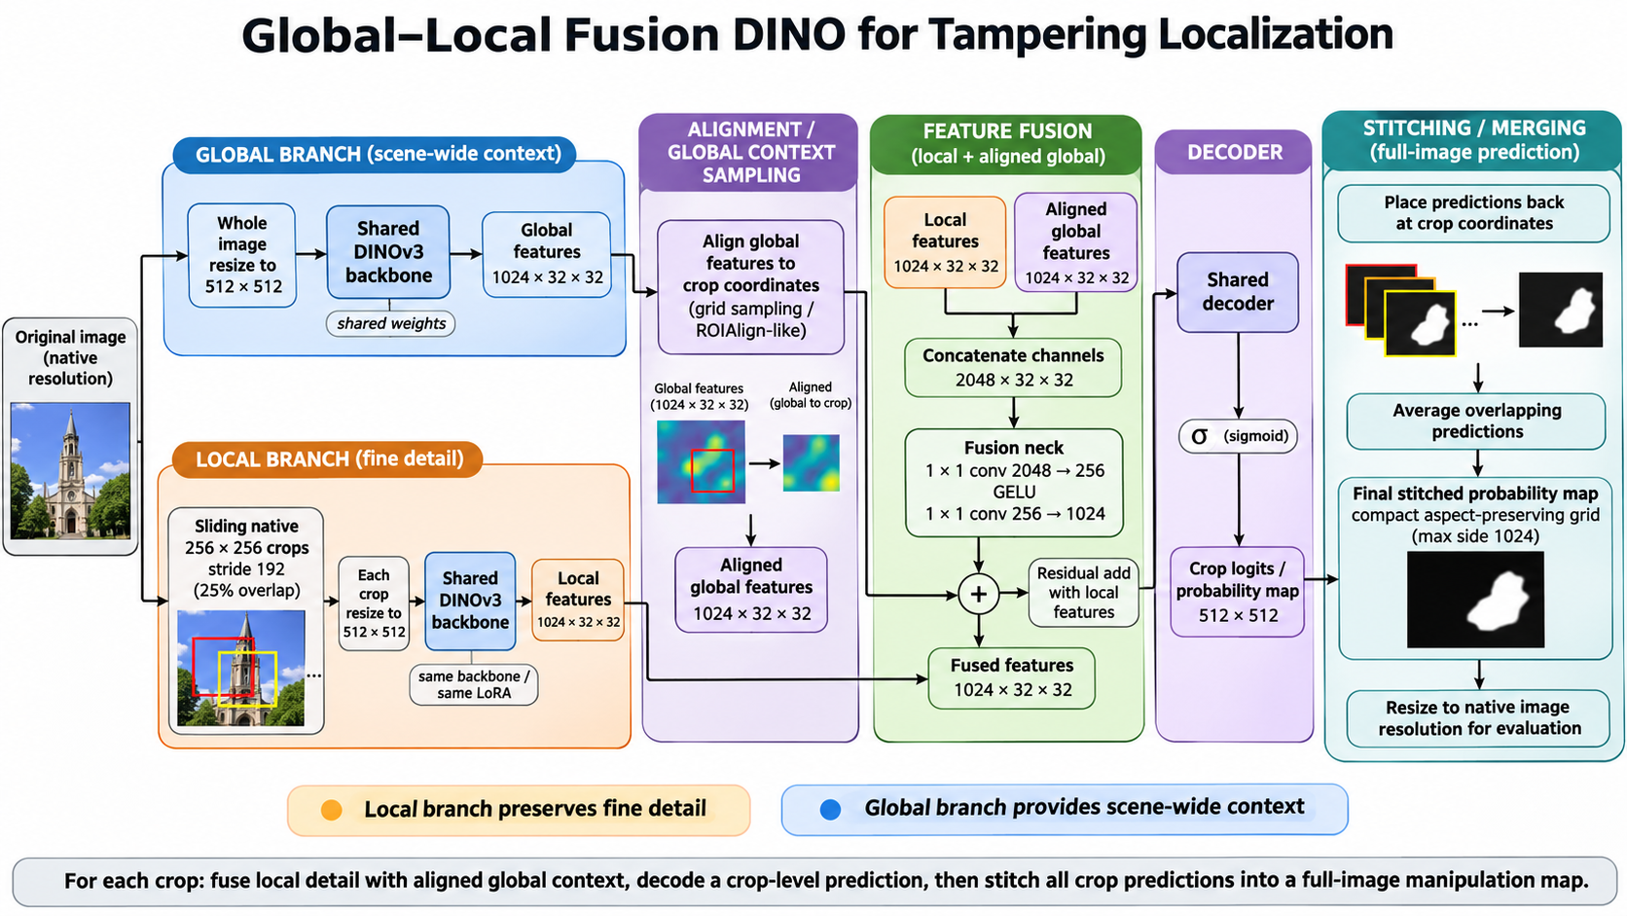
Notes:
The earlier crop experiments either kept an already specialized backbone frozen or combined finished predictions. Here we train fresh LoRA adapters to work with local crops and ask whether whole-image context adds useful information. All six models start from original DINOv3 pretraining, with separate classical, document and generative training pairs.
The global path resizes the whole image to 512 by 512. The local path extracts native 256-by-256 crops and enlarges each crop to 512 before encoding it. Both paths share the same DINOv3 ViT-L/16 backbone and LoRA parameters. The pretrained base stays frozen; LoRA, the fusion neck and the segmentation decoder train. Both views produce a 1,024-channel, 32-by-32 feature map.
Local windows use stride 192, giving 64 pixels or nominal 25% overlap. Final windows anchor to the image boundary, so their overlap can be greater. For example, a 512-pixel image has starts at 0, 192 and 256 along each dimension, giving nine crops. Enlarging a local region allocates more model tokens to it. On prepared 512-pixel DocTamper images it cannot recover missing original scan pixels, because those extra source pixels are not available.
For each local token, native coordinates identify the corresponding location in the whole-image feature map. Bilinear sampling aligns the global features to the crop. We concatenate local and aligned-global maps, apply projections from 2,048 to 256 and then 1,024 channels, and add the result back to the local features. The original decoder predicts crop scores. A matched local-only model uses local features twice in the same neck, keeping its capacity and initialization controlled.
At inference, the global encoding is computed once and crops are processed in batches. Overlapping probabilities are averaged on an aspect-preserving output grid with longest side at most 1,024; the evaluator restores it to native mask geometry. That 1,024 limit is an output convention, not the global input size. Each paired model receives approximately 10,000 attempted update windows with matched source presentations. Source validation selects checkpoints.
Global–local versus local-only tests added context within this design. Comparison with the independently selected long global model changes the complete processing and supervision package. Multiple encoder views also increase inference cost; small same-device benchmarks show roughly 9–18 times lower throughput than global-only, depending on source dimensions and tile counts.
Sources:
https://github.com/ZanMervic/Thesis/blob/72fe247fa55cb10f8d36fcdc6f8e19d5a446835f/Code/experiments/research_global_local_dino_e3_frida/DESIGN.md
https://github.com/ZanMervic/Thesis/blob/72fe247fa55cb10f8d36fcdc6f8e19d5a446835f/Code/experiments/research_global_local_dino_e3_frida/PROVISIONAL_RESULTS.md
Research snapshot: 29 October 2026.

Slide 29
Global context for classical edits
Compare matched crop-trained models and the long-trained whole-image reference on the same output geometry.
Dataset | Long global F1 | Local-only F1 | Local + global F1
CASIA1 | 0.8894 | 0.8692 | 0.8978
Columbia | 0.9161 | 0.4350 | 0.9142
NIST16 | 0.6330 | 0.3784 | 0.6467
COVERAGE | 0.8774 | 0.8535 | 0.8941
IMD2020 | 0.6460 | 0.5934 | 0.6853
Five-set mean | 0.7924 | 0.6259 | 0.8076
Context recovers a large local-only deficit. The complete system gains 1.53 F1 points over long global DINO.
Notes:
The classical results show why the local-only control matters. Crops give a region more spatial representation, but they remove surrounding information. In this experiment the local-only system performs especially poorly on Columbia and NIST16: F1 is approximately 0.435 and 0.378. Adding aligned whole-image features raises them to approximately 0.914 and 0.647. Context appears particularly important within this crop-trained architecture.
Across five classical datasets, mean F1 rises from 0.6259 for local-only to 0.8076 for global–local, an 18.17-percentage-point difference. That is not the gain over our previous whole-image model. The matched longer global baseline is already strong at 0.7924, so the practical complete-system gain is 1.53 points. Columbia remains slightly below the global baseline at the fixed threshold, while IMD2020 improves from 0.6460 to 0.6853. No model improves every dataset uniformly.
The later paired IMD2020 analysis adds useful detail. Against long-global E1, global–local gains approximately 21.26 F1 points for edits below 0.1% of native image area, 12.61 points for edits between 0.1% and 1%, 3.02 points for 1–10%, and 0.98 points for larger edits. This is consistent with local processing helping small regions. However, the smallest group contains only 23 images. These are exploratory system comparisons on already inspected benchmarks, and they do not isolate preserved original detail from crop supervision, denser local representation or fusion.
All table columns use the same image membership and compact output geometry; the global baseline was reevaluated for that purpose. Classical predictions have full recorded saved-map verification. The paired crop models control initialization and source presentations, but only one training seed was used. The global baseline differs in training supervision and checkpoint-selection geometry, so it remains a broader comparator.
The improvement also costs computation. On a small fixed classical source cohort using one B300, global-only processed approximately 34.93 images per second and global–local 3.65, about 9.6 times lower throughput. Those adapter timings exclude loading and metrics. The result supports context within this crop design and an accuracy–cost trade-off, rather than a universal replacement for ordinary global inference.
Sources:
https://github.com/ZanMervic/Thesis/blob/72fe247fa55cb10f8d36fcdc6f8e19d5a446835f/Code/experiments/research_global_local_dino_e3_frida/PROVISIONAL_RESULTS.md
https://github.com/ZanMervic/Thesis/blob/72fe247fa55cb10f8d36fcdc6f8e19d5a446835f/Code/experiments/research_global_local_dino_e3_frida/review_evidence/C1_analysis/imd2020.json
https://github.com/ZanMervic/Thesis/blob/72fe247fa55cb10f8d36fcdc6f8e19d5a446835f/Code/experiments/research_global_local_dino_e3_frida/review_evidence/source_inference_benchmark_b300.json
Research snapshot: 29 October 2026.
Additional descriptive size analysis on IMD2020: global-local minus long global mean F1 was +0.212627 for edits below 0.1% (23 images), +0.126094 for 0.1–1% (259), +0.030203 for 1–10% (1,202), and +0.009773 for at least 10% (526). This compares complete systems and does not isolate global fusion. The small first stratum and repeated test exploration limit inference. Source: https://github.com/ZanMervic/Thesis/blob/72fe247fa55cb10f8d36fcdc6f8e19d5a446835f/Code/experiments/research_global_local_dino_e3_frida/review_evidence/C1_analysis/imd2020.json

Slide 30
Crop-trained DINO on documents
Train both crop-based models only on DocTamper. Compare native crops alone with crops plus whole-page features.
Dataset | Long global F1 | Local-only F1 | Local + global F1
DocTamper Test | 0.8047 | 0.9155 | 0.9135
FCD | 0.6326 | 0.6587 | 0.6793
SCD | 0.7385 | 0.8752 | 0.8764
RTM | 0.0703 | 0.1120 | 0.1101
Crops account for most of the gain. Whole-page context has mixed effects.
RTM improves to about 0.11 F1 and remains difficult.
Notes:
Both crop-trained document models use only DocTamper training data. RTM remains a cross-source test here, unlike the separate RTM-only and mixed-data training experiment. The document predictions and saved-map replay are complete in the committed record.
The improvement over the longer whole-image reference is substantial on the synthetic-document datasets. Local-only reaches 0.9155 F1 on DocTamper Test and 0.8752 on SCD, compared with 0.8047 and 0.7385 for global-only. Global–local is very similar, at 0.9135 and 0.8764. These results show the usefulness of the crop-processing package, which changes local scale, spatial representation, sampled supervision and inference. They cannot identify one of those changes as the sole cause.
A particularly important point is that prepared DocTamper images are already 512 by 512. Extracting a 256-pixel region and enlarging it does not reveal hidden original scan pixels. It gives that existing region more input positions and more DINO tokens. This agrees with the detail-removal experiment, where a larger model grid helped even after extra original detail had been removed.
The cleanest context comparison is global–local versus local-only. Adding the whole page slightly reduces F1 on Test and RTM, barely changes SCD, and raises FCD from 0.6587 to 0.6793. FCD AP, however, falls from 0.7923 to 0.7659. Test AP also slightly decreases, and RTM AP falls from 0.1526 to 0.1457. Therefore the global branch does not add a consistent document benefit, even though both crop systems beat the global reference.
RTM remains weak at approximately 0.11 F1. Global context also increases average authentic RTM positive area by 0.3571 percentage points relative to local-only. That is an area statistic, not an alert-rate change. The separately trained DocTamper–RTM mixture reaches higher RTM F1, but it explicitly uses RTM supervision and cannot be treated as a zero-shot competitor.
The small same-B300 document benchmark measured approximately 35.47 images per second for global-only versus 3.92 for global–local, roughly nine times lower throughput. It excludes I/O and metrics. For documents, the result motivates considering local-only as a simpler crop-system option, while retaining the unresolved realistic-document transfer and computational-cost limitations. There is no combined document mean.
Sources:
https://github.com/ZanMervic/Thesis/blob/72fe247fa55cb10f8d36fcdc6f8e19d5a446835f/Code/experiments/research_global_local_dino_e3_frida/PROVISIONAL_RESULTS.md
https://github.com/ZanMervic/Thesis/blob/72fe247fa55cb10f8d36fcdc6f8e19d5a446835f/Code/experiments/research_global_local_dino_e3_frida/review_evidence/D1_primary_paired_comparison.json
https://github.com/ZanMervic/Thesis/blob/72fe247fa55cb10f8d36fcdc6f8e19d5a446835f/Code/experiments/research_global_local_dino_e3_frida/review_evidence/source_inference_benchmark_b300.json
Research snapshot: 29 October 2026.

Slide 31
Global and local views for AI-assisted edits
Pixel F1. Global + local results are provisional: sampled replay, full check pending.
Dataset | Long global | Local only | Local + global provisional
SD1.5 | 0.8842 | 0.8878 | 0.9123
SD2.1 | 0.8427 | 0.8382 | 0.8787
SDXL | 0.6864 | 0.6791 | 0.7512
SD3 | 0.7903 | 0.7614 | 0.8442
FLUX | 0.3225 | 0.2628 | 0.3732
OpenSDI mean | 0.7052 | 0.6859 | 0.7519
CocoGlide | 0.8039 | 0.7093 | 0.8330
AutoSplice | 0.4430 | 0.4637 | 0.4488
OpenSDI mean rises by 4.67 F1 points over long global DINO.
AutoSplice AP falls from 0.8123 to 0.7557.
Notes:
The generative global–local evaluation now has complete predictions and summary metrics, so we can show the result. Its verification status remains provisional: all 81,918 records were reconciled for IDs, labels and reporting, and a deterministic sample of 100 saved maps passed native-mask metric replay. Exhaustive replay of every global–local map and the remaining generative geometry analysis were explicitly deferred. The local-only arm and matched long-global controls retain their full recorded verification. This qualification applies to every global–local number on this slide, including CocoGlide and AutoSplice.
The main result is encouraging. Across the five OpenSDI generator groups, mean F1 rises from 0.7052 for the longer global model to 0.7519 for global–local, a 4.67-percentage-point system gain. Against the matched local-only model at 0.6859, the gain is 6.60 points. Adding global context improves all five generator groups and CocoGlide. This suggests that local magnification and global information complement each other under the tested training distribution.
FLUX improves from 0.3225 to 0.3732 against the long-global model, but remains much weaker than SD1.5 at 0.9123. CocoGlide improves to 0.8330. AutoSplice is an exception: global–local reaches 0.4488 F1, slightly above the global baseline's 0.4430 but below local-only at 0.4637. Its AP falls from 0.8123 for global to 0.7557 for global–local. A higher aggregate does not imply uniformly stronger editor transfer.
Authentic images add another qualification. Global context increases positive area compared with local-only across all seven groups. On AutoSplice it rises from approximately 0.85% to 2.59%. Compared with the global baseline, however, global–local reduces positive area across the five OpenSDI groups. The conclusion therefore depends on the comparator, and none of these areas is an image-level alert rate.
The additional inference is costly: a small same-B300 source benchmark measured about 34.58 images per second for global and 1.94 for global–local, roughly 17.8 times lower throughput. This excludes image loading, metrics and model loading. The experiment uses one paired seed and previously explored benchmarks; it supports a promising system result, not a universal architecture or unseen-editor guarantee.
Sources:
https://github.com/ZanMervic/Thesis/blob/72fe247fa55cb10f8d36fcdc6f8e19d5a446835f/Code/experiments/research_global_local_dino_e3_frida/PROVISIONAL_RESULTS.md
https://github.com/ZanMervic/Thesis/blob/72fe247fa55cb10f8d36fcdc6f8e19d5a446835f/Code/experiments/research_global_local_dino_e3_frida/review_evidence/source_inference_benchmark_b300.json
Research snapshot: 29 October 2026. Generative global–local results provisional.

Slide 32
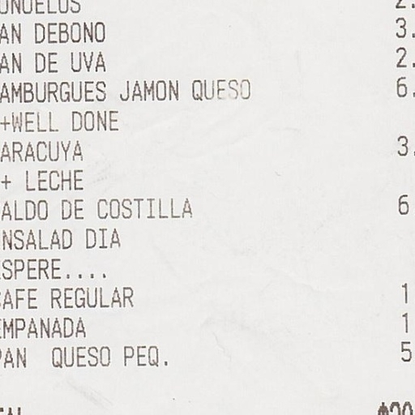
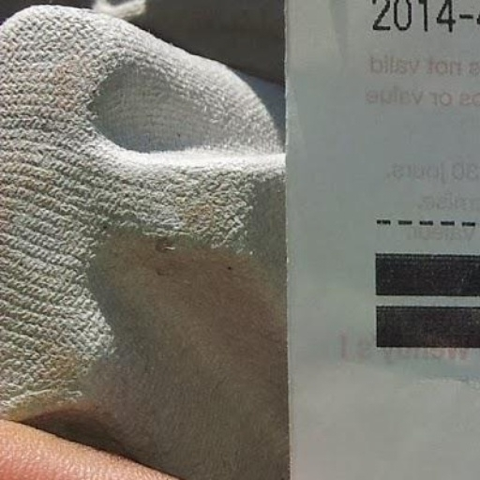
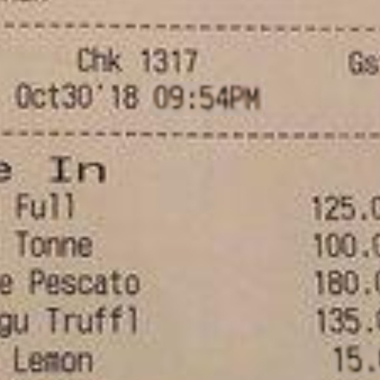


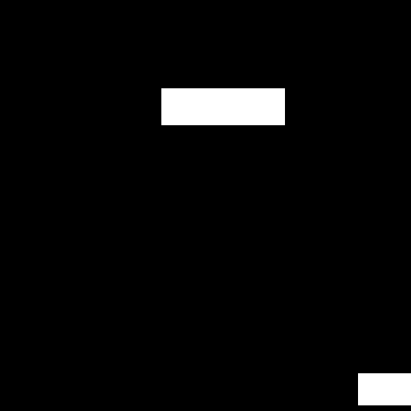
DocTamper Test examples
Synthetic text edits: copy-move, splicing and rendered text replacement.
Edited test images: 512 × 512 px
Images above, ground-truth masks below. White marks edited pixels.
1: 0.19% edited
2: 0.084% edited
3: 3.71% edited
Notes:
These are the actual supplied DocTamper Test test examples, selected with seed 43. Three manipulated images are shown, plus a separate authentic control when one was exported. The authentic image is not claimed to be the original version of any edited image.
Synthetic text edits: copy-move, splicing and rendered text replacement. The size range on the slide comes from the complete accepted manipulated-test manifest, not the three examples. Width and height extrema can come from different images. Native image dimensions are shown on the slide.
In each column, the upper picture is the loader-decoded RGB image and the lower picture is its accepted binary ground-truth mask. All images and masks are 512 × 512 natively; the masks are displayed smaller to make document text easier to inspect. White means edited, black means unedited. These are annotations, not model predictions. No scores or predictions were used for selection. Pictures preserve their aspect ratios.
Native PNGs are lossless exports of decoded RGB, not the original encoded file bytes. Full examples remain visible; there is no evidence crop on this overview slide. The appendix illustrates appearance and label conventions; a few random examples cannot establish why one model generalizes poorly.
Dataset edition: Official DocTamperV1 DocTamperV1-TestingSet
Accepted test population: {"authentic":0,"manipulated":30000}. Sample source: https://github.com/qcf-568/DocTamper
Export provenance: dataset_examples_seed43, seed 43; base code commit 75f077cb4a745fbe61871ab99f3fdd494e0486c0. Group manifest SHA-256: 64c62d3d0831fb42d5112810d3194e3814b052869fdcad45b9849f09d516c21a.
All supplied payloads and masks passed the export integrity checks. OpenSDI full upstream shard-byte hashes remain unverified; this does not change which selected image and mask bytes are displayed.
Examples in reading order:
1. manipulated; doctamper__TestingSet__000013223; 512 × 512 px; edited area 0.185776%; source references {"image":"DocTamperV1-TestingSet/images/image-000013223.jpg","mask":"DocTamperV1-TestingSet/masks/label-000013223.png"}; RGB SHA-256 5c864311d714dbb129d2924d768164cc2ff39dd637af278476d8c0853eb18716; mask convention: grayscale GT; every nonzero pixel is manipulated; prepared binary mask interpreted by IMDLDataset Pillow L >127
2. manipulated; doctamper__TestingSet__000005262; 512 × 512 px; edited area 0.084305%; source references {"image":"DocTamperV1-TestingSet/images/image-000005262.jpg","mask":"DocTamperV1-TestingSet/masks/label-000005262.png"}; RGB SHA-256 30fd884aa3d85cb6312f174a060c53faaf52aa3ec3300f5fdc4a530ccd05d00a; mask convention: grayscale GT; every nonzero pixel is manipulated; prepared binary mask interpreted by IMDLDataset Pillow L >127
3. manipulated; doctamper__TestingSet__000014964; 512 × 512 px; edited area 3.709412%; source references {"image":"DocTamperV1-TestingSet/images/image-000014964.jpg","mask":"DocTamperV1-TestingSet/masks/label-000014964.png"}; RGB SHA-256 ed05a3e72a7201854ccf069257f4da9ab291eb0cac2c11467046200a6f35f359; mask convention: grayscale GT; every nonzero pixel is manipulated; prepared binary mask interpreted by IMDLDataset Pillow L >127

Slide 33
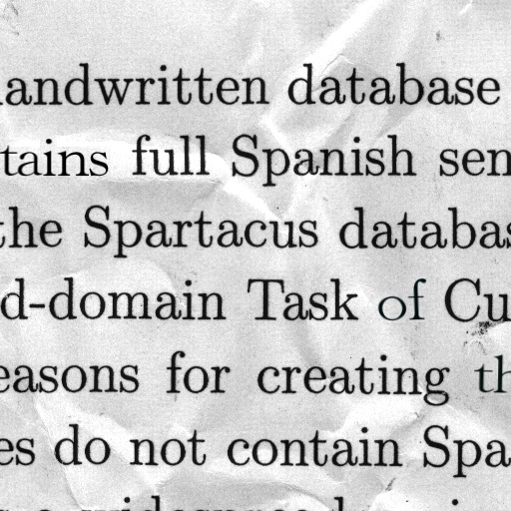
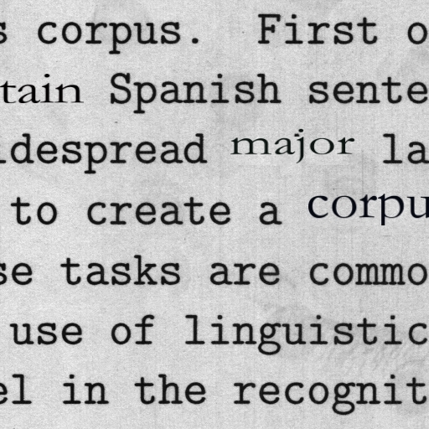
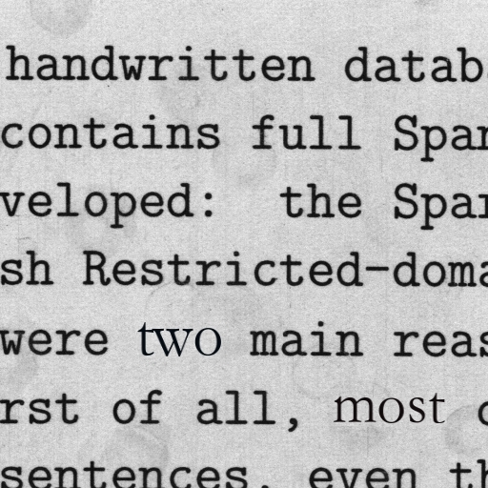
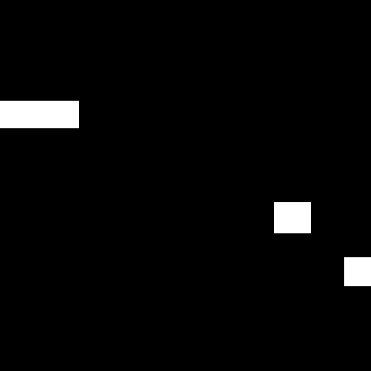
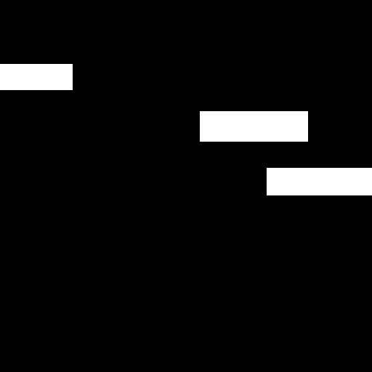
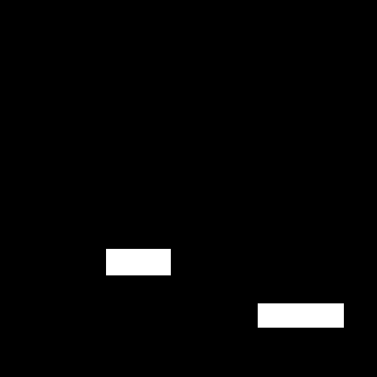
DocTamper FCD examples
Synthetic text edits on a different document-source collection.
Edited test images: 512 × 512 px
Images above, ground-truth masks below. White marks edited pixels.
1: 2.98% edited
2: 5.86% edited
3: 2.68% edited
Notes:
These are the actual supplied DocTamper FCD test examples, selected with seed 43. Three manipulated images are shown, plus a separate authentic control when one was exported. The authentic image is not claimed to be the original version of any edited image.
Synthetic text edits on a different document-source collection. The size range on the slide comes from the complete accepted manipulated-test manifest, not the three examples. Width and height extrema can come from different images. Native image dimensions are shown on the slide.
In each column, the upper picture is the loader-decoded RGB image and the lower picture is its accepted binary ground-truth mask. All images and masks are 512 × 512 natively; the masks are displayed smaller to make document text easier to inspect. White means edited, black means unedited. These are annotations, not model predictions. No scores or predictions were used for selection. Pictures preserve their aspect ratios.
Native PNGs are lossless exports of decoded RGB, not the original encoded file bytes. Full examples remain visible; there is no evidence crop on this overview slide. The appendix illustrates appearance and label conventions; a few random examples cannot establish why one model generalizes poorly.
Dataset edition: Official DocTamperV1 DocTamperV1-FCD
Accepted test population: {"authentic":0,"manipulated":2000}. Sample source: https://github.com/qcf-568/DocTamper
Export provenance: dataset_examples_seed43, seed 43; base code commit 75f077cb4a745fbe61871ab99f3fdd494e0486c0. Group manifest SHA-256: 43e709199bc173dd5976e4a8c66b9b9162405dcab5a4573c5edad35625a4a93d.
All supplied payloads and masks passed the export integrity checks. OpenSDI full upstream shard-byte hashes remain unverified; this does not change which selected image and mask bytes are displayed.
Examples in reading order:
1. manipulated; doctamper__FCD__000000972; 512 × 512 px; edited area 2.981186%; source references {"image":"DocTamperV1-FCD/images/image-000000972.jpg","mask":"DocTamperV1-FCD/masks/label-000000972.png"}; RGB SHA-256 d469ae9bb8b0d495438b8ff8ac23d8772e0b79c245a4ea2992d41c9ba8dc0879; mask convention: grayscale GT; every nonzero pixel is manipulated; prepared binary mask interpreted by IMDLDataset Pillow L >127
2. manipulated; doctamper__FCD__000001871; 512 × 512 px; edited area 5.862427%; source references {"image":"DocTamperV1-FCD/images/image-000001871.jpg","mask":"DocTamperV1-FCD/masks/label-000001871.png"}; RGB SHA-256 a267d16682fe311389b80215bfcd93071a12be349645e916e74884fdd02147c3; mask convention: grayscale GT; every nonzero pixel is manipulated; prepared binary mask interpreted by IMDLDataset Pillow L >127
3. manipulated; doctamper__FCD__000000238; 512 × 512 px; edited area 2.681351%; source references {"image":"DocTamperV1-FCD/images/image-000000238.jpg","mask":"DocTamperV1-FCD/masks/label-000000238.png"}; RGB SHA-256 7e8330e203727ce8453b5385fc8da0701971ca0ead83d4d6278f139f33ab8e97; mask convention: grayscale GT; every nonzero pixel is manipulated; prepared binary mask interpreted by IMDLDataset Pillow L >127

Slide 34
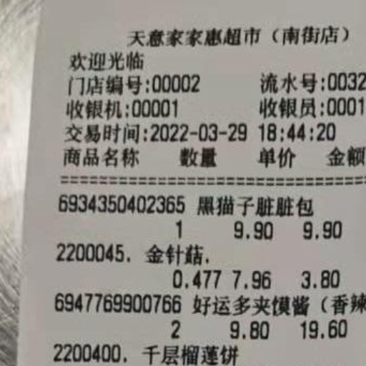
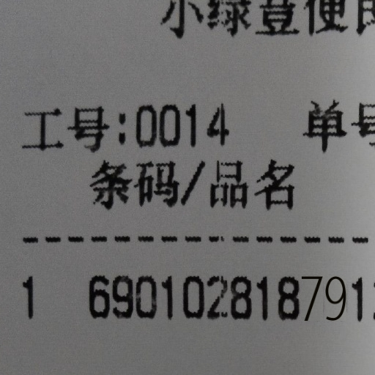
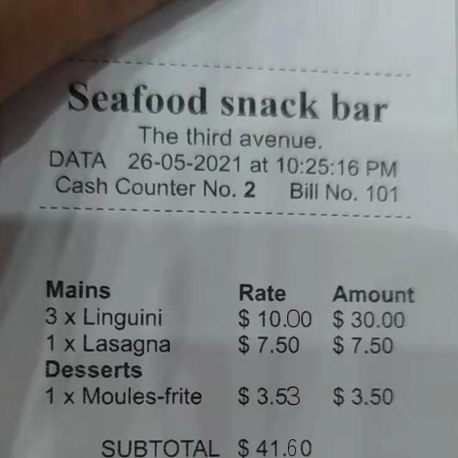


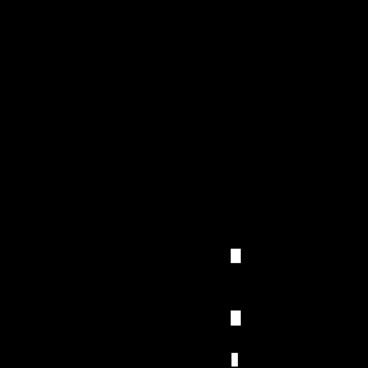
DocTamper SCD examples
Synthetic text edits on a second document-source collection.
Edited test images: 512 × 512 px
Images above, ground-truth masks below. White marks edited pixels.
1: 0.077% edited
2: 1.37% edited
3: 0.28% edited
Notes:
These are the actual supplied DocTamper SCD test examples, selected with seed 43. Three manipulated images are shown, plus a separate authentic control when one was exported. The authentic image is not claimed to be the original version of any edited image.
Synthetic text edits on a second document-source collection. The size range on the slide comes from the complete accepted manipulated-test manifest, not the three examples. Width and height extrema can come from different images. Native image dimensions are shown on the slide.
In each column, the upper picture is the loader-decoded RGB image and the lower picture is its accepted binary ground-truth mask. All images and masks are 512 × 512 natively; the masks are displayed smaller to make document text easier to inspect. White means edited, black means unedited. These are annotations, not model predictions. No scores or predictions were used for selection. Pictures preserve their aspect ratios.
Native PNGs are lossless exports of decoded RGB, not the original encoded file bytes. Full examples remain visible; there is no evidence crop on this overview slide. The appendix illustrates appearance and label conventions; a few random examples cannot establish why one model generalizes poorly.
Dataset edition: Official DocTamperV1 DocTamperV1-SCD
Accepted test population: {"authentic":0,"manipulated":18000}. Sample source: https://github.com/qcf-568/DocTamper
Export provenance: dataset_examples_seed43, seed 43; base code commit 75f077cb4a745fbe61871ab99f3fdd494e0486c0. Group manifest SHA-256: 7f63568c5f19a4ad50d59645688df671c6aeef3062f3cbb79ab9e4a94cfa31fa.
All supplied payloads and masks passed the export integrity checks. OpenSDI full upstream shard-byte hashes remain unverified; this does not change which selected image and mask bytes are displayed.
Examples in reading order:
1. manipulated; doctamper__SCD__000006925; 512 × 512 px; edited area 0.077438%; source references {"image":"DocTamperV1-SCD/images/image-000006925.jpg","mask":"DocTamperV1-SCD/masks/label-000006925.png"}; RGB SHA-256 699c89aeba08e5127d6eb0f1cc5b7ba754ed7af7b3e9df5dfbe5024537683fd4; mask convention: grayscale GT; every nonzero pixel is manipulated; prepared binary mask interpreted by IMDLDataset Pillow L >127
2. manipulated; doctamper__SCD__000007887; 512 × 512 px; edited area 1.372910%; source references {"image":"DocTamperV1-SCD/images/image-000007887.jpg","mask":"DocTamperV1-SCD/masks/label-000007887.png"}; RGB SHA-256 51142d8edc95cdddd1183861abedb570e62f878bffd934636a67c45768338e65; mask convention: grayscale GT; every nonzero pixel is manipulated; prepared binary mask interpreted by IMDLDataset Pillow L >127
3. manipulated; doctamper__SCD__000007838; 512 × 512 px; edited area 0.284195%; source references {"image":"DocTamperV1-SCD/images/image-000007838.jpg","mask":"DocTamperV1-SCD/masks/label-000007838.png"}; RGB SHA-256 dea2fc35f907ccef5e0ba3b8d72264eaee54d32dfe4a0fb21ab94a58e38ba1f9; mask convention: grayscale GT; every nonzero pixel is manipulated; prepared binary mask interpreted by IMDLDataset Pillow L >127

Slide 35
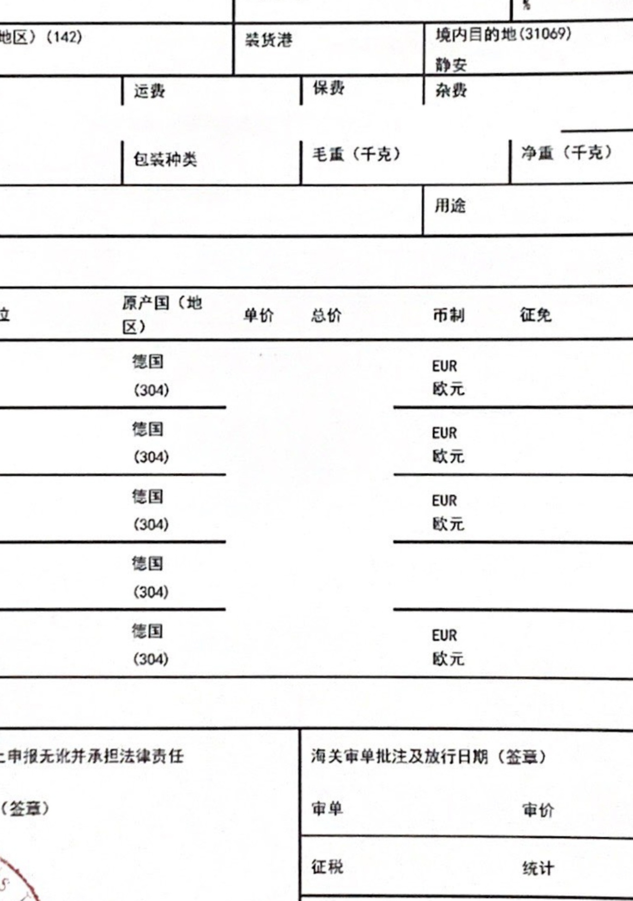

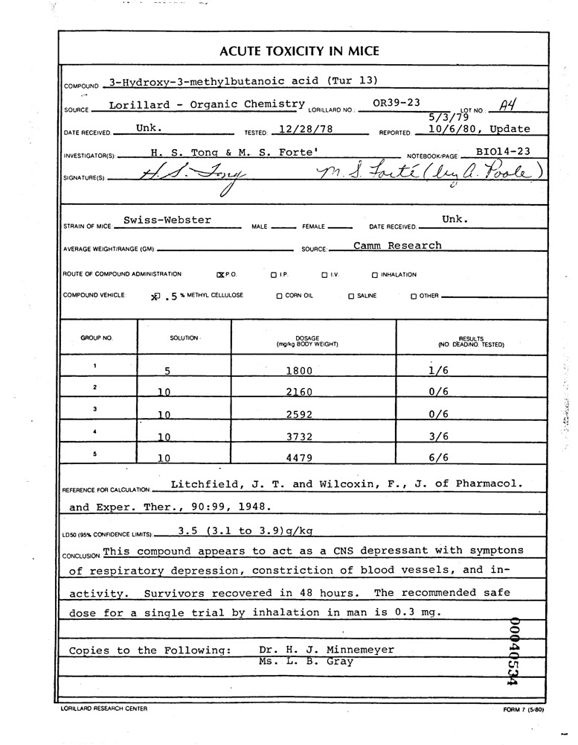
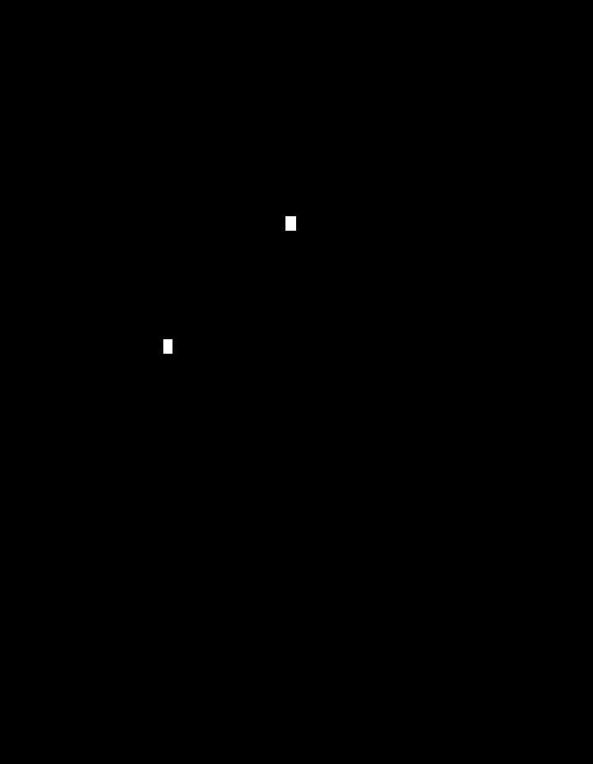
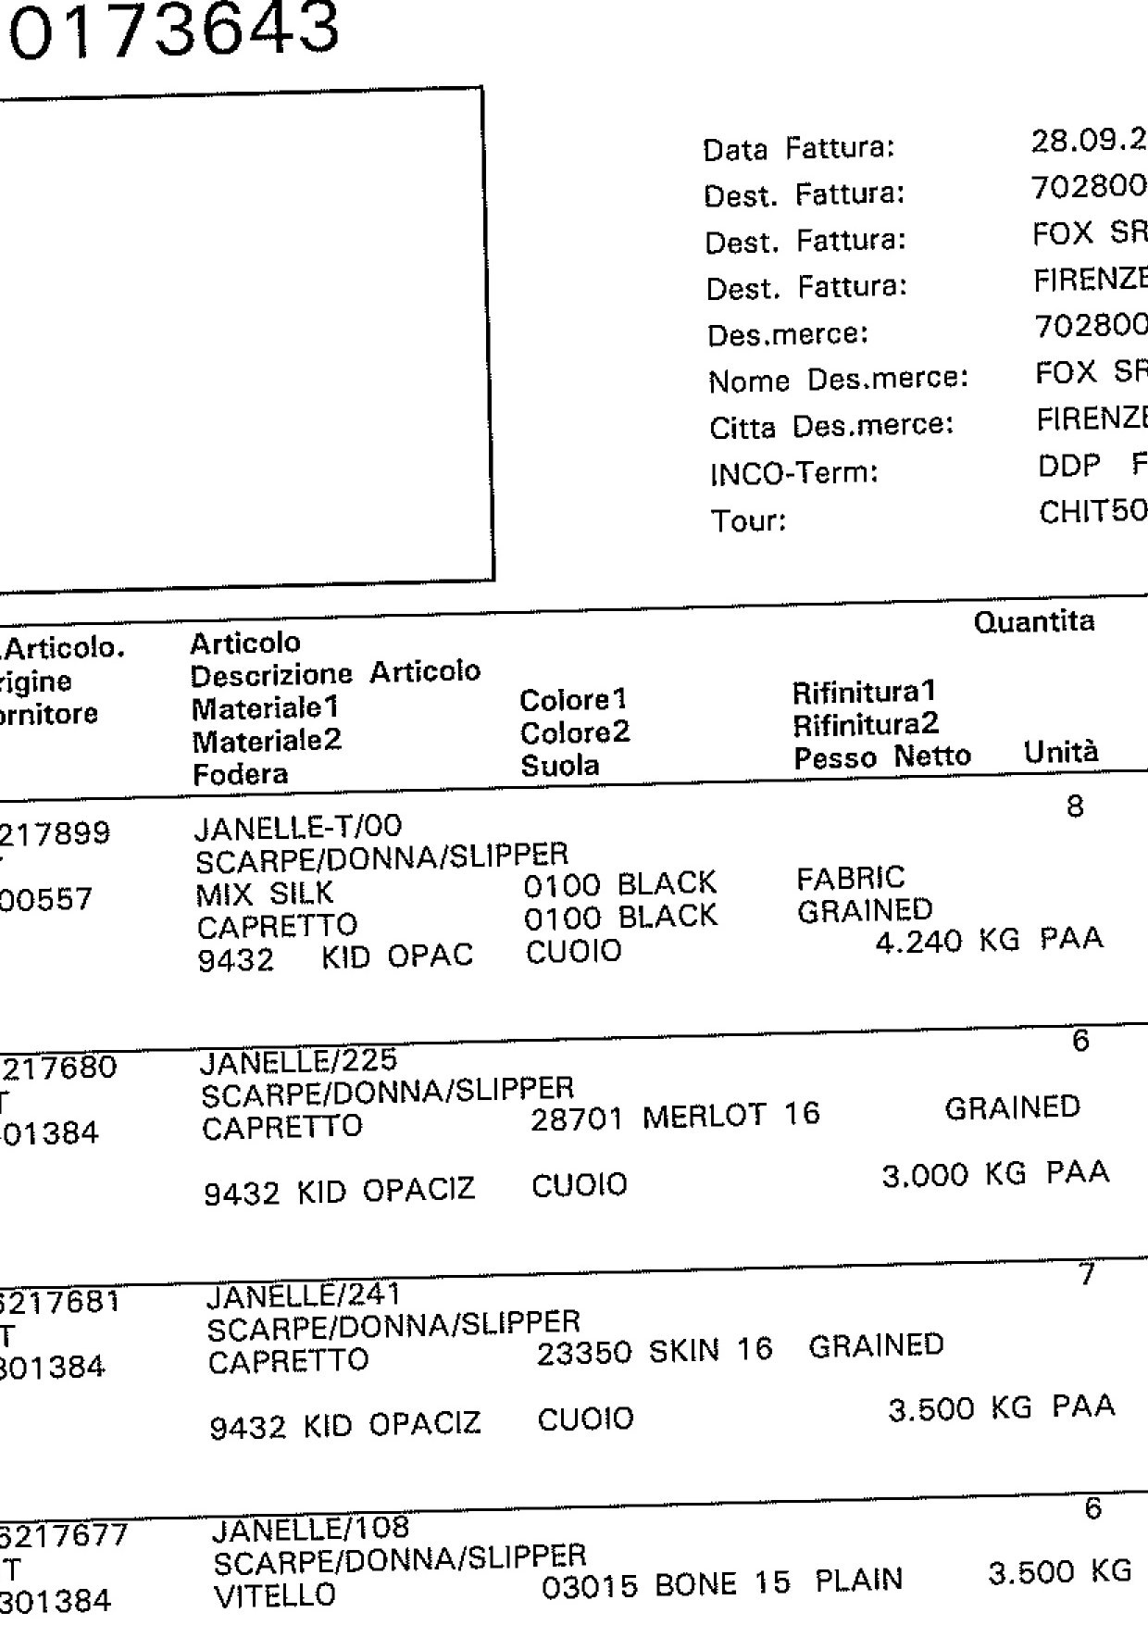

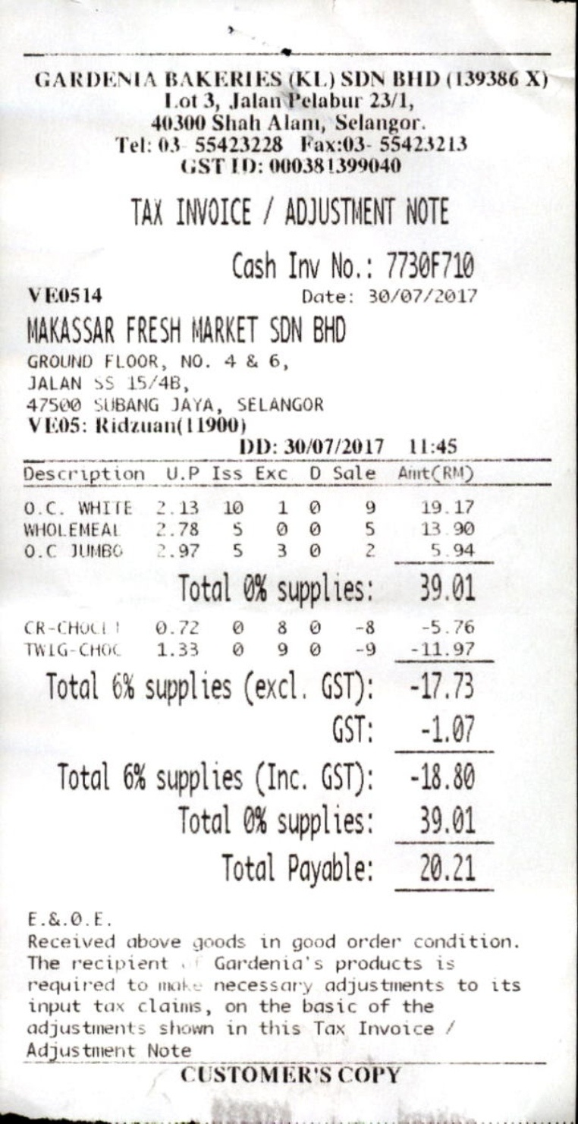


RTM document examples
Manual text manipulation in full document pages.
Edited test images: width 513–1995 px, height 512–1986 px
Image left, ground truth right. White marks edited pixels.
1: 1370 × 1949 px, 0.61% edited
2: 777 × 1000 px, 0.064% edited
3: 1240 × 1755 px, 0.49% edited
Authentic control: 762 × 1481 px
Notes:
These are the actual supplied RTM test examples, selected with seed 43. Three manipulated images are shown, plus a separate authentic control when one was exported. The authentic image is not claimed to be the original version of any edited image.
Manual text manipulation in full document pages. The size range on the slide comes from the complete accepted manipulated-test manifest, not the three examples. Width and height extrema can come from different images. Native image dimensions are shown on the slide.
In every pair, the left picture is the loader-decoded RGB image and the right picture is its accepted binary ground-truth mask. White means edited, black means unedited. These are annotations, not model predictions. No scores or predictions were used for selection. Pictures preserve their aspect ratios.
Native PNGs are lossless exports of decoded RGB, not the original encoded file bytes. Full examples remain visible; there is no evidence crop on this overview slide. The appendix illustrates appearance and label conventions; a few random examples cannot establish why one model generalizes poorly.
Dataset edition: RTM official test.txt; 1203 manipulated / 1994 authentic
Accepted test population: {"authentic":1994,"manipulated":1203}. Sample source: https://github.com/DrLuo/RTM
Export provenance: dataset_examples_seed43, seed 43; base code commit 75f077cb4a745fbe61871ab99f3fdd494e0486c0. Group manifest SHA-256: 3e831ca0e50cc9c9bd3a9dd285f91ea1f0dc99a2516dea37c95b3e64e11eea05.
All supplied payloads and masks passed the export integrity checks. OpenSDI full upstream shard-byte hashes remain unverified; this does not change which selected image and mask bytes are displayed.
Examples in reading order:
1. manipulated; rtm__cover_0940; 1370 × 1949 px; edited area 0.606038%; source references {"image":"JPEGImages/cover_0940.jpg","mask":"SegmentationClass/cover_0940.png"}; RGB SHA-256 c22f26c76b338e552ca61510d78682f0c0bc840829a52e72f29f4c653d76857f; mask convention: binary grayscale; nonzero pixels are manipulated; zero mask is authentic; prepared binary mask interpreted by IMDLDataset Pillow L >127
2. manipulated; rtm__cover_0895; 777 × 1000 px; edited area 0.063578%; source references {"image":"JPEGImages/cover_0895.jpg","mask":"SegmentationClass/cover_0895.png"}; RGB SHA-256 45833e33508f0aef60bd16b6da6ad6303ed7f0c8e754cf242f26bda70861c32f; mask convention: binary grayscale; nonzero pixels are manipulated; zero mask is authentic; prepared binary mask interpreted by IMDLDataset Pillow L >127
3. manipulated; rtm__cpmv_2627; 1240 × 1755 px; edited area 0.492142%; source references {"image":"JPEGImages/cpmv_2627.jpg","mask":"SegmentationClass/cpmv_2627.png"}; RGB SHA-256 7c82b52d6befc73dfd69d302f20b7c3f4ae01b230b33cdb546ba495610fa1629; mask convention: binary grayscale; nonzero pixels are manipulated; zero mask is authentic; prepared binary mask interpreted by IMDLDataset Pillow L >127
4. authentic; rtm__good_2510; 762 × 1481 px; edited area 0.000000%; source references {"image":"JPEGImages/good_2510.jpg","mask":null}; RGB SHA-256 74fc79e17af546846ee74074363294c6da4429628c83a4d07810e829925151a1; mask convention: binary grayscale; nonzero pixels are manipulated; zero mask is authentic; prepared binary mask interpreted by IMDLDataset Pillow L >127

Slide 36
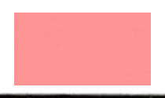
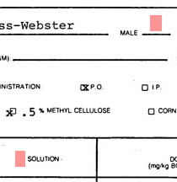

RTM text edits in close-up
The same three edited pages, cropped around their annotations.
Image crops above. Ground-truth overlays below; red marks edited pixels.
Blank field: 0.61% edited
Page 2: 0.064% edited
Page 3: 0.49% edited
Notes:
These are close-ups of the same three randomly selected RTM manipulated examples on the previous slide. Repetition is intentional so the full-page context and actual text edit can both be inspected.
The exporter created these crops from the union of all positive ground-truth components with padding. They are display aids, not a detector, a model prediction or model-selected regions. Each crop includes all annotated components; the second example has multiple separated components. Red pixels in the lower row are the supplied ground-truth overlay.
The percentages describe edited area in the complete native page, not the crop. The crop and its overlay retain their original aspect ratio. Different display magnifications do not imply equal native character sizes.
DocTamper also contains extremely small changes, so these examples do not show that every RTM edit is smaller or harder. The relevant difference is that RTM supplies manually manipulated full pages from a different construction pipeline. The quantitative transfer problem comes from the benchmark results, not from these illustrations.
Page 1: rtm__cover_0940; native 1370 × 1949; crop {"height":125,"width":210}; source crop bounds [873,1195,1083,1320]; native edited fraction 0.006060379082666387; rtm_test__test__manipulated__01__rtm__cover_0_2e15ab3a__union__image.png
Page 2: rtm__cover_0895; native 777 × 1000; crop {"height":216,"width":210}; source crop bounds [196,265,406,481]; native edited fraction 0.0006357786357786358; rtm_test__test__manipulated__02__rtm__cover_0_3b33ddd2__union__image.png
Page 3: rtm__cpmv_2627; native 1240 × 1755; crop {"height":98,"width":208}; source crop bounds [1032,1648,1240,1746]; native edited fraction 0.004921422663358147; rtm_test__test__manipulated__03__rtm__cpmv_26_778b9507__union__image.png
Source: https://github.com/DrLuo/RTM. User-supplied dataset_examples_seed43 export, seed 43, base code 75f077cb4a745fbe61871ab99f3fdd494e0486c0.

Slide 37
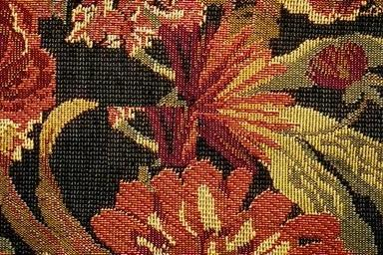

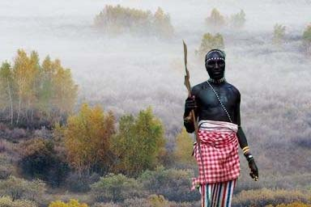
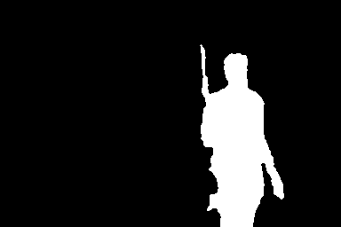
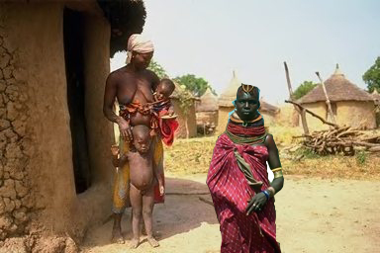
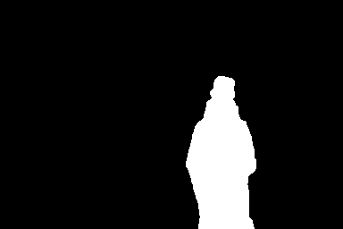
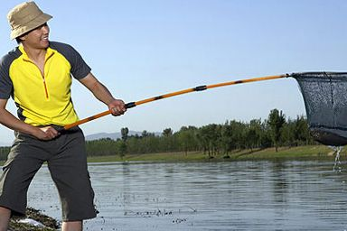

CASIA1 examples
Handcrafted photo splicing and copy-move.
Edited test images: width 256–384 px, height 246–500 px
Image left, ground truth right. White marks edited pixels.
1: 384 × 256 px, 5.49% edited
2: 384 × 256 px, 11.09% edited
3: 384 × 256 px, 9.51% edited
Authentic control: 384 × 256 px
Notes:
These are the actual supplied CASIA1 test examples, selected with seed 43. Three manipulated images are shown, plus a separate authentic control when one was exported. The authentic image is not claimed to be the original version of any edited image.
Handcrafted photo splicing and copy-move. The size range on the slide comes from the complete accepted manipulated-test manifest, not the three examples. Width and height extrema can come from different images. Native image dimensions are shown on the slide.
In every pair, the left picture is the loader-decoded RGB image and the right picture is its accepted binary ground-truth mask. White means edited, black means unedited. These are annotations, not model predictions. No scores or predictions were used for selection. Pictures preserve their aspect ratios.
Native PNGs are lossless exports of decoded RGB, not the original encoded file bytes. Full examples remain visible; there is no evidence crop on this overview slide. The appendix illustrates appearance and label conventions; a few random examples cannot establish why one model generalizes poorly.
Dataset edition: Corrected modified Tp images and Pham native GT; 920 M / 800 A; known unannotated sample excluded
Accepted test population: {"authentic":800,"manipulated":920}. Sample source: https://github.com/namtpham/casia1groundtruth
Export provenance: dataset_examples_seed43, seed 43; base code commit 75f077cb4a745fbe61871ab99f3fdd494e0486c0. Group manifest SHA-256: 51589698a652623742707c1e1ef1095e02756377c249f3aa1bc9d6f3d7e5d85e.
All supplied payloads and masks passed the export integrity checks. OpenSDI full upstream shard-byte hashes remain unverified; this does not change which selected image and mask bytes are displayed.
Examples in reading order:
1. manipulated; Tp__CM__Sp_S_NNN_R_txt0074_txt0074_0074; 384 × 256 px; edited area 5.493164%; source references {"image":"Tp/CM/Sp_S_NNN_R_txt0074_txt0074_0074.jpg","mask":"CASIA 1.0 groundtruth/CM/Sp_S_NNN_R_txt0074_txt0074_0074_gt.png"}; RGB SHA-256 2df1054f3ef1c2f1a96285f64581d3246d350d742fa6280b1bded6533b390913; mask convention: Separate annotated GT PNG; accepted loader Pillow L >127; authentic label from Au directory
2. manipulated; Tp__Sp__Sp_D_NNN_A_nat0087_cha0016_0331; 384 × 256 px; edited area 11.088053%; source references {"image":"Tp/Sp/Sp_D_NNN_A_nat0087_cha0016_0331.jpg","mask":"CASIA 1.0 groundtruth/Sp/Sp_D_NNN_A_nat0087_cha0016_0331_gt.png"}; RGB SHA-256 7c26218a889a70e3b9a95699afbcd0281b306279e6b0e15d74d9a203fbb0bfac; mask convention: Separate annotated GT PNG; accepted loader Pillow L >127; authentic label from Au directory
3. manipulated; Tp__Sp__Sp_D_NRN_A_cha0011_cha0014_0488; 384 × 256 px; edited area 9.507243%; source references {"image":"Tp/Sp/Sp_D_NRN_A_cha0011_cha0014_0488.jpg","mask":"CASIA 1.0 groundtruth/Sp/Sp_D_NRN_A_cha0011_cha0014_0488_gt.png"}; RGB SHA-256 d41c58b8154698551136fd3e59d566bcf8923e9bdf8500621ece082e850ae11e; mask convention: Separate annotated GT PNG; accepted loader Pillow L >127; authentic label from Au directory
4. authentic; Au__Au_cha_0068; 384 × 256 px; edited area 0.000000%; source references {"image":"Au/Au_cha_0068.jpg","mask":null}; RGB SHA-256 aed759ff26d1cee002e8322b0caeb2698371d35afcbd00fae1ba647702f47f9a; mask convention: Separate annotated GT PNG; accepted loader Pillow L >127; authentic label from Au directory

Slide 38
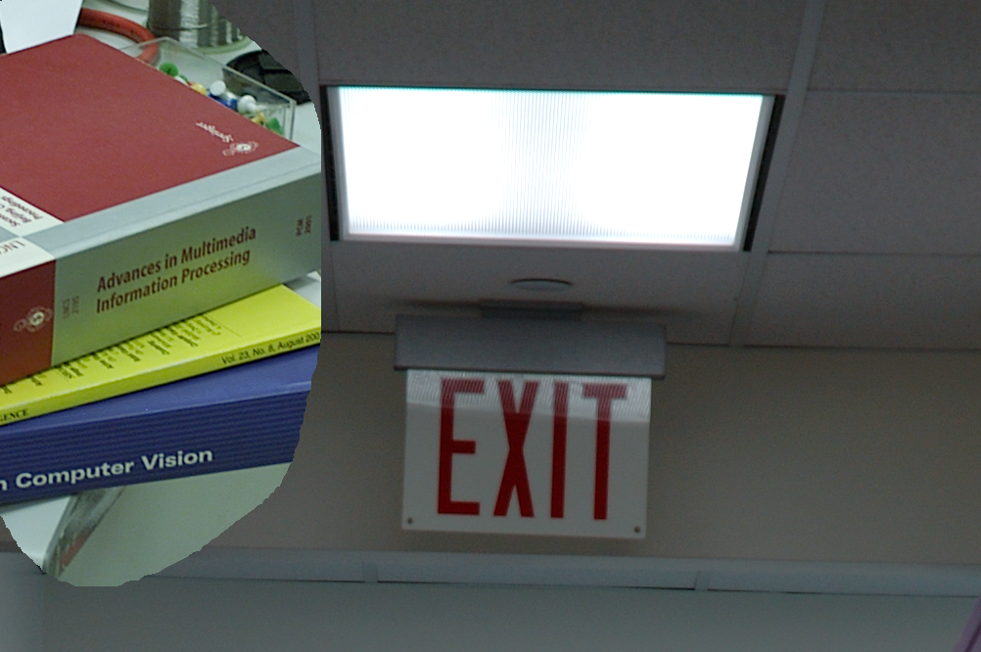

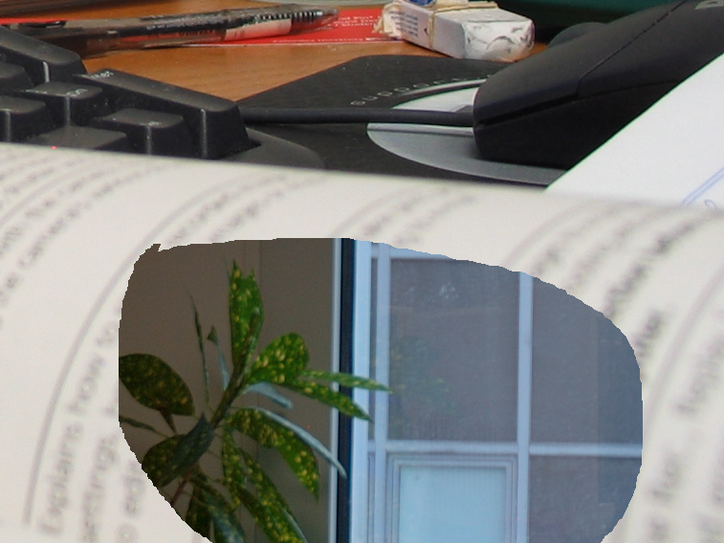
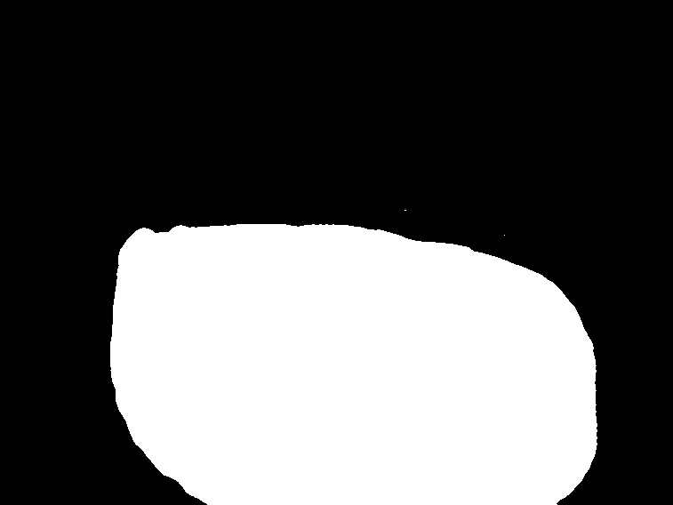
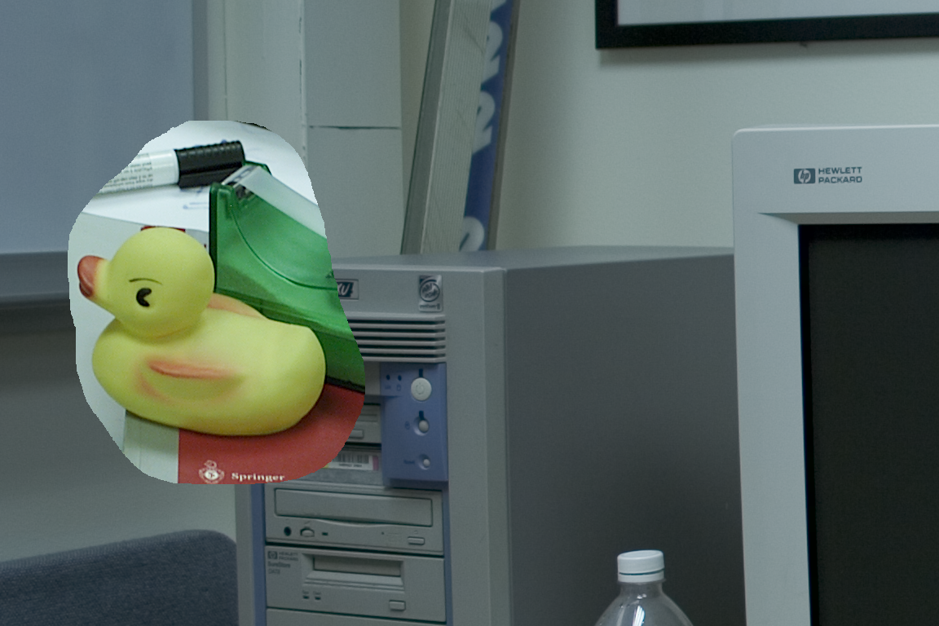
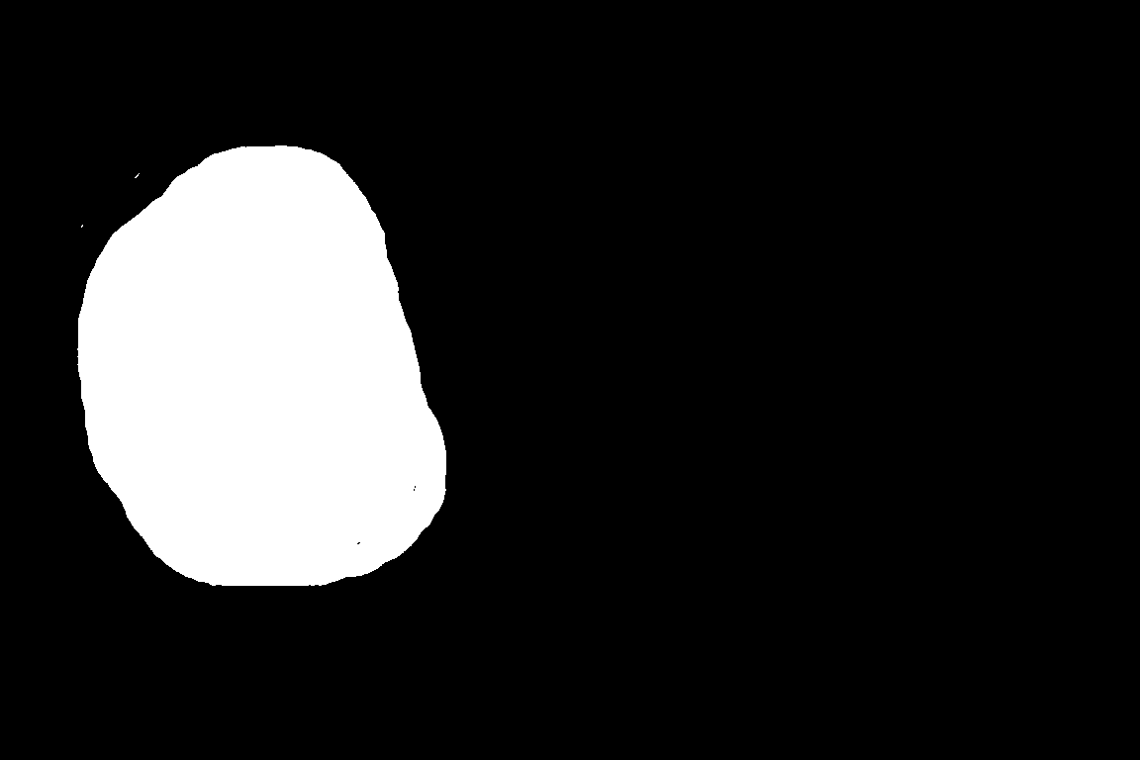
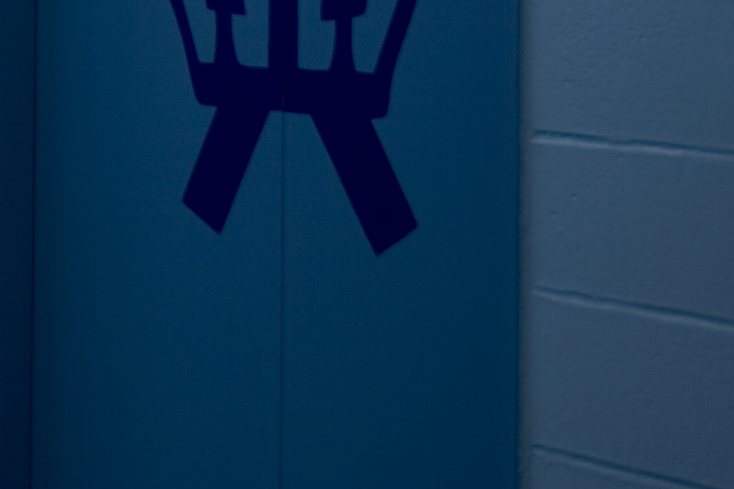

Columbia examples
Controlled photo splicing. Sources from four cameras, originally uncompressed.
Edited test images: width 757–1152 px, height 568–1152 px
Image left, ground truth right. White marks edited pixels.
1: 1002 × 666 px, 26.15% edited
2: 757 × 568 px, 35.73% edited
3: 1152 × 768 px, 14.56% edited
Authentic control: 1152 × 768 px
Notes:
These are the actual supplied Columbia test examples, selected with seed 43. Three manipulated images are shown, plus a separate authentic control when one was exported. The authentic image is not claimed to be the original version of any edited image.
Controlled photo splicing. Sources from four cameras, originally uncompressed. The size range on the slide comes from the complete accepted manipulated-test manifest, not the three examples. Width and height extrema can come from different images. Native image dimensions are shown on the slide.
In every pair, the left picture is the loader-decoded RGB image and the right picture is its accepted binary ground-truth mask. White means edited, black means unedited. These are annotations, not model predictions. No scores or predictions were used for selection. Pictures preserve their aspect ratios.
Native PNGs are lossless exports of decoded RGB, not the original encoded file bytes. Full examples remain visible; there is no evidence crop on this overview slide. The appendix illustrates appearance and label conventions; a few random examples cannot establish why one model generalizes poorly.
Dataset edition: Columbia uncompressed 4cam; 180 spliced / 183 authentic
Accepted test population: {"authentic":183,"manipulated":180}. Sample source: https://www.ee.columbia.edu/ln/dvmm/downloads/authsplcuncmp/
Export provenance: dataset_examples_seed43, seed 43; base code commit 75f077cb4a745fbe61871ab99f3fdd494e0486c0. Group manifest SHA-256: 9a113d408497fdf424a8310d5c53380a63cbfca2d5e7cb6f2aadc6dd9c9b4f1d.
All supplied payloads and masks passed the export integrity checks. OpenSDI full upstream shard-byte hashes remain unverified; this does not change which selected image and mask bytes are displayed.
Examples in reading order:
1. manipulated; 4cam_splc__nikond70_kodakdcs330_sub_23; 1002 × 666 px; edited area 26.152200%; source references {"image":"4cam_splc/nikond70_kodakdcs330_sub_23.tif","mask":"gt/nikond70_kodakdcs330_sub_23_gt.png"}; RGB SHA-256 d873dd81ba3166a4aaebf060b26e67df476ce591ffc77f549e69f086b34dabcd; mask convention: Prepared native GT from *_edgemask.jpg green>red; _edgemask_3 excluded; authentic object edge annotations ignored; loader Pillow L >127
2. manipulated; 4cam_splc__canong3_nikond70_sub_22; 757 × 568 px; edited area 35.731297%; source references {"image":"4cam_splc/canong3_nikond70_sub_22.tif","mask":"gt/canong3_nikond70_sub_22_gt.png"}; RGB SHA-256 aec2d445c7fda6b39284598c01e656b08e71300da74a98f4d4d46fa2c5814f9d; mask convention: Prepared native GT from *_edgemask.jpg green>red; _edgemask_3 excluded; authentic object edge annotations ignored; loader Pillow L >127
3. manipulated; 4cam_splc__canonxt_kodakdcs330_sub_02; 1152 × 768 px; edited area 14.558580%; source references {"image":"4cam_splc/canonxt_kodakdcs330_sub_02.tif","mask":"gt/canonxt_kodakdcs330_sub_02_gt.png"}; RGB SHA-256 2b44fd57128557ac148b6a0ea8950144d859167b94506adcd080e4c9a8af2463; mask convention: Prepared native GT from *_edgemask.jpg green>red; _edgemask_3 excluded; authentic object edge annotations ignored; loader Pillow L >127
4. authentic; 4cam_auth__canonxt_29_sub_09; 1152 × 768 px; edited area 0.000000%; source references {"image":"4cam_auth/canonxt_29_sub_09.tif","mask":null}; RGB SHA-256 0d7e265a7cde77957467f3d0dd1841837736ce619fa7dabd6d9b41c57370f8cb; mask convention: Prepared native GT from *_edgemask.jpg green>red; _edgemask_3 excluded; authentic object edge annotations ignored; loader Pillow L >127

Slide 39
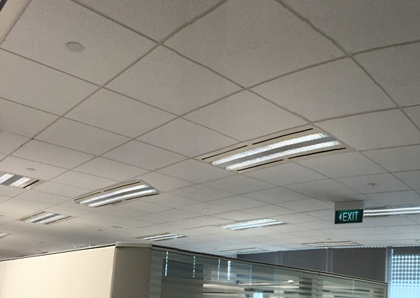

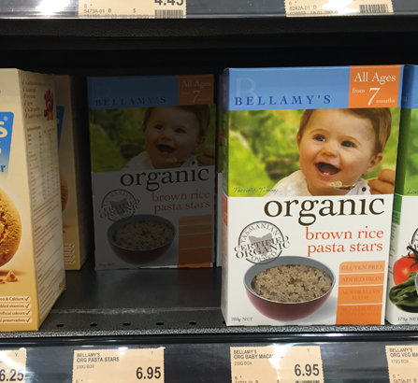

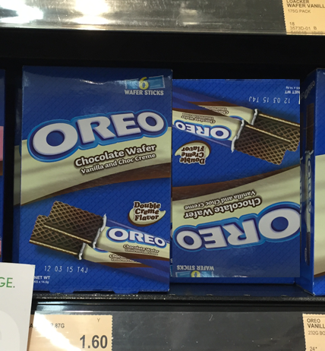

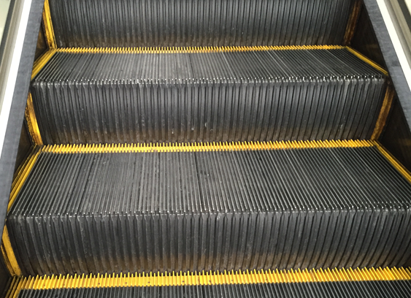

COVERAGE examples
Handcrafted copy-move among visually similar genuine objects.
Edited test images: width 235–752 px, height 158–563 px
Image left, ground truth right. White marks edited pixels.
1: 565 × 401 px, 1.20% edited
2: 447 × 410 px, 14.71% edited
3: 428 × 462 px, 22.18% edited
Authentic control: 563 × 408 px
Notes:
These are the actual supplied COVERAGE test examples, selected with seed 43. Three manipulated images are shown, plus a separate authentic control when one was exported. The authentic image is not claimed to be the original version of any edited image.
Handcrafted copy-move among visually similar genuine objects. The size range on the slide comes from the complete accepted manipulated-test manifest, not the three examples. Width and height extrema can come from different images. Native image dimensions are shown on the slide.
In every pair, the left picture is the loader-decoded RGB image and the right picture is its accepted binary ground-truth mask. White means edited, black means unedited. These are annotations, not model predictions. No scores or predictions were used for selection. Pictures preserve their aspect ratios.
Native PNGs are lossless exports of decoded RGB, not the original encoded file bytes. Full examples remain visible; there is no evidence crop on this overview slide. The appendix illustrates appearance and label conventions; a few random examples cannot establish why one model generalizes poorly.
Dataset edition: 100 manipulated / 100 authentic; nine revised forged-region masks
Accepted test population: {"authentic":100,"manipulated":100}. Sample source: https://github.com/wenbihan/coverage
Export provenance: dataset_examples_seed43, seed 43; base code commit 75f077cb4a745fbe61871ab99f3fdd494e0486c0. Group manifest SHA-256: d22b93082bd09c1cf0bdf87a9b4bcba620c978114bc56025e34307fb19b899ab.
All supplied payloads and masks passed the export integrity checks. OpenSDI full upstream shard-byte hashes remain unverified; this does not change which selected image and mask bytes are displayed.
Examples in reading order:
1. manipulated; image__58t; 565 × 401 px; edited area 1.196125%; source references {"image":"image/58t.tif","mask":"revised_masks/58forged.tif"}; RGB SHA-256 1290273578aa842671f5249201681f6b6759f6ce842b6da7b17ffd3aaa09bfc1; mask convention: Pasted/forged region only; revised_masks/Nforged.tif takes precedence for nine corrections; donor region excluded; Pillow L >127
2. manipulated; image__25t; 447 × 410 px; edited area 14.714356%; source references {"image":"image/25t.tif","mask":"mask/25forged.tif"}; RGB SHA-256 f9e16593fd2137c864bfa3ff78fabfdb8ae1770f7c16a597ec25839c05571d80; mask convention: Pasted/forged region only; revised_masks/Nforged.tif takes precedence for nine corrections; donor region excluded; Pillow L >127
3. manipulated; image__33t; 428 × 462 px; edited area 22.175021%; source references {"image":"image/33t.tif","mask":"mask/33forged.tif"}; RGB SHA-256 f063ab4ab728391ea976123bea56407ca52880c64b053e61b1385a30688bb588; mask convention: Pasted/forged region only; revised_masks/Nforged.tif takes precedence for nine corrections; donor region excluded; Pillow L >127
4. authentic; image__26; 563 × 408 px; edited area 0.000000%; source references {"image":"image/26.tif","mask":null}; RGB SHA-256 7bc1f9b8dbdea76c4fd8f25b31df51a41346aa196db5f9d78139038a6a5d3d16; mask convention: Pasted/forged region only; revised_masks/Nforged.tif takes precedence for nine corrections; donor region excluded; Pillow L >127

Slide 40
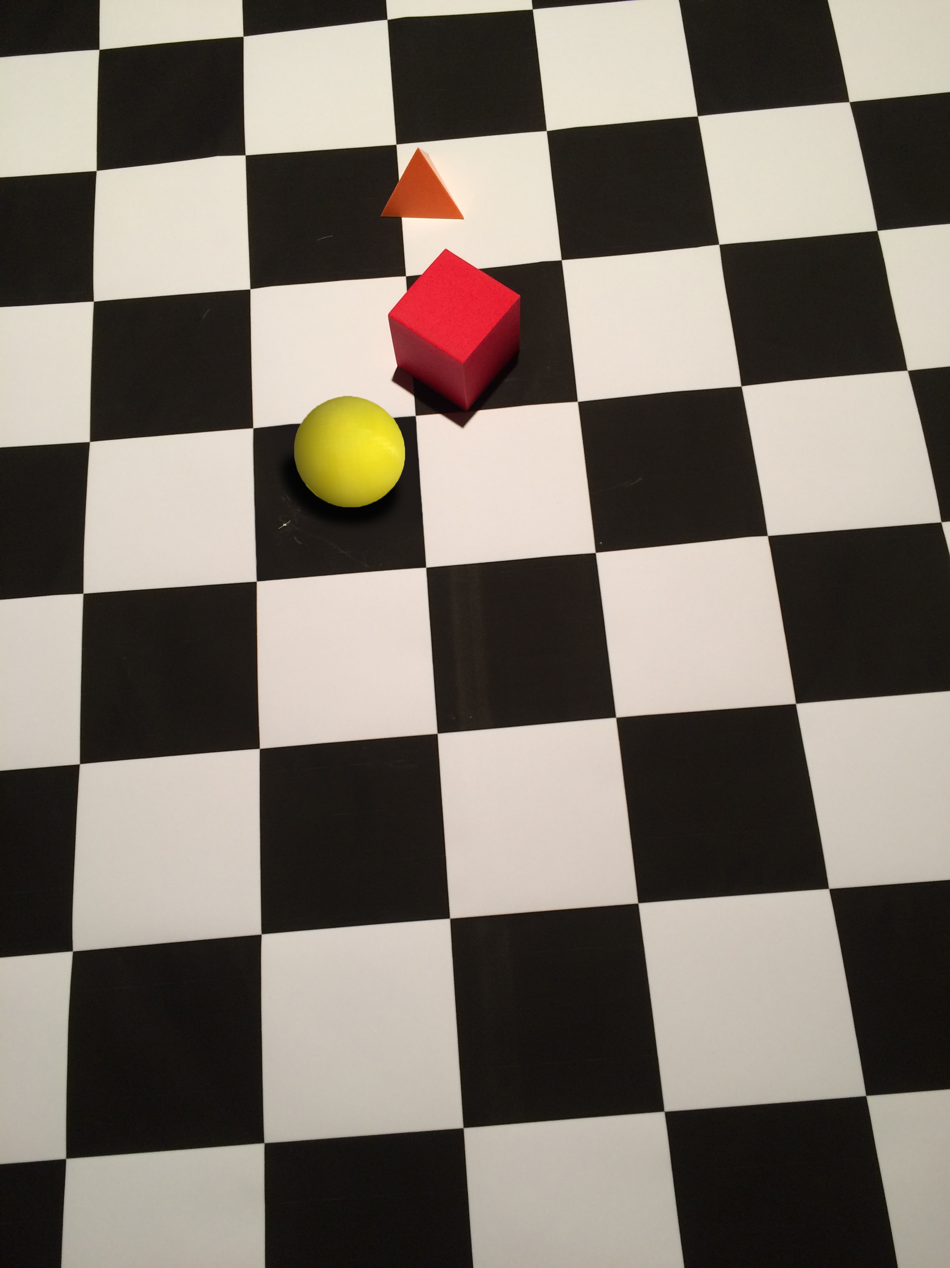

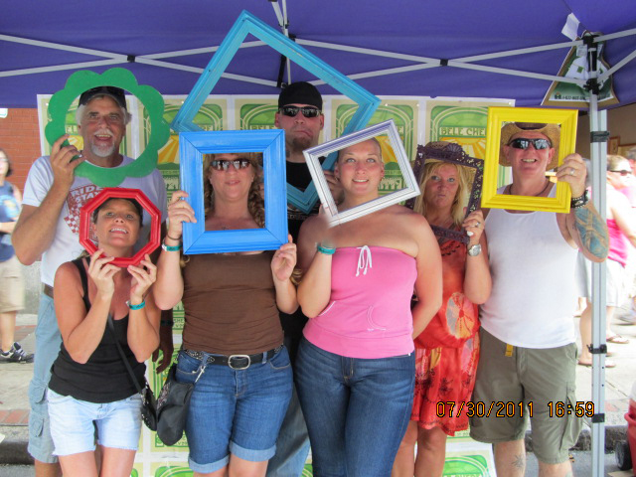
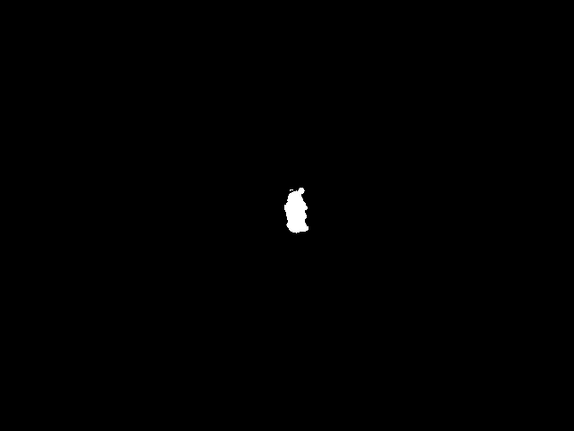
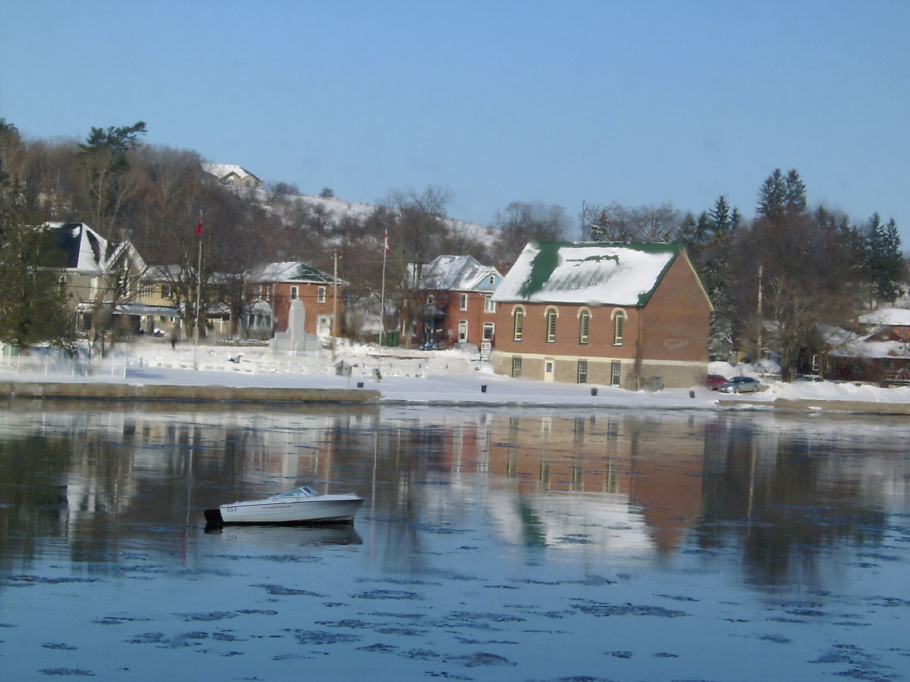
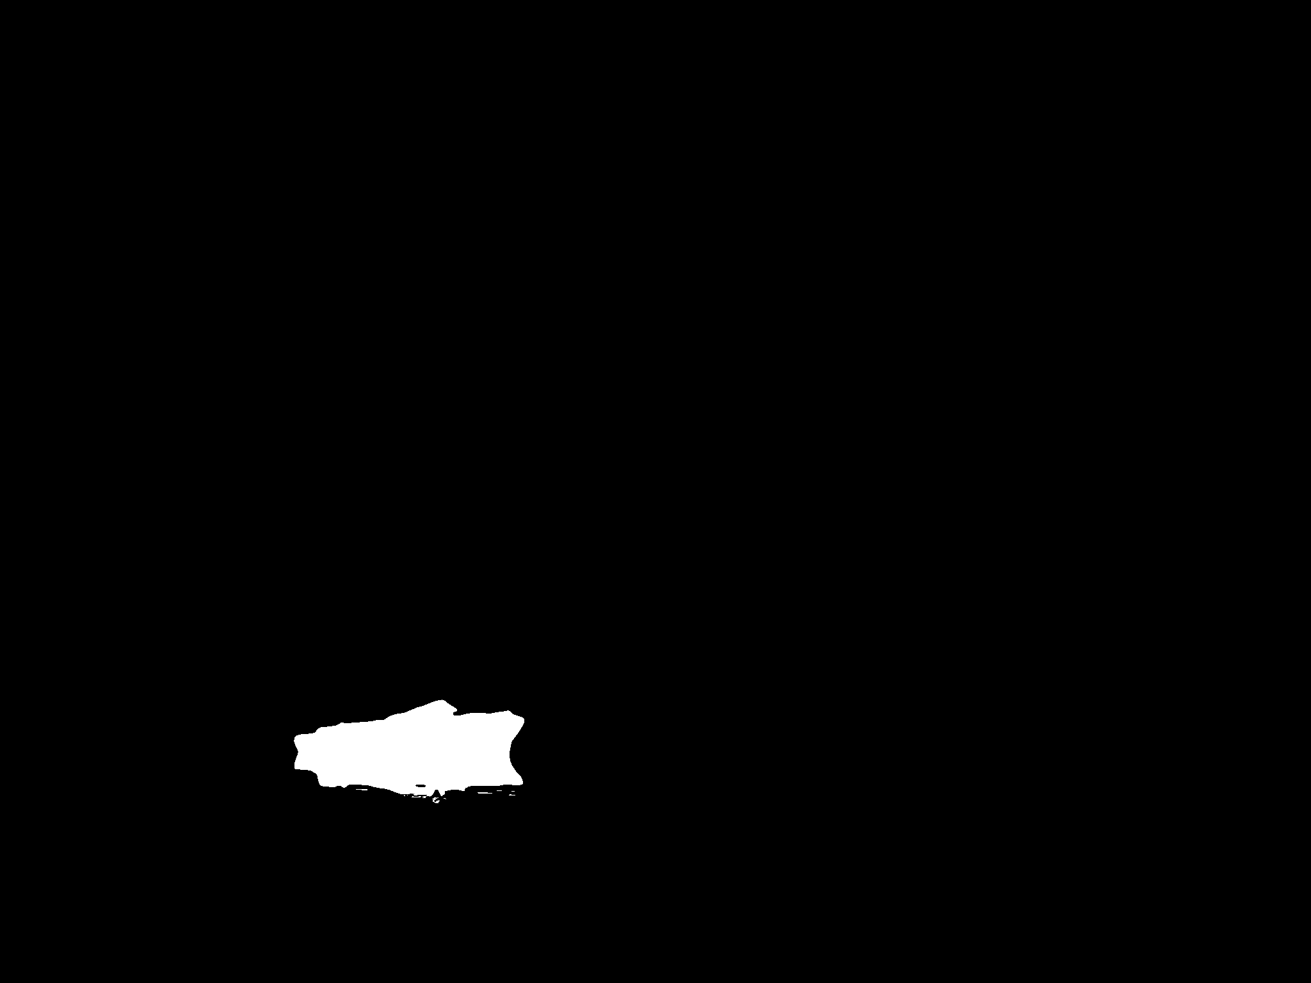
NIST16 examples
Mixed classical photo edits. The project uses a 564-image redistributed subset.
Edited test images: width 500–5616 px, height 480–3744 px
Image left, ground truth right. White marks edited pixels.
1: 2448 × 3264 px, 2.23% edited
2: 640 × 480 px, 0.31% edited
3: 2048 × 1536 px, 1.21% edited
Notes:
These are the actual supplied NIST16 test examples, selected with seed 43. Three manipulated images are shown, plus a separate authentic control when one was exported. The authentic image is not claimed to be the original version of any edited image.
Mixed classical photo edits. The project uses a 564-image redistributed subset. The size range on the slide comes from the complete accepted manipulated-test manifest, not the three examples. Width and height extrema can come from different images. Native image dimensions are shown on the slide.
In every pair, the left picture is the loader-decoded RGB image and the right picture is its accepted binary ground-truth mask. White means edited, black means unedited. These are annotations, not model predictions. No scores or predictions were used for selection. Pictures preserve their aspect ratios.
Native PNGs are lossless exports of decoded RGB, not the original encoded file bytes. Full examples remain visible; there is no evidence crop on this overview slide. The appendix illustrates appearance and label conventions; a few random examples cannot establish why one model generalizes poorly.
Dataset edition: Selected 564-image manipulated-only normal OSN research redistribution; excludes social-media variants and NIST16-C
Accepted test population: {"authentic":0,"manipulated":564}. Sample source: https://github.com/ZanMervic/Thesis/blob/75f077cb4a745fbe61871ab99f3fdd494e0486c0/Code/data/README.md
Export provenance: dataset_examples_seed43, seed 43; base code commit 75f077cb4a745fbe61871ab99f3fdd494e0486c0. Group manifest SHA-256: 3c3fc993d33f4a0ec4cb6aa2b23667a52bdf612ec86f65b3c1ba328b8160b38d.
All supplied payloads and masks passed the export integrity checks. OpenSDI full upstream shard-byte hashes remain unverified; this does not change which selected image and mask bytes are displayed.
Examples in reading order:
1. manipulated; NIST16__000029; 2448 × 3264 px; edited area 2.234292%; source references {"image":"NIST16/000029.jpg","mask":"NIST16_GT/000029_gt.png"}; RGB SHA-256 74d2fd148234afee1ed44d4bf190d730f116837d0c648ae2796dd9c2a62c063b; mask convention: Supplied NIST16_GT native annotation; Pillow L >127; no authentic controls in accepted subset
2. manipulated; NIST16__000436; 640 × 480 px; edited area 0.310547%; source references {"image":"NIST16/000436.jpg","mask":"NIST16_GT/000436_gt.png"}; RGB SHA-256 931f116ed44e245485e93213037dcde94964295f5f68db6c122a415a8ca34d1c; mask convention: Supplied NIST16_GT native annotation; Pillow L >127; no authentic controls in accepted subset
3. manipulated; NIST16__000411; 2048 × 1536 px; edited area 1.207542%; source references {"image":"NIST16/000411.jpg","mask":"NIST16_GT/000411_gt.png"}; RGB SHA-256 b0e69ab0e702f8d4ec7fcda76deca315d2785bd993c7ab5b9f3f68e80ef8fe2d; mask convention: Supplied NIST16_GT native annotation; Pillow L >127; no authentic controls in accepted subset

Slide 41
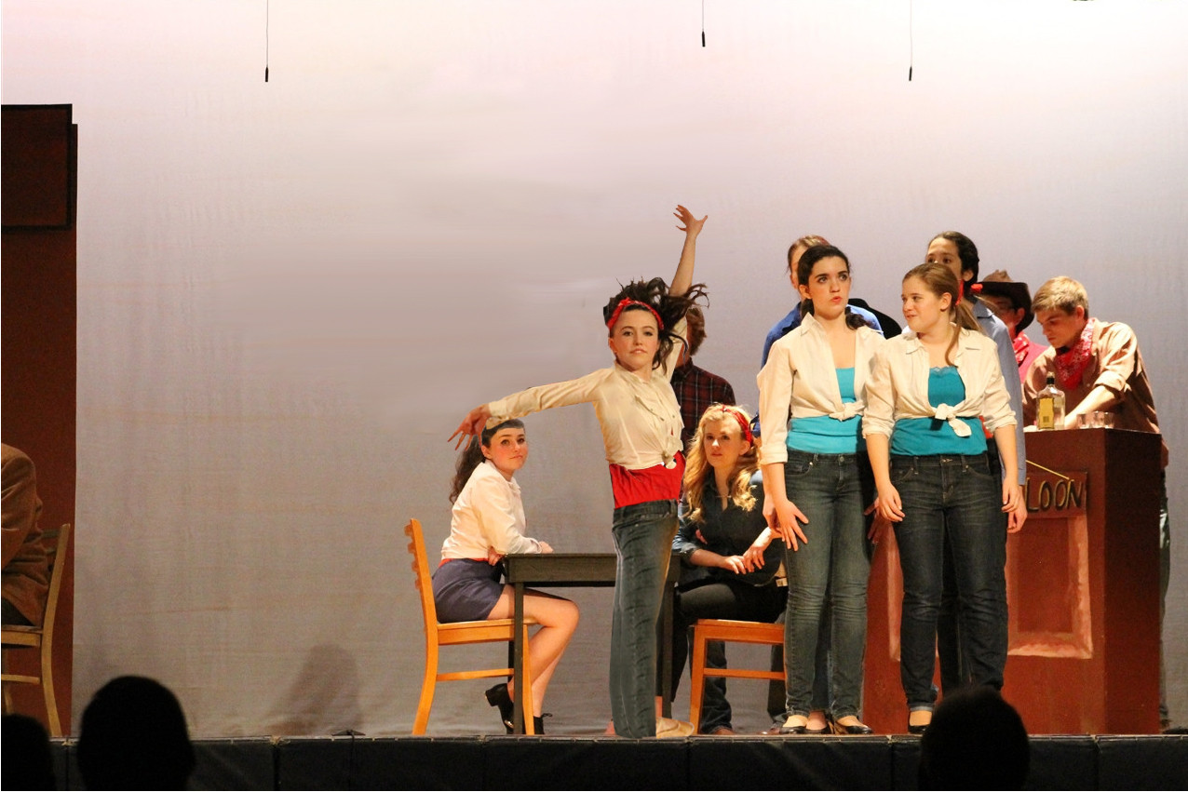
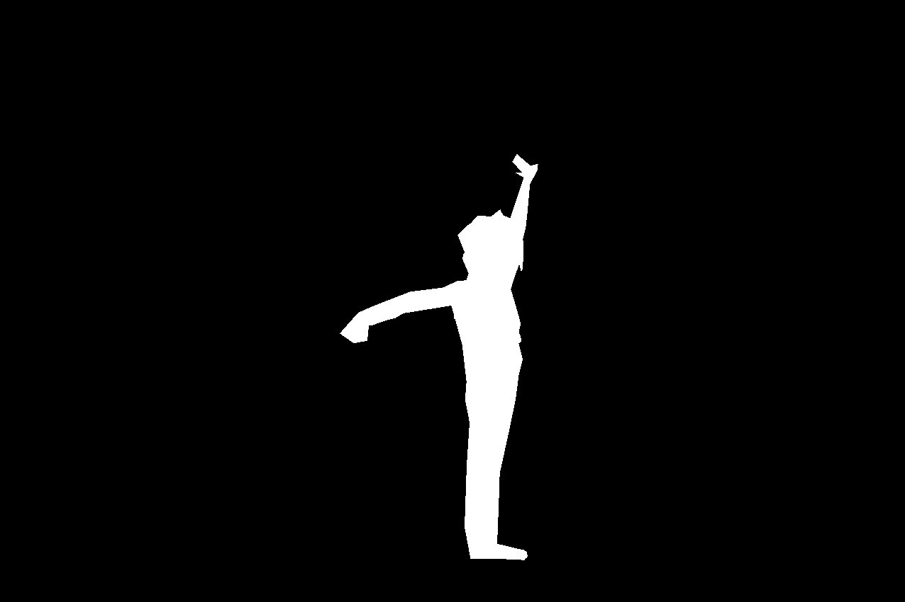
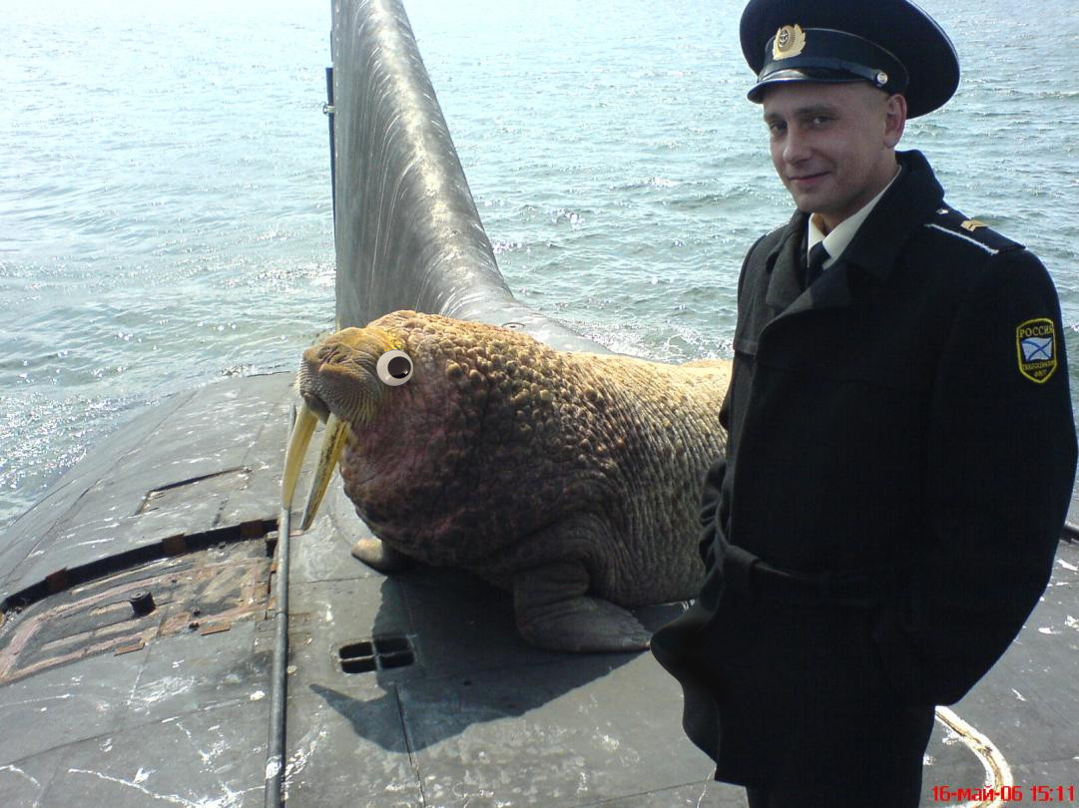
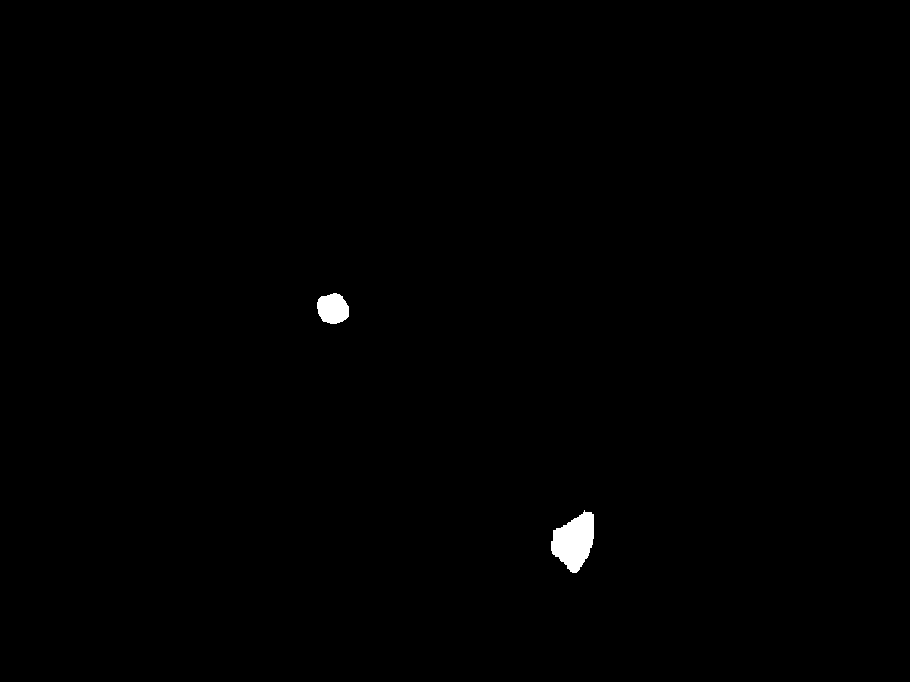
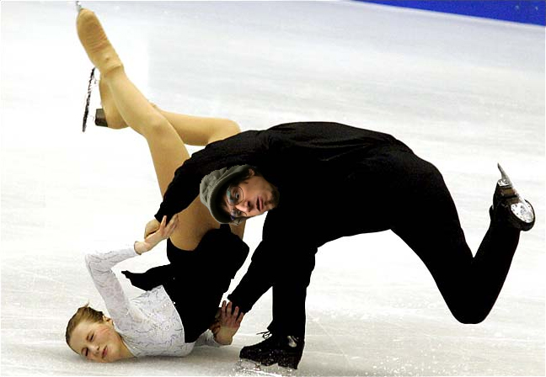

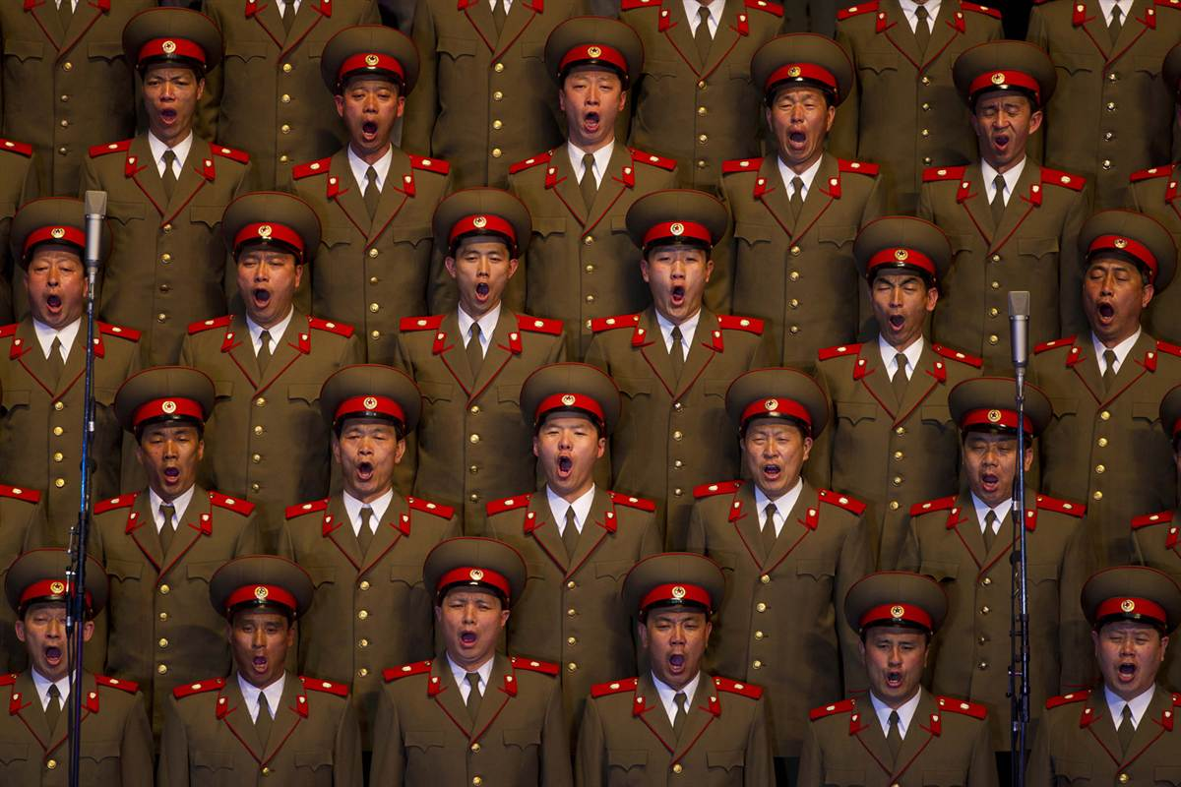

IMD2020 examples
Collected real-world photo manipulations with varied edits and image sizes.
Edited test images: width 219–4300 px, height 176–4437 px
Image left, ground truth right. White marks edited pixels.
1: 1276 × 851 px, 3.63% edited
2: 1081 × 810 px, 0.41% edited
3: 648 × 448 px, 1.61% edited
Authentic control: 1200 × 800 px
Notes:
These are the actual supplied IMD2020 test examples, selected with seed 43. Three manipulated images are shown, plus a separate authentic control when one was exported. The authentic image is not claimed to be the original version of any edited image.
Collected real-world photo manipulations with varied edits and image sizes. The size range on the slide comes from the complete accepted manipulated-test manifest, not the three examples. Width and height extrema can come from different images. Native image dimensions are shown on the slide.
In every pair, the left picture is the loader-decoded RGB image and the right picture is its accepted binary ground-truth mask. White means edited, black means unedited. These are annotations, not model predictions. No scores or predictions were used for selection. Pictures preserve their aspect ratios.
Native PNGs are lossless exports of decoded RGB, not the original encoded file bytes. Full examples remain visible; there is no evidence crop on this overview slide. The appendix illustrates appearance and label conventions; a few random examples cannot establish why one model generalizes poorly.
Dataset edition: Real-life 2010 manipulated / 414 authentic; corrected z14/00030_fake_mask.png
Accepted test population: {"authentic":414,"manipulated":2010}. Sample source: https://staff.utia.cas.cz/novozada/db/
Export provenance: dataset_examples_seed43, seed 43; base code commit 75f077cb4a745fbe61871ab99f3fdd494e0486c0. Group manifest SHA-256: bfcc4925aa766a4c9e046599f0eb2ffab2e9303862b11aac25dd6445d970bdb3.
All supplied payloads and masks passed the export integrity checks. OpenSDI full upstream shard-byte hashes remain unverified; this does not change which selected image and mask bytes are displayed.
Examples in reading order:
1. manipulated; 1cquf3__c9j64u7_0; 1276 × 851 px; edited area 3.633932%; source references {"image":"1cquf3/c9j64u7_0.jpg","mask":"1cquf3/c9j64u7_0_mask.png"}; RGB SHA-256 2c15941e0e7d179e476b48c1eac1e1e3880ef77da743a3fe0db9a5e91135b32e; mask convention: Supplied *_mask.png including accepted correction; RGB artifacts converted with Pillow L then >127; *_orig authentic controls
2. manipulated; 1djqwm__c9r9rgc_0; 1081 × 810 px; edited area 0.409657%; source references {"image":"1djqwm/c9r9rgc_0.jpg","mask":"1djqwm/c9r9rgc_0_mask.png"}; RGB SHA-256 3172d1766310fc857ee5f4ae0e6c8f79fd1003eeaf6ae3b4014ddf3e4ec609ac; mask convention: Supplied *_mask.png including accepted correction; RGB artifacts converted with Pillow L then >127; *_orig authentic controls
3. manipulated; 1d9ygm__c9ockip_0; 648 × 448 px; edited area 1.605558%; source references {"image":"1d9ygm/c9ockip_0.jpg","mask":"1d9ygm/c9ockip_0_mask.png"}; RGB SHA-256 aa687e5a2217af2f964208832410c8dd7817783ed7f44e2562520b54b7ce4cf1; mask convention: Supplied *_mask.png including accepted correction; RGB artifacts converted with Pillow L then >127; *_orig authentic controls
4. authentic; 1atm1o__1atm1o_orig; 1200 × 800 px; edited area 0.000000%; source references {"image":"1atm1o/1atm1o_orig.jpg","mask":null}; RGB SHA-256 0b44b8c2011e64f3d68d0564d67df85f0a158ab872cdcc0643000991edcd0593; mask convention: Supplied *_mask.png including accepted correction; RGB artifacts converted with Pillow L then >127; *_orig authentic controls

Slide 42
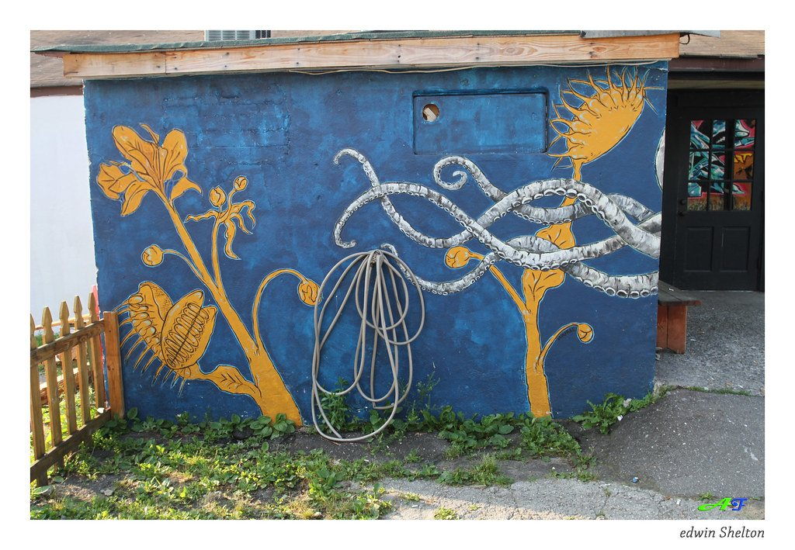







OpenSDI examples from Stable Diffusion 1.5
AI inpainting with Stable Diffusion 1.5. Local edits with separate authentic controls.
Edited test images: width 300–1024 px, height 300–1024 px
Image left, ground truth right. White marks edited pixels.
1: 1024 × 709 px, 1.53% edited
2: 1023 × 682 px, 30.22% edited
3: 1024 × 683 px, 12.57% edited
Authentic control: 1024 × 765 px
Notes:
These are the actual supplied OpenSDI SD1.5 test examples, selected with seed 43. Three manipulated images are shown, plus a separate authentic control when one was exported. The authentic image is not claimed to be the original version of any edited image.
AI inpainting with Stable Diffusion 1.5. Local edits with separate authentic controls. The size range on the slide comes from the complete accepted manipulated-test manifest, not the three examples. Width and height extrema can come from different images. Native image dimensions are shown on the slide.
In every pair, the left picture is the loader-decoded RGB image and the right picture is its accepted binary ground-truth mask. White means edited, black means unedited. These are annotations, not model predictions. No scores or predictions were used for selection. Pictures preserve their aspect ratios.
Native PNGs are lossless exports of decoded RGB, not the original encoded file bytes. Full examples remain visible; there is no evidence crop on this overview slide. The appendix illustrates appearance and label conventions; a few random examples cannot establish why one model generalizes poorly.
Dataset edition: OpenSDI_test release 7e233eaf98fcfee4c74c788f0e34d06feb7ad0df; accepted partial local fakes + label-0 controls
Accepted test population: {"authentic":10000,"manipulated":5000}. Sample source: https://huggingface.co/datasets/nebula/OpenSDI_test
Export provenance: dataset_examples_seed43, seed 43; base code commit 75f077cb4a745fbe61871ab99f3fdd494e0486c0. Group manifest SHA-256: 230bd1680861d623db1450e240e389b194315469436ed3e1d6df5e4c14bf2864.
All supplied payloads and masks passed the export integrity checks. OpenSDI full upstream shard-byte hashes remain unverified; this does not change which selected image and mask bytes are displayed.
Examples in reading order:
1. manipulated; opensdi__test__sd15__900aeacc991b2022aa4d; 1024 × 709 px; edited area 1.532060%; source references {"image":"test/sd15/images/opensdi__test__sd15__900aeacc991b2022aa4d.jpg","mask":"test/sd15/masks/opensdi__test__sd15__900aeacc991b2022aa4d.png"}; RGB SHA-256 ebd17cfe43ca050fbf828a13cfe0d1f6fffe64d6951f76441b2135a1279028ed; mask convention: RGB channel mean >127.5 marks manipulated pixels; exported mask is binary 0/255; prepared binary mask interpreted by IMDLDataset Pillow L >127
2. manipulated; opensdi__test__sd15__e51bb0c949cd71aaab31; 1023 × 682 px; edited area 30.217892%; source references {"image":"test/sd15/images/opensdi__test__sd15__e51bb0c949cd71aaab31.jpg","mask":"test/sd15/masks/opensdi__test__sd15__e51bb0c949cd71aaab31.png"}; RGB SHA-256 4259949388e1a21c9fc43afcfc26b21a052ac435d5eb7b40327b71fa8ae80866; mask convention: RGB channel mean >127.5 marks manipulated pixels; exported mask is binary 0/255; prepared binary mask interpreted by IMDLDataset Pillow L >127
3. manipulated; opensdi__test__sd15__d1ab4d80e72f968ae95e; 1024 × 683 px; edited area 12.568774%; source references {"image":"test/sd15/images/opensdi__test__sd15__d1ab4d80e72f968ae95e.jpg","mask":"test/sd15/masks/opensdi__test__sd15__d1ab4d80e72f968ae95e.png"}; RGB SHA-256 8661c0b75389d2a2e057e6c1e50edbd5e388e08be3e02d61cf488f9b7cb5c333; mask convention: RGB channel mean >127.5 marks manipulated pixels; exported mask is binary 0/255; prepared binary mask interpreted by IMDLDataset Pillow L >127
4. authentic; opensdi__test__sd15__5c2c04628740b8aecf4d; 1024 × 765 px; edited area 0.000000%; source references {"image":"test/sd15/images/opensdi__test__sd15__5c2c04628740b8aecf4d.jpg","mask":null}; RGB SHA-256 4f661f528550b1cda208f384e37a9dcea96421f62da2a5e3e6d4ad74a98145ad; mask convention: RGB channel mean >127.5 marks manipulated pixels; exported mask is binary 0/255; prepared binary mask interpreted by IMDLDataset Pillow L >127

Slide 43








OpenSDI examples from Stable Diffusion 2.1
AI inpainting with Stable Diffusion 2.1. Local edits with separate authentic controls.
Edited test images: width 271–1024 px, height 300–1024 px
Image left, ground truth right. White marks edited pixels.
1: 1024 × 749 px, 13.18% edited
2: 1023 × 655 px, 7.43% edited
3: 1024 × 683 px, 2.63% edited
Authentic control: 1024 × 768 px
Notes:
These are the actual supplied OpenSDI SD2.1 test examples, selected with seed 43. Three manipulated images are shown, plus a separate authentic control when one was exported. The authentic image is not claimed to be the original version of any edited image.
AI inpainting with Stable Diffusion 2.1. Local edits with separate authentic controls. The size range on the slide comes from the complete accepted manipulated-test manifest, not the three examples. Width and height extrema can come from different images. Native image dimensions are shown on the slide.
In every pair, the left picture is the loader-decoded RGB image and the right picture is its accepted binary ground-truth mask. White means edited, black means unedited. These are annotations, not model predictions. No scores or predictions were used for selection. Pictures preserve their aspect ratios.
Native PNGs are lossless exports of decoded RGB, not the original encoded file bytes. Full examples remain visible; there is no evidence crop on this overview slide. The appendix illustrates appearance and label conventions; a few random examples cannot establish why one model generalizes poorly.
Dataset edition: OpenSDI_test release 7e233eaf98fcfee4c74c788f0e34d06feb7ad0df; accepted partial local fakes + label-0 controls
Accepted test population: {"authentic":10000,"manipulated":5000}. Sample source: https://huggingface.co/datasets/nebula/OpenSDI_test
Export provenance: dataset_examples_seed43, seed 43; base code commit 75f077cb4a745fbe61871ab99f3fdd494e0486c0. Group manifest SHA-256: 7f242adfab668b3a260e9d2b745446144bd11e5bbb0dc8798e2eb3a342a9fa3f.
All supplied payloads and masks passed the export integrity checks. OpenSDI full upstream shard-byte hashes remain unverified; this does not change which selected image and mask bytes are displayed.
Examples in reading order:
1. manipulated; opensdi__test__sd2__b0555c92131337c296ac; 1024 × 749 px; edited area 13.175901%; source references {"image":"test/sd2/images/opensdi__test__sd2__b0555c92131337c296ac.jpg","mask":"test/sd2/masks/opensdi__test__sd2__b0555c92131337c296ac.png"}; RGB SHA-256 e8c2bffd4c644e1125528208bd3c6cc0eb598e58b55368bd2bd6df87c2ffbcee; mask convention: RGB channel mean >127.5 marks manipulated pixels; exported mask is binary 0/255; prepared binary mask interpreted by IMDLDataset Pillow L >127
2. manipulated; opensdi__test__sd2__02abd17e6fdc4487b9d5; 1023 × 655 px; edited area 7.426145%; source references {"image":"test/sd2/images/opensdi__test__sd2__02abd17e6fdc4487b9d5.jpg","mask":"test/sd2/masks/opensdi__test__sd2__02abd17e6fdc4487b9d5.png"}; RGB SHA-256 4a4d4abd4c94b020b89bb67041d8ac78287f1ec89c378f1c546d73b0e9df8fc8; mask convention: RGB channel mean >127.5 marks manipulated pixels; exported mask is binary 0/255; prepared binary mask interpreted by IMDLDataset Pillow L >127
3. manipulated; opensdi__test__sd2__720765d5332fdbd7f903; 1024 × 683 px; edited area 2.634717%; source references {"image":"test/sd2/images/opensdi__test__sd2__720765d5332fdbd7f903.jpg","mask":"test/sd2/masks/opensdi__test__sd2__720765d5332fdbd7f903.png"}; RGB SHA-256 59a3e0f15d6171a2c5e12e325306593429011d18c97604884c4fb844e7aacd92; mask convention: RGB channel mean >127.5 marks manipulated pixels; exported mask is binary 0/255; prepared binary mask interpreted by IMDLDataset Pillow L >127
4. authentic; opensdi__test__sd2__50400b167980fef3fafd; 1024 × 768 px; edited area 0.000000%; source references {"image":"test/sd2/images/opensdi__test__sd2__50400b167980fef3fafd.jpg","mask":null}; RGB SHA-256 2f03504b042724af24f60d6c69828c3650e42dd14579c3e10168459d3400f45f; mask convention: RGB channel mean >127.5 marks manipulated pixels; exported mask is binary 0/255; prepared binary mask interpreted by IMDLDataset Pillow L >127

Slide 44








OpenSDI examples from SDXL
AI inpainting with SDXL. Local edits with separate authentic controls.
Edited test images: width 290–1024 px, height 267–1024 px
Image left, ground truth right. White marks edited pixels.
1: 768 × 1024 px, 30.29% edited
2: 1024 × 768 px, 80.46% edited
3: 1024 × 684 px, 32.08% edited
Authentic control: 494 × 640 px
Notes:
These are the actual supplied OpenSDI SDXL test examples, selected with seed 43. Three manipulated images are shown, plus a separate authentic control when one was exported. The authentic image is not claimed to be the original version of any edited image.
AI inpainting with SDXL. Local edits with separate authentic controls. The size range on the slide comes from the complete accepted manipulated-test manifest, not the three examples. Width and height extrema can come from different images. Native image dimensions are shown on the slide.
In every pair, the left picture is the loader-decoded RGB image and the right picture is its accepted binary ground-truth mask. White means edited, black means unedited. These are annotations, not model predictions. No scores or predictions were used for selection. Pictures preserve their aspect ratios.
Native PNGs are lossless exports of decoded RGB, not the original encoded file bytes. Full examples remain visible; there is no evidence crop on this overview slide. The appendix illustrates appearance and label conventions; a few random examples cannot establish why one model generalizes poorly.
Dataset edition: OpenSDI_test release 7e233eaf98fcfee4c74c788f0e34d06feb7ad0df; accepted partial local fakes + label-0 controls
Accepted test population: {"authentic":10000,"manipulated":5000}. Sample source: https://huggingface.co/datasets/nebula/OpenSDI_test
Export provenance: dataset_examples_seed43, seed 43; base code commit 75f077cb4a745fbe61871ab99f3fdd494e0486c0. Group manifest SHA-256: d56f415d0c153650b37dfa7e89a206ebbdfc8f0353979dbe61a304c42b3a7c1d.
All supplied payloads and masks passed the export integrity checks. OpenSDI full upstream shard-byte hashes remain unverified; this does not change which selected image and mask bytes are displayed.
Examples in reading order:
1. manipulated; opensdi__test__sdxl__7a4e83849ceb62671760; 768 × 1024 px; edited area 30.287170%; source references {"image":"test/sdxl/images/opensdi__test__sdxl__7a4e83849ceb62671760.jpg","mask":"test/sdxl/masks/opensdi__test__sdxl__7a4e83849ceb62671760.png"}; RGB SHA-256 1c32e21a37429810e68c3586be427798f214996cd709b84f275cfd46ca89cc69; mask convention: RGB channel mean >127.5 marks manipulated pixels; exported mask is binary 0/255; prepared binary mask interpreted by IMDLDataset Pillow L >127
2. manipulated; opensdi__test__sdxl__faede568d6087b8ff385; 1024 × 768 px; edited area 80.457052%; source references {"image":"test/sdxl/images/opensdi__test__sdxl__faede568d6087b8ff385.jpg","mask":"test/sdxl/masks/opensdi__test__sdxl__faede568d6087b8ff385.png"}; RGB SHA-256 6f29f37571b015e8317e7612ca0f71abc93e0207ab89ac22f9af2b949acfb120; mask convention: RGB channel mean >127.5 marks manipulated pixels; exported mask is binary 0/255; prepared binary mask interpreted by IMDLDataset Pillow L >127
3. manipulated; opensdi__test__sdxl__ad82b5314bb567e5856c; 1024 × 684 px; edited area 32.081506%; source references {"image":"test/sdxl/images/opensdi__test__sdxl__ad82b5314bb567e5856c.jpg","mask":"test/sdxl/masks/opensdi__test__sdxl__ad82b5314bb567e5856c.png"}; RGB SHA-256 5273b6fa448166b2aa49faf1ca0a135b15f5e56f435867f7c7f596e20e63d443; mask convention: RGB channel mean >127.5 marks manipulated pixels; exported mask is binary 0/255; prepared binary mask interpreted by IMDLDataset Pillow L >127
4. authentic; opensdi__test__sdxl__ff0eea965652bd3ac90b; 494 × 640 px; edited area 0.000000%; source references {"image":"test/sdxl/images/opensdi__test__sdxl__ff0eea965652bd3ac90b.jpg","mask":null}; RGB SHA-256 dd833589149c1474ebf81add9114dbe08d6c9beee20447cd15edebc7f9ba49d6; mask convention: RGB channel mean >127.5 marks manipulated pixels; exported mask is binary 0/255; prepared binary mask interpreted by IMDLDataset Pillow L >127

Slide 45








OpenSDI examples from Stable Diffusion 3
AI inpainting with Stable Diffusion 3. Local edits with separate authentic controls.
Edited test images: width 298–1024 px, height 267–1024 px
Image left, ground truth right. White marks edited pixels.
1: 1024 × 678 px, 2.53% edited
2: 1024 × 683 px, 5.75% edited
3: 1024 × 683 px, 5.57% edited
Authentic control: 640 × 427 px
Notes:
These are the actual supplied OpenSDI SD3 test examples, selected with seed 43. Three manipulated images are shown, plus a separate authentic control when one was exported. The authentic image is not claimed to be the original version of any edited image.
AI inpainting with Stable Diffusion 3. Local edits with separate authentic controls. The size range on the slide comes from the complete accepted manipulated-test manifest, not the three examples. Width and height extrema can come from different images. Native image dimensions are shown on the slide.
In every pair, the left picture is the loader-decoded RGB image and the right picture is its accepted binary ground-truth mask. White means edited, black means unedited. These are annotations, not model predictions. No scores or predictions were used for selection. Pictures preserve their aspect ratios.
Native PNGs are lossless exports of decoded RGB, not the original encoded file bytes. Full examples remain visible; there is no evidence crop on this overview slide. The appendix illustrates appearance and label conventions; a few random examples cannot establish why one model generalizes poorly.
Dataset edition: OpenSDI_test release 7e233eaf98fcfee4c74c788f0e34d06feb7ad0df; accepted partial local fakes + label-0 controls
Accepted test population: {"authentic":10000,"manipulated":5000}. Sample source: https://huggingface.co/datasets/nebula/OpenSDI_test
Export provenance: dataset_examples_seed43, seed 43; base code commit 75f077cb4a745fbe61871ab99f3fdd494e0486c0. Group manifest SHA-256: de26019a55b3df2e1143f6457578e3a5b4924fcaf88110ca85c535b0228e39ae.
All supplied payloads and masks passed the export integrity checks. OpenSDI full upstream shard-byte hashes remain unverified; this does not change which selected image and mask bytes are displayed.
Examples in reading order:
1. manipulated; opensdi__test__sd3__b29e0cab1b6d2993a093; 1024 × 678 px; edited area 2.527684%; source references {"image":"test/sd3/images/opensdi__test__sd3__b29e0cab1b6d2993a093.jpg","mask":"test/sd3/masks/opensdi__test__sd3__b29e0cab1b6d2993a093.png"}; RGB SHA-256 39ec5bc89c66c87377e74f74c0c860b4b53bad5f661db50128de08bacf80a71b; mask convention: RGB channel mean >127.5 marks manipulated pixels; exported mask is binary 0/255; prepared binary mask interpreted by IMDLDataset Pillow L >127
2. manipulated; opensdi__test__sd3__256e827e1831d14e2213; 1024 × 683 px; edited area 5.753712%; source references {"image":"test/sd3/images/opensdi__test__sd3__256e827e1831d14e2213.jpg","mask":"test/sd3/masks/opensdi__test__sd3__256e827e1831d14e2213.png"}; RGB SHA-256 e31f1791324798a508cba495d889b6257b7943de93f5578804f40a233bd2c265; mask convention: RGB channel mean >127.5 marks manipulated pixels; exported mask is binary 0/255; prepared binary mask interpreted by IMDLDataset Pillow L >127
3. manipulated; opensdi__test__sd3__7c5958a7e50fee3150e7; 1024 × 683 px; edited area 5.570839%; source references {"image":"test/sd3/images/opensdi__test__sd3__7c5958a7e50fee3150e7.jpg","mask":"test/sd3/masks/opensdi__test__sd3__7c5958a7e50fee3150e7.png"}; RGB SHA-256 6a48f3c4e587ff3e6cbe43c1442c195f4c4d78b9323d958c6cbc1b11ecf13ef7; mask convention: RGB channel mean >127.5 marks manipulated pixels; exported mask is binary 0/255; prepared binary mask interpreted by IMDLDataset Pillow L >127
4. authentic; opensdi__test__sd3__accda22fc7d255ee1797; 640 × 427 px; edited area 0.000000%; source references {"image":"test/sd3/images/opensdi__test__sd3__accda22fc7d255ee1797.jpg","mask":null}; RGB SHA-256 47a5ab81a3be1ee5b842aae4822c6e95251e3bcd5f7f7cf5c647af2a98b8671b; mask convention: RGB channel mean >127.5 marks manipulated pixels; exported mask is binary 0/255; prepared binary mask interpreted by IMDLDataset Pillow L >127

Slide 46








OpenSDI examples from FLUX
AI inpainting with FLUX. Local edits with separate authentic controls.
Edited test images: width 290–1024 px, height 265–1024 px
Image left, ground truth right. White marks edited pixels.
1: 1024 × 683 px, 5.47% edited
2: 1024 × 660 px, 6.61% edited
3: 1023 × 682 px, 31.59% edited
Authentic control: 640 × 513 px
Notes:
These are the actual supplied OpenSDI FLUX test examples, selected with seed 43. Three manipulated images are shown, plus a separate authentic control when one was exported. The authentic image is not claimed to be the original version of any edited image.
AI inpainting with FLUX. Local edits with separate authentic controls. The size range on the slide comes from the complete accepted manipulated-test manifest, not the three examples. Width and height extrema can come from different images. Native image dimensions are shown on the slide.
In every pair, the left picture is the loader-decoded RGB image and the right picture is its accepted binary ground-truth mask. White means edited, black means unedited. These are annotations, not model predictions. No scores or predictions were used for selection. Pictures preserve their aspect ratios.
Native PNGs are lossless exports of decoded RGB, not the original encoded file bytes. Full examples remain visible; there is no evidence crop on this overview slide. The appendix illustrates appearance and label conventions; a few random examples cannot establish why one model generalizes poorly.
Dataset edition: OpenSDI_test release 7e233eaf98fcfee4c74c788f0e34d06feb7ad0df; accepted partial local fakes + label-0 controls
Accepted test population: {"authentic":10000,"manipulated":5000}. Sample source: https://huggingface.co/datasets/nebula/OpenSDI_test
Export provenance: dataset_examples_seed43, seed 43; base code commit 75f077cb4a745fbe61871ab99f3fdd494e0486c0. Group manifest SHA-256: 464eac9271ccc1910b52af2964074c4c4f635eb0c7b15cf7d06a6aae249dea2e.
All supplied payloads and masks passed the export integrity checks. OpenSDI full upstream shard-byte hashes remain unverified; this does not change which selected image and mask bytes are displayed.
Examples in reading order:
1. manipulated; opensdi__test__flux__3c9d34bf39abb3938bc4; 1024 × 683 px; edited area 5.473468%; source references {"image":"test/flux/images/opensdi__test__flux__3c9d34bf39abb3938bc4.jpg","mask":"test/flux/masks/opensdi__test__flux__3c9d34bf39abb3938bc4.png"}; RGB SHA-256 f9aa471eb6644454bea93914b154145b8bf40746f2c1099460d823cda59c2584; mask convention: RGB channel mean >127.5 marks manipulated pixels; exported mask is binary 0/255; prepared binary mask interpreted by IMDLDataset Pillow L >127
2. manipulated; opensdi__test__flux__9ad13acab5e9ce051e4a; 1024 × 660 px; edited area 6.611624%; source references {"image":"test/flux/images/opensdi__test__flux__9ad13acab5e9ce051e4a.jpg","mask":"test/flux/masks/opensdi__test__flux__9ad13acab5e9ce051e4a.png"}; RGB SHA-256 bf9c637cb37452c03a76106fa2d6ca7393e30ebcc30ed123e375cd1484a1957f; mask convention: RGB channel mean >127.5 marks manipulated pixels; exported mask is binary 0/255; prepared binary mask interpreted by IMDLDataset Pillow L >127
3. manipulated; opensdi__test__flux__0c67610998a374f6d85d; 1023 × 682 px; edited area 31.590142%; source references {"image":"test/flux/images/opensdi__test__flux__0c67610998a374f6d85d.jpg","mask":"test/flux/masks/opensdi__test__flux__0c67610998a374f6d85d.png"}; RGB SHA-256 dd1005c6b38d533b02223b43e4600f7211890140f949ae81f74e38fdb444489f; mask convention: RGB channel mean >127.5 marks manipulated pixels; exported mask is binary 0/255; prepared binary mask interpreted by IMDLDataset Pillow L >127
4. authentic; opensdi__test__flux__b25e601a562c332b98f4; 640 × 513 px; edited area 0.000000%; source references {"image":"test/flux/images/opensdi__test__flux__b25e601a562c332b98f4.jpg","mask":null}; RGB SHA-256 2eb56eeb0ff35690c5e451eb4d3021c53f2b95d275daf922cee24c85a617b48f; mask convention: RGB channel mean >127.5 marks manipulated pixels; exported mask is binary 0/255; prepared binary mask interpreted by IMDLDataset Pillow L >127

Slide 47








CocoGlide examples
GLIDE inpainting on COCO-derived image crops.
Edited test images: 256 × 256 px
Image left, ground truth right. White marks edited pixels.
1: 256 × 256 px, 9.07% edited
2: 256 × 256 px, 8.45% edited
3: 256 × 256 px, 12.07% edited
Authentic control: 256 × 256 px
Notes:
These are the actual supplied CocoGlide test examples, selected with seed 43. Three manipulated images are shown, plus a separate authentic control when one was exported. The authentic image is not claimed to be the original version of any edited image.
GLIDE inpainting on COCO-derived image crops. The size range on the slide comes from the complete accepted manipulated-test manifest, not the three examples. Width and height extrema can come from different images. Native image dimensions are shown on the slide.
In every pair, the left picture is the loader-decoded RGB image and the right picture is its accepted binary ground-truth mask. White means edited, black means unedited. These are annotations, not model predictions. No scores or predictions were used for selection. Pictures preserve their aspect ratios.
Native PNGs are lossless exports of decoded RGB, not the original encoded file bytes. Full examples remain visible; there is no evidence crop on this overview slide. The appendix illustrates appearance and label conventions; a few random examples cannot establish why one model generalizes poorly.
Dataset edition: 512 GLIDE local edits and 512 paired original COCO controls
Accepted test population: {"authentic":512,"manipulated":512}. Sample source: https://grip-unina.github.io/TruFor/
Export provenance: dataset_examples_seed43, seed 43; base code commit 75f077cb4a745fbe61871ab99f3fdd494e0486c0. Group manifest SHA-256: f8f212b354c89b5ad2526b164500c8e9fb64a10c1085bd1e4550742a2a2d7d64.
All supplied payloads and masks passed the export integrity checks. OpenSDI full upstream shard-byte hashes remain unverified; this does not change which selected image and mask bytes are displayed.
Examples in reading order:
1. manipulated; fake__glide_inpainting_val2017_322574_up; 256 × 256 px; edited area 9.071350%; source references {"image":"fake/glide_inpainting_val2017_322574_up.png","mask":"mask/sandwich_322574_mask.png"}; RGB SHA-256 13b49c50b0fbcb90ffe4e9fbc5613e8b75982144da760691b1e70332933424f4; mask convention: table.csv pairing; native binary mask white=edited; group_id COCO source; authentic from table real column
2. manipulated; fake__glide_inpainting_val2017_233033_up; 256 × 256 px; edited area 8.453369%; source references {"image":"fake/glide_inpainting_val2017_233033_up.png","mask":"mask/umbrella_233033_mask.png"}; RGB SHA-256 1a6b009b6795f47c104600250058e78604cf92d8c0db1086be9cf5357e0d73be; mask convention: table.csv pairing; native binary mask white=edited; group_id COCO source; authentic from table real column
3. manipulated; fake__glide_inpainting_val2017_430871_up; 256 × 256 px; edited area 12.065125%; source references {"image":"fake/glide_inpainting_val2017_430871_up.png","mask":"mask/parking meter_430871_mask.png"}; RGB SHA-256 2752cbf3c78796fcbe92903c27e241c0a526067cb895d3f60850476239a3b074; mask convention: table.csv pairing; native binary mask white=edited; group_id COCO source; authentic from table real column
4. authentic; real__fork_485972; 256 × 256 px; edited area 0.000000%; source references {"image":"real/fork_485972.png","mask":null}; RGB SHA-256 a4cb55d4d9df34b40f43308baf0040a3e0075e85d22c307d9916625bb2ebcee3; mask convention: table.csv pairing; native binary mask white=edited; group_id COCO source; authentic from table real column

Slide 48








AutoSplice examples
DALL-E 2 replacements composited into news images. JPEG-100 edited subset.
Edited test images: width 256–3744 px, height 256–3744 px
Image left, ground truth right. White marks edited pixels.
1: 383 × 256 px, 77.25% edited
2: 456 × 256 px, 48.02% edited
3: 338 × 256 px, 4.25% edited
Authentic control: 4232 × 4232 px
Notes:
These are the actual supplied AutoSplice JPEG-100 test examples, selected with seed 43. Three manipulated images are shown, plus a separate authentic control when one was exported. The authentic image is not claimed to be the original version of any edited image.
DALL-E 2 replacements composited into news images. JPEG-100 edited subset. The size range on the slide comes from the complete accepted manipulated-test manifest, not the three examples. Width and height extrema can come from different images. Native image dimensions are shown on the slide.
In every pair, the left picture is the loader-decoded RGB image and the right picture is its accepted binary ground-truth mask. White means edited, black means unedited. These are annotations, not model predictions. No scores or predictions were used for selection. Pictures preserve their aspect ratios.
Native PNGs are lossless exports of decoded RGB, not the original encoded file bytes. Full examples remain visible; there is no evidence crop on this overview slide. The appendix illustrates appearance and label conventions; a few random examples cannot establish why one model generalizes poorly.
Dataset edition: Forged_JPEG100 only: 3621 manipulated / 2273 authentic
Accepted test population: {"authentic":2273,"manipulated":3621}. Sample source: https://github.com/shanface33/AutoSplice_Dataset
Export provenance: dataset_examples_seed43, seed 43; base code commit 75f077cb4a745fbe61871ab99f3fdd494e0486c0. Group manifest SHA-256: 386264f99a46ca807dd46ee59f280c639551207fb37b2e8e93d1e47089d799d9.
All supplied payloads and masks passed the export integrity checks. OpenSDI full upstream shard-byte hashes remain unverified; this does not change which selected image and mask bytes are displayed.
Examples in reading order:
1. manipulated; Forged_JPEG100__58254_0; 383 × 256 px; edited area 77.248898%; source references {"image":"Forged_JPEG100/58254_0.jpg","mask":"Mask/58254_mask.png"}; RGB SHA-256 9906557f489389bed5dff5771c32580ecf5bba26c1c07ac4ca9e871d7bc964dd; mask convention: Native Mask/<source_id>_mask.png binary annotation; JPEG90/75 excluded; authentic from Authentic directory
2. manipulated; Forged_JPEG100__39890_2; 456 × 256 px; edited area 48.016893%; source references {"image":"Forged_JPEG100/39890_2.jpg","mask":"Mask/39890_mask.png"}; RGB SHA-256 3015930d394f47f3414cb5ac00e799236cded95081df27728b25536695ac09ed; mask convention: Native Mask/<source_id>_mask.png binary annotation; JPEG90/75 excluded; authentic from Authentic directory
3. manipulated; Forged_JPEG100__66299_0; 338 × 256 px; edited area 4.250647%; source references {"image":"Forged_JPEG100/66299_0.jpg","mask":"Mask/66299_mask.png"}; RGB SHA-256 7ee1960743a4061424ae476975e1c5d9c465e97a49111345fd014664734d8b14; mask convention: Native Mask/<source_id>_mask.png binary annotation; JPEG90/75 excluded; authentic from Authentic directory
4. authentic; Authentic__62206; 4232 × 4232 px; edited area 0.000000%; source references {"image":"Authentic/62206.jpg","mask":null}; RGB SHA-256 b8fcfd58715379b68a0a869cdf979ba19fb3d06f8e20afc541dc8af68d4569a7; mask convention: Native Mask/<source_id>_mask.png binary annotation; JPEG90/75 excluded; authentic from Authentic directory

