Slide 1
Artela KYT Aspect
Transaction Security on Artela Network
Notes:
Hello every one. My name is Steve.I am deeply honored here today and introduce a significant contribution to artela network – the KYT Aspect.

Slide 2
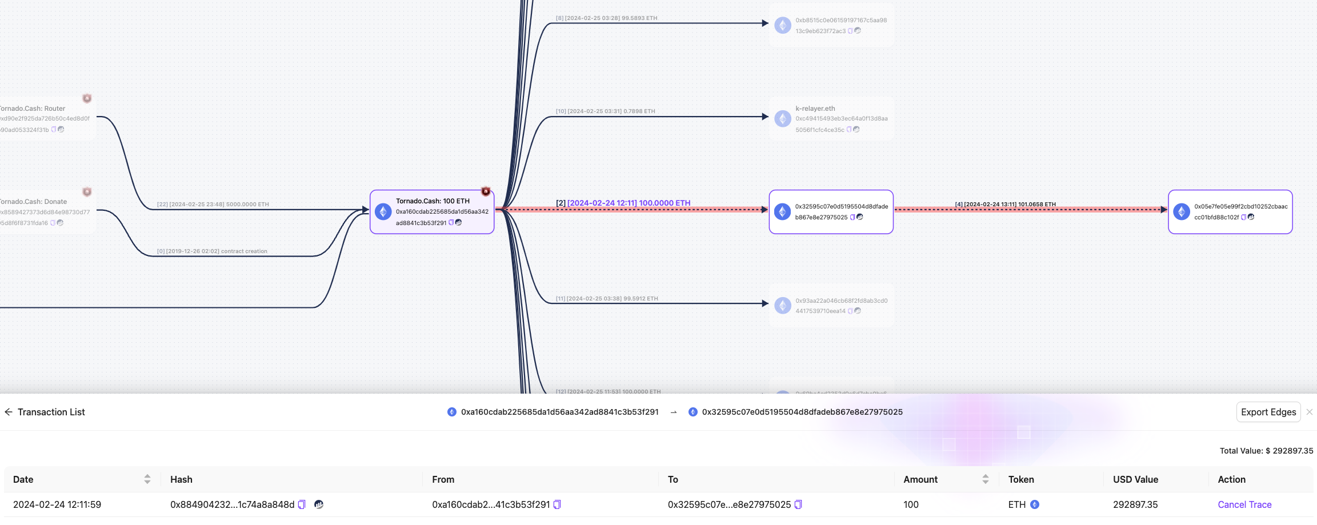
What is KYT(Know Your Transaction)?
Notes:
As many of you are aware, in the traditional finance, the concept of KYC, or Know Your Customer, is an indispensable practice. However, when we compare this to the Web3 world, the process of registering customer identity information on the blockchain presents significant challenges.
Therefore, on public blockchains, our focus shifts toward monitoring the dynamic transactional activities of customer addresses. The practice of KYT, or Know Your Transaction, comes into play here, where transactions are assessed for risk based on factors, such as the origin of transactions, their intended purpose, amount, frequency, and more. This process allows us to promptly identify suspicious or abnormal behaviors.

Slide 3
KYT Aspect
Generic On-chain KYT Aspect
Hybrid On-chain and Off-chain KYT System
Notes:
In response to this, we have thoughtfully designed the KYT Aspect with a strong emphasis on scalability specifically for Artela Aspect. Moreover, based on the evolving form of Aspect, we have divided it into two distinct systems: the Generic On-Chain KYT Aspect and the Hybrid KYT System that combines both on-chain and off-chain elements.

Slide 4
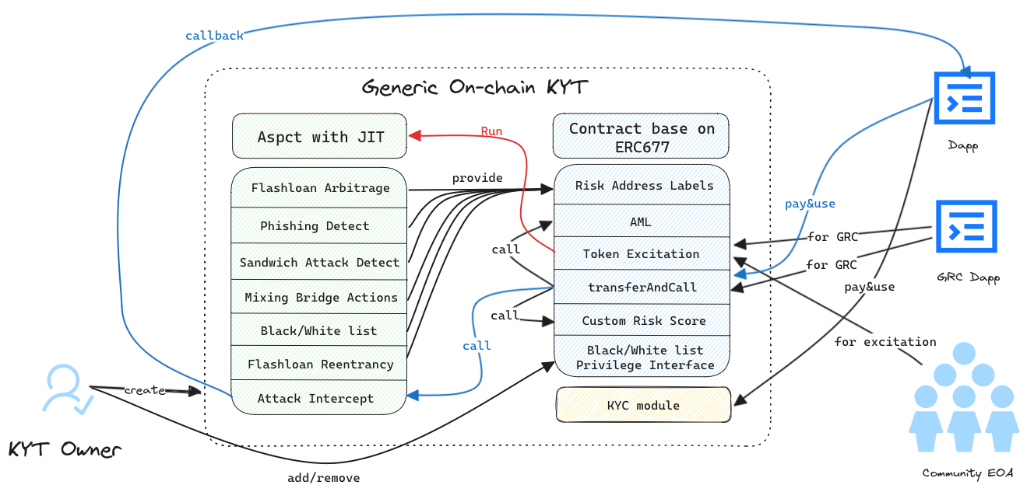
Generic On-chain KYT Aspect
Notes:
Our system is composed of an aspect alongside an ERC677 contract. The aspect is adept at identifying and monitoring flash-loan arbitrage, detecting sandwich attacks, supervising the flow of medium to high-risk address transactions, and overseeing behaviors of blacklisted/whitelisted addresses. It is capable of identifying phishing attempts, flash loan reentrancy, and various other functions.
Because KYT data can be both provided and utilized. our model looks like a Chainlink oracle. So we can adopt a similar standard to the ERC677 token to build a economic model

Slide 5
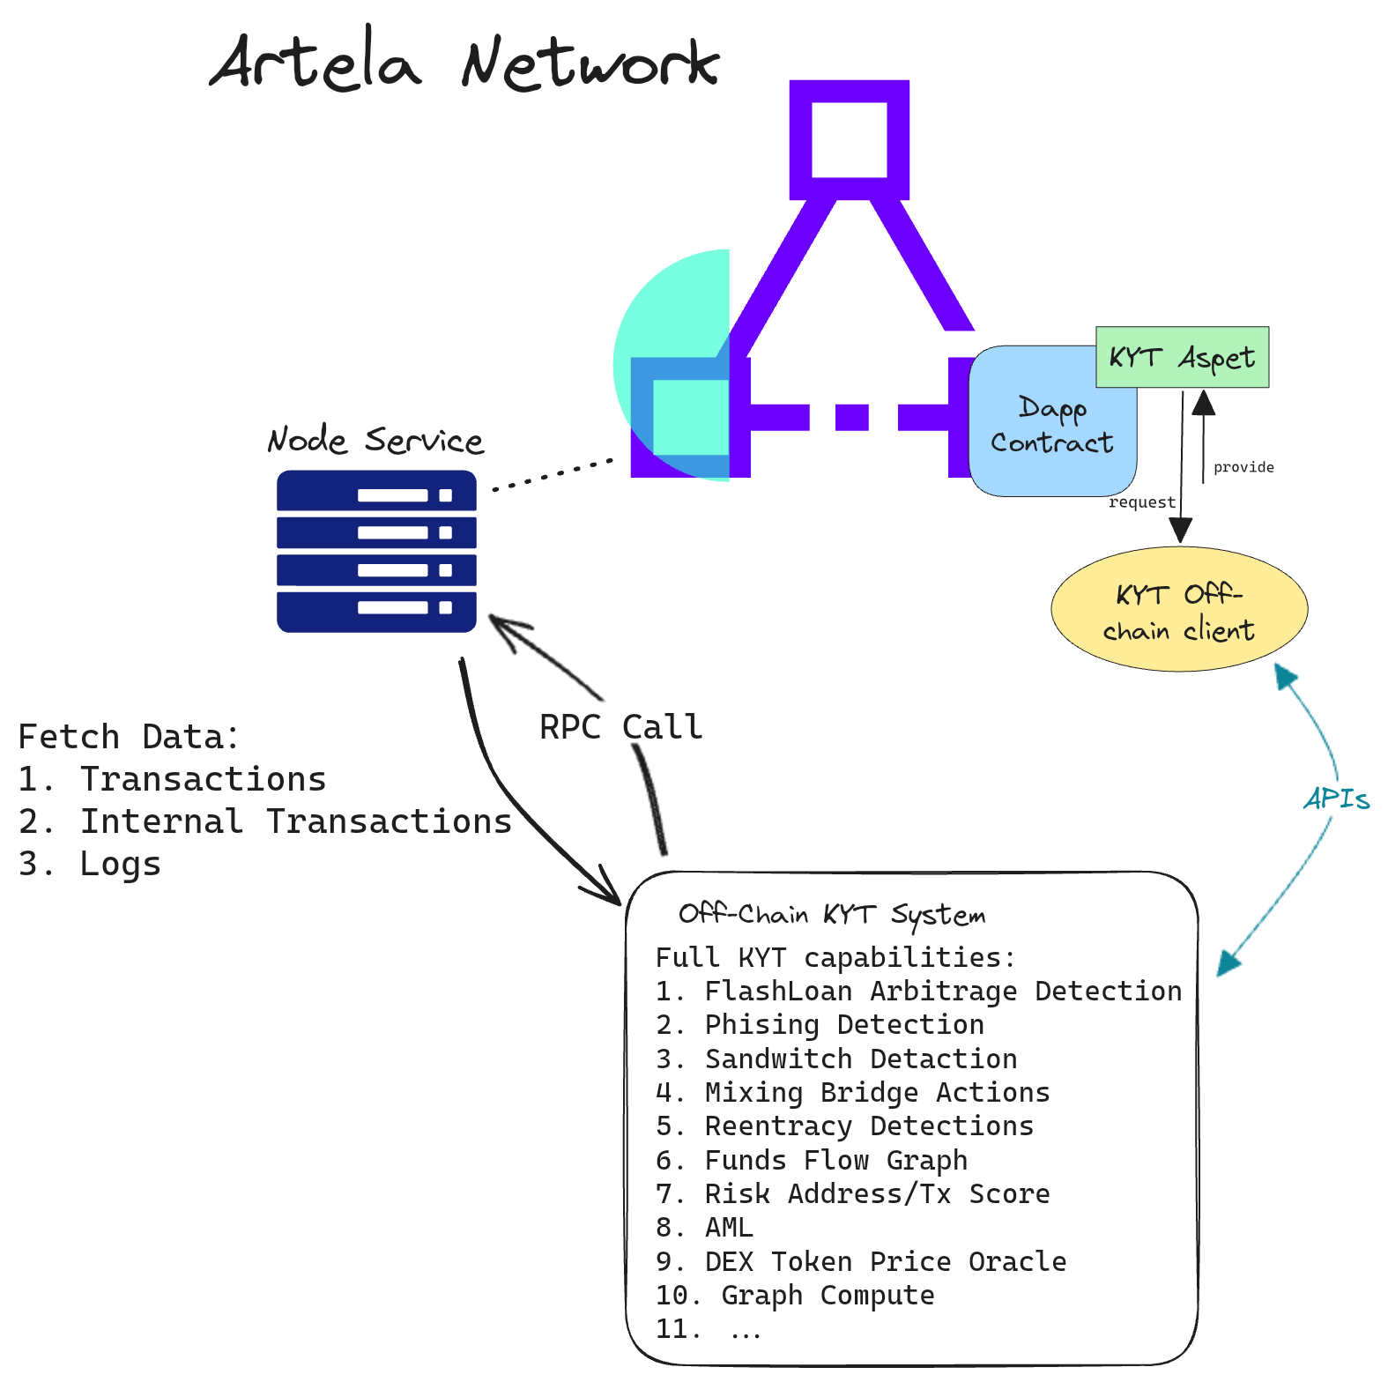
Hybrid On-chain and Off-chain KYT System
KYT Aspect as Oracle
Off-chain data provider
Full KYT System Functions
Large-scale Computation Tasks
Notes:
In terms of practical implementation, our fully on-chain generic KYT Aspect has the capacity to tackle many issues in off-chain KYT solutions, such as on-chain attack interception. However, bring all KYT capabilities from offline to online is full of challenges.
Therefore, considering our medium to short-term strategy, we have opted to integrate parts of our KYT rules and architecture into the on-chain Aspect. For more complex algorithms , we have leveraged the capacities of off-chain KYT APIs.

Slide 6
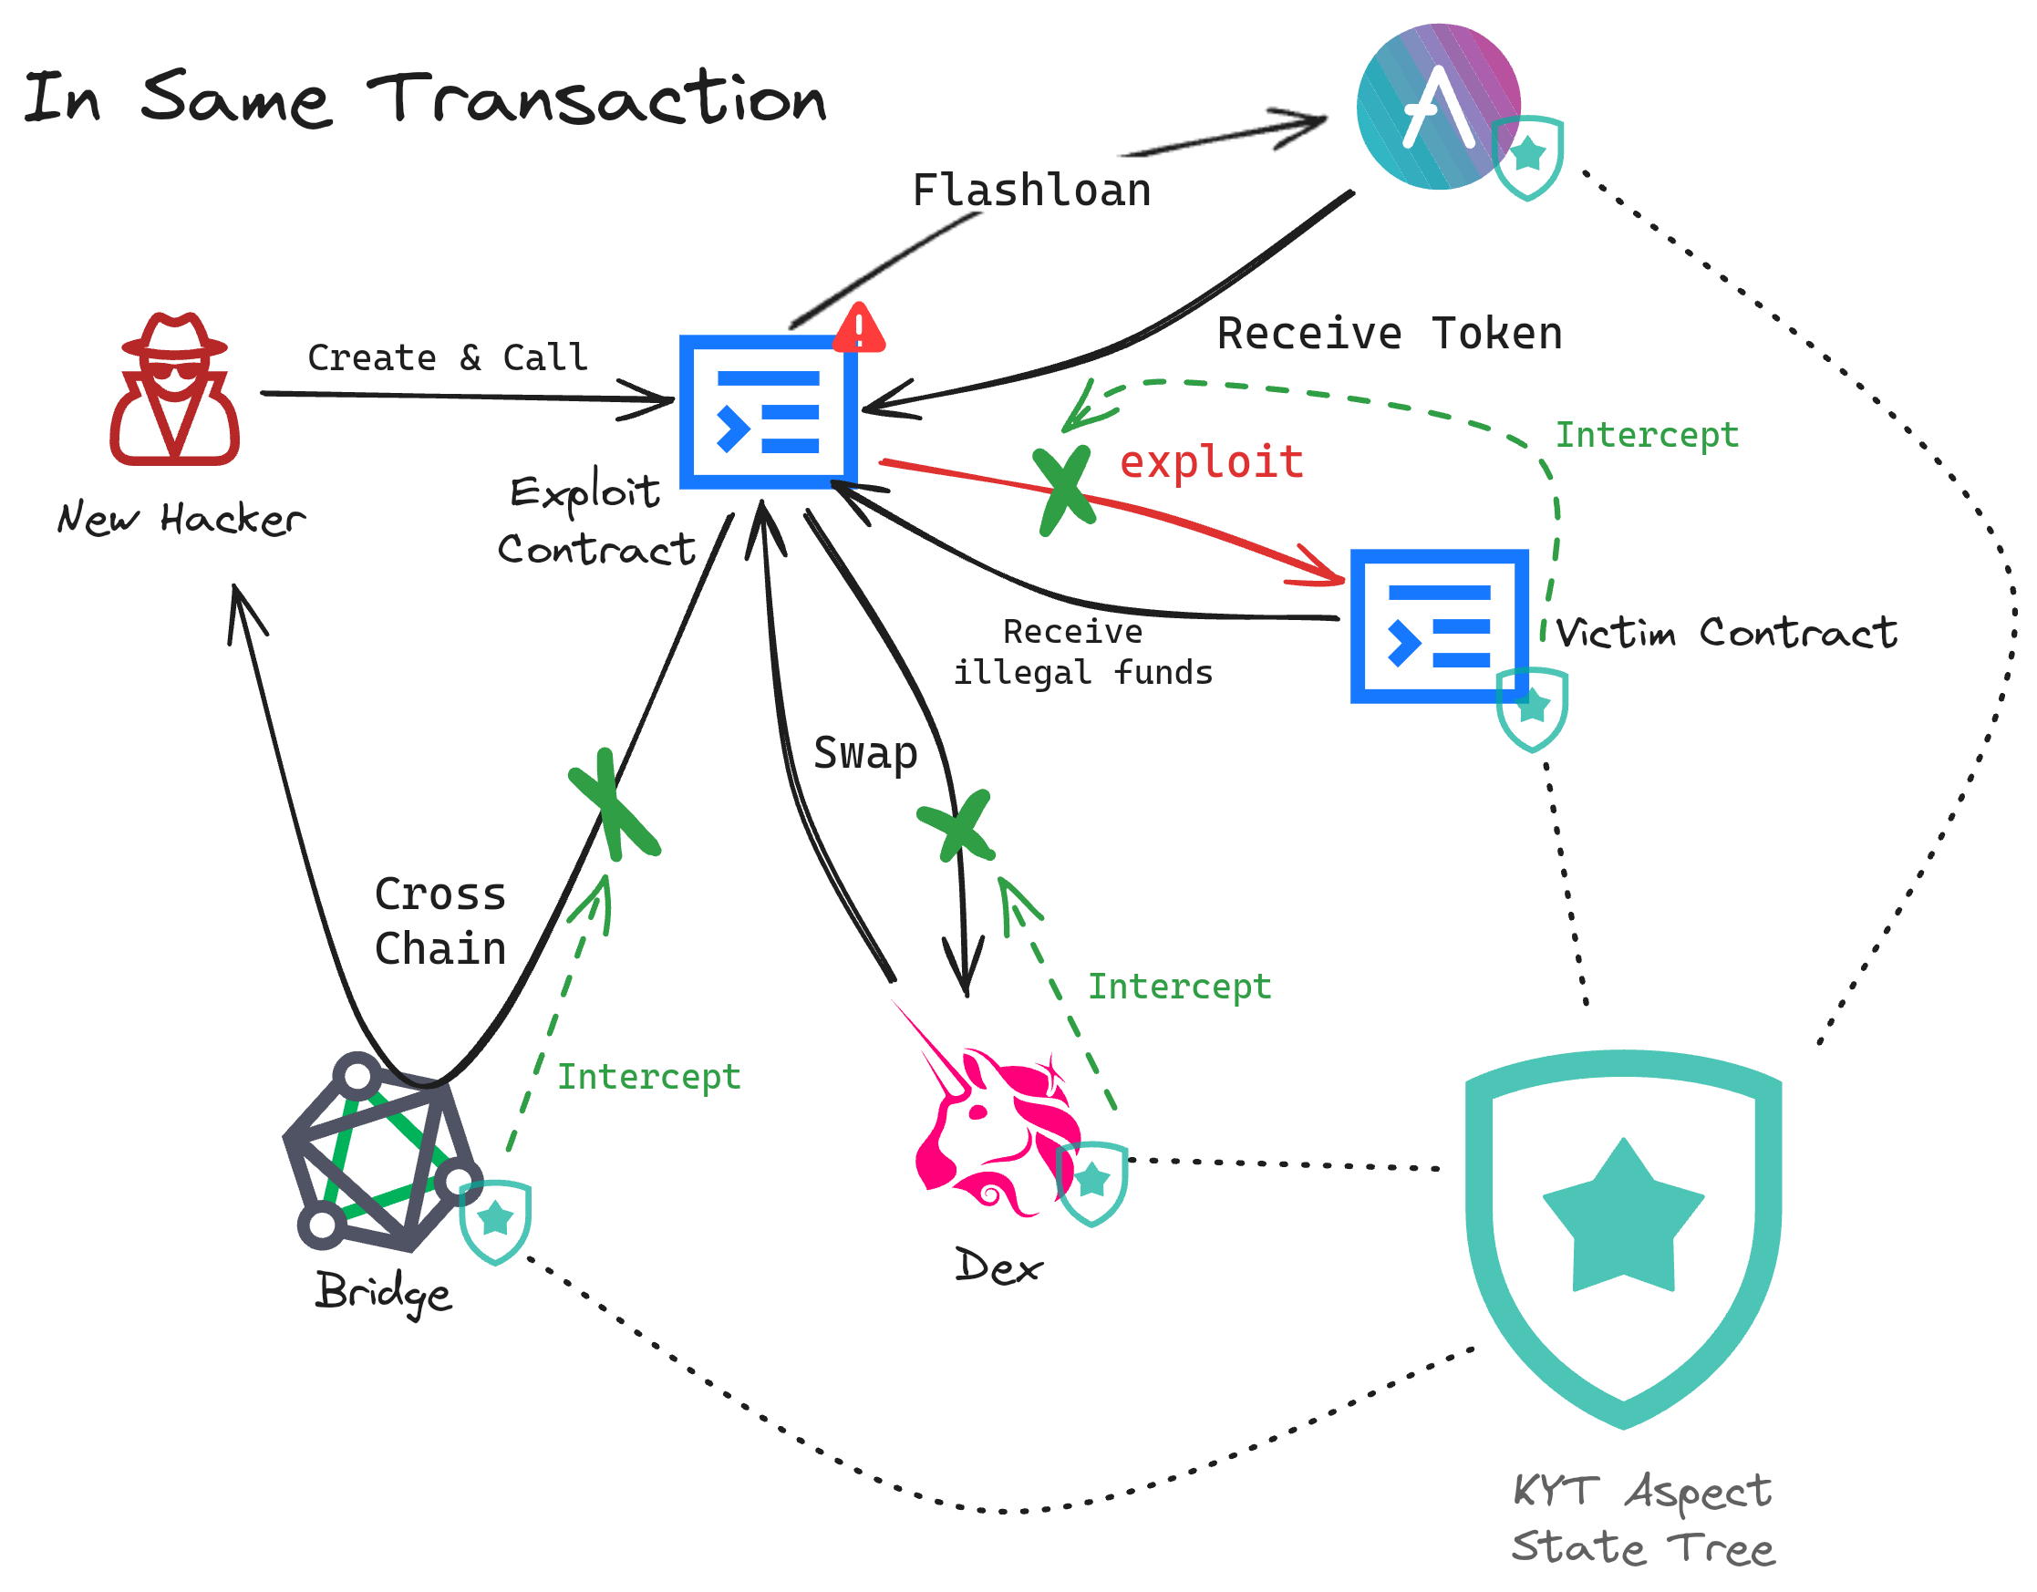
Target Users
High Regulatory Compliance
High Degree of Risk Control
Corporate and Individual Users
with High-Value Assets
Notes:
being a Public Good, KYT Aspect is aimed at all participants and projects within the entire ecosystem, such as DEXes, Lending, Bridges, Staking, RWA, etc.
this figure shows an entire attack-chain in one transaction, if the projects mentioned above had integrate the KYT aspect, the attack could be detected and intercepted at any steps.

Slide 7
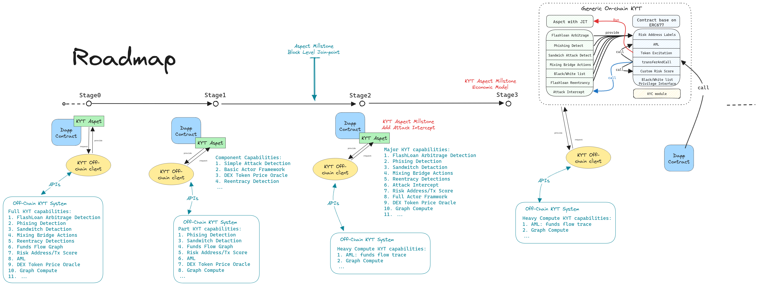
Roadmap
Notes:
The development of KYT Aspect can be divided into at four stages:
In the beging phase, the data for the KYT Aspect is entirely provided by the off-chain KYT system and is periodically updated by off-chain data providers.
At the final stage, main KYT functionalities such as phishing attack detection and risk scoring systems can be migrated from off-chain to on-chain, we can also crafting an economic and decentralized governance model for the on-chain KYT system.

Slide 8
Thank You
https://github.com/ZanTeam/KYTAspect
Notes:
Thank you all for listening. For the complete design scheme and code, please visit our github page.

