Slide 1


Placement review
By Zan Zver, 5.5.2021

Slide 2
Table of contents
About the company
About the team
What tech have I used
Top 3 projects
Tech that I will use
Questions

Slide 3
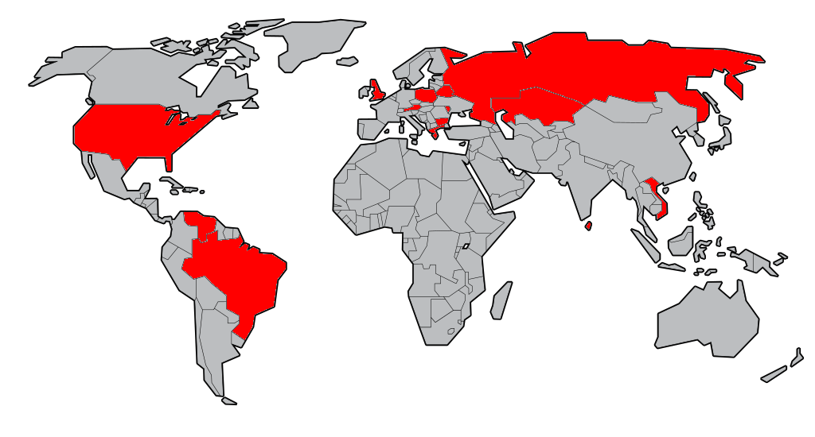
About the company
Private owned company
Focus is software development
Based in UK with global co-workers

Slide 4
About the team (sysadmin)
manager
senior
junior
junior
junior
junior
senior
senior
junior

Slide 5
What tech have I used

Slide 6
Top 3 projects
S3 transfer
SQL anonymization
Server migration

Slide 7
S3 transfer
Situation
We had to automatically clone data from production to test
Task
Clone some folders of bucket 1 to bucket 2
Action
Use AWS CLI and Python to transfer the data
Result
Task is now automated with Crontab

Slide 8
SQL anonymization
Situation
Due to GDPR we had to anonymise data and move it
Task
Clone SQL, anonymise data and transfer it
Action
Use AWS CLI, find optimal Python library
Result
Automatic anonymization with Crontab

Slide 9
Server migration
Situation
To reduce cost of hosting, we are migrating servers
Task
Identify servers, plan downtime, migrate from Ireland to London
Action
Follow the migration steps
Result
Server is migrated, guide is set

Slide 10
Tech that I will use
Password manager
Selfhosted projects
Wiki -> book stack
Grafana
Monitoring -> Pulseway
Jupiter
Git -> GitEa

Slide 11
Questions
?

