Slide 1
Versioning with Git/Github
Zan Zver

Slide 2
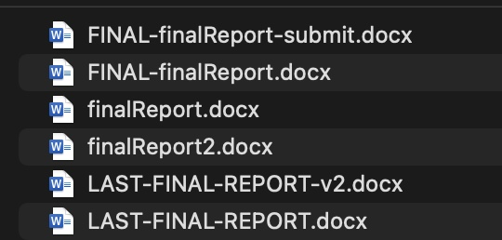
Versioning
User modification(s)
History control -> track progress

Slide 3

Git
Open source
Developed by Linus Torvalds

Slide 4
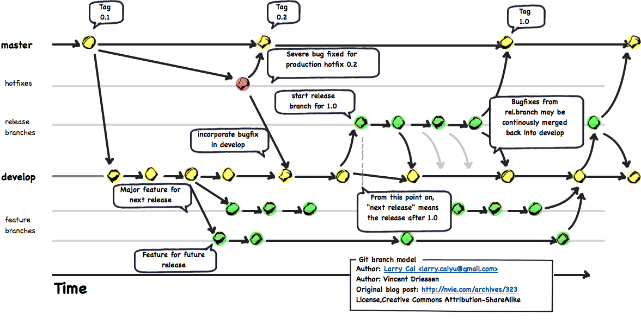
Git branches
Main (master)
Develop
Test

Slide 5
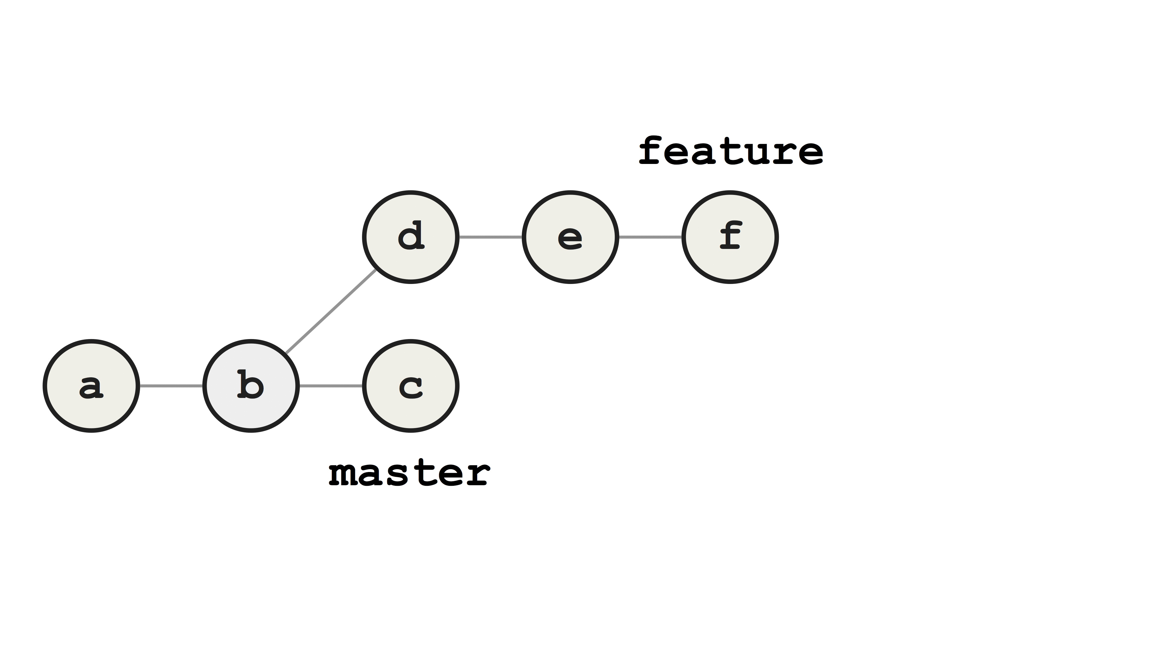

Slide 6
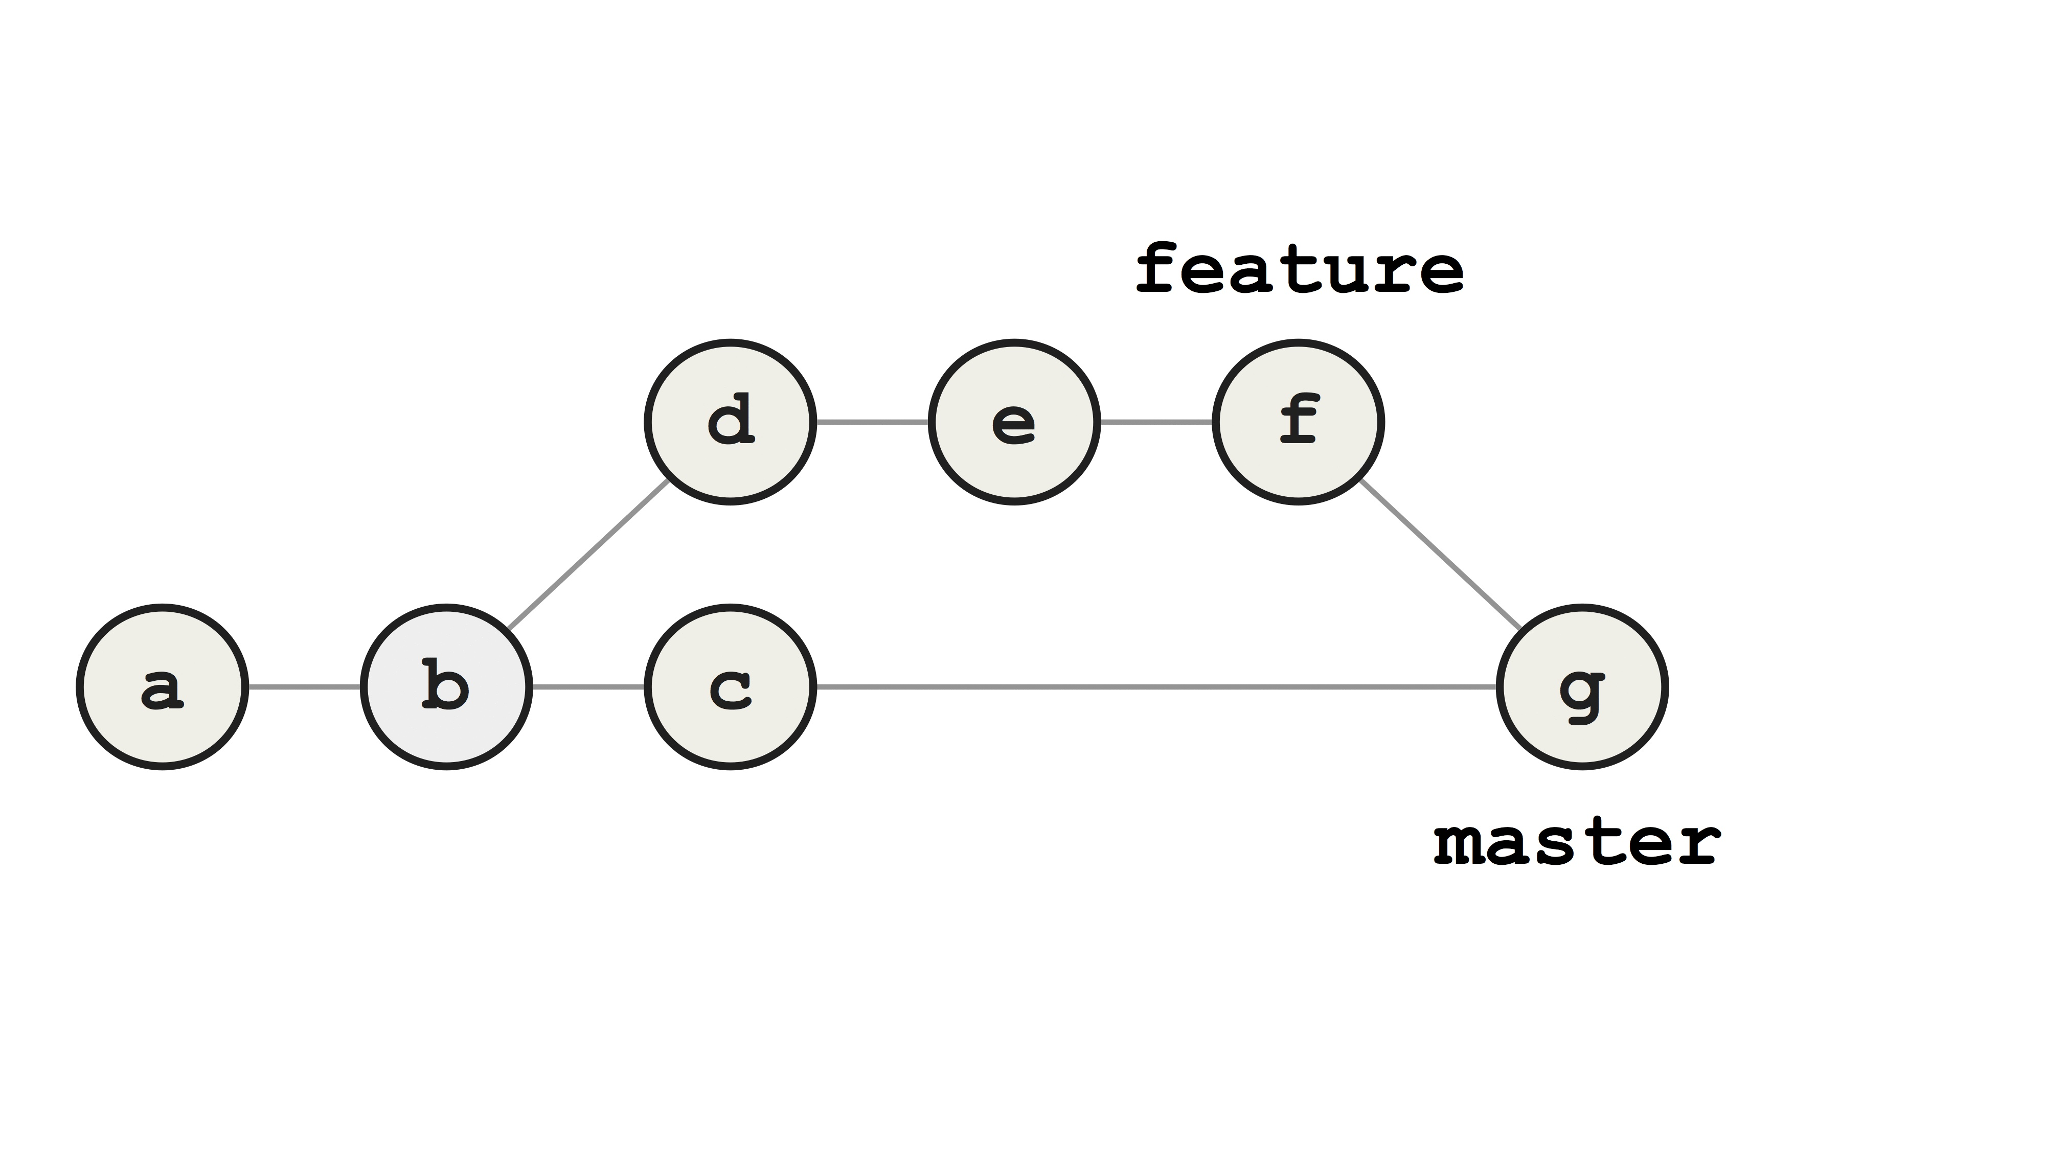

Slide 7



Git providers
GitHub
GitLab
Bitbucket

Slide 8
GitHub

Slide 9
Github
One of the most popular platforms
Free to use
Recently been purchased by Microsoft
Offers free stuff for students

Slide 10
Why GitHub
Store / share the code
Collab with others
Your portfolio!

Slide 11
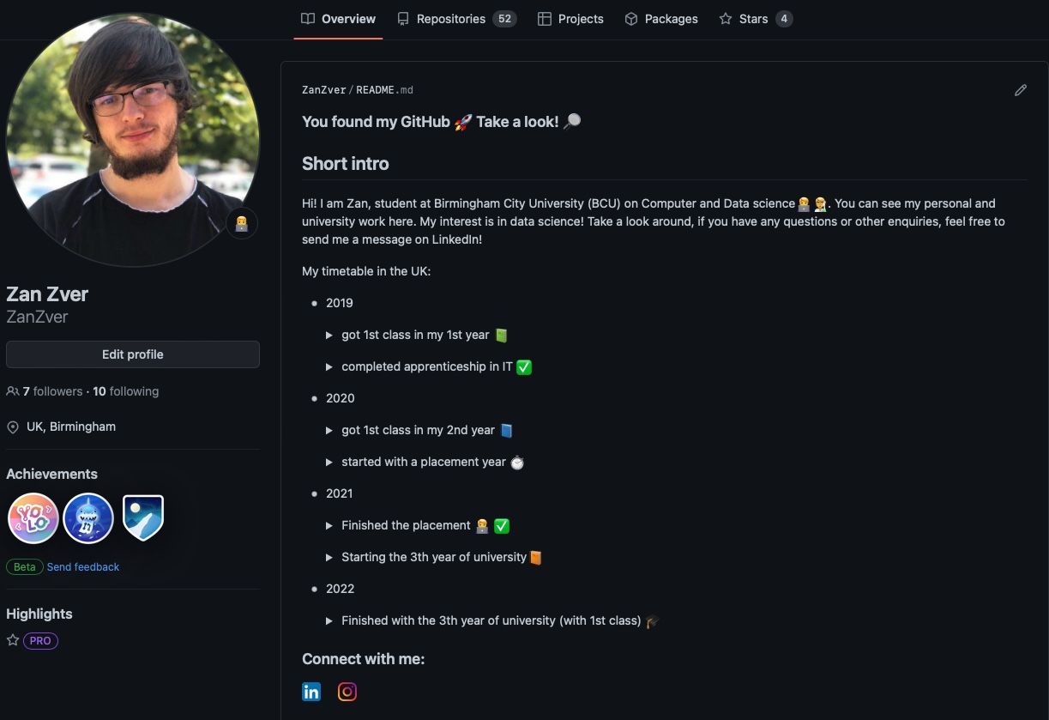

Slide 12

Github sign up

Slide 13
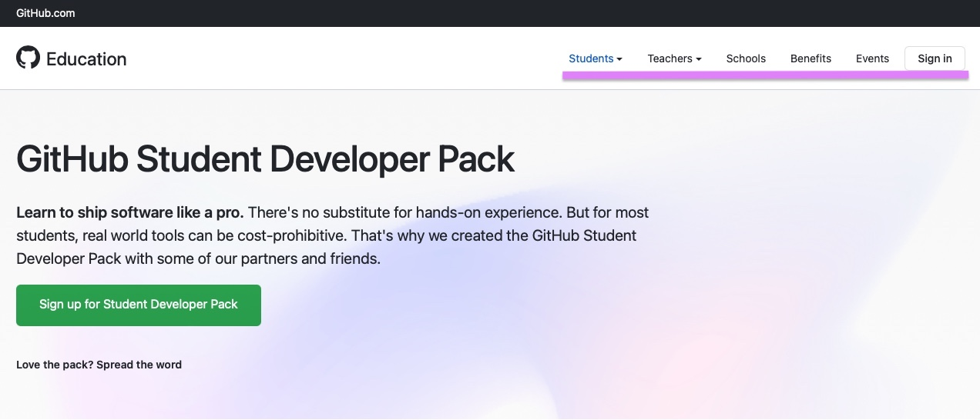
Github student pack

Slide 14


Packs

Slide 15





Slide 16
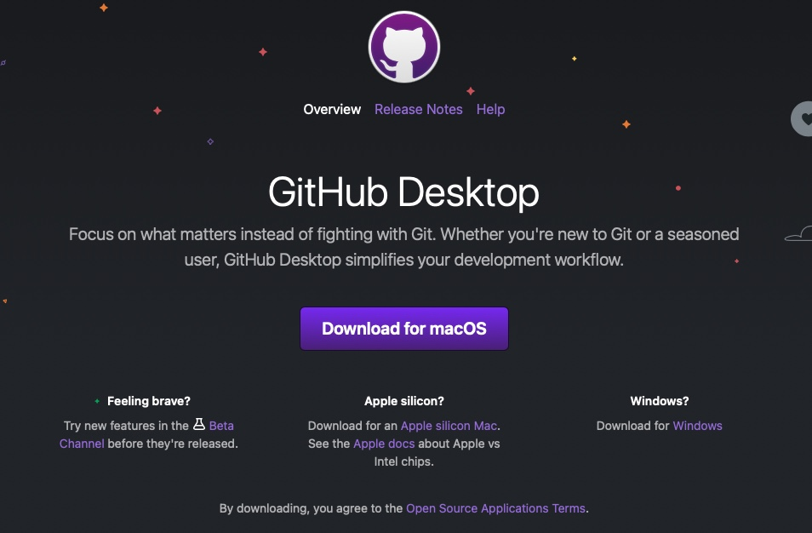
Github app

Slide 17
Practical activity
Explore Pandas repo:
https://github.com/desktop/desktop
Explore my profile & repo:
https://github.com/ZanZver/
Create GitHub repo and upload this PPTX

