Slide 1
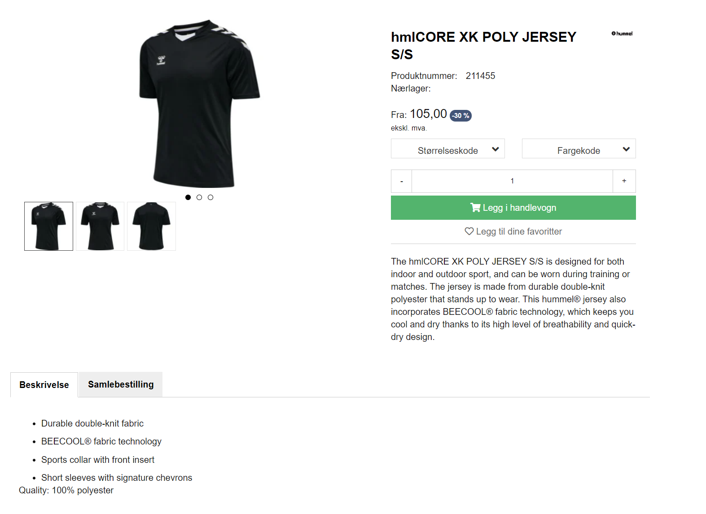
2
1
5
URL to example product:
https://www.assistco.no/hmlcore-xk-poly-jersey-s-s
3
4

