Slide 1
Multitask Management

Slide 2

Introduction
Process execution
Java Virtual Machine is a system process. You can run new processes through the java.lang.Runtime Object.
The Runtime object is retrieved through a static method:
Multitask Management
Mutli-processus:
Spaw local processes that communicates together
In Java : StdIn, StdOut, StdErr…
Can run anything (from C programs to a new JVM !)
Multithread:
Faster
Shared Memory managements
Java Classes
Runtime myRuntime = Runtime.getRuntime();
Runtime Object:
Executes systems processes (exec):
Synchronized execution (method: waitFor())
Not synchronized execution (default)
Gives a Process Object to handle the spawned processus (StdIn/StdOut/StdErr, Kill, Exit Code & Join)
Tells stuff about JVM memory usage (Mx, …)
Runs Garbage Collection operations
Runs finalizations.
Changes VM behavior

Slide 3
Process Execution - example
Runtime myRuntime = Runtime.getRuntime();
System.out.println(“java -mx Parameter:“+myRuntime.maxMemory());
Process notepad = myRuntime.exec("notepad.exe");
notepad.waitFor();
String envp [] = {"MY_ENV_VAR=Java is cool!"};
Process process =
myRuntime.exec("CMD.EXE /A /C \"echo %MY_ENV_VAR%\"", envp);
InputStream ins = process.getInputStream();
OutputStream out = process.getOutputStream();
int inputBuffer = 0;
while ( (inputBuffer = ins.read()) != -1)
{
System.out.print((char)inputBuffer);
}
System.out.println("Process Exit Value=" + process.exitValue());

Slide 4
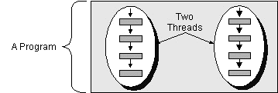
Thread
notions
Definition:
A thread is a sequential flow of control within a processus.
A program that uses more than one Thread are Multithreaded programs.
Well known threads:
main (Remember: Exception in thread "main“… ☺)
Garbage collector
Called sometimes: execution context or lightweight process.
Used to isolate tasks
In Java:
Threads are instances of classes that:
extends the java.lang.Thread class
or implements the java.lan.Runnable interface
Each Java Thread must implement a run() method. The content of this method will run in a new (a separate) stack of instruction (a thread !) . public void run()
You start the Thread by calling the start() method executes the run() method in a new execution stack.

Slide 5
First Thread Example
class TwoAsyncThread {
public static void main(String args[ ]) {
new MyThread("1 --> First Thread").start();
new MyThread("2 ==> Second Thread").start();
}
}
class MyThread extends java.lang.Thread {
public MyThread(String str) {
super(str);
}
public void run() {
for (int i=0; i<10; i++) {
System.out.println(i+" "+ this.getName());
try {sleep((int)(Math.random()*10));}
catch (InterruptedException e){}
}
System.out.println(getName() + " est finie");
}
}

Slide 6
First Thread Example (cont.)
class TwoErrAsyncThread {
public static void main(String args[ ]) {
new MyThread("1 --> First Thread").start();
new MyThread("2 ==> Second Thread").start();
throw new Error("error");
}
}
J:\>java visionitgroup.java05.TwoAsyncThread
Exception in thread "main" java.lang.Error: error
at visionitgroup.java05.TwoAsyncThread.main(TwoAsyncThread.java:7)
0 1 --> First Thread
0 2 ==> Second Thread
1 1 --> First Thread
1 2 ==> Second Thread
2 1 --> First Thread
[...]

Slide 7
Threaded classes
notions
Extends java.lang.Thread :
or implements java.lang.Runnable:
Needed to make Runnable a class that should extends an other one (Frames, Applets…) :
class MyThreadedClass extends Thread {
public void run() {
}
}
class MyRunnableClass implements Runnable {
public void run() {
}
}
class MonAppletThread extends java.applet.Applet implements Runnable { public void run() { }}

Slide 8
Two Samples
Samples
An auto-start Thread :
An auto-start Thread within Runnable interface :
class C1 extends Thread {
public C1() { this.start(); }
public void run() {
System.out.println("C1 is cool");
}
}
class C1 extends Thread {
public C1() { this.start(); }
public void run() {
System.out.println("C1 is cool");
}
}

Slide 9
Thread
Samples
Everything in Java runs into a Thread!
Main ones:
void start(): starts the current Thread.
void stop(): NEVER USE IT ! (deprecated)
void suspend() : suspends Thread execution (deprecated)
void resume() : resumes a suspended Thread (deprecated)
static void sleep() : sleep method.
public class TestMain extends Thread {
public static void main(String [] args) {
Thread t = Thread.currentThread();
System.out.println(t);
}
}
J:\>java TestMain
Thread[main,5,main]

Slide 10
How to stop a thread
public class MyThread extends Thread {
private boolean runSwitch = true;
public void run() {
while (runSwitch) {
[...]
}
}
public void stopIt() {
thisrunSwitch = false
}
public static void main(String [] args) {
MyThread mt = new MyThread();
[...]
System.out.println(t);
mt.stopIt();
[...]
}
}

Slide 11
Wait, notify, notifyAll
Samples
Each object has the following methods: wait, notify, notifyAll
In a synchronized method of an object:
wait(): releases the lock and holds
notify(): wakes up a Thread (FIFO algorithm)
notifyAll(): wakes up every waiting Thread.
Avoid Deadlocks !
class MyThing {
synchronized void waiterMethod() {...; wait(); ...}
synchronized void notifyMethod() {...; notify(); ...}
synchronized void anOtherMethod() {...}
}

Slide 12
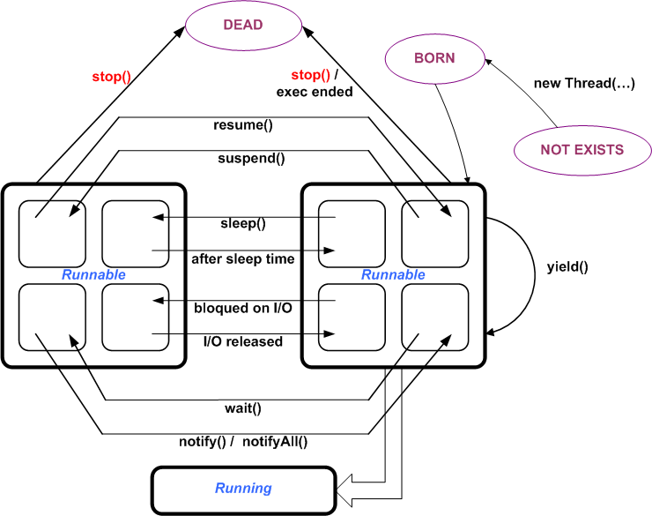
Thread Status

Slide 13
Thread Scheduler
notions
Threading management:
Eligibility for CPU time (Priority management).
Time-slicing (yield or sleep)
Kernel Threads
Thread Groups
Thread priorities:
Each Thread is associated to a priority.
In the JVM a priority is a number which values goes from Thread.MAX_PRIORITY (10) to Thread.MIN_PRIORITY (1).
You can set it through setPriority(int) or retrieve it through getMinPriotrity() method.

Slide 14
Threadgroup
notions
Threads are managed in the JVM through group:
Destruction, counting, enumeration, priority management, hierarchy and so on…
ThreadGroup toto = new ThreadGroup("Toto");
toto.setMaxPriority(4);
(new TestGroup(toto, "--mth1--")).start();
(new TestGroup(toto, "--mth2--")).start();
toto.list();
System.out.println("Parent:" + toto.getParent());
J:\>java visionitgroup.java05.TestGroup
java.lang.ThreadGroup[name=Toto,maxpri=4]
Thread[--mth1--,4,Toto]
Thread[--mth2--,4,Toto]
Parent:java.lang.ThreadGroup[name=main,maxpri=10]

Slide 15
Thread Stack
notions
Each Thread has its own Java Stack in the JVM:
public class TestStack extends java.lang.Thread {
public static void testIt() {
Thread.dumpStack();
}
public static void main(String [] args) {
testIt();
System.out.println("After all this..");
}
}
J:\>java visionitgroup.java05.TestStack
java.lang.Exception: Stack trace
at java.lang.Thread.dumpStack(Thread.java:1064)
at visionitgroup.java05.TestStack.testIt(TestStack.java:7)
at visionitgroup.java05.TestStack.main(TestStack.java:12)
After all this..

Slide 16
Mutual Access Management
notions
Java uses a Monitor to check if an object’s access is allowed. A Thread can access an object if no other Thread has locked it.
You can lock an object in Java using synchronized key word.
Explicitly on an object:
Thread t = Thread.currentThread();
Object mData = new Object();
System.out.println(t);
System.out.println(Thread.holdsLock(mData)); //false
synchronized (mData) { //Object Locked
System.out.println(Thread.holdsLock(mData));//true
}
[...] //Object Released

Slide 17
Mutual Access Management (cont.)
notions
Implicitly through a function :
Which is translated to :
synchronized void myMethod() {...}
void myMethod() {
synchronized (this) {
}
}

Slide 18
Mutual Access Protection Example
public class TestMain extends Thread {
class Bank {
synchronized void deposit(int montant) {...}
synchronized void withdraw(int montant) {...}
}
class Client implements Runnable {
bank b;
public Client(Bank b) {
this.b = b;
Thread t = new Thread(this); t.start();
}
public void run() {
... b.deposit(100); ... b.withdraw(10); ...
}
}
Bank b = new Bank();
Client c1 = new Client (b); Client c2 = new Client(b);

