Slide 1




Boost your creativity with Bootstrap 5:
A PRACTICAL GUIDE WEBINAR

Slide 2
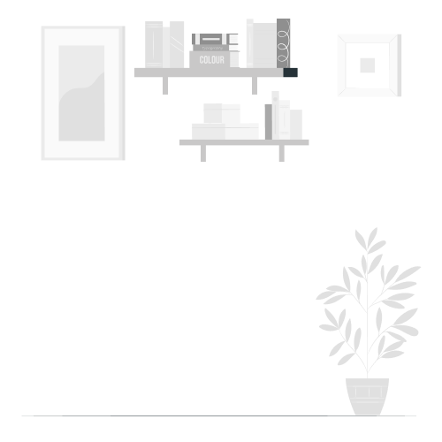












Slide 3

01
TIMES UP!
Can you guess the word behind this image?
Javascript

Slide 4

02
TIMES UP!
Can you guess the word behind this image?
C ++

Slide 5
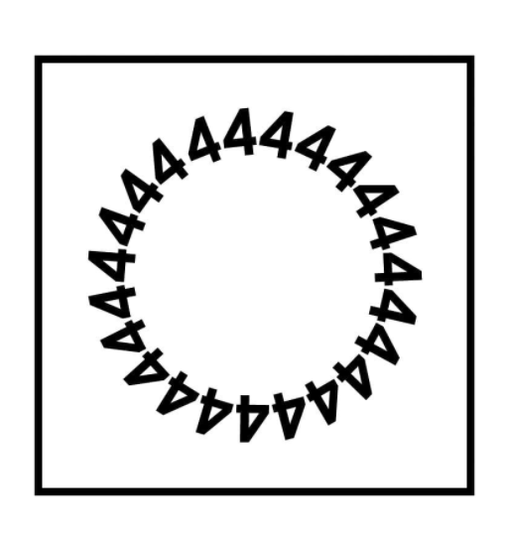
03
TIMES UP!
Can you guess the word behind this image?
For loop

Slide 6
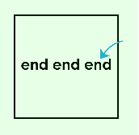
04
TIMES UP!
Can you guess the word behind this image?
Front End

Slide 7

05
TIMES UP!
Can you guess the word behind this image?
Grape

Slide 8

What is Bootstrap?
Bootstrap is a giant collection of handy, reusable bits of code written in HTML, CSS, and JavaScript. It’s also a frontend development framework that enables developers and designers to quickly build fully responsive websites.
Essentially, Bootstrap saves you from writing lots of CSS code, giving you more time to spend on designing webpages.
Boost your creativity with Bootstrap 5
1

Slide 9
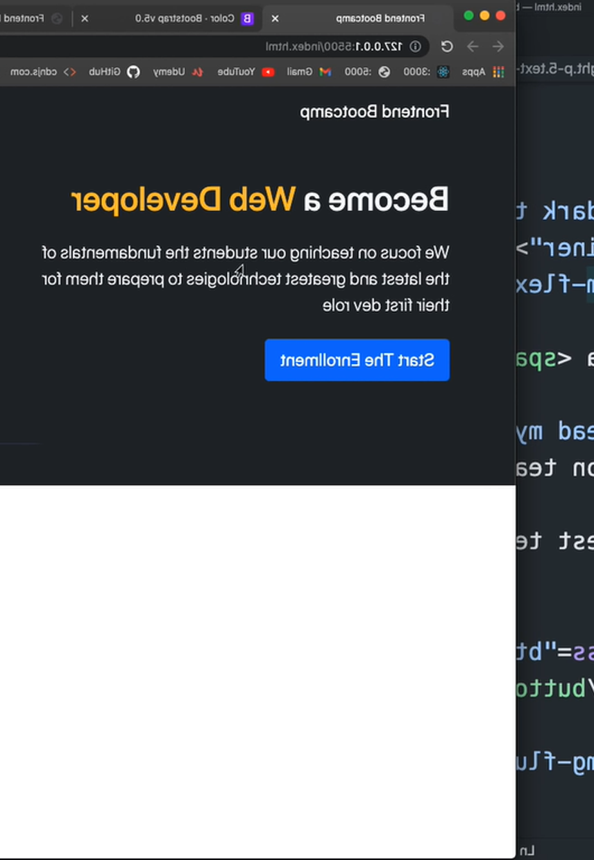
Why use Bootstrap on your Front-End Development?
Ease of Use
First and foremost, Bootstrap is easy to learn. Due to its popularity, plenty of tutorials and online forums are available to help you get started.
One of the reasons why Bootstrap is so popular among web developers and web designers is that it has a simple file structure. Its files are compiled for easy access, and it only requires basic knowledge of HTML, CSS, and JS to modify them.
Boost your creativity with Bootstrap 5
2

Slide 10

Why use Bootstrap on your Front-End Development?
Browser Compatibility
Making your website accessible via different browsers helps reduce the bounce rate and rank higher in search results. Bootstrap fulfills that requirement by being compatible with the latest versions of popular browsers.
Boost your creativity with Bootstrap 5
3

Slide 11

Why use Bootstrap on your Front-End Development?
Bootstrap Image System
Bootstrap handles the image display and responsiveness with its predefined HTML and CSS rules.
Adding the .img-responsive class will automatically resize images based on the users’ screen size. This will benefit your website’s performance, as reducing image sizes is part of the site optimization process.
Boost your creativity with Bootstrap 5
4

Slide 12
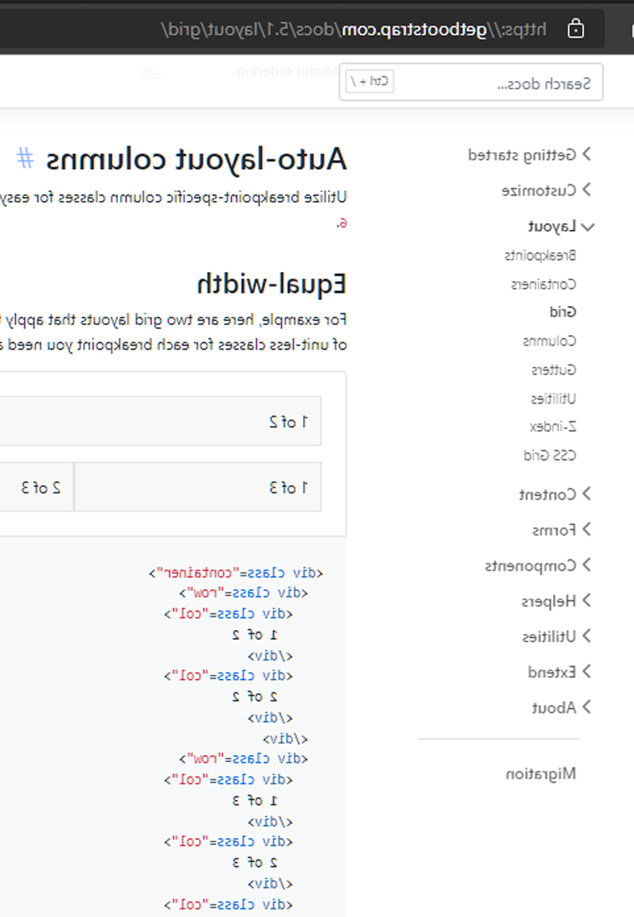
Why use Bootstrap on your Front-End Development?
Bootstrap Documentation
Bootstrap’s documentation is some of the best we’ve ever seen. Every piece of code is described and explained in explicit detail on their website.
Explanations also include code samples for basic implementation, simplifying the process for even the most beginner of beginners. All you need to do is choose a component, copy and paste the code into your page, and tweak from there.
Boost your creativity with Bootstrap 5
5

Slide 13

How to use Bootstrap?
Environment Setup
Boost your creativity with Bootstrap 5
6

Slide 14
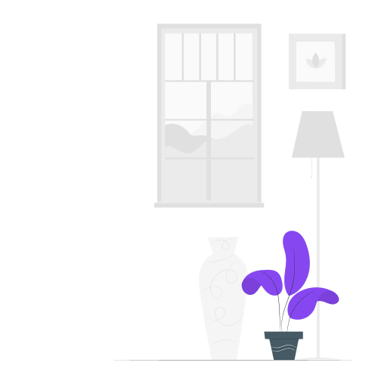
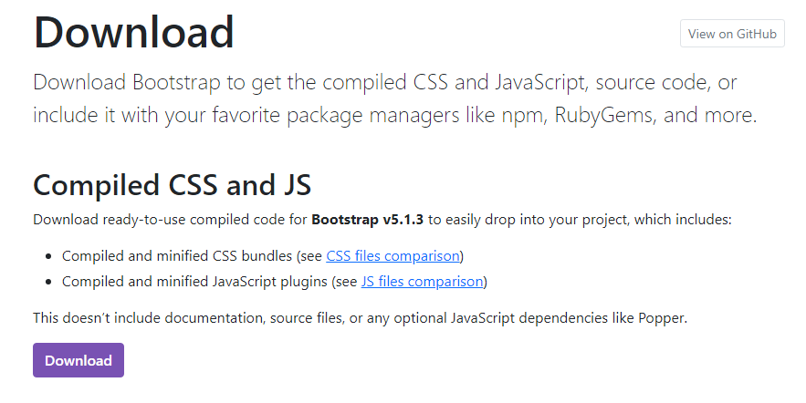
Installing Bootstrap
Download directly from site the bootstrap CSS and JS file.
Includes compiled and minified versions of CSS bundles and Javascript plugins.
Download · Bootstrap v5.1 (getbootstrap.com)
Boost your creativity with Bootstrap 5
7

Slide 15
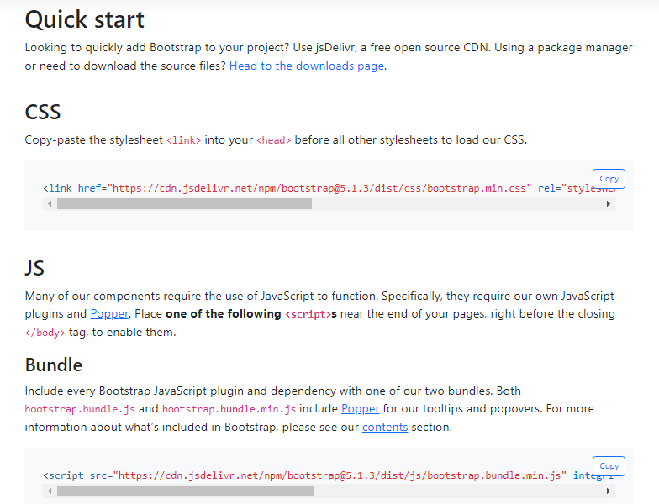
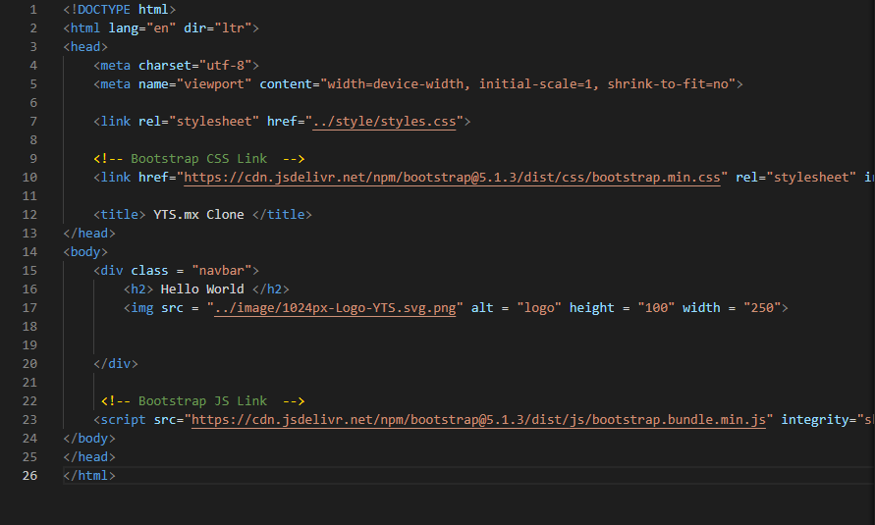
Installing Bootstrap
Use the Bootstrap CDN links.
Copy the CSS and JS link from the site and paste it to your code.
Boost your creativity with Bootstrap 5
8

Slide 16

Bootstrap Components
Boost your creativity with Bootstrap 5
9

Slide 17
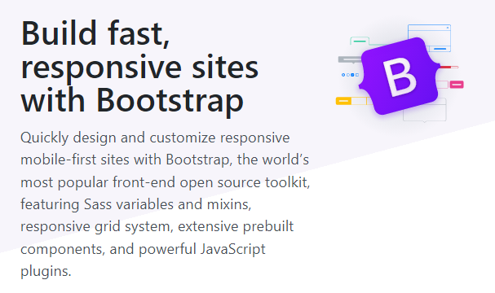
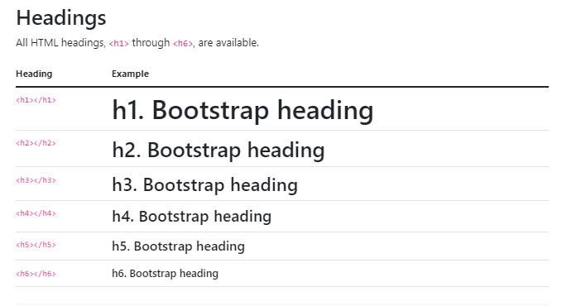
Typography
Typography is a feature of Bootstrap for styling and formatting the text content.
It is used to create customized headings, inline subheadings, lists, paragraphs, aligning, adding more design-oriented font styles and much more.
Boost your creativity with Bootstrap 5
10

Slide 18
Buttons
Buttons are used for various purposes. For submiting or resetting an HTML form, perform interactive actions such as showing or hiding something on a web page on click of the button, redirecting the user to another page, etc. Bootstrap provides a quick and easy way to create and customize the buttons.
Bootstrap includes several predefined button styles, each serving its own semantic purpose, with a few extras thrown in for more control.
Boost your creativity with Bootstrap 5
11

Slide 19
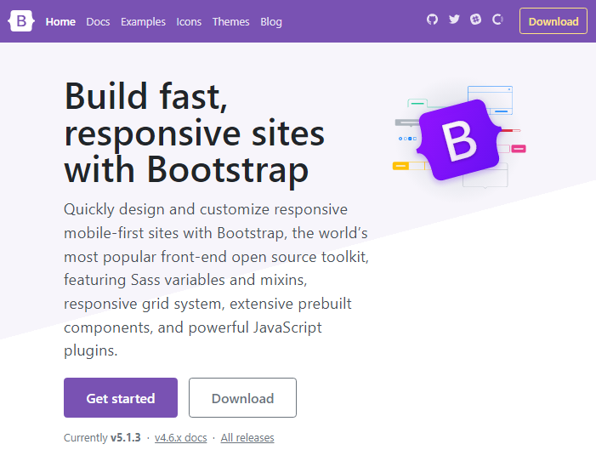
Navs and Tabs
The navbar is one of the prominent features of Bootstrap sites. Navbars are responsive 'meta' components that serve as navigation headers for your application or site.
Meanwhile, Tab based navigations provides a powerful mechanism to handle huge amount of content within a small area through separating content into different panes where each pane is viewable one at a time. User can quickly access the content through switching between the panes without leaving the page.
Boost your creativity with Bootstrap 5
12

Slide 20
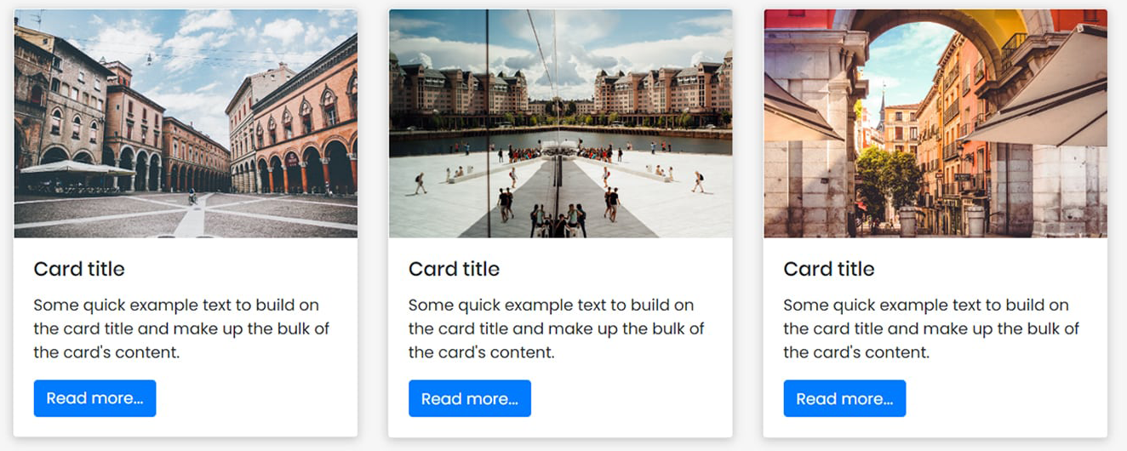
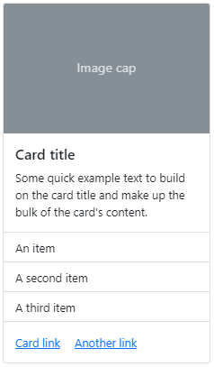
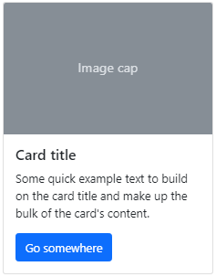
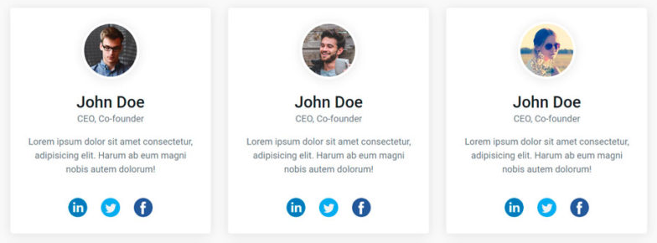
Cards
A Bootstrap card component is a content container. It incorporates options for images, headers, and footers, a wide variety of content, contextual background colors, and excellent display options. Bootstrap cards replace old Bootstrap panels, Bootstrap wells, and Bootstrap thumbnails.
Boost your creativity with Bootstrap 5
13

Slide 21
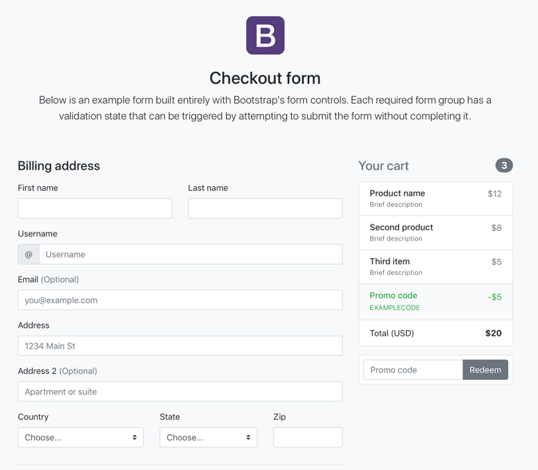
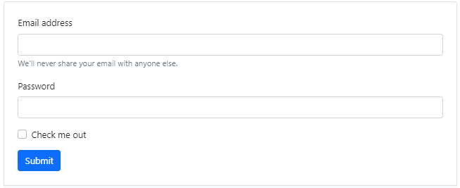
Forms
HTML forms are an integral part of the web pages and applications, but creating the form layouts or styling the form controls manually one by one using CSS are often boring and tedious. Bootstrap greatly simplifies the process of styling and alignment of form controls like labels, input fields, selectboxes, textareas, buttons, etc. through predefined set of classes.
Boost your creativity with Bootstrap 5
14

Slide 22

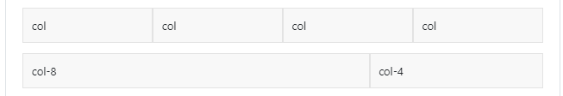
Grid
Bootstrap's grid system is responsive, and the columns will re-arrange depending on the screen size: On a big screen it might look better with the content organized in three columns, but on a small screen it would be better if the content items were stacked on top of each other.
Remember that grid columns should add up to twelve for a row. More than that, columns will stack no matter the viewport.
Boost your creativity with Bootstrap 5
15

Slide 23
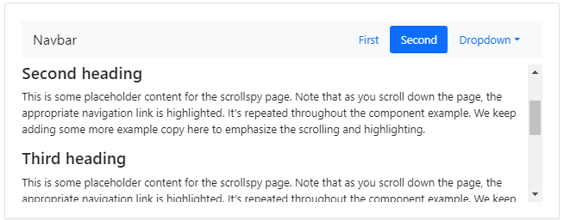
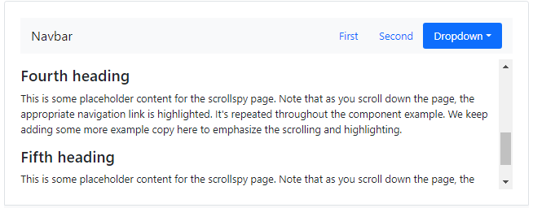
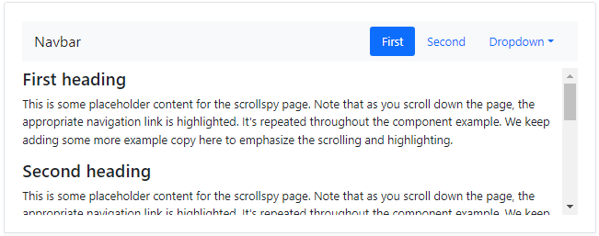
Scrollspy
The Bootstrap scrollspy is a navigation mechanism that automatically highlights the nav links based on the scroll position to indicate the visitor where they are currently on the page.
The scrollspy will make your web page more elegant and accessible, if you're using the bookmark links for directing the visitors to the different sections of a page that has a huge amount of content.
Boost your creativity with Bootstrap 5
16

Slide 24
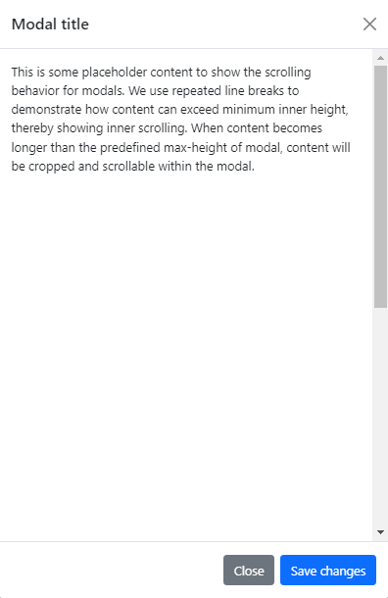
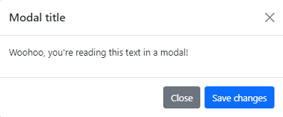
Modal
Modals are built with HTML, CSS, and JavaScript. They're positioned over everything else in the document and remove scroll from the <body> so that modal content scrolls instead.
Clicking on the modal “backdrop” will automatically close the modal. Bootstrap only supports one modal window at a time.
Boost your creativity with Bootstrap 5
17

Slide 25
References
DEFINITIONS
https://careerfoundry.com/en/blog/web-development/what-is-bootstrap-a-beginners-guide/
https://www.hostinger.ph/tutorials/what-is-bootstrap/
https://getbootstrap.com/docs/4.0/getting-started/download/
https://www.geeksforgeeks.org/typography-in-bootstrap/
https://www.edureka.co/blog/bootstrap-buttons/
https://www.tutorialspoint.com/bootstrap/bootstrap_navbar.htm
https://www.tutorialrepublic.com/twitter-bootstrap-tutorial/bootstrap-tabs.php
https://getbootstrap.com/docs/4.0/components/card/
https://www.tutorialrepublic.com/twitter-bootstrap-tutorial/bootstrap-forms.php
https://www.w3schools.com/bootstrap/bootstrap_grid_system.asp
https://www.tutorialrepublic.com/twitter-bootstrap-tutorial/bootstrap-scrollspy.php
https://getbootstrap.com/docs/4.3/components/modal/
ILLUSTRATIONS
https://storyset.com/pana

