Slide 1
Understanding the cardiac point clouds
DATA EXPLORATION / 900 labelled patients + 100 additional evaluation patients
Each patient contains
INSERT: 3D HEART VISUALISATION
10
cardiac frames
Use the generated figure:
results/presentation_figures/heart_structures.png
18,000
points per frame
3
anatomical surfaces
LV inner
LV outer
RV
Goal: distinguish healthy from previous myocardial infarction (pMI).
MI classification · exploratory pipeline · group presentation
01
Notes:
We began by visualising individual hearts over ten frames. The three anatomical surfaces provide geometry and temporal information, while demographics offer complementary risk factors.

Slide 2
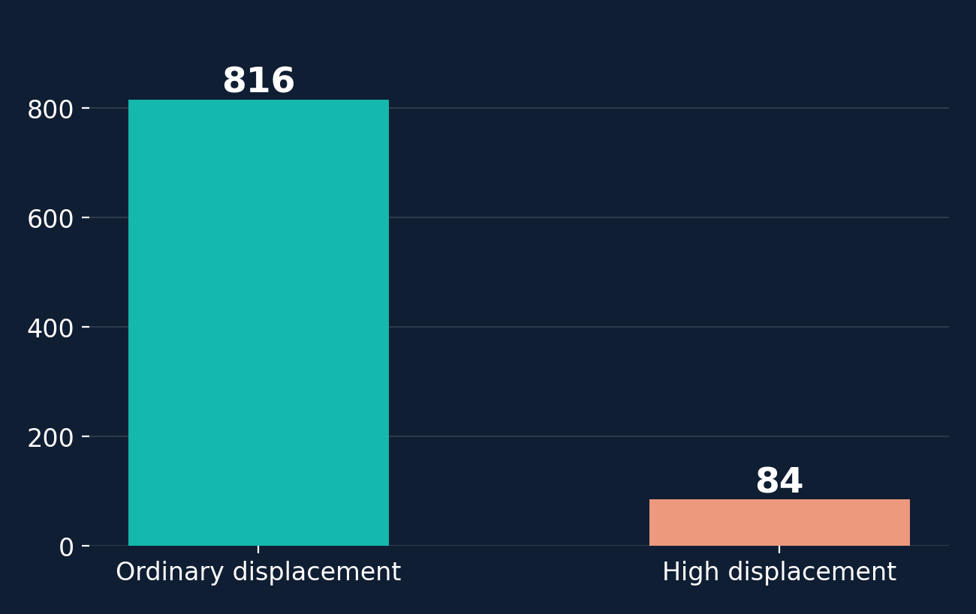
Anatomical QC: an unusual movement subgroup
EXPLORATION / point-wise frame-to-frame spatial displacement
84 / 900
patients exceeded P95 displacement > 15 in the training data.
PCA and k-means primarily separated movement regimes rather than MI status.
Interpretation: possible synthetic / correspondence artefacts — not confirmed corrupted cases.
MI classification · exploratory pipeline · group presentation
02
Notes:
We used the 95th percentile of point-wise movement across consecutive frames. 84 of 900 training patients exceeded our exploratory cutoff of 15. This might reflect atypical motion or point correspondence, but corruption is not established. QC-gating the separate 100 patients flagged none, and did not improve predictions.

Slide 3
Feature engineering: whole heart → regional motion
BIOLOGY / infarction can cause localised dysfunction rather than a uniform global change
LV inner
LV outer
RV
endocardial surface
epicardial surface
right ventricle
Region 2
Region 1
Region 0
PCA-defined long axis
Each cardiac surface divided into three equal-count longitudinal regions.
27 global size/change + 54 regional motion/radial + 7 demographic features
Motivation: infarcted myocardium may show regional wall-motion abnormalities.
MI classification · exploratory pipeline · group presentation
03
Notes:
Myocardial infarction can cause regional wall-motion abnormalities: affected segments may contract less strongly. We therefore divided each anatomical surface into three longitudinal tertiles using an unsupervised PCA axis (these are not validated clinical AHA segments). We engineered movement and radial-change features, alongside whole-heart geometry and demographics.

Slide 4
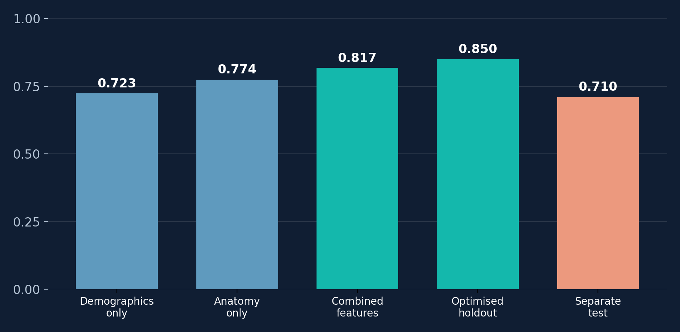
Predictive modelling: what worked — and what did not
MODEL COMPARISON / macro-F1; distinguish cross-validation from held-out testing
Models tried
Logistic regression
Random forest
Histogram gradient boosting
100-patient test
F1 = 0.710
Optimisation: 302 trial search; top feature recipe = demographics + global + LV outer regional.
MI classification · exploratory pipeline · group presentation
04
Notes:
We tested classical models and varied feature sets. Macro-F1 figures 0.723, 0.774 and 0.817 are cross-validated results on 900 labelled patients (baseline demographics / anatomy / combined). A large hyperparameter search reached 0.850 on an internal 180-patient holdout, but generalised to only 0.710 macro-F1 on the separate 100. This prompted an alternative representation-learning approach from our teammate.

Slide 5
VAE: learning cardiac motion
Spatial and temporal attention
sample z
Point clouds
Encoder
8D latent
Decoder
Reconstruction
10 frames
384 points/frame
2 attention blocks
μ, log σ²
1 attention block
10 × 384 XYZ
mean μ
Demographics
MI classifier
P(pMI)
7 features
128, 64 units
Sigmoid
521 train / 174 validation
Reconstruction + KL + classification loss
MI classification · exploratory pipeline · group presentation
05
Notes:
The saved model uses 8 latent dimensions and dropout 0.1. The experiment is named mi-vae-z15, but the saved configuration is authoritative. The current VAEConfig default is 15; that is not the evaluated model.
Input: ten frames and 384 correspondence-preserving sampled points, 128 per anatomical region. XYZ and region embeddings enter the encoder. Sixteen learned queries pool each frame. Two axial blocks apply spatial attention then temporal attention with width 384 and eight heads. Mean pooling produces the two Gaussian parameter heads. Reconstruction samples z during training. The decoder has one axial block and reconstructs the sampled XYZ coordinates without encoder shortcuts.
Classification uses the deterministic posterior mean plus seven demographics, then hidden layers of 128 and 64 units. Demographics enter only this head.
Original 60:20:20 patient split, seed 42: 540 training, 180 validation, 180 held-out test. Quality filtering leaves 521 training, 174 validation and 173 internal test patients. Scaling is fitted on training patients only. AdamW learning rate 0.0003, weight decay 0.001, batch size 8. KL weight warms to 0.01 over ten epochs. The selected checkpoint is epoch 683, chosen by validation macro-F1 0.792665.
Sources: /Users/thartigan/Documents/Classes/ML/myocardia_prediction_project/src/mcpp/vae.py; /Users/thartigan/Documents/Classes/ML/myocardia_prediction_project/src/mcpp/vae_training.py; /Users/thartigan/Documents/Classes/ML/myocardia_prediction_project/results/vae_training/mi-vae-z15/experiment.json; /Users/thartigan/Documents/Classes/ML/myocardia_prediction_project/results/vae_training/mi-vae-z15/final_evaluation/val_best/mi_classification_report.json.

Slide 6
VAE: results on 100 test patients
Separate labelled test set, decision threshold 0.5
Confusion matrix
0.809
81%
Predicted
Actual | Healthy | pMI
Healthy | 37 | 11
pMI | 8 | 44
Macro-F1
Accuracy
0.822
0.877
pMI F1
ROC-AUC
Engineered features: 0.710 macro-F1
Synthetic data. Clinical validation still needed.
MI classification · exploratory pipeline · group presentation
06
Notes:
Independent evaluation of the saved epoch-683 model on all 100 labelled patients in data/test_samples/test.csv, patient IDs 900–999. No quality exclusions. This is the labelled external test set, not the later test_samples_final submission dataset, for which predictions alone do not establish performance.
Macro-F1 0.8090644156366193; pMI F1 0.822429906542056; accuracy 0.81; ROC-AUC 0.8774038461538461. Class order is healthy, pMI. Confusion matrix rows are actual and columns predicted: [[37,11],[8,44]]. There are 48 healthy and 52 pMI patients. The model correctly classified 81, missed 8 pMI cases and classified 11 healthy patients as pMI.
The engineered-feature baseline macro-F1 of 0.710 comes from slide 4 and its notes in the supplied presentation, described there as evaluation on the separate 100 patients. The VAE improves the reported macro-F1 by approximately 0.099. Baseline patient-level predictions were not available here for a paired comparison.
The architecture learns spatial and temporal features jointly. These results alone do not establish which anatomical signals explain the gain; an ablation or interpretation study would be needed. The data are synthetic and the test sample is small. Clinical transfer remains untested.
Sources: /Users/thartigan/Documents/Classes/ML/myocardia_prediction_project/results/vae_training/mi-vae-z15/final_evaluation/val_best/mi_classification_report.json; /Users/thartigan/Downloads/MI_group_presentation_6_slides.pptx, slide 4 and speaker notes.

