Slide 1
DIGITAL-DREAMERS: Spam SMS Detection

Slide 2
Team members
Zandiswa Cetywayo-Project Manager
Nosihle Dzanibe-frontend developer
Memory Sidumo-Designer
Siniko Mgwatyu-backend developer
Chuleza Dotye- Researcher
Ntombizodwa Mbuthuma- Tester

Slide 3
Project Overview
A machine learning-based model to classify SMS messages as spam or legitimate using Natural Language Processing (NLP) techniques. Spam messages are a common issue, often leading to scams and phishing. The project aims to build an AI model that can accurately detect spam messages using TF-IDF, word embeddings, and classifiers like Naive Bayes, Logistic Regression and SVM.

Slide 4
Introduction
In the digital age, SMS remains a primary communication channel, but it is increasingly exploited by spammers and malicious actors.
These unsolicited messages range from mere annoyances to serious security threats like phishing attacks and financial scams.
Manual filtering is impractical, necessitating an automated, intelligent solution. The DIGITAL-DREAMERS Spam SMS Detector project addresses this critical need. We have developed a robust web application powered by a Machine Learning (ML) model that automatically analyzes and classifies SMS messages in real-time.
By leveraging Natural Language Processing (NLP), our system provides users with a clear, instant assessment of whether a message is "Spam" or "Not Spam," enhancing both security and user experience.

Slide 5
2. Team Members & Roles
Our team's success is built on a clear division of responsibilities and collaborative effort.
• Zandiswa Cetywayo - Project Manager
• Nosihle Dzanibe - Frontend Developer
• Memory Sidumo – Designer
• Siniko Mgwatyu - Backend Developer
• Chuleza Dotye – Researcher
• Ntombizodwa Mbuthuma - Tester

Slide 6
3. Software Development Methodology
We adopted an Agile methodology for this project. This iterative approach allowed for flexible planning, continuous development, and frequent testing.
We worked in sprints, enabling us to incorporate feedback, adapt to changes quickly, and deliver a functional product incrementally, from a basic model to a fully-featured web application.

Slide 7
4. Research & Adaptability
Our research phase was critical to selecting the most effective technologies.
• NLP Techniques: We explored and implemented TF-IDF (Term Frequency-Inverse Document Frequency) for its effectiveness in converting text into a meaningful numerical representation, highlighting the importance of words in a message.
• ML Models: A comparative analysis was conducted on various classifiers, including Naive Bayes, Logistic Regression, and Support Vector Machines (SVM), to determine which offered the best balance of accuracy, speed, and computational efficiency for our task.

Slide 8
• Technology Stack: For the backend, Flask was chosen for its simplicity and suitability for building REST APIs. The frontend was built with standard web technologies (HTML, CSS, JS) for broad compatibility.
• Adaptability: The model is designed to be retrained with new data, allowing it to adapt to evolving spam tactics. The modular system design also makes it easy to swap out or upgrade the ML model in the future.

Slide 9
5. System Requirements
Functional Requirements:
The system shall allow users to input an SMS message via a text area.
2. The system shall provide a button to trigger the analysis of the message.
3. The system shall display the classification result ("Spam" or "Not Spam") clearly to the user.
4. The system shall maintain a history of analyzed messages and their results. 5. The system shall offer a light and dark mode user interface.

Slide 10
Non-Functional Requirements:
Usability: The interface must be intuitive and easy to use for all demographics.
2. Performance: The classification of a message must occur in near real-time (< 2 seconds).
3. Reliability: The system must be available and function correctly under normal use.
4. Security: User data and analyzed messages should be handled securely (e.g., not stored
permanently without consent).

Slide 11
6. System Design
The system follows a client-server architecture.
1. Frontend (Client): A web-based dashboard where users interact with the application. It sends user-inputted messages to the backend and displays the results.
2. Backend (Server): A Flask server that hosts the trained ML model. It receives messages from the frontend, processes them through the model, and returns the prediction.
3. ML Model: The core intelligence, residing on the backend, which performs the actual spam classification.

Slide 12
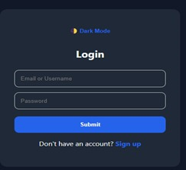
User Interface Design:
The application features a clean and responsive design with both light and dark mode options, as
shown in the provided images.
User Authentication:

Slide 13
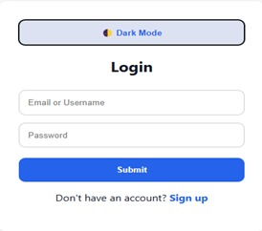

Slide 14
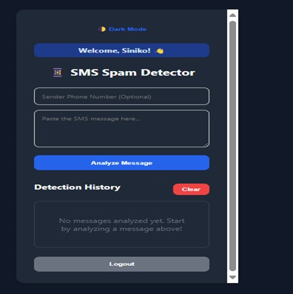
Main Application Dashboard:
The core interface where users paste and analyze messages and The application's initial state before any messages are analyzed

Slide 15
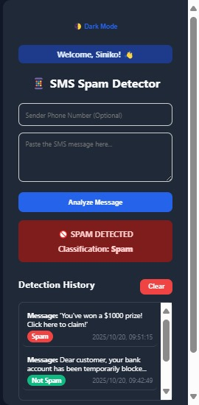
The main dashboard in dark mode, showing a "Spam" Not Spam" result. A detailed view showing the analysis button and a history log of past detections.

Slide 16
7. Implementation
The implementation was divided into two main streams
Backend & Machine Learning :
Data Preprocessing: The SMS dataset was cleaned by removing stop words, punctuation, and performing tokenization.
2. Feature Engineering: The text data was vectorized using the TF-IDF technique.
3. Model Training & Selection: Multiple models (Naive Bayes, Logistic Regression, SVM) were trained, evaluated, and the best-performing one was integrated into the system.

Slide 17
4. API Development: A REST API was built using Flask. It exposes an endpoint (e.g., /analyze) that accepts a POST request with the SMS message and returns a JSON response with the classification.
Frontend & Design:
UI/UX Design: Wireframes and mockups were created for all screens, ensuring a consistent and user-friendly experience.
2. Development: The interactive web dashboard was built using HTML, CSS, and JavaScript. It communicates asynchronously with the backend API to submit messages and display results without reloading the page.
3. Feature Integration: The "Detection History" log and theme toggling (light/dark mode) were implemented on the frontend.

Slide 18
8. Testing
A comprehensive testing strategy was employed to ensure quality:
• Model Testing: The ML model was tested for accuracy, precision, recall, and F1-score using a separate test dataset to validate its performance.
• Unit Testing: Individual components of the backend API and frontend logic were tested in isolation.
• Integration Testing: The interaction between the frontend and backend was tested to ensure seamless data flow and correct display of results.
• User Acceptance Testing (UAT): The application was tested against the initial functional requirements to ensure it met user needs and was easy to use, as evidenced by the clear and functional interfaces in the screenshots.

Slide 19
9. Teamwork & Roles in Action
The project's success was a direct result of effective teamwork and clear role definition.
• The Project Manager kept the team on track and facilitated communication. • The Researcher provided the foundational knowledge on ML models and NLP techniques.
• The Designer created the visual blueprint that the Frontend Developer brought to life.
• The Backend Developer built the engine that powers the application's intelligence.
• The Tester ensured every part of the system worked reliably and met quality standards. Regular meetings and collaborative tools ensured all components integrated smoothly into the final product.

Slide 20
10. Conclusion
The DIGITAL-DREAMERS Spam SMS Detector successfully demonstrates the practical application of machine learning and NLP to solve a real-world problem.
We have delivered a functional, user friendly web application that can accurately distinguish between spam and legitimate messages.
The project honed our technical skills in full-stack development and ML integration, while also strengthening our collaborative and project management abilities.

