Slide 1
Rendezvous
Toward distributed secure
temporary storage
Kelly Kaoudis

Slide 2





Motivation
hidden services and rendezvous points, somewhat widely in use
+
packet (not circuit) based routing, onion protocol, decentralized
files only, “hops-to-live”, decentralized
LEDBAT, high availability of (popular) individual files, decentralized (especially w/ magnets)

Slide 3

Last semester...
Anonymous large file transfer?
(low-latency, usable, secure: pick two)
Tor's implementation and performance
  Onion routing & other protocols
  Random circuit generation
  Modeling the network: Shadow, ExperimenTor
  Usability (tor for newbs?)

Slide 4
Tor
Sybil attack
Dirty nodes, esp. exits
  Malware: either user → node, or node → user
  Protocol header injection
  Confirmation attacks
  The NSA
  … etc
Flow record analysis (Cisco's Netflow)
Social engineering
Users who don't know any better

Slide 5
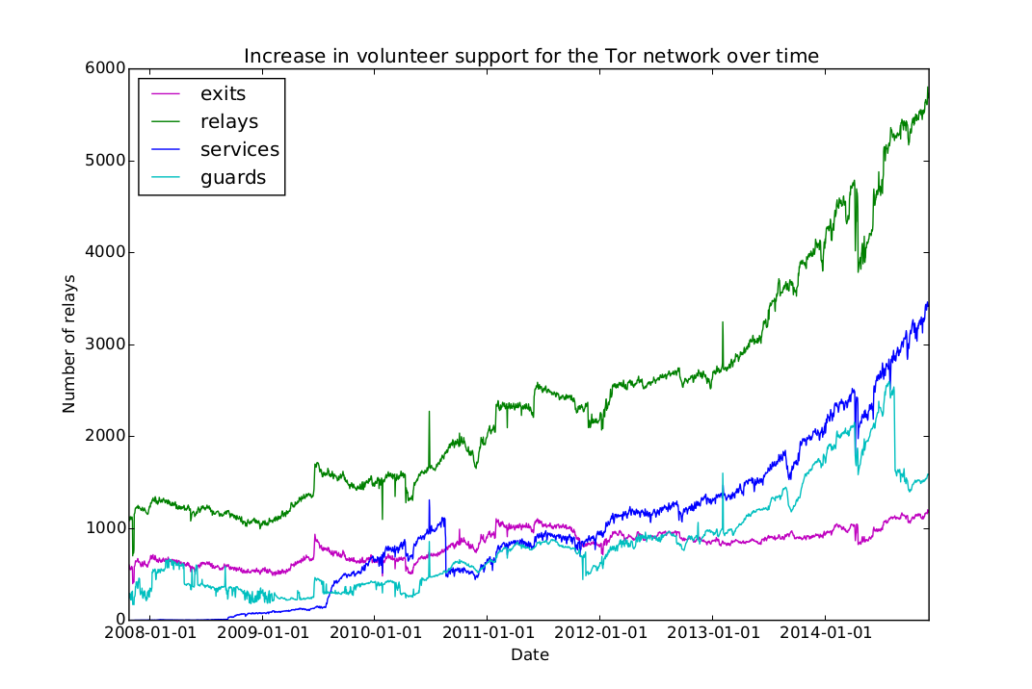

Slide 6
Design overview
UNIX-like design philosophy: security, usability, simplicity, modularity
  Usability != the client is dumb
NoSQL-like key/value store model
  Client can GET, PUT, DELETE
Secret sharing scheme
  Files encrypted and split up randomly among a random selection of all available nodes
PGP (emails are files too!)
  Need one of the right pub key(s) to download anything
  All files (self) signed by originator at encryption time
  DELETE request must be signed, signature matching file

Slide 7
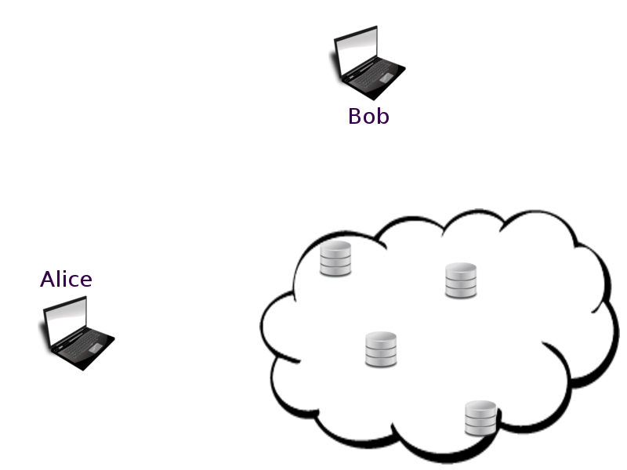

?
GET
PUT
PUT
PUT

Slide 8
Threat model
Every user for themselves
  Malicious nodes
  Discovering pub key / linking public key back to PII
  Wrong file / adding malicious file chunks / file corruption
  Flow analysis by other users or a global adversary
  (purposeful) infinitely looping lookup
Sybil attack
Nodes randomly offline (failure or users done sharing)
Users inadvertently expose PII (usability)

Slide 9




Clientside
Upload or generate a new keypair, encrypt file before other ops
PUT (id*, file chunk)
PUT(id) + GET (id, file)
DELETE (id, file)
Node discovery
Identifiers hashed with file hashes:
“destination hashes”
{ h(h(f), keyA, keyB),
h(h(f), keyA, keyC),
…}
PUT(id)
GET(id, file)
* recall: id == hashed pub key

Slide 10
Clientside crypto... in Javascript
Google's crypto-js
  SHA2 hashes for files and public keys
  (also SHA3 -- less widely in use currently so less portable)
openpgp.js
  Private/public key pair
  (encrypt and sign files, add destination list)
  Option to generate a fresh key pair for each file (though downloading a file requires a public key the sender knows about)
Transactions between client and db after encryption

Slide 11


Datastore DHT
Each node:
  random set of file chunks, each mapped to dest hashes list
  If 1+ chunks of d mapped to same hashes, dest list maps to chunk list
File chunk & location mapping not stored but discovered on request
{ , , , , }
f1
{ }
{ }
g14, g6
h5
n

Slide 12
In consideration: metadata DHT
Would sit alongside data store on every node
Maps sources to files
Bob needs the right public key, keyB (and also Alice's keyA) to get the parts of file f from the data store
“.onion” key hashes stored, not public keys
How i2p and Freenet do it... maybe not necessary here

Slide 13

Data in
n
Data chunk passed to n from client
n randomly chooses m
n negotiates (onion protocol) session keys with m, if m has available storage space
n passes d to m
d
{ , , }
m

Slide 14
Data out (Floodfill)
{ , , }
d3
Bob
d3
X
m
?
p
r
X
Nope stack
q
X
X
n
m
Bob asks n for h(h(f), idA, idB).
n searches itself (hash table lookup).
If not found, color node. Pass query + nopes to random set of s neighbors.
m can only select nodes to check that aren't in the nope stack.
If hash is found, start download to Bob and stop search.
n
r
q

Slide 15
How long does output take?
Set of n nodes randomly picked with no replacement from all N nodes currently up (if we pick a node not containing a data item we want, we color it “nope”).
K “yes” items: the parts of the file we want to retrieve.
Each random sample has x successes
(probability of success changes each draw)
[KCx] * [(N-K)C(n-x)]
p(x, N, n, K) =
[NCn]
X
(
) * K
X

Slide 16
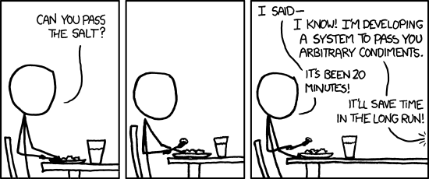
Next...
LEDBAT over DTLS... in node
Crude random load balancing +
Floodfill implementation
Benchmarking what I have, then figuring out optimal file chunk redundancy, then more benchmarking
Torrent client(s) as additional front end?

Slide 17
Partial bibliography
Freehaven's Anonymity Timeline
http://freehaven.net/anonbib/full/date.html
CRYPTOME http://cryptome.org/
Tahoe-LAFS https://tahoe-lafs.org
The Freenet Project https://freenetproject.org/
I2p Anonymous Network https://geti2p.net/en/
Crypto-js https://code.google.com/p/crypto-js/
Apache CouchDB http://couchdb.apache.org/

