Slide 1
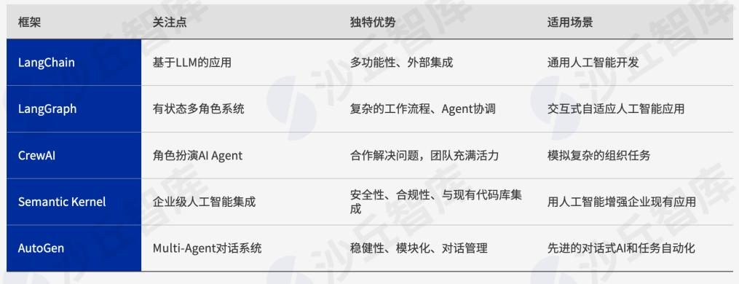
Different AI agent architecture

Slide 2
NLP
CV
AI Agent

Slide 3
Medical & Healthcare Community
Intake Area
Intake
Agent
Health
Assessment
Agent

Slide 4
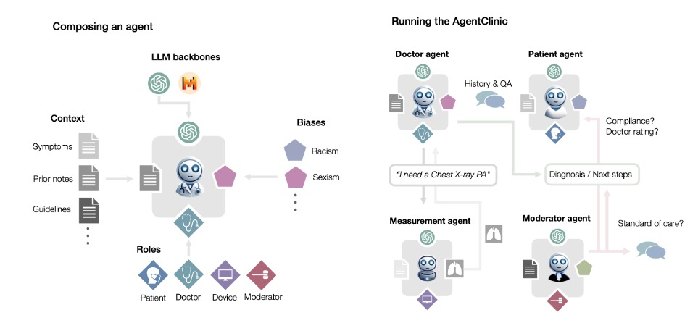
MAS Multi-agents System Moderator agent to rectify diagnose
DA
PA
Moderator Agent
Measurement Agent

Slide 5
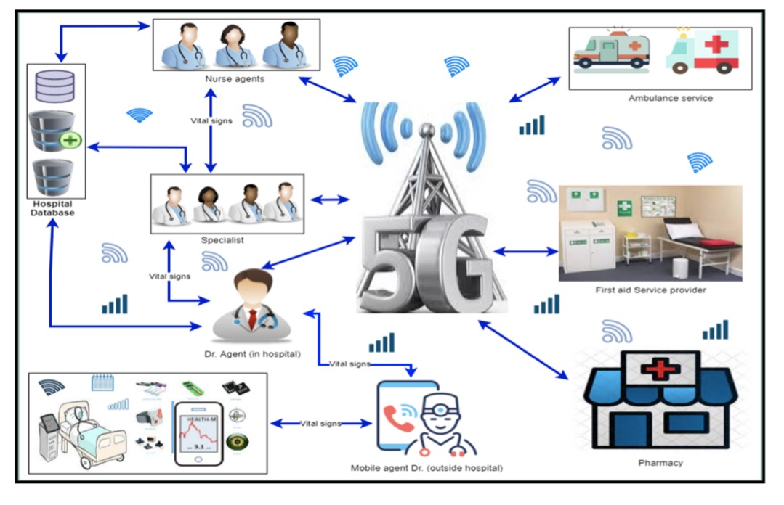
MAS Multi-agents System Inside/Outside hospital with data sensor
Doctor Agent
Nurse Agent
Pharmacy Agent

Slide 6
Common agents in hospital/medical
Medical Professional Agent:
Doctor Agent
Nurse Agent
Pharmacy Agent
Specialist Agent
Mobile Agent Doctor
Moderator Agent
Measurement Agent
Resident Agent
Patient Agent
Multi-agents
Multi-cases

Slide 7
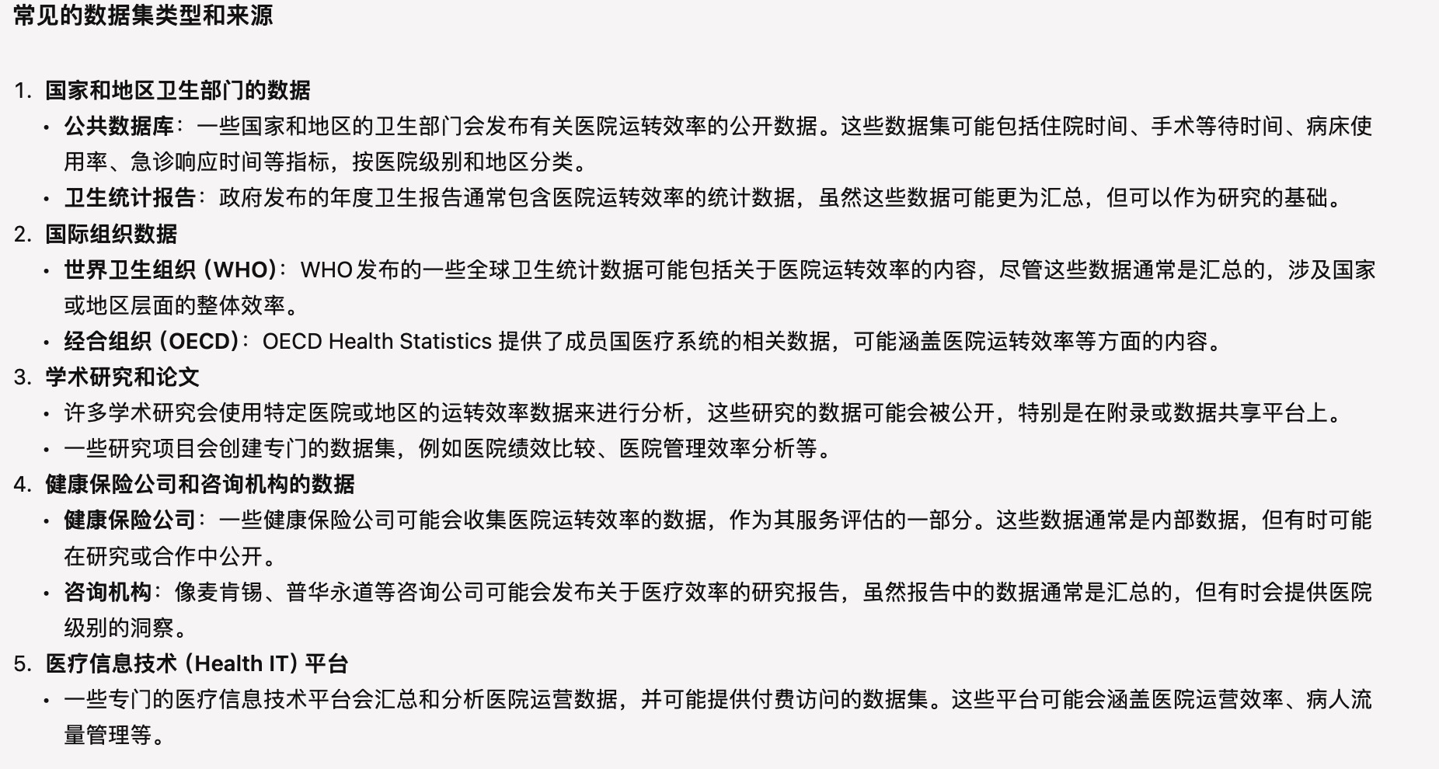
分级诊疗
对比数据集来源？

