Slide 1
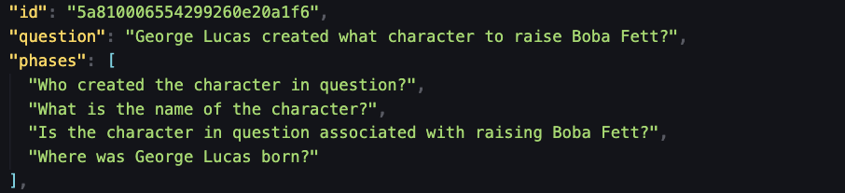
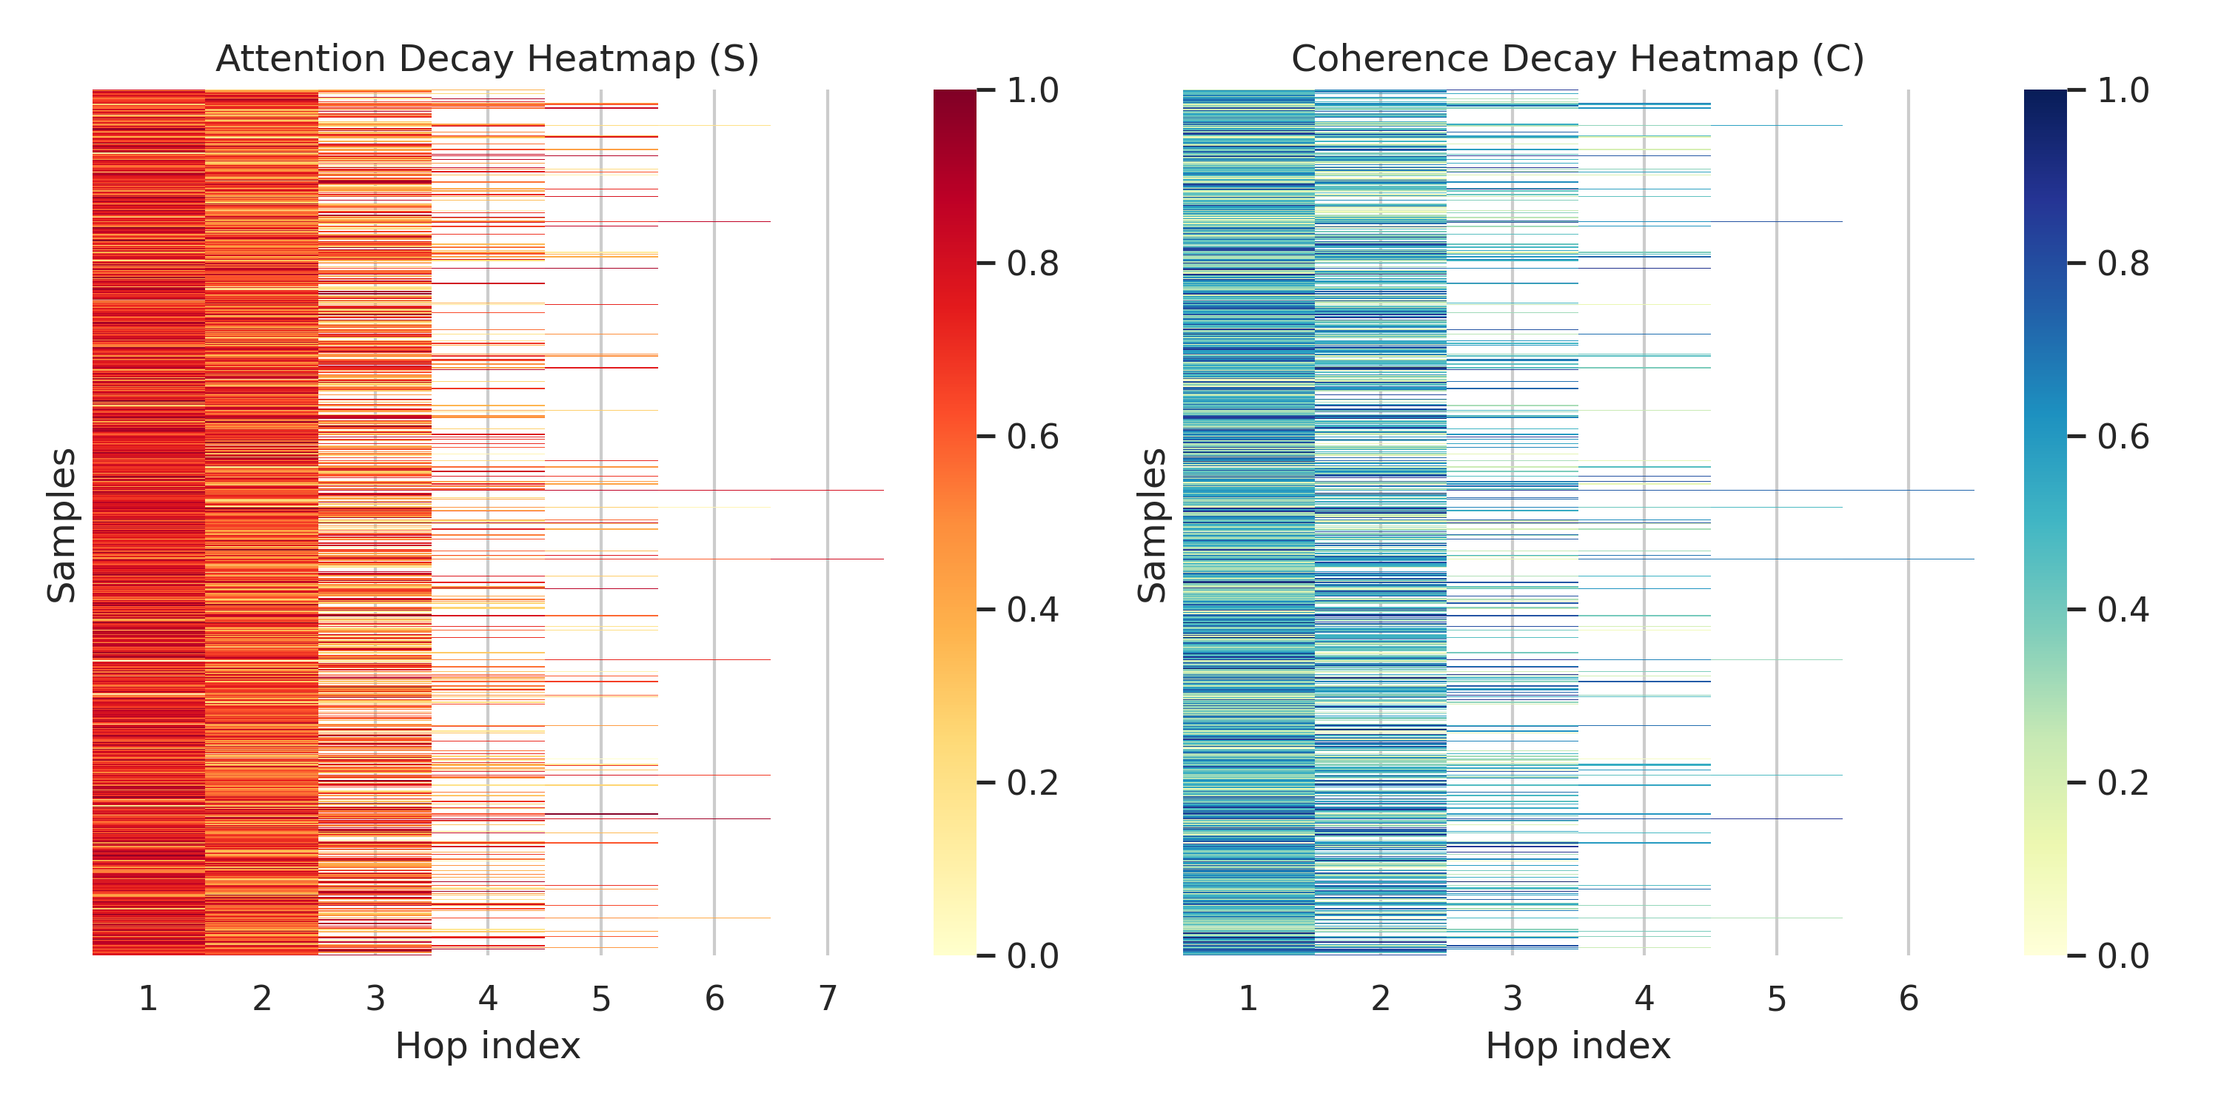
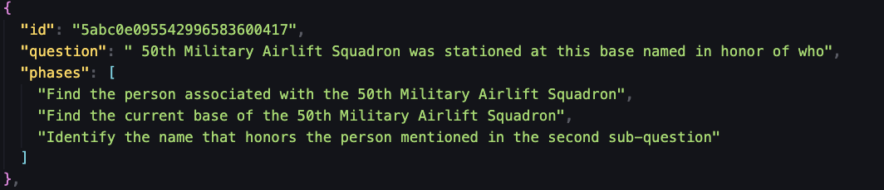
Problem & Core Bottleneck Examples
多跳问题的注意力衰减问题
越往后越不知道自己原来想要干什么，加上大模型的幻觉，会逐渐偏离核心主问题。
2. 逻辑空间坍缩
大模型或者CoT思考的推理路径过于单一，过早收敛，专注检索，没有多推理链发散。
注意力和子问题连贯性会随着跳数增加而逐步衰减。

Slide 2
Problem & Core Bottleneck Examples
Frame Shift
Question: “George Lucas created what character to raise Boba Fett?”
Sub-questions:
What is the name of the character that George Lucas created?
Which character is associated with raising Boba Fett?
Where was George Lucas born? ❌
注意力和子问题连贯性会随着跳数增加而逐步衰减。
Anchor Shift
Question: When was the employer of John J. Collins established?
Sub-questions:
Who was the employer of John J. Collins? ❌
Fact [1] mentions Lucas Bradley employed John Collins as an architect.
When was Lucas Bradley established?

Slide 3
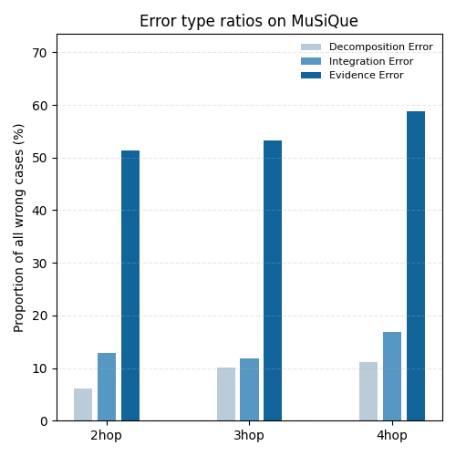
Problem & Core Bottleneck Examples
Decomposition Error
Model fails at breaking the question into the right sub-questions and the subsequent reasoning is built on an incorrect path.
Integration Error
Model failures in the final answer integration or logical aggregation step, given that the model has already retrieved all the necessary evidence.
Evidence Error
Model retrieval insufficient facts or cite the wrong supporting fact even if the surface structure of the question decomposition is correct.

Slide 4
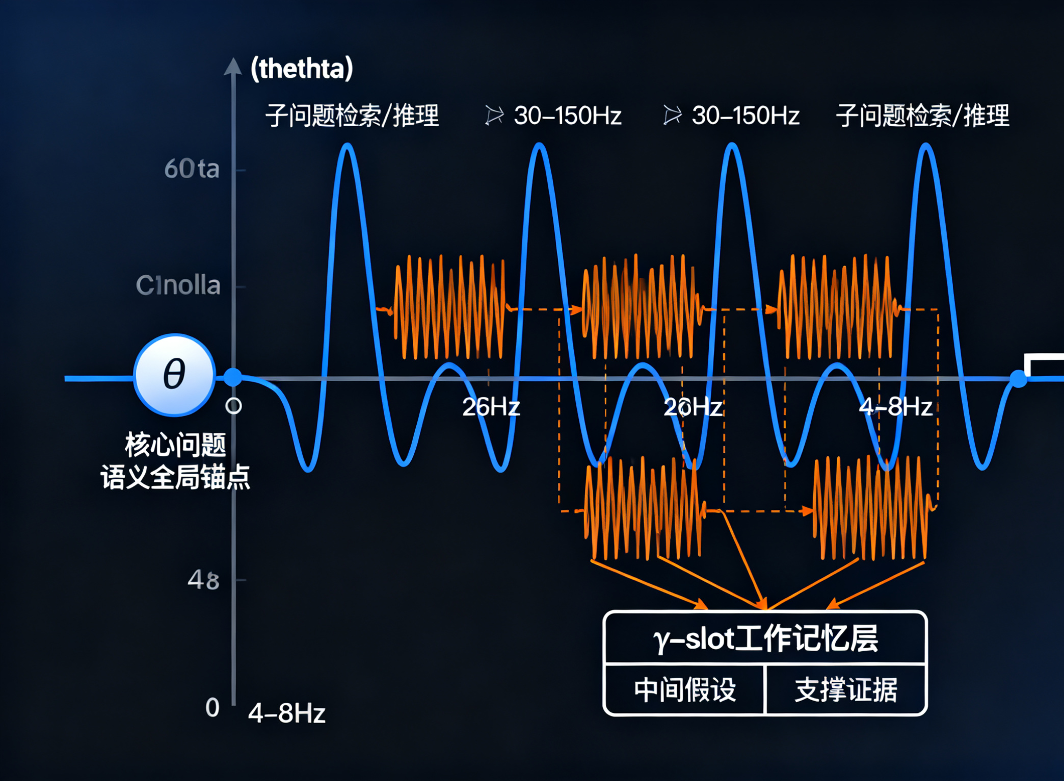
Innovation and Architecture
Theta-Gamma框架是一个脑启发、模块化计算机架构，旨在解决NLP多跳推理问题，通过模拟人脑theta-gamma耦合（序列组织与局部编码）。从输入查询 → Theta生成全局链条，整合信息 → Gamma填充局部细节，探索逻辑推理路径 → 输出优化链条。核心耦合通过频率嵌入（theta低频全局、gamma高频局部）和反馈信号实现，类似于脑中相位-幅度耦合（PAC）。
Theta Rhythm θ 维持核心注意 | θ Controller用于 维持核心问题语义表示作为全局锚点。 主要解决注意力衰减问题。
Gamma Rhythm γ 拓展推理空间 | γ-slot 在每个 θ 周期内生成多个并行推理分支。 每个 γ-slot 存储一个“中间假设 + 支撑证据”。 主要解决逻辑空间坍缩问题。
Theta-Gamma Coupling θ–γ 耦合机制 | 前额叶在γ相位负责任务规划，海马负责在θ相位记忆重现与路径推理，两者通过θ–γ耦合进行跨模态整合。

