Slide 1
Memory mapped i/0

Slide 2
Communication
What is a bus?
A bit highway that allows bits to move from one “functional unit” to another “functional unit” in the system.
Examples:
PCI
ISA
SCSI
USB

Slide 3
What kinds of things use i/o
Examples of i/o devices
Keyboard
Disk Drive
Mouse
Cameras
Microphone
Scanner

Slide 4
One bus – so many devices
I/O handler structure
The MIPS address space

Slide 5
MIPS ADDRESS SPACE
0xfffffffc
Memory Mapped I/O
0xffff0000
OS
0x80000080
Stack
Heap
0x10040000
Data
Code
0x00400000

Slide 6
I/O handler structure
Data
32 bits wide
7
6
5
4
3
2
1
0
Control
32 bits wide
0
Device busy/ready (1 = ready)

Slide 7
Quick review of base addressing
Base addressing starts with a base address
Other addresses are referenced from this base address
lw $t1, 8($a3)
Contents of a3 is base address
loading word into address 8 bytes higher
The 8 is decimal not hex!

Slide 8
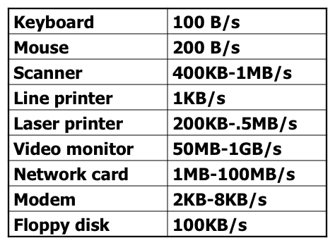
Data Rates of different devices

Slide 9
Implications of different speeds
In many cases, the devices are much slower than the cpus operating speed and any data sent to the processor is dealt with essentially instantly from the perspective of the external device.

Slide 10
Dealing with Speed Differences
Polling
Polling is a looping code structure
The loop continues to read a variable/memory location until an expected change occurs and then the loop exits and some code execute

Slide 11
memory mapped i/o on mips
Interacting with a keyboard and display

Slide 12
Keyboard I/O in MIPS
Data
7
6
5
4
3
2
1
0
0xffff0004
Control
0
0xffff0000

Slide 13
Reading from keyboard
li $a3, 0xffff0000
CkReady:
lw $t1, 0($a3) #read from control register
andi $t1, $t1, 1 # extract ready bit
beqz $t1, CkReady # if not ready repeat
lw $t0, 4($a3) #get character from keyboard

Slide 14
Display I/O in MIPS
Data
7
6
5
4
3
2
1
0
0xffff000c
Control
0
0xffff0008
Data
7
6
5
4
3
2
1
0
0xffff0004
Control
0
0xffff0000

Slide 15
Writing to display
li $a3, 0xffff0000
XReady:
lw $t1, 8($a3) #read from control register
andi $t1, $t1, 1 # extract ready bit
beqz $t1, XReady # if not ready repeat
sw $t0, 12($a3) #Send character to the display

Slide 16
POLLING two input devices
How would we poll two input devices?

Slide 17
Adding mouse
Data
7
6
5
4
3
2
1
0
0xffff0014
MOUSE
Control
0
0xffff0010
Data
7
6
5
4
3
2
1
0
0xffff000c
Control
0
0xffff0008
Data
7
6
5
4
3
2
1
0
0xffff0004
KEYBOARD
Control
0
0xffff0000

Slide 18
example

