Slide 1

Chapter 9:
Pointers

Slide 2
9.1
Getting the Address of a Variable

Slide 3

Getting the Address of a Variable
Each variable in program is stored at a unique address
Use address operator & to get address of a variable:
  int num = -99;
  cout << &num; // prints address
  // in hexadecimal

Slide 4
9.2
Pointer Variables

Slide 5
Pointer Variables
Pointer variable : Often just called a pointer, it's a variable that holds an address
Because a pointer variable holds the address of another piece of data, it "points" to the data

Slide 6
Something Like Pointers: Arrays
We have already worked with something similar to pointers, when we learned to pass arrays as arguments to functions.
For example, suppose we use this statement to pass the array numbers to the showValues function:
showValues(numbers, SIZE);

Slide 7
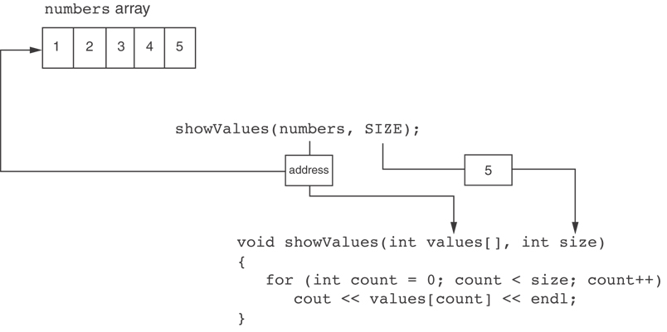
Something Like Pointers : Arrays
The values parameter, in the showValues function, points to the numbers array.
C++ automatically stores the address of numbers in the values parameter.

Slide 8
Something Like Pointers: Reference Variables
We have also worked with something like pointers when we learned to use reference variables. Suppose we have this function:
void getOrder(int &donuts)
{
cout << "How many doughnuts do you want? ";
cin >> donuts;
}
And we call it with this code:
int jellyDonuts;
getOrder(jellyDonuts);

Slide 9
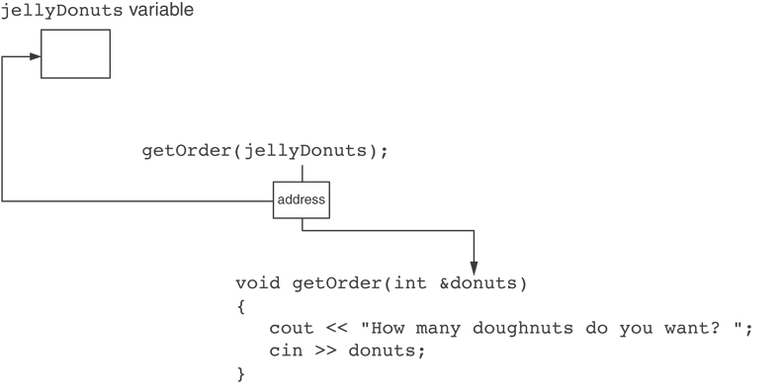
Something Like Pointers: Reference Variables
The donuts parameter, in the getOrder function, points to the jellyDonuts variable.
C++ automatically stores the address of jellyDonuts in the donuts parameter.

Slide 10
Pointer Variables
Pointer variables are yet another way using a memory address to work with a piece of data.
Pointers are more "low-level" than arrays and reference variables.
This means you are responsible for finding the address you want to store in the pointer and correctly using it.

Slide 11
Pointer Variables
Definition:
  int *intptr;
Read as:
“intptr can hold the address of an int”
Spacing in definition does not matter:
  int * intptr; // same as above
  int* intptr; // same as above

Slide 12
Pointer Variables
Assigning an address to a pointer variable:
  int *intptr;
  intptr = &num;
Memory layout:
num
intptr
25
0x4a00
address of num: 0x4a00

Slide 13
Pointer Variables
Initialize pointer variables with the special value nullptr.
In C++ 11, the nullptr key word was introduced to represent the address 0.
Here is an example of how you define a pointer variable and initialize it with the value nullptr:
int *ptr = nullptr;

Slide 14
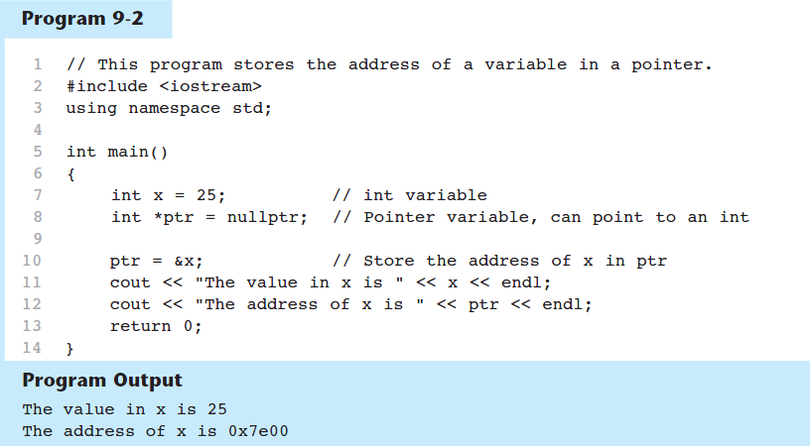
A Pointer Variable in Program 9-2

Slide 15
The Indirection Operator
The indirection operator (*) dereferences a pointer.
It allows you to access the item that the pointer points to.
int x = 25;
int *intptr = &x;
cout << *intptr << endl;
This prints 25.

Slide 16
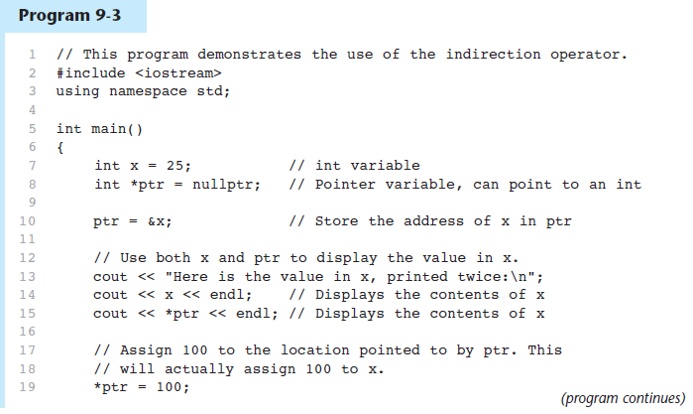
The Indirection Operator in Program 9-3

Slide 17
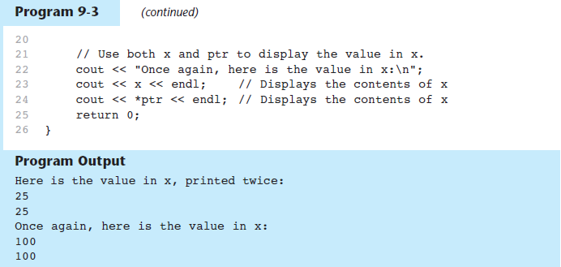
The Indirection Operator in Program 9-3

Slide 18
9.3
The Relationship Between Arrays and Pointers

Slide 19
9.8
Dynamic Memory Allocation

Slide 20
Dynamic Memory Allocation
Can allocate storage for a variable while program is running
Computer returns address of newly allocated variable
Uses new operator to allocate memory:
  double *dptr = nullptr;
  dptr = new double;
new returns address of memory location

Slide 21
Dynamic Memory Allocation
Can also use new to allocate array:
const int SIZE = 25;
double *arrayPtr = new double[SIZE];
Can then use [] or pointer arithmetic to access array:
  for(i = 0; i < SIZE; i++)
  arrayptr[i] = i * i;
  or
  for(i = 0; i < SIZE; i++)
  *(arrayptr + i) = i * i;
Program will terminate if not enough memory available to allocate

Slide 22
Releasing Dynamic Memory
Use delete to free dynamic memory:
  delete fptr;
Use [] to free dynamic array:
  delete [] arrayptr;
Only use delete with dynamic memory!

Slide 23
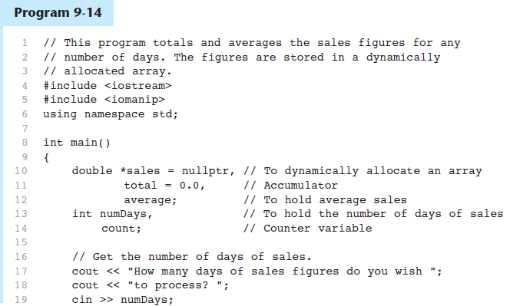
Dynamic Memory Allocation in Program 9-14

Slide 24
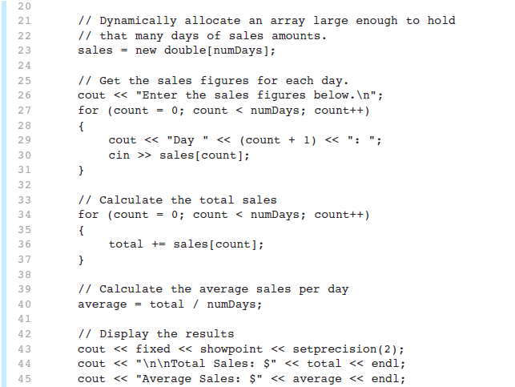
Dynamic Memory Allocation in Program 9-14
Program 9-14 (Continued)

Slide 25
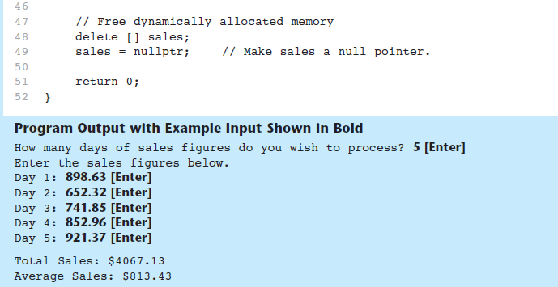
Dynamic Memory Allocation in Program 9-14
Program 9-14 (Continued)
Notice that in line 49 nullptr is assigned to the sales pointer. The delete operator is designed to have no effect when used on a null pointer.

Slide 26
9.9
Returning Pointers from Functions

Slide 27
Returning Pointers from Functions
Pointer can be the return type of a function:
  int* newNum();
The function must not return a pointer to a local variable in the function.
A function should only return a pointer:
  to data that was passed to the function as an argument, or
  to dynamically allocated memory

