Slide 1
Code
343052

Slide 2
Lecture 10 Project3 and Other Stuff
Greg Lakomski
CS3339
FALL 2018

Slide 3
Today
Multilevel Cache – a bit more
Arithmetic Shift in Python – What I learned and it ain’t pretty.
Project 3 – Go over project in detail
Project 3 – I will add more insight in future lectures but you start coding as soon as you finish Project 2

Slide 4
Announcements
Project 2 due Next week
Please do not expect me to spend as much time pushing you along with this one
Homework 3 due next week
Next Monday – Isaac Van Til will present lecture on SMP, CPU parallism, superscalar pipeline, and OPENMP. There will be questions on this on the midterm!

Slide 5
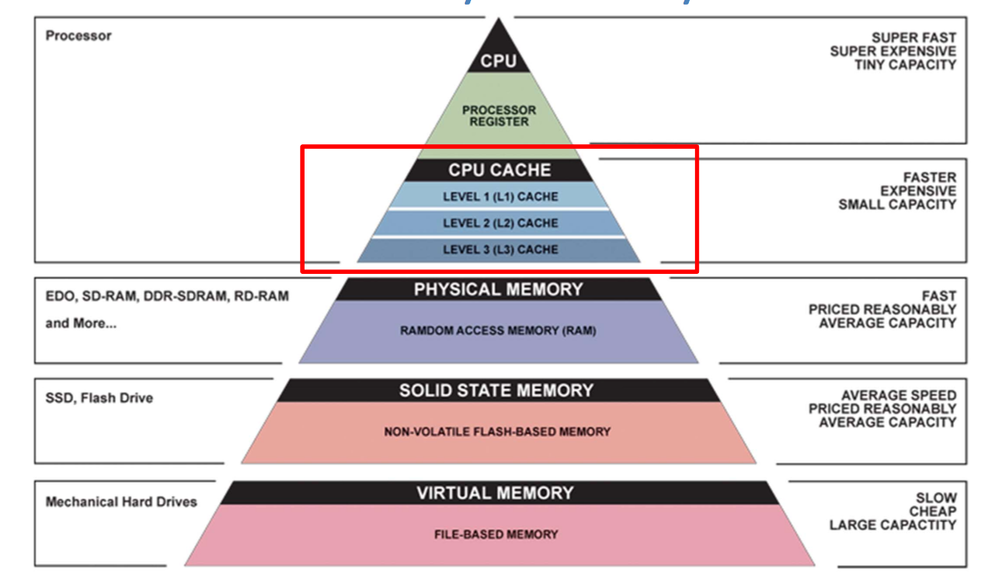
Multilevel Cache

Slide 6
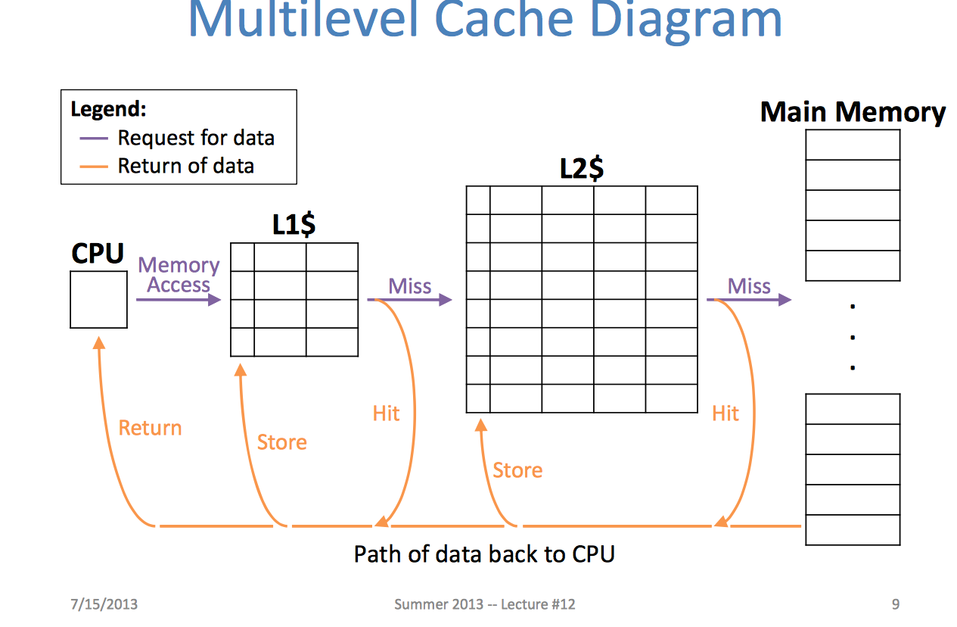
Multilevel Cache

Slide 7
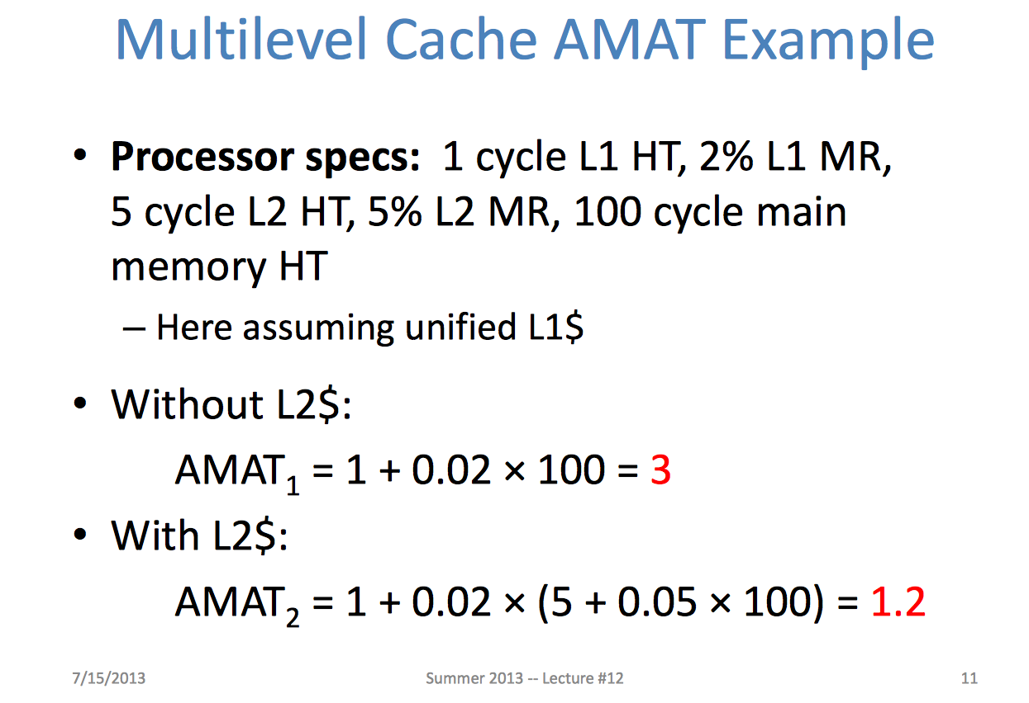
Multilevel Cache

Slide 8
Multilevel Cache

Slide 9
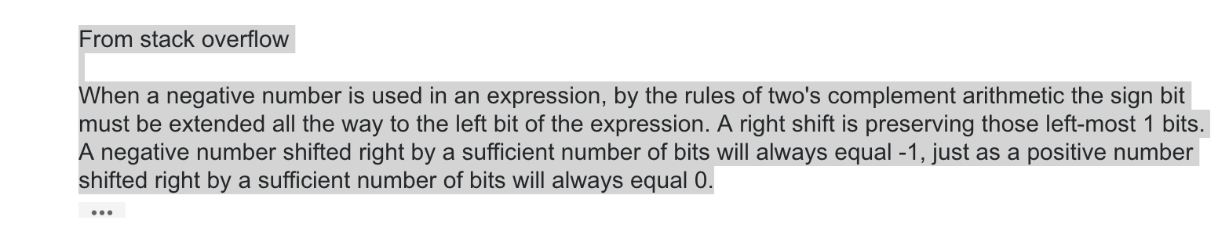
Arithmetic Shift in Python
>> is Arithmetic Shift in Python it divides by two
So to do LSR you must specifically code just moving the bits and adding zeros! So LSR in python is a moving a bit pattern with no implied numerical implications. 11101 -> 1110 and would be an unsigned integer only.

Slide 10
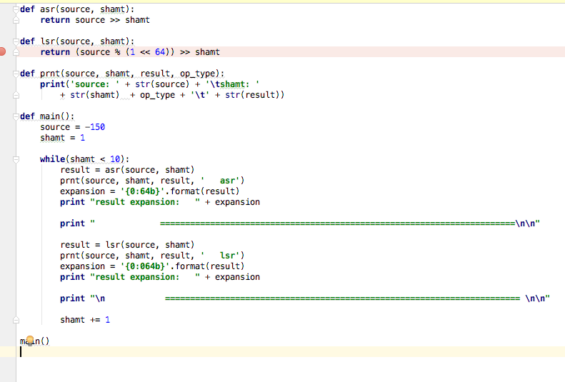
ASR vrs LSR

Slide 11
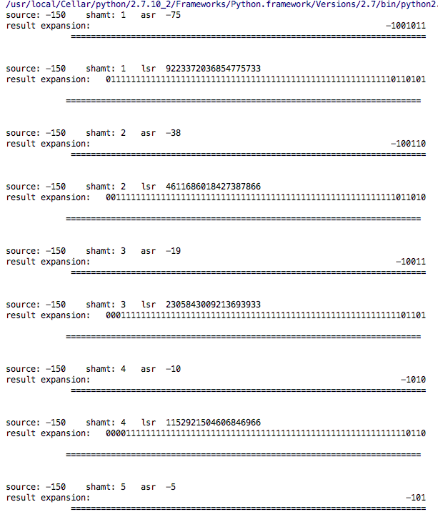

Slide 12
Pr0ject 3 – Data structures and algorithms

Slide 13
WARNING!
I am not finished recoding my own project 3 to use ARM code
BUT
I wanted to get you started early
SO
Some of what you will see will have MIPS instructions in it but the concepts will be the same
If that freaks you out – sorry – some of this takes me as long to do as it does you. I won’t ask you to code something I am not coding too.

Slide 14
Introduction
The goal of this lecture is to make sure you see this project in the same way that I do.
The Project 3 description you received was vague in some places and I had expected to receive more questions than I have on it.
In the interest of time and student happiness (if that is ever possible) I am going to tell you a lot more about Project 3.
I will be sharing snippets ( and some large blocks) of code but what is more important is the logic, algorithms and data structures as well as seeing how the problem is organized in code. Not perfect but it works.

Slide 15
Introduction
Try to follow and then spend time figuring it out.
My goal of showing you my code is to help you all finish the project and make sure you don’t get stuck a lot. I will likely go over more code as soon as I am certain it is working.
You are free to disregard anything I am suggesting at your peril.

Slide 16
Preconditions
simClass
def __init__( self, instrs, opcodes, mem, valids, addrs, args1, args2, args3, numInstrs, dest, src1, src2 ):
self.instruction = instrs self.opcode = opcodes self.memory = mem self.address = addrs self.numInstructions = numInstrs self.arg1 = arg1 self.arg2 = arg2 self.arg3 = arg3 self.destReg = dest self.src1Reg = src1 self.src2Reg = src2
These are the lists and values generated by my disassembler that I am using in the simulator. I will explain these in detail.

Slide 17
Input Lists
instrs:
<type 'list'>: ['10100000000001000000000000000000', '10100000000001011111111111111111', '10000000100001010011000000100000', '10000100110000000000000000000100', '10101100000001100000000001111000', '10000000000000000000000000001101', '00000000000000000000000000000010', '00000000000000000000000000000011']

Slide 18
Input Lists
opcodes: (MIPS)
<type 'list'>: [8, 8, 0, 1, 11, 0, 0, 0]
mem:
<type 'list'>: [2, 3]

Slide 19
Input Lists
addrs:
<type 'list'>: [96, 100, 104, 108, 112, 116, 120, 124]
args1: (what it is depends on instr type)
<type 'list'>: [0, 0, 4, 6, 0, 0]
args2:
<type 'list'>: [4, 5, 5, 0, 6, 0]
args3:
<type 'list'>: [0, -1, 6, 4, 120, 0]

Slide 20
Input Lists
numInstrs:
{int} 6
dest: (these are reg numbers)
<type 'list'>: [4, 5, 6, -10, -2, -6]
src1:
<type 'list'>: [0, 0, 4, 6, 0, -7]
src2:
<type 'list'>: [-1, -1, 5, -9, 6, -8]
NOTE: the last three are new. I found it necessary to catalog the actual register values by instruction. If there was no actual dest or src then I made it a negative number and test for the neg . The sequential numbers is good for debugging.

Slide 21
Main sim execution flow
def run( self): go = True while go: self.WB.run() self.ALU.run() self.MEM.run() self.issue.run() go = self.fetch.run() self.printState( ) self.cycle += 1

Slide 22
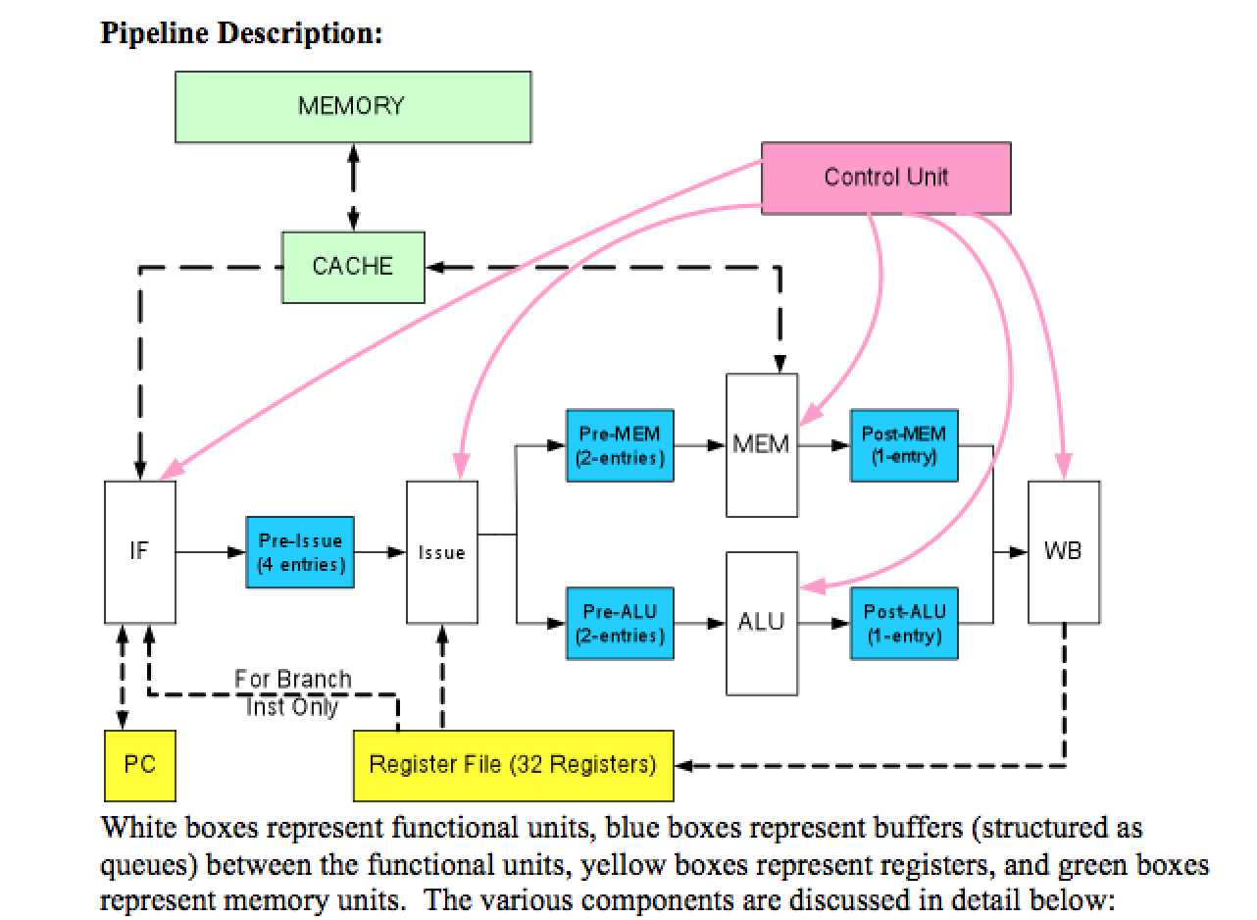

Slide 23
The Big Challenge
Each stage and unit may be executing a different instruction. SO how do we know which. We move the instruction number from stage to stage using the buffers. example: [ 23,2] -> data,instruction or [2,3,4,5] -> instruction, instruction, instruction,instruction depending on the buffer
As the instruction propagates through the pipeline, so does the instruction number! So if you did what I said to do and set up your data structures as synchronized lists getting all the info you need is a piece of cake

Slide 24
WB – Write Back Unit
Don’t confuse with write-back cache!
Input data structures:
Post – Mem Buffer: (-1’s are used indicate empty)
postMemBuff = [-1,-1] # first number is value, second is instruction index
Post – ALU Buffer:
postALUBuff = [-1,-1] # first number is value, second is instruction index
[34,2] for example 34 is the data, 2 is the instruction you are executing.
Output data structure:
Writes out to register file so NO special output data structure

Slide 25
Write-Back Unit
Algorithm and flow:
#pre- Uses the lists generated by the dissassembler unit module so there must be valid lists. Uses ALU postbuf and MEM postbuf as inputs into WB unit. Checks for existence of valid instruction index in both buffers as indicator something to do. Can deal with valid instruction in BOTH buffers in same cycle.
#during - if valid inst exists (post<X> buf[1] != -1), write value in [0] back to register in instruction index in [1]
ex: sim.R[ sim.destReg[ sim.postMemBuff[1] ] ] = sim.postMemBuff[0]
# post- resets input buffer to [-1,-1] if accessed

Slide 26
Write-Back Unit
In a nutshell, the write back unit looks at the post-MEM and post-ALU buffers every cycle and if there is something there it writes it back to the appropriate register.
Write Back Unit: (From Instructions)
The WB unit can execute two write-backs in one cycle. It fetches the contents of the post-ALU and post-MEM buffers and updates the register file.

Slide 27
Coding Strategy – Unit Test
Create a Write Back class and code it.
Create a driver for the class that keeps loading stuff into the two buffers and test the poo out of the class.
Do not move forward until you are absolutely certain the write back works with all data and register numbers, resets buffers empty when the stuff is removed, and will do the above with all combinations of data and reg numbers
This is how I code and how you as a pro will need to code
Even better, write the test driver before you write the class!

Slide 29
ALU Unit
Input data structure:
Pre – ALU Buffer
preALUBuff = [-1,-1] # first number is instruction index, second is instruction index
preALUBuff can hold two instruction indexes per project spec!
Output data structure:
Post – ALU Buffer:
postALUBuff = [-1,-1] # first number is value, second is instr index

Slide 30
ALU Unit
Algorithm and flow:
#pre - Uses lists from dis for args. Expects valid prebuf values or -1's
# during - gets instruction and decodes which ALU instruction to execute. Executes instruction and updates alu post buffer with instruction index and the result of the ALU instruction
example of decoding and buff interaction:
if sim.opcode[ i ] == 0 and (int(sim.instruction[i],base=2)& specialMask) == 32: #ADD sim.postALUBuff = [sim.R[ sim.arg1[i] ] + sim.R[ sim.arg2[i] ], i]
or if you stored what the instruction was you could if sim.opcodeStr == “ADD”:
sim.postALUBuff = [sim.R[ sim.arg1[i] ] + sim.R[ sim.arg2[i] ], i]
#post – will move second index to position 0 and reset position 1 to -1. So you consume buff[0] first, move buff[1] to buff[0], and free up buff[1] . Then the next stage can put something in buff[1]

Slide 32
Mem Unit
Input data structure:
Pre – Mem Buffer
preMemBuff = [-1,-1] # first number is index, second is index
preMemBuff can hold two instructions per spec
Output data structure:
Post – Mem Buffer:
postMemBuff = [-1,-1] # first number is value, second is instr index

Slide 33
Mem Unit
Algorithm and flow:
#pre- uses lists from dis for args. Expects valid prebuf values or -1's
#during – decodes instruction – is it STUR or LDUR? Check cache for address. Call cache.accessMem(memIndex, i, isSW, sim.R[sim.arg2[i]]) If miss, Cache controller will return with miss on first cycle and will handle the memory access and cache load on that cycle and should return a hit on NEXT cycle. If hit, will return true with value. Return hit, update the premem buffer setting premem[0] to premem[1] and setting premem[1] to -1. Then either write cache for a store or write value obtained from cache to the postmembuff. All the mem unit is doing is either storing or loading mem values along with checking cache.
#post – will leave second index in position 0 and position 1 at -1

Slide 34
From Instructions
A STUR takes one cycle to finish if there is room in the cache. If it cannot write in the cache, then the operation cannot be performed and must be retried in the next cycle. In this case, the operation remains in the pre-mem buffer. When a cache write occurs, the STUR instruction just finshes. The STUR instruction never goes into the post-MEM buffer. It just disappears. Everyone gets updated in the same cycle that the write happens. If the required set is full then you must figure out what to kick out on one cycle and write everything the next cycle. This may cause a stall since you are checking to see that all instructions in flight that might access the memory location have to wait. A RAW hazard.

Slide 35
For LDUR, it takes one cycle to finish if it hits in the cache. If it misses in the cache, then the operation cannot be performed and must be retried in the next cycle. In this case, the operation remains in the pre-mem buffer. When a cache hit occurs, the operation finishes and the instruction and data will be written to the post-MEM buffer.

Slide 37
Issue Unit
Input data structure
Pre Issue Buffer
<type 'list'>: [-1, -1, -1, -1] – List of four instruction indexes
Output data structure
Pre – Mem Buffer
preMemBuff = [-1,-1] # first number is index, second is index
preMemBuff can hold two instructions per spec
Pre – ALU Buffer
preALUBuff = [-1,-1] # first number is index, second is index
preALUBuff can hold two instructions per spec

Slide 38
Issue Unit
Algorithm and flow:
pre – pre issue buff exists and has at least one instruction from fetch unit
during – process preIssueBuff entries in order 0…3 looking for hazards and if none found issue up to two instructions into appropriate preALU or preMEM buffer. Enforce ordering of LDUR and STUR instructions so that all stores get done prior to adjacent loads. Every issue reorders the buffer upward and allows queue to take on more instructions to keep full
post – pre issue buffer can be left with both unprocessed instructions and instructions that were delayed for hazards.

Slide 39
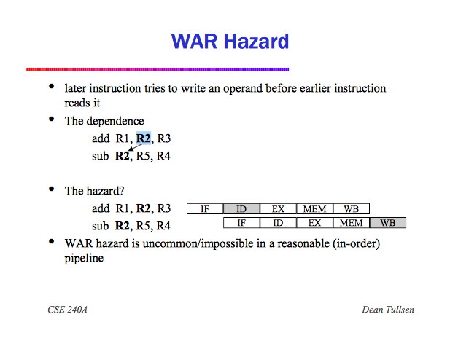

Slide 40
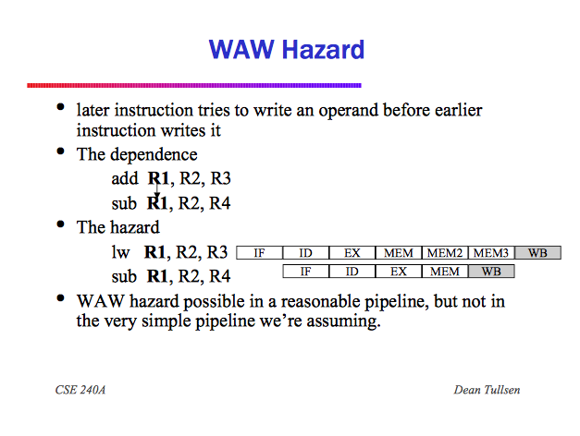

Slide 41
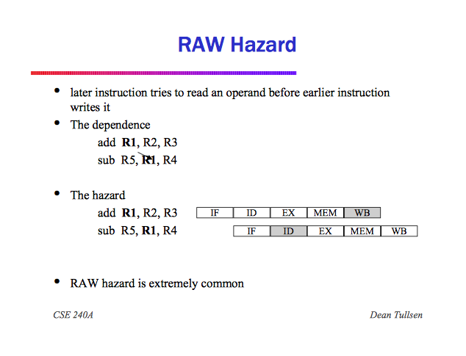

Slide 42
Issue Unit Code
Class Issue:
def: run
1. Determine what's in the preIssueBuff at start of the cycle to get initial value ( numInIssueAtClockCycleBegin)
2. Process instructions in preIssueBuff in 0 .. 3 order. Look for hazards of all types between mostly adjacent instructions.
while( numIssued < 2 and numInPreIssueBuff > 0 and curr < 4 ): # curr is current pre issue element – means you are in the queue
2.1 Start with curr = preBuff [0]
2.2 Check for room in the preMemBuff and preALUBuff
if sim.isMemOp( index ) and not -1 in sim.preMemBuff:
..... ..... .....
2.3 Do WAR hazard check - I am dropping this requirement

Slide 43
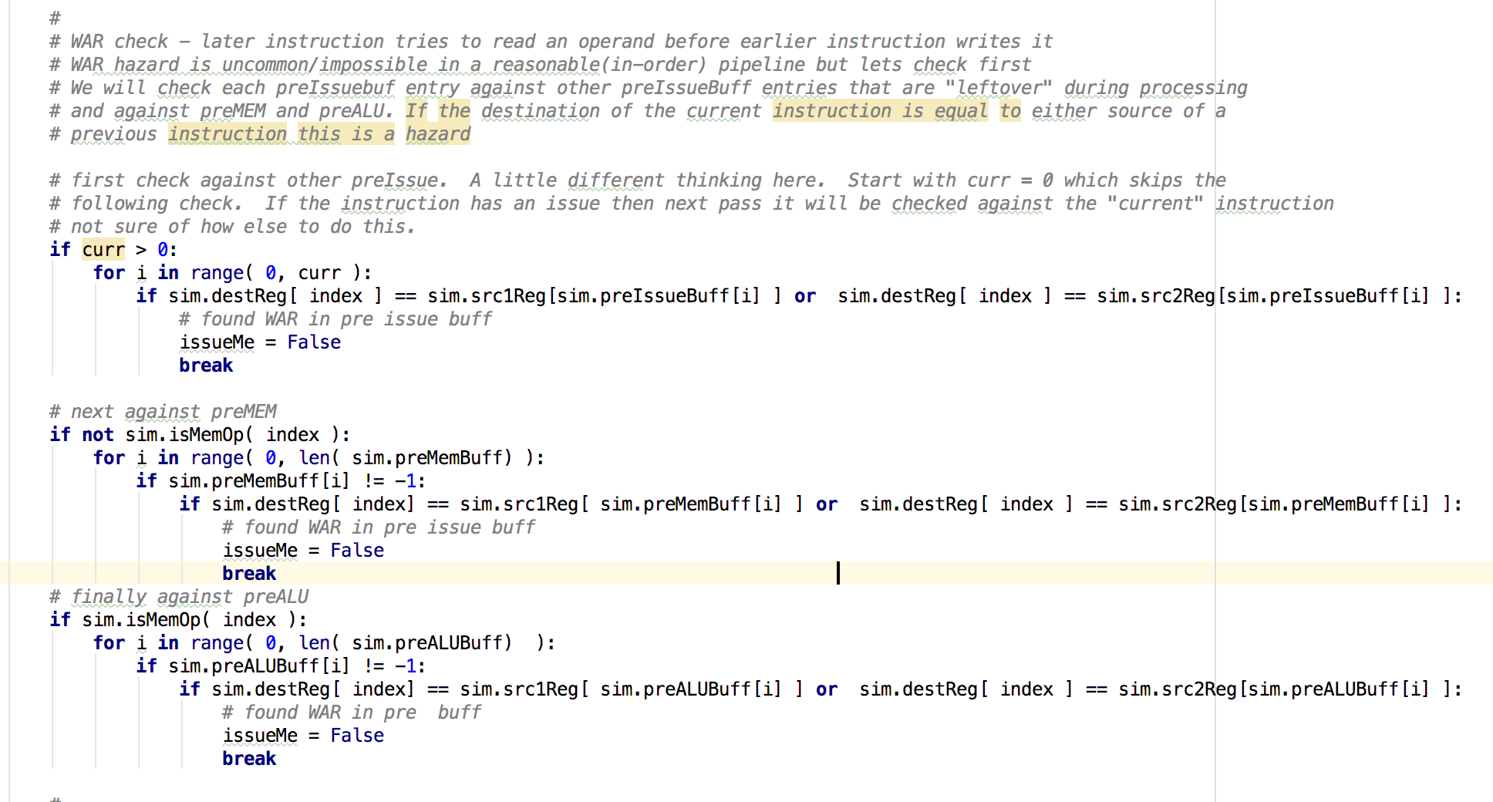
Issue Unit Code – with error

Slide 44
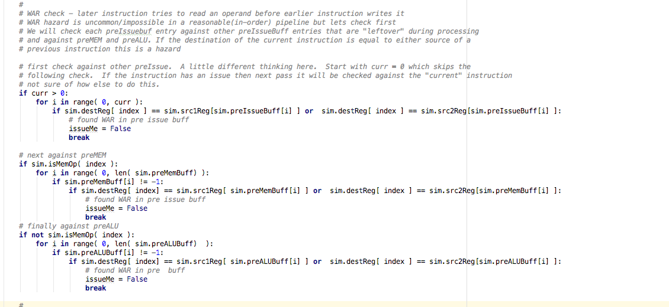
Issue Unit Code – No Error

Slide 45
Issue Unit Code
2.4 Do RAW Check same as above plus check post buffs also
# RAW check - later instruction tries to read an operand before earlier instruction writes it - extremely common hazard # We will check each preIssuebuf entry against other preIssueBuff entries that are "leftover" during processing # and against preMEM and preALU. If either source of the current instruction is equal to the destination # of the previous instruction this is a hazard. This is like a LDUR issue with a stall and forward so we check post buffer too

Slide 46
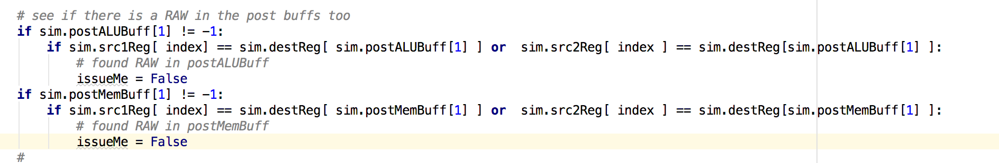
Issue Unit Code
2.5 Do WAW Check same as above # WAW check - later instruction tries to write an operand before earlier instruction writes it - pretty rare but # possible in our simulator pipeline since mem and alu are stacked. Execution order important. If the destination of
# current instruction is equal to the destination of the previous instruction we have a hazard. Check post buffs too.

Slide 47
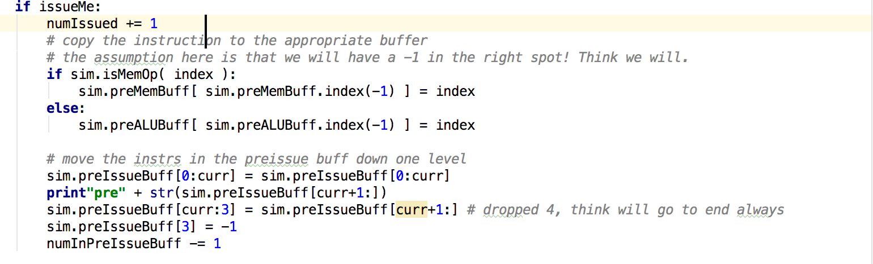
Issue Unit Code
2.6 Enforce ordering of LW and SW
# Enforce ordering of LWs and SWs so we make sure all stores get done # before loads
2.7 Issue and move instructions down one level in the preIssueBuff
Pre-Issue Buffer:
The pre-issue buffer has 4 entries, each entry can store a single instruction. The instructions are sorted in their program order (entry 0 always contains the oldest instruction and entry 3 contains the newest).
2.8 Else increment curr and make another pass curr is which instruction you are looking at

Slide 49
Fetch Unit
Input data structure:
All of the lists from the dissasembler
Output data structure:
Pre Issue Buffer
<type 'list'>: [-1, -1, -1, -1] – List of four instruction indexes

Slide 50
Fetch Unit
Algorithm and flow:
pre – Have all of the lists from the disassembler
during - We will fetch up to two empty slots in the preissue buffer. We get an instruction, check in cache for it, If hit we will determine if it is a branch or B instructions. If is a branch instruction will check for hazards and if none perform the branch instruction. B done without checking. The branch will never get posted to the pre issue buffer. Checks for break instruction and if found perfoms clean up making sure all instructions finish. Else we don't have a break instruction. If we can't get the first instruction out of cache we can't fetch the next instruction.
post – When the correct number of instructions fetched, the entire program will cycle and start execution over again.

Slide 51
Cache Unit
Two functions to define:
Flush:
Writes out all dirty blocks to memory at the conclusion of execution
Access Memory:
Primary cache function
Takes memIndex, instructionIndex, isWriteToMem, dataToWrite as arguments
Returns boolean “got a hit”, and data/instruction at cache location
[ valid, dirty, tag, data, data] 4 sets of two blocks with two words per block. Each block has valid, dirty, tag
Data structure - cacheSets = [ [ [0,0,0,0,0], [0,0,0,0,0] ], [ [0,0,0,0,0], [0,0,0,0,0] ], [ [0,0,0,0,0], [0,0,0,0,0] ], [ [0,0,0,0,0], [0,0,0,0,0] ] ]
one lru bit for s
Data structure - lruBit = [0,0,0,0]

Slide 52
Cache Code
Cache Class:
Initalize / declare all the data structures
def accessMem:
1. Given the index, calculate the address of the memory location (example 0 -> 96), figure out which block in set (dataword = 0 or 1)
Check if instruction or data and calculate appropriate address
2. Based on address, align address to two word alignment and create addresses for the two words in block (address1 and address2) based on dataword value. Remember, we are enforcing that block 0 is associated with address 96+ n8!
if (adddress % 8 ==0):
dataWord = 0 # block 0 was the address address1 = address address2 = address + 4 #check for "alignment" # this picks the second word as address so we need to fix it # set address1 - block 1 address to address - 4 if address % 8 != 0: dataWord = 1 # block 1 was the address address1 = address - 4 address2 = address
3. Get the word value for each address (data1 and data2) from the memory. We are not in cache yet!
4. IF WRITING TO MEM (memIndex != -1 and isWritetoMem ==1)
Overwrite either data1 or data2 with the passed in dataToWrite based on dataword value
if isWriteToMem and dataWord == 0: data1 = dataToWrite
elif isWriteToMem and dataWord == 1: data2 = dataToWrite
5. Decode the cache address from the address for word0 (tag, set)
6. Look in cache and see if the address we are looking for is either one of the blocks. If hit, set assocblock to the block num.
7. If hit and we are writing to mem

Slide 53
Cache Code
Update cache blocks dirty bit, update set LRU bit, write the data to cache.
Recognize that we should only be writing "data" to cache other than the initial load.
Return (TRUE, word from requested set/block)
8. If hit and we are NOT writing to mem
Update set LRU bit, return (TRUE, word requested from set/block)
9. If miss figure out if this is the initial miss or the second miss
10. If second miss we need to go to memory and get the appropriate data and if there is already something there we need to first write back if we have a dirty DATA entry in the cache where we need to put the fetched word.
# Architecture of Cache # valid, dirty, tag, data, data # 4 sets of two blocks with two words per block. Each block has valid, dirty, tag #cacheSets = [[[0, 0, 0, 0, 0], [0, 0, 0, 0, 0]], [[0, 0, 0, 0, 0], [0, 0, 0, 0, 0]],[[0, 0, 0, 0, 0], [0, 0, 0, 0, 0]], [[0, 0, 0, 0, 0], [0, 0, 0, 0, 0]]] # now add to the the cache # check the set number, block number based on lru bit setting, and dirty bit for the block number: if dirty bit is 1 we got a data # if the block in the set in cache we want to write to is dirty we will write data words in that block to memory # if the lru bit for the set is zero, the set / blocks could be empty. If so then blocks dirty bit will certainly be 0 # if the dirty bit is 1 then fine, write back both words in block. But it is also possible that block 1 is dirty. SO write it back. If the lru bit is 1, then certainly the set/block is not empty and it is # possible that block zero's dirty bit is 1. Then write back. #NOTE: we are getting the tag associated with the block that is being written back and set but we will write both blocks # back if both blocks are on the data side. Takes care of the case where you are across the boundry. if self.cacheSets[setNum][ self.lruBit[setNum] ][1] == 1: # write back the memory address asociated with the block wbAddr = self.cacheSets[setNum][ self.lruBit[setNum] ][2] #tag # modify tag to get back to the original address, remember all addresses are inherently word aligned # lower 2 bits are zero !!!! wbAddr = (wbAddr << 5) +( setNum << 3) # we will, we better, only have dirty cache entries for data mem, not instructions # update data mem locations! # if the cache tag: set gives us a double word aligned value ie. 96,104, # Lets say that word 0 is the last instruction and word on is the first data element # we would only want to update the second word # But if lets say we have two data elemeents, then the cache would have two data element and we would write # back both even if one was dirty. This takes care of the boundry condition. if( wbAddr >= (sim.numInstructions *4) + 96 ): sim.memory[ sim.getIndexOfMemAddress(wbAddr) ] = self.cacheSets[setNum][ self.lruBit[setNum] ][3] if( wbAddr+4 >= (sim.numInstructions *4) + 96 ): sim.memory[ sim.getIndexOfMemAddress(wbAddr+4) ] = self.cacheSets[setNum][ self.lruBit[setNum] ][4]

Slide 54
Cache Code
# now update the cache flag bits self.cacheSets[setNum][ self.lruBit[setNum] ][0] = 1 #valid we are writing a block self.cacheSets[setNum][ self.lruBit[setNum] ][1] = 0 #reset the dirty bit if( isWriteToMem ): self.cacheSets[setNum][ self.lruBit[setNum] ][1] = 1 #dirty if is data mem is dirty again, intruction mem never dirty # update both words in the actual cache block in set self.cacheSets[setNum][ self.lruBit[setNum] ][2] = tag #tag self.cacheSets[setNum][ self.lruBit[setNum] ][3] = data1 #data self.cacheSets[setNum][ self.lruBit[setNum] ][4] = data2 #nextData self.lruBit[setNum] = (self.lruBit[setNum] + 1) % 2 # set lru to show block is recently used #finally return [True, self.cacheSets[setNum][(self.lruBit[setNum] + 1) % 2][dataWord+3] ] # dataword was the actual word thatgenerated the hit
11. Then return (TRUE , word requested from cache)
12. Only other case is first miss.
Add address to justMissedList, return(FALSE,0)

Slide 55
Strategy
Strategy:
Add the lists I showed you to your dis code
Start with the WB unit and unit test it.

