Slide 1
Attendance Code
512403

Slide 2
Computer Arithmetic : Floating-point
CS 3339
Lecture 6b
Greg LaKomski
Texas State University
Fall 2018

Slide 3
Who is Jordan Rudash?

Slide 4
Who is Jordan Rudash?
One of the best keyboard players in existence.
Plays with John Petrucci who is one of the best guitarists in existence.
And Mike Portnoy who is: wait for it –

Slide 5
Who is Jordan Rudash?
One of the best keyboard players in existence.
Plays with John Petrucci who is one of the best guitarists in existence.
And Mike Portnoy who is: wait for it –
one of the best drummers in existence
“Break the Meter” has one of the best drum tracks in existence if you really appreciate drumming that is not so self absorbed ( example: Phil Collins – good but its all about ME ME ME)

Slide 6
Announcements
Homework 1 back
We will go over quickly!
Section 3 due at 5PM
Homework 2 is up on TRACS
Project:
Team mates – If you cannot contact your team mate let me know now!
Work as a team
Be sure to remove all debug prints from what you turn in. I don’t want your code to print anything to console unless you detect a “fatal error”

Slide 7

ALKEK IS HAVING THIS NEXT WEEK!

Slide 8
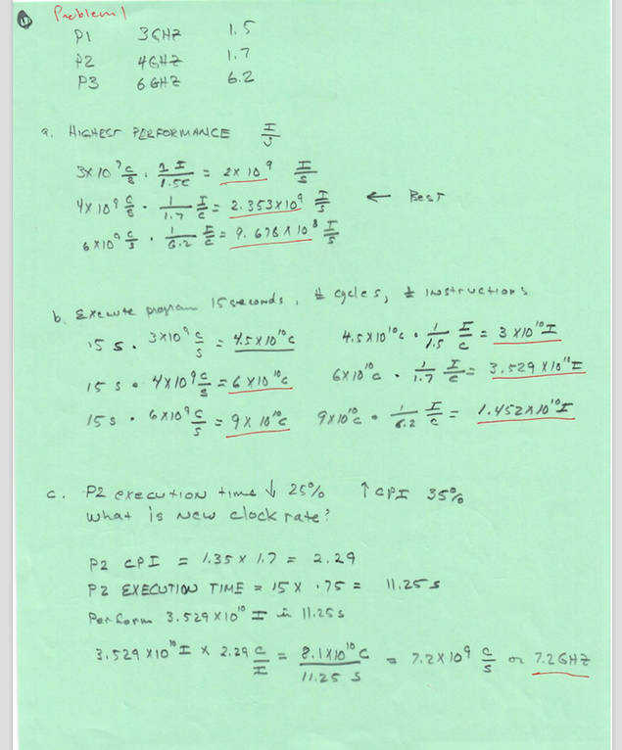
Homework 1

Slide 9
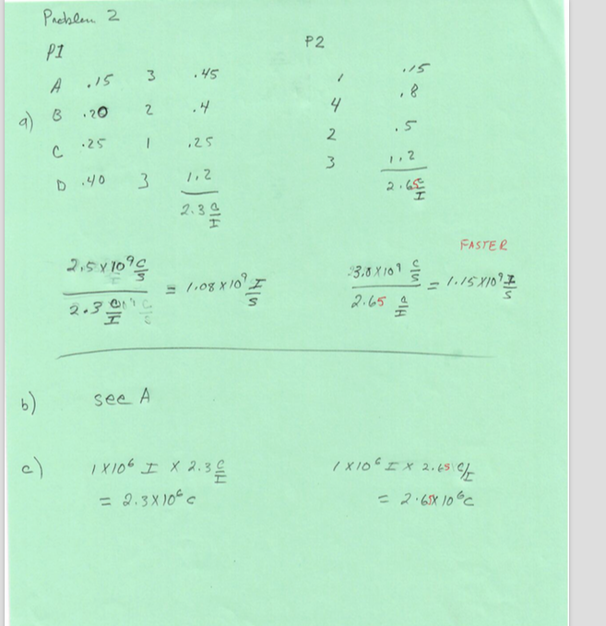
Homework 1

Slide 10
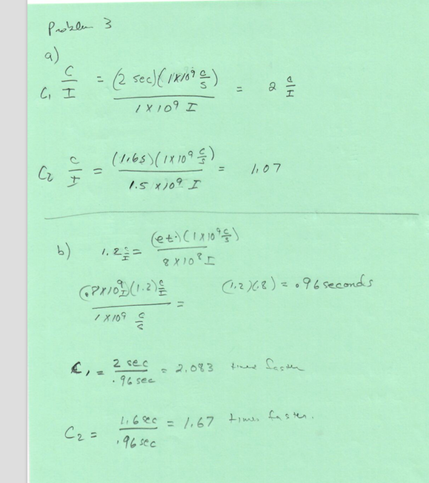
Homework 1

Slide 11
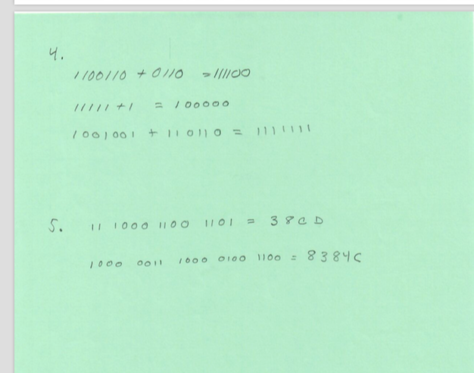
Homework 1

Slide 12
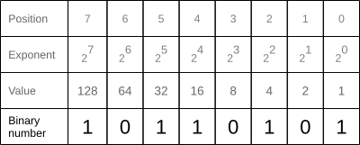
Converting a decimal floating point number to binary
Converting a decimal value to binary requires the addition of each bit-position value where the bit is 1
The decimal value of the binary number 10110101 is 1+4+16+32+128=181 (see picture on the right). When dealing with floating point numbers, the procedure is very similar but some additional steps are required. Converting a decimal floating point number to its binary form is more complicated than the other way around. The conversion to binary is explained first because it shows and explains all parts of a binary floating point number step by step.
https://blog.penjee.com/binary-numbers-floating-point-conversion/

Slide 13
Right of the point in binary
…
Position | 0 | 1 | 2 | 3 | 4 | 5 | 6 | 7
Exponent | 2⁻¹ | 2⁻² | 2⁻³ | 2⁻⁴ | 2⁻⁵ | 2⁻⁶ | 2⁻⁷ | 2⁻⁸
Value | 1/2 | 1/4 | 1/8 | 1/16 | 1/32
. | 1 | 1 | 0 | 1 | 1 | 0 | 1 | 0
https://blog.penjee.com/binary-numbers-floating-point-conversion/
Notes:
Showing how to the right of the decimal point in binary the values are inverses of two to the n

Slide 14
Conversion Process
A floating point number has an integral part and a fractional part. As example in number 34.890625, the integral part is the number in front of the decimal point (34), the fractional part is the rest after the decimal point (.890625). Here are the steps to convert a decimal number to binary (the steps will be explained in detail after):
Convert decimal number to binary scientific notation, processing the integral and fractional part independently.
The scientific binary number is then normalized (the decimal point is moved to the left most position, adjusting the exponent accordingly)
The exponent is converted to binary
The binary floating point number is constructed with all converted number parts. The first 1 of the mantissa is omitted.
https://blog.penjee.com/binary-numbers-floating-point-conversion/

Slide 15
Step 1
The very first step is to convert the number to binary scientific notation. To convert this floating point value to binary, the integral and fractional part are processed independently.
Converting the integral part to binary:The integral part is converted like any whole number: 34 is 10 0010 in binary. In the first step, the integral part is divided by 2 (2 because we want to convert to the binary system). Then the whole number part of the result is used to divide by 2 again, and so on until the whole number part reaches 0.
Calculation | Result | Whole number | Remainder (bit)
34 / 2 | 17 | 17 | 0
17 / 2 | 8.5 | 8 | 1
8 / 2 | 4 | 4 | 0
4 / 2 | 2 | 2 | 0
2 / 2 | 1 | 1 | 0
1 / 2 | 0.5 | 0 | 1
The resulting bits are calculated in reverse order. Reading the binary number from bottom to top gives us 10 0010 (Hint: writing binary numbers in groups of 4, which is one byte, makes it easier to read them).
https://blog.penjee.com/binary-numbers-floating-point-conversion/

Slide 16
Converting the fractional part to binary:
To convert the fractional part, instead of using division as used for the integral part, multiplication is used. If it is a whole number (>= 1.0), the bit is 1. The fractional part of the result is then used for the next calculation. Once the result reaches 1.0, the conversion is finished. However, there are many numbers which do not end up at a 1.0 result. Since there are 23 possible bits for the mantissa (in a single precision floating point number), the conversion ends as soon as 23 bits are reached.
The example number with the fractional part .890625 has been chosen on purpose to reach an end of the conversion after only a few calculations.
The resulting bits are calculated in the order they are written, which gives us a binary number 111001. The integral and fractional parts of the number 34.890625 combined gives the scientific binary number 100010.111001*2⁰
34 = 100010 and .890625 = 111001) with the base 2 because it is a binary number (and not a decimal number with the base 10).
Calculation | Result | Whole number | Bit
.890625 * 2 | 1.78125 | yes | 1
.78125 * 2 | 1.5625 | yes | 1
.5625 * 2 | 1.125 | yes | 1
.125 * 2 | 0.25 | no | 0
.25 * 2 | 0.5 | no | 0
.5 * 2 | 1 | yes | 1
https://blog.penjee.com/binary-numbers-floating-point-conversion/

Slide 17
STEP 2
Normalizing a scientific number means that the decimal point is moved to the left-most possible position by adjusting the exponent accordingly. For the number 100010.111001*2⁰, the decimal point can be moved 5 positions to the left, which increases the exponent by 5:
100010.111001*2⁰ →→→→→→→→ 1.00010111001*2⁵.
Note: As for any scientific notation, the decimal point is always moved to the left-most position so that there is no leading zero. For example, there is no 0.234*10² or 0.365*10⁵. Those numbers would be written as 2.34*10¹ and 3.65*10⁴. The same rule is used for the binary scientific notation which means that any normalized scientific binary number starts with a 1.
https://blog.penjee.com/binary-numbers-floating-point-conversion/

Slide 18
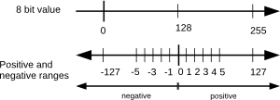
STEP 3
The normalization of the binary number resulted in the adjusted exponent of 5. As noted previously, the binary floating point exponent has a negative range and a positive range. Thus, 127 has to be added to the exponent of 5 and then converted to binary: 5+127=132 which is 1000 0100 in binary.
https://blog.penjee.com/binary-numbers-floating-point-conversion/

Slide 19
STEP 4
Now, the binary floating point number can be constructed. Steps 1 – 3 resulted in:
the positive number in binary form: 1.00010111001
the exponent in binary form: 1000 0100
These numbers can now be filled into the bit areas of a 32 bit floating point number.
Sign
The number is positive which means the sign is 0
Mantissa
The mantissa is 00010111001. Where did the preceding 1 go? As noted in Step 2, any scientific notation ends up with a preceding 1.
Therefore, the preceding 1 is omitted since no space has to be wasted for a bit whose state is known.
Exponent
The exponent is 1000 0100
The resulting floating point value is 0 10000100 0001011100100000000000:
https://blog.penjee.com/binary-numbers-floating-point-conversion/

Slide 20
Converting a binary floating point number to decimal
Converting a binary floating point number to decimal is much simpler than the reverse. For simplicity, we will use the previously converted number again and convert it back to decimal. If everything is done right, the result should be 34.890625.
The binary 32 bit floating point number was: 0 10000100 0001011100100000000000
Again, this is a positive number (the first bit, the sign, is 0), the exponent is 10000100 and the mantissa is 1.00010111001 (omitting any zeros at the end and adding back the omitted 1 in front of the decimal point).
https://blog.penjee.com/binary-numbers-floating-point-conversion/

Slide 21
Converting the exponent to decimal
The conversion is a basic binary to decimal conversion.
2² + 2⁷ = 132
or
4+128=132
Since there is the positive and negative range of +- 127 for exponents (as mentioned earlier), 127 has to be subtracted from the the converted value:
132-127=5
The resulting exponent is 5.
https://blog.penjee.com/binary-numbers-floating-point-conversion/

Slide 22
The whole mantissa can now be converted to decimal
Converting the mantissa does not need the normalization to be undone. The whole number can be calculated as follows:1.00010111001 * 2⁵
either with negative exponents: (20 + 2-4 + 2-6 + 2-7 + 2-8 + 2-11) * 2⁵ = 34.890625
or fractions: (1 + 1/16 + 1/64 + 1/128 + 1/256 + 1/2048) * 2⁵ = 34.890625
The number is now successfully converted to decimal and the result is 34.890625 which is the decimal representation of the floating point number we started with.
https://blog.penjee.com/binary-numbers-floating-point-conversion/

Slide 23
Single-Precision Range
Exponents 00000000 and 11111111 are reserved
Smallest value
smallest stored exponent: 00000001 ⇒ actual exponent = 1 – 127 = –126
Fraction: 000…00 ⇒ significand = 1.0
±1.0 × 2^{–126} ≈ ±1.2 × 10^{–38}
Largest value
largest stored exponent: 11111110 ⇒ actual exponent = 254 – 127 = +127
Fraction: 111…11 ⇒ significand ≈ 2.0
±2.0 × 2⁺¹²⁷ ≈ ± 3.4 × 10⁺³⁸
Notes:
Why is 0 reserved?

Slide 24
Double-Precision Range
Exponents 0000…00 and 1111…11 reserved
Smallest value
Exponent: 00000000001 ⇒ actual exponent = 1 – 1023 = –1022
Fraction: 000…00 ⇒ significand = 1.0
±1.0 × 2^{–1022} ≈ ±2.2 × 10^{–308}
Largest value
Exponent: 11111111110 ⇒ actual exponent = 2046 – 1023 = +1023
Fraction: 111…11 ⇒ significand ≈ 2.0
±2.0 × 2⁺¹⁰²³ ≈ ±1.8 × 10⁺³⁰⁸

Slide 25
IEEE 754 FP Standard : Examples
Smallest+: 0 00000001 1.00000000000000000000000 = 1.0 x 2¹⁻¹²⁷
Zero: 0 00000000 00000000000000000000000 = true 0
Largest+: 0 11111110 1.11111111111111111111111 = 2-2⁻²³ x 2²⁵⁴⁻¹²⁷

Slide 26
Floating-point Addition in Base 10
To add
F₁ x 10^{E1} and F₂ x 10^{E2}
Divide/Multiply one of the numbers to make the exponents the same
Factor out the exponent
Add the fractions
3.2 x 10² + 1.456 x 10⁴
= 0.032 x 10⁴ + 1.456 x 10⁴
= (0.032 + 1.456) x 10⁴ = 1.488 x 10⁴

Slide 27
Floating-point Addition in Binary
Addition (and subtraction)
(±F1 × 2^{E1}) + (±F2 × 2^{E2}) = ±F3 × 2^{E3}
Step 0: Restore the hidden bit in F1 and in F2
Step 1: Align fractions by right shifting F2 by (E1 - E2) positions
(assuming E1 ≥ E2)
Step 2: Add the resulting F2 to F1 to form F3
Step 3: Normalize F3 (so it is in the form 1.XXXXX …)
If E1 and E2 have the same sign check for overflow
If E1 and E2 have different signs check for underflow
Step 4: Round F3 and possibly normalize F3 again
if F3 has more bits then we have room for
Step 5: Re-hide the most significant bit of F3 before storing the result
8 x 2⁴ = 8/2 x 2³ = 4 x 2³
Divide by 2 ≈ right shift
Number too small!
Notes:
Note that the smaller fraction is the one shifted (while increasing its exponent until it is equal to the larger exponent)

Slide 28
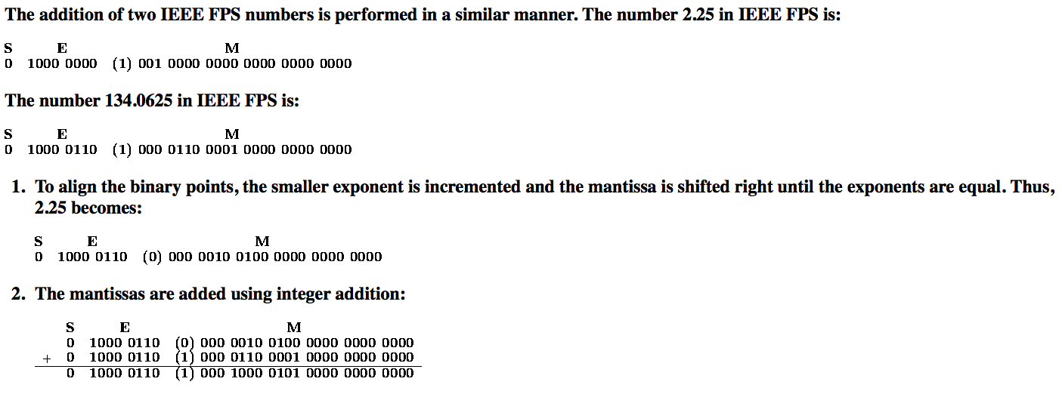
Floating Point Addition
https://www.cs.uaf.edu/2000/fall/cs301/notes/Chapter6/node3.html

Slide 29
Floating Point Addition
1000 0000 incremented six times = 1000 0110
https://www.cs.uaf.edu/2000/fall/cs301/notes/Chapter6/node3.html

Slide 30
Floating Point Addition
000 0110 0001 0000 ….
shifted 6 right
= (0) 000 0010 0100 …
https://www.cs.uaf.edu/2000/fall/cs301/notes/Chapter6/node3.html

Slide 31
Floating Point Multiplication
Multiplication
(±F1 × 2^{E1}) x (±F2 × 2^{E2}) = ±F3 × 2^{E3}
Step 0: Restore the hidden bit in F1 and in F2
Step 1: Add the two exponents and adjust for bias
E1 + E2 – bias = E3
determine the sign of the product
Step 2: Multiply F1 by F2 to form a double precision F3
Step 3: Normalize F3 (so it is in the form 1.XXXXX …)
1 bit right shift F3 and increment E3
Check for overflow/underflow
Step 4: Round F3 and possibly normalize F3 again
Step 5: Re-hide the most significant bit of F3 before storing the result
E1 = 5, E2 = 4, bias = 3
E3 = ((5 – 3) + (4 – 3)) + 3
Subtract bias twice, add once
Could we use a basic logic operation to determine sign?

Slide 32
Floating Point Multiplication Example
Multiply (assume 32-bit single-precision values)
(0.5 = 1.0000 × 2⁻¹) x (-0.4375 = -1.1100× 2⁻²)
Hidden bits restored in the representation above
Step 0:
Step 1:
Step 2:
Step 3:
Step 4:
Step 5:
Add the exponents
E1 = -1+ 127 = 126, E2 = -2 + 127 = 125
= (126 + 125) – 127 = 124
Multiply the significands
1.0000 x 1.1100= 1.110000
Normalize the product, checking for exponent over/underflow
1.110000 x 2⁻³ is already normalized
No need to round
Re-hide the hidden bit before storing
Notes:
For lecture

Slide 33
MIPS Floating Point Instructions
MIPS has a separate Floating Point Register File ($f0, $f1, …, $f31) with special instructions to load to and store from them
lwc1 $f1,16($s2) #$f1 = Memory[$s2+16]
swc1 $f1,24($s4) #Memory[$s4+24] = $f1
the registers are used in pairs for double precision values
supports IEEE 754 single and double-precision operations
add.s $f2,$f4,$f6 #$f2 = $f4 + $f6
add.d $f2,$f4,$f6 #$f2||$f3 = $f4||$f5 + $f6||$f7
Similarly, instructions for sub.s, sub.d, mul.s, mul.d, div.s, div.d

Slide 34
MIPS Floating Point Instructions
Floating point single precision comparison operations
c.x.s $f2,$f4 #if($f2 < $f4) cond=1; else cond=0
where x may be eq, neq, lt, le, gt, ge
Double-precision comparison operations
c.x.d $f2, $f4 #$f2||$f3 < $f4||$f5 cond=1; else cond=0
Floating point branch operations
bclt 25 #if(cond==1) go to PC+4+25
bclf 25 #if(cond==0)

Slide 35
Frequency of Common MIPS Instructions
 | SPECint | SPECfp
addu | 5.2% | 3.5%
addiu | 9.0% | 7.2%
or | 4.0% | 1.2%
sll | 4.4% | 1.9%
lui | 3.3% | 0.5%
lw | 18.6% | 5.8%
sw | 7.6% | 2.0%
lbu | 3.7% | 0.1%
beq | 8.6% | 2.2%
bne | 8.4% | 1.4%
slt | 9.9% | 2.3%
slti | 3.1% | 0.3%
sltu | 3.4% | 0.8%
 | SPECint | SPECfp
add.d | 0.0% | 10.6%
sub.d | 0.0% | 4.9%
mul.d | 0.0% | 15.0%
add.s | 0.0% | 1.5%
sub.s | 0.0% | 1.8%
mul.s | 0.0% | 2.4%
l.d | 0.0% | 17.5%
s.d | 0.0% | 4.9%
l.s | 0.0% | 4.2%
s.s | 0.0% | 1.1%
lhu | 1.3% | 0.0%
only included those with >3% and >1%
Notes:
Chart that shows that Spec int uses almost no floating point instructions while spec fp uses few non floating point math instructions

Slide 36
Associativity
Associativity matters in floating-point operations
What are the implications?
Need to be especially careful in parallelizing FP applications
Incorrect results, even if no dependence!

Slide 37
Accurate Arithmetic
IEEE Standard 754 specifies additional rounding control
Extra bits of precision (guard, round, sticky)
Choice of rounding modes
Allows programmer to fine-tune numerical behavior of a computation
Not all FP units implement all options
Most programming languages and FP libraries just use defaults
Trade-off between hardware complexity, performance, and market requirements

Slide 38
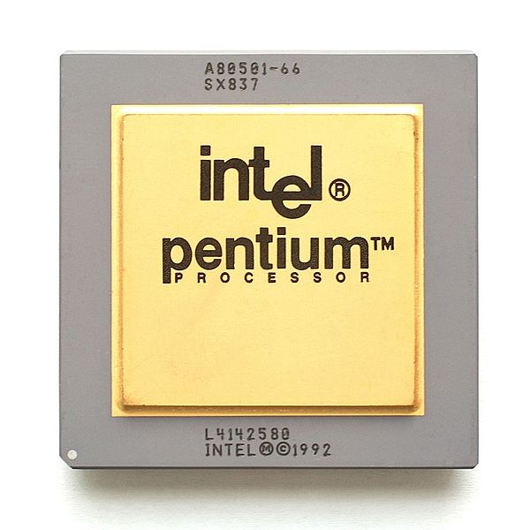
Who Cares About FP Accuracy?
Important for scientific code
But for everyday consumer use?
“My bank balance is off by 0.0002¢!”
The Intel Pentium FDIV bug
The market expects accuracy
whether they need it or not
Q: Why didn't Intel call the Pentium the 586?
A: Because they added 486 and 100 on the Pentium and got 585.999983605.

Slide 39
Summary
ISAs support arithmetic
Signed and unsigned integers
Floating-point approximation to reals
Bounded range and precision
Operations can overflow and underflow

