Slide 1
Processor Datapath I
CS 3339
Lecture 7a
Greg LaKomski
Texas State University
Fall 2018
*some slides adopted from P&H

Slide 2
Today We Begin – Processor Design !
THE PROCESSOR DATAPATH
Implementation of instructions
ALU
Memory
Branch – maybe today

Slide 3
Processor Datapath and Control
At the micro-architectural level we have two types of components in the processor
Datapath : set of components that combine to execute an instruction
Bit of a misnomer – that’s an understatement. Lost in the annals of space and time.
Control : set of components that tell the datapath what to do
Works like an OS at the hardware level

Slide 4
Processor Datapath and Control
Datapath and Control combine to provide a processor implementation
elements are connected through wires
only means of communication
need to think in binary!
Each element in the datapath and the control unit has corresponding hardware
We will not use an HDL in this class
HDLs work best at a lower abstraction level
Hardware Descriptive Language - Verilog
We will use diagrams (like the one in the next slide) to understand the design and implementation issues

Slide 5
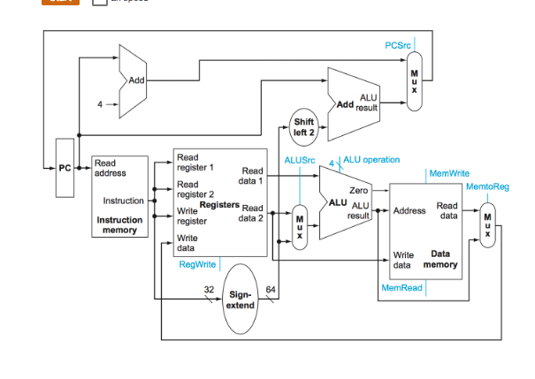
Example Datapath Diagram

Slide 6
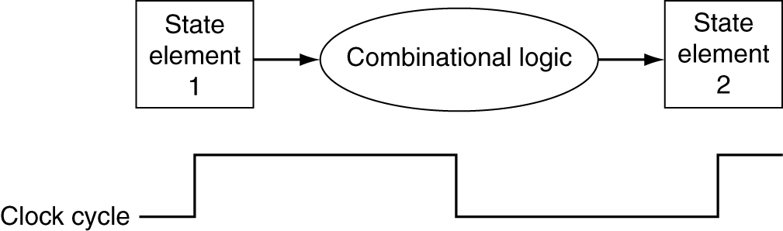
Logic Design Basics
Information encoded in binary
Low voltage = 0, High voltage = 1
One wire per bit
Multi-bit data encoded on multi-wire buses
Combinational and state elements
ALU, MUX, Gates are combinational elements
cannot store value
output solely dependent on current input
registers and memory are called state elements
can store value

Slide 7
Clock Cycle
We are assuming an edge triggered clocking methodology
Means values stored in a sequential logic element are updated on either a falling or rising edge.

Slide 8
Sequential Logic
In digital circuit theory, sequential logic is a type of logic circuit whose output depends not only on the present value of its input signals but on the sequence of past inputs, the input history. ... Sequential logic is used to construct finite state machines, a basic building block in all digital circuitry.
wikipedia

Slide 9
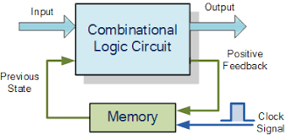
Sequential Logic

Slide 10
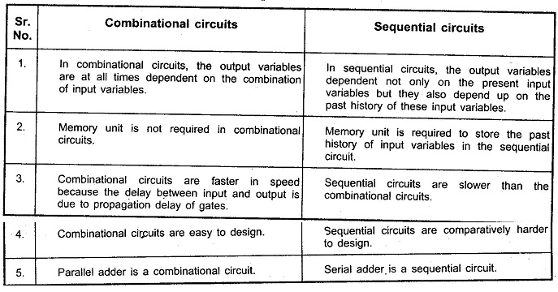
Sequential Logic

Slide 11
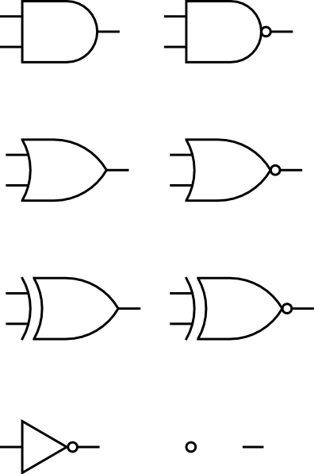
Datapath Elements : Gates
AND
OR
XOR
NOT

Slide 12
Datapath Elements : Registers
Can store data
Implemented with D-flip-flops
Delay the output
Set of registers implemented as a file
Special registers : PC
D₀
I₀
Q₀
D₁
I₁
Q₁
D₂
I₂
Q₂
D₃
I₃
Q₃
clk
4-bit register
PC

Slide 13
REGISTER UNIT

Slide 14
Datapath Elements : ALU
Arithmetic/Logic Unit
Y = F(A, B)
Adder
Y = A + B
A
A
ALU
Y
+
Y
B
B
F
Sometimes use specialized ALU (e.g. adders) if addition is all we need
Adders are ALUs hardwired to do addition

Slide 15
ALU
zero
overflow
OP1
ALU
RESULT
OP2
4 bit control

Slide 16
Datapath Elements : Multiplexer
Two wires in
Which one gets hooked to
D determined by C
s0
M U X
D
s1
Can’t just join wires together
C

Slide 17
Datapath Elements : Memory
On chip memory
aka the first level cache
Separate data and instruction memory
Slower than registers but faster than main memory
2-10 cycles for loads
Larger than registers but smaller than main memory
address
read port
on-chip
memory
write port

Slide 18
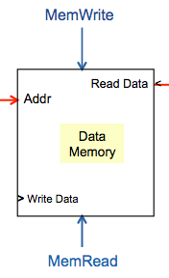
Memory Unit

Slide 19
Processor Implementation
Implementing a processor implies implementing all instructions for a given ISA using the available datapath elements
Different instructions may have different resource requirements
Requirements for the same class of instructions will be similar
Some tasks we need to perform for every instruction
Get the instruction (Fetch)
Determine what instruction it is (Decode)

Slide 20
Instruction Fetch
Need to
Fetch an instruction
Determine which instruction to fetch next
Components we need …
address
read port
memory
write port
A
PC
ALU
Y
B
F

Slide 21
Instruction Fetch
ADD
Increment by 4 for next instruction
4
PC
read port
<
instruction
read
address
Instruction
Memory
(L1 I-Cache)
Can send instruction address and compute next instruction in parallel
Specialized adder more efficient than regular ALU
Notes:
Block 1 for Edgar

Slide 22
Instruction Execution
The tasks involved in instruction execution can be generalized as follows
Fetch
Decode
Execute
Depending on instruction class
Use ALU to calculate
Arithmetic result
Memory address for load/store
Branch target address
Access data memory for load/store
Fetch next …
A
Fetch-Decode-Execute Loop
A

Slide 23
Question
How would the other instructions that affect the PC change this diagram???

Slide 24
Instruction Fetch
Maybe we have to get the PC+4 and add an offset plus shift left 2.
ADD
Increment by 4 for next instruction
4
PC
read port
<
instruction
read
address
Instruction
Memory
(L1 I-Cache)
Can send instruction address and compute next instruction in parallel
Specialized adder more efficient than regular ALU
Notes:
Block 1 for Edgar

