Slide 1
890405

Slide 2
Processor Datapath II
CS 3339
Lecture 7b
Greg LaKomski
Texas State University
Fall 2018
*some slides adopted from P&H

Slide 3
Announcements
Reading for 4 is under assignments
I am expecting one slide
Schedule is updated to Rev 3
Does anyone need ethernet cabling?

Slide 4
Competitive Coding Club
We are making progress on the Competitive Coding Club- It will be called the “ Titans”
The focus is on advanced algorithms, white board skills, competitive coding and interview questions
Weekly meetings, training, and practice
If you are interesting in helping form the club, contact Shervone “Chevy” Mayes – sem194. There are officer positions.
Great for your resume and skills

Slide 5
Slides and Presentations
There are worlds of difference between good slides and bad slides
It is an art form to make good ones
I had a boss at Intel that was awesome.
Ramesh Peri – Architect of ICC compiler and general genius type
Was very persuasive and got his way a lot

Slide 6
Slides from a presentation I gave
It was an ok but not great set of slides
Used smart art graphics in PP
Little goes a long way

Slide 7
Enabling nrf24L01 Radio on D2000 using Synthetic SPI

Slide 8
Motivation

Slide 9
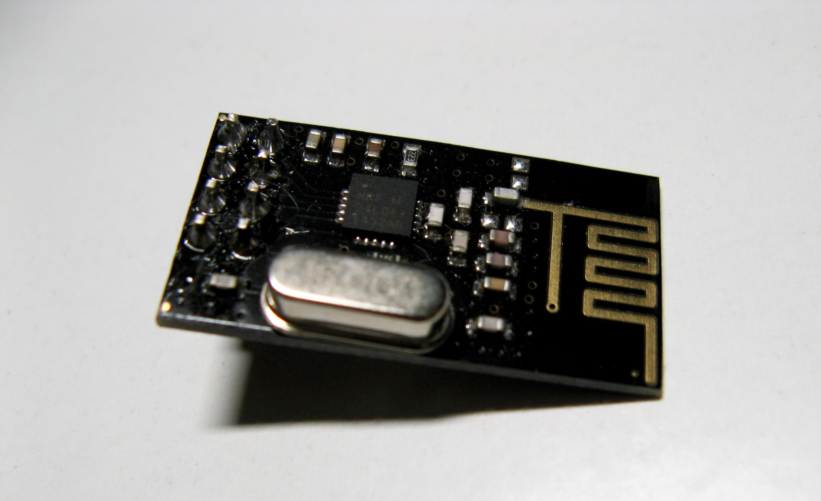
Close up of nrf24L01Transceiver

Slide 10
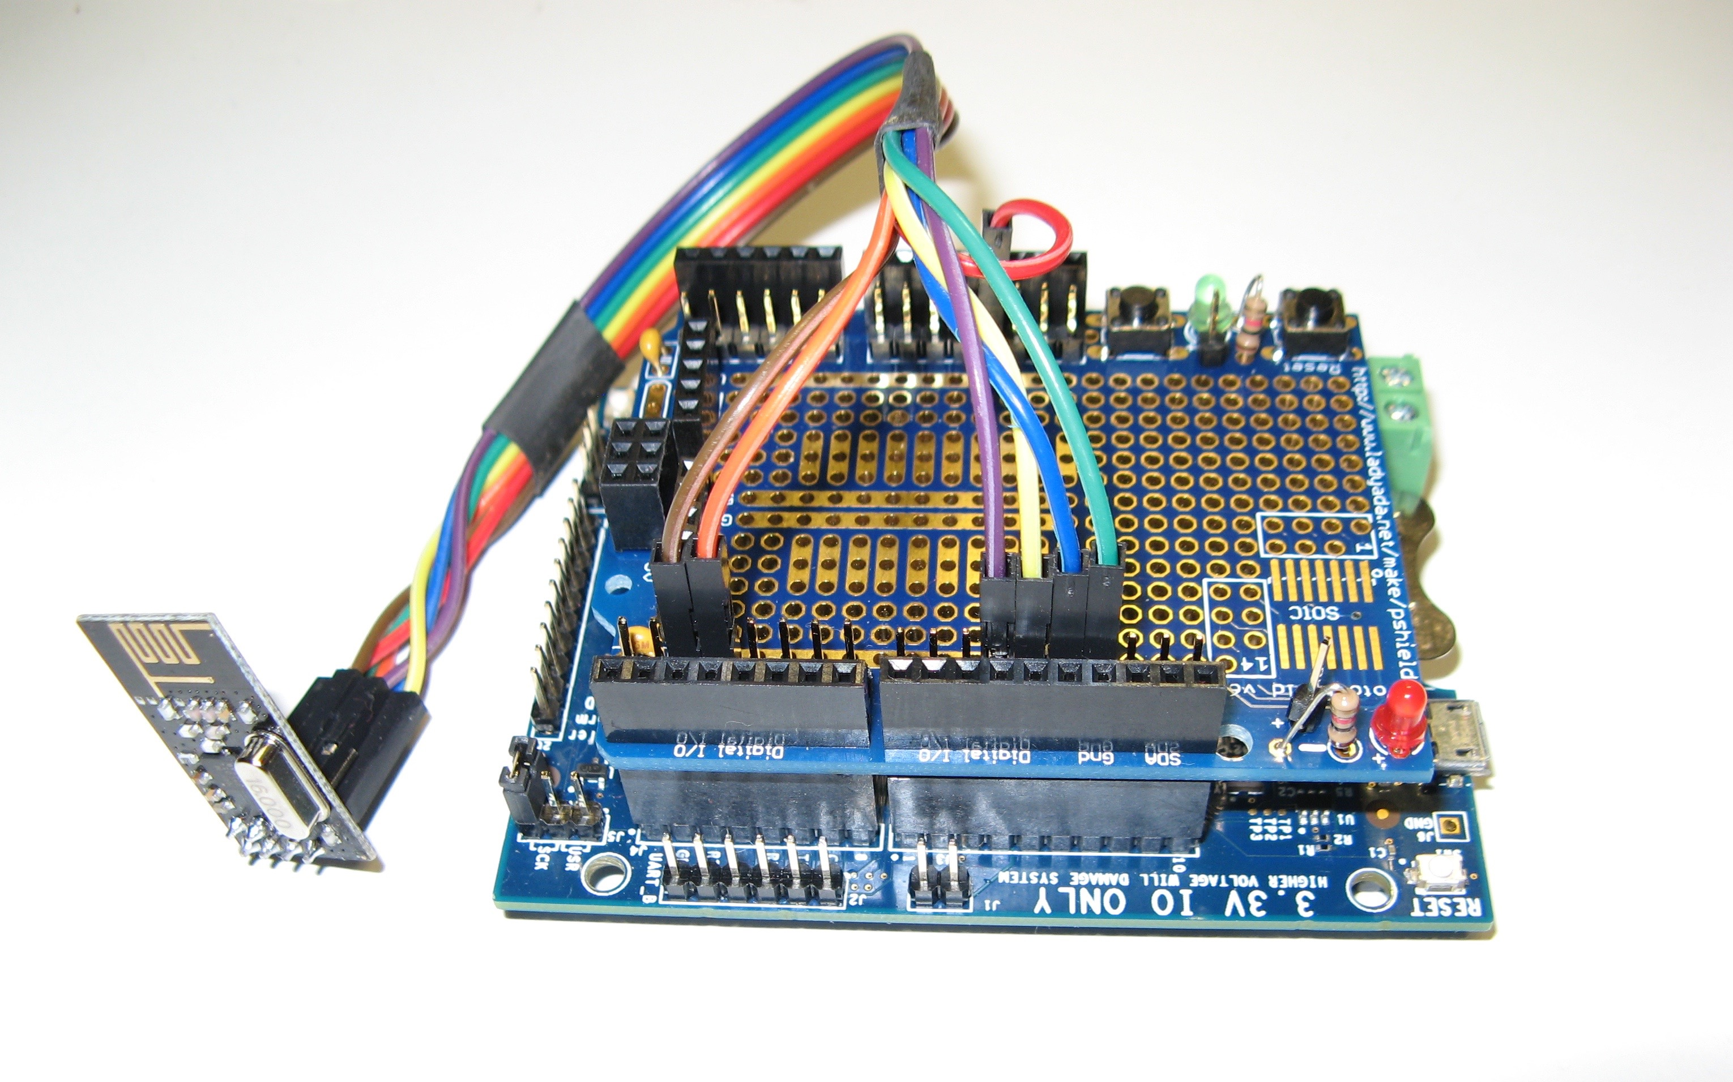
Transceiver on D2000 Dev Board

Slide 11
Why nrf24L01?

Slide 12
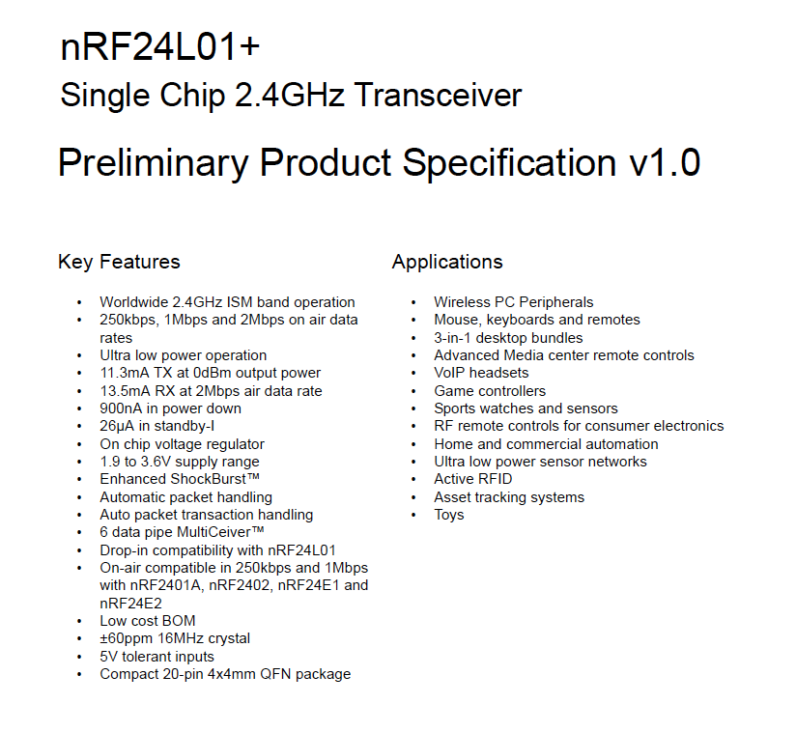
nrf24L01 Specs(from datasheet)

Slide 13
Approach

Slide 14
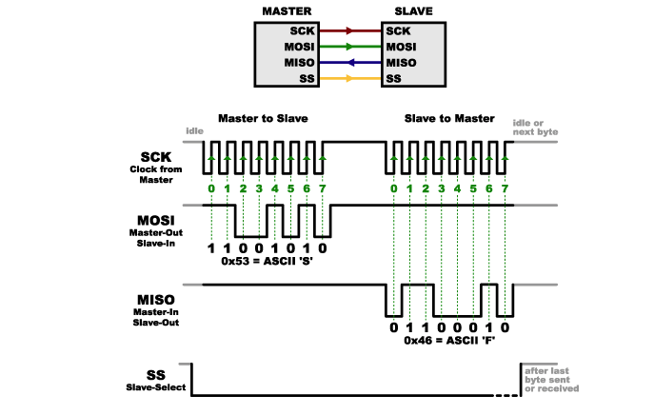
Serial Peripheral Interface from wikipedia

Slide 15
Slides
How long does it take to present a slide?
What’s the biggest challenge in presenting?
?

Slide 16
30 second speech
You should be able to describe what your main expertise is/are in 30 seconds
Your resume in 30 seconds
You should practice this until you have it cold
WHY YOU SAY???

Slide 17
Answer

Slide 18
Answer

Slide 19
Answer

Slide 20
Answer

Slide 21
Your life is primarily a function of luck
If you want to be a great coder at Google, find out what great coders look like, how they behave, how they dress, what they do in their spare time, what they eat and what games they play, where they hang out, ect.
Practice being a Google coder
The probability of a excellent outcome is greatly enhanced.

Slide 22
Review

Slide 23
Processor Datapath and Control
Datapath and Control combine to provide a processor implementation
elements are connected through wires
only means of communication
need to think in binary!
Each element in the datapath and the control unit has corresponding hardware
We will not use an HDL in this class
HDLs work best at a lower abstraction level
Hardware Descriptive Language - Verilog
We will use diagrams (like the one in the next slide) to understand the design and implementation issues

Slide 24
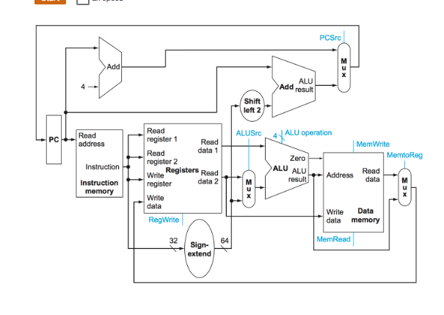
Example Datapath Diagram

Slide 25
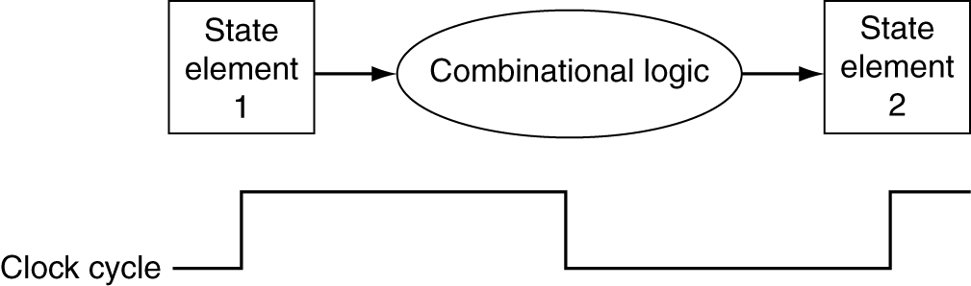
Logic Design Basics
Information encoded in binary
Low voltage = 0, High voltage = 1
One wire per bit
Multi-bit data encoded on multi-wire buses
Combinational and state elements
ALU, MUX, Gates are combinational elements
cannot store value
output solely dependent on current input
registers and memory are called state elements
can store value

Slide 26
Clock Cycle
We are assuming an edge triggered clocking methodology
Means values stored in a sequential logic element are updated on either a falling or rising edge.

Slide 27
Sequential Logic
In digital circuit theory, sequential logic is a type of logic circuit whose output depends not only on the present value of its input signals but on the sequence of past inputs, the input history. ... Sequential logic is used to construct finite state machines, a basic building block in all digital circuitry.
wikipedia

Slide 28
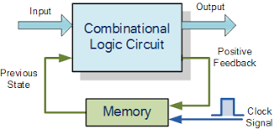
Sequential Logic

Slide 29
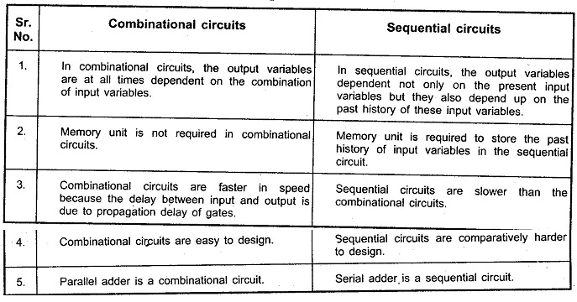
Sequential Logic

Slide 30
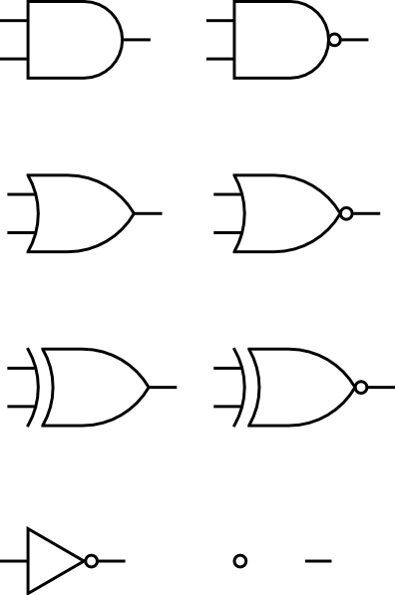
Datapath Elements : Gates
AND
OR
XOR
NOT

Slide 31
Datapath Elements : Registers
Can store data
Implemented with D-flip-flops
Delay the output
Set of registers implemented as a file
Special registers : PC
D₀
I₀
Q₀
D₁
I₁
Q₁
D₂
I₂
Q₂
D₃
I₃
Q₃
clk
4-bit register
PC

Slide 32
REGISTER UNIT

Slide 33
Datapath Elements : ALU
Arithmetic/Logic Unit
Y = F(A, B)
Adder
Y = A + B
A
A
ALU
Y
+
Y
B
B
F
Sometimes use specialized ALU (e.g. adders) if addition is all we need
Adders are ALUs hardwired to do addition

Slide 34
ALU
zero
overflow
OP1
ALU
RESULT
OP2
4 bit control

Slide 35
Datapath Elements : Multiplexer
Two wires in
Which one gets hooked to
D determined by C
s0
M U X
D
s1
Can’t just join wires together
C

Slide 36
Datapath Elements : Memory
On chip memory
aka the first level cache
Separate data and instruction memory
Slower than registers but faster than main memory
2-10 cycles for loads
Larger than registers but smaller than main memory
address
read port
on-chip
memory
write port

Slide 37
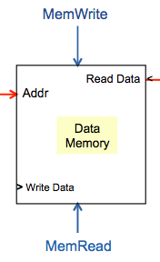
Memory Unit

Slide 38
Processor Implementation
Implementing a processor implies implementing all instructions for a given ISA using the available datapath elements
Different instructions may have different resource requirements
Requirements for the same class of instructions will be similar
Some tasks we need to perform for every instruction
Get the instruction (Fetch)
Determine what instruction it is (Decode)

Slide 39
Instruction Fetch
Need to
Fetch an instruction
Determine which instruction to fetch next
Components we need …
address
read port
memory
write port
A
PC
ALU
Y
B
F

Slide 40
Instruction Fetch
ADD
Increment by 4 for next instruction
4
PC
read port
<
instruction
read
address
Instruction
Memory
(L1 I-Cache)
Can send instruction address and compute next instruction in parallel
Specialized adder more efficient than regular ALU
Notes:
Block 1 for Edgar

Slide 41
Instruction Execution
The tasks involved in instruction execution can be generalized as follows
Fetch
Decode
Execute
Depending on instruction class
Use ALU to calculate
Arithmetic result
Memory address for load/store
Branch target address
Access data memory for load/store
Fetch next …
A
Fetch-Decode-Execute Loop
A

Slide 42
Question
How would the other instructions that affect the PC change this diagram???

Slide 43
Instruction Fetch
Maybe we have to get the PC+4 and add an offset plus shift left 2.
ADD
Increment by 4 for next instruction
4
PC
read port
<
instruction
read
address
Instruction
Memory
(L1 I-Cache)
Can send instruction address and compute next instruction in parallel
Specialized adder more efficient than regular ALU
Notes:
Block 1 for Edgar

Slide 44
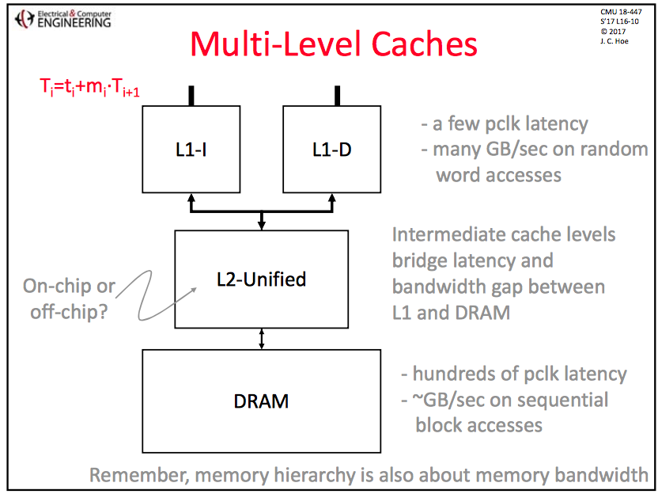

Slide 45
Instruction Decode – ALU - R Type
Decoding involves determining opcode, extracting register number extracting memory address
Just a matter of redirecting wires!
[10-15]
Need to know where to send these
?
[20-16]
ALU Instruction
[5-9]
register file
oper
dest
shamt
src2
src1
[4-0]
[31-21]
?
Do we always want to send the same set of wires to the register file?

Slide 46
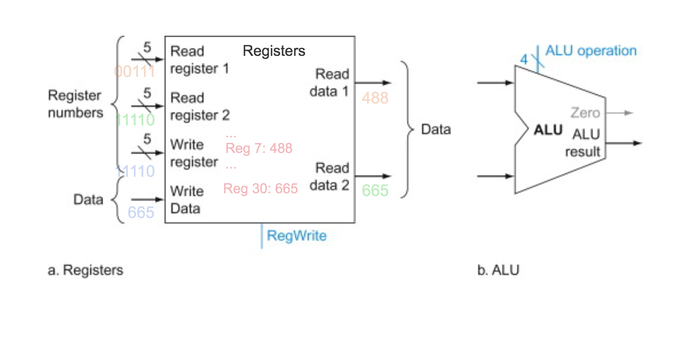
Implementing an R Instruction

Slide 47
Register Unit
Always puts the read register contents on the read data buses!
Selectively writes data to the write register based on the setting of the write control line.

Slide 48
Instruction Decode – D Type – LD/ST
Decoding a load instruction
Opcode tells us which bits to send to the register file
Need something to process the opcode before sending the bits
[12-20]
base
[4-0
Load Instruction
register file
oper
offset
op
dest
[9-5]
[30-21]

Slide 49
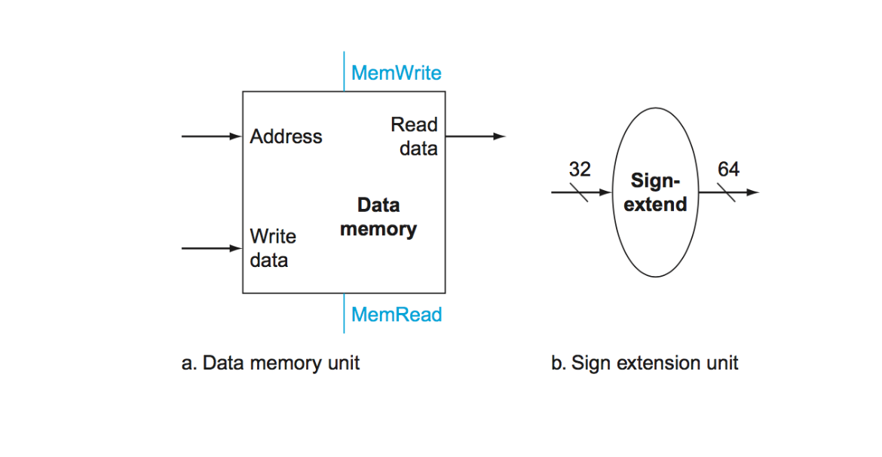
Additional Elements Needed for LD/ST

Slide 50
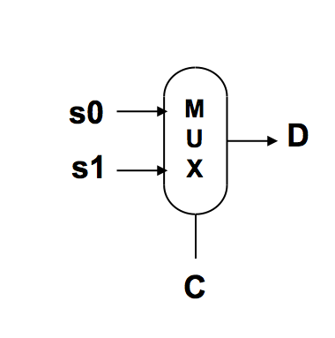
AND a MUX

Slide 51
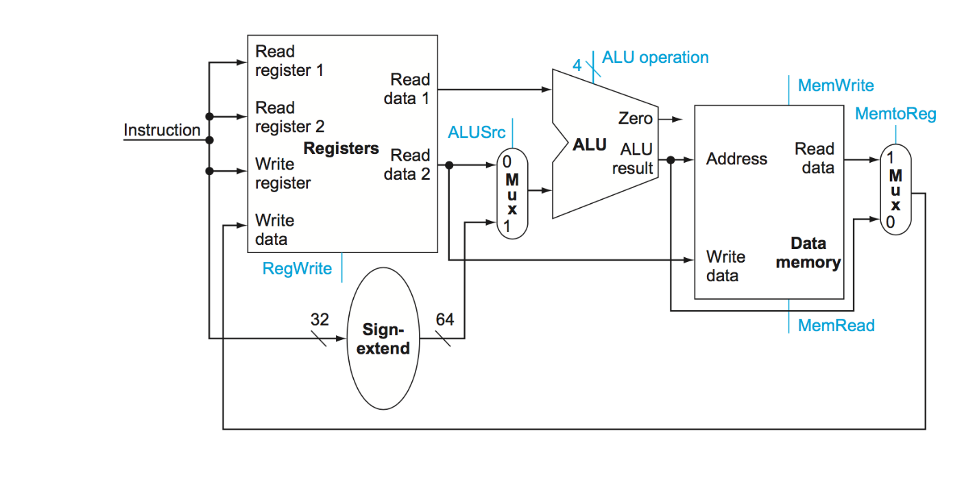
Data Path for R and D instructions

Slide 52
Control for “MATH”
0
0
0
1
0

Slide 53
Control for LD
0
1
1
1
1

Slide 54
Control for ST
1
0
1
0
0

Slide 55
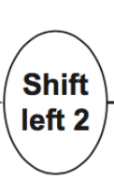
Conditional Branch Instructions
Read register operand
Compare operand to condition
Calculate target address
Sign-extend offset
Shift offset left 2
Add to PC + 4
oper
offset in words
comp
CBZ, CBNZ
Read
Addr 1
Read
Data 1 <
Read
Addr 2
Register
File
Write
Addr
Read
Data 2 <
> Write Data
Shift throws away only sign bits
since sign extended from 19 bits
PC
Sign
Extend
ALU

Slide 56
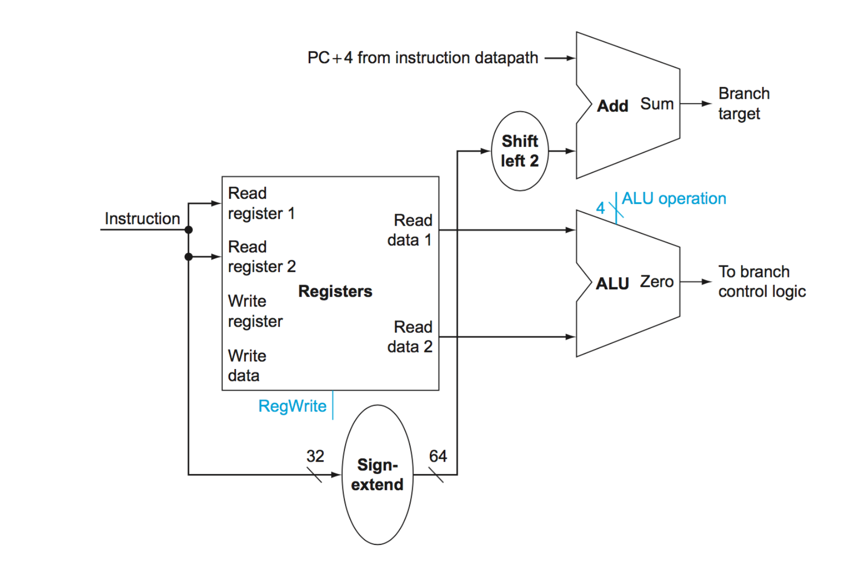
Implementing Conditional Branch

Slide 57
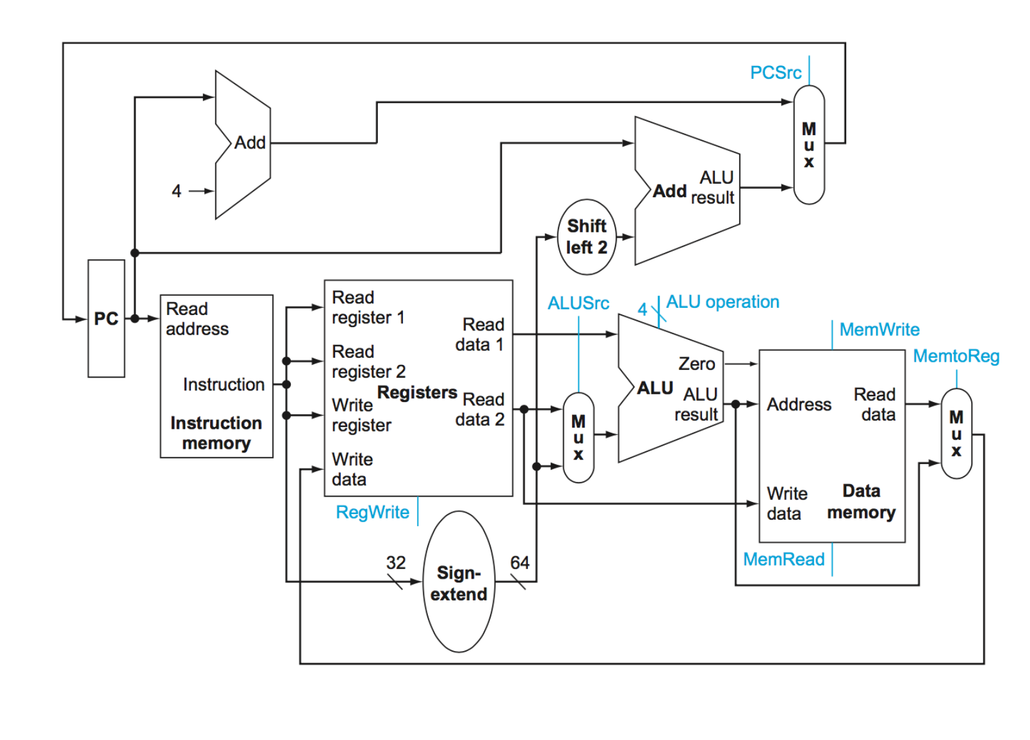
Putting the Elements Together

Slide 58
Control for CBZ
1
0
0
0
0
0

Slide 59
Adding Control to the Datapath
At any given cycle
tell each MUX which operand to select
tell ALUs which operation to perform
let registers and memory know if we are doing a read or write
Need to add HW to accomplish each of the above
mostly just pulling wires and selecting from a bus
a few gates

Slide 60
Single Cycle Datapath
The processor design we looked at is a design for a single cycle datapath
In this scheme
Signals are generated at every clock tick
Need to finish all work with generated signals
The length of the clock cycle is determined by the time it takes to execute an instruction
What are the tasks that take up time in instruction execution?

Slide 61
Estimating Instruction Times
What is the clock cycle time assuming
Instruction and Data Memory (200 ps)
ALU and adders (200 ps)
Register File access (reads or writes) (100 ps)
(Assume negligible delays for muxes, control unit, sign extend, PC access, shift left 2, wires)
Instr. | I Mem | Reg Rd | ALU Op | D Mem | Reg Wr | Total
ALU
LD
ST
CBZ
B

Slide 62
Estimating Instruction Times
What is the clock cycle time, assuming
Instruction and Data Memory (200 ps)
ALU and adders (200 ps)
Register File access (reads or writes) (100 ps)
Assume negligible delays for muxes, control unit, sign extend, PC access, shift left 2, wires
Instr. | I Mem | Reg Rd | ALU Op | D Mem | Reg Wr | Total
ALU
LD
ST
CBZ
B
200 | 100 | 200 |  | 100 | 600
200 | 100 | 200 | 200 | 100 | 800
200 | 100 | 200 | 200 |  | 700
200 | 100 | 200 |  |  | 500
200 |  |  |  |  | 200

Slide 63
Single Cycle Disadvantages & Advantages
Uses the clock cycle inefficiently
the clock cycle must be timed to accommodate the slowest instruction
especially problematic for more complex instructions like floating point multiply
Some wastage in terms of space
some functional units (e.g., adders) must be duplicated since they can not be shared during a clock cycle
Cycle 1
Cycle 2
Clk
LD
ST
Waste

Slide 64
How Can We Make It Faster?
Fetch (and execute) more than one instruction at a time
Superscalar processing
More Cores
Use SW and HW techniques for exploiting ILP
Generate instruction stream in a way so that while instruction A is utilizing resource X, instruction B can utilize resource Y
VLIW

Slide 65
How Can We Make It Faster?
Start fetching and executing the next instruction before the current one has completed
Pipelining
(all?) modern processors are pipelined for performance
Recall the performance equation: CPU time = CPI * CC * IC
Under ideal conditions and with a large number of instructions, the speedup from pipelining is approximately equal to the number of pipe stages
A five stage pipeline is nearly five times faster because the CC is nearly five times faster

