Slide 1
820107

Slide 2
Pipelining 2: Hazards
CS 3339
Lecture 8b
Greg LaKomski
Texas State University
Spring 2018
some slides ©2001-2003 Howard Huang

Slide 3
Announcements
I have prizes for slides !
Next homework out on 15th due 29
Cover pipeline and cache
Projects
Most are done
Three are in process
Project 2 is out with first simple file
I will be adding files – maybe one tonight

Slide 4
Midterm
Scores not that great
Test was really not very hard – sorry if you think so - please do not whine about it
If you didn’t really do any of project one coding, you likely suffered.
If you really did not do the homework and copied someone else’s you were toast
If you really didn’t read the book or the slides you missed a lot of easy points
Reading and learning is becoming a lost skill.

Slide 5
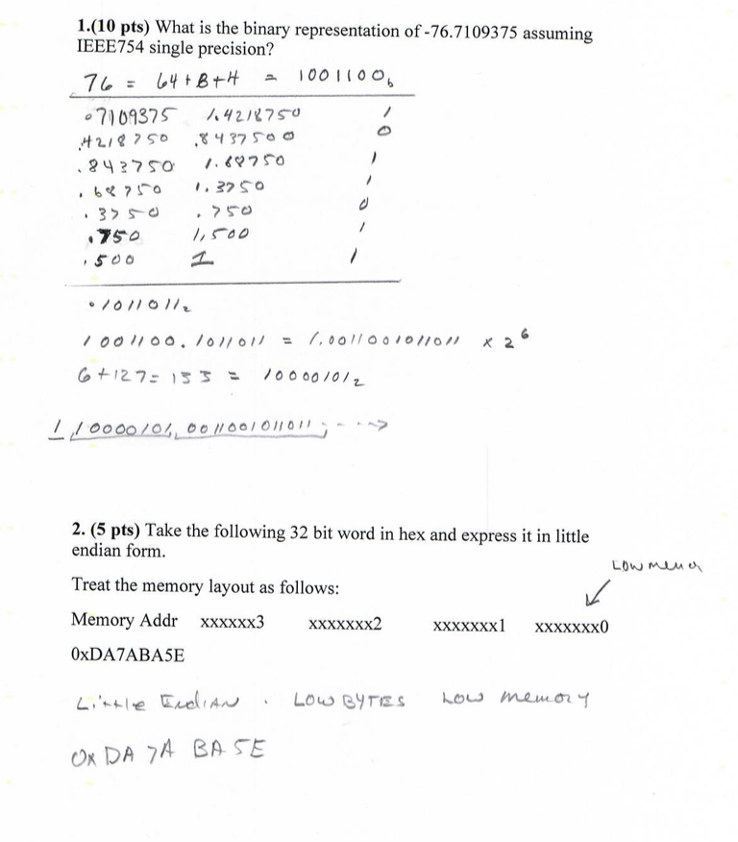
Midterm

Slide 6
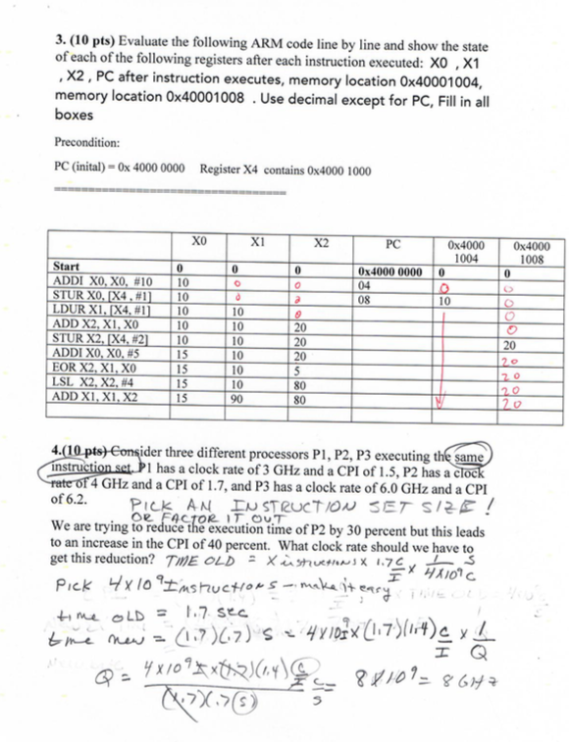
Midterm

Slide 7
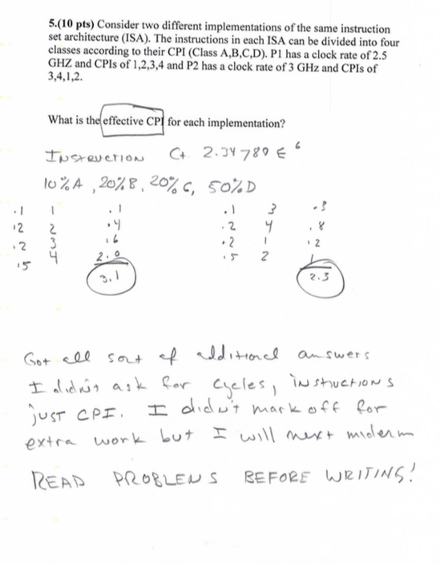
Midterm

Slide 8
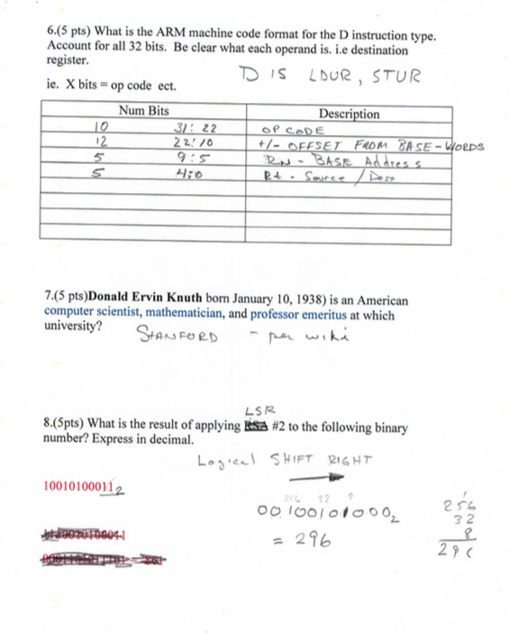
Midterm

Slide 9
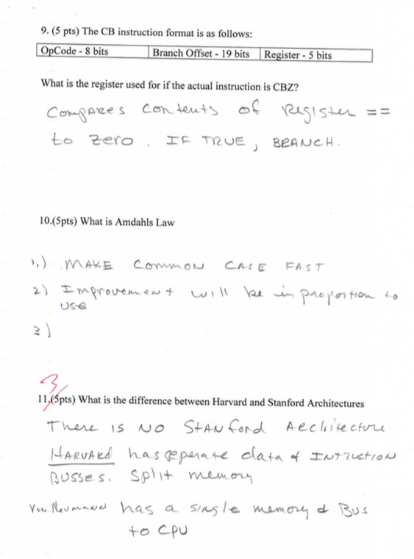
Midterm

Slide 10
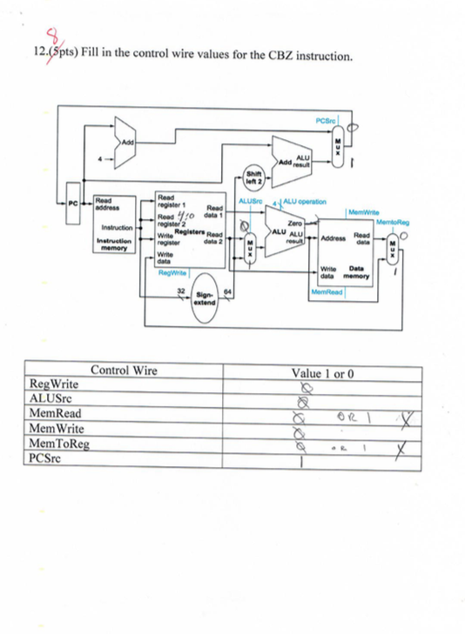
Midterm

Slide 11
Midterm

Slide 12
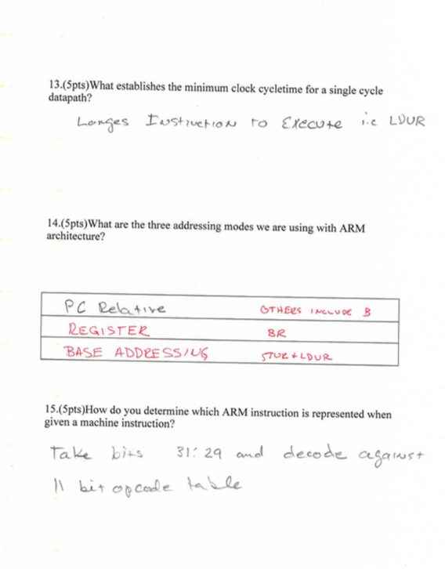
Midterm

Slide 13

Forwarding
We introduced a pipelined ARM processor which executes several instructions simultaneously.
Each instruction requires five stages, and five cycles, to complete.
Each stage uses different functional units of the datapath.
So we can execute up to five instructions in any clock cycle, with each instruction in a different stage and using different hardware.
Today we’ll introduce some problems that data hazards can cause for our pipelined processor, and show how to handle them with forwarding.
March 31, 2003
©2001-2003 Howard Huang
1

Slide 14
Pipeline Registers
Pipeline registers are the key to making a pipeline work
IF/ID
ID/EX
EX/MEM
MEM/WB

Slide 15
The pipelined datapath
1
0
ID/EX
PCSrc
WB
EX/MEM
Control
M
WB
MEM/WB
4
IF/ID
EX
M
WB
P C
Add
Add
RegWrite
Shift left 2
Read register 1
Read register 2
Write register
Write data
Read data 1
Read data 2
Read Instruction
address [31-0]
Instruction memory
ALU
MemWrite
Zero
0
Result
Address
1
Data memory
MemToReg
Registers
ALUOp
ALUSrc
Write data
Read data
1
Instr 32 bits
Sign extend
MemRead
0
Instr 4:0]

Slide 16
Pipeline diagram review
Clock cycle
 | 1 | 2 | 3 | 4 | 5 | 6 | 7 | 8 | 9
LDUR X8, [X29, #4] | IF | ID | EX | MEM | WB
SUB X2, X4, X5 |  | IF | ID | EX | MEM | WB
AND X9, X10, X11 |  |  | IF | ID | EX | MEM | WB
ORR X16, X17, X18 |  |  |  | IF | ID | EX | MEM | WB
ADD X13, X14, X1 |  |  |  |  | IF | ID | EX | MEM | WB
This diagram shows the execution of an ideal code fragment.
Each instruction needs a total of five cycles for execution.
One instruction begins on every clock cycle for the first five cycles.
One instruction completes on each cycle from that time on.

Slide 17
Our examples are too simple
Here is the example instruction sequence used to illustrate pipelining on the previous page.
LDUR X8, [X29, #4]
SUB X2, X4, X5
AND X9, X10, X11
ORR X16, X17, X18
ADD X13, X14, X1
The instructions in this example are independent.
Each instruction reads and writes completely different registers.
Our datapath handles this sequence easily, as we saw last time.
But most sequences of instructions are not independent!

Slide 18
An example with dependencies
SUB | X2 | X1 X3
AND | X12 | X2 X5
ORR | X13 | X6 X2
ADD | X14 | X2 X8
STUR | X15 | [X2, #100]
There are several dependencies in this new code fragment.
The first instruction, SUB, stores a value into X2.
That register is used as a source in the rest of the instructions.
This is not a problem for the single-cycle and multicycle datapaths.
Each instruction is executed completely before the next one begins.
This ensures that instructions 2 through 5 above use the new value of
X2 (the sub result), just as we expect.
How would this code sequence fare in our pipelined datapath?

Slide 19
Data hazards in the pipeline diagram
Clock cycle 5
1
2
3
4
6
7
8
9
SUB | X2 | X1 X3
AND | X12 | X2 X5
ORR | X13 | X6 X2
ADD | X14 | X2 X8
STUR | X15 | [X2, #100]
IF
ID EX MEM WB
EX MEM
IF
ID
WB
IF | ID | EX | MEM | WB
IF | ID | EX | MEM | WB
IF | ID | EX | MEM | WB
The SUB instruction does not write to register X2 until clock cycle 5. This causes two data hazards in our current pipelined datapath.
The AND reads register X2 in cycle 3. Since SUB hasn’t modified the register yet, this will be the old value of X2, not the new one.
Similarly, the OR instruction uses register X2 in cycle 4, again before it’s actually updated by SUB.

Slide 20
Things that are okay
Clock cycle 5
1
2
3
4
6
7
8
9
SUB | X2 | X1 X3
AND | X12 | X2 X5
ORR | X13 | X6 X2
ADD | X14 | X2 X8
STUR | X15 | [X2, #100]
IF
ID EX MEM WB
EX MEM
ID EX
IF ID
IF
ID
WB
IF
MEM WB
EX MEM WB
IF | ID | EX | MEM | WB
The ADD instruction is okay, because of the register file design.
Registers are written at the beginning of a clock cycle.
The new value will be available by the end of that cycle.
The STUR is no problem at all, since it reads X2 after the SUB finishes.

Slide 21
Dependency arrows
Clock cycle 5
1
2
3
4
6
7
8
9
SUB | X2 | X1 X3
AND | X12 | X2 X5
ORR | X13 | X6 X2
ADD | X14 | X2 X8
STUR | X15 | [X2, #100]
IF
ID EX MEM WB
EX MEM
ID EX
IF ID
IF
ID
WB
IF
MEM WB
EX MEM WB
IF | ID | EX | MEM | WB
Arrows indicate the flow of data between instructions.
The tails of the arrows show when register X2 is written.
The heads of the arrows show when X2 is read.
Any arrow that points backwards in time represents a data hazard in our basic pipelined datapath. Here, hazards exist between instructions 1 & 2 and 1 & 3.

Slide 22
A fancier pipeline diagram
Clock cycle 4 5
1
2
3
6
7
8
9
SUB | X2 | X1 X3
AND | X12 | X2 X5
ORR | X13 | X6 X2
ADD | X14 | X2 X8
STUR | X15 | [X2, #100]
IM
Reg
DM
Reg
IM
Reg
DM
Reg
IM
Reg
DM
Reg
IM
Reg
DM
Reg
IM
Reg
DM
Reg

Slide 23
A more detailed look at the pipeline
We have to eliminate the hazards, so the AND and OR instructions in our example will use the correct value for register X2.
Let’s look at when the data is actually produced and consumed.
The SUB instruction produces its result in its EX stage, during cycle 3 in the diagram below.
The AND and ORR need the new value of X2 in their EX stages, during clock cycles 4-5 here.
Clock cycle
 | 1 | 2 | 3 | 4 | 5 | 6 | 7
SUB X2, X1, X3 | IF | ID | EX | MEM | WB
AND X12, X2, X5 |  | IF | ID | EX | MEM | WB
ORR X13, X6, X2 |  |  | IF | ID | EX | MEM | WB

Slide 24
Bypassing the register file
The actual result X1 – X3 is computed in clock cycle 3, before it’s needed in cycles 4 and 5.
If we could somehow bypass the writeback and register read stages when needed, then we can eliminate these data hazards.
Essentially we need to pass the ALU output from SUB directly to the AND and ORR instructions, without going through the register file.
Clock cycle
 | 1 | 2 | 3 | 4 | 5 | 6 | 7
SUB X2, X1, X3 | IF | ID | EX | MEM | WB
AND X12, X2, X5 |  | IF | ID | EX | MEM | WB
ORR X13, X6, X2 |  |  | IF | ID | EX | MEM | WB

Slide 25
Where to find the ALU result
The ALU result generated in the EX stage is normally passed through the pipeline registers to the MEM and WB stages, before it is finally written to the register file.
This is an abridged diagram of our pipelined datapath.
IF/ID ID/EX EX/MEM MEM/WB
PC
Registers
Instruction memory
ALU
Data memory
1
Rt Rd
0
0
1

Slide 26
Forwarding
Since the pipeline registers already contain the ALU result, we could just forward that value to subsequent instructions, to prevent data hazards.
In clock cycle 4, the AND instruction can get the value X1 - X3 from the EX/MEM pipeline register used by sub.
Then in cycle 5, the ORR can get that same result from the MEM/WB pipeline register being used by SUB.
Clock cycle
1 2 3 4 5 6 7
SUB | X2, X1, X3
AND | X12, X2, X5
ORR | X13, X6, X2
IM
Reg
DM
Reg
IM
Reg
DM
Reg
IM
Reg
DM
Reg

Slide 27
Outline of forwarding hardware
A forwarding unit selects the correct ALU inputs for the EX stage.
If there is no hazard, the ALU’s operands will come from the register file, just like before.
If there is a hazard, the operands will come from either the EX/MEM or MEM/WB pipeline registers instead.
The ALU sources will be selected by two new multiplexers, with control signals named ForwardA and ForwardB.
SUB | X2, X1, X3
AND | X12, X2, X5
ORR | X13, X6, X2
IM
Reg
DM
Reg
IM
Reg
DM
Reg
IM
Reg
DM
Reg

Slide 28
Simplified datapath with forwarding muxes
IF/ID
ID/EX
EX/MEM
MEM/WB
PC
Registers ForwardA
0
1
2
Instruction memory
ALU
Data memory
0
1
2
1
Rt Rd
ForwardB
0
0
1

Slide 29
Detecting EX/MEM data hazards
So how can the hardware determine if a hazard exists?
An EX/MEM hazard occurs between the instruction currently in its EX stage and the previous instruction if:
The previous instruction will write to the register file, and
The destination is one of the ALU source registers in the EX stage.
There is an EX/MEM hazard between the two instructions below.
SUB X2, X1, X3
IM
Reg
DM
Reg
AND X12, X2, X5
IM
Reg
DM
Reg
Data in a pipeline register can be referenced using a class-like syntax. For example, ID/EX.RegisterRt refers to the rt field stored in the ID/EX pipeline.

Slide 30
EX/MEM data hazard equations
The first ALU source comes from the pipeline register when necessary. if (EX/MEM.RegWrite = 1
and EX/MEM.RegisterRd = ID/EX.RegisterRs) then ForwardA = 2
The second ALU source is similar.
if (EX/MEM.RegWrite = 1
and EX/MEM.RegisterRd = ID/EX.RegisterRt) then ForwardB = 2
SUB X2, X1, X3
IM
Reg
DM
Reg
AND X12, X2, X5
IM
Reg
DM
Reg

Slide 31
Detecting MEM/WB data hazards
A MEM/WB hazard may occur between an instruction in the EX stage and the instruction from two cycles ago.
One new problem is if a register is updated twice in a row.
ADD | X1, | X2, | X3
ADD | X1, | X1, | X4
SUB | X5, | X5, | X1
The SUB depends on both of the previous instructions, but only the most recent result (from the second ADD) should be forwarded.
ADD | X1, X2, X3
ADD | X1, X1, X4
SUB | X5, X5, X1
IM
Reg
DM
Reg
IM
Reg
DM
Reg
IM
Reg
DM
Reg

Slide 32
MEM/WB hazard equations
Here is an equation for detecting and handling MEM/WB hazards for the first ALU source.
if (MEM/WB.RegWrite = 1
and MEM/WB.RegisterRd = ID/EX.RegisterRs and EX/MEM.RegisterRd ≠ ID/EX.RegisterRs)
then ForwardA = 1
The second ALU operand is handled similarly.
if (MEM/WB.RegWrite = 1
and MEM/WB.RegisterRd = ID/EX.RegisterRt and EX/MEM.RegisterRd ≠ ID/EX.RegisterRt)
then ForwardB = 1

Slide 33
Simplified datapath with forwarding
IF/ID
ID/EX
EX/MEM
MEM/WB
PC
Registers
0
1
2
Instruction memory
ForwardA
Data memory
ALU
0
1
2
1
Rt Rd Rs
ForwardB
0
0
ID/EX.
RegisterRt
1
EX/MEM.RegisterRd
Forwarding Unit
MEM/WB.RegisterRd
ID/EX.
RegisterRs

Slide 34
The forwarding unit
The forwarding unit has several control signals as inputs.
ID/EX.RegisterRs | EX/MEM.RegisterRd | MEM/WB.RegisterRd
ID/EX.RegisterRt | EX/MEM.RegWrite | MEM/WB.RegWrite
(The two RegWrite signals are not shown in the diagram, but they come from the control unit.)
The fowarding unit outputs are selectors for the ForwardA and ForwardB multiplexers attached to the ALU. These outputs are generated from the inputs using the equations on the previous pages.
Some new buses route data from pipeline registers to the new muxes.

Slide 35
Example
SUB | X2 | X1 X3
AND | X12 | X2 X5
ORR | X13 | X6 X2
ADD | X14 | X2 X2
STUR | X15 | [X2, #100]
Assume again each register initially contains its number plus 100.
After the first instruction, X2 should contain -2 (101 - 103).
The other instructions should all use -2 as one of their operands.
We’ll try to keep the example short.
Assume no forwarding is needed except for register 2.
We’ll skip the first two cycles, since they’re the same as before.

Slide 36
Clock cycle 3
IF: or $13, $6, $2
ID: AND X12, X2, X5
EX: SUB X2, X1, X3
IF/ID
ID/EX
EX/MEM
MEM/WB
PC
2
101
0
1
2
102
101
Instruction memory
5
0
Registers
ALU
Data memory
X
105
103
0
1
2
103
-2
X
1
5 (Rt)
12 (Rd)
2 (Rs)
0
0
0
2
2
1
ID/EX.
EX/MEM.RegisterRd
RegisterRt
3
Forwarding Unit
ID/EX. 1
RegisterRs
MEM/WB.RegisterRd

Slide 37
Clock cycle 4: forwarding $2 from EX/MEM
IF: add $14, $2, $2
ID: or $13, $6, $2
EX: and $12, $2, $5
MEM: sub $2, $1, $3
IF/ID
ID/EX
EX/MEM
MEM/WB
PC
6
102
0
1
2
106
-2
Instruction memory
2
2
Registers
ALU
-2
Data memory
X
102
105
0
1
2
105
104
X
1
2 (Rt)
13 (Rd)
6 (Rs)
0
0
0
12
12
1
ID/EX.
EX/MEM.RegisterRd
RegisterRt
2
5
Forwarding Unit
ID/EX.
2
MEM/WB.RegisterRd
RegisterRs
-2

Slide 38
Clock cycle 5: forwarding $2 from MEM/WB
IF: sw $15, 100($2)
ID: ADD X14, X2, X2
EX: ORR X13, X6, X2
MEM: AND X12, X2, X5
WB: sub
X2, X1, X3
IF/ID
ID/EX
EX/MEM
MEM/WB
PC
2
106
0
1
2
-2
106
Instruction memory
2
0
Registers
ALU
104
Data memory
2
-2
102
0
1
2
-2
-2
-2
-2
X
1
1
-2
2 (Rt)
14 (Rd)
2 (Rs)
0
0
13
13
ID/EX.
1
EX/MEM.RegisterRd
2
RegisterRt
12
2
Forwarding Unit
ID/EX. 6
RegisterRs
2
MEM/WB.RegisterRd
104
-2

Slide 39
Lots of data hazards
The first data hazard occurs during cycle 4.
The forwarding unit notices that the ALU’s first source register for the AND is also the destination of the SUB instruction.
The correct value is forwarded from the EX/MEM register, overriding the incorrect old value still in the register file.
A second hazard occurs during clock cycle 5.
The ALU’s second source (for OR) is the SUB destination again.
This time, the value has to be forwarded from the MEM/WB pipeline register instead.
There are no other hazards involving the SUB instruction.
During cycle 5, SUB writes its result back into register $2.
The ADD instruction can read this new value from the register file in the same cycle.

Slide 40
Complete pipelined datapath...so far
ID/EX
WB
EX/MEM
Control
M
WB
MEM/WB
IF/ID
EX
M
WB
PC
Read register 1
Read register 2
Write register
Read data 1
0
1
2
Addr
Instr
ALU
Zero
Result
Read data 2
ALUSrc
Address
Data memory
Write Read data data
Instruction memory
0
1
2
0
Write data
Registers
1
Instr [15 - 0]
RegDst
1
Rt Rd Rs
Extend
0
0
1
EX/MEM.RegisterRd
Forwarding Unit
MEM/WB.RegisterRd

Slide 41
Miscellaneous comments
Each ARM instruction writes to at most one register.
This makes the forwarding hardware easier to design, since there is only one destination register that ever needs to be forwarded.
How could you handle the LDUR+ instruction?
Forwarding is especially important, but especially difficult, with deep pipelines like the ones in all current PC processors.

Slide 42
Summary
In real code, most instructions are dependent upon other ones.
This can lead to data hazards in our original pipelined datapath.
Instructions can’t write back to the register file soon enough for the next two instructions to read.
Forwarding eliminates data hazards involving arithmetic instructions.
The forwarding unit detects hazards by comparing the destination registers of previous instructions to the source registers of the current instruction.
Hazards are avoided by grabbing results from the pipeline registers
before they are written back to the register file.
Next time we’ll finish up pipelining.
Forwarding can’t save us in some cases involving lw.
We still haven’t talked about branches for the pipelined datapath.

