Slide 1
142611

Slide 2
Cache Performance and Optimization
CS 3339
Lecture 9c
Greg LaKomski
Texas State University
Fall 2018

Slide 3
Announcements
5.6, 5.7 Due by next Wednesday
PLEASE PAY ATTENTION TODAY!

Slide 4
Cache Writing

Slide 5
Writing to a cache
Writing to a cache raises several additional issues.
First, let’s assume that the address we want to write to is already loaded in the cache. We’ll assume a simple direct-mapped cache.
CACHE |  |  |  | MAIN MEMORY
Index | V | Tag | Data | Address Data
... |  |  |  | ...
110 | 1 | 11010 | 42803 | 1101 0110 42803
... |  |  |  | ...
If we write a new value to that address, we can store the new data in the cache, and avoid an expensive main memory access.
Mem[214] = 21763
Index | V | Tag | Data | Address Data
... |  |  |  | ...
110 | 1 | 11010 | 21763 | 1101 0110 42803
... |  |  |  | ...

Slide 6
Inconsistent memory
But now the cache and memory contain different, inconsistent data!
How can we ensure that subsequent loads will return the right value?
This is also problematic if other devices are sharing the main memory, as in a multiprocessor system.
Index | V | Tag | Data | Address Data
... |  |  |  | ...
110 | 1 | 11010 | 21763 | 1101 0110 42803
... |  |  |  | ...

Slide 7
Write-through caches
A write-through cache solves the inconsistency problem by forcing all writes to update both the cache and the main memory.
Mem[214] = 21763
Index | V | Tag | Data | Address Data
... |  |  |  | ...
110 | 1 | 11010 | 21763 | 1101 0110 21763
... |  |  |  | ...
This is simple to implement and keeps the cache and memory consistent.
The bad thing is that forcing every write to go to main memory negates the advantage of having a cache—the whole point was to avoid accessing main memory!

Slide 8
Write-back caches
In a write-back cache, the memory is not updated until the cache block needs to be replaced (e.g., when loading data into a full cache set).
For example, we might write some data to the cache at first, leaving it inconsistent with the main memory as shown before.
Mem[214] = 21763
Index | V | Tag | Data | Address Data
... |  |  |  | 1000 1110 1225
110 | 1 | 11010 | 21763 | 1101 0110 42803
... |  |  |  | ...
Subsequent reads to the same memory address will be serviced by the cache, which contains the correct, updated data.

Slide 9
Finishing the write back
We don’t need to store the new value back to main memory unless the cache block gets replaced.
For example, on a read from Mem[142], which maps to the same cache block, the modified cache contents will first be written to main memory.
Index | V | Tag | Data | Address Data
... |  |  |  | 1000 1110 1225
110 | 1 | 11010 | 21763 | 1101 0110 21763
... |  |  |  | ...
Only then can the cache block be replaced with data from address 142.
Index | V | Tag | Data | Address Data
... |  |  |  | 1000 1110 1225
110 | 1 | 10001 | 1225 | 1101 0110 21763
... |  |  |  | ...

Slide 10
Write-back cache discussion
Each block in a write-back cache needs a dirty bit to indicate whether or not it must be saved to main memory before being replaced—otherwise we might perform unnecessary writebacks.
Notice the penalty for the main memory access will not be applied until the execution of some subsequent instruction following the write.
In our example, the write to Mem[214] affected only the cache.
But the load from Mem[142] resulted in two memory accesses: one to save data to address 214, and one to load data from address 142.
This makes it harder to predict execution time and performance.
The advantage of write-back caches is that not all write operations need to access main memory, as with write-through caches.
If a single address is frequently written to, then it doesn’t pay to keep writing that data through to main memory.
If several bytes within the same cache block are modified, they will only force one memory write operation at write-back time.

Slide 11
Write misses
A second scenario is if we try to write to an address that is not already contained in the cache; this is called a write miss.
Let’s say we want to store 21763 into Mem[1101 0110] but we find that address is not currently in the cache.
Index | V | Tag | Data | Address Data
... |  |  |  | ...
110 | 1 | 00010 | 123456 | 1101 0110 6378
... |  |  |  | ...
When we update Mem[1101 0110], should we also load it into the cache?

Slide 12
Write around caches
With a write around policy, the write operation goes directly to main memory without affecting the cache.
Mem[214] = 21763
Index | V | Tag | Data | Address Data
... |  |  |  | ...
110 | 1 | 00010 | 123456 | 1101 0110 21763
... |  |  |  | ...
This is good when data is written but not immediately used again, in which case there’s no point to load it into the cache yet.
for (int i = 0; i < SIZE; i++) a[i] = i;

Slide 13
Allocate on write
An allocate on write strategy would instead load the newly written data into the cache.
Mem[214] = 21763
Index | V | Tag | Data | Address Data
... |  |  |  | ...
110 | 1 | 11010 | 21763 | 1101 0110 21763
... |  |  |  | ...
If that data is needed again soon, it will be available in the cache.

Slide 14
Cache performance
Caches take advantage of locality to speed up most data accesses.
Increasing the block size can take advantage of spatial locality.
Increasing cache associativity helps reduce the miss rate.
April 23, 2003
©2001-2003 Howard Huang
1

Slide 15
Hits and misses
To examine the performance of a memory system, we need to focus on a couple of important factors.
How long does it take to send data from the cache to the CPU?
How long does it take to copy data from memory into the cache?
How often do we have to access main memory?
There are names for all of these variables.
The hit time is how long it takes data to be sent from the cache to the processor. This is usually fast, on the order of 1-3 clock cycles.
The miss penalty is the time to copy data from main memory to the cache. This often requires dozens of clock cycles.
The miss rate is the percentage of misses.
CPU
A little static RAM (cache)
Lots of dynamic RAM
15

Slide 16
Average memory access time
The average memory access time, or AMAT, can then be computed.
AMAT = Hit time + (Miss rate × Miss penalty)
This is just averaging the amount of time for cache hits and the amount of time for cache misses.
How can we improve the average memory access time of a system?
Obviously, a lower AMAT is better.
Miss penalties are always much greater than hit times, so the best way to lower AMAT is to reduce the miss penalty or the miss rate.
However, AMAT should only be used a general guideline. Remember that execution time is still the best performance metric.
16

Slide 17
Memory and overall performance
How do cache hits and misses affect overall system performance?
Assuming a hit time of one CPU clock cycle, program execution will continue normally on a cache hit. (Our earlier computations always assumed one clock cycle for an instruction fetch or data access.)
For cache misses, we’ll assume the CPU must stall to wait for a load from main memory.
The total number of stall cycles depends on the number of cache misses
and the miss penalty.
Memory stall cycles = Memory accesses × miss rate × miss penalty
To include stalls due to cache misses in CPU performance equations, we have to add them to the “base” number of execution cycles.
CPU time = (CPU execution cycles + Memory stall cycles) × Cycle time
17

Slide 18
Performance example
Assume that 33% of the instructions in a program are data accesses. The cache hit ratio is 97% and the hit time is one cycle, but the miss penalty is 20 cycles.
If the cache was perfect and never missed, the AMAT would be one cycle. But even with just a 3% miss rate, the AMAT here increases 1.6 times!
AMAT = Hit time + (Miss rate × Miss penalty)
= 1 cycle + (3% × 20 cycles)
= 1.6 cycles
What about the overall performance? If I instructions are executed, then the number of wasted cycles will be 0.2 × I.
Memory stall cycles = Memory accesses × Miss rate × Miss penalty
= 0.33 I × 0.03 × 20 cycles
= 0.2 I cycles
This code is 1.2 times slower than a program with a “perfect” CPI of 1!
18

Slide 19
Memory systems are a bottleneck
CPU time = (CPU execution cycles + Memory stall cycles) × Cycle time
Processor performance traditionally outpaces memory performance, so the memory system is often the system bottleneck.
For example, with a base CPI of 1, the CPU time from the last page is:
CPU time = (I + 0.2 I) × Cycle time
What if we could double the CPU performance so the CPI becomes 0.5, but memory performance remained the same?
CPU time = (0.5 I + 0.2 I) × Cycle time
The overall CPU time improves by just 1.2/0.7 = 1.7 times!
Refer back to Amdahl’s Law from Homework 2, and textbook page 101.
19

Slide 20
Improving memory (and overall) performance
Memory stall cycles = Memory accesses × Miss rate × Miss penalty
You can decrease the number of stall cycles by reducing any or all of the individual factors.
Telling programmers to load and store less doesn’t usually work!
It’s probably easier to to reduce the miss rate or the miss penalty.
There are many methods for reducing the miss rate.
Using an associative cache can help reduce conflicts.
Making the cache bigger lets us store more stuff in it.
Adjusting the block size can take advantage of spatial locality.
Later today we’ll see some ways to reduce the miss penalty as well.
20

Slide 21

Comparing cache organizations
Like many architectural features, caches are evaluated experimentally.
As always, performance depends on the actual instruction mix, since different programs will have different memory access patterns.
Simulating or executing real applications is the most accurate way to measure performance characteristics.
The graphs on the next few slides illustrate the simulated miss rates for several different cache designs.
Again lower miss rates are generally better, but remember that the miss rate is just one component of average memory access time and execution time.
You’ll probably do some cache simulations if you take CS333.
21

Slide 22
Associativity tradeoffs and miss rates
As we saw last time, higher associativity means more complex hardware.
But a highly-associative cache will also exhibit a lower miss rate.
Each set has more blocks, so there’s less chance of a conflict between two addresses which both belong in the same set.
Overall, this will reduce AMAT and memory stall cycles.
Figure 7.29 on p. 604 of the textbook shows the miss rates decreasing as the associativity increases.
12%
9%
Miss rate
6%
3%
0%
One-way
Two-way
Associativity
Four-way
Eight-way
22

Slide 23
Cache size and miss rates
The cache size also has a significant impact on performance.
The larger a cache is, the less chance there will be of a conflict.
Again this means the miss rate decreases, so the AMAT and number of memory stall cycles also decrease.
The complete Figure 7.29 depicts the miss rate as a function of both the cache size and its associativity.
15%
12%
Miss rate
9%
KB
KB
4 KB
8 KB
6%
3%
0%
One-way
Two-way
Four-way
Eight-way
Associativity

Slide 24
Block size and miss rates
Finally, Figure 7.12 on p. 559 shows miss rates relative to the block size and overall cache size.
Smaller blocks do not take maximum advantage of spatial locality.
But if blocks are too large, there will be fewer blocks available, and more potential misses due to conflicts.
40%
35%
30%
25%
1 KB
8 KB
16 KB
64 KB
Miss rate
20%
15%
10%
5%
0%
4
16
64
256
Block size (bytes)

Slide 25
Basic main memory design
There are some ways the main memory can be organized to reduce miss penalties and help with caching.
For some concrete examples, let’s assume the following three steps are taken when a cache needs to load data from the main memory.
It takes 1 cycle to send an address to the RAM.
There is a 15-cycle latency for each RAM access.
It takes 1 cycle to return data from the RAM.
In the setup shown here, the buses from the CPU to the cache and from the cache to RAM are all one byte wide.
If the cache has one-byte blocks, then filling a block from RAM (i.e., the miss penalty) would take 17 cycles.
CPU
Cache
Main Memory
1 + 15 + 1 = 17 clock cycles
The cache controller has to send the desired address to the RAM, wait and receive the data.

Slide 26
Miss penalties for larger cache blocks
If the cache has four-byte blocks, then loading a single block would need four individual main memory accesses, and a miss penalty of 68 cycles!
4 × (1 + 15 + 1) = 68 clock cycles
CPU
Cache
Main Memory

Slide 27
A wider memory
A simple way to decrease the miss penalty is to widen the memory and its interface to the cache, so we can read multiple bytes from RAM in one shot.
If we could read four bytes from the memory at once, a four-byte cache load would need just 17 cycles.
1 + 15 + 1 = 17 cycles
The disadvantage is the cost of the wider buses—each additional bit of memory width requires another connection to the cache.
CPU
Cache
Main Memory

Slide 28
An interleaved memory
Another approach is to interleave the memory, or split it into “banks” that can be accessed individually.
The main benefit is overlapping the latencies of accessing each word.
For example, if our main memory has four banks, each one byte wide, then we could load four bytes into a cache block in just 20 cycles.
1 + 15 + (4 × 1) = 20 cycles
Our buses are still one byte wide here, so four cycles are needed to transfer data to the caches.
This is cheaper than implementing a four-byte bus, but not too much slower.
CPU
Cache
Main Memory
Bank | 0 | Bank | 1 | Bank | 2 | Bank | 3

Slide 29
Interleaved memory accesses
Clock cycles
Load word 1
Load word 2
Load word 3
Load word 4
15 cycles
Here is a diagram to show how the memory accesses can be interleaved.
The magenta cycles represent sending an address to a memory bank.
Each memory bank has a 15-cycle latency, and it takes another cycle (shown in blue) to return data from the memory.
This is the same basic idea as pipelining!
As soon as we request data from one memory bank, we can go ahead and request data from another bank as well.
Each individual load takes 17 clock cycles, but four overlapped loads require just 20 cycles.

Slide 30
Summary
Memory system performance depends upon the cache hit time, miss rate and miss penalty, as well as the actual program being executed.
We can use these numbers to find the average memory access time.
We can also revise our CPU time formula to include stall cycles.
AMAT = Hit time + (Miss rate × Miss penalty)
Memory stall cycles = Memory accesses × miss rate × miss penalty CPU time = (CPU execution cycles + Memory stall cycles) × Cycle time
The organization of a memory system affects its performance.
The cache size, block size, and associativity affect the miss rate.
We can organize the main memory to help reduce miss penalties. For example, interleaved memory supports pipelined data accesses.

Slide 31
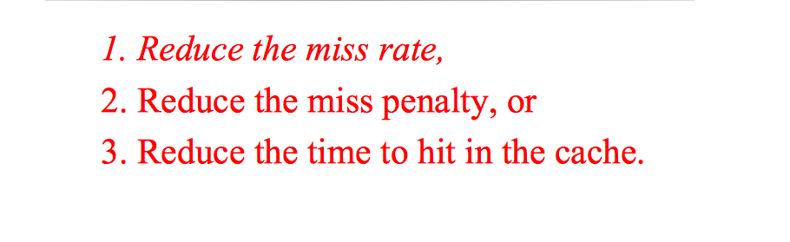
Improving Cache Performance

Slide 32
Improving Cache Performance
– Compulsory—The first access to a block is not in the cache, so the block must be brought into the cache. These are also called cold start misses or first reference misses.
– Capacity—If the cache cannot contain all the blocks needed during execution of a program, capacity misses will occur due to blocks being discarded and later retrieved.
– Conflict—If the block-placement strategy is set associative, conflict misses (in addition to compulsory and capacity misses) will occur because a block can be discarded and later retrieved if too many blocks map to its set. These are also called collision misses or interference misses.

Slide 33
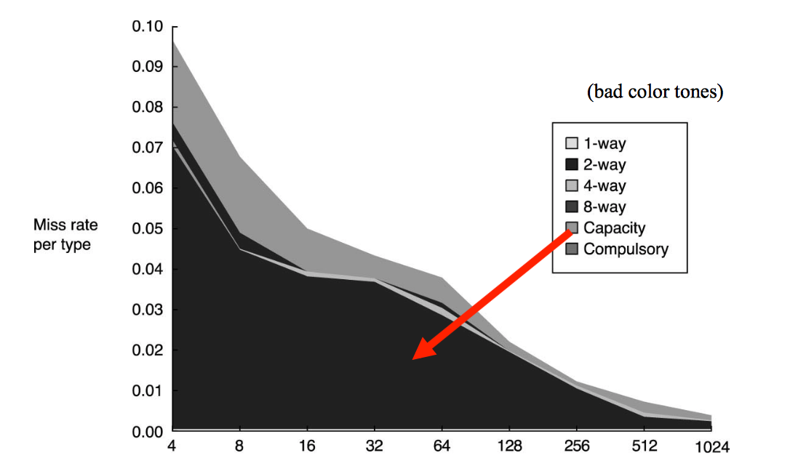
3Cs Absolute Miss Rate

Slide 34
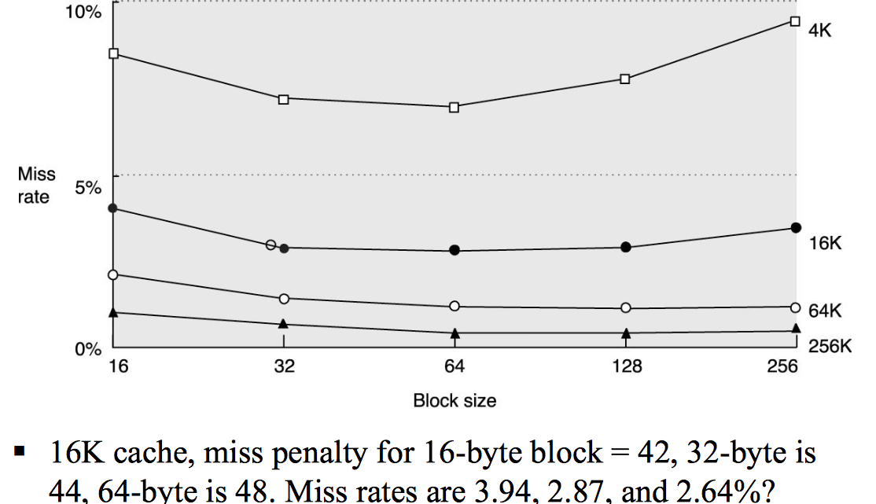
1. Reduce Misses via Larger Block Size

Slide 35
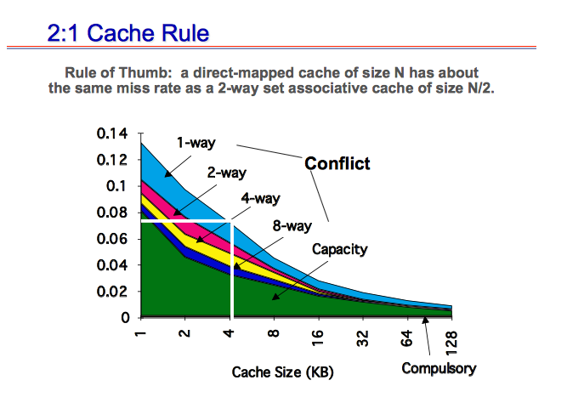
2. Reduce Misses via Higher Associativity
https://www.cs.princeton.edu/courses/archive/fall15/cos375/lectures/16-Cache-2x2.pd

Slide 36
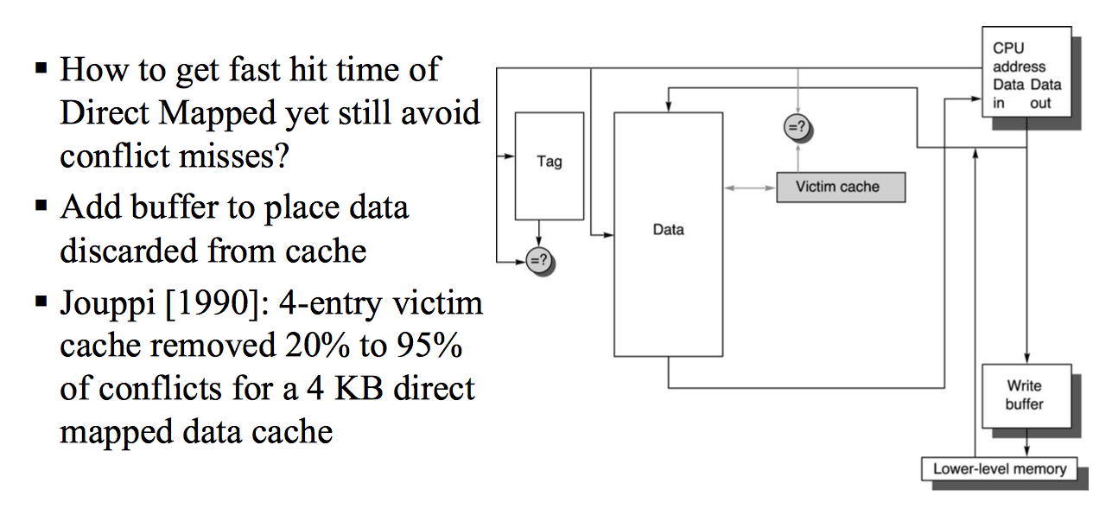
3. Reducing Misses via Victim Cache

Slide 37
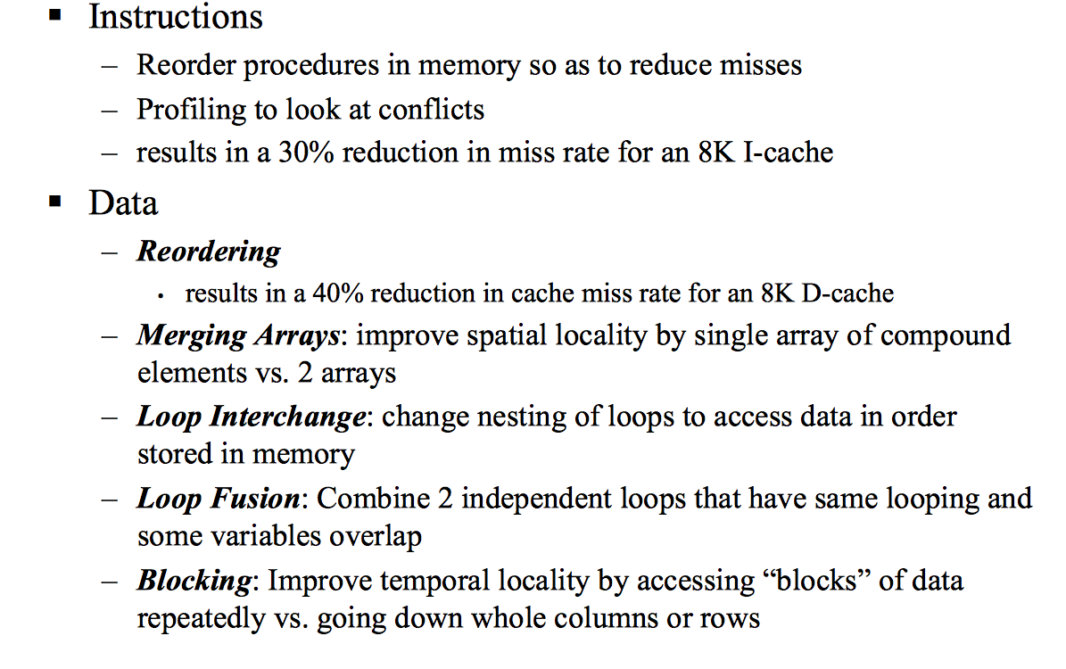
4. Reducing Misses by Various Compiler Optimizations

Slide 38
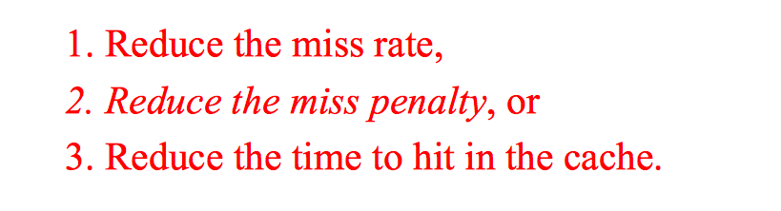
How To Reduce Misses?

Slide 39
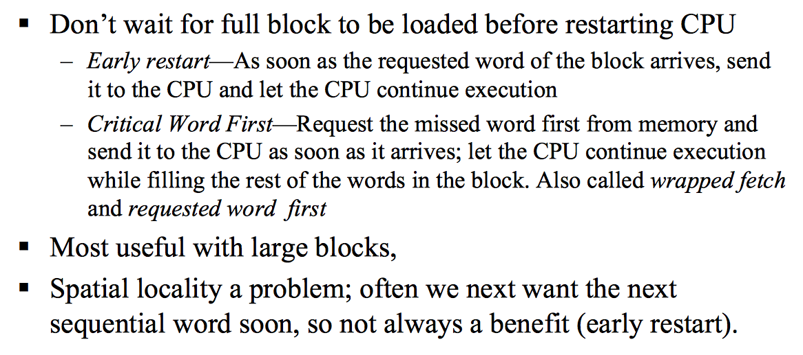
1. Early Restart and Critical Word First

Slide 40
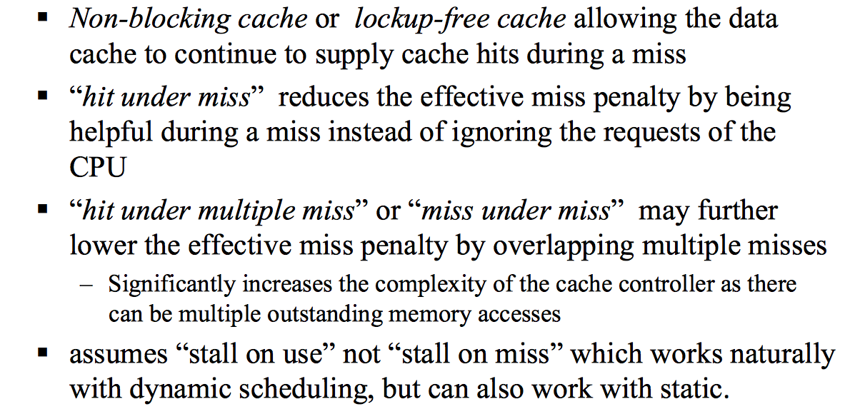
2. Non-blocking Caches to reduce stalls on misses

Slide 41
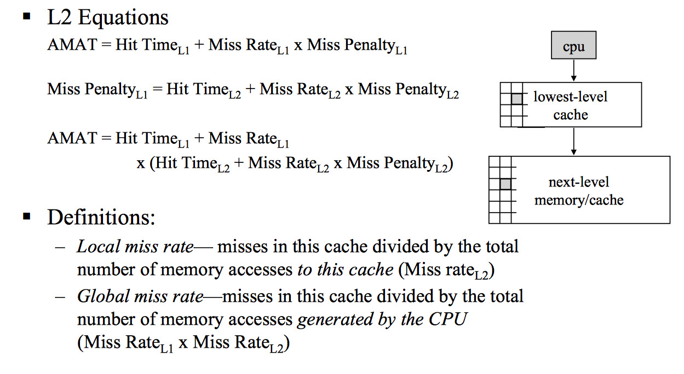
3. Use Multi-level caches

Slide 42
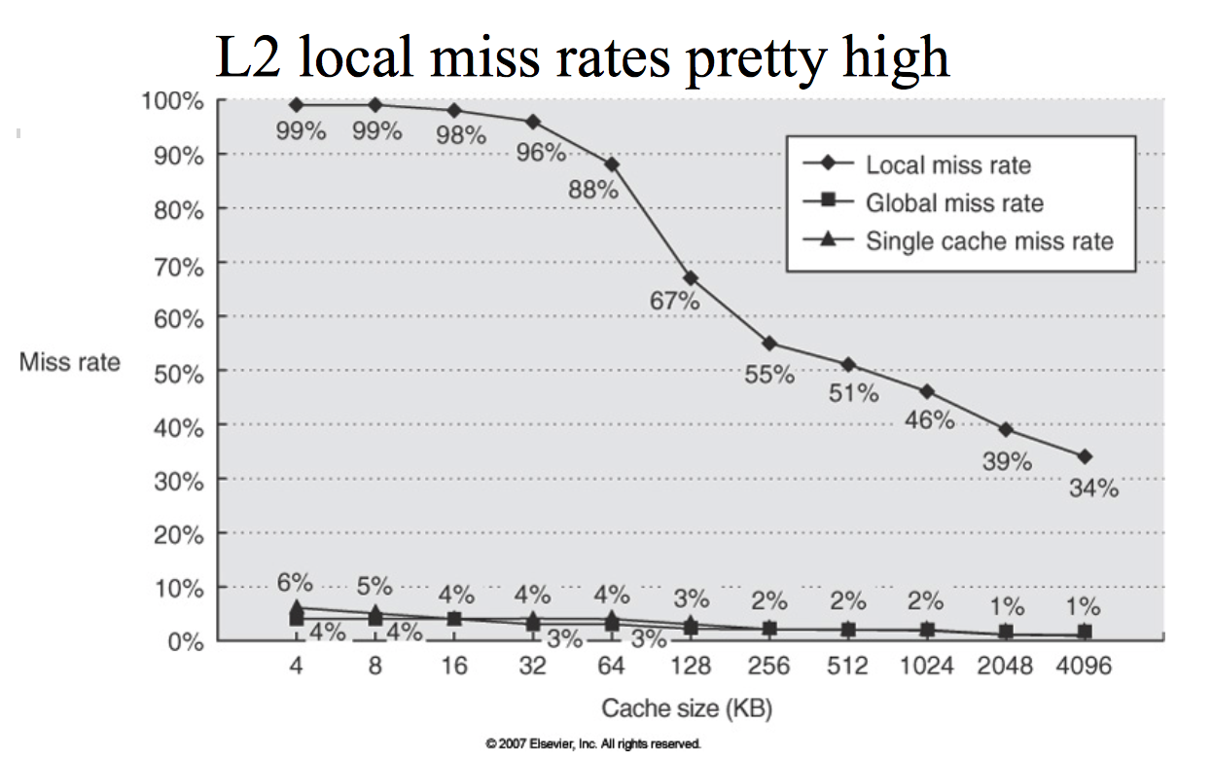
3. Use Multi-level caches

Slide 43
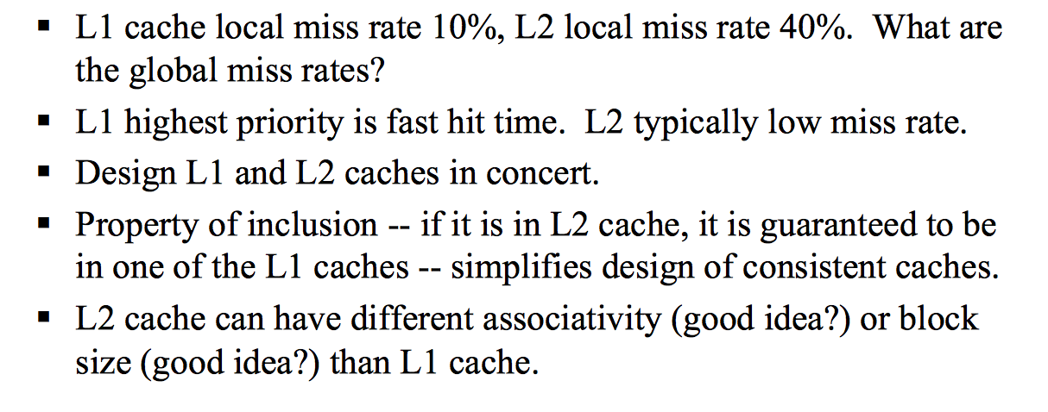
3. Use Multi-level caches

Slide 44
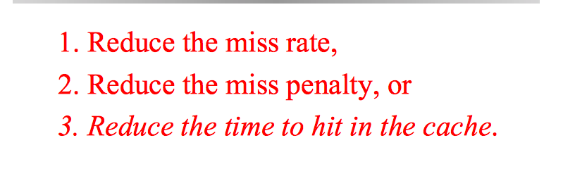
Improving Cache Performance

