Slide 1
ARM ISA I
CS 3339
Lecture 3
Greg LaKomski
Texas State University
Fall 2018

Slide 2
Announcements
Attendance CODE is 860074
Homework due the 10th.
You need to pick your teams ASAP! If not I will pick them for you.
Project 1 will be posted on TRACS by EOD Friday. I will let you know via email. Please read over the project and we will discuss Monday.
Monday we will have a short lesson on debuggers

Slide 3
ENGAGE BRAIN PLEASE!

Slide 4
Questions on Reading or Exercises in Ch 1?

Slide 5
Who is Donald Knuth?

Slide 6
Who Invented the Computer?

Slide 7
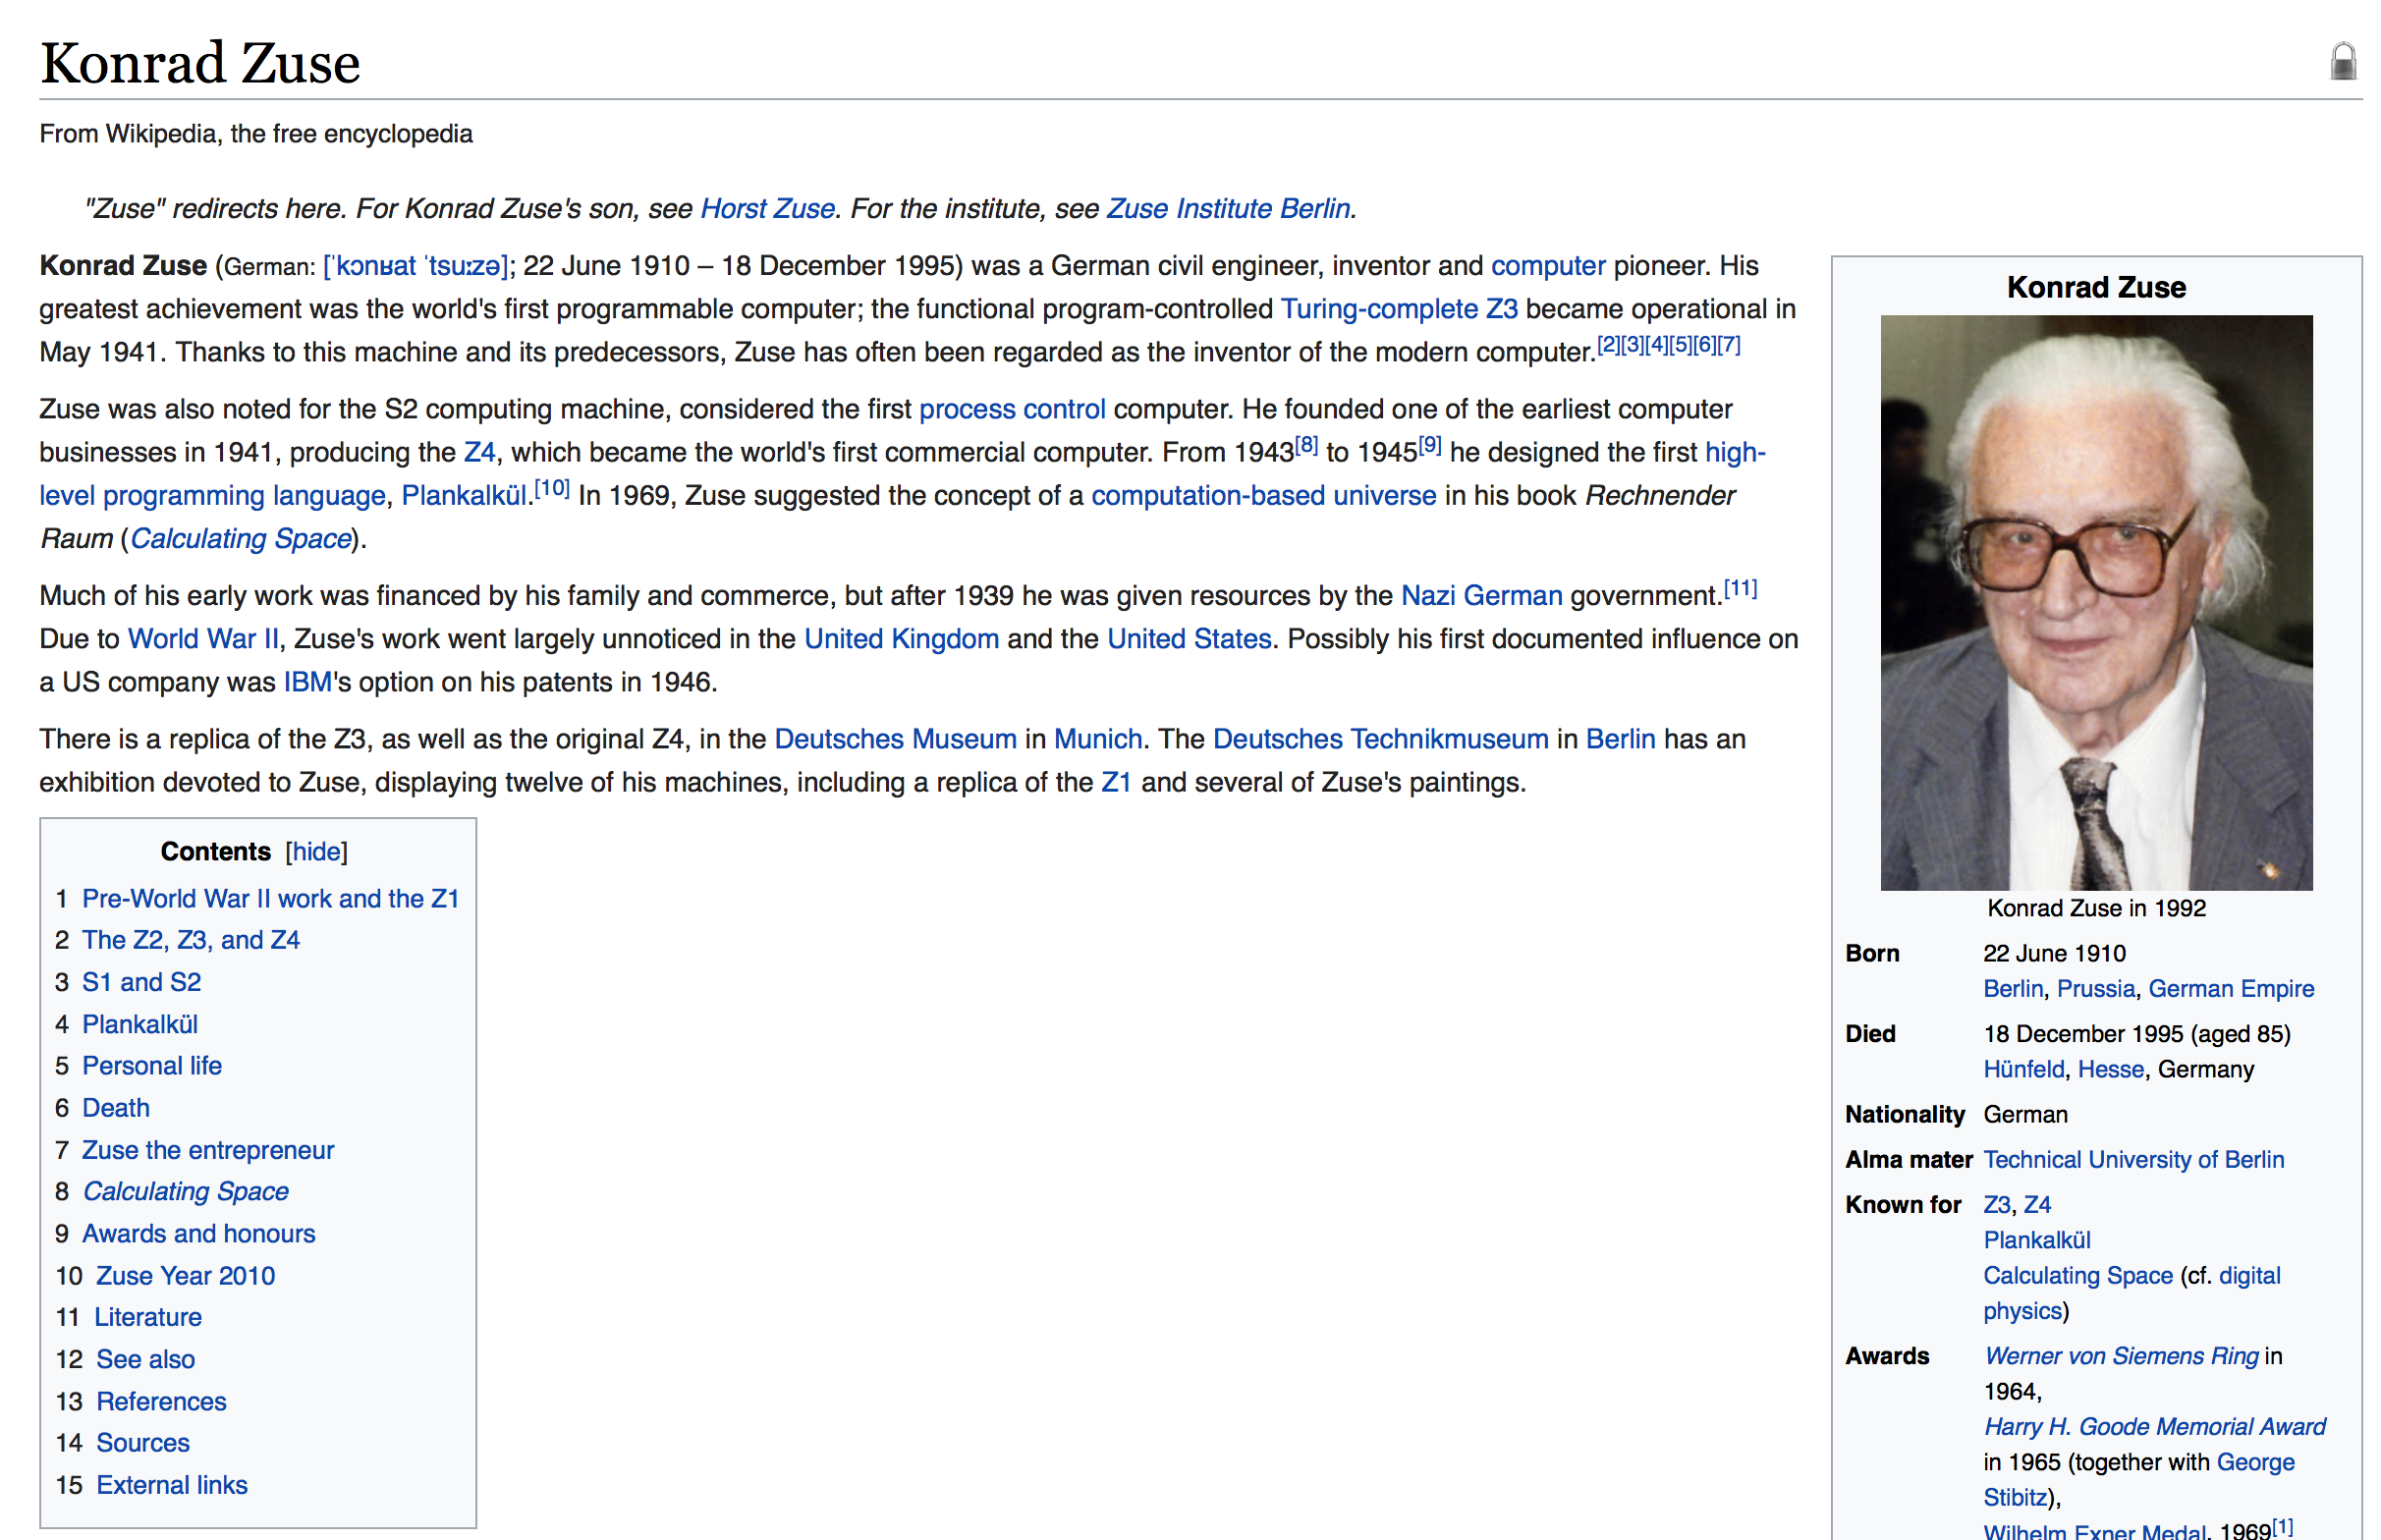
Who Invented the Computer?

Slide 8
Review

Slide 9
Breaking down CPU clock cycles : CPI
Not all instructions take the same amount of time to execute
One way to think about execution time is that it equals the number of instructions executed multiplied by the average time per instruction
Clock cycles per instruction (CPI) – the average number of clock cycles each instruction takes to execute
Can try to reduce number of instructions or CPI

Slide 10
Effective CPI
Computing the overall effective CPI is done by looking at the different types of instructions and their individual cycle counts and averaging
n
Overall effective CPI = Σ (CPI_{i} x IC_{i})
i = 1
Where IC_{i} is the count (percentage) of the number of instructions of class i executed
CPI_{i} is the (average) number of clock cycles per instruction for that instruction class
n is the number of instruction classes
The overall effective CPI varies by instruction mix – a measure of the dynamic frequency of instructions across one or many programs

Slide 11
Example : Effective CPI
Op | Freq | CPI_{i} | Freq x CPI_{i}
ALU | 50% | 1 | 0.5
Load | 20% | 5 | 1.0
Store | 10% | 3 | 0.3
Branch | 20% | 2 | 0.4
 |  |  | Σ = 2.2
Will talk about types of instructions later
Notes:
For lecture

Slide 12
Remember: There Are No Absolutes!
Absolute performance often doesn’t say much
It takes 300 milliseconds to launch Skype on MacBook Pro
Program X runs on platform Y in Z seconds
Need a baseline to measure relative performance
This ratio is called the speedup
If X takes half as long to run as Y on platform Z, we say we achieve a factor of 2 speedup over Y
Speedup > 1 is good, < 1 is bad, never 0
If X is n times faster at something than Y, then (the something is very important)
Notes:
Increasing performance requires decreasing execution time. Equation is ratio of performance of x to performance of y is equal to the ratio of the execution time of y to the execution time of x.

Slide 13
Example : Relative Performance
If computer A runs a program in 10 seconds and computer B
runs the same program in 15 seconds, how much faster is A
than B?
The performance ratio is
So A is 1.5 times faster than B
Notes:
Example of relative performance comparing two execution times of 15 and 10 for a ratio of 1.5

Slide 14
Execution Rate
Measured in instructions per second
1/cycles per instruction * cycles per second
Number of Cycles = cycles/second * seconds
Number of Instructions = number of cycles /CPI

Slide 15
Workloads and Benchmarks
Benchmarks
Especially selected programs used to compare performance
Programs that represent real applications
Workloads
A set of programs that represent a collection of applications that may be run on a system in a given period of time
Use of benchmarks and workloads not ideal, but it’s the best we have
Distinct from the verb ‘benchmark’

Slide 16
Summarizing Performance is Hard
Comparing and summarizing performance is tricky (even if we have accurate measurements)
Which machine is faster?
 | System A | System B | System C
Prog 1 | 2 | 10 | 30
Prog 2 | 1000 | 70 | 30
Total | 1002 | 80 | 60
Notes:
Table of systems

Slide 17
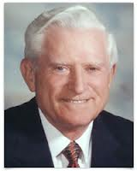

Amdahl’s Law
Achievable speedup is bounded by the amount that the improved feature is used
Implications?
To get most bang for your buck make the common case fast
Notes:
Picture of gene amdahl

Slide 18
ARM ISA
Note: As we go through the ARM ISA using the book, recognize that some instructions have been simplified. You can see this in the elaborations found in section 2.7. If you end up writing an ARM assembler, then you might care.
LegV8 is a small, simplified subset of ARMv8.
Your projects will use an even smaller set, lets call it the stumpy set ☺

Slide 19
Today
Types of ISA
Instruction classes
Issues in instruction encoding
Instruction Length
Number of Operands
Immediate Instructions

Slide 20
What we are going to talk about
Instruction Architectures
Machine Instructions
Ones and Zeros representing and assembly instruction
These bits actually are decoded meaning some have meaning and some are just bits (Data)

Slide 21

Abstraction Layers in Modern Systems
Application
Problem
Algorithm
Programming Language
Operating System/Compilers
Instruction Set Architecture (ISA)
Domain of computer architecture
Microarchitecture
Gates/RTL
Circuits/Devices
Physics
Notes:
ISA layer - close ties with compilers and microarchitecture – this slide shows the layers with the three layers – instruction set architecture or ISA, micro architecture, and gates/rtl highlighted

Slide 22
What is an ISA?
ISA stands for Instruction Set Architecture
Contract between programmer and the hardware
Defines set of instructions that can execute on the processor
Defines visible state of the system
Defines how state changes in response to instruction execution
Analogous to class definitions
For programmer (the compiler writers, really)
ISA is model of how a program will execute
For hardware designer
ISA is formal definition of the correct way to execute a program

Slide 23
ISA vs Architecture vs Implementation
The terms ISA and architecture are closely related and often used interchangeably
Implementation refers to a particular instance of an ISA
AMD Opteron and Intel Core i7 both implement x86 architecture
But different number of registers, cache, datapath etc.

Slide 24
Examples: ISA and Implementations
ISA
MIPS, x86, IBM 360, JVM, ARM
Implementations
360 implementations: model 30 (c. 1964), z990 (c. 2004)
x86 implementations: 8086 (c. 1978), 80186, 286, 386, 486, Pentium, Pentium Pro, Pentium-4 (c. 2000), AMD Athlon, Transmeta Crusoe
MIPS implementations: R2000, R4000, R10000, ...
ARM implementations: V5, V6, V7, V8

Slide 25
Classification Based on Computation Model
Architectures can be classified into three broad categories based on the model of computation
Accumulator : PDP from DEC
Stack : Burroughs, HP 3000
General-Purpose Register (GPR)
CISC : Complex Instruction Set
RISC : Reduced Instruction Set
VLIW : Very Large Instruction Word
Vector
Today, GPR dominates the market
Will be the focus of this course

Slide 26
Accumulator
Also known as the 1-operand architecture
All instructions are 1-operand
A special memory location (register) serves as a source operand and destination location
Example
add 17 // add 17 to accumulator and store
// result in accumulator
ISA design is relatively easy, implementation is hard
performance not that great
code generation difficult
large code size
instructions
Accumulator
Notes:
Has graphic showing instructions going to accumulator and then the accumulator feeding back to the instructions

Slide 27
Accumulator
Except when its not.
The most popular microprocessor family in the world is an accumulator machine
Harvard Architecture
instructions
Accumulator
Notes:
Has graphic showing instructions going to accumulator and then the accumulator feeding back to the instructions

Slide 28
Accumulator
Except when its not.
The most popular microprocessor family in the world is an accumulator machine
Harvard Architecture
The PIC microcontroller.
Billions have been sold
Where are they ???
instructions
Accumulator
Notes:
Has graphic showing instructions going to accumulator and then the accumulator feeding back to the instructions

Slide 29
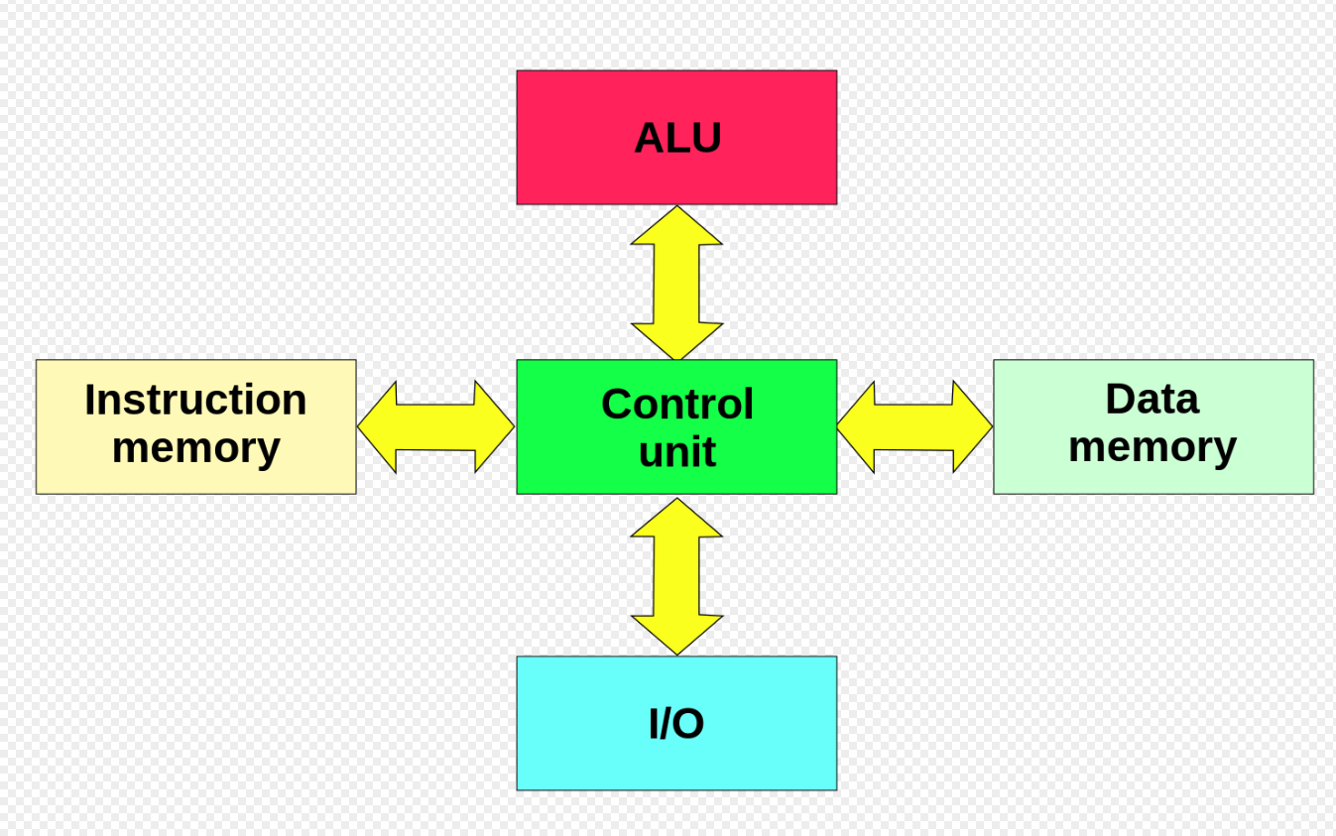
Harvard Architecture

Slide 30
A Stack Machine
A Stack Machine has a stack as part of the processor state
typical operations
push, pop, +, *, ...
Instructions like ‘+’, implicitly
specify the top 2 elements of the stack as operands.
Main
Memory
stack
:
processor
b
a
c
b
a
b
a
push b
push c
pop
a
Notes:
Shows graphic of stack interacting with the main memory. This is like an HP calculator reverse polish notation

Slide 31
Stack Machine Assembly
a b c * + a d c * + e - /
program stack memory refs
push a R0 a
push b R0 R1 b
push c R0 R1 R2 c
* R0 R1
+ R0
push a R0 R1 a
push d R0 R1 R2 d
push c R0 R1 R2 R3 c
* R0 R1 R2
+ R0 R1
push e R0 R1 R2 e
- R0 R1
/ R0
What kind of notation is this?????

Slide 32
What was most famous stack machine?

Slide 33
What was most famous stack machine?
HP Calculator!

Slide 34
ISA Today
Pure stack machines and accumulators died long time ago
Mainly because compilers couldn‘t do much with these machines
Today, they only exist in hybrid systems
8086/87 is hybrid accumulator-GPR-stack architecture
Some embedded processors are accumulator-based
Most desktops and servers are x86
SPARC, MIPS and Power are dying out – bye bye
Variation in embedded and mobile devices but most are ARM

Slide 35
Classic Von Neumann Architecture
Input
Device
Memory
CPU
Output
Device
Notes:
Graphic showing IO, memory, cpu, output device

Slide 36
GPR (general purpose register) Machine Model
Memory
CPU
Registers
Notes:
Graphic showing memory interacting with on board registers and the registers interaction with the cpu

Slide 37
GPR Machine Model
Arithmetic and logical unit
Can have many of these on a processor
Performs the actual computation
ALU
Memory
Registers
Control
Unit
instruction stream
Notes:
Graphic showing same architecture but expanding the cpu into ALU and control unit with an instruction stream flowing to the control unit

Slide 38
GPR Machine Model
ALU
ALU
CISC will allow this
ALU
ALU
Memory
ALU
ALU
Registers
Control
Unit
instruction stream
These pieces are called micro-architectural elements
Notes:
Additional graphic showing the possibility of multiple alu units and says that CISC instruction allow this

Slide 39
ISA Design Goals
Given the micro-architectural building blocks
Define a set of instructions that can be implemented on the machine
Need to think about efficiency
Define the semantics of each instruction
How does the machine’s state change when we execute the instruction?

Slide 40
Why Study ISAs?
For this course, we want to
Understand differences between ISAs
Learn about the issues in designing good ISAs
Evaluate a system based on it’s ISA characteristics
Goal is different from becoming expert assembly programmers
Many common features across all ISAs
We will start with those

Slide 41
ISA Design Goals
Data types
Operations
Interrupts/Events
Instruction formats
Addressing modes
…
instruction
Op
Mode
r1
r2
Machine
State
Machine
State
execution
Before
After
Notes:
Change instruction to match ARM layout

Slide 42
Machine State
Registers
Size/Type
accumulators
index registers
general registers
control registers
Memory
Visible hierarchy (if any)
Addressability
byte, word, bit
byte order (endian-ness)
maximum size
protection/relocation
Program Counter or Instruction Pointer
PC
Memory
Byte addr
Registers
R0-R31
Little Endian
64-bit addr
32 bit
Machine State ARM
Notes:
Shows the machine state is defined by what’s in memory, what’s in the registers, and what’s in the program counter

Slide 43
Whats Endian Mean????

Slide 44
Endianness from wikipedia
Endianness refers to the sequential order used to numerically interpret a range of bytes in computer memory as a larger, composed word value. It also describes the order of byte transmission over a digital link. Words may be represented in big-endian or little-endian format, depending on whether bits or bytes or other components are numbered from the big end (most significant bit) or the little end (least significant bit). When addressing memory or sending/storing words bytewise, in big-endian format, the most significant byte, which is the byte containing the most significant bit, is sent first (has the lowest address) and the following bytes are sent (or addressed) in decreasing significance order with the least significant byte, which is the byte containing the least significant bit, thus being sent in last place (and having the highest address). Little-endian format reverses the order of the sequence and addresses/sends/stores the least significant byte first (lowest address) and the most significant byte last (highest address). The order of bits within a byte or word can also have endianness (as discussed later); however, a byte is typically handled as a numerical value or character symbol and so bit sequence order is obviated

Slide 45
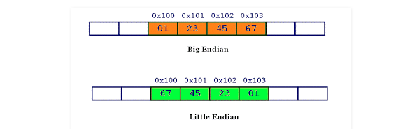
0x01234567 starting mem location 0x100
Supposedly 99% of ARM implementations are Little-Endian

Slide 46
Instruction Classes
For most architectures, instructions can be grouped into three classes
ALU operations
Control Flow
Data Movement
Consider instructions in programming languages …

Slide 47
ALU Instructions
Arithmetic and logic operations
add, sub, mult, div
add $1, $2, $3 // three operand
add $1, $2 // two operand
shift
AND, OR, XOR
Have floating-point and integer versions of most
Each arithmetic instruction performs one operation
Tied to the underlying functional units
Notes:
Covers arithmetic and loc instructions

Slide 48
Control Instructions
Control Flow or branch instructions
Need them for if statements and loops
Example
beq $1,$2,LOOP // jump to LOOP if $1 == $2
j ADDR // jump to ADDR
Two main types
Conditional jumps
check condition and move to label
Unconditional jumps
move to label
Implemented by manipulating the program counter
You are moving about in the program space!

Slide 49
Data Movement Instructions
Three main types of data movement instructions
Store : Take a value in a register and send it to memory
Load : Take a value in memory and bring it to a register
Move : Move a value from one register to another (less common)
CISC combines ld / store with ALU operations
Key difference between RISC and CISC

Slide 50
Instruction Encoding
Specify a binary encoding for each instruction so that when the hardware sees the bit stream it knows what to do
Assembly vs. Machine Language
Semantically (almost) equivalent
Assembly | Machine
human-readable | machine-readable
usually associated with an architecture | usually tied to a specific hardware
e.g., x86 assembly | e.g., machine code for Opteron
Notes:
Slide has table comparing assembly language to machine code. Main point is that assembly associated with architecture and machine code with specific hardware

Slide 51
The C Code Translation Hierarchy
C program
What is a disassembler???
You will soon find out ☺
compiler
assembly code
assembler
object code
library routines
linker
executable
machine code
loader
memory
Notes:
Four logical phases all programs go through
C code – x.c or .TXT
assembly code – x.s or .ASM
object code – x.o or .OBJ
executable – a.out or .EXE

Slide 52
Instruction Encoding
Similar across many ISAs
Operations or opcodes
Number of operands
Operand values or which register to get the values
Operand specifiers
Which one is source which one is destination
add $1, $2, $3
opcode
src1
src2
dst
10001011000
00010
00011
00001
Notes:
Need to add ARM opcode

Slide 53
Variable-length Instruction Encoding
Use only the bits that is required for each instruction
Variable-length instructions give more efficient encodings
no bits to represent unused fields/operands
Examples
VAX-11, Intel x86 (byte variable)
Intel 432 (bit variable)
Can make fast implementation difficult
sequential determination of location of each operand
8
Op
8
4
4
Op
R
M
8
4
4
4
4
4
4
Op
R
M
R
M
R
M
8
4
4
32
Op
R
M
Disp
VAX instrs: 1-53 bytes!
Will revisit this issue when we discuss instruction decoding
Notes:
Illustrations of variable length instructions on vax

Slide 54
Multi-length Instruction Encoding
Compromise and choose
Gives much better code density than fixed-format
important for embedded processors
Simple to decode
Examples:
ARM Thumb, MIPS 16
Another approach
On-the fly instruction decompression (IBM CodePack)
6
5
5
5
1
10
Op
R1
R2
R3
Const
6
5
5
Op
R1
R2
4
4
4
4
Op
R1
R2
R3
Notes:
Illustration of multi length instructions. Point is that it has better code density which makes it good for embedded.

Slide 55
Instruction Encoding Variations – Fixed Length – That’s us folks!
Different instructions need to specify different types of information
return
increment R1
R3 ← R1 + R2
jump to 64-bit address
Frequency varies
instructions
constants
registers
Can encode
fixed format
small number of formats
byte/bit variable
How long should an instruction be?
Notes:
Change this slide over to ARM formats

Slide 56
Fixed-length Instruction Encoding
Most architectures today support only fixed-length instructions
One exception are VLIW architectures (sort of)
Variable length instruction packets get executed
Compiler responsible for creating packets
E.g. Itanium
Most 64-bit machines will support both 32-bit and 64-bit instructions
ARM V8 supports v7 32 bit for legacy purposes

Slide 57
Instruction Encoding Variations – Fixed Length – That’s us folks!
11
5
6
5
5
R: Rd ← Rn op Rm
Opcode
Rm
Shamt
Rn
Rd
11
9
2
5
5
D: ld/st: Rt← Rn [Address]
Opcode
Address
Opcode2
Rn
Rt
10
12
5
5
I: Rd← Rn + Immediate
Opcode
Immediate
Rn
Rd
There are more!
32 bits ☺
rev 2
Notes:
Corrected Error in D instruction to 11 bits – rev2 9/2018

Slide 58
Number of Operands - not necessarily ARM
No Operands HALT
NOP
1 operand NOT $4 // $4 ⇐ ~ $4 J LOOP
2 operands ADD $1, $2 // $1 ⇐ $1 + $2
3 operands ADD $1, $2, $3 // $1 ⇐ $2 + $3
> 3 operands MADD $4, $1, $2, $3 // $4 ⇐ $1+($2 * $3)
Some ISAs are classified based on the number of operands they support

Slide 59
Number of Operands and Performance
Assign
E = (C+D)*(C-D)
C ⇒ $1
D ⇒ $2
E ⇒ $3
3 operand machine
2 operand machine
add $3,$1,$2
sub $4,$1,$2
mult $3,$4,$3
mov $3,$1 // can’t add directly
add $3,$2
sub $2,$1
mult $3,$2
What is the impact on performance?
Notes:
Shows that two operand machine requires more steps than three operand machine. But question still is based on how many cycles each instruction takes

Slide 60
Immediate Instructions
Constants are used often in typical code
Possible approaches
Put “typical constants” in memory and load them
create hard-wired registers (like $zero)
have special instructions that contain constants
What’s the most common constant used in assembly programs?
Immediate Instructions
addi $1, $1, 4
1001000100 000000000100 00001 00001
The constant is kept inside the instruction itself!
Notes:
Need to incorporate ARM instruction for ADDI

Slide 61
Size of a Constant
What is the largest integer constant we can use in a C program?
2³² (maybe larger?)
How many bits do we need to represent the largest integer constant?
32
What is the largest integer constant we can put in an immediate instruction?
size of instruction – other stuff
if size of instruction is 32 bits then < 2³²
Way to work around it – use two instructions!
Notes:
Check this for ARM

