Slide 1
ISA II : Memory and Control Instructions
CS 3339
Lecture 5
Greg LaKomski
Texas State University
Fall 2018

Slide 2
845057
Section 3 reading and exercises due next Monday at 5
Section 2 was due two days ago but if you haven’t done it you better. Why? Its IMPORTANT
I am grading your homework – some observations:
Exponential notation
Following directions print out, staple, pencil, work
Not showing units
Please print out single sided!!!!!!!!
Homework 2 out prob over the weekend

Slide 3
Make sure you review my slides on the program and heed their sage wisdom!
Data structures
Unit testing
Work in teams
Get started NOW.
I expect not to move Midterm 1 date
but
Check the schedule on TRACS this weekend for changes

Slide 4
Unsigned Integers
Minimum Unsigned Integer
0000 0000 0000 0000 0000 0000 0000 0000 -> 0
Maximum Unsigned Integer
1111 1111 1111 1111 1111 1111 1111 1111 -> 2³²-1 -> 4,294,967,295
Why the “-1” ?

Slide 5
Signed Binary Representation
32-bit signed numbers (2’s complement): 0000 0000 0000 0000 0000 0000 0000 0000_{two} = 0_{ten} 0000 0000 0000 0000 0000 0000 0000 0001_{two} = + 1_{ten} ...
0111 1111 1111 1111 1111 1111 1111 1110_{two} = + 2,147,483,646_{ten} 0111 1111 1111 1111 1111 1111 1111 1111_{two} = + 2,147,483,647_{ten} 1000 0000 0000 0000 0000 0000 0000 0000_{two} = – 2,147,483,648_{ten} 1000 0000 0000 0000 0000 0000 0000 0001_{two} = – 2,147,483,647_{ten} ...
1111 1111 1111 1111 1111 1111 1111 1110_{two} = – 2_{ten} 1111 1111 1111 1111 1111 1111 1111 1111_{two} = – 1_{ten}
MAXINT
MININT
MSB
LSB
Converting <32-bit values into 32-bit values
copy the most significant bit (the sign bit) into the “empty” bits 0010 -> 0000 0000 … 0000 0010 1010 -> 1111 1111 … 1111 1010
sign extend versus zero extend

Slide 6
Binary Shift
A binary shift has the effect of multiplying or dividing a number by 2
Left shift implies multiplication
Right shift implies division
The bit that is shifted is “lost”
This can be avoided if we allocate larger storage (e.g., 64-bit register instead of 32) and put the value in the top/bottom half
shift left w/ 0
0100 => 1000
shift right w/ 0
0100 => 0010

Slide 7
Overflow
Overflow occurs when the result of an operation cannot be represented with the number of bits in the destination register
e.g. operands are 32 bits, result is > 32 bits
Overflow can occur
For integer and floating point operations
For signed and unsigned operations
For addition, subtraction, multiplication, division

Slide 8
Overflow

Slide 9
ARM machine code
Six different formats:
R – Register Format
D – Data Transfer Format
I – Immediate Format
B – Jump Format
IM – Wide Immediate Format
CB – Conditional Branch Format

Slide 10
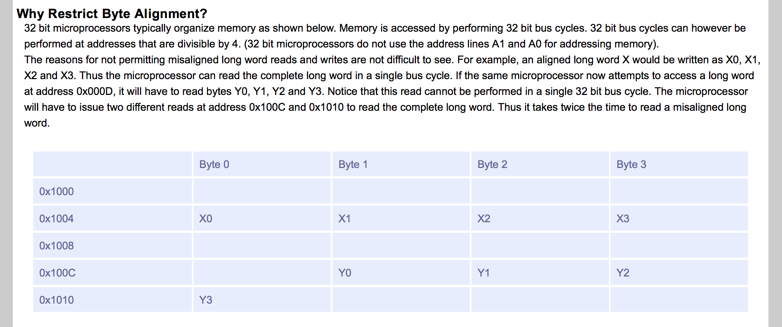
Byte Alignment

Slide 11
Today
Memory Instructions
Addressing Modes
Addressable Unit
Alignment
Endianness
Data Types
Control Instructions
Support for parallel execution

Slide 12
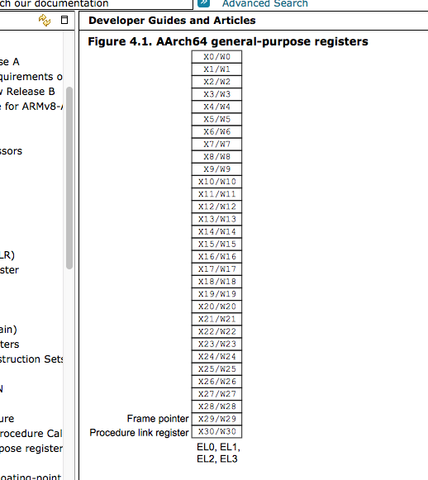
Registers

Slide 13
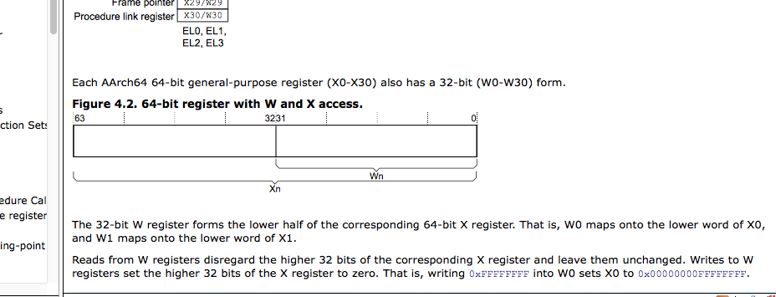
Registers

Slide 14
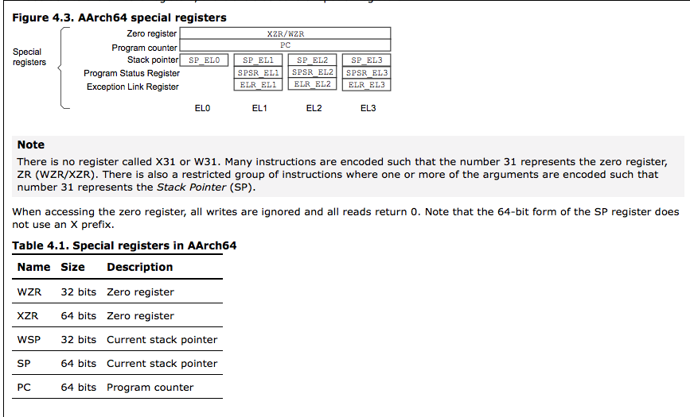

Slide 15
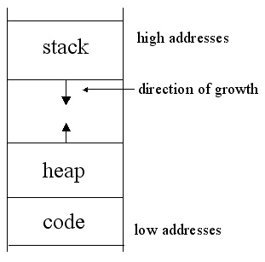
ARM Memory Layout - BASIC
Notes:
Graphic showing stack and heap

Slide 16
Addressable Unit
ISAs won’t allow access to memory at bit-level
For most architectures a memory address needs to specify a byte location
For some, the addressable unit may be larger
half word : 2 bytes
word : 4 bytes
double word : 8 bytes
Some architectures support multiple addressable units
Need to explicitly specify unit in instruction
What is the main advantage of having larger addressable units?
fewer bits used in specifying address

Slide 17
A word on word
How big is a word?
A word is considered a natural unit of access in a computer
Size of data most frequently accessed
Usually corresponds to the size of a register
Over the years we have moved from 8-bit to 64-bit words
Sometimes ISA implementations may be referenced using their word size
e.g., 64-bit Opteron, Intel IA-32

Slide 18
32-bit vs 64-bit
Features and components that differ
Addressable memory locations
Can specify up to 2⁶⁴
Register size
Number of registers may or may not change
Instruction length
Operating System and Compiler
Code generation
Exploit 64-bit features
load byte vs word
Memory allocation
Virtual to Physical Memory mapping
Coding
long long
This is the key
What are the performance benefits of a 64-bit machine?

Slide 19
ARM Addressing Modes
ARM has only a small number of ways that is computes addresses in memory. The address can be an address of an instruction (for branch and jump instructions) or it can be an address of data (for load and store instructions).
https://www.cs.umd.edu/class/sum2003/cmsc311/Notes/Mips/addr.html

Slide 20
Addressing Modes
For load/store and branches we need to specify a memory address within the instruction
What is the highest memory address we can specify?
Available bits = 32 – 6 = 26
Highest address = 2²⁶ bytes
What does that imply?
Largest program
2²⁶ ~ 65 MB ~ 165 K instructions
Max Data
65 MB
Specifying absolute address will not work in a lot of cases

Slide 21
Addressing Modes
PC-Relative Addressing This is used in the CBZ and CBNZ (branch equal, branch not equal) instructions. A form of “Base” addressing where the base is the PC. In ARM the B instruction is PC Relative
Register Addressing: This is used in the (branch register) BR instruction.
Base Addressing This is used in the STUR and LDUR (load register, store register) instructions.
We are not using immediate addressing ( I think)

Slide 22
How far do we need to jump on a jump?
Where do jumps come from?
loops and if-else statements
Where do we jump if the if test is true?
next instruction
Where do we jump if the loop condition is true?
next instruction for while and for loops
How far do we need to jump if the conditions are false?
past the if clause
beginning/end of loop body
How large are loop bodies? if statements?
SPEC benchmarks show that most jumps are within 16 assembly instructions

Slide 23
Memory Locations for Program Data
high
Memory
double x[100] ; int *y = malloc(1000);
void foo(int a) { int j ;
for(j = 0; j < 10; j++)
x[j] = 3 + a * x[j-1] ;
bar(a); }
// global
heap
// dynamic
y[ ]…
// argument
// local
bar
y
static data
x[0-99]
array reference
globals
stack
procedure
…
constant
argument
a
j
SP
local variable
low

Slide 24
Addressing Mode for Program Data
Local variable and arguments are on the stack
Use SP register as base address
SP + offset
Global variables are also close by
One-level indirection from stack
reg = [SP + k]
reg + offset
Base address of dynamic arrays on stack (or global)
Involves some address computation
May need multiple registers
high
Memory
y[ ]…
heap
bar
y
static data
x[0-99]
globals
stack
…
a
j
SP
low

Slide 25
Addressing Distant Locations
Possible solutions
Allow more bits for addressing
Make instructions longer
Store the address in a register
Store address in multiple instructions
High-order bits in one instruction, low-order bits in another
One solution that works quite well is indirect or relative addressing
Access instructions and data using an offset from a common base address
Store the base address in some register
PC, SP, FP etc.

Slide 26
PC Relative Addressing
Most common form of indirect addressing is PC-relative addressing
Can use address of current instruction as base address
Current instruction stored in PC
Used by most modern architectures
This doesn’t solve problem with jumps entirely
What else can change control-flow in programs and cause jumps?
Function calls
Code for a function may be far far away

Slide 27
Register Addressing
Register addressing is used in the BR instruction.
Because a register stores 64 bits, and because an address in a ARV V8 CPU is also 64 bits, you can specify any address in memory.
The typical call is:
BR $Rs
where $rs is replaced by any register.
The semantics of this is:
PC <- R[s]
This means the PC (program counter) is updated with the contents of register s. Recall that a jump or branch is updated by modifying the contents of the program counter. Register addressing gives you the ability to generate any address in memory.

Slide 28
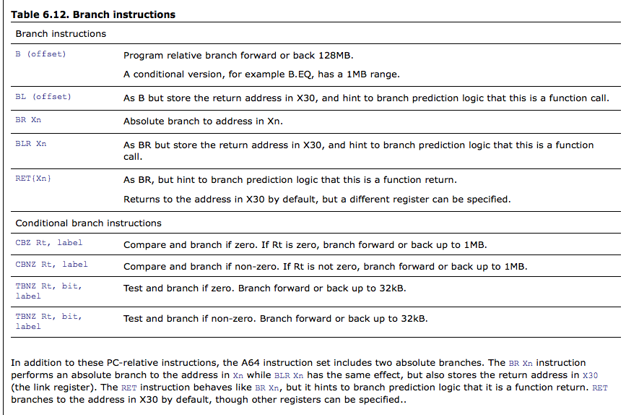
Branching from ARM V8 Manual
http://infocenter.arm.com/help/index.jsp?topic=/com.arm.doc.den0024a/ch09s01s02.html

Slide 29
Control Instruction Implementation
All control instructions need to update PC, so that it points to the next instruction to be executed
Implicit control on each instruction
PC = PC + 4
No explicit machine code needed
Need to implement
Unconditional jumps
Conditional jumps (or branches)

Slide 30
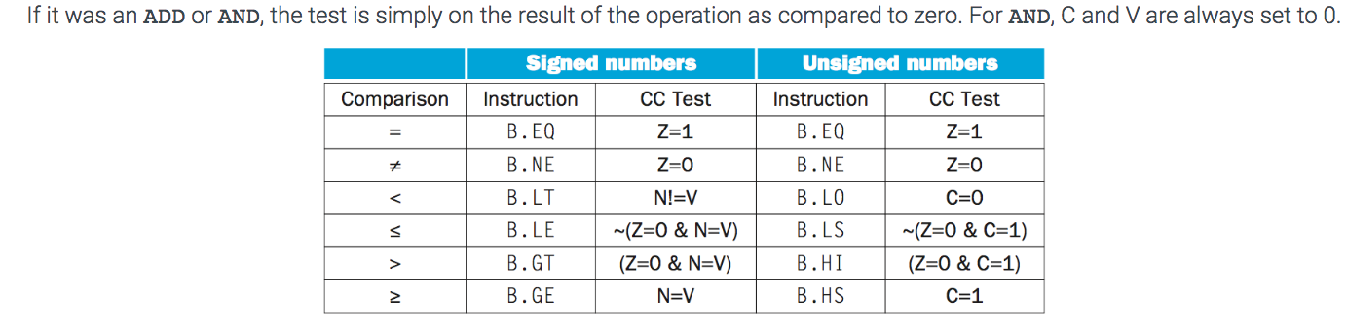
Conditional Jumps Beside CBZ
Two tasks
Evaluate condition
Jump to new address based on result
Some instructions can set condition codes ADDS, ADDIS, ANDS, ANDIS, SUBS, SUBIS
PC = PC + (($r == $s) ? 17 :13)
Z
N
C
O
zero
carry
negative
overflow

Slide 31
Base Addressing – Load / Store
Let's consider the following instruction.
LDUR rt, [rs, offset] load contents of base in $rs + se(offset) into $rt
where $rs and $rt are any two registers.
The offset is the 9 bit immediate value from the instruction. The 9 bits are the number of words we are offsetting.

Slide 32
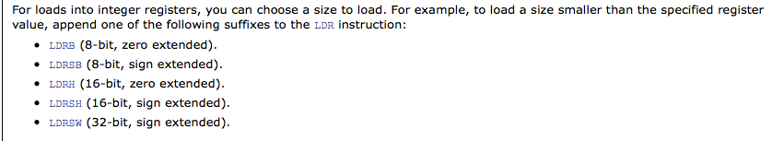
Amount of Data Transfer
The amount of data loaded or stored in each instruction may vary in some ISAs
Some ISAs support separate load and store instructions that specify how much data is to be accessed
In reality, almost never bring in just one byte or one word from memory
Many advantages to bringing in more data than you need!
Caches and locality of reference

Slide 33
Alignment
Some architectures restrict addresses that can be used for different-sized data transfers
Bytes accessed at any address
Half-words only at even addresses
Words accessed only at multiples of 4
This is called an alignment restriction
There are other types of data alignment issues that can affect performance
alignment with cache line boundaries
alignment of array starting addresses
Mainly the compilers responsibility
unaligned word access
byte address
0
1
2
3
4
5

Slide 34
Data Types
Need a mechanism to interpret contents of memory and registers according to their data type
Does the bit pattern represent an integer or a character?
Data types that need to be handled depends on the application
Signal processing : 16-bit fixed point
Text processing : 8-bit characters
Scientific computing : 64-bit floating point
At the hardware level really need to worry about two main types
Integer (fixed) or floating-point
Also
8, 16, 32, 64-bit
signed and unsigned

Slide 35
Handling Data Types
Two main schemes for handling data types
Tag
store information in instruction or data
wastes space
interpretation is slow
Use
Pass the responsibility on to the compiler or the assembly programmer
Generate FP instructions if data is FP, interpret data accordingly
int
12345
str
“abcd”
Example tags

Slide 36
Representing Floating-point Numbers
Format
S, 1-bit for sign
8-bit exponent
23-bit mantissa
Interpretation
value = (-1)^{s} x 2^{(E-127)} x 1.M
Operations
add, mult, sub, div
1
8
23
s
exp
mantissa
32-bit floating-point
We will look at this in detail!

Slide 37
Synchronization in Parallel Programs
Almost all parallel programs need to do some level of synchronization
Simple Example
Execute region X sequentially
Execute region Y in parallel
Execute region Z sequentially
Must ensure that Z is executed only after Y has completed
Synchronization between concurrent threads may be necessary to protect shared data
Ensure thread 2 executes instruction i only after thread 1 has finished executing instruction j
Prevent race conditions or data races
At the software-level synchronization is most commonly implemented using
mutual exclusion and critical sections
Also need hardware support for mutual exclusion

Slide 38
Architectural Support for Synchronization
To implement any form of mutual exclusion or critical section the architecture needs to have the ability to perform atomic operations
Execute instruction X and Y
Guarantee that no other instruction gets executed between X and Y
A particular type of atomic operation that is used often is a swap
An instruction that performs a load followed by a store atomically
These atomic operations are used to implement locks
If atomic operation is successful, then thread acquires lock

Slide 39
ISA Support for Vector Instructions
Most modern ISA support some form of vector/multimedia extension
Usually a co-processor embedded on chip
Main idea
perform the same operation on multiple pieces of data in parallel (usually pipelined)
aka SIMD
Compiler’s responsibility to issue the vector instructions
vload $vr1, [MEM]
vadd $vr1, $vr2, $vr3

Slide 40
Principles of ISA Design I
Keep it simple (KISS)
complexity
increases logic area
increases pipe stages
increases development time
evolution tends to make kludges
Orthogonality (modularity)
simple rules, few exceptions
all ops in all registers
Frequency
make the common case fast
some instructions (cases) are more important than others
Data Types
Regs
Operations
Formats
Add Modes
Slide courtesy : Doug Burger
Notes:
Graphics to try to illustrate Orthoginality

Slide 41
Principles of ISA Design II
Generality
not all problems need the same features/instructions
principle of least surprise
performance should be easy to predict
Locality and concurrency
design ISA to permit efficient implementation
today
10 years from now
vs
F
D
R
E
W
F
D
R
E
W
F
D
R
E
W
F
D
R
E
W
Slide courtesy : Doug Burger

