Slide 1


Python I
Some material adapted from Upenn cmpe391 slides and other sources

Slide 2
Overview
History
Installing & Running Python
Names & Assignment
Sequences types: Lists, Tuples, and Strings
Mutability
Understanding Reference Semantics in Python

Slide 3
Brief History of Python
Invented in the Netherlands, early 90s by Guido van Rossum
Named after Monty Python
Open sourced from the beginning
Considered a scripting language, but is much more
Scalable, object oriented and functional from the beginning
Used by Google from the beginning

Slide 4

Python’s Benevolent Dictator For Life
“Python is an experiment in how much freedom program-mers need. Too much freedom and nobody can read another's code; too little and expressive-ness is endangered.”
- Guido van Rossum

Slide 5
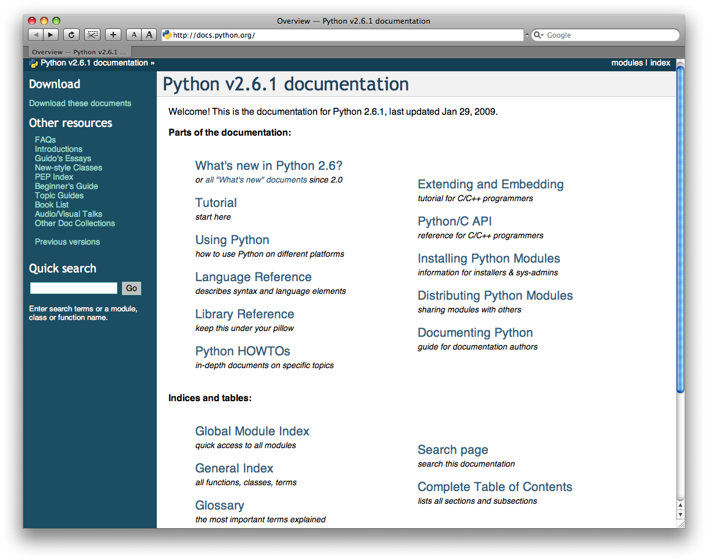
http://docs.python.org/

Slide 6
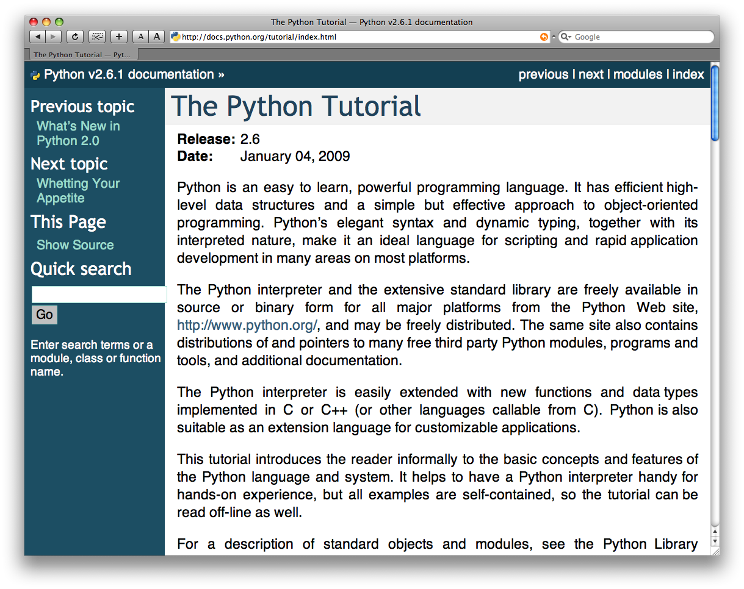
The Python tutorial is good!

Slide 7

Running Python

Slide 8
The Python Interpreter
Typical Python implementations offer
both an interpreter and compiler
Interactive interface to Python with a
read-eval-print loop
    [finin@linux2 ~]$ python
    Python 2.4.3 (#1, Jan 14 2008, 18:32:40)
    [GCC 4.1.2 20070626 (Red Hat 4.1.2-14)] on linux2
    Type "help", "copyright", "credits" or "license" for more information.
    >>> def square(x):
    ... return x * x
    ...
    >>> map(square, [1, 2, 3, 4])
    [1, 4, 9, 16]
    >>>

Slide 9
Installing
Python is pre-installed on most Unix systems, including Linux and MAC OS X
The pre-installed version may not be the most recent one (2.6 as of Nov 2008)
Download from http://python.org/download/
Python comes with a large library of standard modules
There are several options for an IDE
  IDLE – works well with Windows
  Emacs with python-mode or your favorite text editor
  Eclipse with Pydev (http://pydev.sourceforge.net/)

Slide 10
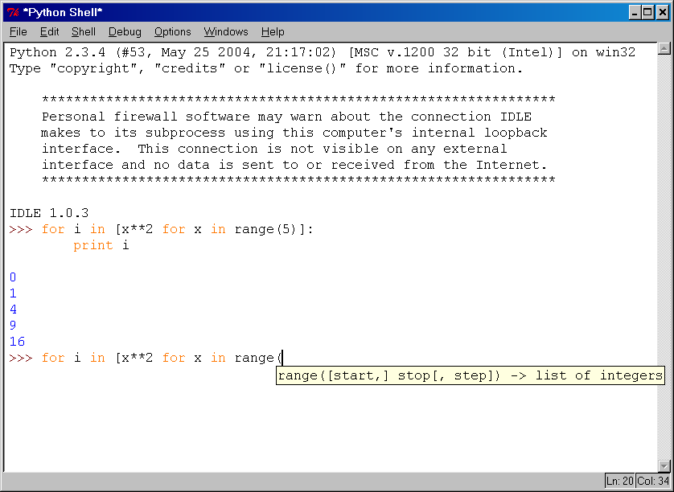
IDLE Development Environment
IDLE is an Integrated DeveLopment Environ-ment for Python, typically used on Windows
Multi-window text editor with syntax highlighting, auto-completion, smart indent and other.
Python shell with syntax highlighting.
Integrated debugger
with stepping, persis-
tent breakpoints,
and call stack visi-
bility

Slide 11
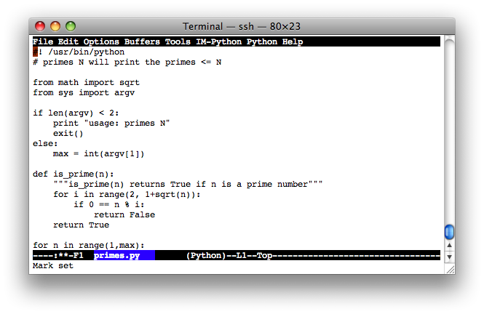
Editing Python in Emacs
Emacs python-mode has good support for editing Python, enabled enabled by default for .py files
Features: completion, symbol help, eldoc, and inferior interpreter shell, etc.

Slide 12
Running Interactively on UNIX
On Unix…
  % python
  >>> 3+3
  6
Python prompts with ‘>>>’.
To exit Python (not Idle):
  In Unix, type CONTROL-D
  In Windows, type CONTROL-Z + <Enter>
  Evaluate exit()

Slide 13
Running Programs on UNIX
Call python program via the python interpreter
  % python fact.py
Make a python file directly executable by
  Adding the appropriate path to your python interpreter as the first line of your file
    #!/usr/bin/python
  Making the file executable
    % chmod a+x fact.py
  Invoking file from Unix command line
    % fact.py

Slide 14
Example ‘script’: fact.py
#! /usr/bin/python
def fact(x):
"""Returns the factorial of its argument, assumed to be a posint"""
if x == 0:
return 1
return x * fact(x - 1)
print
print ’N fact(N)’
print "---------"
for n in range(10):
print n, fact(n)

Slide 15
Python Scripts
When you call a python program from the command line the interpreter evaluates each expression in the file
Familiar mechanisms are used to provide command line arguments and/or redirect input and output
Python also has mechanisms to allow a python program to act both as a script and as a module to be imported and used by another python program

Slide 16
Example of a Script
#! /usr/bin/python
""" reads text from standard input and outputs any email
addresses it finds, one to a line.
"""
import re
from sys import stdin
# a regular expression ~ for a valid email address
pat = re.compile(r'[-\w][-.\w]*@[-\w][-\w.]+[a-zA-Z]{2,4}')
for line in stdin.readlines():
for address in pat.findall(line):
print address

Slide 17
results
python> python email0.py <email.txt
bill@msft.com
gates@microsoft.com
steve@apple.com
bill@msft.com
python>

Slide 18
Getting a unique, sorted list
import re
from sys import stdin
pat = re.compile(r'[-\w][-.\w]*@[-\w][-\w.]+[a-zA-Z]{2,4}’)
# found is an initially empty set (a list w/o duplicates)
found = set()
for line in stdin.readlines():
for address in pat.findall(line):
found.add(address)
# sorted() takes a sequence, returns a sorted list of its elements
for address in sorted(found):
print address

Slide 19
results
python> python email2.py <email.txt
bill@msft.com
gates@microsoft.com
steve@apple.com
python>

Slide 20

The Basics

Slide 21
A Code Sample (in IDLE)
x = 34 - 23 # A comment.
y = “Hello” # Another one.
z = 3.45
if z == 3.45 or y == “Hello”:
x = x + 1
y = y + “ World” # String concat.
print x
print y

Slide 22
Enough to Understand the Code
Indentation matters to the meaning of the code
  Block structure indicated by indentation
The first assignment to a variable creates it
  Variable types don’t need to be declared.
  Python figures out the variable types on its own.
Assignment uses = and comparison uses ==
For numbers + - * / % are as expected.
  Special use of + for string concatenation.
  Special use of % for string formatting (as with printf in C)
Logical operators are words (and, or, not)
not symbols
The basic printing command is print

Slide 23
Basic Datatypes
Integers (default for numbers)
  z = 5 / 2 # Answer 2, integer division
Floats
  x = 3.456
Strings
  Can use “” or ‘’ to specify.
  “abc” ‘abc’ (Same thing.)
  Unmatched can occur within the string.
  “matt’s”
  Use triple double-quotes for multi-line strings or strings than contain both ‘ and “ inside of them:
  “““a‘b“c”””

Slide 24
Whitespace
Whitespace is meaningful in Python: especially indentation and placement of newlines
Use a newline to end a line of code
    Use \ when must go to next line prematurely
No braces {} to mark blocks of code, use consistent indentation instead
    First line with less indentation is outside of the block
    First line with more indentation starts a nested block
Colons start of a new block in many constructs, e.g. function definitions, then clauses

Slide 25
Comments
Start comments with #, rest of line is ignored
Can include a “documentation string” as the first line of a new function or class you define
Development environments, debugger, and other tools use it: it’s good style to include one
  def fact(n):
  “““fact(n) assumes n is a positive integer and returns facorial of n.”””
  assert(n>0)
  return 1 if n==1 else n*fact(n-1)

Slide 26
Assignment
Binding a variable in Python means setting a name to hold a reference to some object
  Assignment creates references, not copies
Names in Python do not have an intrinsic type, objects have types
  Python determines the type of the reference automatically based on what data is assigned to it
You create a name the first time it appears on the left side of an assignment expression:
x = 3
A reference is deleted via garbage collection after any names bound to it have passed out of scope
Python uses reference semantics (more later)

Slide 27
Naming Rules
Names are case sensitive and cannot start with a number. They can contain letters, numbers, and underscores.
  bob Bob _bob _2_bob_ bob_2 BoB
There are some reserved words:
  and, assert, break, class, continue, def, del, elif, else, except, exec, finally, for, from, global, if, import, in, is, lambda, not, or, pass, print, raise, return, try, while

Slide 28
Naming conventions
The Python community has these recommended naming conventions
joined_lower for functions, methods and, attributes
joined_lower or ALL_CAPS for constants
StudlyCaps for classes
camelCase only to conform to pre-existing conventions
Attributes: interface, _internal, __private

Slide 29
Assignment
You can assign to multiple names at the same time
  >>> x, y = 2, 3
  >>> x
  2
  >>> y
  3
This makes it easy to swap values
  >>> x, y = y, x
Assignments return values
  >>> a = b = x = 2

Slide 30
Accessing Non-Existent Name
Accessing a name before it’s been properly created (by placing it on the left side of an assignment), raises an error
>>> y
Traceback (most recent call last):
File "<pyshell#16>", line 1, in -toplevel-
y
NameError: name ‘y' is not defined
>>> y = 3
>>> y
3

Slide 31

Sequence types: Tuples, Lists, and Strings

Slide 32
Sequence Types
Tuple
  A simple immutable ordered sequence of items
  Items can be of mixed types, including collection types
Strings
  Immutable
  Conceptually very much like a tuple
List
  Mutable ordered sequence of items of mixed types

Slide 33
Similar Syntax
All three sequence types (tuples, strings, and lists) share much of the same syntax and functionality.
Key difference:
  Tuples and strings are immutable
  Lists are mutable
The operations shown in this section can be applied to all sequence types
  most examples will just show the operation performed on one

Slide 34
Sequence Types 1
Define tuples using parentheses and commas
  >>> tu = (23, ‘abc’, 4.56, (2,3), ‘def’)
Define lists are using square brackets and commas
  >>> li = [“abc”, 34, 4.34, 23]
Define strings using quotes (“, ‘, or “““).
  >>> st = “Hello World”
  >>> st = ‘Hello World’
  >>> st = “““This is a multi-line
  string that uses triple quotes.”””

Slide 35
Sequence Types 2
Access individual members of a tuple, list, or string using square bracket “array” notation
Note that all are 0 based…
>>> tu = (23, ‘abc’, 4.56, (2,3), ‘def’)
>>> tu[1] # Second item in the tuple.
‘abc’
>>> li = [“abc”, 34, 4.34, 23]
>>> li[1] # Second item in the list.
34
>>> st = “Hello World”
>>> st[1] # Second character in string.
‘e’

Slide 36
Positive and negative indices
>>> t = (23, ‘abc’, 4.56, (2,3), ‘def’)
Positive index: count from the left, starting with 0
  >>> t[1]
  ‘abc’
Negative index: count from right, starting with –1
  >>> t[-3]
  4.56

Slide 37
Slicing: Return Copy of a Subset
>>> t = (23, ‘abc’, 4.56, (2,3), ‘def’)
Return a copy of the container with a subset of the original members. Start copying at the first index, and stop copying before the second index.
  >>> t[1:4]
  (‘abc’, 4.56, (2,3))
You can also use negative indices
  >>> t[1:-1]
  (‘abc’, 4.56, (2,3))

Slide 38
Slicing: Return Copy of a Subset
>>> t = (23, ‘abc’, 4.56, (2,3), ‘def’)
Omit first index to make a copy starting from the beginning of the container
>>> t[:2]
(23, ‘abc’)
Omit second index to make a copy starting at the first index and going to the end of the container
>>> t[2:]
(4.56, (2,3), ‘def’)

Slide 39
Copying the Whole Sequence
[ : ] makes a copy of an entire sequence
>>> t[:]
(23, ‘abc’, 4.56, (2,3), ‘def’)
Note the difference between these two lines for mutable sequences
>>> l2 = l1 # Both refer to 1 ref,
# changing one affects both
>>> l2 = l1[:] # Independent copies, two refs

Slide 40
The ‘in’ Operator
Boolean test whether a value is inside a container:
    >>> t = [1, 2, 4, 5]
    >>> 3 in t
    False
    >>> 4 in t
    True
    >>> 4 not in t
    False
For strings, tests for substrings
    >>> a = 'abcde'
    >>> 'c' in a
    True
    >>> 'cd' in a
    True
    >>> 'ac' in a
    False
Be careful: the in keyword is also used in the syntax of for loops and list comprehensions

Slide 41
The + Operator
The + operator produces a new tuple, list, or string whose value is the concatenation of its arguments.
>>> (1, 2, 3) + (4, 5, 6)
(1, 2, 3, 4, 5, 6)
>>> [1, 2, 3] + [4, 5, 6]
[1, 2, 3, 4, 5, 6]
>>> “Hello” + “ ” + “World”
‘Hello World’

Slide 42
The * Operator
The * operator produces a new tuple, list, or string that “repeats” the original content.
>>> (1, 2, 3) * 3
(1, 2, 3, 1, 2, 3, 1, 2, 3)
>>> [1, 2, 3] * 3
[1, 2, 3, 1, 2, 3, 1, 2, 3]
>>> “Hello” * 3
‘HelloHelloHello’

Slide 43

Mutability:
Tuples vs. Lists

Slide 44
Lists are mutable
>>> li = [‘abc’, 23, 4.34, 23]
>>> li[1] = 45
>>> li
[‘abc’, 45, 4.34, 23]
We can change lists in place.
Name li still points to the same memory reference when we’re done.

Slide 45
Tuples are immutable
>>> t = (23, ‘abc’, 4.56, (2,3), ‘def’)
>>> t[2] = 3.14
Traceback (most recent call last):
File "<pyshell#75>", line 1, in -toplevel-
tu[2] = 3.14
TypeError: object doesn't support item assignment
You can’t change a tuple.
You can make a fresh tuple and assign its reference to a previously used name.
>>> t = (23, ‘abc’, 3.14, (2,3), ‘def’)
The immutability of tuples means they’re faster than lists.

Slide 46
Operations on Lists Only
>>> li = [1, 11, 3, 4, 5]
>>> li.append(‘a’) # Note the method syntax
>>> li
[1, 11, 3, 4, 5, ‘a’]
>>> li.insert(2, ‘i’)
>>>li
[1, 11, ‘i’, 3, 4, 5, ‘a’]

Slide 47
The extend method vs +
+ creates a fresh list with a new memory ref
extend operates on list li in place.
  >>> li.extend([9, 8, 7])
  >>> li
  [1, 2, ‘i’, 3, 4, 5, ‘a’, 9, 8, 7]
Potentially confusing:
  extend takes a list as an argument.
  append takes a singleton as an argument.
  >>> li.append([10, 11, 12])
  >>> li
  [1, 2, ‘i’, 3, 4, 5, ‘a’, 9, 8, 7, [10, 11, 12]]

Slide 48
Operations on Lists Only
Lists have many methods, including index, count, remove, reverse, sort
>>> li = [‘a’, ‘b’, ‘c’, ‘b’]
>>> li.index(‘b’) # index of 1st occurrence
1
>>> li.count(‘b’) # number of occurrences
2
>>> li.remove(‘b’) # remove 1st occurrence
>>> li
[‘a’, ‘c’, ‘b’]

Slide 49
Operations on Lists Only
>>> li = [5, 2, 6, 8]
>>> li.reverse() # reverse the list *in place*
>>> li
[8, 6, 2, 5]
>>> li.sort() # sort the list *in place*
>>> li
[2, 5, 6, 8]
>>> li.sort(some_function)
# sort in place using user-defined comparison

Slide 50
Tuple details
The comma is the tuple creation operator, not parens
  >>> 1,
  (1,)
Python shows parens for clarity (best practice)
  >>> (1,)
  (1,)
Don't forget the comma!
  >>> (1)
  1
Trailing comma only required for singletons others
Empty tuples have a special syntactic form
  >>> ()
  ()
  >>> tuple()
  ()

Slide 51
Summary: Tuples vs. Lists
Lists slower but more powerful than tuples
  Lists can be modified, and they have lots of handy operations and mehtods
  Tuples are immutable and have fewer features
To convert between tuples and lists use the list() and tuple() functions:
  li = list(tu)
  tu = tuple(li)

Slide 52

Understanding Reference Semantics in Python

Slide 53
Understanding Reference Semantics
Assignment manipulates references
    x = y does not make a copy of the object y references
    x = y makes x reference the object y references
Very useful; but beware!, e.g.
    >>> a = [1, 2, 3] # a now references the list [1, 2, 3]
    >>> b = a # b now references what a references
    >>> a.append(4) # this changes the list a references
    >>> print b # if we print what b references,
    [1, 2, 3, 4] # SURPRISE! It has changed…
Why?

Slide 54
Understanding Reference Semantics
There’s a lot going on with x = 3
An integer 3 is created and stored in memory
A name x is created
An reference to the memory location storing the 3 is then assigned to the name x
So: When we say that the value of x is 3
we mean that x now refers to the integer 3
Name: x
Ref: <address1>
Type: Integer
Data: 3
name list
memory

Slide 55
Understanding Reference Semantics
The data 3 we created is of type integer – objects are typed, variables are not
In Python, the datatypes integer, float, and string (and tuple) are “immutable”
This doesn’t mean we can’t change the value of x, i.e. change what x refers to …
For example, we could increment x:
  >>> x = 3
  >>> x = x + 1
  >>> print x
  4

Slide 56
Understanding Reference Semantics
When we increment x, then what happens is:
  The reference of name x is looked up.
  The value at that reference is retrieved.
Type: Integer
Data: 3
Name: x
Ref: <address1>
  >>> x = x + 1

Slide 57
Understanding Reference Semantics
When we increment x, then what happening is:
  The reference of name x is looked up.
  The value at that reference is retrieved.
  The 3+1 calculation occurs, producing a new data element 4 which is assigned to a fresh memory location with a new reference
Type: Integer
Data: 3
Name: x
Ref: <address1>
Type: Integer
Data: 4
  >>> x = x + 1

Slide 58
Understanding Reference Semantics
When we increment x, then what happening is:
  The reference of name x is looked up.
  The value at that reference is retrieved.
  The 3+1 calculation occurs, producing a new data element 4 which is assigned to a fresh memory location with a new reference
  The name x is changed to point to new ref
Type: Integer
Data: 3
Name: x
Ref: <address1>
Type: Integer
Data: 4
  >>> x = x + 1

Slide 59
Assignment
So, for simple built-in datatypes (integers, floats, strings) assignment behaves as expected
>>> x = 3 # Creates 3, name x refers to 3
>>> y = x # Creates name y, refers to 3
>>> y = 4 # Creates ref for 4. Changes y
>>> print x # No effect on x, still ref 3
3

Slide 60
Assignment
So, for simple built-in datatypes (integers, floats, strings) assignment behaves as expected
>>> x = 3 # Creates 3, name x refers to 3
>>> y = x # Creates name y, refers to 3
>>> y = 4 # Creates ref for 4. Changes y
>>> print x # No effect on x, still ref 3
3
Name: x
Ref: <address1>
Type: Integer
Data: 3

Slide 61
Assignment
So, for simple built-in datatypes (integers, floats, strings) assignment behaves as expected
>>> x = 3 # Creates 3, name x refers to 3
>>> y = x # Creates name y, refers to 3
>>> y = 4 # Creates ref for 4. Changes y
>>> print x # No effect on x, still ref 3
3
Name: x
Ref: <address1>
Type: Integer
Data: 3
Name: y
Ref: <address2>

Slide 62
Assignment
So, for simple built-in datatypes (integers, floats, strings) assignment behaves as expected
>>> x = 3 # Creates 3, name x refers to 3
>>> y = x # Creates name y, refers to 3
>>> y = 4 # Creates ref for 4. Changes y
>>> print x # No effect on x, still ref 3
3
Name: x
Ref: <address1>
Type: Integer
Data: 3
Name: y
Ref: <address2>
Type: Integer
Data: 4

Slide 63
Assignment
So, for simple built-in datatypes (integers, floats, strings) assignment behaves as expected
>>> x = 3 # Creates 3, name x refers to 3
>>> y = x # Creates name y, refers to 3
>>> y = 4 # Creates ref for 4. Changes y
>>> print x # No effect on x, still ref 3
3
Name: x
Ref: <address1>
Type: Integer
Data: 3
Name: y
Ref: <address2>
Type: Integer
Data: 4

Slide 64
Assignment
So, for simple built-in datatypes (integers, floats, strings) assignment behaves as expected
>>> x = 3 # Creates 3, name x refers to 3
>>> y = x # Creates name y, refers to 3
>>> y = 4 # Creates ref for 4. Changes y
>>> print x # No effect on x, still ref 3
3
Name: x
Ref: <address1>
Type: Integer
Data: 3
Name: y
Ref: <address2>
Type: Integer
Data: 4

Slide 65
Assignment
So, for simple built-in datatypes (integers, floats, strings) assignment behaves as expected
>>> x = 3 # Creates 3, name x refers to 3
>>> y = x # Creates name y, refers to 3
>>> y = 4 # Creates ref for 4. Changes y
>>> print x # No effect on x, still ref 3
3
Name: x
Ref: <address1>
Type: Integer
Data: 3
Name: y
Ref: <address2>
Type: Integer
Data: 4

Slide 66
Assignment & mutable objects
For other data types (lists, dictionaries, user-defined types), assignment works differently
  These datatypes are “mutable”
  Change occur in place
  We don’t copy them into a new memory address each time
  If we type y=x and then modify y, both x and y are changed
>>> x = 3 x = some mutable object
>>> y = x y = x
>>> y = 4 make a change to y
>>> print x look at x
3 x will be changed as well
immutable
mutable

Slide 67
Why? Changing a Shared List
a
1
2
3
a = [1, 2, 3]
a
1
2
3
b = a
b
a
1
2
3
a.append(4)
4
b

Slide 68
Surprising example surprising no more
So now, here’s our code:
    >>> a = [1, 2, 3] # a now references the list [1, 2, 3]
    >>> b = a # b now references what a references
    >>> a.append(4) # this changes the list a references
    >>> print b # if we print what b references,
    [1, 2, 3, 4] # SURPRISE! It has changed…

Slide 69
Dictionaries: A Mapping type
Dictionaries store a mapping between a set of keys and a set of values
  Keys can be any immutable type.
  Values can be any type
  A single dictionary can store values of different types
You can define, modify, view, lookup or delete the key-value pairs in the dictionary
Python’s dictionaries are also known as hash tables and associative arrays

Slide 70
Creating & accessing dictionaries
>>> d = {‘user’:‘bozo’, ‘pswd’:1234}
>>> d[‘user’]
‘bozo’
>>> d[‘pswd’]
123
>>> d[‘bozo’]
Traceback (innermost last):
File ‘<interactive input>’ line 1, in ?
KeyError: bozo

Slide 71
Updating Dictionaries
  >>> d = {‘user’:‘bozo’, ‘pswd’:1234}
  >>> d[‘user’] = ‘clown’
  >>> d
  {‘user’:‘clown’, ‘pswd’:1234}
Keys must be unique
Assigning to an existing key replaces its value
  >>> d[‘id’] = 45
  >>> d
  {‘user’:‘clown’, ‘id’:45, ‘pswd’:1234}
Dictionaries are unordered
  New entries can appear anywhere in output
Dictionaries work by hashing

Slide 72
Removing dictionary entries
>>> d = {‘user’:‘bozo’, ‘p’:1234, ‘i’:34}
>>> del d[‘user’] # Remove one.
>>> d
{‘p’:1234, ‘i’:34}
>>> d.clear() # Remove all.
>>> d
{}
>>> a=[1,2]
>>> del a[1] # del works on lists, too
>>> a
[1]

Slide 73
Useful Accessor Methods
>>> d = {‘user’:‘bozo’, ‘p’:1234, ‘i’:34}
>>> d.keys() # List of keys, VERY useful
[‘user’, ‘p’, ‘i’]
>>> d.values() # List of values.
[‘bozo’, 1234, 34]
>>> d.items() # List of item tuples.
[(‘user’,‘bozo’), (‘p’,1234), (‘i’,34)]

Slide 74
A Dictionary Example
Problem: count the frequency of each word in text read from the standard input, print results
Six versions of increasing complexity
wf1.py is a simple start
wf2.py uses a common idiom for default values
wf3.py sorts the output alphabetically
wf4.py downcase and strip punctuation from words and ignore stop words
wf5.py sort output by frequency
wf6.py add command line options: -n, -t, -h

Slide 75
Dictionary example: wf1.py
#!/usr/bin/python
import sys
freq = {} # frequency of words in text
for line in sys.stdin:
for word in line.split():
if word in freq:
freq[word] = 1 + freq[word]
else:
freq[word] = 1
print freq

Slide 76
Dictionary example wf1.py
#!/usr/bin/python
import sys
freq = {} # frequency of words in text
for line in sys.stdin:
for word in line.split():
if word in freq:
freq[word] = 1 + freq[word]
else:
freq[word] = 1
print freq
This is a common pattern

Slide 77
Dictionary example wf2.py
#!/usr/bin/python
import sys
freq = {} # frequency of words in text
for line in sys.stdin:
for word in line.split():
freq[word] = freq.get(word,0)
print freq
key
Default value if not found

Slide 78
Dictionary example wf3.py
#!/usr/bin/python
import sys
freq = {} # frequency of words in text
for line in sys.stdin:
for word in line.split():
freq[word] = freq.get(word,0)
words = freq.keys()
words.sort()
for w in words:
print w, freq[w]

Slide 79
Dictionary example wf4.py
#!/usr/bin/python
import sys
from operator import itemgetter
punctuation = """'!"#$%&\'()*+,-./:;<=>?@[\\]^_`{|}~'"""
freq = {} # frequency of words in text
stop_words = {}
for line in open("stop_words.txt"):
stop_words[line.strip()] = True

Slide 80
Dictionary example wf5.py
for line in sys.stdin:
for word in line.split():
word = word.strip(punctuation).lower()
if not word in stop_words:
freq[word] = freq.get(word,0) + 1
words = sorted(freq.iteritems(), key=itemgetter(1), reverse=True)
for w in words:
print w[1], w[0]

Slide 81
Dictionary example wf6.py
from optparse import OptionParser
# read command line arguments and process
parser = OptionParser()
parser.add_option('-n', '--number', type="int", default=-1, help='number of words to report')
parser.add_option("-t", "--threshold", type="int", default=0, help=”print if frequency > threshold")
(options, args) = parser.parse_args()
...
# print the top option.number words but only those
# with freq>option.threshold
for (word, freq) in words[:options.number]:
if freq > options.threshold:
print freq, word

Slide 82
Why must keys be immutable?
The keys used in a dictionary must be immutable objects?
  >>> name1, name2 = 'john', ['bob', 'marley']
  >>> fav = name2
  >>> d = {name1: 'alive', name2: 'dead'}
  Traceback (most recent call last):
  File "<stdin>", line 1, in <module>
  TypeError: list objects are unhashable
Why is this?
Suppose we could index a value for name2
and then did fav[0] = “Bobby”
Could we find d[name2] or d[fav] or …?

Slide 83

Functions in Python

Slide 84
Defining Functions
Function definition begins with “def.”
Function name and its arguments.
    def get_final_answer(filename):
    “““Documentation String”””
    line1
    line2
    return total_counter
Colon.
The indentation matters…
First line with less
indentation is considered to be
outside of the function definition.
The keyword ‘return’ indicates the
value to be sent back to the caller.
No header file or declaration of types of function or arguments

Slide 85
Python and Types
Dynamic typing: Python determines the data types of variable bindings in a program automatically
Strong typing: But Python’s not casual about types, it enforces the types of objects
For example, you can’t just append an integer
to a string, but must first convert it to a string
x = “the answer is ” # x bound to a string
y = 23 # y bound to an integer.
print x + y # Python will complain!

Slide 86
Calling a Function
The syntax for a function call is:
  >>> def myfun(x, y):
  return x * y
  >>> myfun(3, 4)
  12
Parameters in Python are Call by Assignment
  Old values for the variables that are parameter names are hidden, and these variables are simply made to refer to the new values
  All assignment in Python, including binding function parameters, uses reference semantics.

Slide 87
Functions without returns
All functions in Python have a return value, even if no return line inside the code
Functions without a return return the special value None
  None is a special constant in the language
  None is used like NULL, void, or nil in other languages
  None is also logically equivalent to False
  The interpreter doesn’t print None

Slide 88
Function overloading? No.
There is no function overloading in Python
  Unlike C++, a Python function is specified by its name alone
    The number, order, names, or types of its arguments cannot be used to distinguish between two functions with the same name
  Two different functions can’t have the same name, even if they have different arguments
But: see operator overloading in later slides
(Note: van Rossum playing with function overloading for the future)

Slide 89
Default Values for Arguments
You can provide default values for a function’s arguments
These arguments are optional when the function is called
>>> def myfun(b, c=3, d=“hello”):
return b + c
>>> myfun(5,3,”hello”)
>>> myfun(5,3)
>>> myfun(5)
All of the above function calls return 8

Slide 90
Keyword Arguments
You can call a function with some or all of its arguments out of order as long as you specify their names
You can also just use keywords for a final subset of the arguments.
    >>> def myfun(a, b, c):
    return a-b
    >>> myfun(2, 1, 43)
    1
    >>> myfun(c=43, b=1, a=2)
    1
    >>> myfun(2, c=43, b=1)
    1

Slide 91
Functions are first-class objects
Functions can be used as any other datatype, eg:
  Arguments to function
  Return values of functions
  Assigned to variables
  Parts of tuples, lists, etc
>>> def square(x):
return x*x
>>> def applier(q, x):
return q(x)
>>> applier(square, 7)
49

Slide 92
Lambda Notation
Python uses a lambda notation to create anonymous functions
  >>> applier(lambda z: z * 4, 7)
    28
Python supports functional programming idioms, including closures and continuations

Slide 93
Lambda Notation
Not everything is possible…
    >>> f = lambda x,y : 2 * x + y
    >>> f
    <function <lambda> at 0x87d30>
    >>> f(3, 4)
    10
    >>> v = lambda x: x*x(100)
    >>> v
    <function <lambda> at 0x87df0>
    >>> v(100)
    Traceback (most recent call last):
    File "<stdin>", line 1, in <module>
    File "<stdin>", line 1, in <lambda>
    TypeError: 'int' object is not callable

Slide 94
Example: composition
>>> def square(x):
return x*x
>>> def twice(f):
return lambda x: f(f(x))
>>> twice
<function twice at 0x87db0>
>>> quad = twice(square)
>>> quad
<function <lambda> at 0x87d30>
>>> quad(5)
625

Slide 95
Example: closure
>>> def counter(start=0, step=1):
x = [start]
def _inc():
x[0] += step
return x[0]
return _inc
>>> c1 = counter()
>>> c2 = counter(100, -10)
>>> c1()
1
>>> c2()
90

Slide 96

Logical Expressions

Slide 97
True and False
True and False are constants in Python.
Other values equivalent to True and False:
  False: zero, None, empty container or object
  True: non-zero numbers, non-empty objects
Comparison operators: ==, !=, <, <=, etc.
  X and Y have same value: X == Y
  Compare with X is Y :
    X and Y are two variables that refer to the identical same object.

Slide 98
Boolean Logic Expressions
You can also combine Boolean expressions.
  True if a is True and b is True: a and b
  True if a is True or b is True: a or b
  True if a is False: not a
Use parentheses as needed to disambiguate complex Boolean expressions.

Slide 99
Special Properties of and & or
Actually and and or don’t return True or False but value of one of their sub-expressions, which may be a non-Boolean value
X and Y and Z
  If all are true, returns value of Z
  Otherwise, returns value of first false sub-expression
X or Y or Z
  If all are false, returns value of Z
  Otherwise, returns value of first true sub-expression
And and or use lazy evaluation, so no further expressions are evaluated

Slide 100
The “and-or” Trick
An old deprecated trick to implement a simple conditional
result = test and expr1 or expr2
  When test is True, result is assigned expr1
  When test is False, result is assigned expr2
  Works almost like C++’s (test ? expr1 : expr2)
But if the value of expr1 is ever False, the trick doesn’t work
Don’t use it; made unnecessary by conditional expressions in Python 2.5 (see next slide)

Slide 101
Conditional Expressions in Python 2.5
x = true_value if condition else false_value
Uses lazy evaluation:
  First, condition is evaluated
  If True, true_value is evaluated and returned
  If False, false_value is evaluated and returned
Standard use:
    x = (true_value if condition else false_value)

Slide 102

Control of Flow

Slide 103
if Statements
    if x == 3:
    print “X equals 3.”
    elif x == 2:
    print “X equals 2.”
    else:
    print “X equals something else.”
    print “This is outside the ‘if’.”
Be careful! The keyword if is also used in the syntax of filtered list comprehensions. Note:
Use of indentation for blocks
Colon (:) after boolean expression

Slide 104
while Loops
>>> x = 3
>>> while x < 5:
print x, "still in the loop"
x = x + 1
3 still in the loop
4 still in the loop
>>> x = 6
>>> while x < 5:
print x, "still in the loop"
>>>

Slide 105
break and continue
You can use the keyword break inside a loop to leave the while loop entirely.
You can use the keyword continue inside a loop to stop processing the current iteration of the loop and to immediately go on to the next one.

Slide 106
assert
An assert statement will check to make sure that something is true during the course of a program.
  If the condition if false, the program stops
    (more accurately: the program throws an exception)
assert(number_of_players < 5)

Slide 107
List Comprehensions

Slide 108
Python’s higher-order functions
Python supports higher-order functions that operate on lists similar to Scheme’s
  >>> def square(x):
  return x*x
  >>> def even(x):
  return 0 == x % 2
  >>> map(square, range(10,20))
  [100, 121, 144, 169, 196, 225, 256, 289, 324, 361]
  >>> filter(even, range(10,20))
  [10, 12, 14, 16, 18]
  >>> map(square, filter(even, range(10,20)))
  [100, 144, 196, 256, 324]
But many Python programmers prefer to use list comprehensions, instead

Slide 109
List Comprehensions
A list comprehension is a programming language construct for creating a list based on existing lists
  Haskell, Erlang, Scala and Python have them
Why “comprehension”? The term is borrowed from math’s set comprehension notation for defining sets in terms of other sets
A powerful and popular feature in Python
  Generate a new list by applying a function to every member of an original list
Python’s notation:
[ expression for name in list ]

Slide 110
List Comprehensions
The syntax of a list comprehension is somewhat tricky
    [x-10 for x in grades if x>0]
Syntax suggests that of a for-loop, an in operation, or an if statement
All three of these keywords (‘for’, ‘in’, and ‘if’) are also used in the syntax of forms of list comprehensions
[ expression for name in list ]

Slide 111
List Comprehensions
  Note: Non-standard colors on next few slides clarify the list comprehension syntax.
>>> li = [3, 6, 2, 7]
>>> [elem*2 for elem in li]
[6, 12, 4, 14]
[ expression for name in list ]
  Where expression is some calculation or operation acting upon the variable name.
  For each member of the list, the list comprehension
    sets name equal to that member,
    calculates a new value using expression,
  It then collects these new values into a list which is the return value of the list comprehension.
[ expression for name in list ]

Slide 112
List Comprehensions
If list contains elements of different types, then expression must operate correctly on the types of all of list members.
If the elements of list are other containers, then the name can consist of a container of names that match the type and “shape” of the list members.
>>> li = [(‘a’, 1), (‘b’, 2), (‘c’, 7)]
>>> [ n * 3 for (x, n) in li]
[3, 6, 21]
[ expression for name in list ]

Slide 113
List Comprehensions
expression can also contain user-defined functions.
  >>> def subtract(a, b):
  return a – b
  >>> oplist = [(6, 3), (1, 7), (5, 5)]
  >>> [subtract(y, x) for (x, y) in oplist]
  [-3, 6, 0]
[ expression for name in list ]

Slide 114
Syntactic sugar
List comprehensions can be viewed as syntactic sugar for a typical higher-order functions
[ expression for name in list ]
map( lambda name: expression, list )
[ 2*x+1 for x in [10, 20, 30] ]
map( lambda x: 2*x+1, [10, 20, 30] )

Slide 115
Filtered List Comprehension
Filter determines whether expression is performed on each member of the list.
For each element of list, checks if it satisfies the filter condition.
If the filter condition returns False, that element is omitted from the list before the list comprehension is evaluated.
[ expression for name in list if filter]

Slide 116
Filtered List Comprehension
>>> li = [3, 6, 2, 7, 1, 9]
>>> [elem*2 for elem in li if elem > 4]
[12, 14, 18]
Only 6, 7, and 9 satisfy the filter condition
So, only 12, 14, and 18 are produce.
[ expression for name in list if filter]

Slide 117
More syntactic sugar
Including an if clause begins to show the benefits of the sweetened form
[ expression for name in list if filt ]
map( lambda name . expression, filter(filt, list) )
[ 2*x+1 for x in [10, 20, 30] if x > 0 ]
map( lambda x: 2*x+1,
filter( lambda x: x > 0 , [10, 20, 30] )

Slide 118
Nested List Comprehensions
Since list comprehensions take a list as input and produce a list as output, they are easily nested
  >>> li = [3, 2, 4, 1]
  >>> [elem*2 for elem in
  [item+1 for item in li] ]
  [8, 6, 10, 4]
The inner comprehension produces: [4, 3, 5, 2]
So, the outer one produces: [8, 6, 10, 4]
[ expression for name in list ]

Slide 119
Syntactic sugar
[ e1 for n1 in [ e1 for n1 list ] ]
map( lambda n1: e1,
map( lambda n2: e2, list ) )
[2*x+1 for x in [y*y for y in [10, 20, 30]]]
map( lambda x: 2*x+1,
map( lambda y: y*y, [10, 20, 30] ))

Slide 120
For Loops

Slide 121
For Loops / List Comprehensions
Python’s list comprehensions provide a natural idiom that usually requires a for-loop in other programming languages.
  As a result, Python code uses many fewer for-loops
  Nevertheless, it’s important to learn about for-loops.
Take care! The keywords for and in are also used in the syntax of list comprehensions, but this is a totally different construction.

Slide 122
For Loops 1
A for-loop steps through each of the items in a collection type, or any other type of object which is “iterable”
    for <item> in <collection>:
    <statements>
If <collection> is a list or a tuple, then the loop steps through each element of the sequence
If <collection> is a string, then the loop steps through each character of the string
    for someChar in “Hello World”:
    print someChar

Slide 123
For Loops 2
  for <item> in <collection>:
  <statements>
<item> can be more than a single variable name
When the <collection> elements are themselves sequences, then <item> can match the structure of the elements.
This multiple assignment can make it easier to access the individual parts of each element
  for (x,y) in [(a,1),(b,2),(c,3),(d,4)]:
  print x

Slide 124
For loops & the range() function
Since a variable often ranges over some sequence of numbers, the range() function returns a list of numbers from 0 up to but not including the number we pass to it.
range(5) returns [0,1,2,3,4]
So we could say:
for x in range(5):
print x
(There are more complex forms of range() that provide richer functionality…)

Slide 125
For Loops and Dictionaries
>>> ages = { "Sam" : 4, "Mary" : 3, "Bill" : 2 }
>>> ages
{'Bill': 2, 'Mary': 3, 'Sam': 4}
>>> for name in ages.keys():
print name, ages[name]
Bill 2
Mary 3
Sam 4
>>>

Slide 126

Assignment and Containers

Slide 127
Multiple Assignment with Sequences
We’ve seen multiple assignment before:
>>> x, y = 2, 3
But you can also do it with sequences.
The type and “shape” just has to match.
>>> (x, y, (w, z)) = (2, 3, (4, 5))
>>> [x, y] = [4, 5]

Slide 128
Empty Containers 1
Assignment creates a name, if it didn’t exist already.
x = 3 Creates name x of type integer.
Assignment is also what creates named references to containers.
>>> d = {‘a’:3, ‘b’:4}
We can also create empty containers:
>>> li = []
>>> tu = ()
>>> di = {}
These three are empty, but of different types
Note: an empty container
is logically equivalent to
False. (Just like None.)

Slide 129
Empty Containers 2
Why create a named reference to empty container?
  To initialize an empty list, e.g., before using append
  This would cause an unknown name error if a named reference to the right data type wasn’t created first
  >>> g.append(3)
  Python complains here about the unknown name ‘g’!
  >>> g = []
  >>> g.append(3)
  >>> g
  [3]

Slide 130

String Operations

Slide 131
String Operations
A number of methods for the string class perform useful formatting operations:
  >>> “hello”.upper()
  ‘HELLO’
Check the Python documentation for many other handy string operations.
Helpful hint: use <string>.strip() to strip off final newlines from lines read from files

Slide 132
String Formatting Operator: %
The operator % allows strings to be built out of many data items a la “fill in the blanks”
  Allows control of how the final output appears
  For example, we could force a number to display with a specific number of digits after the decimal point
Very similar to the sprintf command of C.
      >>> x = “abc”
      >>> y = 34
      >>> “%s xyz %d” % (x, y)
      ‘abc xyz 34’
The tuple following the % operator used to fill in blanks in original string marked with %s or %d.
Check Python documentation for codes

Slide 133
Printing with Python
You can print a string to the screen using print
Using the % operator in combination with print, we can format our output text
  >>> print “%s xyz %d” % (“abc”, 34)
  abc xyz 34
Print adds a newline to the end of the string. If you include a list of strings, it will concatenate them with a space between them
  >>> print “abc” >>> print “abc”, “def”
  abc abc def
Useful trick: >>> print “abc”, doesn’t add newline just a single space

Slide 134

String Conversions

Slide 135
Join and Split
Join turns a list of strings into one string
<separator_string>.join( <some_list> )
>>> “;”.join( [“abc”, “def”, “ghi”] )
  “abc;def;ghi”
Split turns one string into a list of strings
<some_string>.split( <separator_string> )
>>> “abc;def;ghi”.split( “;” )
  [“abc”, “def”, “ghi”]
Note the inversion in the syntax

Slide 136
Split & Join with List Comprehensions
Split and join can be used in a list compre-hension in the following Python idiom:
>>> " ".join( [s.capitalize() for s in "this is a test ".split( )] )
'This Is A Test‘
>>> # For clarification:
>>> "this is a test" .split( )
['this', 'is', 'a', 'test']
>>> [s.capitalize() for s in "this is a test" .split()]
['This', 'Is', 'A', 'Test’]

Slide 137
Convert Anything to a String
The builtin str() function can convert an instance of any data type into a string.
You define how this function behaves for user-created data types
You can also redefine the behavior of this function for many types.
>>> “Hello ” + str(2)
“Hello 2”

Slide 138

Importing and Modules

Slide 139
Importing and Modules
Use classes & functions defined in another file
A Python module is a file with the same name (plus the .py extension)
Like Java import, C++ include
Three formats of the command:
import somefile
from somefile import *
from somefile import className
The difference? What gets imported from the file and what name refers to it after importing

Slide 140
import …
import somefile
Everything in somefile.py gets imported.
To refer to something in the file, append the text “somefile.” to the front of its name:
somefile.className.method(“abc”)
somefile.myFunction(34)

Slide 141
from … import *
from somefile import *
Everything in somefile.py gets imported
To refer to anything in the module, just use its name. Everything in the module is now in the current namespace.
Take care! Using this import command can easily overwrite the definition of an existing function or variable!
className.method(“abc”)
myFunction(34)

Slide 142
from … import …
from somefile import className
Only the item className in somefile.py gets imported.
After importing className, you can just use it without a module prefix. It’s brought into the current namespace.
Take care! Overwrites the definition of this name if already defined in the current namespace!
className.method(“abc”) ⬅ imported
myFunction(34) ⬅ Not imported

Slide 143
Directories for module files
Where does Python look for module files?
The list of directories where Python will look for the files to be imported is sys.path
This is just a variable named ‘path’ stored inside the ‘sys’ module
  >>> import sys
  >>> sys.path
  ['', '/Library/Frameworks/Python.framework/Versions/2.5/lib/python2.5/site-packages/setuptools-0.6c5-py2.5.egg’, …]
To add a directory of your own to this list, append it to this list
  sys.path.append(‘/my/new/path’)

Slide 144
Object Oriented Programming in Python:
Defining Classes

Slide 145
It’s all objects…
Everything in Python is really an object.
  We’ve seen hints of this already…
  “hello”.upper()
  list3.append(‘a’)
  dict2.keys()
  These look like Java or C++ method calls.
  New object classes can easily be defined in addition to these built-in data-types.
In fact, programming in Python is typically done in an object oriented fashion.

Slide 146
Defining a Class
A class is a special data type which defines how to build a certain kind of object.
The class also stores some data items that are shared by all the instances of this class
Instances are objects that are created which follow the definition given inside of the class
Python doesn’t use separate class interface definitions as in some languages
You just define the class and then use it

Slide 147
Methods in Classes
Define a method in a class by including function definitions within the scope of the class block
There must be a special first argument self in all of method definitions which gets bound to the calling instance
There is usually a special method called __init__ in most classes
We’ll talk about both later…

Slide 148
A simple class def: student
class student:
“““A class representing a student ”””
def __init__(self,n,a):
self.full_name = n
self.age = a
def get_age(self):
return self.age

Slide 149
Creating and Deleting Instances

Slide 150
Instantiating Objects
There is no “new” keyword as in Java.
Just use the class name with ( ) notation and assign the result to a variable
__init__ serves as a constructor for the class. Usually does some initialization work
The arguments passed to the class name are given to its __init__() method
So, the __init__ method for student is passed “Bob” and 21 and the new class instance is bound to b:
b = student(“Bob”, 21)

Slide 151
Constructor: __init__
An __init__ method can take any number of arguments.
Like other functions or methods, the arguments can be defined with default values, making them optional to the caller.
However, the first argument self in the definition of __init__ is special…

Slide 152
Self
The first argument of every method is a reference to the current instance of the class
By convention, we name this argument self
In __init__, self refers to the object currently being created; so, in other class methods, it refers to the instance whose method was called
Similar to the keyword this in Java or C++
But Python uses self more often than Java uses this

Slide 153
Self
Although you must specify self explicitly when defining the method, you don’t include it when calling the method.
Python passes it for you automatically
Defining a method: Calling a method:
(this code inside a class definition.)
def set_age(self, num): >>> x.set_age(23)
self.age = num

Slide 154
Deleting instances: No Need to “free”
When you are done with an object, you don’t have to delete or free it explicitly.
Python has automatic garbage collection.
Python will automatically detect when all of the references to a piece of memory have gone out of scope. Automatically frees that memory.
Generally works well, few memory leaks
There’s also no “destructor” method for classes

Slide 155
Access to Attributes and Methods

Slide 156
Definition of student
class student:
“““A class representing a student ”””
def __init__(self,n,a):
self.full_name = n
self.age = a
def get_age(self):
return self.age

Slide 157
Traditional Syntax for Access
>>> f = student(“Bob Smith”, 23)
>>> f.full_name # Access attribute
“Bob Smith”
>>> f.get_age() # Access a method
23

Slide 158
Accessing unknown members
Problem: Occasionally the name of an attribute or method of a class is only given at run time…
Solution:
    getattr(object_instance, string)
string is a string which contains the name of an attribute or method of a class
getattr(object_instance, string) returns a reference to that attribute or method

Slide 159
getattr(object_instance, string)
>>> f = student(“Bob Smith”, 23)
>>> getattr(f, “full_name”)
“Bob Smith”
>>> getattr(f, “get_age”)
<method get_age of class studentClass at 010B3C2>
>>> getattr(f, “get_age”)() # call it
23
>>> getattr(f, “get_birthday”)
# Raises AttributeError – No method!

Slide 160
hasattr(object_instance,string)
>>> f = student(“Bob Smith”, 23)
>>> hasattr(f, “full_name”)
True
>>> hasattr(f, “get_age”)
True
>>> hasattr(f, “get_birthday”)
False

Slide 161
Attributes

Slide 162
Two Kinds of Attributes
The non-method data stored by objects are called attributes
Data attributes
  Variable owned by a particular instance of a class
  Each instance has its own value for it
  These are the most common kind of attribute
Class attributes
  Owned by the class as a whole
  All class instances share the same value for it
  Called “static” variables in some languages
  Good for (1) class-wide constants and (2) building counter of how many instances of the class have been made

Slide 163
Data Attributes
Data attributes are created and initialized by an __init__() method.
  Simply assigning to a name creates the attribute
  Inside the class, refer to data attributes using self
    for example, self.full_name
class teacher:
“A class representing teachers.”
def __init__(self,n):
self.full_name = n
def print_name(self):
print self.full_name

Slide 164
Class Attributes
Because all instances of a class share one copy of a class attribute, when any instance changes it, the value is changed for all instances
Class attributes are defined within a class definition and outside of any method
Since there is one of these attributes per class and not one per instance, they’re accessed via a different notation:
  Access class attributes using self.__class__.name notation -- This is just one way to do this & the safest in general.
class sample: >>> a = sample()
x = 23 >>> a.increment()
def increment(self): >>> a.__class__.x
self.__class__.x += 1 24

Slide 165
Data vs. Class Attributes
class counter:
overall_total = 0
# class attribute
def __init__(self):
self.my_total = 0
# data attribute
def increment(self):
counter.overall_total = \
counter.overall_total + 1
self.my_total = \
self.my_total + 1
>>> a = counter()
>>> b = counter()
>>> a.increment()
>>> b.increment()
>>> b.increment()
>>> a.my_total
1
>>> a.__class__.overall_total
3
>>> b.my_total
2
>>> b.__class__.overall_total
3

Slide 166

Inheritance

Slide 167
Subclasses
A class can extend the definition of another class
  Allows use (or extension ) of methods and attributes already defined in the previous one.
  New class: subclass. Original: parent, ancestor or superclass
To define a subclass, put the name of the superclass in parentheses after the subclass’s name on the first line of the definition.
Class Cs_student(student):
  Python has no ‘extends’ keyword like Java.
  Multiple inheritance is supported.

Slide 168
Redefining Methods
To redefine a method of the parent class, include a new definition using the same name in the subclass.
  The old code won’t get executed.
To execute the method in the parent class in addition to new code for some method, explicitly call the parent’s version of the method.
  parentClass.methodName(self, a, b, c)
  The only time you ever explicitly pass ‘self’ as an argument is when calling a method of an ancestor.

Slide 169
Definition of a class extending student
Class Student:
“A class representing a student.”
def __init__(self,n,a):
self.full_name = n
self.age = a
def get_age(self):
return self.age
Class Cs_student (student):
“A class extending student.”
def __init__(self,n,a,s):
student.__init__(self,n,a) #Call __init__ for student
self.section_num = s
def get_age(): #Redefines get_age method entirely
print “Age: ” + str(self.age)

Slide 170
Extending __init__
Same as for redefining any other method…
  Commonly, the ancestor’s __init__ method is executed in addition to new commands.
  You’ll often see something like this in the __init__ method of subclasses:
parentClass.__init__(self, x, y)
where parentClass is the name of the parent’s class.

Slide 171

Special Built-In
Methods and Attributes

Slide 172
Built-In Members of Classes
Classes contain many methods and attributes that are included by Python even if you don’t define them explicitly.
  Most of these methods define automatic functionality triggered by special operators or usage of that class.
  The built-in attributes define information that must be stored for all classes.
All built-in members have double underscores around their names: __init__ __doc__

Slide 173
Special Methods
For example, the method __repr__ exists for all classes, and you can always redefine it
The definition of this method specifies how to turn an instance of the class into a string
  print f sometimes calls f.__repr__() to produce a string for object f
  If you type f at the prompt and hit ENTER, then you are also calling __repr__ to determine what to display to the user as output

Slide 174
Special Methods – Example
class student:
...
def __repr__(self):
return “I’m named ” + self.full_name
...
>>> f = student(“Bob Smith”, 23)
>>> print f
I’m named Bob Smith
>>> f
“I’m named Bob Smith”

Slide 175
Special Methods
You can redefine these as well:
  __init__ : The constructor for the class
  __cmp__ : Define how == works for class
  __len__ : Define how len( obj ) works
  __copy__ : Define how to copy a class
Other built-in methods allow you to give a class the ability to use [ ] notation like an array or ( ) notation like a function call

Slide 176
Special Data Items
These attributes exist for all classes.
  __doc__ : Variable for documentation string for class
  __class__ : Variable which gives you a reference to the class from any instance of it
  __module__ : Variable which gives a reference to the module in which the particular class is defined
  __dict__ :The dictionary that is actually the namespace for a class (but not its superclasses)
Useful:
  dir(x) returns a list of all methods and attributes defined for object x

Slide 177
Special Data Items – Example
>>> f = student(“Bob Smith”, 23)
>>> print f.__doc__
A class representing a student.
>>> f.__class__
< class studentClass at 010B4C6 >
>>> g = f.__class__(“Tom Jones”, 34)

Slide 178
Private Data and Methods
Any attribute/method with 2 leading under-scores in its name (but none at the end) is private and can’t be accessed outside of class
Note: Names with two underscores at the beginning and the end are for built-in methods or attributes for the class
Note: There is no ‘protected’ status in Python; so, subclasses would be unable to access these private data either.

