Slide 1
Computer and Robot Vision I
Chapter 2
Binary Machine Vision:
Thresholding and Segmentation
Presented by: 傅楸善 & 李志洸
0972498002
yaolin45040@gmail.com
指導教授：傅楸善 教授

Slide 2
Outline
2.1 Introduction
2.2 Thresholding
2.2.1 Minimizing Within-Group Variance
2.2.2 Minimizing Kullback Information Distance
2.3 Connected Components Labeling
2.3.1 Connected Components Operators
2.3.2 Connected Components Algorithms
2.3.3 An Iterative Algorithm
2.3.4 The Classical Algorithm
2.3.5 A Space-Efficient Two-Pass Algorithm That Uses a Local Equivalence Table
2.3.6 An Efficient Run-Length Implementation of the Local Table Method
2.4 Signature Segmentation and Analysis
2.5 Summary

Slide 3

2.1 Introduction

Slide 4


Slide 5
2.1 Introduction
binary value 1: considered part of object
binary value 0: background pixel
binary machine vision: generation and analysis of binary image
Notes:
電腦看到東西→需要先辨認
那辨認之前需要先分割出目標
二進位影像在二進位的表達方式下：1就是物體本身，０就歸類到背景(或是我們沒興趣的東西)
二進位電腦視覺：生成與分析二進位影像

Slide 6
2.2 Thresholding
if
if
r: row, c: column
I: grayscale intensity, B: binary intensity
T: intensity threshold
Notes:
T為閥值
在(r,c)這個位置的像素的灰階強度
大於等於：1
小於：0

Slide 7
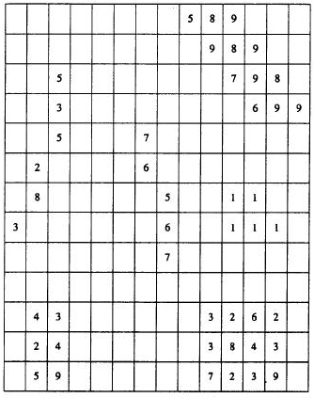
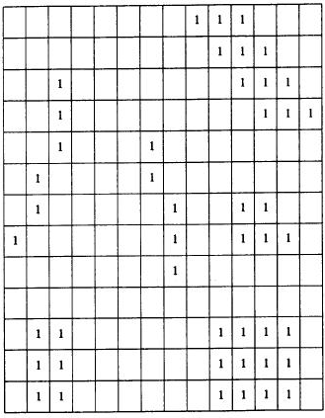
2.2 Thresholding
Figure 2.1 Original gray scale image. Pixels having no numbers have value of 0.
Figure 2.2 Thresholded gray scale image. All pixels greater than 0 are marked with a binary 1.

Slide 8
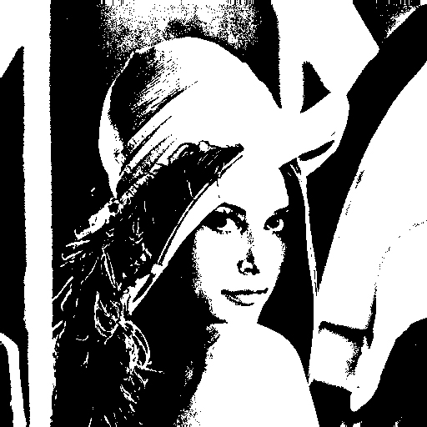
2.2 Thresholding
Lena
Notes:
灰階→取閥值→二進位影像

Slide 9
2.2 Thresholding
histogram
m spans each gray level value e.g. 0 - 255
#: operator counts the number of elements in a set
Notes:
直方圖~視覺化的分析
X為灰階影像的強度
Y則是在區域內，強度為X的數量

Slide 10
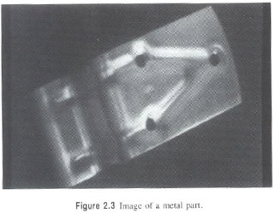
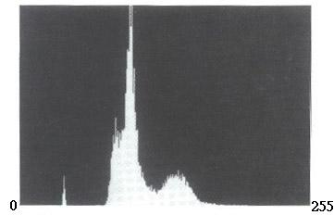
2.2 Thresholding
Figure 2.3 Image of a metal part.
Figure 2.4 Histogram of the image of Fig. 2.3. The histogram shows two dominant modes. The small mode on the left tail is not significant.
Notes:
T = 148 約在中間的波谷。

Slide 11
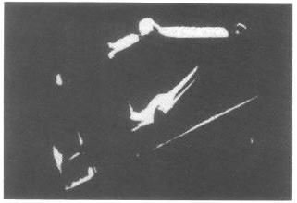
2.2 Thresholding
Figure 2.3 Image of a metal part.
Figure 2.5 Metal-part image of Fig 2.3 thresholded at gray level 148, which is in the valley between the two dominant modes.

Slide 12

2.2 Thresholding
0
255

Slide 13
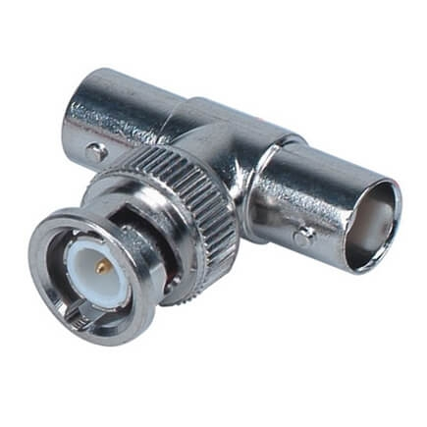
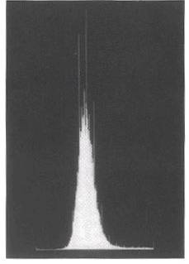
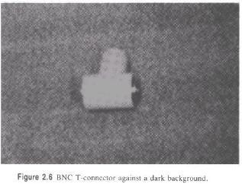
2.2 Thresholding
Figure 2.6 BNC T-connector against a dark background.
0
255
Figure 2.7 Histogram of the BNC T-connector image of Fig. 2.6.
BNC: Bayonet Neill-Concelman
Notes:
Bayonet Neill Concelman Connector (BNC)
The standard connector used to connect IEEE 802.3 10 Base2 coaxial cable to an MAU(媒體附著單元 (Media attachment unit))
用來連接IEEE 802.3 10 Base2 coaxial cable to a媒體附著單元 (Media attachment unit))
BNC公轉母T型頭：T型接頭用於連線細纜的BNC連線器和網卡。T型接頭提供信號進出的兩個電纜連線

Slide 14
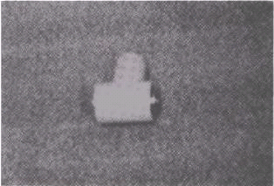
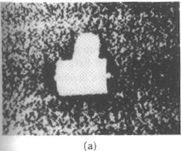
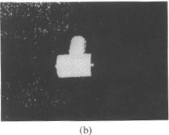
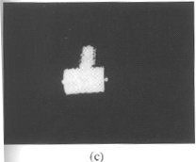
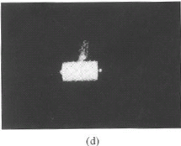
2.2 Thresholding
Figure 2.8 Image of the BNC T-connector thresholded at four levels: (a) 110, (b) 130, (c) 150, and (d) 170.

Slide 15
2.2.1 Minimizing Within-Group Variance
: histogram probabilities of
gray values
: the spatial domain of the image
Notes:
otsu

Slide 16
2.2.1 Minimizing Within-Group Variance
Within-group variance : weighted sum of group
variances
: probability for the group with values
: probability for the group with values
: variance for the group with values
: variance for the group with values
Notes:
個體變異數乘上它們的機率大小(比重)

Slide 17
2.2.1 Minimizing Within-Group Variance
find which minimizes

Slide 18
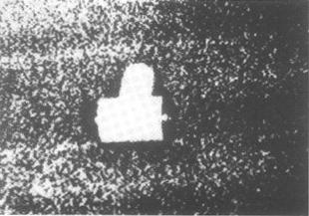
2.2.1 Minimizing Within-Group Variance
Figure 2.9 Binary image produced by thresholding the T-connector image of Fig. 2.6 with Otsu (大津) threshold.
Notes:
可是這樣的話還是會很混亂，背景的雜訊會被挑選出來
因為顆粒雜訊被歸到白色。因為相較之下雜訊比較接近物體顏色，而不是背景

Slide 19
2.2.2 Minimizing Kullback Information Distance
Kittler and Illingworth suggest a different criterion from Otsu's.
minimize the Kullback directed divergence
mixture distribution of the two Gaussians in histogram:
Notes:
Kullback directed divergence Kullback 定向差異，又稱作直接最小誤差法
他們假設
物體和背景值都是常態分佈，高斯曲線
該方法還假設兩個總體分布重疊較小同時推倒中所產生的截斷誤差可忽略
假設的 f(i) 函數與實際分布P(i)函數
當P(i) 跟 f(i) 完全符合時，entropy = 0
所以J 可以理解為我們假設的 f(i) 函數與實際分布P(i)之間相差的距離。
Kittler and Illingworth (1985) suggest a different criterion from Otsu's.
They assume that the observations come from a mixture of two Gaussian distributions having respective means and variances (𝜇1, 𝜎1^2) and (𝜇2, 𝜎2^2) and respective proportions 𝑞1 and 𝑞2.
They determine the threshold 𝑇 that results in 𝑞1, 𝑞2, 𝜇1, 𝜇2, 𝜎1, 𝜎2, which minimize the Kullback (1959) directed divergence 𝐽 from the observed histogram 𝑃(1), …, 𝑃(𝐼) to the unknown mixture distribution 𝑓.

Slide 20

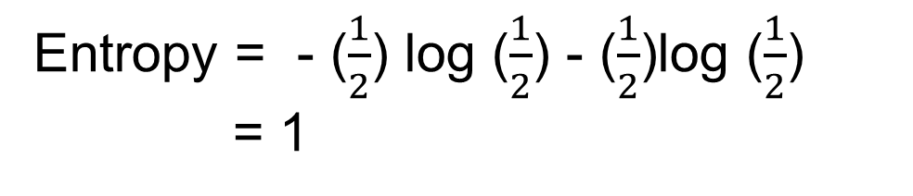
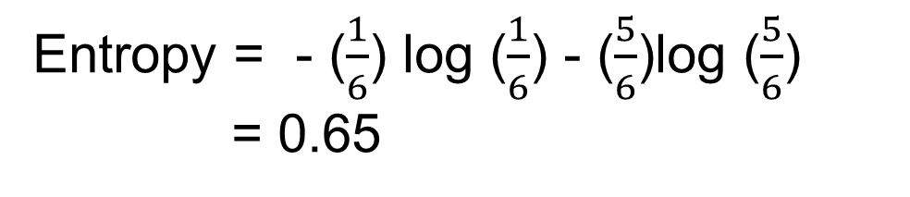
2.2.2 Minimizing Kullback Information Distance
Entropy = - ($\frac{1}{2}$) log ($\frac{1}{2}$) - ($\frac{1}{2}$)log ($\frac{1}{2}$) = 1
Entropy = - ($\frac{1}{6}$) log ($\frac{1}{6}$) - ($\frac{5}{6}$)log ($\frac{5}{6}$) = 0.65
Notes:
用 entropy 熵 ㄕㄤ 做比喻。

Slide 21
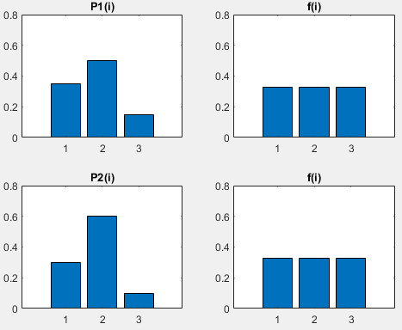
2.2.2 Minimizing Kullback Information Distance
P1 | P2 | f
0.35 | 0.3 | 0.33
0.5 | 0.6 | 0.33
0.15 | 0.1 | 0.33
J = 0.35*ln(0.35/0.33)+
0.50*ln(0.50/0.33)+
0.15*ln(0.15/0.33)
= 0.1010
J = 0.3*ln(0.3/0.33)+
0.6*ln(0.6/0.33)+
0.1*ln(0.1/0.33)
= 0.2017

Slide 22
2.2.2 Minimizing Kullback Information Distance
find which minimizes

Slide 23
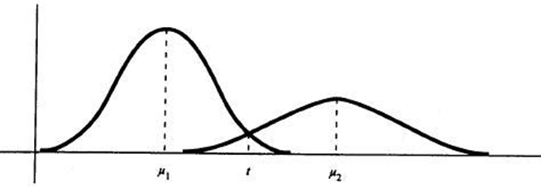



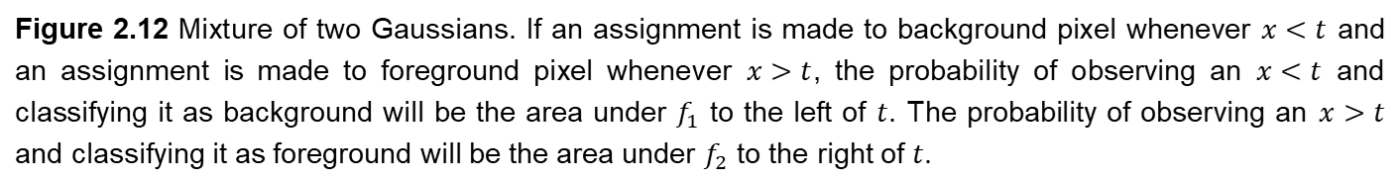
2.2.2 Minimizing Kullback Information Distance
: mean of distribution

Slide 24
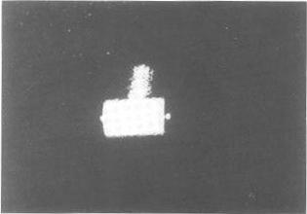
2.2.2 Minimizing Kullback Information Distance
Figure 2.10 Binary image produced by thresholding the T-connector image of Fig. 2.6 with Kittler-Illingworth threshold.

Slide 25
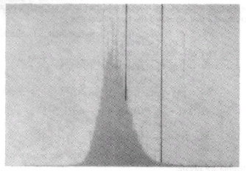
2.2.2 Minimizing Kullback Information Distance
Left dark line: Otsu
Right dark line:
Kittler-Illingworth
0
255
Figure 2.11 Histogram of the image of Fig. 2.6 showing where the Otsu and Kittler-Illingworth techniques choose the threshold value. The leftmost dark line is the Otsu threshold. The rightmost dark line is the Kittler-Illingworth threshold.
Notes:
還有更多其他種類的threshold 方法，e.g. adaptive threshold

Slide 26
2.3 Connected Components Labeling
Connected components analysis:
connected components labeling of the binary-1 pixels
property measurement of the component regions
decision making
All pixels that have value binary-1 and are connected to each other by a path of pixels all with value binary-1 are given the same identifying label.
Notes:
連通區域分析
標示在二元影像中互相連接的元素
連通區域的特性分析
做決定→ 辨識物件 物件上面的瑕疵 特徵
在一個二元影像中，所有聯通在一起的像素會給予一個相通的標籤

Slide 27
2.3 Connected Components Labeling
label: unique name, index of the region. An identifier for a potential object region
pixel property: position, gray level or brightness level
region property: shape, bounding box, position, intensity statistics
connected components labeling: a grouping operation
Notes:
Term explanation
Bounding box?
標籤：獨特的名字或是索引。作為具有潛在目標區域的辨識碼
像素的屬性：位置以及含有灰階或是亮度資訊
區域的屬性：形狀，邊界框、位置、強度統計資訊
總結：連通區域分析是一個分組的行為

Slide 28
2.3.1 Connected Components Operators
Two 1-pixels and belong to the same
connected component if there is a sequence of
1-pixels of where
and is a neighbor of for
Notes:
Definition
當有一個序列的像素p0-pn組成的連通元素C
P0=P
Pn=Q
而且P1到Pn互相為鄰居
那我們就會說P跟Q是位於同一個連通元素C

Slide 29
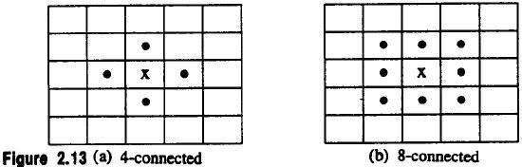
2.3.1 Connected Components Operators
4-connected: north, south, east, west
8-connected: north, south, east, west,
northeast, northwest, southeast, southwest
Figure 2.13 (a) 4-connected (b) 8-connected
Border: subset of 1-pixels also adjacent to 0-pixels
Notes:
To explain what neighborhood is
鄰居的定義有下列的兩種
4連接或8連接

Slide 30
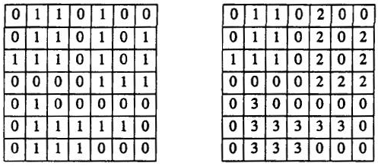
2.3.1 Connected Components Operators
Figure 2.14 (a) Original image (b) connected components
Notes:
Example
只有 (a) 的 (r, c) = (7,3) 不是border

Slide 31
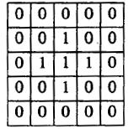
2.3.1 Connected Components Operators
Rosenfeld has shown that
if C is a component of 1s and
D is an adjacent component of 0s
and
if 4-connectedness is used for 1 (/0) -pixels and
8-connectedness is used for 0 (/1) -pixels
then either C surrounds D (D is a hole in C) or
D surrounds C (C is a hole in D)
Notes:
theory

Slide 32
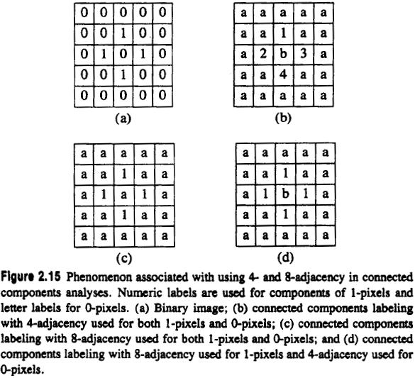
0 : 4-connected
1 : 4-connected
0 : 8-connected
1 : 8-connected
0 : 4-connected
1 : 8-connected
Figure 2.15 Phenomenon associated with using 4- and 8-adjacency in connected components analyses. Numeric labels are used for components of 1-pixels and letter labels for 0-pixels. (a) Binary image; (b) connected components labeling with 4-adjacency used for both 1-pixels and 0-pixels; (c) connected components labeling with 8-adjacency used for both 1-pixels and 0-pixels; and (d) connected components labeling with 8-adjacency used for 1-pixels and 4-adjacency used for 0-pixels.
Notes:
Phenomenon:現象
example
:

Slide 33
2.3.2 Connected Components Algorithms
All the algorithms process a row of the image at a time
All the algorithms assign new labels to the first pixel of each component and attempt to propagate the label of a pixel to right or below neighbors
This process continues until the pixel marked A in row 4 encountered

Slide 34
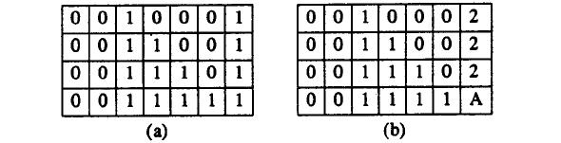
2.3.2 Connected Components Algorithms
Figure 2.16 Propagation process. Label 1 has been propagated from the left to reach pixel A. Label 2 has been propagated down to reach pixel A. The connected components algorithm must assign a label to A and make labels 1 and 2 equivalent. Part (a) shows the original binary image, and (b) the partially processed image.
Notes:
Principle & stop condition
Propagate 停止
Row →
任何的演算法皆是要將自己的標籤開始於第一個碰到的像素，並且試著向右傳或是向下傳遞標籤
而這個行為當兩個不同位置的標籤相接的時候結束

Slide 35
2.3.2 Connected Components Algorithms
The differences among the algorithms of three types:
What label should be assigned to pixel A?
How to keep track of the equivalence of two or more labels?
How to use the equivalence information to complete processing?
Notes:
Issue
連通元素演算法之間的差異
衝突點A用什麼標籤
如何記錄相同元素的不同標籤
如何利用相同資訊完成程序

Slide 36
2.3.2 Connected Components Algorithms
An Iterative Algorithm
The Classical Algorithm (Transitive Closure)
A Space-Efficient Two-Pass Algorithm That Uses a Local Equivalence Table
An Efficient Run-Length Implementation of the Local Equivalence Table Method
Notes:
table

Slide 37
2.3.3 An Iterative Algorithm
Step 1. initialization of each pixel to a unique label
Step 2. iteration of top-down followed by bottom-up passes until no change
Notes:
Algorithm’s flow
Top-down left-right followed by bottom-up right-left
缺點: 慢、迭代可能不只一次。

Slide 38
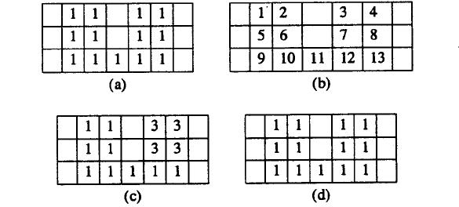
Figure 2.17 Iterative algorithm for connected components labeling. Part (a) shows the original binary image; (b) the results after initialization of each 1-pixel to a unique label; (c) the results after the first top-down pass, in which the value of each nonzero pixel is replaced by the minimum value of its nonzero neighbors in a recursive manner going from left to right and top to bottom; and (d) the results after the first bottom-up pass.
Notes:
Why can’t just one iterative
Jump to 35(ori) 36(after top-down)=>12與7的交界處

Slide 39
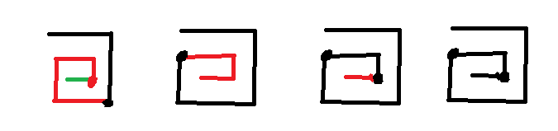
2.3.3 An Iterative Algorithm
Example:
iteration: 1 2 3 4

Slide 40
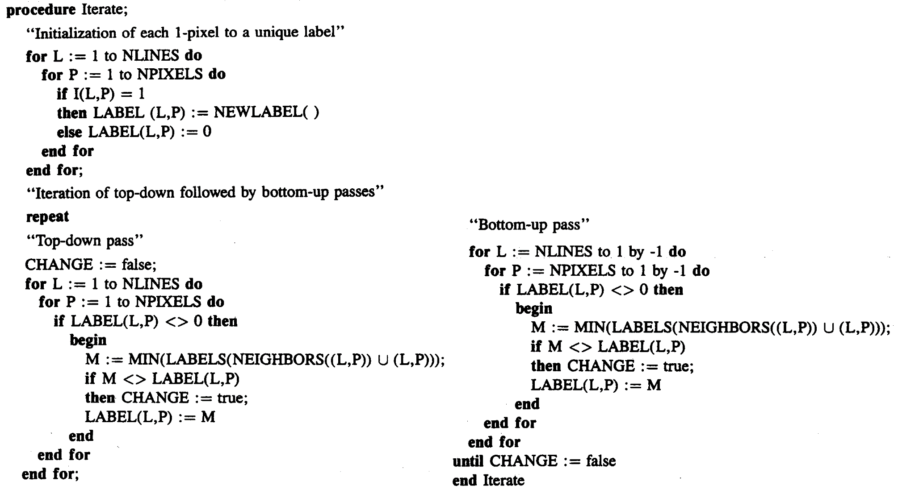
2.3.3 An Iterative Algorithm
1.
2.

Slide 41
2.3.4 The Classical Algorithm
makes two top-down passes but requires a large global table for equivalences
first top-down pass: performs label propagation as iterative algorithm.
when two different labels propagate to the same pixel, the smaller label propagates and equivalence entered into table
equivalence classes are found by transitive closure
second top-down pass: performs a translation
Notes:
Two top-down phase
First phase: assign label and establish equ_table
mid-phase: find equivalence classes
Second phase: change label according to equ_label

Slide 42
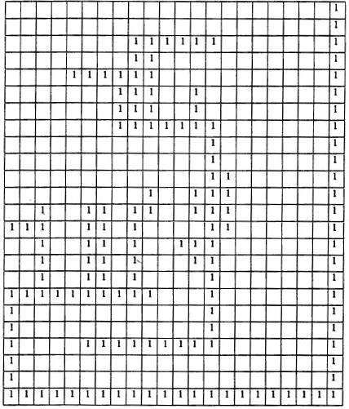
2.3.4 The Classical Algorithm
Figure 2.18 Classical connected components labeling algorithm: (a) shows the initial binary image

Slide 43
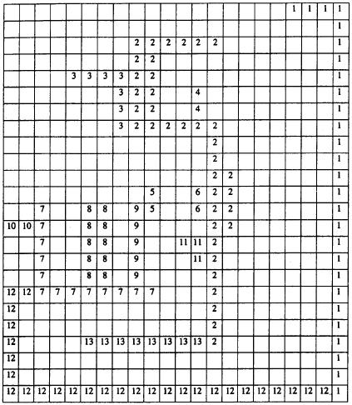
(2,3)
(2,4)
(2,6)
(2,11)
(2,13)
(5,9)
(7,10)
(7,12)
(7,8)
(7,9)
(1,12)
Figure 2.18 Classical connected components labeling algorithm: (b) the labeling after the first top-down pass of the algorithm. The equivalence classes found are 1: { 1,12,7,8,9,10,5 } and 2: { 2,3,4,6,11,13 }

Slide 44
2.3.4 The Classical Algorithm
main problem: global equivalence table may be
too large for memory
Notes:
Problem
有可能演算法要燒到電路板，希望可以節省 memory

Slide 45
2.3.5 A Space-Efficient Two-Pass Algorithm That Uses a Local Equivalence Table
Small table stores only equivalences from current and preceding lines
Maximum number of equivalences = image width
Relabel each line with equivalence labels when equivalence detected
Notes:
Top-down then bottom-up

Slide 46
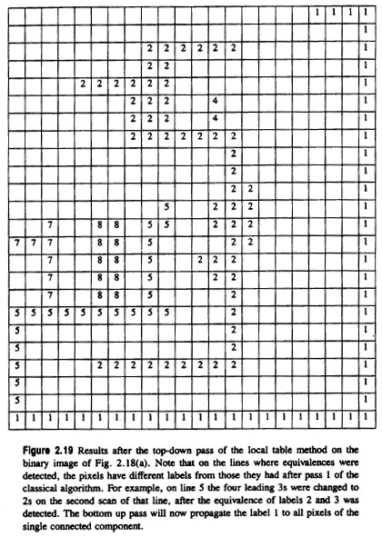
3 → 2
6 → 2
9 → 5
10 → 7
12 → 7
7 → 5
13 → 2
Figure 2.19 Results after the top-down pass of the local table method on the binary image of Fig. 2.18(a). Note that on the lines where equivalences were detected, the pixels have different labels from those they had after pass 1 of the classical algorithm. For example, on line 5 the four leading 3s were changed to 2s on the second scan of that line, after the equivalence of labels 2 and 3 was detected. The bottom up pass will now propagate the label 1 to all pixels of the single connected component.
Notes:
直接reassign，沒必要在一個 equivalence class 中 maintain 多餘的 label
Equivalence table 每進行一列就會忘記前一次的 eq table 的內容，以節省記憶體。

Slide 47
2.3.6 An Efficient Run-Length Implementation of the Local Table Method
run-length encoding: transmits lengths of runs
of zeros and ones
Example: 11111000110001→ [5, 3, 2, 3,1]
RUN | START | END
1 | 1 | 5
2 | 9 | 10
3 | 14 | 14
Notes:
之前的方法，對於每個單獨的pixel 都access 太多次了。

Slide 48
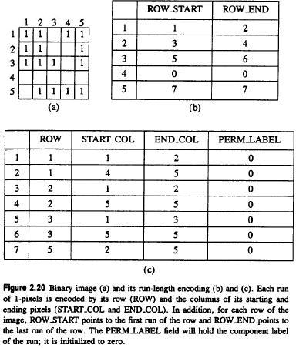
run 1
run 2
run 7
run number
Figure 2.20 Binary image (a) and its run-length encoding (b) and (c). Each run of 1-pixels is encoded by its row (ROW) and the columns of its starting and ending pixels (START_COL and END_COL). In addition, for each row of the image, ROW_START points to the first run of the row and ROW_END points to the last run of the row. The PERM_LABEL field will hold the component label of the run; it is initialized to zero.
PERM_LABEL : permanent label
Notes:
Original picture
Label number start and end

Slide 49
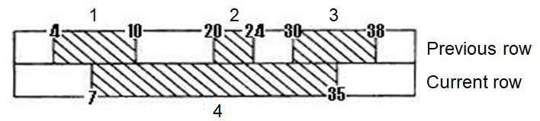
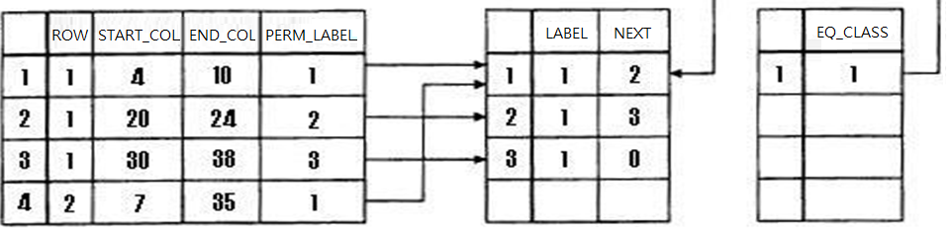
LABEL/NEXT array
EQ_CLASS array
Figure 2.21 Data structures used for keeping track of equivalence classes. In this example, run 4 has PERM_LABEL 1, which is an index into the LABEL array, that gives the equivalence class label for each possible PERM_LABEL value. In the example, PERM_LABELS 1,2, and 3 have all been determined to be equivalent, so LABEL(1), LABEL(2), and LABEL(3) all contain the equivalence class label, which is 1. Furthermore, the equivalence class label is an index into the EQ_CLASS array that contains pointers to the beginnings of the equivalence classes that are linked lists in the LABEL/NEXT structure. In this example there is only one equivalence class, class 1, and three elements of the LABEL/NEXT array are linked together to form this class.
Notes:
Mid-table: LABEL/NEXT array
Right-table: EQ_CLASS array
EQ_class : 存同一個 equivalence class 起始的label
其實可用資料結構的 set 來取代。

Slide 50
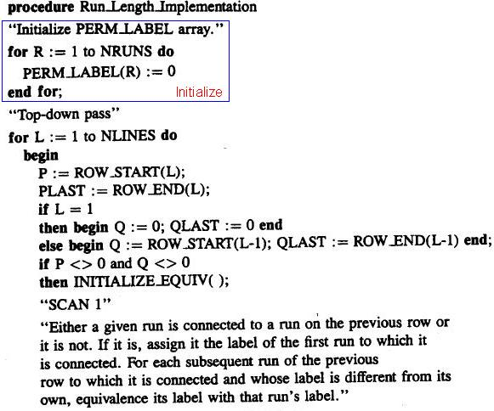
2.3.6 An Efficient Run-Length Implementation of the Local Table Method

Slide 51
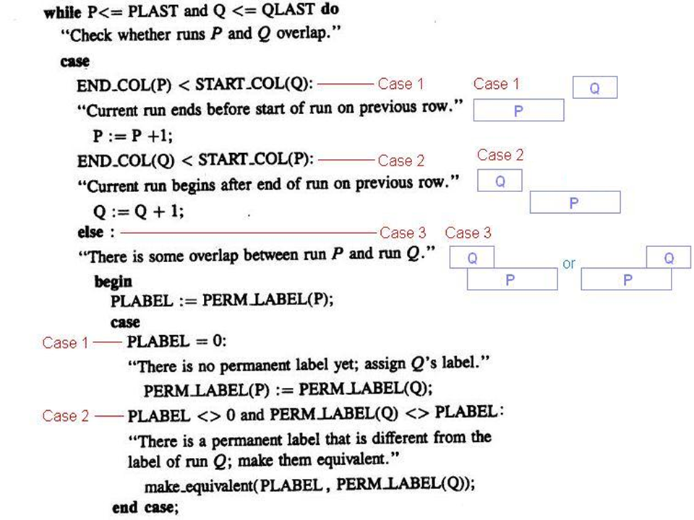

Slide 52
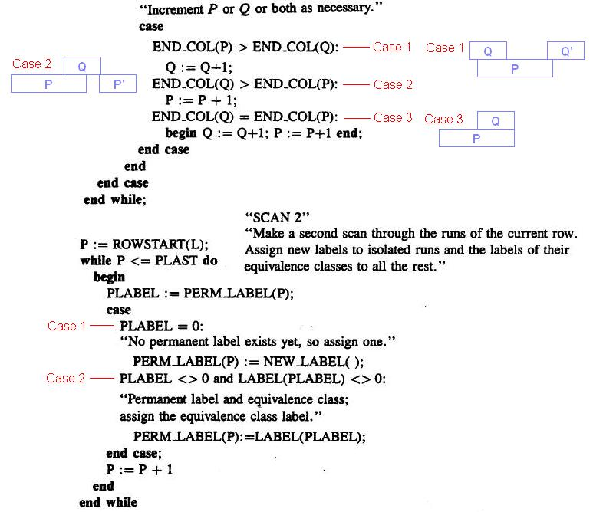

Slide 53
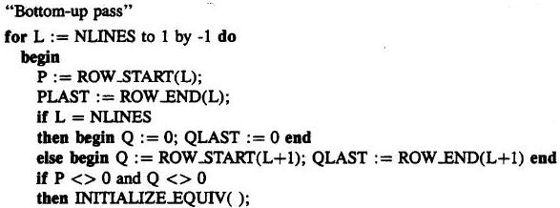
2.3.6 An Efficient Run-Length Implementation of the Local Table Method

Slide 54
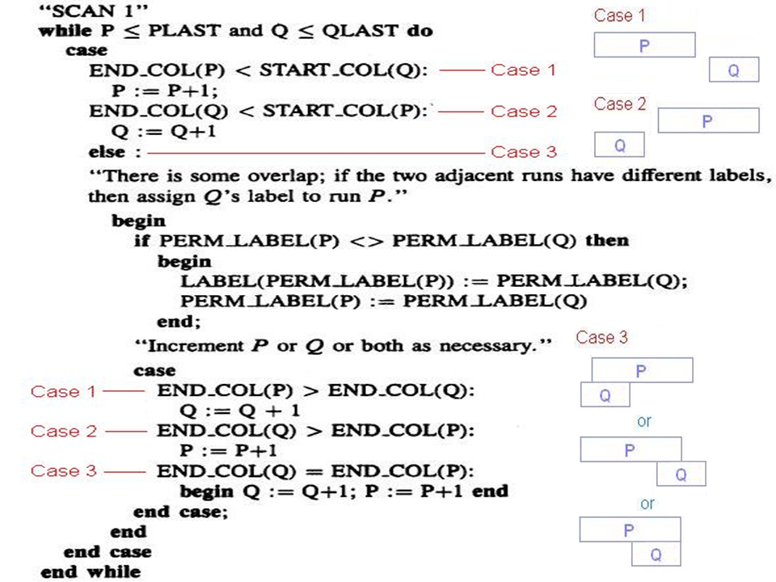

Slide 55
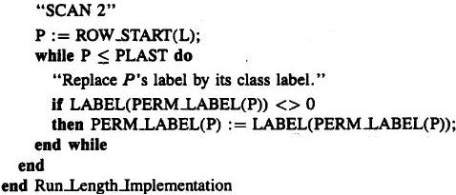
2.3.6 An Efficient Run-Length Implementation of the Local Table Method

Slide 56
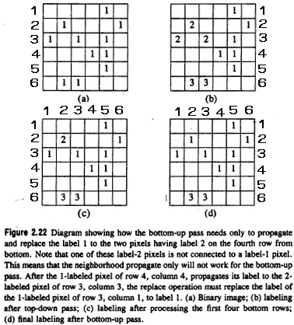
Figure 2.22 Diagram showing how the bottom-up pass needs only to propagate and replace the label 1 to the two pixels having label 2 on the fourth row from bottom. Note that one of these label-2 pixels is not connected to a label-1 pixel. This means that the neighborhood propagate only will not work for the bottom-up pass. After the 1-labeled pixel of row 4, column 4, propagates its label to the 2-labeled pixel of row 3, column 3, the replace operation must replace the label of the 2-labeled pixel of row 3, column 1, to label 1. (a) Binary image; (b) labeling after top-down pass; (c) labeling after processing the first four bottom rows; (d) final labeling after bottom-up pass.

Slide 57
2.4 Signature Segmentation and Analysis
signature: histogram of the nonzero pixels of the resulting masked image
signature: a projection
projections can be vertical, horizontal, diagonal, circular, radial…

Slide 58
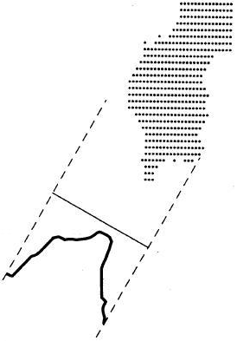
Figure 2.23 Diagonal projection of a shape. The direction of the projection is 45° counterclockwise from the column axis.

Slide 59
2.4 Signature Segmentation and Analysis
vertical projection of a segment:
column between
horizontal projection: row between
vertical and horizontal projections define a rectangle
and
Notes:
S, t : rectangle 的左右邊界
U,v : rectangle 的上下邊界

Slide 60
2.4 Signature Segmentation and Analysis
segment the vertical and horizontal projections
treat each rectangular subimage as the image

Slide 61
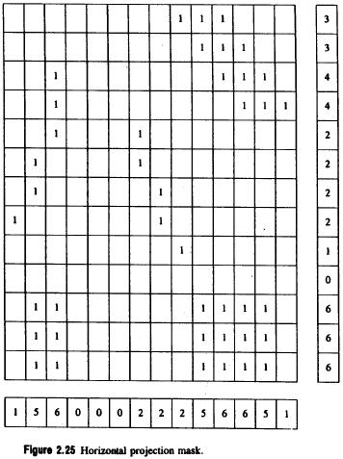
2.4 Signature Segmentation and Analysis
Figure 2.25 Vertical and horizontal projections.

Slide 62
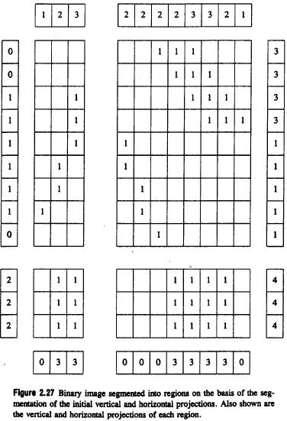
Figure 2.27 Binary image segmented into regions on the basis of the segmentation of the initial vertical and horizontal projections. Also shown are the vertical and horizontal projections of each region.

Slide 63
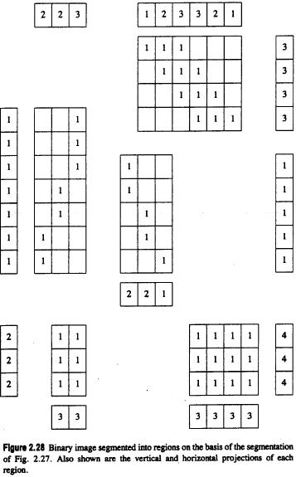
Figure 2.28 Binary image segmented into regions on the basis of the segmentation of Fig. 2.27. Also shown are the vertical and horizontal projections of each region.

Slide 64

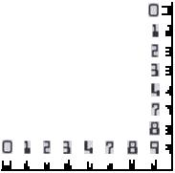
2.4 Signature Segmentation and Analysis
OCR: Optical Character Recognition
MICR: Magnetic Ink Character Recognition
Notes:
Magnetic ink character recognition

Slide 65
2.4 Signature Segmentation and Analysis
Diagonal projections:
: from upper left to lower right
: from upper right to lower left
object area: sum of all the projections values in the segment

Slide 66
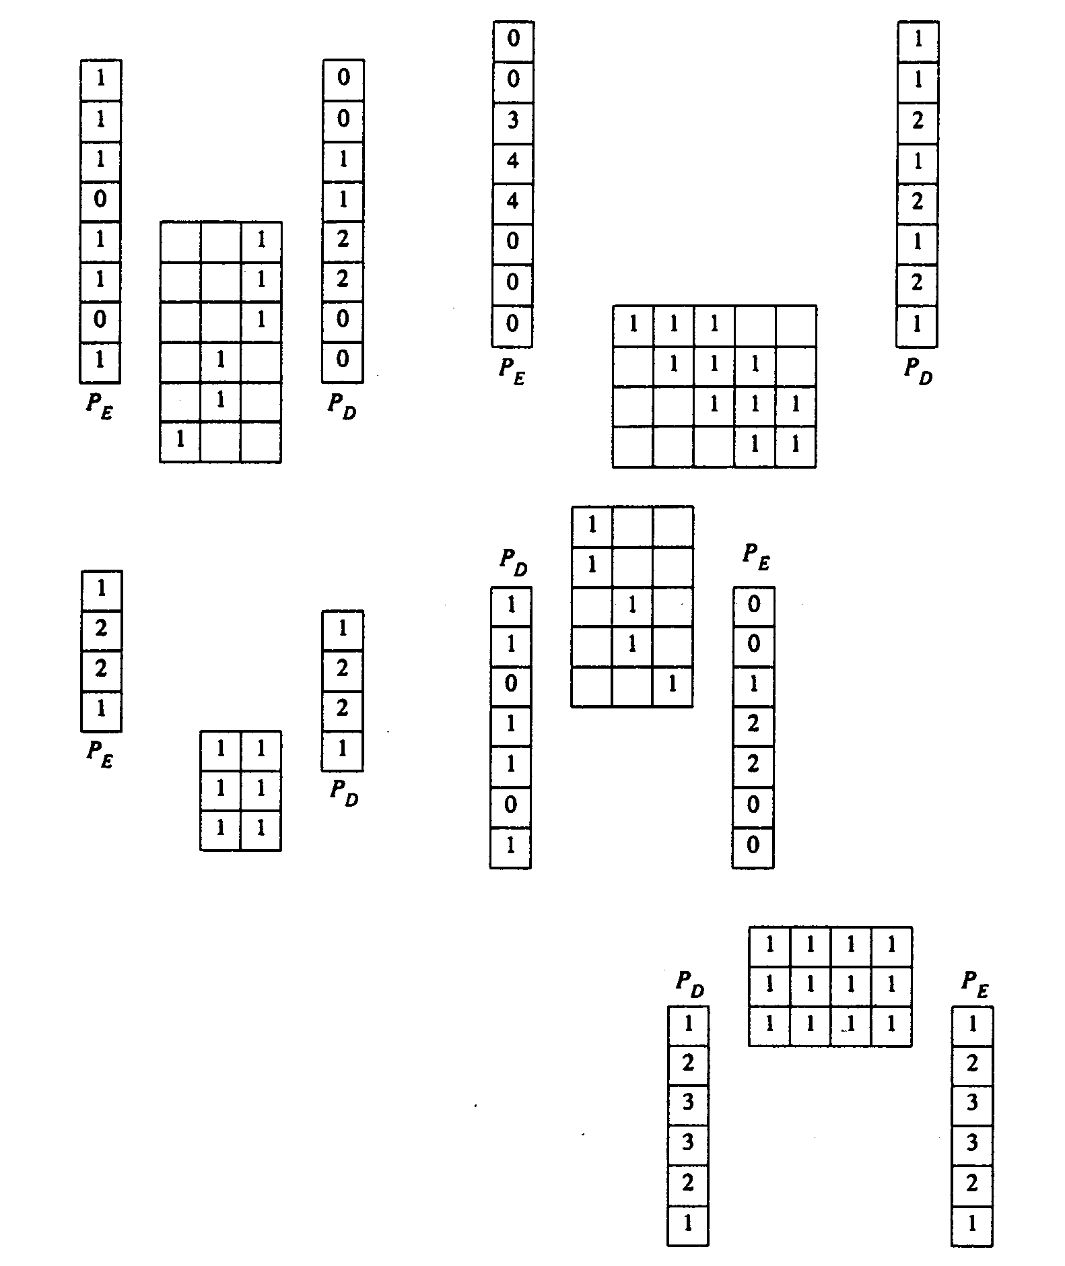
Figure 2.29 Diagonal projections P_{D} and P_{E} for each of the five image regions of Fig. 2.28. P_{D} is the diagonal projection taken 45° clockwise from the horizontal. P_{E} is the diagonal projection taken 135° clockwise from the horizontal.

Slide 67
Project due Oct. 6
Write a program to generate:
a binary image (threshold at 128)
a histogram
connected components (regions with + at centroid, bounding box)

Slide 68
這裡什麼都沒有，反白也絕對不會有什麼白色的字
舉兩種connected component labeling ，以及他們的傳播方向、次數與其特色。
Signature segmentation 可以有什麼切法，舉兩種
舉出兩種你所知道的thresholding 演算法

