Slide 1
Curtailment OPTIMIZATION analysis
made by Dimitris Zanganas
Athens, October 2024

Slide 2
Data preprocessing & cleaning
Conducted data preprocessing to structure and organize the dataset for analysis.
Completed data cleaning to remove inconsistencies, missing values, duplicated rows and outliers.
Applied rules to filter out rows based on specific criteria, ensuring only relevant data remains for analysis:
Resources were selected for curtailment (difference between LR_LFCMX and SETPOINT_BINOUT is greater than 1)
Exclude rows where the wind resource cannot receive (WINDC_ON = 0 or WINCSUSP = 1) a curtailment BINOUT command
Ensure the SCADA feedback value (SCADA_SETPOINT_FB) is slightly less than the SETPOINT_BINOUT due to cable losses (difference ≤ 2)
Exclude rows where resources have a problem or are switched off (GROSS_VALUE ≤ 0.1).
Exclude rows where LR_LFCMX is zero.

Slide 3
Datasets description June - September
The table includes the final data we analyzed after the preprocessing and data cleaning.
Initial # of rows for both datasets: 1048575
JUNE
Final # of rows | # of PV | # of WIND | # of total assets
162501 | 40 | 123 | 163
Total of 163 - 174 (June-Sept) assets (10 assets from June’s dataset and 8 assets from September’s)
SEPTEMBER
Final # of rows | # of PV | # of WIND | # of total assets
353040 | 45 | 129 | 174
Columns used for identification:
DEVICE_B1_NAME
DEVICE_B2_NAME
DEVICE_B3_NAME
DEVICE_SCADA_B2_NAME
DEVICE_SCADA_B3_NAME
RES_TYPE

Slide 4
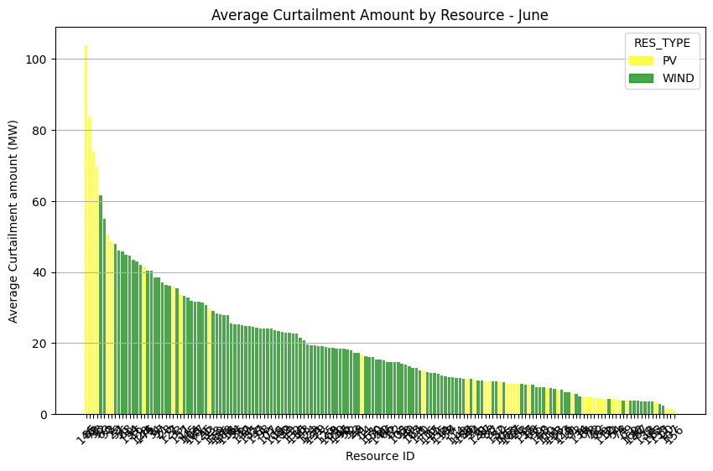
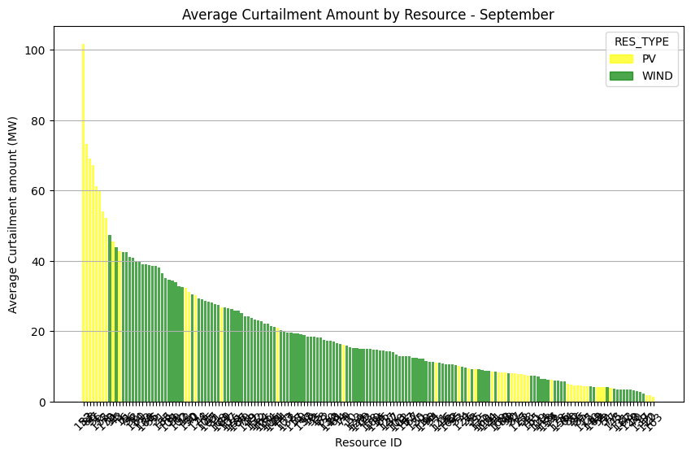
Average Curtailment Amount by Resource (JUNE-SEPT)
Curtailment amount = GROSS_VALUE – SCADA_SETPOINT_FB
Average Curtailment amount = MEAN(GROSS_VALUE – SCADA_SETPOINT_FB)
Sorted barplot from the asset with the highest curtailment to the lowest
JUNE
SEPT

Slide 5
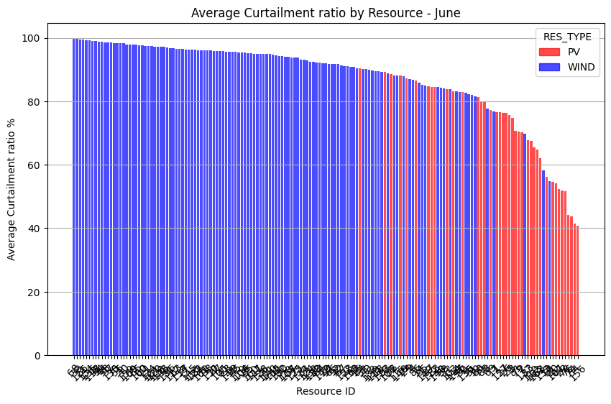
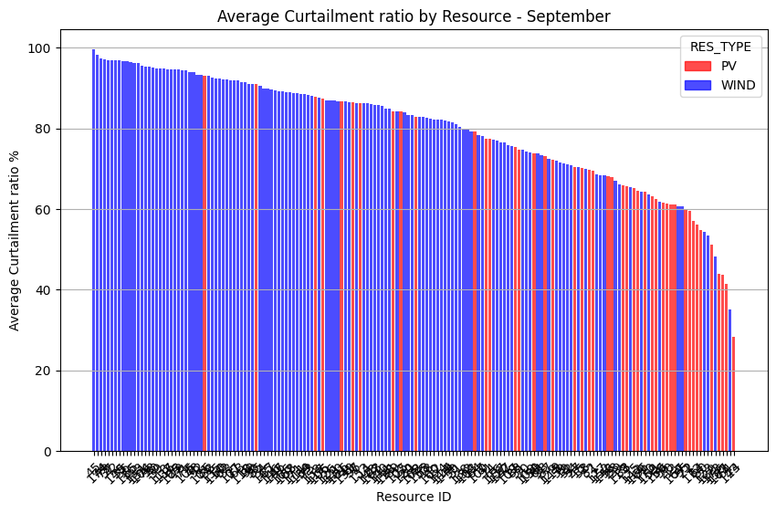
Average Curtailment ratio by Resource (JUNE-SEPT)
Average Curtailment RATIO = MEAN( Curtailment amount / GROSS_VALUE) *100%
Sorted barplot from the asset with the highest curtailment ratio to the lowest
JUNE
SEPT

Slide 6
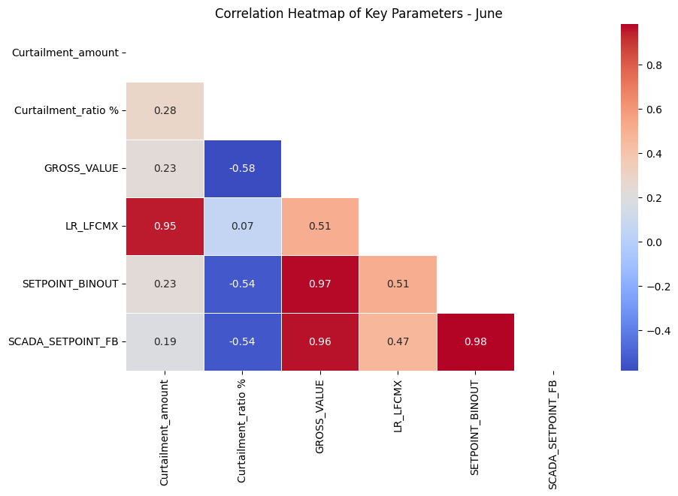
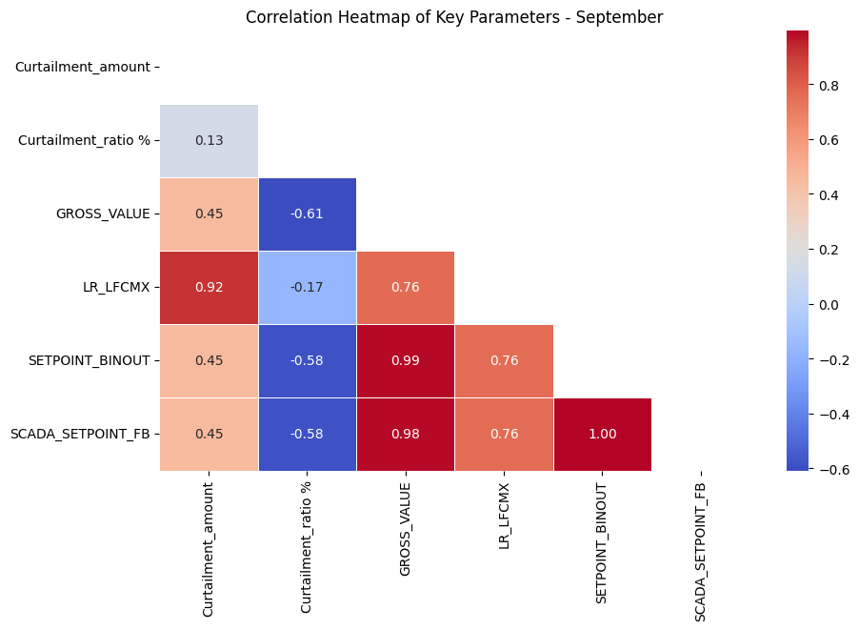
Correlation heatmaps (JUNE - SEPT)
JUNE
SEPT

Slide 7
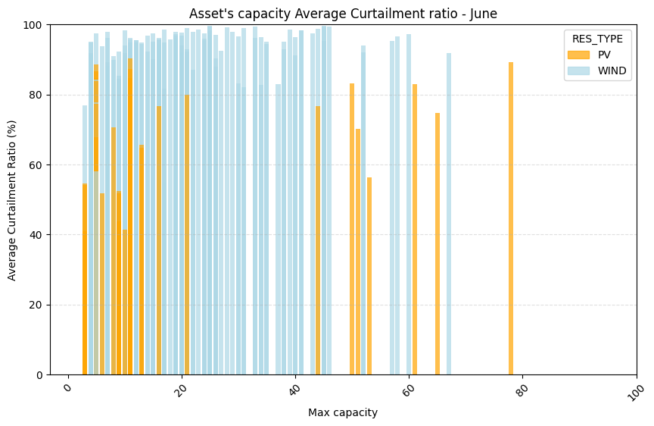
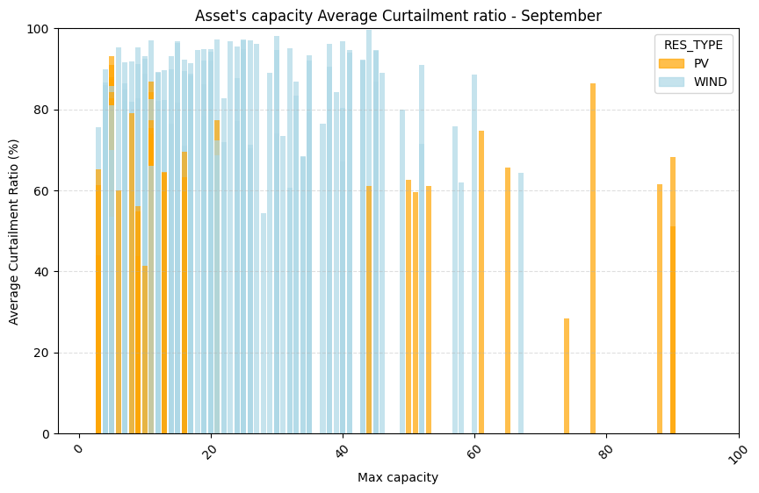
Average Curtailment ratio by Max capacity (JUNE-SEPT)
The average curtailment ratio by asset’s max capacity is displayed
JUNE
SEPT

Slide 8
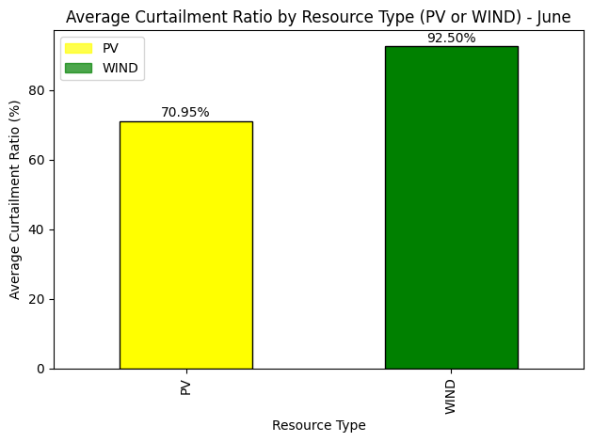
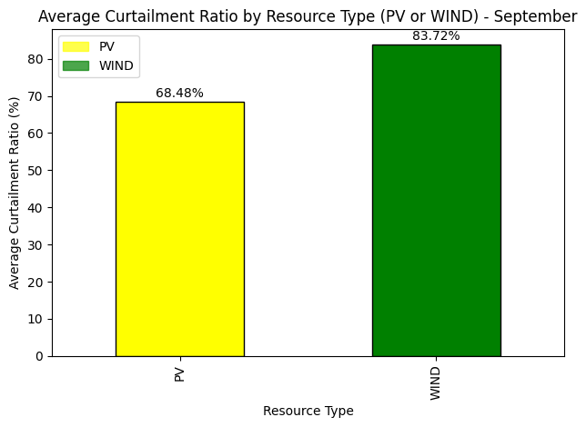
Average Curtailment Ratio by Resource Type
The average curtailment ratio for both resource types PV and WIND
JUNE
SEPT

Slide 9
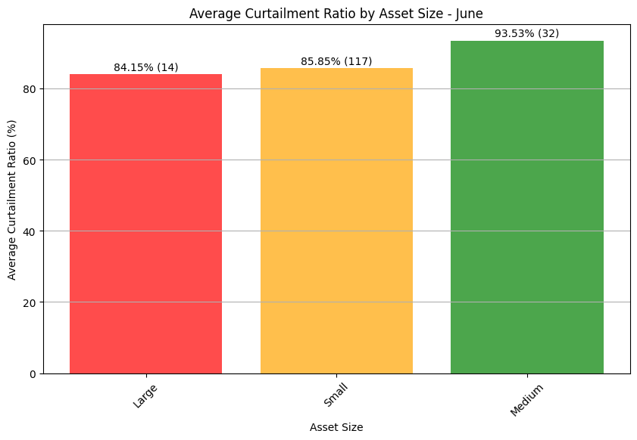
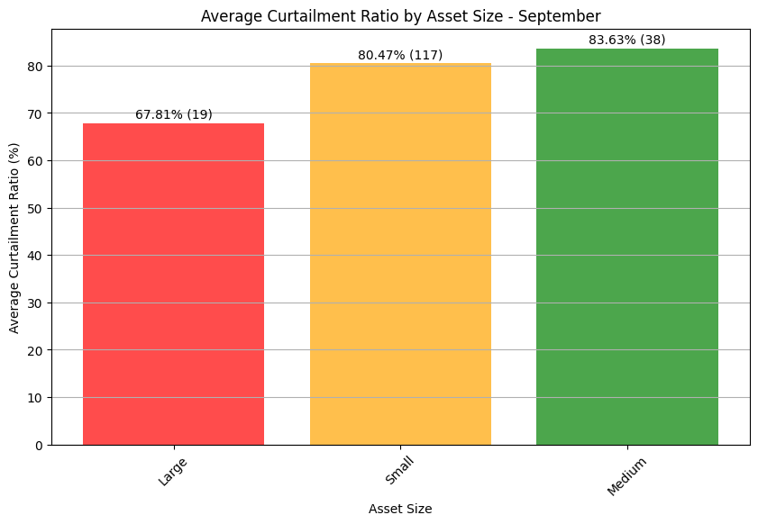
Average curtailment ration by size group (1)
Assets were divided in 3 categories based on their capacities (June- September):
Small: 1-25 MW (117 - 117 assets)
Medium: 25-50 MW (32 - 38 assets)
Large: 50-100 MW (14 - 19 assets)
Sorted barplot (ascending) from the group with the lowest curtailment ratio to the highest
JUNE
SEPT

Slide 10
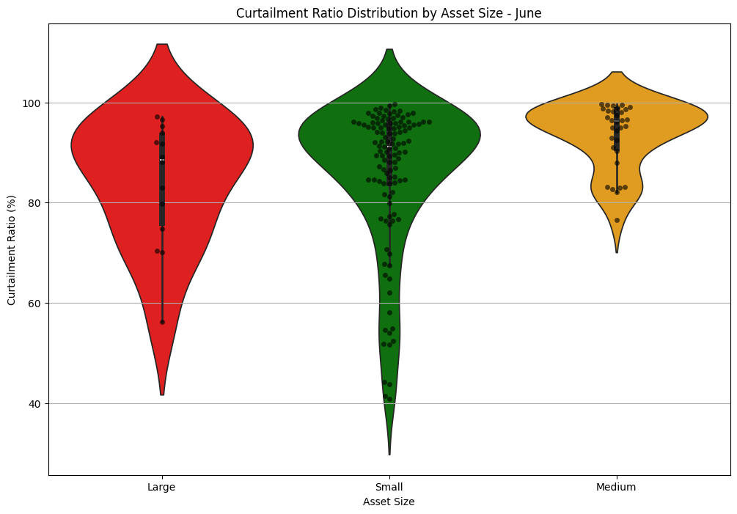
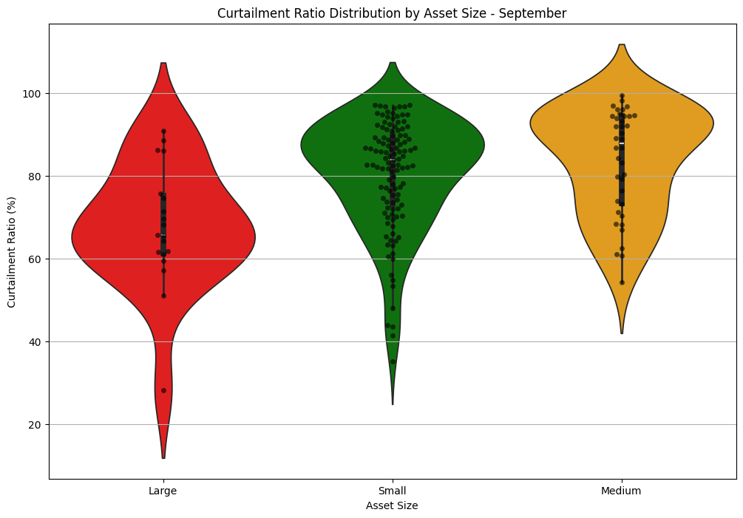
Data preprocessing & cleaning
JUNE
JUNE
Small: 1-25 MW (117 assets)
Medium: 25-50 MW (32 assets)
Large: 50-100 MW (15 assets)
SEPT
SEPT
Small: 1-25 MW (117 assets)
Medium: 25-50 MW (38 assets)
Large: 50-100 MW (19 assets)
Notes:
Unequal Treatment of Assets with the Same Size:
Small: The distribution of curtailment ratios varies, with some small assets experiencing much less curtailment compared to others.
Medium: Curtailment is more evenly distributed, showing fairer treatment across assets.
Large: Some large assets are favored with less curtailment, leading to unequal treatment.

Slide 11
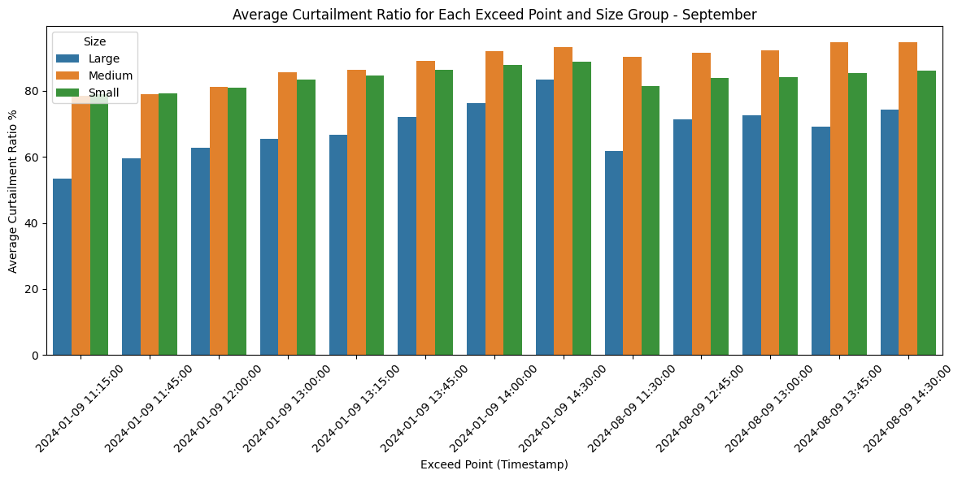
Average curtailment ratio for each exceed point (SEPT) by size
Exceed points are the timestamps where: AVAILABLE_GENERATION > RES_LIMIT (Total: 145 points in the 15_min dataset, 31 on JUNE 13 on SEPT)
Theoretically this is the point in which the controller should send a curtailment command and choose assets for generation reduction
The bar plot shows what curtailment ratio performed the next 15 minutes after the exceed point for each size group
Notes:
Curtailment ratios 15 minutes after exceeding points (RES_limit < AVAILABLE_GENERATION)
Privilege order: Large > Small > Medium
Key insight: Large assets experience less curtailment while medium more than small

Slide 12
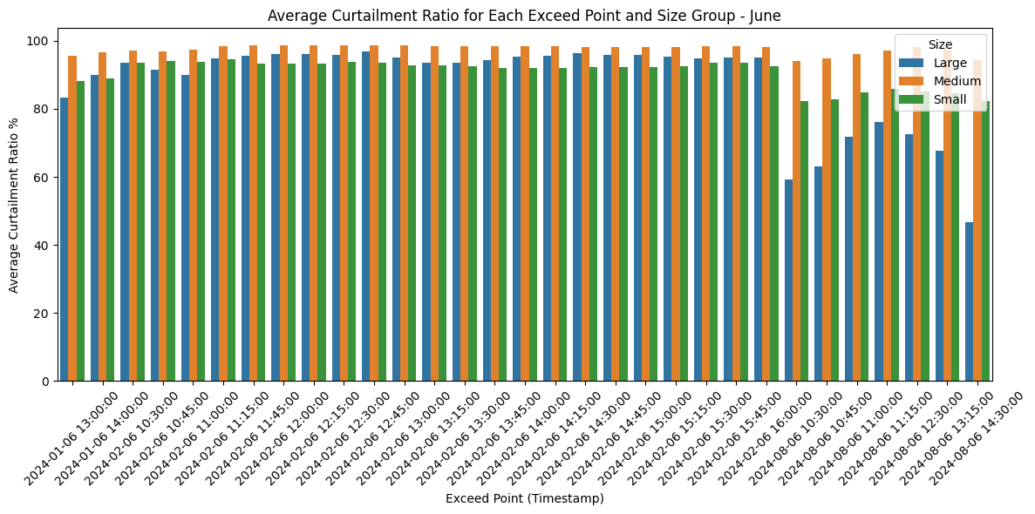
Average curtailment ratio for each exceed point (JUNE)
Exceed points on 02/06!
Exceed points on 08/06!
Notes:
Curtailment ratios 15 minutes after exceeding points (RES_limit < AVAILABLE_GENERATION)
Privilege order: Large > Small > Medium
Key insight: Large assets experience less curtailment while medium more than small

Slide 13
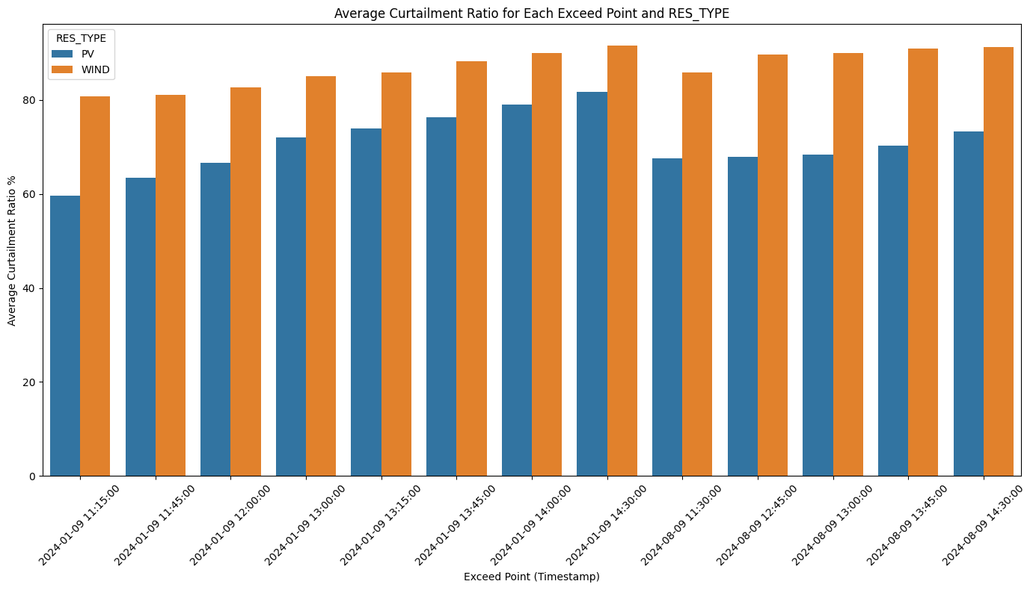
Average curtailment ratio for each exceed point (SEPT) by RES
The bar plot shows the curtailment ratio performed the next 15 minutes after the exceed point for each resource type
Notes:
Curtailment ratios 15 minutes after exceeding points (RES_limit < AVAILABLE_GENERATION)
Privilege order: PV > WIND
Key insight: PV assets experience less curtailment

Slide 14
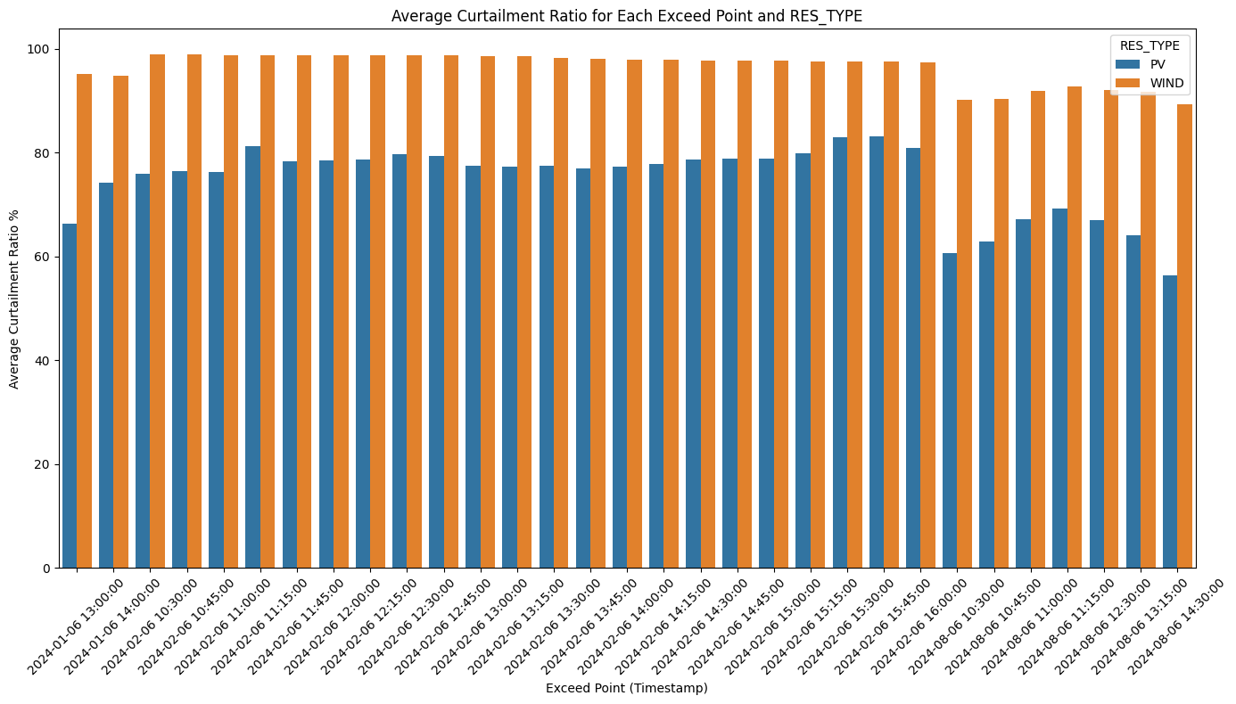
Average curtailment ratio for each exceed point (JUNE) by RES
Exceed points on 02/06!
Exceed points on 08/06!

Slide 15
Conclusions (1)
Curtailment Ratio by Month:
June: Curtailment ratios ranged from 40% to 100%.
September: For all assets, the curtailment ratio ranged from 25% to 100%.
We observe high curtailment ratios in WIND resource type probably because the of prioritizing PV assets leaving the WIND assts curtailed.
SCADA System Effectiveness: The SCADA system functions as expected, with SCADA setpoints accurately following the curtailment levels set by the curtailment application controller (strong correlation in the heatmap between SETPOINT_BINOUT and SCADA_SETPOINT_FB )
Curtailment ratio % vs. Max Capacity: There is a slightly inverse correlation in the period of September. This means that larger assets are slightly more privileged during this month
Unequal Curtailment Treatment Across Asset Sizes:
June: Medium assets face higher curtailment ratios than small, and large, with large to face the lowest curtailment.
September: Same applies in this month with large assets to face less curtailment
Notes:
Curtailment ratios 15 minutes after exceeding points (RES_limit < AVAILABLE_GENERATION)
Privilege order: PV > WIND
Key insight: PV assets experience less curtailment

Slide 16
Conclusions (2)
Unequal Curtailment treatment across asset sizes in exceeding points:
In both months, large assets experience less curtailment ratio, while medium capacity assets more than small (Large > Small > Medium)
The point here is that even if the curtailment is not equal, it can be reasonable for the order to be like: Small > Medium > Large
Unequal Curtailment treatment across RES type in exceeding points:
In both months, PV assets experience less curtailment compared to WIND assets

Slide 17
Thank you
Athens, October 2024

