Slide 1
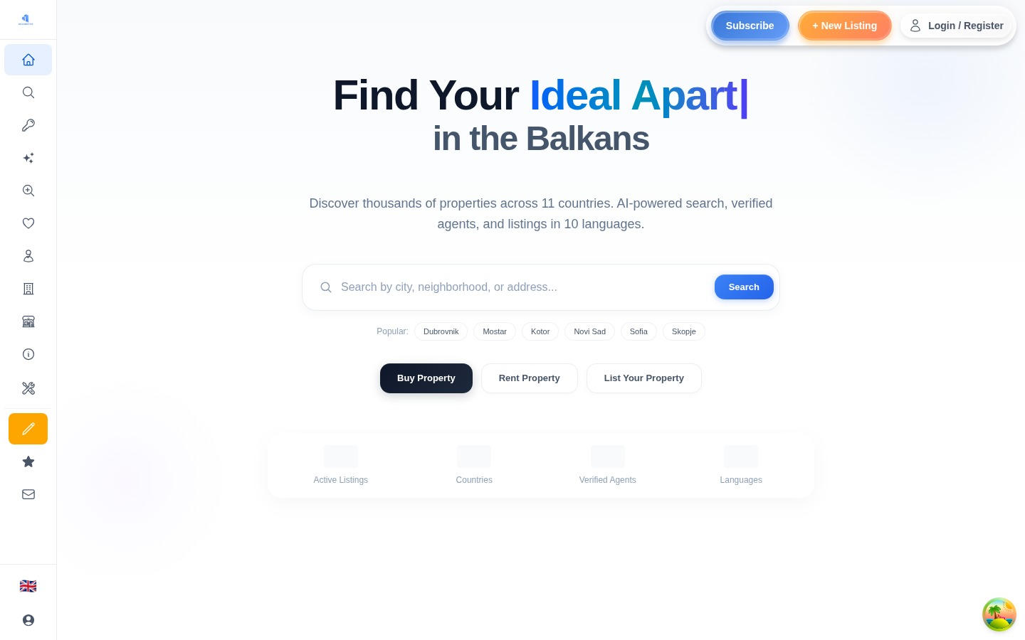
B
BalkanEstate
Investor Overview · 2025
Real Estate for
Southeast Europe
One platform. 10 countries. 10 languages.
Buyers, sellers, and agents — all connected.
10
10
100%
Countries
Languages
Live
Zani Dalipi · zanoin@gmail.com · balkanestate.com

Slide 2
The Problem
Southeast Europe's Real Estate
Market is Broken
€15B+
Market TAM
Millions of buyers and sellers — zero unified platform. Every country has its own fragmented portals, language barriers, and trust issues.
40M+
🗺️
Fragmented Markets
🌐
Language Barriers
10 countries, 40+ separate portals — no cross-border search exists
Listings only in local language — foreign buyers left out entirely
Households
❓
No Trust Layer
📵
No Digital Tools
Zero
Unverified agents, no reviews, no accountability — fraud is rampant
No AI valuations, no mortgage calculators, no instant messaging
Unified
Portal

Slide 3
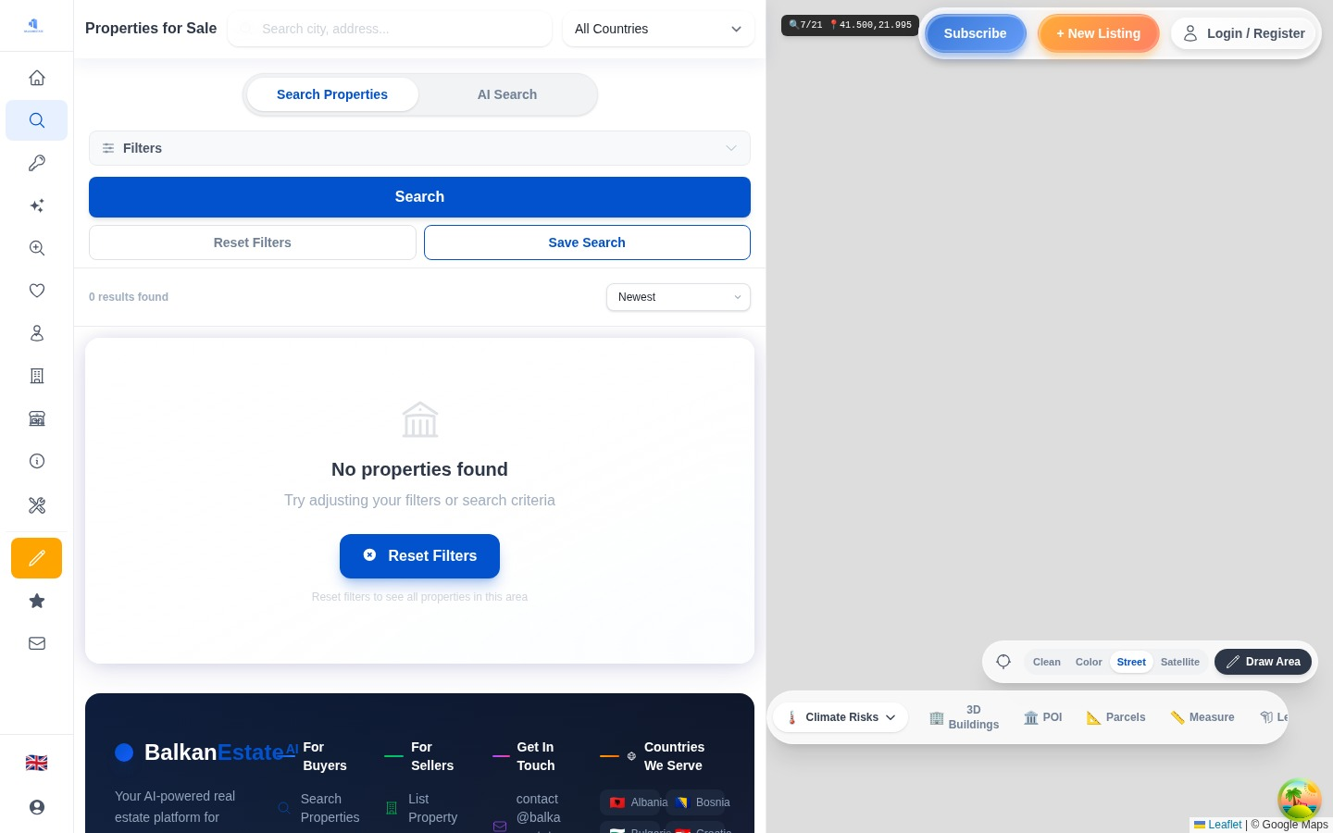
The Solution
One Platform.
Every Market. Every Language.
🔍
🏠
🤖
💬
Smart Search
Rich Listings
AI Valuation
Live Chat
🧮
📱
🌍
✅
Mortgage Calc
PWA App
10 Languages
Verified Agents

Slide 4
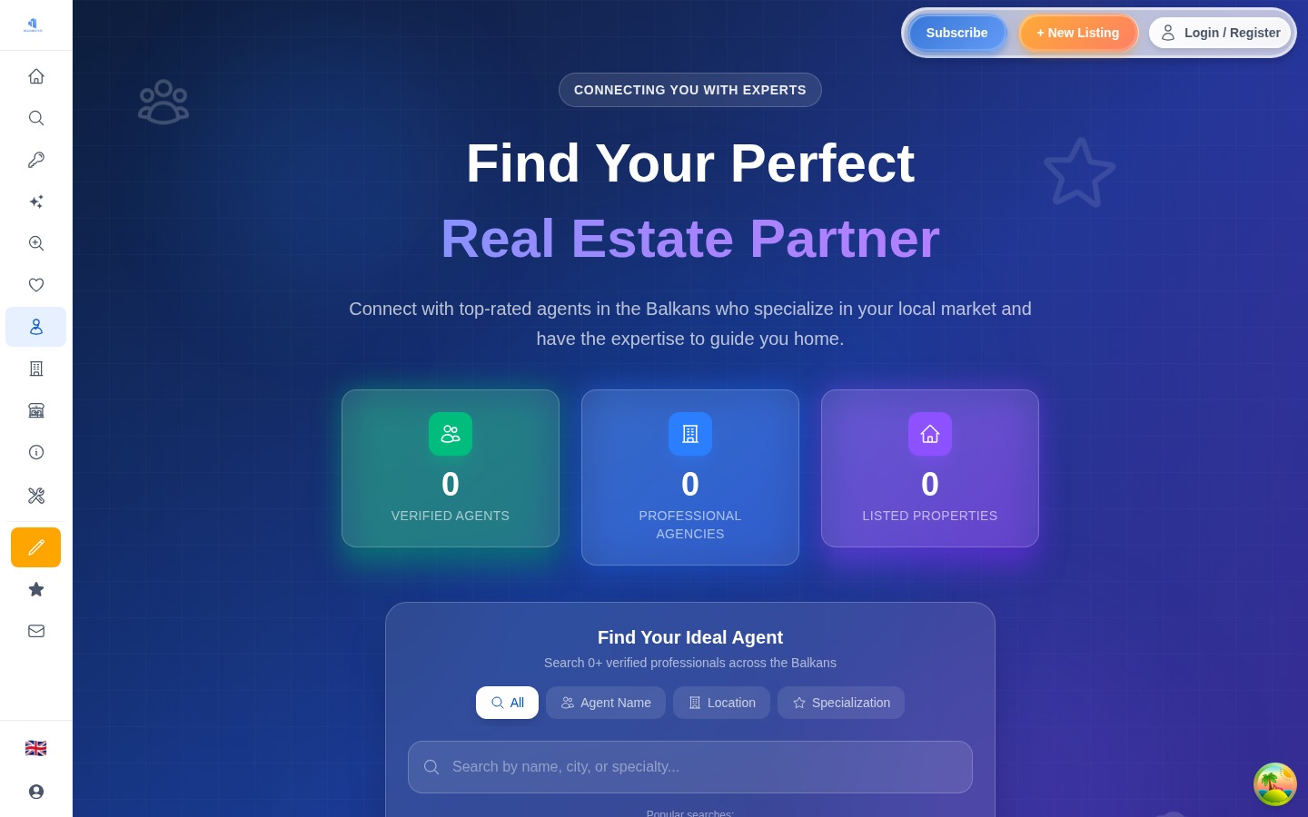
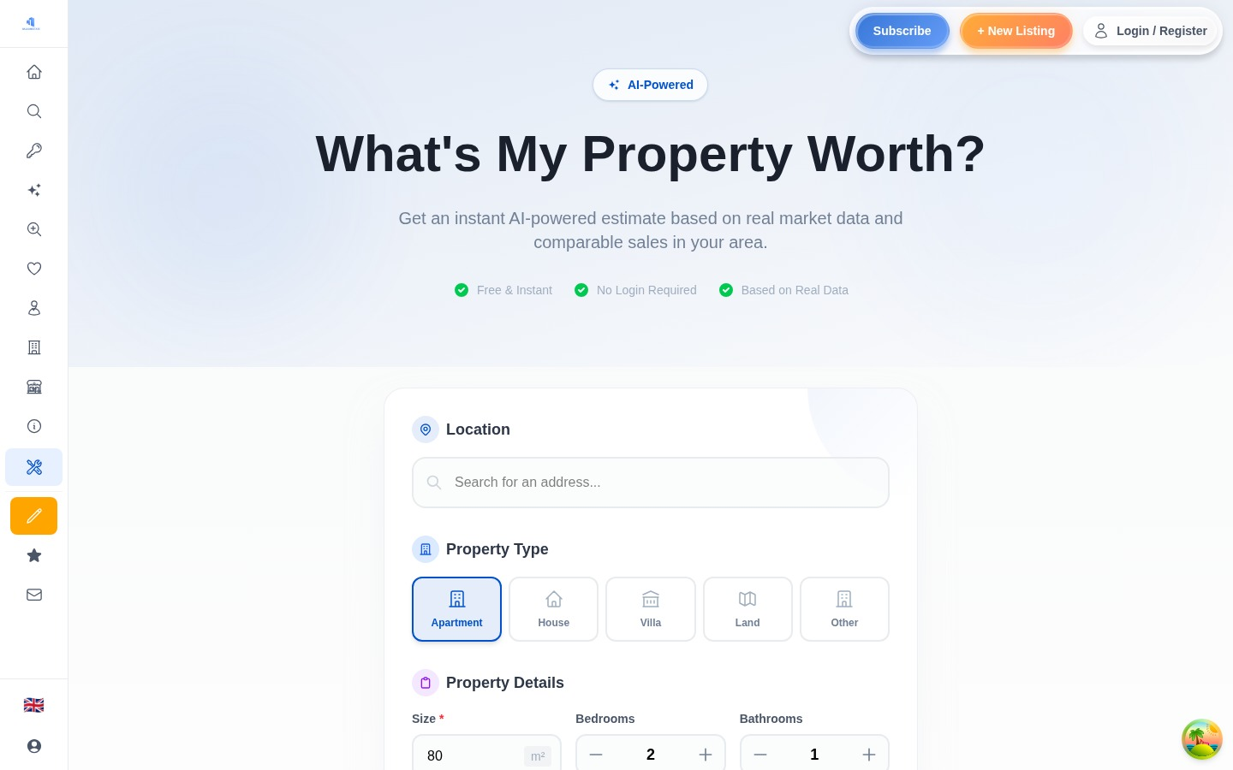
The Product
Built. Live. Ready.
Every screen you see below is the real, live platform — not a mockup.
Homepage & Search
Agent Directory
AI Valuation Tool

Slide 5
Market Size
A €15B+ Opportunity —
Untouched by Modern Tech
TAM
SAM
SOM
€15B+
€2.5B
€5M
Total real estate
transactions in SEE
Online-reachable
segment today
Year 1 realistic
reachable revenue
⏰ Why Now:
Post-COVID digital adoption surge · EU accession tailwinds (Albania, Serbia, N. Macedonia) · No dominant pan-Balkan portal exists · Mobile penetration now >80% across SEE

Slide 6
Business Model
Clear Revenue Streams.
Strong Unit Economics.
Pro Monthly
Pro Yearly
Enterprise
Promoted Listings
€60/mo
€400/yr
€1,500/yr
€9.99–€229
30 listings · Analytics
Priority support
400 listings · Save 44%
vs monthly
1,000 listings · Agency
dashboard · API access
Featured · Highlighted
Premium placement
LTV
CAC
Payback
Gross Margin
€720
<€80
<2 mo
>85%

Slide 7
Traction
What We've Already Built
Pre-revenue, but the hard part is done — the platform is live and fully functional.
🌐
Platform Live
🤖
AI Integration
🌍
10 Languages
balkanestate.com is live and publicly accessible today
Google Gemini-powered valuations and neighborhood insights
Full localization — Albanian, Serbian, Greek, Bulgarian & more
💬
Real-time Messaging
📱
PWA / Mobile
💳
Payments Live
Socket.io live chat between buyers and agents, zero latency
Installable on iOS and Android — no app store needed
Paysera + Stripe integrated — subscription billing ready

Slide 8
The Team
Built by a Founder Who
Knows Real Estate & Tech
ZD
Zani Dalipi
Founder & CEO · BalkanEstate.com
zanoin@gmail.com
✓ Full-stack Development
✓ Real Estate Domain
✓ Product Design
✓ SEE Market Knowledge
Solo founder — building fast, shipping real features, staying lean.

Slide 9
The Ask
Let's Build the
Future of Real Estate
in Southeast Europe
Raising
40%
Growth & Marketing
$250,000
SEO, paid acquisition, agent onboarding
Seed · Pre-revenue · SAFE or convertible note
30%
Engineering
Team hire, feature expansion, mobile app
12-Month Targets
20%
Operations
→ 500+ active agent subscriptions
Legal, compliance, regional partnerships
→ 50,000+ monthly active users
→ €30K+ MRR by month 12
10%
Working Capital
Buffer for 18-month runway
Ready to talk? zanoin@gmail.com · balkanestate.com

