Slide 1


Slide 2
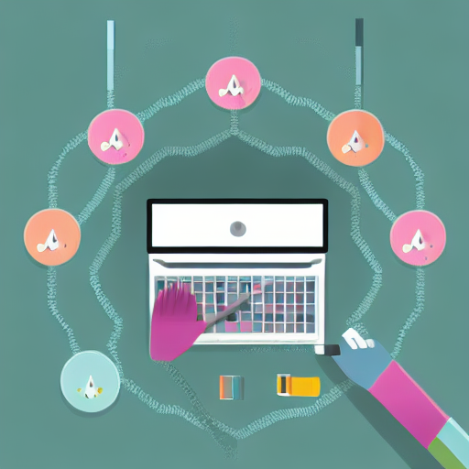
Learning Python the Right Way
Find something you actually want to do with Python
Having a project or goal in mind is crucial for motivation

Slide 3

Pick a Project that Challenges You
It can be a crazy problem you want to solve
It can be a small bot or automating a task
Make it something that interests you

Slide 4
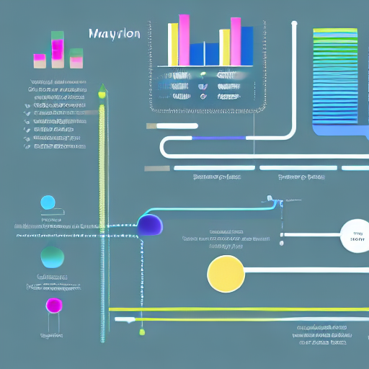
Using Machine Learning to Learn Python
Use pretrained models to do something cool
Learn just enough to run the model and figure out the basics
A good way to get started with Python and machine learning

Slide 5
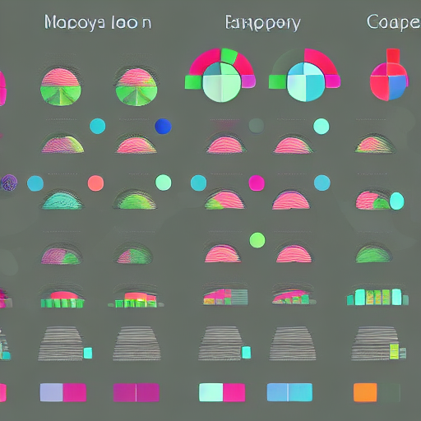
Can You Learn Python in a Short Amount of Time?
You can't expect to learn Python from a onehour video
But, you can learn something in an hour to get hooked
It takes skill to be an educator and condense complex ideas into a short time

Slide 6
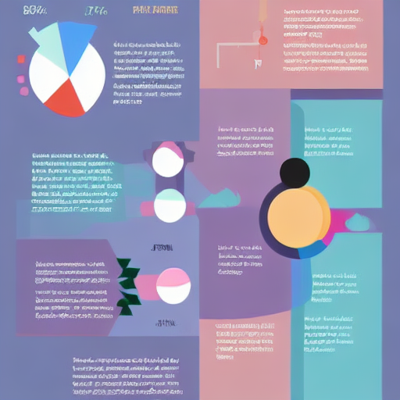
The Importance of Practice and Experience
You can memorize syntax, but that doesn't make you a coder
The 10year experience is about the pain and practice along the way
Coding involves copying and adjusting code from others

Slide 7
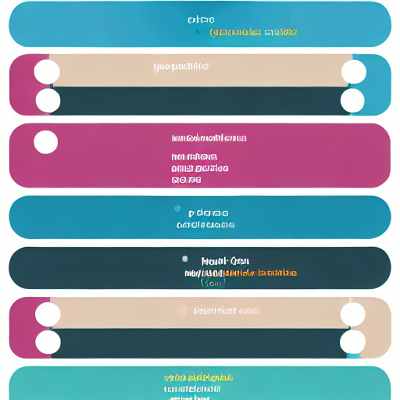
The Future of Coding with AI
AIpowered tools like GitHub Copilot can write code for you
These tools can save time and be a great assistant
But, they don't replace the creative work of deciding what to do

Slide 8

Are Programming Jobs Threatened by AI?
AI helps with boring tasks, but doesn't replace creative work
Programmers' jobs are not threatened by AI or Stack Overflow
AI is a tool to augment and assist, not replace human programmers

