Slide 1
Movie Rating vs. the world
Presented by:
Saki Amagai Cody Hanchett
Bridget O’Connell Zanny O’Donnell

Slide 2

Motivation & Summary
Motivation:
What’s in a movie rating? That which we review by any other standard is still a film.
Questions:
Is average rating affected by any of the following?
Volume of movies released in a year
Genre
Number of votes for each movie
Run time of movie
Findings:
Spoiler alert! Nothing substantial
This Photo by Unknown Author is licensed under CC BY-NC-ND
Notes:
*Cody

Slide 3
Data Cleanup & Exploration
Data exploration
Downloaded from https://datasets.imdbws.com/
title.basics.tsv.gz
title.ratings.tsv.gz
Notes:
*Cody

Slide 4
Original data
Cleaned up data!
Notes:
*Saki
-movie
Rating
Year
Adult item
Duplicates
Run time /n
Movies after 2011 and after

Slide 5
Clean up process
1. Removed videos and games, which are NOT movies
2. Removed anything without ratings
3. Removed anything without start year
7. Removed movies after 2010
DONE!! ☺
4. Removed ”adult” films
6. Removed “Run time” with “/N”
5. Removed duplicates
Notes:
*Saki

Slide 6
Final Dataset Notes
Over 100,000 movies (data points)
Release years: 1894 - 2010
Includes foreign and domestic films
Ratings are scaled 1 (bad) to 10 (good)
Submitted by IMDb registered users
No user data was available to pull from IMDb
When selecting a particular movie, show, etc. a breakdown of the ratings submitted by users is shown (gender, age group) however, IMDb does not make this data available in mass
Notes:
*Zanny

Slide 7
Data Analysis
Question 1
Is the volume of movies released related to movie rating?
Question 2
Is movie genre related to movie rating?
Question 3
Is the number of votes related to movie rating?
Question 4
Is movie run time related to movie rating?
Notes:
*Zanny

Slide 8
Question 1
Is the volume of movies released related to movie rating?
Notes:
Cody

Slide 9
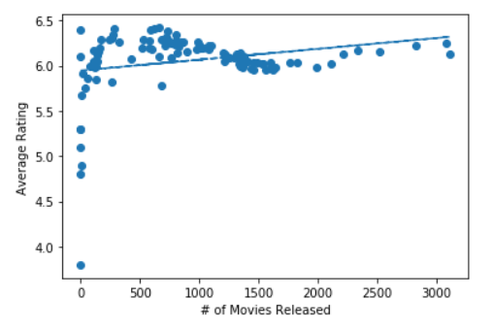
Is the volume of movies released related to movie rating?
Parameters
Compared number of movies released in each year to average rating
Rating is average of average rating for individual years
Findings
Not really
Notes:
Zanny

Slide 10
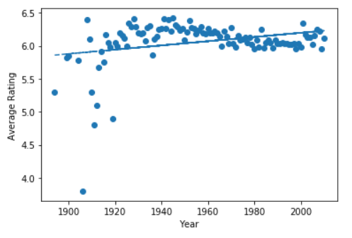
Does the release year affect movie rating?
Parameters
Compared the number of movies released in each year to the average rating
Rating is average all ratings for all movies in individual years
Findings
Not really
Notes:
Zanny

Slide 11
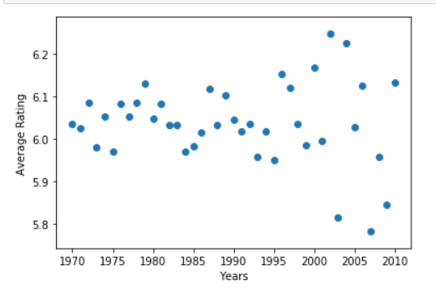
Does the release year affect movie rating in recent years?
Parameters
Compared the number of movies released in each year (1970-2010) to the average rating
Rating is average all ratings for all movies in individual years
Findings
Still no
Notes:
Zanny
* Look up and include year with most releases and the year with highest average rating

Slide 12
Question 2
Is movie genre related to movie rating?
Notes:
Cody

Slide 13
What were the 3 most popular genres between 1970-2010?
Definition of popular genre: large volume of movies produced/released in that genre
Method
1. Created new dataframe with only movie, genre, and year released
2. Created 4 bins
(i.e. 1970-1980, 1980-1990 etc.)
3. Grouped by year released and genre
4. Counted the volume of movies in each genre
Notes:
Saki

Slide 14
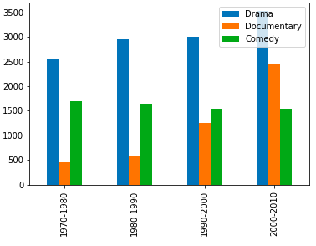
Result: Drama, Documentary and Comedy were consistently the top 3
Documentary significantly increased over time
Upward trend for Drama
Downward trend for Comedy
Notes:
Saki

Slide 15
Does documentary have a higher rating?
Method
1. Created new dataframe with only movie, genre, and year released and ratings
4. Calculated the mean average rating for Documentary, Comedy and Drama
2. Created 4 bins
(i.e. 1970-1980, 1980-1990 etc.)
3. Grouped by year released and genre
Notes:
Saki

Slide 16
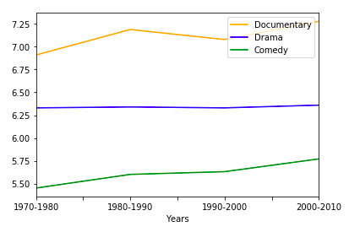
Result: Documentary has the highest rating!
Comedy’s average rating increased (although volume of movies released decreased…)
Drama: same
Notes:
Saki

Slide 17

Perhaps the popularity of documentaries makes sense...
Notes:
Saki

Slide 18

Limitations
Some movies are part of multiple genres (i.e. comedy AND drama AND horror)
IMDB lists movies with multiple genre as a separate genre (i.e. comedy, drama, horror)
More complex methods of analysis will be needed
Notes:
Saki

Slide 19
Question 3
Is the number of votes related to movie rating?
Notes:
Cody

Slide 20
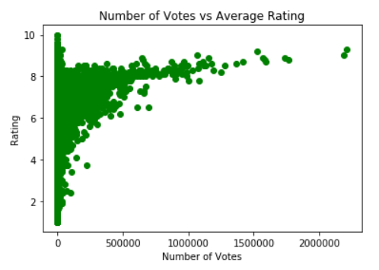
Full Dataset
Correlation Coefficient of 0.11
Highly skewed towards a low number of votes
Shows no correlation between the two factors
Notes:
Cody

Slide 21
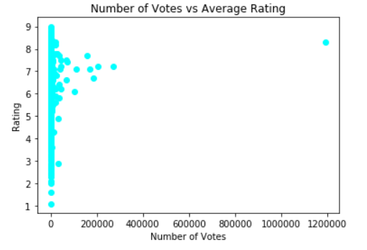
Sample of full dataset
Sample size of 1000
Pandas random sample of full dataset
Correlation Coefficient of 0.09
Highly skewed towards a low number of votes
Shows no correlation between the two factors
Notes:
Cody

Slide 22
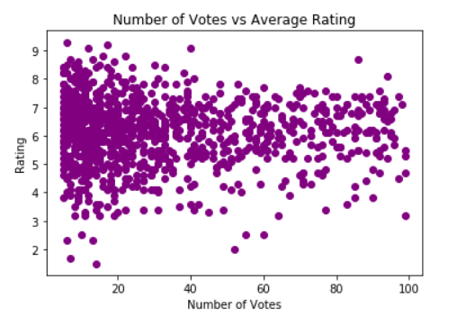
Sample of a section of dataset
Removed any movie with more than 100 votes
Sample size of 1000
Pandas random sample of reduced dataset
Correlation Coefficient of -0.03
Shows no correlation between the two factors
Notes:
Cody

Slide 23
Question 3 Conclusion
All calculated correlation coefficients show no correlation between the number of votes a movie receives and the average rating of the movie.
Notes:
Cody

Slide 24
Question 4
Is movie run time related to movie rating?
Notes:
Cody

Slide 25
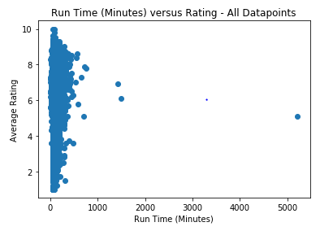
Is movie run time related to movie rating?
Parameters:
Run time is in minutes
Ratings are scaled 1 (bad) to 10 (good)
Initial hypothesis: The longer the movie, the lower the rating.
Using all datapoints, run time versus average rating is:
Notes:
Bridget

Slide 26
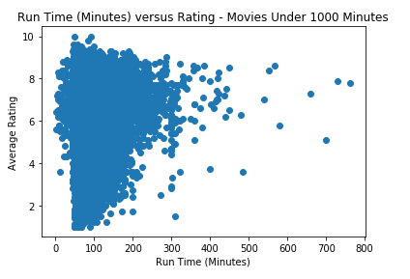
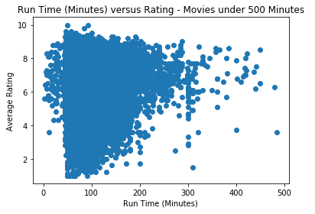
Narrowing down the run time…
Removing movies over 1,000 minutes (16+ hours):
Removing movies over 500 minutes (8+ hours):
Notes:
Bridget

Slide 27
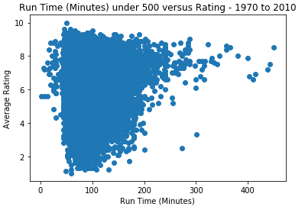
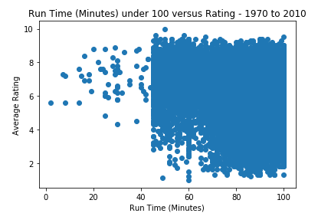
Narrowing down the movies...1970 to 2010
Movies released in 1970 to 2010 under 500 minutes:
Movies released in 1970 to 2010 under 100 minutes:
Run time stats:
Mean 97.16 minutes
Min 2 min; Max 450 min
Standard deviation 22.50 minutes
Run time stats:
Mean 86.54 minutes
Min 2 min; Max 100 min
Standard deviation 11.47 minutes
Notes:
Bridget

Slide 28
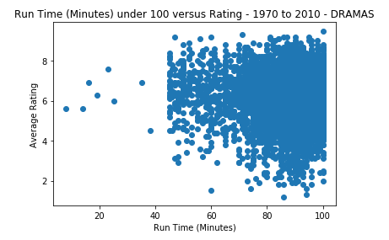
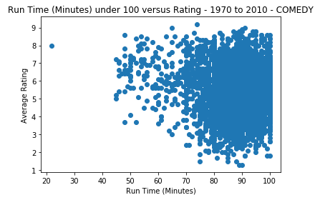
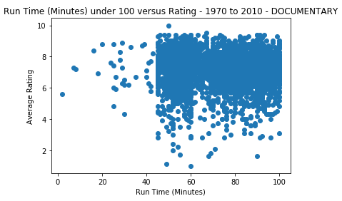
Any correlation in a certain genre?
Movies released in 1970 to 2010 under 100 minutes:
Drama – 7,931 movies
Comedy – 5,407 movies
Conclusion:
No clear correlation in run time versus average rating.
Documentary – 4,178 movies
Notes:
Bridget

Slide 29
Post Mortem
Difficulties (or lack thereof):
Tab separated, converted to comma separated
Data was free use and download
Not API
Additional questions/further examination:
IMDb vs. other rating systems
Explore multi- and subgenre data further
“Home Alone” effect
Dark comedy, family comedy, etc.
Movie budget/profit
Actors/directors/producers/studios
Find more data about other influential factors
Data of users
Age
Gender
Location
Socioeconomic factors
Notes:
*Bridget

Slide 30

Questions?
This Photo by Unknown Author is licensed under CC BY-NC
Notes:
*All

