Slide 1
TECHNICAL RECRUITMENT
Data Warehouse & Business Intelligence
An end-to-end ETL project: from business requirements to a dimensional
Data Warehouse in PostgreSQL, analyzed with Power BI.
ETL Workshop 1 — Group G01
Samuel Izquierdo Bonilla
Notes:
Welcome the audience. State the project in one sentence: an end-to-end ETL pipeline and dimensional Data Warehouse built from a real recruitment dataset, analyzed in Power BI. Introduce yourself.

Slide 2
Agenda
What we'll cover today
01
Business Context & Requirements
02
Dataset & Data Profiling
03
Dimensional Model (Star Schema)
04
ETL Pipeline & Data Warehouse
05
Analytical Results (R1–R5)
06
BI Visualizations in Power BI
07
Key Findings & Recommendations
Recruitment Data Warehouse — ETL Workshop 1
2
Notes:
Walk through the agenda at a glance — don't read every line, just orient the audience to the arc of the talk: business first, then data, then the technical build, then results.

Slide 3
Project Objective & Business Context
Business Context
Objective
1
Thousands of applications from candidates with different profiles, experience levels, countries, and technical specialties.
Design and implement a dimensional Data Warehouse that lets a tech recruitment company analyze its candidate selection process: hiring trends over time, performance by technology, by candidate profile (seniority and experience), and by country of origin.
2
Each candidate is evaluated with two scores: Code Challenge Score and Technical Interview Score.
The project covers the full flow: business requirements → data profiling → dimensional modeling → ETL → PostgreSQL Data Warehouse → analytical queries → Power BI visualization.
3
Data currently lives in a flat file — the organization needs an analytical system to understand hiring patterns.
Recruitment Data Warehouse — ETL Workshop 1
3
Notes:
Explain the objective in your own words. Emphasize this is a real recruitment company scenario: thousands of applications, two scores per candidate, and a business need to turn a flat file into an analytical system.

Slide 4
Five Business Requirements
Everything in this project traces back to R1–R5
R1
R2
R3
R4
R5
Hiring Trends
Technology Analysis
Candidate Profile
Experience vs. Outcome
Geographic Analysis
How does the hiring rate evolve month by month?
Which technologies generate the most hired candidates?
How do outcomes vary by seniority and experience?
Within a seniority level, does more YOE help?
Which countries drive volume and hiring rate?
Recruitment Data Warehouse — ETL Workshop 1
4
Notes:
These five requirements are the backbone of the entire project — every dimension, measure, and query traces back to one of them. Read each one briefly; you'll refer back to R1-R5 for the rest of the talk.

Slide 5
Dataset Overview
data/raw/candidates.csv — original file, unmodified
50,000
10
0
Applications
Columns
Null Values
244
24
7
Countries
Technologies
Seniority Levels
Recruitment Data Warehouse — ETL Workshop 1
5
Notes:
Quick orientation to the source data before diving into profiling. Note this is the original, unmodified file — nothing was changed at the source.

Slide 6
Key Findings from Data Profiling
Task 1 — notebooks/data_profiling.ipynb
Clean data
Repeat applicants
0 exact duplicate rows and no null values across all 50,000 rows.
167 duplicate emails — candidates who applied more than once. All rows are kept: the grain is the application, not the candidate.
Time span
The HIRED rule
Application Date ranges from 2018-01-01 to 2022-07-04 (~4.5 years).
HIRED = (Code Challenge Score ≥ 7) AND (Technical Interview Score ≥ 7). Applied to all 50,000 rows, 6,698 applications (13.4%) qualify as HIRED.
Recruitment Data Warehouse — ETL Workshop 1
6
Notes:
Highlight the duplicate-email decision — it's a meaningful design choice, not an oversight: each row is an application, not a candidate, so duplicates are kept. Then introduce the HIRED business rule, which everything downstream depends on.

Slide 7
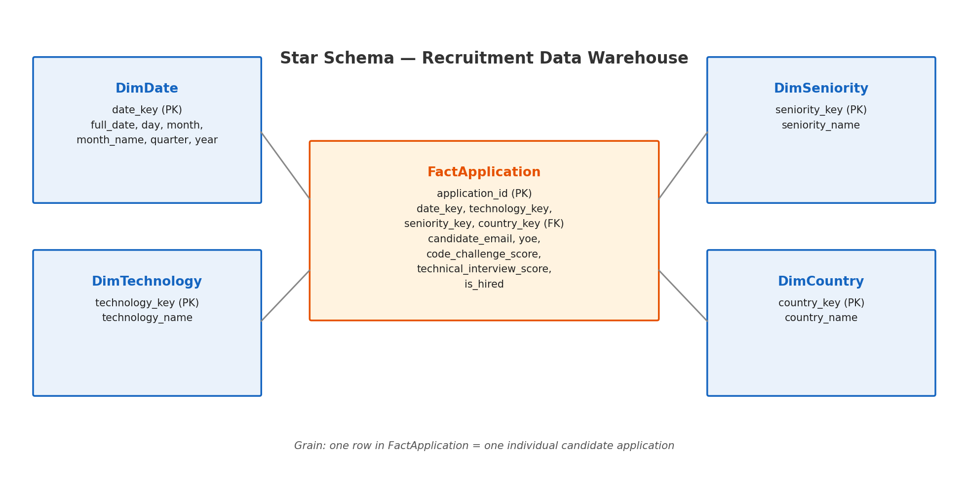
Dimensional Model — Star Schema
One fact table, four dimensions, five business requirements covered
Recruitment Data Warehouse — ETL Workshop 1
7
Notes:
Walk through the star schema: one fact table at the grain of a single application, four dimensions (Date, Technology, Seniority, Country). Mention that YOE was deliberately kept as a fact attribute rather than its own dimension, to avoid an unnecessary low-value dimension.

Slide 8
ETL Pipeline Architecture
src/main.py orchestrates the full flow
EXTRACT
TRANSFORM
DIMENSIONAL
MODEL
LOAD
DATA
WAREHOUSE
src/extract.py
src/transform.py
src/dimensional_model.py
src/load.py
PostgreSQL
Data flows one way, in order — dimensions are always loaded before the fact table, so foreign keys never break:
DimDate → DimTechnology → DimSeniority → DimCountry → FactApplication (50,000 rows).
The HIRED business rule is applied in the Transform stage — not in Extract — keeping business logic separate from raw ingestion.
Recruitment Data Warehouse — ETL Workshop 1
8
Notes:
Walk left to right through the pipeline. Emphasize the load order — dimensions before the fact table — and that the HIRED rule lives in Transform, not Extract, keeping raw ingestion separate from business logic.

Slide 9
Data Warehouse Load — Validated
Loaded and verified against a real PostgreSQL instance
1,646
24
7
244
50,000
DimDate
DimTechnology
DimSeniority
DimCountry
FactApplication
Integrity check
A join across FactApplication and all four dimensions found 0 orphaned rows — every application correctly resolves to a valid date, technology, seniority, and country. create_tables.sql and analytical_queries.sql ran unmodified against the live PostgreSQL database (recruitment_dw).
Recruitment Data Warehouse — ETL Workshop 1
9
Notes:
This is proof the pipeline actually ran end-to-end against a real PostgreSQL database, not just in theory. The 0 orphaned rows is the key number — it means referential integrity holds across all 50,000 facts.

Slide 10
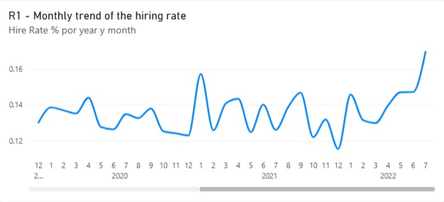
R1 — Monthly Hiring Trend
Temporal visualization, built in Power BI from the live Data Warehouse
KPI
Monthly Hire Rate %
Finding
The rate oscillates between 11.5% and 17%, in short cycles, with no sustained growth or decline over 4.5 years.
Business takeaway
The hiring process has stayed stable over time — no seasonal or long-term pattern to react to.
Recruitment Data Warehouse — ETL Workshop 1
10
Notes:
This is a real screenshot from Power BI, connected directly to PostgreSQL. Point out the oscillation without trend — the takeaway is stability, not growth or decline.

Slide 11
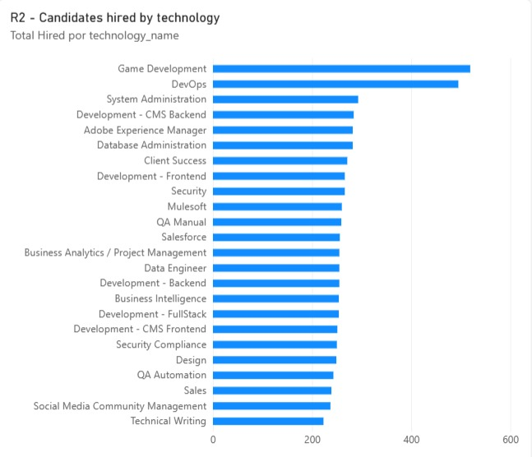
R2 — Candidates Hired by Technology
Comparative visualization across 24 technology categories
KPI
Total Hired by Technology
Finding
Game Development and DevOps lead in absolute hires — but that tracks their higher application volume, not a better conversion rate. The hiring rate is similar across all technologies (~13-15%).
Business takeaway
Sourcing decisions should weigh conversion rate, not just raw applicant volume.
Recruitment Data Warehouse — ETL Workshop 1
11
Notes:
Careful with this one — it's tempting to read 'tallest bar wins,' but the real insight is that volume and conversion rate are different things. Make that distinction explicit for the audience.

Slide 12
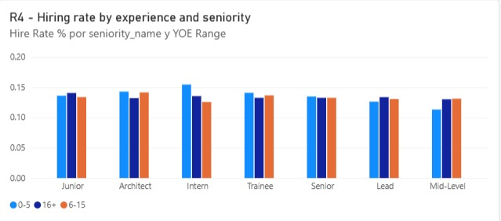
R4 — Experience vs. Seniority
Does more experience (YOE) improve outcomes within the same seniority level?
KPI
Hire Rate by YOE Range
Finding
Within every seniority level, the 0-5, 6-15, and 16+ year bars are nearly identical (12-16%).
Business takeaway
YOE is not a reliable predictor of hiring success — using it as a hard pre-screening filter should be reconsidered.
Recruitment Data Warehouse — ETL Workshop 1
12
Notes:
This is probably the most counter-intuitive finding of the whole project — more experience does not mean a better outcome. Give the audience a second to absorb it before moving to the recommendation.

Slide 13
Key Findings & Recommendations
What we found
Recommended actions
Overall hiring rate: 13.4% — stable across time, technology, seniority, and country.
Prioritize sourcing investment in technologies with better conversion, not just higher volume (R2).
Seniority and YOE show no clear link to hiring outcome — the evaluation process behaves independently of these declared attributes.
Reconsider YOE and seniority as hard pre-screening filters, since neither predicts the hiring outcome (R3, R4).
No single technology or country dominates application volume — the candidate base is diversified.
Use country-level volume and hiring rate to guide where to strengthen recruitment presence (R5).
Recruitment Data Warehouse — ETL Workshop 1
13
Notes:
This is the synthesis slide — connect every finding to a concrete action. Left side is what the data shows; right side is what the business should do about it. End on the recommendations, not just the findings.

Slide 14
Thank You
Questions?
Samuel Izquierdo Bonilla | ETL Workshop 1 — Group G01
Notes:
Thank the audience and open the floor for questions.

