Slide 1
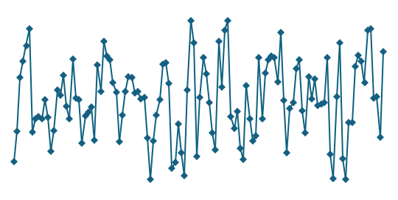
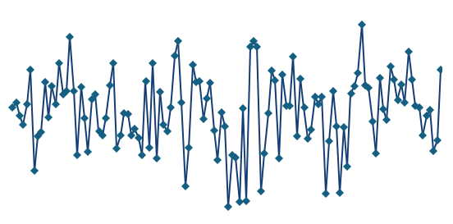
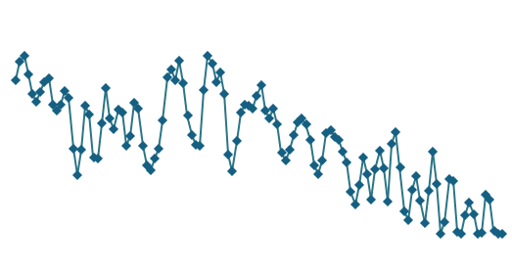
1
Data acquisition
2
Conditional diffusion model
3
Inference & evaluation
Multi-modal mouse recordings (RT n=5, VPM n=4)
Past tokens (preictal STFT)
Sample 16 x_0 via
DDIM, guidance=2.0
...
x_t derived from real target x_0
(real target shown at t=0)
EEG
EMG
Photometry
(256 Hz)
(256 Hz)
(resampled)
Past encoder ->
cross-attention U-Net
(denoiser)
Frozen target classifier ->
p(ictal | x_0)
seizure onset (t=0)
Ensemble p(ictal | x_0)
1.0
x_0 (target spectrogram)
preictal: 18 s
ictal : 3 s
0.5
CE on x_0
Feature
matching on x_0
Past CE head
3 s
3 s
3 s
3 s
3 s
3 s
0.0
h5
h4
h3
h2
h1
h0
Frozen target classifier (ResNet-18)
seed 1
seed 2
seed 3
seed 4
seed 5
Classifier-free guidance via condition dropout (CFG)
5-seed ensemble +
bootstrap 95% CI
Inference-time inputs: preictal window only - no labels, no real target, no preictal classifier

