Slide 1
Travel
Ziyao He 2019/11/18

Slide 2
Outline
1.Short Review of Dataset
2.Project Progress & Issues
3. Ideas

Slide 3
Campsites Dataset
Location Data, Campsites, Rating, Comments from other user
10758 Campsites, 107 from Mexico, 9558+ from US, 937 from Canada

Slide 4
Project Progress
Try WRLD3D API: Limited map, the view angle is also limited(But some issues can be possible to solve)
Try Google API: not avalible(Didn’t look deep into that.)
Mapbox API:Able to display satellite map of a specific area (With Location values and zoomlevel) .

Slide 5
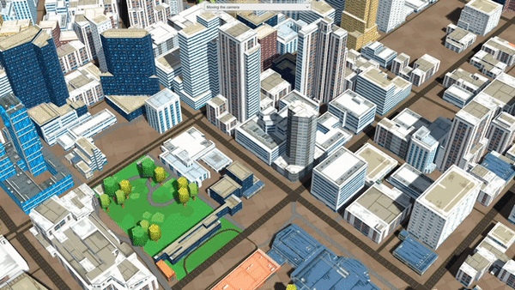
WRLD3D
Notes:
You can move camera From one side to the other side if you code the script with specific location, but the view angle is limited, lack of details in other places

Slide 6
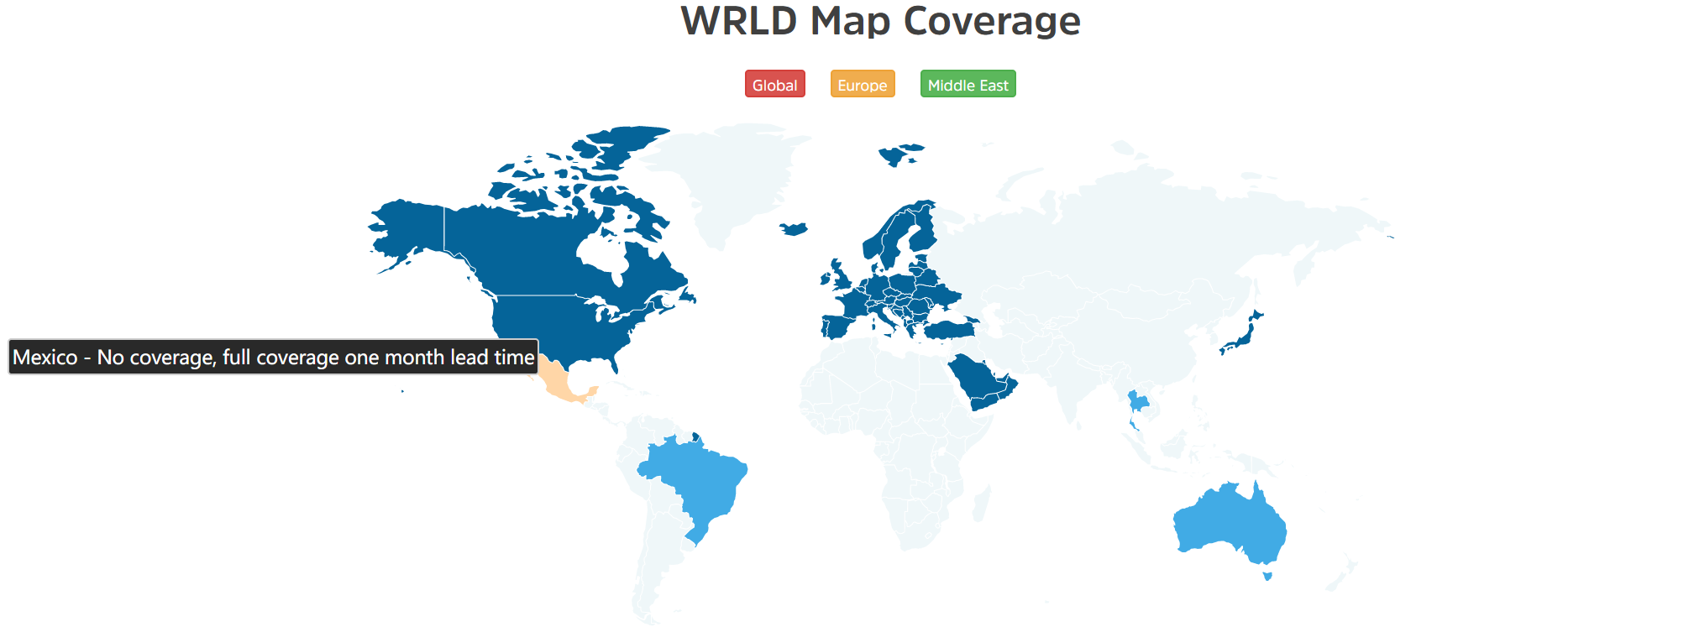
WRLD3D
Notes:
not a big problem since the number of campsites in Mexico is only 107 but mapbox can obtain better results

Slide 7
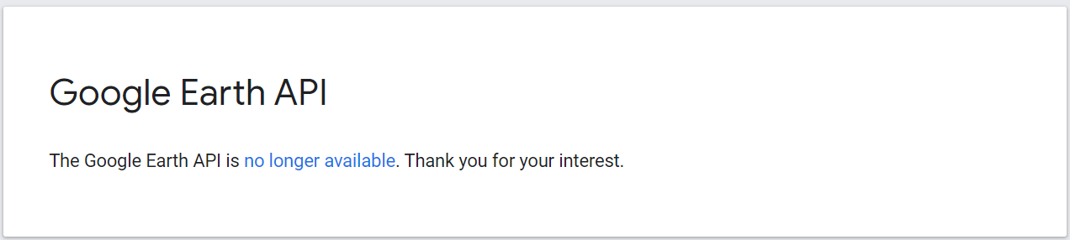
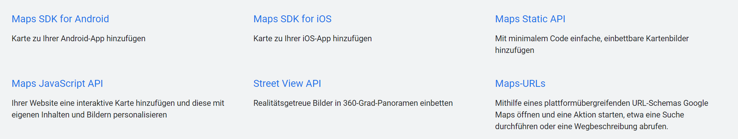
Google
Google Earth: not available
Google Map for unity: I found the package can see some nice examples builded in. But can’t find corresponding api key for unity.
Notes:
I also created some scene to test the unity package unfortunately I forgot to get the screenshot from the computer in laboratory.

Slide 8
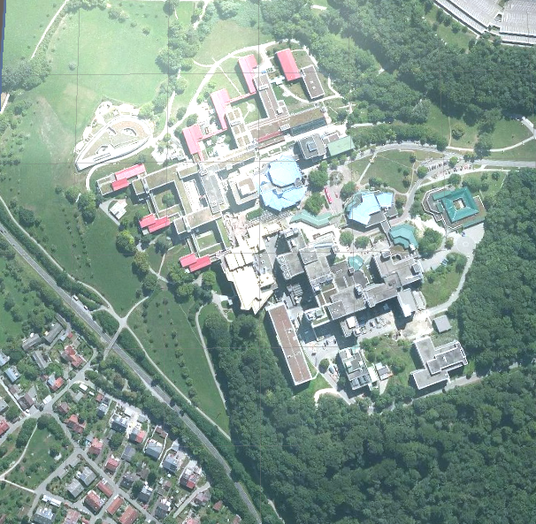
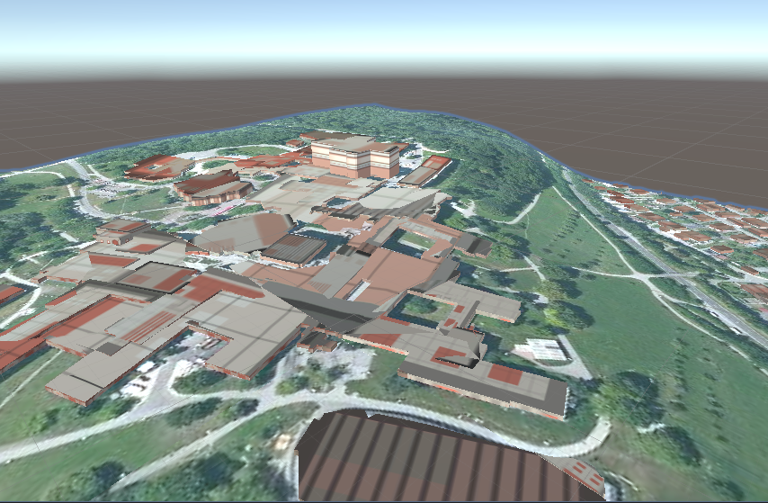
Mapbox
Notes:
Left Figure is a satellite map as a Flat Terrain of the map, RIght Figure is the Terrain evaluated by heights and generated buildings automatically. Issue is the mesh doesn’t look so good sometimes, and

Slide 9
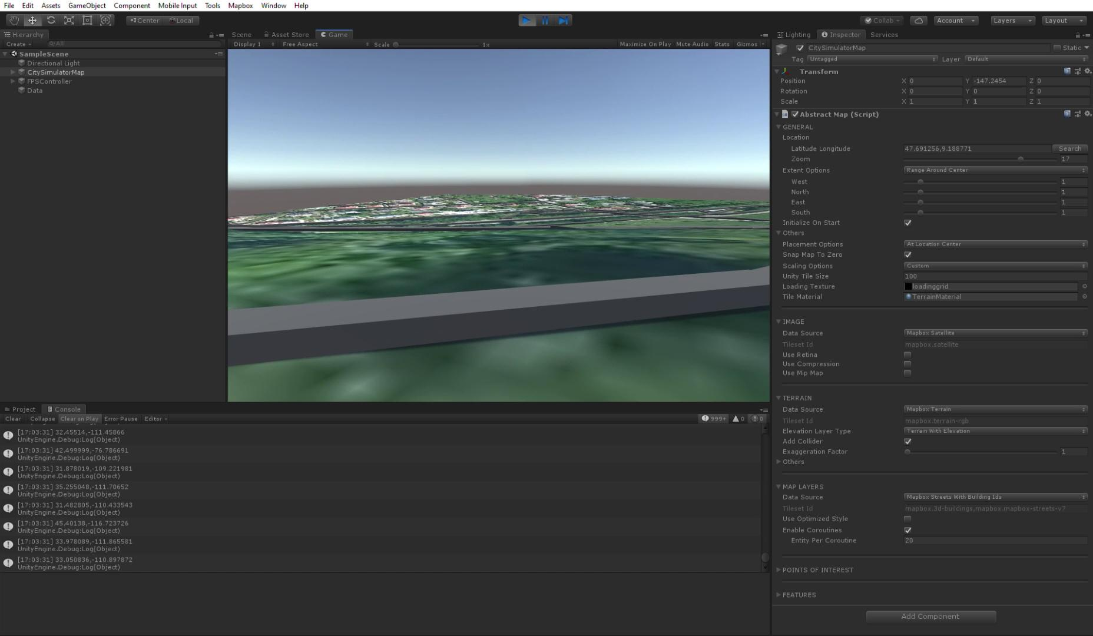
Notes:
This is the video recorded yesterday, and I use FPS controller to test the scene. As you can see in the console I managed to load the different Location values into unity. There are a lot of settings I can try with this map, but there is some limitation: when I change zoom level and positions, then the map can struck.

Slide 10
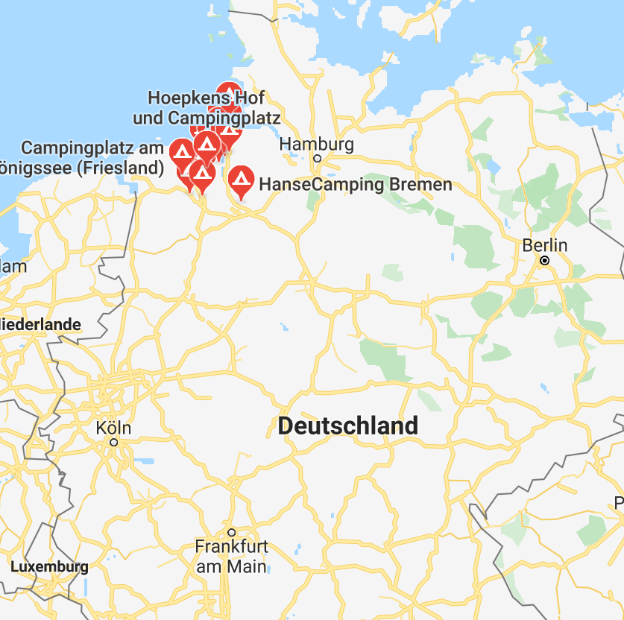
Ideas
-Display the general view of campsites in the whole world.(2D is fine)
This is the screen shot from google maps when you search campsites
-Jump to 3D view like what I showed before when user select one of the campsite.
-Also try some possibility of generating mountain as terrain using mapbox or other asserts
Notes:
Next step is to display the campsites in a bigger map let the user able to select one place and zoom or jump into another scene.

Slide 11
Discussion
Thank you for listening!

