Slide 1
ALL IN WITH LOVE • WEEK TWO
The Cross That
Shows Love
Philippians 2:5–8
◆
◆
Pembroke Park Church of Christ

Slide 2

SECTION I
The Mindset of Christ
“Have this mind among yourselves,
which is yours in Christ Jesus…”
— Philippians 2:5
The Contrast:
The World says: “Climb UP”
Christ says: “Descend DOWN”
phronēte (φρονεῖτε) — "set your mind on"

Slide 3
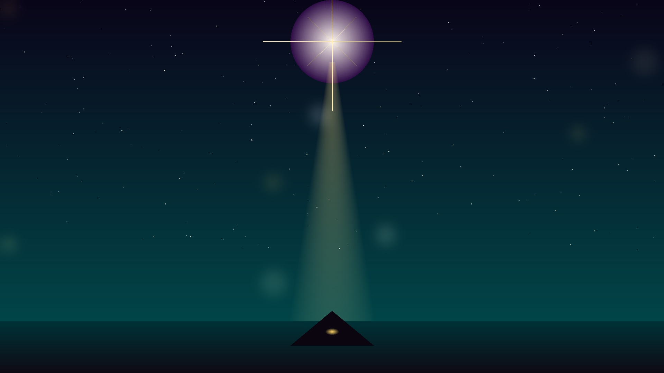
SECTION II
God With Us—
The Incarnation
“Form of God” (morphē)
Essential divine nature (v. 6)
Did not grasp equality with God
Refused to cling to divine privileges
The Infinite became Finite
Complete identification with humanity
The Creator entered His own creation—
complete identification with humanity

Slide 4

SECTION III
He Emptied Himself
KENŌSIS (κένωσις)
Greek: self-emptying
▼ Gave up privileges of deity
▼ Took form of a servant (doulos)
▼ Born in likeness of men
“Not emptying deity,
but the privileges of deity”

Slide 5
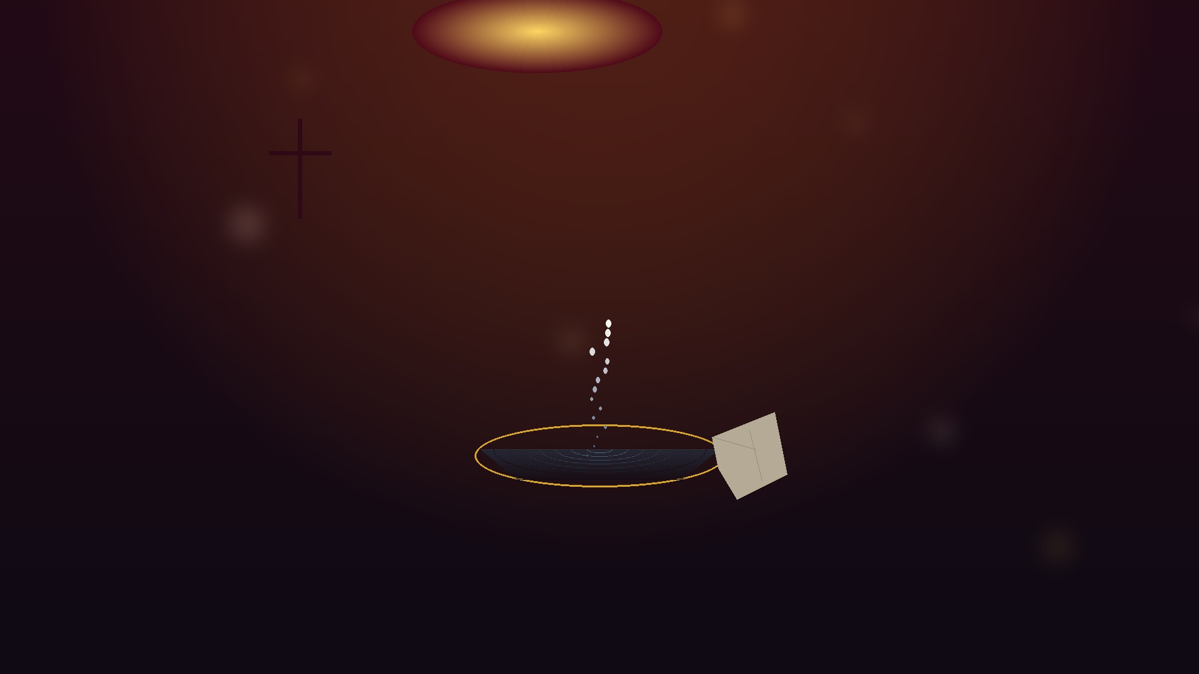
SECTION IV
He Humbled Himself
Active Humility, Not Passive Humiliation
“Humbled himself”
He CHOSE this path (v. 8a)
Found in human form
No special recognition or status
“He had no form or majesty that we should
look at him, and no beauty that we should
desire him.”
— Isaiah 53:2

Slide 6
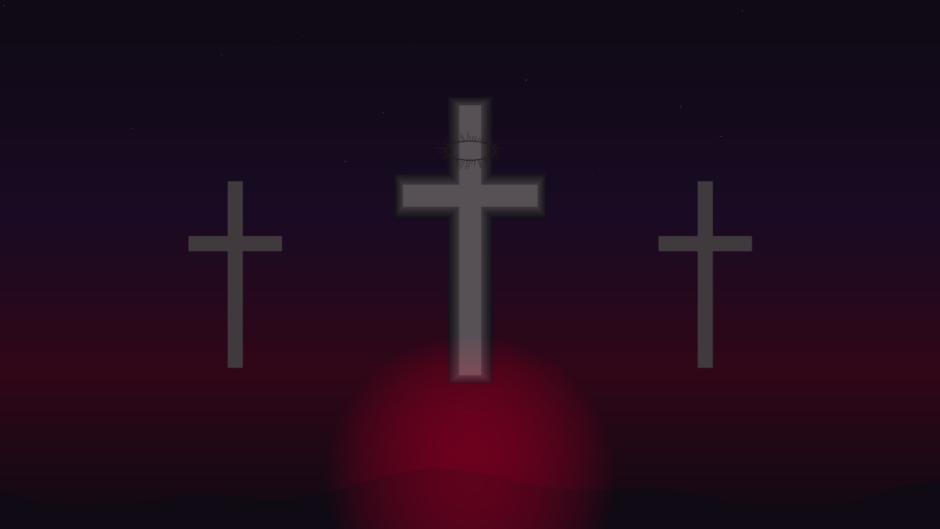
SECTION V
Obedient to Death
“Even death on a cross” — v. 8b
Most Shameful Death
Reserved for slaves and criminals
Most Painful Death
Designed for maximum suffering
Cursed by God
Deuteronomy 21:23
Love’s descent to the absolute bottom

Slide 7
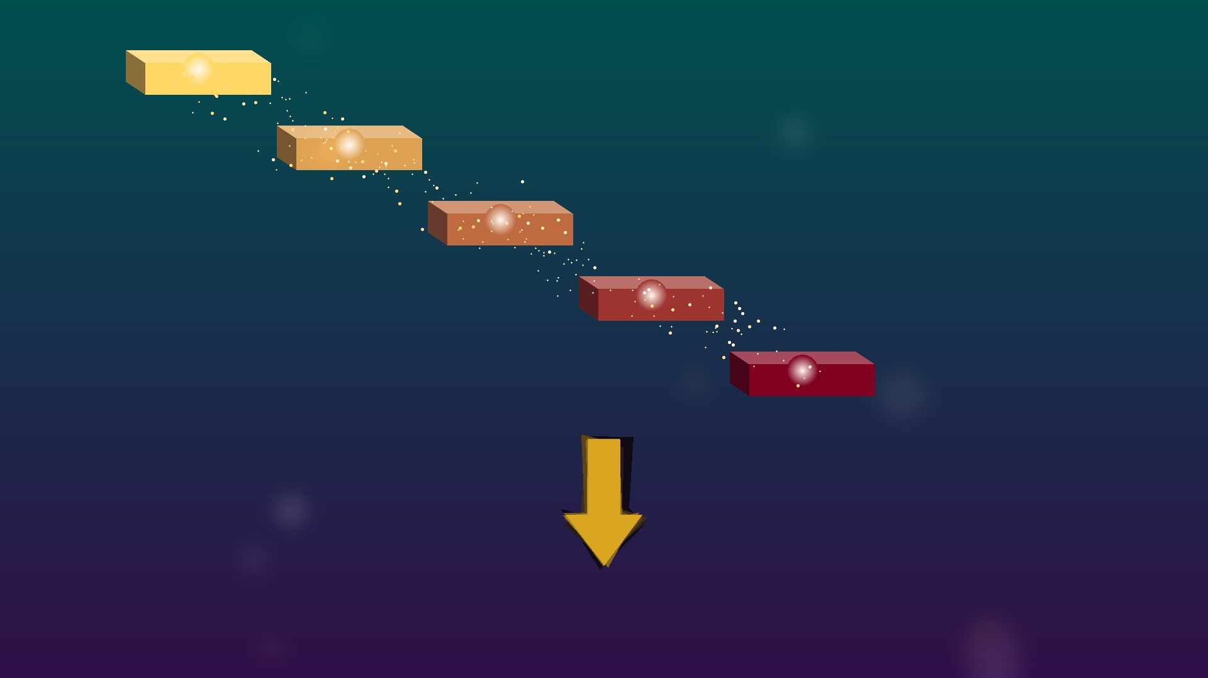
SUMMARY
The Five Descending
Movements
1
The Mindset
Chose to think differently
▼
2
God With Us
The Incarnation
▼
3
Self-Emptying
Became a servant
▼
4
Humbling
Chose the lower place
▼
5
Obedience unto Death
Even the cross

Slide 8

APPLICATION
The Pattern for
Our Lives
You cannot be “all in” with love while holding back from the downward path.
The cross is our pattern for living
‣ Serve others
Follow Christ’s example of humble service
‣ Give up rights
Release what you’re entitled to for others’ sake
‣ Choose humility
Actively take the lower place

Slide 9
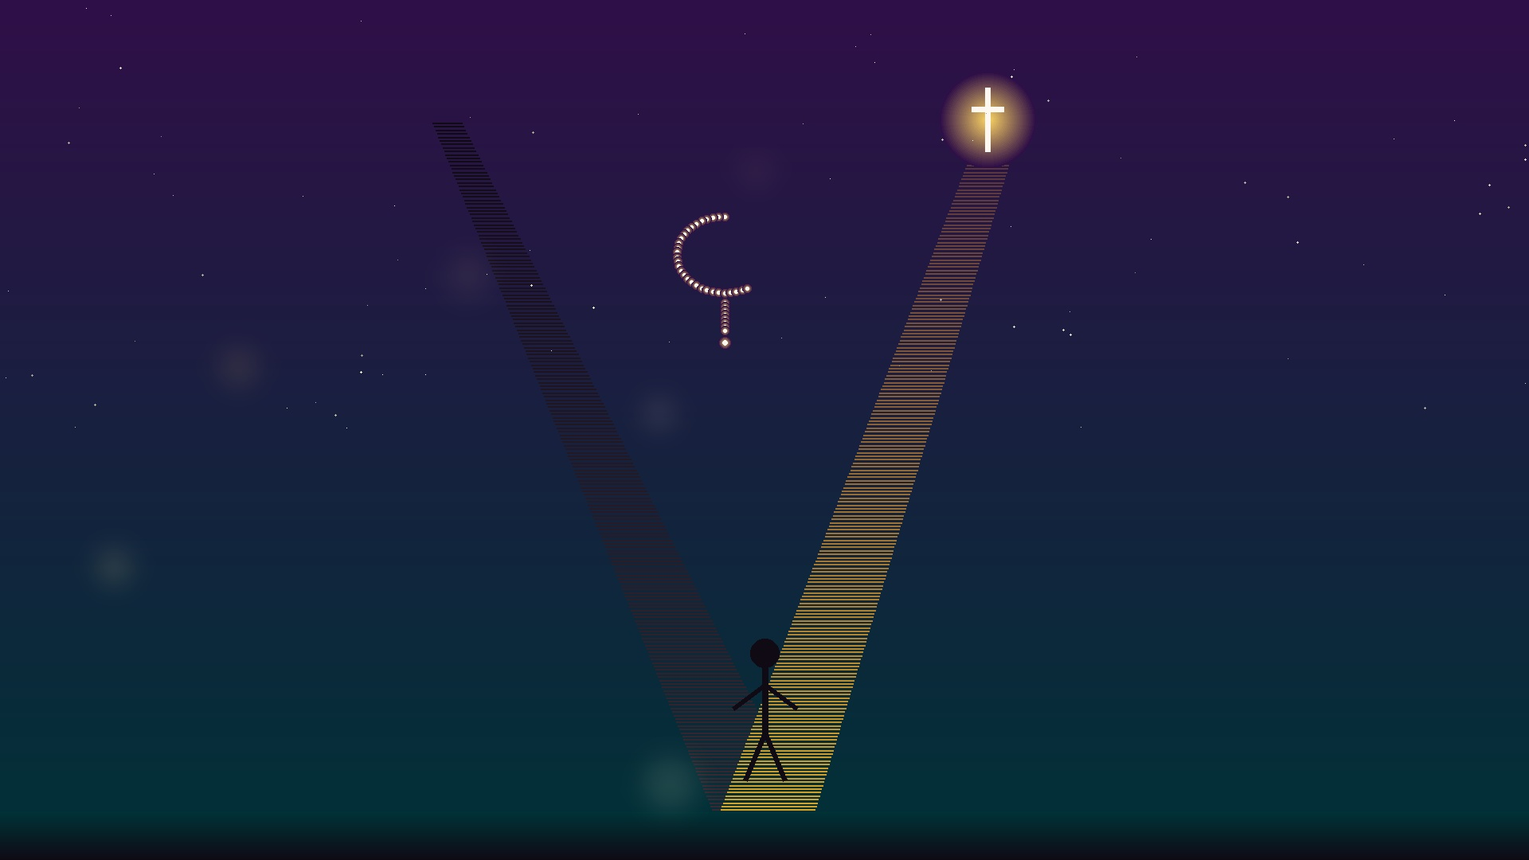
CHALLENGE
This Week’s
Challenge
IDENTIFY
one area where you’re clinging
to privilege or status
THEN
Take one step DOWN this week
Where are you
holding back?

Slide 10
THE WORLD SAYS:
Look out for yourself. Climb the ladder. Protect your rights.
◆
THE CROSS SAYS:
Give yourself away. Descend to serve. Renounce your rights.
◆
These are opposite paths.
You cannot walk both.
Choose the way of the cross.

