Slide 1




Optimizing Umbrella Inventory
STOCHASTIC NEWSVENDOR APPROACH
Author: Pritham Prajwin V (BSD-BG-2512) · Institution: ISI Bangalore
The Metro Station Scenario
A sudden 3 PM downpour at MG Road Metro or Vidhana Soudha. commuters scramble for cover while a street vendor watches demand spike in minutes. Every morning, this vendor must decide how many umbrellas to stock, betting on Bangalore's famously unpredictable weather with no chance to restock mid-day.
Problem Statement: Determine the optimal daily inventory Q that minimizes the total expected cost under stochastic demand.
Notes:
1

Slide 2






Why the Newsvendor Model
PERFECT FIT CONDITIONS
Single-Period Decision
Asymmetric Costs
Stock must be ordered before demand is realized; no mid-day replenishment.
The financial penalty for having one too many (c_o) differs from having one too few (c )
u
Demand Uncertainty
Perishability of Opportunity
Demand is a random variable D dependent on stochastic weather patterns.
While the product is durable, the high-demand window (rainy hours) is highly perishable.
Notes:
2

Slide 3

Notation & Parameter Costs
THE ECONOMICS OF AN UMBRELLA
Core Parameters
Symbol
Meaning
Parameter
Value
Meaning
Q
Order quantity,in units. This is the decision variable we optimize.
p (Selling Price)
₹150
Revenue per unit sold
D
Daily demand,a random variable. Its distribution is estimated from IMD rainfall data.
Q*
The optimal stocking quantity that minimizes expected cost.
c (Wholesale Cost)
₹80
Cost per unit ordered
s (Salvage Value)
₹30
Recovery per unsold unit
Symbol
Meaning
f (•)
Probability density function (pdf) of daily demand D
Derived Cost Metrics
D
F (•)
Cumulative distribution function (CDF) of daily demand D; F (Q) = P(D ≤Q)
D
Cost of Underage (c_u)
Cost of Overage (c_o)
D
---1
Quantile function of D; inverse CDF used to find Q * directly
F (•)
p - c = ₹70 — Profit lost per unit not sold when demand exceeds supply.
D
c - s = ₹50 — Loss incurred per unsold unit at end of day.
---1
Standard normal quantile function
(used when D ∼ N(µ,σ ))
Φ (•)
D
2
Notes:
3

Slide 4
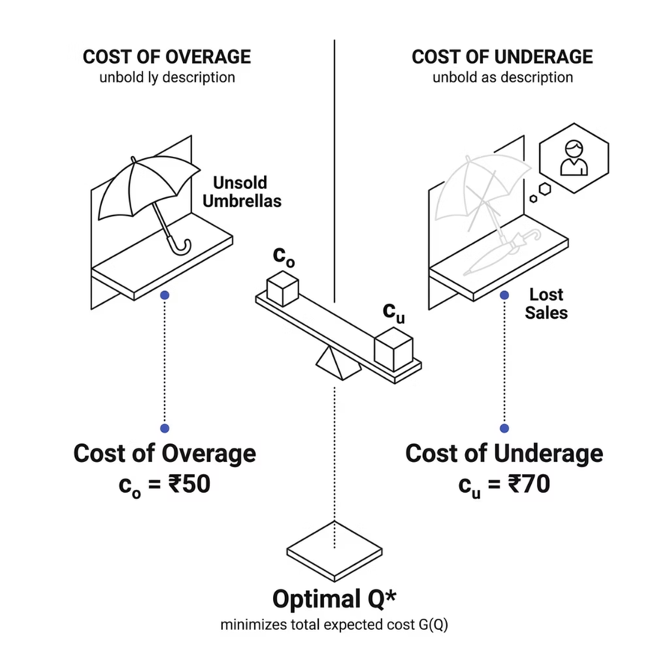
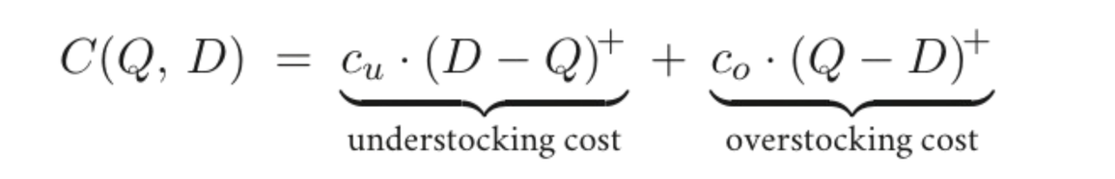
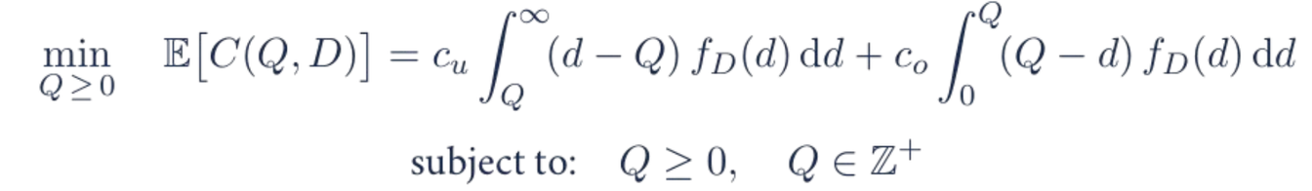


MATHEMATICAL OPTIMIZATION
Objective Function
Optimization Goal
Constraints
⁺
Budget
Constraints
Q ≥0
Q∈
ℤ
Single-period,
no replenishment
Notes:
4

Slide 5






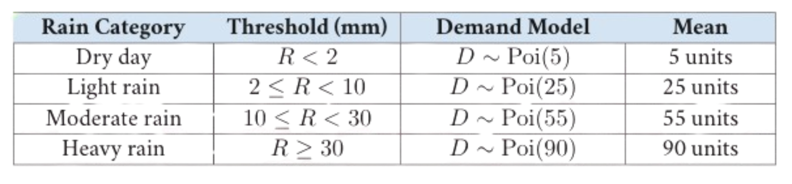
Data Collection & Rainfall-to-Demand Mapping
VARIABLES AND SOURCES
Data Sources
Three specific reasons for this choice:
IMD Observed Rainfall — official meteorological records
Kaggle Bangalore Weather Snapshot — supplementary historical data
Daily granularity
Public
and
Reproducible
Key Variables
date
Live Updates
location_name
RD Mapping (Poisson → Normal Transition)
precip_mm
month
demand_est
Notes:
5

Slide 6


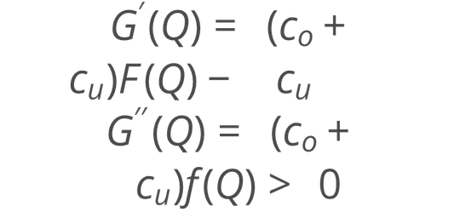
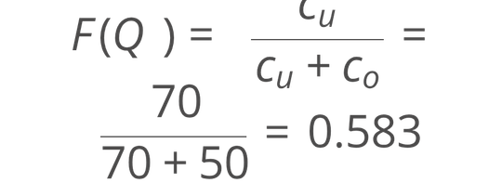
Methodology & Proofs
STEPS TAKEN
1
Data Cleaning
2
Proving Convexity
3
Deriving Critical Ratio (CR)
Handling missing values and outliers in the IMD dataset to ensure a reliable demand distribution estimate.
Shown via Leibniz's Integral Rule, confirming a unique global minimum exists:
Equating G'(Q) = 0 yields the optimal service level:
Notes:
6

Slide 7

Descriptive Statistics & Optimal Solution
RESULTS
78
70
Monsoon Season
Shoulder Season
Optimal units Q^* during peak rainfall months
Optimal units Q^* during transitional weather periods
21
Dry Season
Optimal units Q^* during low-rainfall months
Mean Demand (\mu): Variable by season — Monsoon peak vs. Summer low. Standard Deviation (\sigma): Reflects weather volatility across the year. These seasonal Q^* values are derived from the critical ratio F(Q^*) = 0.583 applied to each season's demand distribution.
Notes:
7

Slide 8
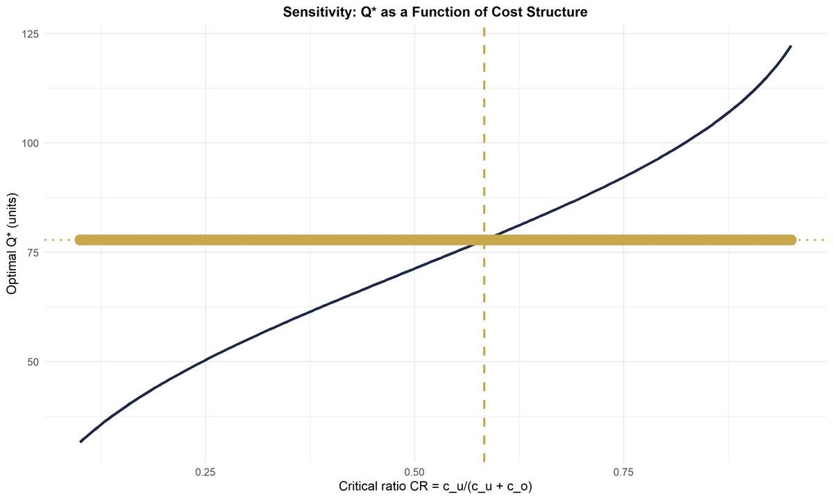
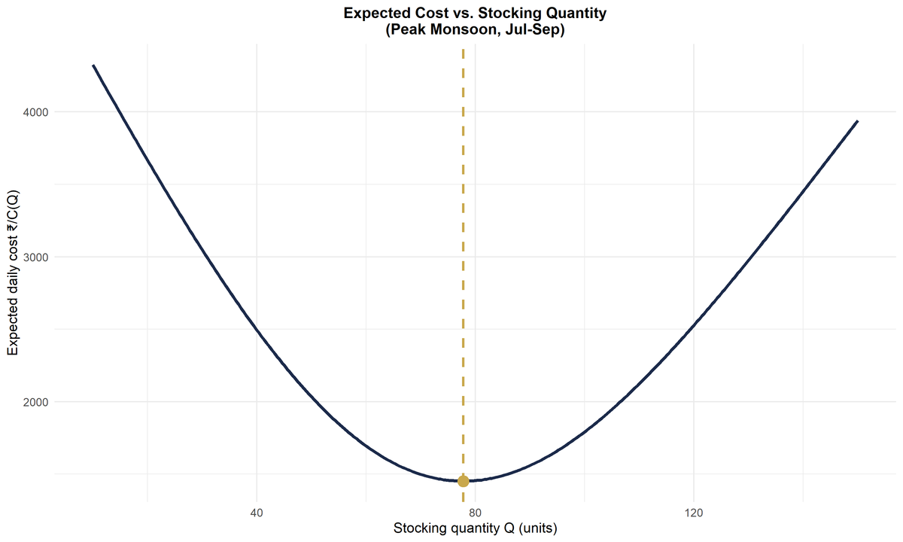
Computational Implementation &
Visualization
FUNCTIONS AND PLOTS
Key Functions Used
1
optimize_inventory()
Analytical solver using the Normal CDF to compute Q^* directly from the critical ratio.
2
saa_simulation()
Sample Average Approximation for numerical validation of the analytical solution.
3
ggplot_cost_curve()
Visualizing the convex cost function G(Q) to confirm the minimum at Q^*.
Visualizations include plots of Total Expected Cost vs. Order Quantity (confirming convexity) and the Demand Distribution across seasonal scenarios.
Notes:
8

Slide 9

Key Findings, Limitations & Extensions
SYNTHESIS
🏆 Key Finding
⚠️ Limitations
Optimization reduces daily loss by ~15% compared to naive mean-stocking strategies.
Assumes Normal distribution; does not account for multi-day "persistent" rain events that shift demand dynamics.
🔭 Extensions
Applying Thompson Sampling for reinforcement learning on demand enabling adaptive inventory decisions over time.
Notes:
9

Slide 10

References & Acknowledgments
ACADEMIC CONTEXT
References
Acknowledgments
Optimization and Numerical Methods Course Notes,
TA: Gahin Maiti , ISI - B
Inventory Management and Production Planning — Silver, Pyke & Peterson
This project was developed as part of the Optimization and Numerical Methods course at the Indian Statistical Institute, Bangalore.
Various textbooks from multi sources Online
Thank You!
CVXR Package — Fu, Narasimhan & Boyd (Convex Optimization in R)
Questions? — Pritham Prajwin V (BSD-BG-2512), ISI Bangalore
Notes:
10

