Slide 1


Slide 2
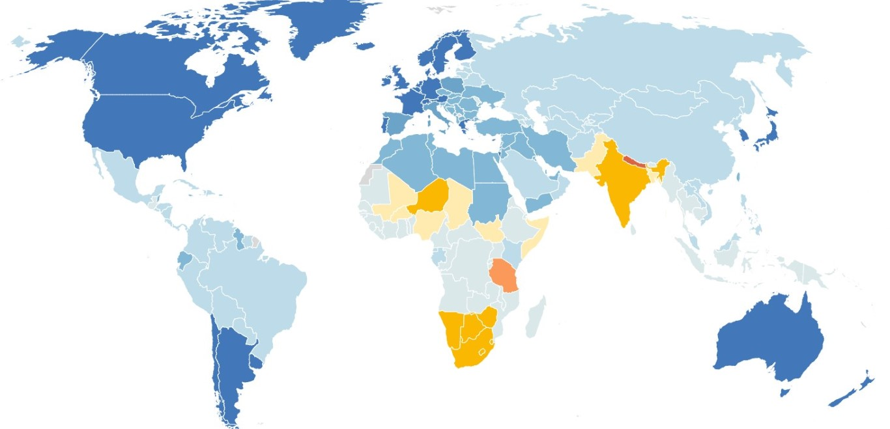
Vision impairment by region
44.75%
Central-East Europe & Asia
36.97%
53.23%
MENA
South Asia
38.75%
47.26 %
Latin America & Caribbean
Sub Saharan Africa
Source : SciDev.Net

Slide 3


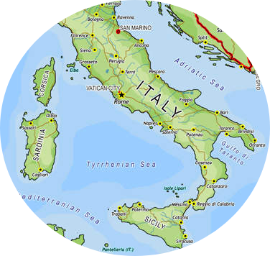



Visual Impairment in Italy
Blindness
0
18
7634 (30%)
Glaucoma
Production value
Childhood
19.6 B €
19
65
7476 (29%)
undefined
Number of enterprise
Chataract
10454 (41%)
Trachoma
4767
65
Total
225564
Source : ISTAT

Slide 4

Year | x_{i} | x_{i} - x͞ | (x_{i} - x͞)²
2015 | 29.691 | 3.630 | 13.173.270
2016 | 22.091 | - 3.971 | 15.764.870
2017 | 26.900 | 839 | 703.082
2018 | 25.564 | - 498 | 247.506
∑ | 104.246 |  | 29.888.729
x͞ | 26.062
σ | 3.156
Source :
Ministry of
public health
Solid help for
Doctors and
professionals

