Slide 1

Notes:
“Hello everyone, this presentation covers the sales and operational analysis of Northwind Traders.
The objective of this analysis is to evaluate business performance across five key dimensions structured using a MECE framework — ensuring that each area of analysis is mutually exclusive and collectively exhaustive.
The five categories include:
Sales Performance
Customer & Revenue Performance
Workforce & Organizational Insights
Pricing & Demand Patterns
Supplier & Regional Insights
Let’s begin with Sales Performance.”

Slide 2
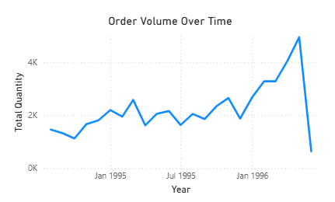
Sales Performance Analysis
Notes:
This slide focuses on overall revenue performance.
First, looking at Revenue Trends, we analyze how sales evolve over time to detect growth patterns and seasonality. This helps identify whether performance is stable, growing, or volatile.
Second, Top Performing Products highlights which specific products contribute the most revenue. This allows the business to prioritize high-performing SKUs and optimize inventory focus.
Third, Geographic Revenue Distribution evaluates how revenue is distributed across countries. This helps us understand revenue concentration and identify potential markets for expansion or diversification.
Together, these insights provide a complete picture of overall sales performance.”

Slide 3
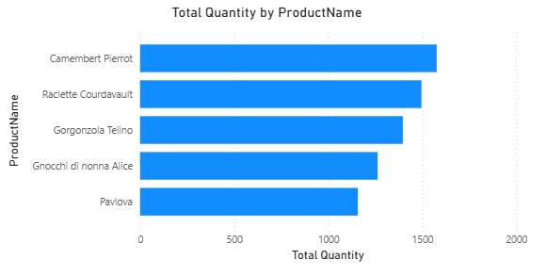
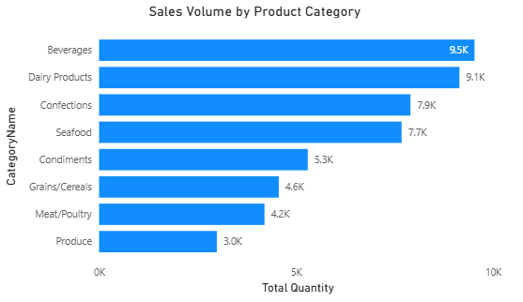
Product & Revenue Performance
Notes:
This slide drills deeper into product-level analysis.
First, Category Contribution shows which product categories drive the majority of revenue and volume. This helps identify growth drivers within the portfolio.
Second, the Top Products by Sales Volume highlights demand strength across individual products. This indicates customer preference and sales intensity.
Third, we evaluate product-level performance relative to revenue contribution, helping identify high-margin and high-demand combinations.
This section bridges overall sales performance with detailed product insights.”

Slide 4
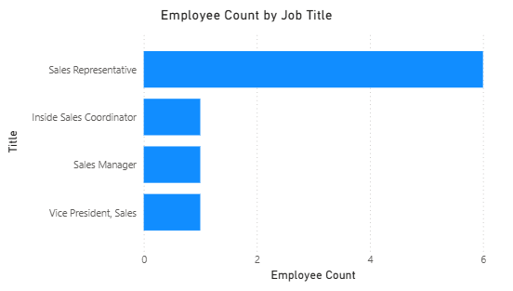
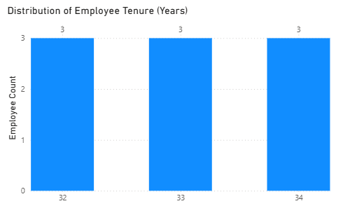
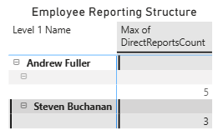
Workforce & Organization Insights
Notes:
This slide analyzes the internal workforce structure.
First, Employee Count by Job Title gives visibility into workforce allocation across roles.
Second, the Employee Tenure Distribution highlights experience levels and potential workforce stability or turnover risks.
Third, the Reporting Structure Matrix visualizes organizational hierarchy, helping assess management layers and reporting distribution.
These insights support operational alignment and organizational efficiency

Slide 5
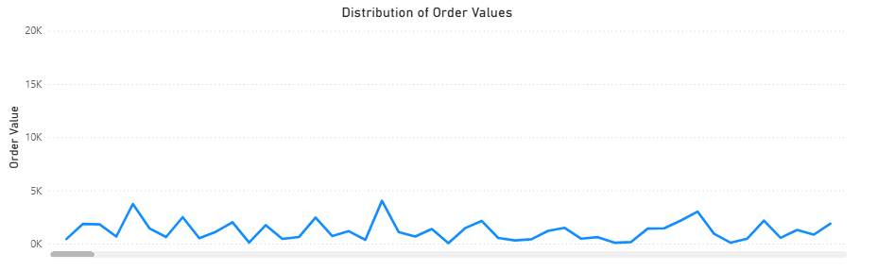
Pricing, Demand & Sales Patterns
Notes:
This section evaluates pricing strategy and demand behavior.
First, the Price vs Units Sold relationship helps identify whether higher pricing impacts demand negatively or whether premium pricing is sustained by strong volume.
Second, the Monthly Product Demand Trend highlights seasonality and fluctuations in purchasing behavior.
Third, the Distribution of Order Values provides insight into transaction size patterns, helping understand whether revenue is driven by high-frequency small orders or large transactions.
This slide connects pricing strategy directly to customer purchasing behavior.

Slide 6
Supplier & Regional Insights
Notes:
The final section focuses on supplier performance and procurement strategy.
First, Average Supplier Pricing by Region compares cost structures across different supplier geographies.
Second, Supplier Concentration by Category evaluates dependency risk — identifying whether certain categories rely heavily on limited suppliers.
Third, Regional Supplier Distribution helps assess sourcing diversification and supply stability.
These insights are critical for cost optimization and risk management.

Slide 7
  Thank You
Notes:
“In conclusion, using a MECE framework allowed us to systematically evaluate Northwind Traders across sales performance, customer behavior, product contribution, workforce structure, pricing strategy, and supplier dynamics.
Together, these insights provide a comprehensive and structured view of business performance, enabling data-driven strategic decisions.
Thank you.”

