Slide 1

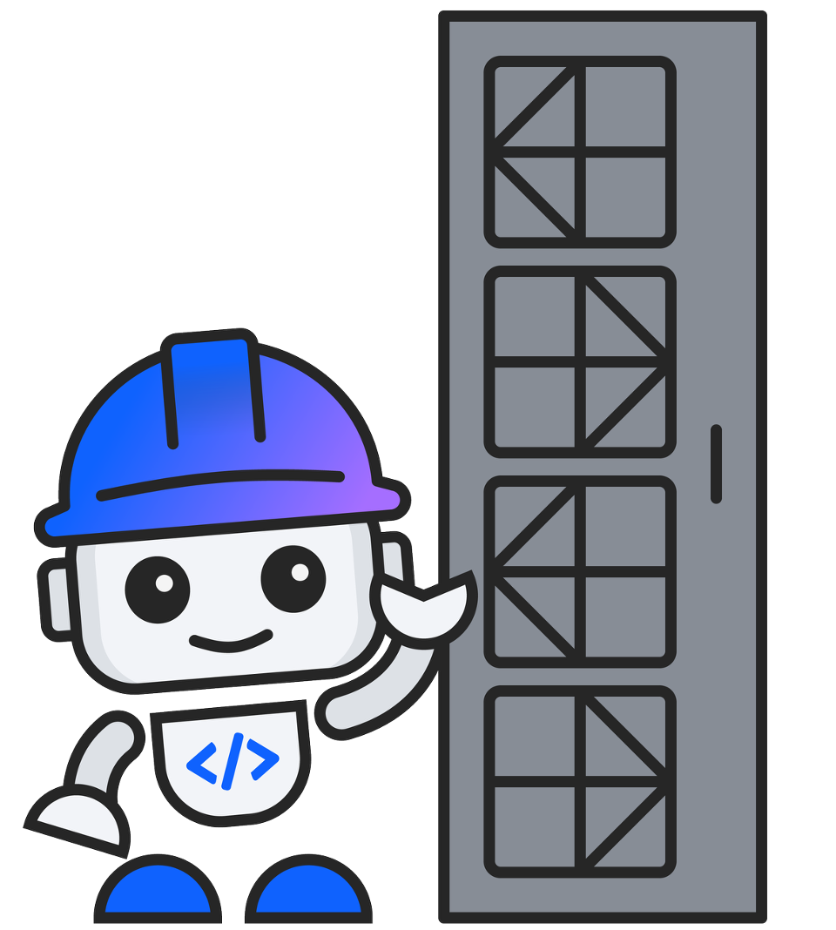
IBM Bob Premium for Z
Bobathon for Z
What to Expect
A hands-on day with IBM Client Engineering — build something real with your own code.
Created by Sophie Harrison & Renate Hamrick — Application Modernization for Z team · bob.ibm.com

Slide 2
What is a Bobathon for Z?
A structured 1-day hands-on workshop — part of the IBM CE engagement model:
The Bobathon sits in the middle — hands-on enablement that builds proof and momentum toward a pilot.
Custom Demo
Bob-a-Thon
Pilot
IBM CE builds a tailored demo
1-day hands-on workshop
Weekly office hours
Uses client's own code & scenarios
Developers + Client Engineers
Executive playbacks
Integrated with client toolchain
Guided labs + open experimentation
Business value KPI tracking
Goal: prove Bob works for your stack
Outcome: functional prototype
Quote / proposal based on BVA
Created by Sophie Harrison & Renate Hamrick — Application Modernization for Z team · bob.ibm.com

Slide 3
What We Can Do Together
Bob helps your teams work with mainframe code in ways that would have taken days — in minutes.
Application Understanding
Impact Analysis
Business Rules Extraction
Generate technical design docs, architecture diagrams, call graphs, and plain-English explanations of any COBOL program. No manual archaeology required.
Identify every program affected by a proposed change. Generate a risk-ranked rollout plan and implement updates across the codebase automatically.
Extract and document the business rules embedded in existing COBOL programs — readable by both technical and non-technical stakeholders.
Refactoring & Service Extraction
Spec-Driven Code Generation
UI Modernization
Break monolithic COBOL into reusable CICS LINK service programs. Reduce duplication and establish a service-oriented architecture on the mainframe.
Generate new CICS COBOL programs from a plain-English specification, aligned to your existing coding standards and copybook conventions.
Transform CICS green screens into a running modern web application — React or Angular frontend with a Spring Boot REST backend — in a single session.
Created by Sophie Harrison & Renate Hamrick — Application Modernization for Z team · bob.ibm.com

Slide 4
What the Day Looks Like
A structured day of guided labs, hands-on experimentation, and real outputs.
Morning Kickoff
Lunch Break
Open Experimentation
Welcome & introductions
Break & informal discussion
Apply Bob to your own code
Bob overview + live demo
IBM CE on hand to assist
Set up workspaces (20 min)
Build something real
9:00
9:30
12:00
1:00
3:30
4:30
Foundation Labs
Your Priority Use Case
Wrap Up
Technical Design Doc (15 min)
Choose 1–2 from:
Team demo / showcase
Impact Analysis (30 min)
Refactoring & Services
Capture open items
Spec-Driven Code Gen
Discuss pilot pathway
Q&A + exploration
UI: Green Screen to Web
Next steps
Created by Sophie Harrison & Renate Hamrick — Application Modernization for Z team · bob.ibm.com

Slide 5

Your Next Steps
After the Bobathon
The Pilot
How to Engage
— You leave with a working prototype
— Weekly office hours with IBM CE
— Talk to your IBM Account team
— All generated artifacts are yours to keep
— Apply Bob to your real priorities
— Request CE via ISC / DSR
— Open items and follow-ups documented
— Track productivity and quality KPIs
— No cost for the CE engagement
— Recording of the session available
— Executive playbacks every 2 weeks
— Start within 2–4 weeks of request
Created by Sophie Harrison & Renate Hamrick — Application Modernization for Z team · bob.ibm.com

