Slide 1

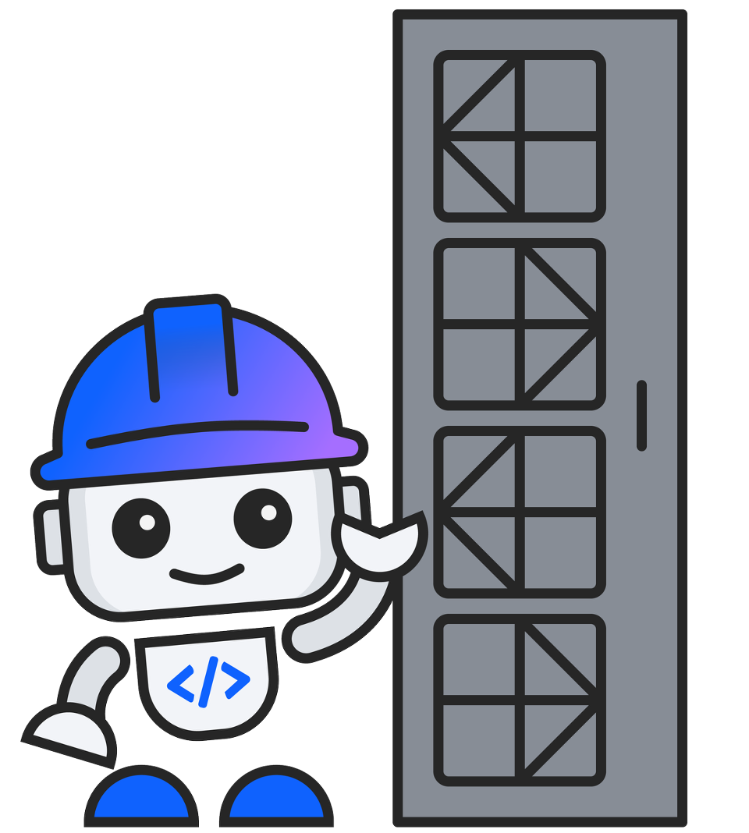
IBM Bob Premium for Z
Bobathon for Z
CE Planning Guide
Everything you need to plan and run a successful Bobathon for Z with your client.
Created by Sophie Harrison & Renate Hamrick — Application Modernization for Z team · bob.ibm.com

Slide 2
What is a Bobathon for Z?
A structured 1-day hands-on workshop — part of the IBM CE engagement model:
The Bobathon sits in the middle — hands-on enablement that builds proof and momentum toward a pilot.
Custom Demo
Bob-a-Thon
Pilot
IBM CE builds a tailored demo
1-day hands-on workshop
Weekly office hours
Uses client's own code & scenarios
Developers + Client Engineers
Executive playbacks
Integrated with client toolchain
Guided labs + open experimentation
Business value KPI tracking
Goal: prove Bob works for your stack
Outcome: functional prototype
Quote / proposal based on BVA
Created by Sophie Harrison & Renate Hamrick — Application Modernization for Z team · bob.ibm.com

Slide 3
How the Labs Work
Labs 1 and 2 are always required. Labs 3–6 are choose-your-own-adventure.
Half-day: Labs 1 + 2 + one adventure lab. Full day: Labs 1 + 2 + two or more adventure labs.
ALWAYS REQUIRED
Lab 1
Getting Started
Lab 2
Technical Design Doc
Workspace scan · Agent.md · Data Dictionary
Architecture docs · Business rules in plain English
~20 min
~15 min
▼ then pick any of:
CHOOSE YOUR ADVENTURE
Lab 3
Lab 4
Lab 5
Lab 6
Impact Analysis
Refactoring & Services
Spec-Driven Code Gen
UI Modernization
~30 min
~60 min
~45 min
~45 min
Created by Sophie Harrison & Renate Hamrick — Application Modernization for Z team · bob.ibm.com

Slide 4
Key Decisions Before You Start
Work through these before scoping the event with your client.
Sample Code or Customer Code?
Who Are the Participants?
Will attendees use GenApp (provided) or bring their own COBOL workspace? If using customer code or custom use cases, allow minimum 3 weeks — SME time is needed to build and curate content.
Hands-on mainframe developers / SAs, or managers? This drives which labs are appropriate and the depth of technical content.
How Many People?
How Long Is the Event?
Ideal: 4–12 developers. More than 15 requires additional CE support. Plan environment provisioning based on headcount.
All 6 labs = ~3–4 hours of lab time, not including presentations or debrief. Half-day: Labs 1 + 2 + one adventure lab.
What Is the Modernization Goal?
Lead Time — Plan Ahead
Documentation, refactoring, UI modernization, or new code generation? Use this to select which adventure labs (4–6) to run.
Minimum 1 week to provision the pp4z instance for GenApp. If using client code or custom use cases, allow at least 3 weeks.
Created by Sophie Harrison & Renate Hamrick — Application Modernization for Z team · bob.ibm.com

Slide 5
Environment Options
Choose the setup path that fits your client's IT constraints.
RECOMMENDED
AIR-GAPPED
ZERO CLIENT SETUP
IBM Cloud Account
Pre-Configured VM
CE-Provided Laptops
Pros
Pros
Pros
No software install required
CE provides ready-to-use VM image
IBM CE brings laptops pre-loaded with VM
Attendees create a free IBM Cloud account
No client install permissions needed
Attendees use CE hardware on the day
Bob Premium accessed via cloud
Bob + VS Code + GenApp pre-loaded
No client machine or install required
Best for: most enterprise clients
Best for: restricted/regulated environments
Best for: strict IT / no BYOD environments
Setup time: ~10 minutes
Cons
Cons
Cons
VM distribution logistics
Limited quantity — plan headcount early
Requires internet access
Hardware requirements for attendees
Coordinate with CE well in advance
Cloud account approval may be needed
Created by Sophie Harrison & Renate Hamrick — Application Modernization for Z team · bob.ibm.com

Slide 6
Top Questions to Ask the Client
Code & Codebase
Sample Application (GenApp)
Client / Customer Code
☐ Are you using our provided GenApp sample?
☐ Is source code accessible in VS Code on the day?
☐ Do your use cases require different sample code ex .asm?
☐ How large is the codebase? (# of programs / copybooks)
*There are size limitations in the local scanners used for Bobathons.
Best Scenenario:
No extra source prep needed — all labs are pre-tested against GenApp
☐ Is the code COBOL, PL/I, HLASM, or a mix?
☐ Allow 3+ weeks lead time — SME needed to curate content
Scope & Goals
Environment & Prerequisites
Team & Constraints
☐ What is your #1 modernization priority right now?
☐ Do attendees have admin rights to install Java, Bob, and potentially Maven?
☐ Is a COBOL expert or z team member available on the day?
☐ Are CICS and DB2 in scope for this event?
☐ Can they create an IBM Cloud account, or is that blocked?
☐ What is the COBOL experience level of attendees?
☐ Is UI modernization a goal, or backend analysis only?
☐ Any air-gapped or no-internet restrictions?
☐ Are there AI tool usage policies or approval requirements?
☐ Java 21 pre-installed — any org-approved distribution is fine.
☐ Who is the executive sponsor and what are their KPIs?
Created by Sophie Harrison & Renate Hamrick — Application Modernization for Z team · bob.ibm.com

Slide 7
Lab Reference — At a Glance
One row per lab. Use this as a quick reference when planning which labs to run.
Lab
Title
Mode
Duration
Difficulty
Description
1
Getting Started
Z Architect
15–20 min
Beginner
Scan the workspace, initialise Agent.md, and generate the Data Dictionary. Must run first — every other lab depends on this.
2
Technical Design Doc
Z Architect
10–15 min
Beginner
Generate a full technical design document with plain-English business rules and Mermaid architecture diagrams.
3
Impact Analysis
Z Architect → Z Code
30 min
Beginner
Identify all programs affected by a field change, produce a risk-ranked rollout plan, and implement updates automatically.
4
Refactoring & Services
Z Code
60 min
Intermediate
Extract shared validation logic from a monolithic COBOL program into a reusable CICS LINK service program.
5
Spec-Driven Code Gen
Z Architect → Z Code
45 min
Intermediate
Derive coding standards from the existing codebase, then generate a complete CICS COBOL program from a plain-English spec.
6
UI Modernization
Z Architect → Z Code
45 min
Intermediate
Analyse CICS BMS maps, generate a React/Angular frontend + Spring Boot backend, and run the app locally.
Created by Sophie Harrison & Renate Hamrick — Application Modernization for Z team · bob.ibm.com

Slide 8
Using GenApp — The Sample Application
GenApp is the fastest path to a Bobathon — pre-tested against all 6 labs, no setup surprises, ideal for first-time events.
Why use GenApp
Key Programs (LG-prefix convention)
— Known-good — all labs are tested and verified against GenApp
LGDPDB01
Policy Delete — DB2 operations
— Full CICS + DB2 + COBOL stack — covers every use case
LGAPDB01
Policy Add — DB2 operations
— Program naming is clean and consistent (LG-prefix)
LGUPDB01
Policy Update — DB2 operations
— Scan always succeeds — outputs are predictable
LGIPDB01
Policy Inquiry — DB2 operations
— Provided as .zip — extract and open folder in Bob
LGACDB01
Account — DB2 operations
LGUCDB01
Customer Update
LGICUS01
Customer Inquiry
LGPOLVAL
Policy Validation Service (extracted)
LGERROR
Error Logging Service
LGRENPOL
Renewal Policy (spec-driven example)
Created by Sophie Harrison & Renate Hamrick — Application Modernization for Z team · bob.ibm.com

Slide 9
CE Tips & Planning Prerequisites
Confirm these before you commit to a date with the client.
Lead Time — Minimum 1 Week (GenApp)
Custom Content or Client Code — 3+ Weeks
Java 21 Must Be Pre-Installed
Provisioning a pp4z instance takes at least 1 week. If using GenApp and standard labs, start the request immediately after scoping. Do not commit to a date until this is confirmed.
If the client wants their own code or custom use cases, an SME must build and curate that content before the event. Allow a minimum of 3 weeks for this preparation.
Attendees must have Java 21 installed before the event. They do not need the IBM distribution — any Java 21 version approved through their organisation's standard software assets is fine. Confirm this with the client IT contact in advance.
COBOL Expert on the Day
Ensure a COBOL expert or z team member is present to support attendees. They unblock questions that Bob cannot answer about proprietary code patterns or system-specific behaviour.
Created by Sophie Harrison & Renate Hamrick — Application Modernization for Z team · bob.ibm.com

Slide 10
What the Day Looks Like
A structured day of guided labs, hands-on experimentation, and real outputs.
Morning Kickoff
Lunch Break
Open Experimentation
Welcome & introductions
Break & informal discussion
Apply Bob to your own code
Bob overview + live demo
IBM CE on hand to assist
Set up workspaces (20 min)
Build something real
9:00
9:30
12:00
1:00
3:30
4:30
Foundation Labs
Your Priority Use Case
Wrap Up
Technical Design Doc (15 min)
Choose 1–2 from:
Team demo / showcase
Impact Analysis (30 min)
Refactoring & Services
Capture open items
Spec-Driven Code Gen
Discuss pilot pathway
Q&A + exploration
UI: Green Screen to Web
Next steps
Created by Sophie Harrison & Renate Hamrick — Application Modernization for Z team · bob.ibm.com

