Slide 1

Team Name : A4CS
Theme: Automation & IOT
Team Members:
Team Lead: Abhijit P
Member 2: Aldo Roger J
Member 3: Snighdha Sarali.B
Member 4: Abhinav S
College Name: SRMIST
UNO-VATE’24

Slide 2
Problem Statement: Al based acoustic wave monitoring of rail defects like cracks, fracture and prediction for rail wear, quality along with other parameter.
Abstract : Develop an IoT-based AI system that uses acoustic wave monitoring to detect rail defects (e.g., cracks, wear) in real-time while trains are in motion. The system consists of a transmission side that sends acoustic waves and a reception side with sensors that analyze the wave patterns to detect anomalies.

Slide 3
Introduction :
How it Works
1. Acoustic Wave Transmission: Waves are sent through the rails.
2. Signal Reception: Sensors capture wave data and transmit it for analysis.
3. AI Analysis: AI models process the data, detecting defects and predicting wear.
4. Real-Time Alerts: Detected issues trigger immediate alerts with precise locations.
5. Communication: Data is sent to a central system via LoRaWAN, GSM, or NB-IoT for real-time monitoring and storage in the cloud.
Addressing the Problem:
Early Detection: Identifies defects before they escalate, reducing accident risks.
Cost Saving, Enables predictive maintenance, lowering repair costs.
Safety: Continuous monitoring enhances rail safety and reduces derailment risks.
Efficiency: Automated, real-time monitoring streamlines operations.

Slide 4
Methodology:
Software:
LabVIEW for signal processing and feature extraction.
Arduino IDE or PlatformIO for microcontroller programming.
ThingsBoard, AWS IoT, or Google Cloud IoT for data storage and real-time monitoring.
Hardware:
Microcontrollers
ESP32/ESP8266: For wireless communication and sensor integration.
Arduino Uno/Nano: For basic control and sensor data acquisition.
Single-board Computers: Raspberry Pi for edge computing and running lightweight AI models on-site.
Sensors:
Acoustic Sensors:
Piezoelectric Sensors: To detect vibrations and acoustic emissions from the rail tracks.
Ultrasonic Sensors: For non-destructive testing and defect detection within the rails.
Accelerometers: To detect vibrations that could indicate rail defects.
Temperature and Humidity Sensors: To monitor environmental conditions that might affect sensor readings

Slide 5
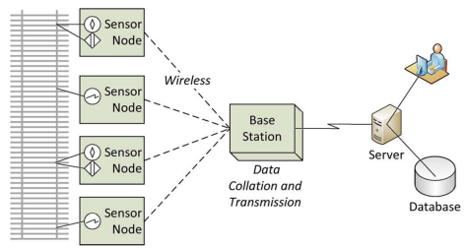
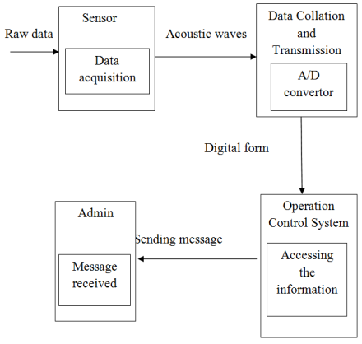
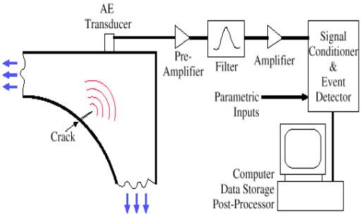
Diagrams/Flowcharts (if any):

